Slide 1
Lipids
PHAR 421

Slide 2
Lipids
Triglycerides
3 x fatty acid + glycerol
4-24 carbons long
18 is most common
Saturated
Unsaturated
Monounsaturated
Polyunsaturated

Slide 3
Structure of a fatty acid

Slide 4
Structure of a triglyceride

Slide 5
Fatty Acids
Saturated
Stearic Acid
18 carbon-most common
Animal fats
Saturated fats increase the risk of CVD!
May increase LDL cholesterol
Systematic review position is variable with regard to CVD risk
Hooper, 2011 (supervisor)
14% reduction in CVD risk
Micha, 2010
Not clear, further investigation
Mozaffarian, 2010
RCT results suggested that replacing SFA with PUFA reduce the risk of CHD mortality.
Siri-Tarino, 2010
5–23 years of follow-up of 347,747 subjects, 11,006 only developed CHD or stroke.

Slide 6
Monounsaturated Fatty Acids
One double bond in the fatty acid molecule
Common for our region
Oleic Acid (or omega-9)
Found Olive oil mainly
One double bond at carbon 9…from what side you start counting?
In general MUFA are found in many plant based oils

Slide 7
Oleic Acid

Slide 8
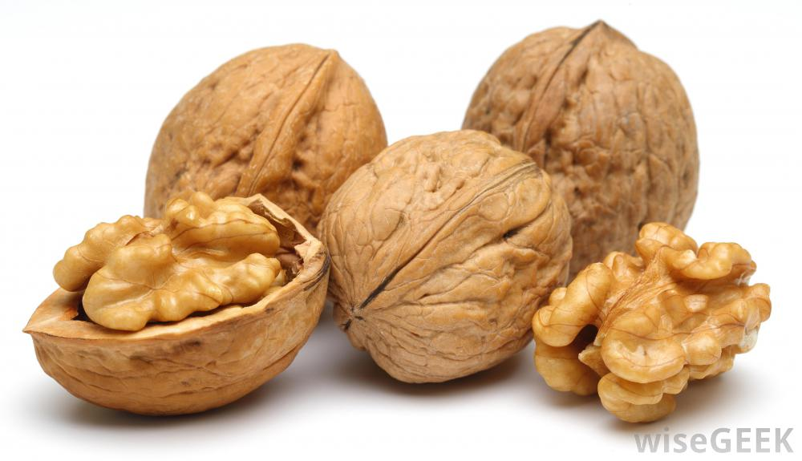
Essential fatty acids
Lenoleic acid (omega-6)
Sunflower and vegetable oils, poultry, some nuts like pine nuts, seeds like sunflower
First double bond is at carbon number 6 from which side?
Lenolenic acid (omega-3)
Oils (walnuts, soybean, canola, flaxseed)
Walnuts, flaxseed
First double bond is at carbon number 3from which side?

Slide 9
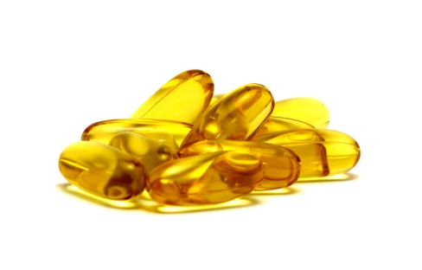
Is that it for EFA
Omega 6 (Lenoleic acid) can be converted to Arachidonic acid (AA)
AA sources in case of omega 6 deficiency
Meats, chicken (poultry in general), eggs
Omega-3 (lenolenic acid) can be converted to
Eicosapentanoic acid (EPA) & Docosahexanoic acid (DHA)
Sources in case of lenolenic acid deficiencies
Human milk, and oil fish

Slide 10
EFA conversion

Slide 11
EFA conversion
Notice
Desaturation and elongation
Lenolenic gets converted to EPA then EPA to DHA
Lenoleic gets converted to AA (second desaturation) which is then converted to the family of omega-6 eicosanoids

Slide 12
EFA and health
Omega-3 and Lipid profile
Suggested to improve lipid profile
↑ HDL (not as much compared to exercise)
↓ LDL
Too much of one thing maybe bad
Increase bleeding time, wound healing time, raise LDL, suppress immune function
Omega-3 and Omega-6 are important in homeostatic processes
Conversion to Eicosoanoids (hormonlike)
Blood pressure, blood clotting, etc….
Prostaglandins, thromboxanes, leukotrienes

Slide 13
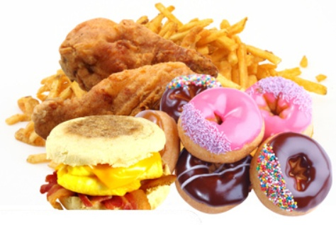
Trans Fatty Acids
Vegetable oils
Liquid at room temperature
Hydrogenation
to increase shelf life
Causes a change in structure to trans
Trans fatty acids are suggested to cause Dyslipidemia
Mainly baked sweet and fast foods

Slide 14
Trans Fats structure

Slide 15
Phospholipids
Phospholipids
Abundant in food
Soybeans, peanuts, liver, eggs, wheat germ
Similar to triglycerides
But instead of three fatty acids + glycerol
A phosphate group+ choline replace the position of one fatty acid
Cell membrane constituent
Main function

Slide 16
Phospholipids

Slide 17
Sterols
Cholesterol part of
Hormones (Testosterone), vitamin D, adrenal hormones (Cortisol), bile acids
Animal based
Plant sterol
Mimic cholesterol
Compete for absorption with cholesterol

Slide 18
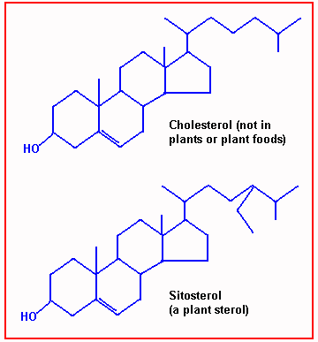
Cholesterol and plant sterol

Slide 19
Fats digestion and Absorption (see Figure 1)
Bile salts help in the formation of micelles in the GI tract to facilitate fat absorption
At the GI tract triglycerides are degraded by intestinal lipases into glycerol and fatty acids
Triglycerides breakdown products are absorbed by intestinal mucosa and converted to triglycerides again

Slide 20
Lipids digestion and absorption
Figure I

Slide 21
Past GI absorption
Absorbed triglycerides with cholesterol are integrated into Chylomicrons
Short and medium chain fatty acids enter the circulation directly
Chylomicrons enter the lymphatic system for delivery to the liver via the circulation (Figure 3)
Chylomicrons may also lose some of their triglycerides as they get degraded by capillary lipoprotein lipase (Figure 2)

Slide 22
Past GI absorption
Figure 2

Slide 23
Past GI absorption (Figure 3)
Chylomicrons content (cholesterol and triglycerides) delivered to the liver are integrated into Very low Density Lipoproteins (VLDL)
VLDL enter the circulation from liver
VLDL looses some of its content to body tissue (by the action of lipoprotein lipase)
VLDL is now LDL (in between VLDL remnant is called IDL)

