Slide 1
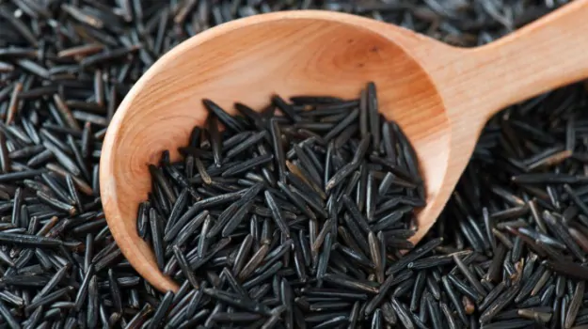
BLACK RICE(FORBIDDEN OR EMPERORS RICE) VALUE AND COST?
The black color: anthocyanin sweet and nutty flavor cereal monocot grain

Slide 2
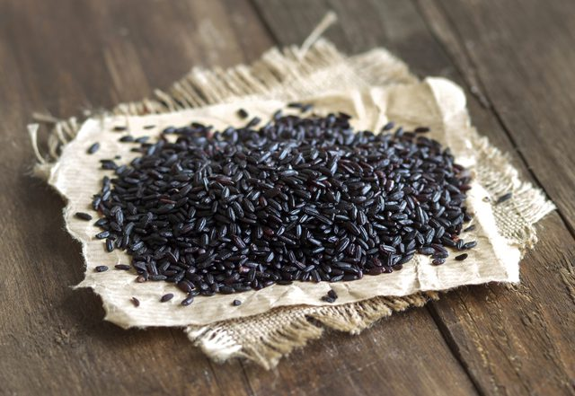
IN WHAT CUISINES CAN IT BE INVOLVED?
It is suitable for creating porridge, dessert, traditional Chinese black rice cake, bread, and noodles.

Slide 3
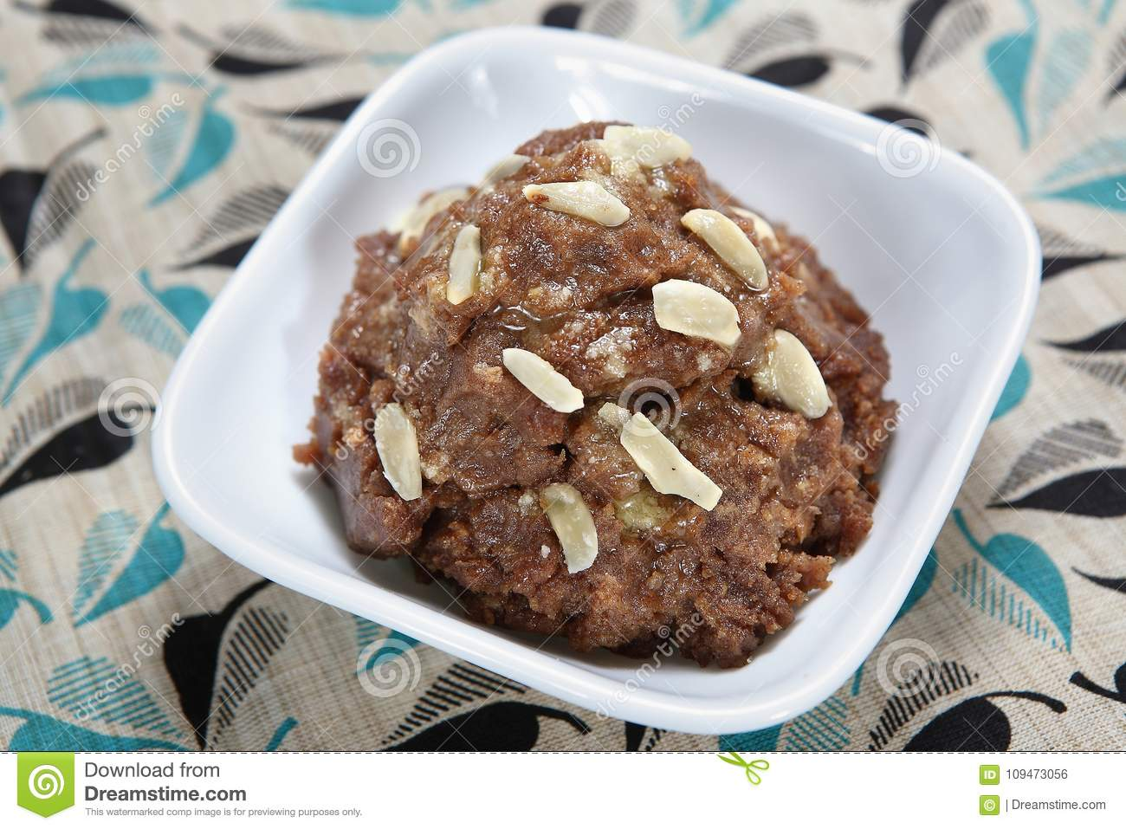

Slide 4
CONTENTS +++

Slide 5
CONTENTS OF MACROMOLECULES

Slide 6
NUTRITIONAL BENEFITS

Slide 7
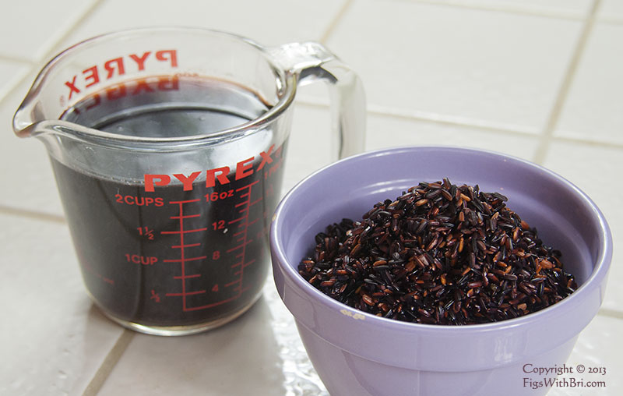
OTHER BENEFITS OF BLACK RICE
Hair growth and skin care

Slide 8
HISTORY: LUCK AND SUCCESS RICE DURING HAN PERIOD HEMATOPOIETIC RICE”MEDICAL RICE” MING PERIOD

Slide 9
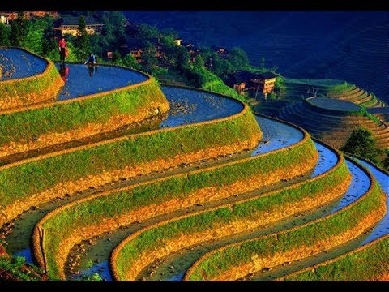
RICE AGRICULTURE IN CHINA(HISTORY)

