Slide 1
Natural products chemistry

Slide 2
Plants make primary products such as:
Carbohydrates
Proteins
Lipids
Enzymes
Secondary products made by plants:
Tannins
Alkaloids
Glycosides
Resins

Slide 3
Secondary plant products
Some plants get rid of nitrogen by synthesis of secondary products
Some secondary products are toxic for humans and animals such as digoxin, strychnine
Some secondary products have bitter taste, or pungent taste… etc.
Some are insect repellant like nicotine, and some are insect attractants

Slide 4
Typically a process of polymerization, stringing monomers
together into a macromolecule that performs a cellular function
sugars polysaccharides
amino acids proteins
fats phospholipid bilayers

Slide 5
Carbohydrates
Natural plant products that contain carbon, hydrogen and oxygen COH
Energy stores like starch
Building blocks in plant cells like cellulose
Unite with different compounds to form glycosides
Protect plants from diseases like gums and resins

Slide 6
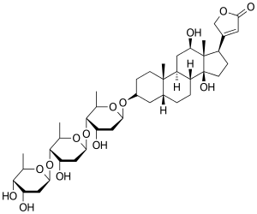
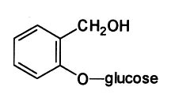
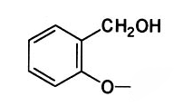
Glycosides
Composed of sugar (glycone) and non-sugar part (aglycone)
Examples
Digoxin from foxglove leaves
Sennosides from senna leaves
Salicin from willow bark, which was used in folk remedies for treating fevers and has led to synthetic analog aspirin
COCH₃
Salicin
Acetyl-salicilic acid: aspirin

Slide 7
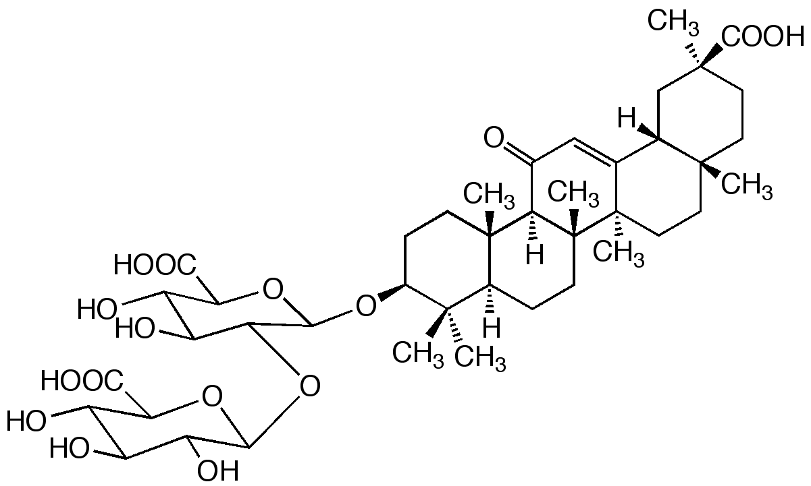
Saponins
Group of glycosides
Most have bitter taste except glycyrrhizin
Aqueous solution form foam

Slide 8
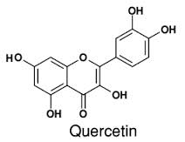
Flavonoids
A group of glycosides
Widely distributed in the plant kingdom, in flowers, peels
Can be found in the free state or glycoside

Slide 9
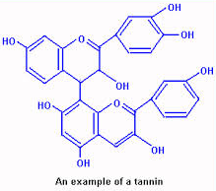
Tannins
Organic non-nitrogenous compounds
Widely distributed in plant kingdoms
Protect the plants
Have astringent properties
Can have anti-inflammatory, anti-diarrheal, mild diuretic effects

Slide 10
Coumarins
Natural biological active substances, at the base of which there lies system of benzo-α-pyrone
Antispasmodic, anticoagulant, coronary vasodilatory
(coumarin)
(o-coumaric acid)

Slide 11
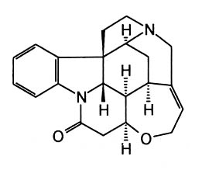
Alkaloid characteristics
Nitrogen containing, basic natural products often have powerful biological activity alkaloids are not as conveniently organized by some common structural components
Common in fungi, plants, insects
Derived from amino acid precursors

Slide 12
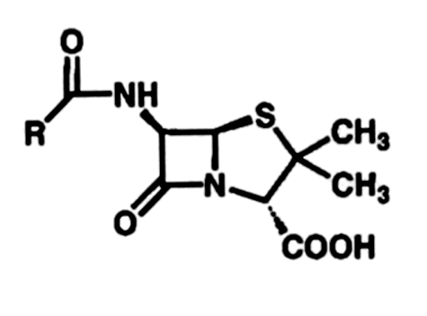
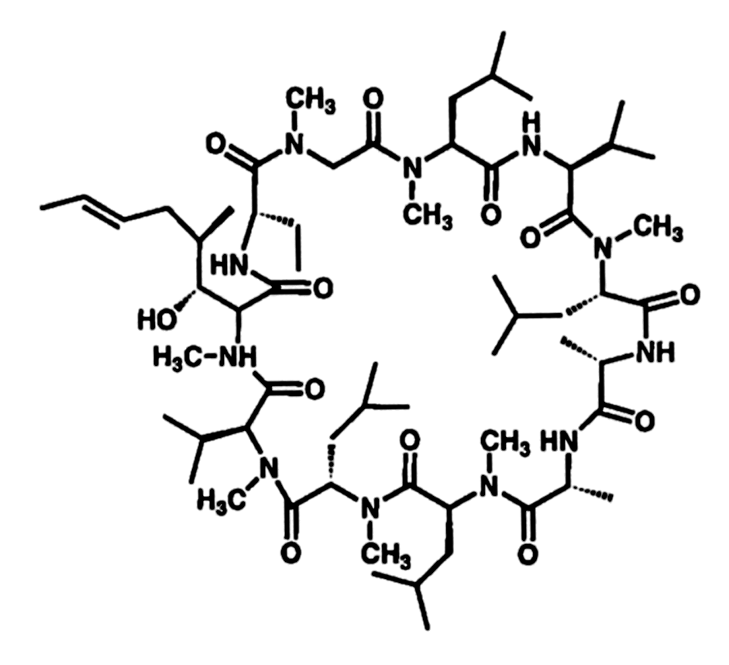
Alkaloids
Amino acids Alkaloids, Peptides, Penicillins
Penicillin
Strychnine
(alkaloid)
Cyclosporin A
(cyclic peptide)

Slide 13
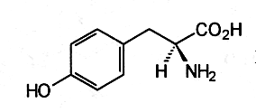
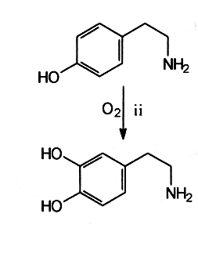
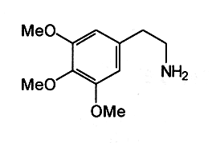
Tyramine
Tyrosine
Dopamine
Mescaline
Mescaline
Potent hallucinogen from the peyote cactus
Competitively binds to dopamine receptors

Slide 14
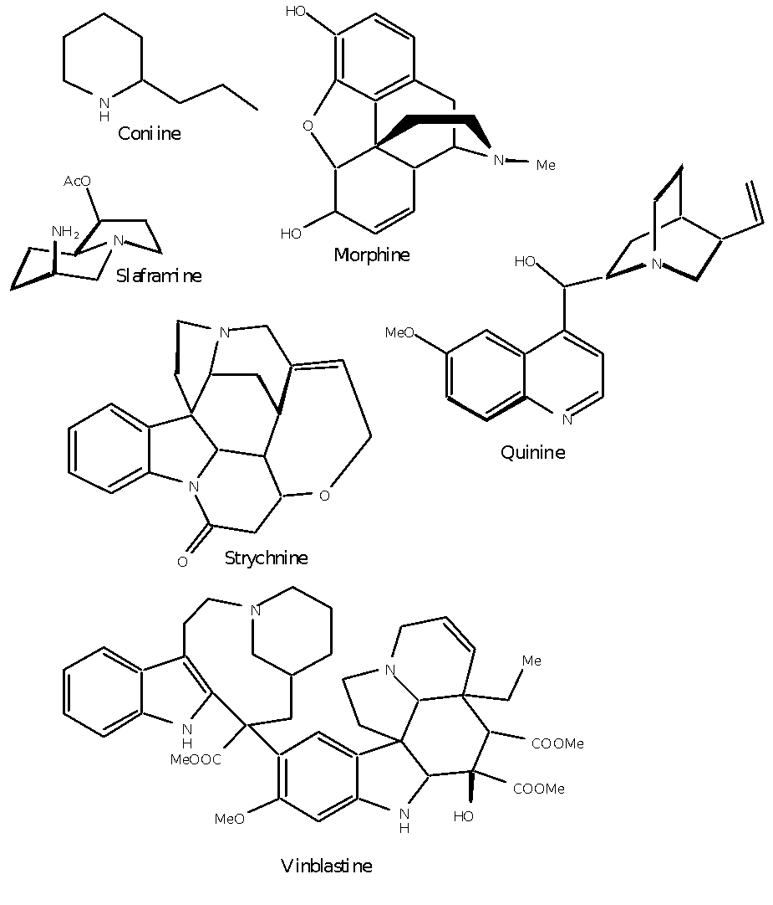
Examples of alkaloids

Slide 15
Terpenes
When we discuss the terpenes we are most interested in the carbon skeleton
Isoprene

Slide 16
Terpenes
Head
Tail
Isoprene
Head
Tail

Slide 17
Terpenes
Head
Tail
Isoprene
Head
Tail

Slide 18
Terpene classification
Class Name Isoprene Units Carbon Number
Monoterpene 2
Sesquiterpene 3
Diterpene 4
Triterpene 6

Slide 19
Monoterpene Examples
O
O
Menthone
α
-Terpinene
Cineole
O
O
OH
Menthol
Carvone
Thujone

