Slide 1
Drugs acting on the nervous system
Stimulants
Depressants
Anticonvulsant
Psychopharmacological

Slide 2
Drugs acting on the nervous system
Drugs affecting mental activity
(Lysergic acid diethylamide) LSD
Mescaline
Cannabis
Purine alkaloids (Caffeine, theophylline, theobromine)
Cocaine
Ginkgo biloba
Ginseng
Galantamine
Lavender
Hypericum
Reserpine
Valerian
Passiflora
Sage

Slide 3
Drugs acting on the nervous system
Analeptics (CNS Stimulants)
Picrotoxin
Lobeline
Strychnine
Camphor
CNS depressants of motor function
Tropane alkaloids (Hyoscine, atropine)

Slide 4
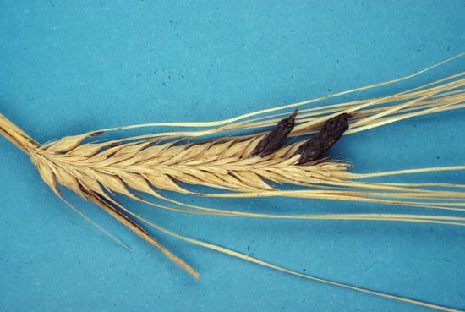
Lysergic acid diethylamide (LSD) -ممنوعة-
Hollucinogen prepared by partial synthesis from ergot alkaloid D-lysergic acid
Ergot-فطر-
Fungus that grows on plants
Claviceps purpurea
Family: Convolvulaceae
Other active ingredients
Ergometrine: Used to facilitate delivery-صار اجهاض خبز Methergin drug
Ergotamine: Anti-migraine-صداع نصفي شقيقة- Cafergot أيضاً بعمل نزيف وغرغرينا

Slide 5
Ergotamine
Adrenaline agonist
The pharmacological mechanisms of ergotamine are extremely complex
The drug has partial agonist and/or antagonist activity against tryptaminergic, dopaminergic and alpha adrenergic receptors depending upon their site
Used for migraine-block serotonin-
Isolated from Ergot Fungus-Ergotesem بصير هلوسة وجرائم في احد البلدان
Claviceps purpurea
Family: Convolvulaceae

Slide 6
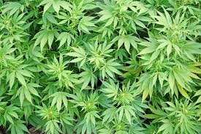
Cannabis من الهند ماريوانا
Hallocinogen
Tetrahydrocanabinol (THC) is the Active ingredients in Cannabis sativa leaves تفتح الشهية-لهذا السبب نعطيه، وللتهدئة، ولكن عندنا ممنوع-مرضى السرطان
Family: Cannabaceae
Other effects:
Antibacterial
Available in the market in some countries to reduce pain and spasticity in multiple sclerosis القرفة والأسبرين ما بنفع مع بعض (مميعان)

Slide 7
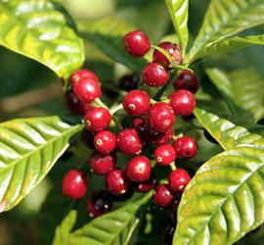
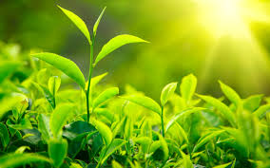
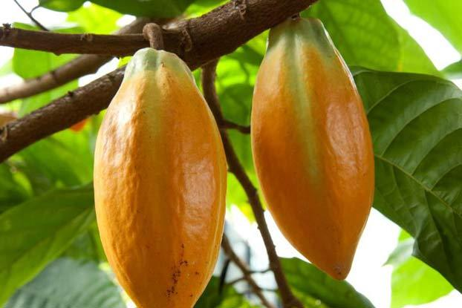
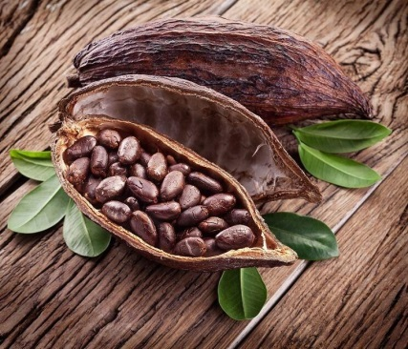
Xanthine/Purine alkaloids-Nitrogen-
Stimulate mental activity
Caffeine-موطن القهوة اليمن
Coffea arabica
Part used: seed
Family: Rubiaceae
Other effects: Diuretic لذلك شرب الماء مهم و ضغطك عالي ما تشرب قهوة كثيرمدر للبول, anorexic تخفف الشهية, Astringent-Beauty product-
Theophylline كان يُعطى بشكل حبوب وقفوه لانه بعمل Arrhythmia
Camellia sinensis (Tea leaves)
Family: Theasceae
Other effects: Bronchodilator
Tea is stimulant, diuretic, astringent, antioxidant and useful in diarrhea
Theobromine
Theobroma cacao
Part used: seeds
Similar effects to caffeine but weaker
Stimulant, diuretic, bronchodilator
Family: Malvaceae

Slide 8
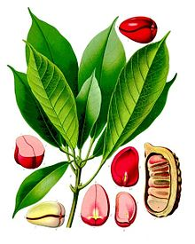
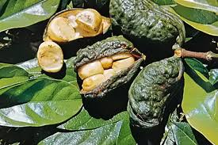
Xanthine/Purine alkaloids
Stimulate mental activity
Cola seeds
Cola vera
CNS stimulant and flavoring agent
Contains caffeine and theobromine

Slide 9
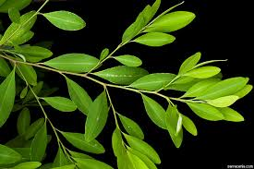
Cocaine اول مخدر، ما في استخدام اله حالياً لانه بعمل كثير ادمان
Limited use as local anesthetic
Found in Erythroxylum coca leaves
Family: Erythroxylaceae
في مخدرات بتعمل CNS depression وغيرها
برفع الدوبامين وغيره
شم وتدخين
مرة وحدة تسبب ادمان
تجربة على الفئران كانوا يتجاهلوا الطعام ويروحوا على الكوكائين

Slide 10
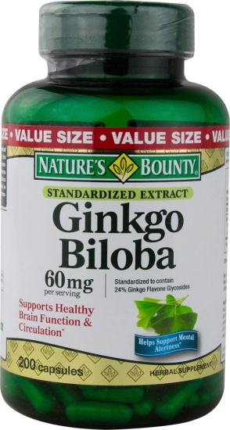
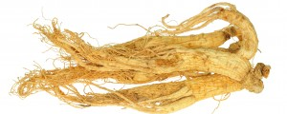
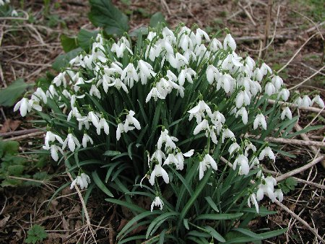
Ginkgo biloba-فش اله مشاكل
Part used: leaves
Family: Ginkgoaceae
Improves short term memory
Used for cognitive deficiencies (especially in the elderly)
Ginseng الصيني
Panax ginseng
root and rhizome
Family: Araliaceae
Improves mental concentration especially in the elderly
Active ingredient: Ginsenoside (saponin glycoside)
Other effects: aphrodisiac-منشط جنسي; treatment of anemia, diabetes; diuretic; adaptogenic agent تساعد على التعامل مع الظروف المختلفة-منشط وبخلي الشخص ينام.
Galantamine-Snowdrop
Galanthus nivalis
Used for Alzheimer’s disease

Slide 11
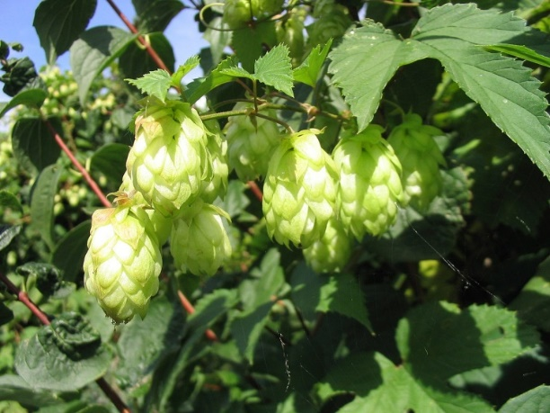
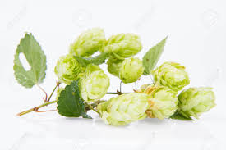
Hops
Humulus lupulus
Sedative, often combined with other herbs
Used for insomnia, neuralgia and excitability
Part of the plant used: flower heads
Active constituents: α-acid humulone, β-acid lupulone
Other activities: antibacterial and antifungal in vitro
Classified as non-toxic

Slide 12
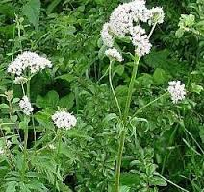
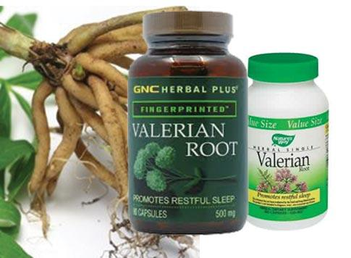
Valerian ما بعمل ادمان
Valeriana officinalis
Family: Valerianceae
Used for insomnia, stress and anxiety-منوم-
Historically used in the treatment of conditions involving nervous excitability, such as hysterical states and insomnia
The parts used pharmaceutically are the root, rhizomes and stolons
Certain components of valerian, particularly valerenic acid may lead to increased concentrations of GABA in the brain, which are associated with decreased CNS activity
Effects of valerian preparations may be enhanced by alcohol consumption-يزيد مفعول الفالارين وهذا سلبي-
There are isolated reports of hepatotoxicity associated with valerian- containing products, although causality has not been established

Slide 13
Valerian uses
1. Anti anxiety
2. Carminative-طارد للغازات مثل الكمون-
3. Antispasmodic effect (specially stomach cramps that cause vomiting)
4. Sedative effect used as a sedative in conditions of nervous unrest, without any narcotic effect.( It is useful for all sorts of nervous conditions).
Also useful in cases of :
1.Migraine 2. Headaches 3. Insomnia 4. Hysteria
5. Stress .

Slide 14
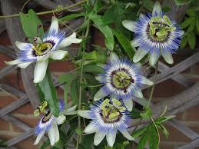
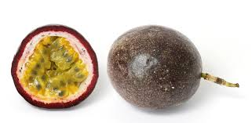
Passiflora
Passiflora incarnata
Family: Passifloraceae
Parts used: leafy aerial parts including flowers and fruits
Chrysin-موجود بالعسل ايضاً has been shown to act as GABA agonist on the benzodiazepine receptors
Passion flower has been used for insomnia, hysteria, nervous tachycardia-التوتر يلي بعمل تاكيكارديا- and neuralgia.
Modern pharmaceutical uses include nervous restlessness and insomnia due to nervous tension
Sedative effects are attributed at least in part to the flavonoids
Edible passion fruit is from P. edulis

Slide 15
Passiflora Actions
Anti-inflammatory
Antispasmodic
Diaphoretic-بزيد التعرق
Hypnotic-اكثر استخدام (also sleeplessness caused by brain inflammation).
Anti- anxiety
Hypotensive (decreased high blood pressure)
Relief of nervousness
Sedative in nervous disorders especially in children.
Analgesic (pain-killing) without side effects.
Relieve bronchial asthma attack.

Slide 16
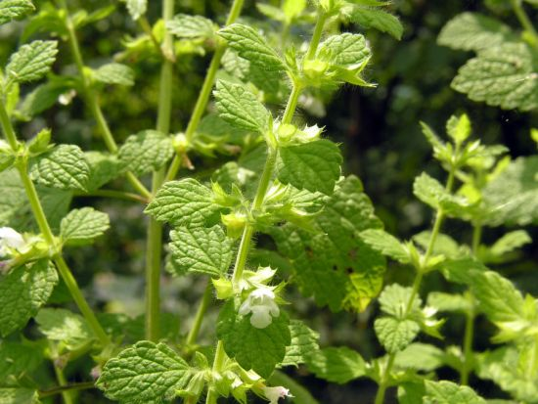
Lemon balm-نعنع رائحة مثل الليمون
Melissa officinalis
Family: Lamiaceae
Used for sedative effects
Other uses: GI disorders; antispasmodic, used topically for Herpes simplex infections
Other effects: anti-thyroid effects, anti-infective
Parts used: dried leaves
Classified as non-toxic but should not be used extensively because of its antithyroid effects

Slide 17
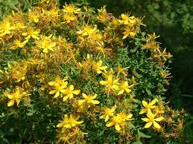
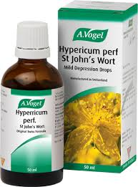
St. John’s wort موجودة بدول البحر الأبيض
Hypericum perforatum
Used to relieve mild to moderate depression and mild anxiety
Active ingredients: Hypericin, Hyperforin ,pseudohypericin
Parts used: flowering tops; leaves, unopened buds, flowers
Major drug interactions with warfarin anticonvulsants, cyclosporin, SSRI, HIV protease inhibitors because of CYP450 induction
Should not be used during pregnancy and lactation

Slide 18
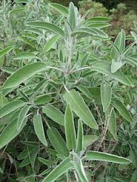
Sage (common name) مرمية
Salvia officinalis
Family: Lamiaceae
Part used leaves
Counter memory loss
Other effects: Have been used for respiratory disorders like asthma; soothing inflammation of the mucous membranes of mouth and throat; antiviral and anti-inflammatory
مفيدة اثناء الدورة –تأخذ وقت ولكن آثارها الجانبية قليلة جداً
-بالماء الساخن- ننقعها نقع افضل تأثير لها

Slide 19
Reserpine
Was historically used as antipsychotic before the introduction of antipsychotic drugs
Reserpine depletes neurotransmitters in the brain resulting in severe depression
May exacerbate symptoms of Parkinson’s disease
Other effects: Anti-hypertensive, sedative, hypnotic
Reserpine is isolated from Rauwolfia root
Rauwolfia serpentina
Family: Apocynaceae

Slide 20
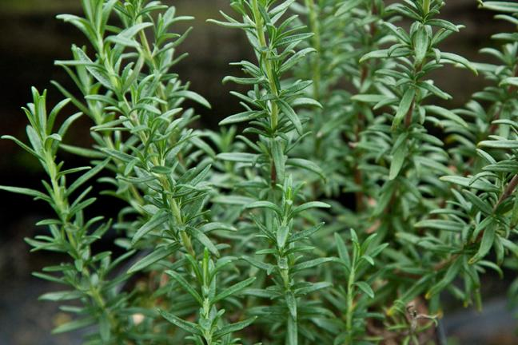
Rosemary (Common name)
Rosmarinus officinalis
Family: Lamiaceae
Part used: Leaves
Active ingredients: rosmarinic acid, caffeic acid which have antioxidant effects
The essential oil contains limonene, cineole, camphor
Has antirheumatoid applications, and for complaints of respiratory, cardiovascular and nervous systems
Has been suggested to improve memory and concentration
Other uses: carminative and spasmolytic

Slide 21
Lavender flowers:
Lavendula officinalis
Lavendula angustifolia
Family: Labiatae

Slide 22
Uses of Lavender
Perfumes , creams , lotions , Shampoo (cosmetics).
Sedative (aromatherapy).
Antispasmodic .
Have antiseptic and anti-inflammatory properties
Toxicity: Used topically, lavender oil is cytotoxic.
Volatile oil constituents : 1. Linalool 2. Limonene 3. Cineole
Drugs
Headache Pads®: Gel pads
Menthol, Eucalyptus, Lavender
Relief headache and migraine

Slide 23
Picrotoxin
GABA inhibitor
Plant product
Toxic, causes convulsions
Lobeline
Found in the leaves and tops of Lobelia inflata
Has similar effects to nicotine, has been used for smoking cessation

Slide 24
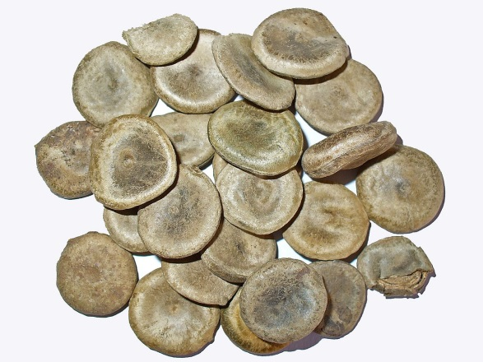
Strychnine
Active ingredient in Strychnos nux-vomica (الجوز المقيء)
Was historically used as a stimulant
Highly poisonous
Camphor
Obtained by synthesis from Cinnamomum camphora
Aromatic stimulant and decongestant
Oil is obtained from the leaves
Other uses: Antiseptic

Slide 25
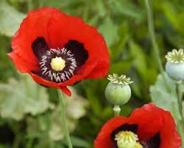
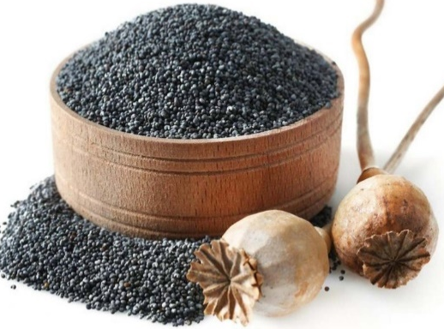
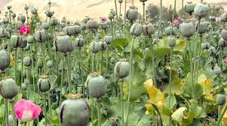
Codeine and morphine
Papaver somniferum
Family: Papaveraceae
Common name: opium poppy (الأفيون)
Opium has been historically used as a pain killer, sedative, cough suppressant and antidiarrheal
Morphine is used in preoperative analgesia , and for short term management of severe pain موجود بالمشفيات حتى قليل نلاقيه بالصيدليات
Codeine is less potent than morphine(Analgesic), used for management of moderate to severe pain like in dental pain, and also is used as cough suppressant
Adverse effects: nausea, constipation, drowsiness, respiratory depression
تشبه الحنون ولكن ليست الحنون
بعملوا ادمان
يعمل شعور بالسعادة وهذا سبب الادمان
الحبوب يلي بحطوها على الحلويات

Slide 26
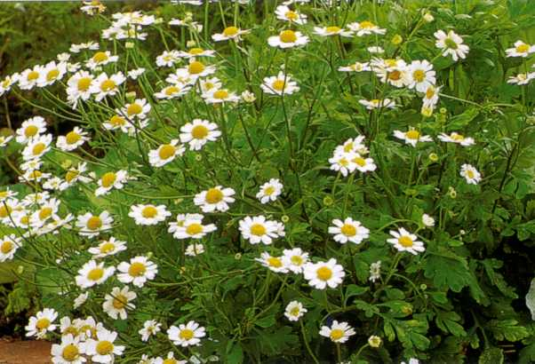
Feverfew (أقحوان)
Tanacetum parthenium
Family: Asteraceae
Used in prophylaxis and treatment of migraine
Fresh leaves can be eaten or standardized extracts taken daily to prevent migraine attacks
Feverfew extracts inhibit secretion of serotonin which is implicated in migraine (الشقيقة سببها تضييق الاوعية)
ممكن نوكل الاوراق 3-5 اوراق

Slide 27
Drugs acting on the GI and biliary system
GI and liver disorders account for minor complaints or major health problems including:
Diarrhea
Constipation
Inflammatory GI conditions: gastritis and ulcers
Nausea and vomiting
Irritable bowel syndrome (IBS), bloating and flatulence
Liver disease
Natural products are commonly used for treatment of diarrhea, constipation and flatulence
Plants and their derivatives also offer treatment alternatives for IBS, motion sickness and dyspepsia-سوء الهضم
الطب الهندي يركز على المعدة والأمعاء، بنظروا على كيفية هضم الطعام وبالتالي كيفية هضم احداث الحياة يلي بتصير معاه.نار الهضم لازم تكون بالنصف لا قوية كثيرو ولا ضعيفة كثير.
عمل تنويع بالطعام مثلاً فطور شوفان، حتى الاكتئاب بربطوه بالفلورا المربوطة بالجسم Ayurveda علم الحياة

Slide 28
Diarrhea
A change in bowel movement frequency or consistency
Normally requires no intervention as long as the loss of electrolytes is under control Defiance mechanism عشان هيك بدون ما نروح على الطبيب لانه بخرج امور سمية ولكن اذا زادت بلزمنا طبيب
Approximately 5 million deaths are due to diarrhea annually
The first step in management is sufficient oral rehydration using sugar salt solutions, starch can be added

Slide 29
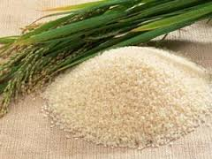
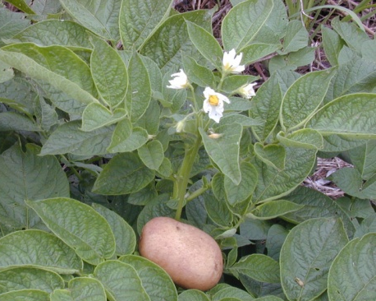
Management of diarrhea
Starch
From Oryza sativa (rice) grains, or Solanum tuberosum (potato)
Used for rehydration purposes as a first line treatment of minor cases
Polysaccharides are hydrolyzed in the GIT and resulting sugars are absorbed by the co-transport of sugar and Na into the cells
Rice suspensions shift the balance of Na and enhance water absorption and provide energy
Opiate derivatives such as loperamide-Diacare-برد والاسهال ما بوقف are sometimes used for management of diarrhea

Slide 30
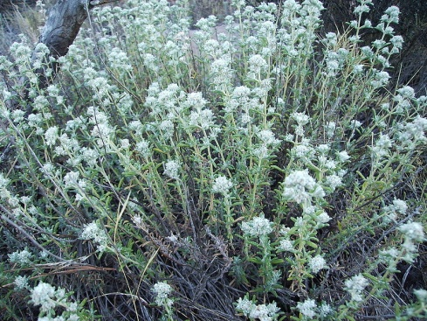
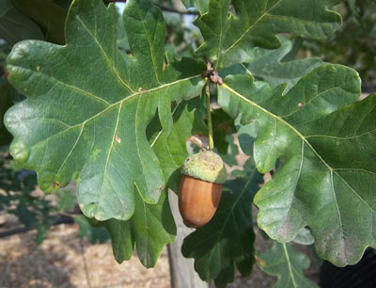
Management of diarrhea
Tannin-containing drugs
Tannins are astringent polymeric polyphenols found in
Cat thyme Teucrium polium الجعدة
Oak bark Quercus robur (السنديان)
Coffee and tea
Tannin containing drugs are generally safe, but they are not compatible with alkaloids and form complexes with protein and amino acids فيتامين سي بحسن الامتصاص

Slide 31
Constipation
Reduced or difficult bowel movement
(less than once in 2-3 days)
Due to inappropriate diet and lack of physical activity or psychological factors
Could be due to medications (opioids)
Should be investigated if it occurs frequently
ماء فاتر مع لمون منيح ، واذا كان الماء دافئ افضل فالامتصاص الها اسهل

Slide 32
Laxatives
Various types of plant-derived laxatives are found:
Stimulant laxatives (purgativesتخرج كل شيء): which act directly on the GI mucosa تزيد حركة الامعاءcaster
Bulk-forming laxatives: physicochemical effects within the bowel lumen بتنفش وبالتالي بتحفز حركة الامعاء تقريباً مثل الفايبر silum
Osmotic laxatives: act by drawing water into the gut and thus softening stool (eg: Mg salts or milk sugars) تسحب الماء لل Gut الملح الانجليزي بعمل اسهال MgCl2 …lactolose مرات بصير تعود فمش لازم نوخذ اللاكستفز لفترة طويلة
مشكلة كثير شائعة الامساك
زيت الخروع منيح للشعر وللرموش
السيرج زيت السمسم
زيت الخروع بحتوي على الرايسن ومستحيل نلاقي ترياق اله لانه بأثر على صناعة البروتين بكل الجسم وفي ناس سمموهم بالرايسن ولكن لما نعمل الزيت بروح هذا الرايسن ما بكون موجود بالزيت(تخيل بكل الخلايا)

Slide 33
Generally bulk-forming laxatives should be used for chronic, long-term conditions while stimulant for acute occasional constipation, because they cause tolerance
Risk of stimulant laxatives: water and electrolyte loss (e.g. hypokalemia)
Fiber ما بتعمل توليرانس

Slide 34
Bulk forming laxatives
Bulking agents with a high fiber content
They swell in the GI tract
They should be taken with plenty of water
They can paradoxically بشكل متناقض be used to treat diarrhea if given with very little fluid, help absorb the fluid from the lumen and increase consistency of the stool
Examples:
Linseed= flaxseed زيت الكتان
Ispaghula
Psyllium
Wheat bran
Oat brans

Slide 35
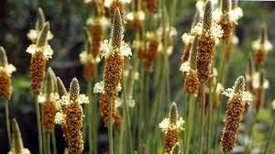
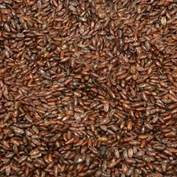
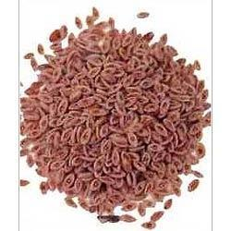
Laxatives
Ispaghula seeds
Plantago ovata
Part used: seeds
Family: Plantaginaceae
The dark brown seeds are useful in treatment of chronic constipation بنزلوا الكوليسترول وبقللوا من الجلطات
Also used in IBS
Psyllium
Plantago psyllium
Family: Plantaginaceae
The seeds are smaller than ispaghula seeds
Contain psyllium
Helps maintain a regular bowel movement

Slide 37
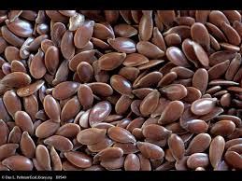
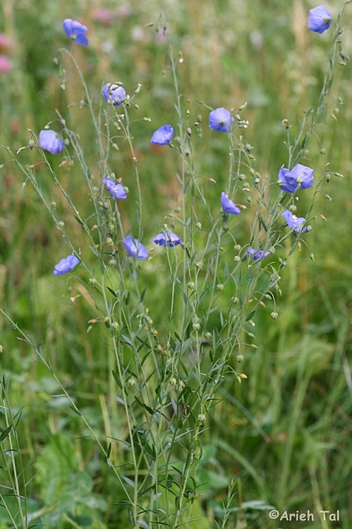
Laxatives
Linseed (الكتان) مهم يكون موجود بكل منزل
Also known as flaxseed
Linum usitatissimum
Family : Linaceae
Ripe, dried seeds of flax
Other effects: Cholesterol lowering due to its Omega-3 fatty acids content, anticancer, anti-inflammatory
The plant is grown for its fiber-قماش- (used in industry) and for the seed oil used in paints and varnishes
لازم نطحنه لما بدنا نستخدمه عشان يضل طازج وفوائدة موجودة مع طحن أفضل لانه الامتصاص بكون اكثر مع الطحن
بنفع يُستخدم للشعر الكيرلي وصحي اكثر وكأنه مش حاطين شيء
جل للشعر، غلي الكتان بماء ومنصفيه اول ما نقيمه من الغاز 10 دقائق ولازم يضل بالثلاجة
فريزيننس للشعر

Slide 38
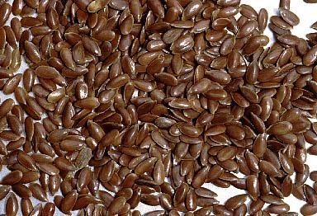
Lin seeds = Flax seeds
Constituents
Fixed oil 30-40 %
Mucilage هذا يلي بخليه جل او بعطيه خصائص
Proteins
Cyanophoric glycosides –linamarin .

Slide 39
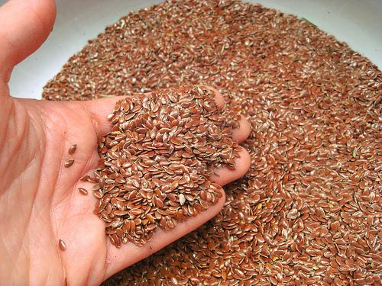
Uses of flaxseed
1.Demulcent ملطف زي حد عنده حرقة بحلقه مثل العسل drink by boiling the seeds with water , which extract the mucilage (has demulcent properties) .
2.Laxative due to mucilage.

Slide 40
Uses of Flaxseed oil
1. Pharmaceutical uses :
a. film coat for tablets
b. base for ointments
2. Cosmetics: emollient & protective properties, used in manufacturing creams and lotions .
3. As food in Egypt .
4. Prevent absorption of cholesterol in GIT so decrease the cholesterol level in blood.
5. Industrial uses: printing ink and paints .

Slide 41
Flax seeds contain high levels of lignans and Omega-3 fatty acids.
Lignans may benefit the heart, possess anti-cancer properties and studies performed on mice found reduced growth in specific types of tumors.
Initial studies suggest that flaxseed taken in the diet may benefit individuals with certain types of breast and prostate cancers

Slide 42
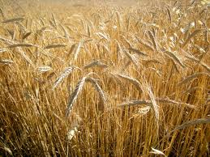
Laxatives
Wheat Bran
Triticum vulgare
Wheat bran is less useful as laxative unless it is a natural part of the diet
High concentrations can complex with other vitamins and minerals and reduce their bioavailability, as it contains high concentrations of phytic acid
However in some patients it may be more effective than other swelling agents
Preparations are taken in water

Slide 43
Osmotic laxatives
Lactulose or lactose, dimeric sugars derived from milk are widely used for treatment of chronic constipation
Lactose is split in the GI tract into glucose and galactose
Adults generally do not absorb galactose well
The bacteria of the colon metabolize galactose resulting in lactic and acetic acids which have an osmotic effect softening feces and increasing peristalsis

Slide 44
Stimulant laxatives
Derived from different types of plants that only share containing the anthraquinone constituents (such as emodin, aloe-emodin)
Anthraquinones are commonly found as glycosides in the living plant
Example sennosides A and B in Senna السنامكي
The laxative effect is due to increased peristalsis حركة of the colon reducing transit time and water reabsorption فترة أقل فعشان هيك اسهل للواحد انه يخرج from the colon القولون هو اكبر مكان لامتصاص الماء تنقبض اسرع بضل البراز بالمعدة

Slide 45
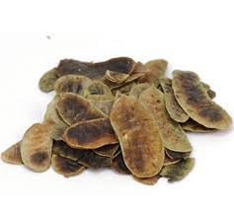
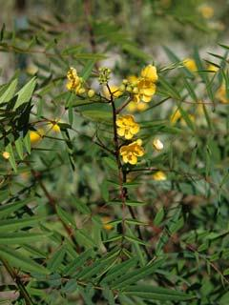
Laxatives
Senna السنامكي عشرق
Senna alexandrina
It is of Arabic origin
Parts used, leaves and pods
Systemic absorption is limited
Active constituents sennoside A and B
بعالج الامساك
مشاكلها انه ممكن كثير تعمل اسهال وتخرب الالكترولايت
Malnutrition
واستخدامها بالتضعيف بعمل مشكلة
واذا صار تعود مصيبة انه ما منروح على الحمام الا اذا استخدمناها
العشرق

Slide 46
Toxicity of anthranoid drugs
Long-term use of anthranoids may result in reversible blackening of the colon (pseudomelanosis coli), which is due to the incorporation of metabolites of anthranoids and is thought to be associated with an increased risk of colon carcinoma
Few toxic effects were observed in practice
Colic-مغص and gripping –امساك-pain due to increased spastic contractions of the smooth muscles of the GIT
In particular with aloes and senna leaves
Loss of electrolytes

Slide 47
Anthranoid laxatives are a group of naturally occurring laxatives which are commonly used in clinical practice and as a self‐medication for chronic constipation. Although the short‐term use of these laxatives is generally safe, results from in vitro and animal studies suggest that they have a tumorigenic potential.

Slide 48
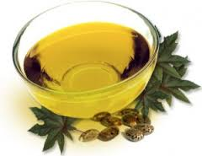
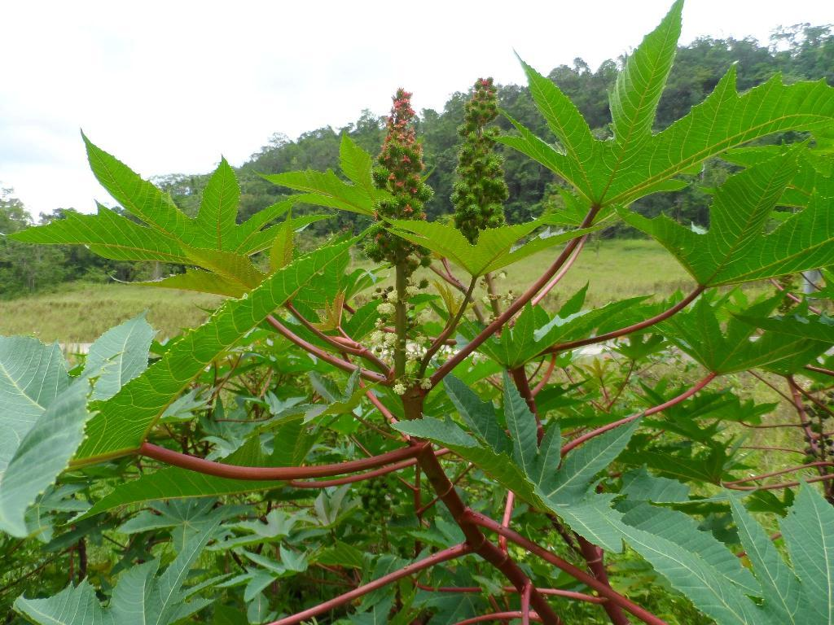
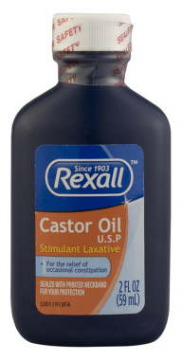
Castor oil زيت الخروع
From the seeds of Ricinus communis
Family: Euphorbiaceae
Stimulant laxative
Also used in the manufacture of soap and as a cream base شعر، رموش
Used in cosmetics
Castor bean contains ricin which is very toxic as a little amount can cause death due to inhibition of protein synthesis
Ricin is denatured during manufacture of the oil

Slide 49
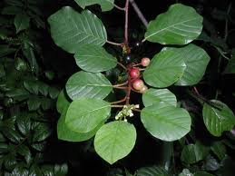
The barks of Rhamnus are used for their purgative يفضي الجهاز الهضمي- اقوى من الملين effects and treatment of habitual constipation
Frangula
Rhamnus frangula
Cascara bark
Rhamnus purshiana
Buckthorn
Rhamnus cathartica
Active constituents emodin and aloe-emodin

Slide 50
Bloating and Flatulence نفخة
IBS: characterized by pain in the left iliac fossa, diarrhea or constipation
Flatulence: the passage of excessive gas from the body. Is a major symptom treated with plant-derived drugs
Carminatives طارد للغازاتare usually taken with food, produce a warm sensation when ingested and promote postprandial elimination of gas الكمون الشومر الكراوية اليانسون نقع البقوليات بالماء فمنتخلص من المواد يلي بتنفخ
Mostly work by their spasmolytic action

Slide 51
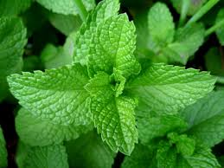
The Mints: Leaves and Oils
Members of this family are widely used for their digestive effects and flavoring qualities
Peppermint
Mentha piperata
Has a characteristic, strongly aromatic and penetrating smell and taste
Leaves in the form of tea, and the oil are used for digestive problems
Peppermint oil is produced by steam distillation
Menthol is a decongestant used in inhalations for respiratory conditions Flavoring Agent

Slide 52
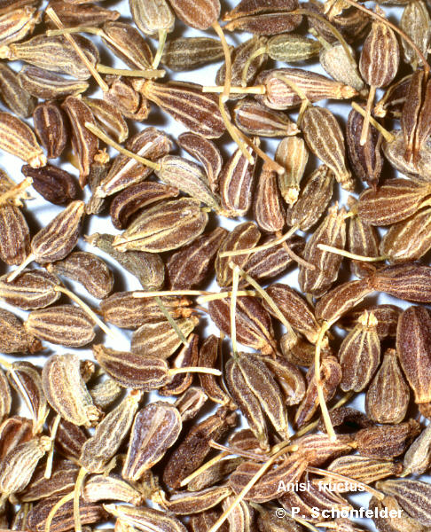
Anise fruits اليانسون
Pimpinella anisum
Family : Umbelliferae
Perennial herb with white umbelliferous flowers .
Odor : aromatic .
Taste : sweet & aromatic .

Slide 53
Chemical constituents
Volatile oil (1-3%): Anethole
Uses
1. Carminative .
2. Condiment .
3. Flavoring agent .
4. Antispasmodic .
5. Popular drink .
6. Anethole has potent antimicrobial properties, against bacteria, yeast, and fungi
7. Expectorant.
8. Sedative.
منوم اذا حد عنده أرق

Slide 54
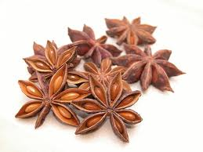
Star Anise fruits يانسون صيني
Illicium verum
Family : Magnoliaceae
Odor: aromatic .
Origin : China & Japan .
Volatile oil (5%-9%): anethole (80%-90%)
Uses: like Anise fruits uses

Slide 55
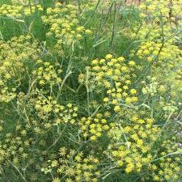
Fennel, (شومر)
Foeniculum vulgare
Family: Umbelliferae نفس العائلة لليانسون
Fennel is used as a carminative بطلع الغازاتand is considered to be very safe and widely used as a supplement and spice.
Fennel oil is used for the same indication and has been shown to be bacteriostatic.
Part used: fruit

Slide 56
Fennel
Constituents
Volatile oil:
Fenchone
Anethole
limonene
Uses
Carminative.
Antispasmodic.
Flavoring agent.
For menstrual pains.
Stomachic. بفتح الشهية

Slide 57
Coriander fruits:
Coriandrum sativum
Family : Umbelliferae
Constituents:
Volatile oil 0.8-1.0%:
1. Linalool 70%
2. Geraniol

Slide 58
Coriander الكزبرة
Uses
1-Carminative.
2-Condemint. بالبهار بالأكل
3-Anti-bad breath.
4- Aphrodisiac. يزيد الرغبة الجنسية
5-Flavoring agent. كزبرة، نعنع، بقدونس بشيلوا روائح الفم

Slide 59
Cumin كمون
Cuminum cyminum
Part used: fruit
Contains volatile oil (5%-9%): anethole (80%-90%)
Uses: like Anise fruits uses
1. Carminative
2. Condiment
3. Stomachic

Slide 60
Caraway, (كراوية):
Carum carvi
Common in many regions of Europe and Asia.
The essential oil acts as a spasmolytic, and has antimicrobial activity (long been used in infant gripe water) للمغص عند الأطفال
بعد الولادة
بالأكل

Slide 61
Dill fruits
Dill الشبت/ عين جرادة
Anethum graveolens
Parts used: seeds and leaves
Constituents
Volatile oil 3-4% – Carvone 60%
Uses
Carminative –given to the infants to relief of flatulence.
Stomachic.

Slide 62
Basil leaves الريحان، حبق
Ocimum bacilicum
Aids in digestion
Used in cold/flu- removes phlegm from lungs
Diaphoretic بساعد بالتعرق فهو ممتاز بعادل درجة حرارة الجسم وبساعد بالتخلص من السموم
Adaptogen يساعد بالتعامل مع التوتر Stress Different mental state لمون مع ريحان
الجزر مفيد لرئة المدخن

Slide 63
Clove buds القرنفل –براعم-
Eugenia caryophyllus
Family: Myrtaceae فوائد للأسنان والمعدة
Chemical constituents
1-Volatile oil (Clove oil) 14%-20%
a- Eugenol 70%-90% هذا نفسه ممكن نستخدمه لنعمل فانيلين
b-Vanillin
c- Caryophyllene
d-Methyl salicylate (painkiller); زيت ندهنه على الاسنان بصير في زي نمنمة، غرغرة منها
2- Tannin : Gallotannic acid 10-13%
3. Flavonoids: eugenin

Slide 64
Clove uses
Condiment.
Carminative.
Clove oil which contain high percentage of eugenol used commercially to produce Vanillin .
Antiseptic. مطهر-مع حشوة الاسنان
Flavoring agent.
Dental uses : as filling material with ZnO
Local anesthetic (dental analgesic)
Expectorant بساعد يطلع البلغم

Slide 65
Dyspepsia and biliousness
In dyspepsia: patients describe the symptoms as nausea, pain, cramps, distention, heartburn and inability to digest food
Treated with bitter stimulants -لزيادة الشهية or a cholagogue (a substance that stimulates bile production) الأشياء المُرة تفتح الشهية وبتزيد افراز اللعاب
Cholagogues should not be used in bile duct obstruction or cholestatic jaundice
Bitter stimulants like gentian and wormwood act directly on the mucosa of the upper GI and bitter receptors on the tongue stimulating production of saliva and gastric and biliary secretions
Taken half an hour before food

Slide 66
Artichoke,الارضي شوكي
Cynara scolymus
The medicinal part is the leaf, which is used to treat indigestion and dyspepsia
The leaf contains the bitter sesquiterpene lactone cynaropicrin and several flavonoids
Pharmacologic effects:
Antihepatotoxic
Stimulates bile production (cholagogue)
Reduces cholesterol and triglyceride levels
Also useful in IBS - Irritable Bowel Syndrome -

Slide 67
A clinical study showed that several parameters including fat intolerance, bloating, flatulence constipation and vomiting were significantly reduced by treatment with artichoke leaf extract
Bile مسوؤل عن هضم الدهون

Slide 68
Bay Leaves ورق الغار
Laurus nobilis
Family Lauraceae
Aids in digestion
Prevent gas
Soothe stomach
Useful for purging بطلعparasites طفيلياتand repelling insects.
Good source of vitamins and minerals Antibacteria and Antifungal منيح للشعر، اضافة ماء سخن ولما يبرد يوضع على الشعر ورائحته حلوة وبقوي الشعر، بساعد انه يمنع القشرة وبمنع التساقط.
في اليونان كان في كثير طقوس للغار انه للتكريم يوضع على الرأس

Slide 69
Gentian
Gentiana lutea
The species is rare and distributed in the alpine regions of Europe and Western Asia
Acts directly on the mucosa of upper part of the GI tract, and especially of bitter receptors on the tongue
This stimulates the secretion of saliva and gastric juices as well as gastrin
Indicated for poor appetite, flatulence and bloating أي شيء مُر منيح للناس يلي شهيتهم قليلة
Studies in mice suggest its ability to suppress liver damage.
والخرفاش كذلك منيح للكبد

Slide 70
Wormwood (الشيح، شيبة العجوز)
Artemisia absinthium
A bitter stimulant derived from aerial parts of Artemisia absinthium, and is popularly used as tea
Used as anthelmintic طارد للديدان
The leaves and stems are densely covered with characteristic greyish-white hairs, which gives it the typical appearance

Slide 71
Wormwood (Cont’d)
The essential oil contains β-thujone as a major constituent, sesquiterpenes lactone absinthin
Pharmacology and clinical efficacy:
Acts via receptors on the tongue, increasing secretion of saliva and digestive juices.
Toxicity:
Thujone, a major component of the essential oil, is toxic and hallucinogenic in large doses. It is neurotoxic, epileptic and can cause long-lasting psychiatric disturbances

Slide 72
Hyoscine =scopolamine حبوب للتقيؤ بسبب السفر، اما العشبة فقد تكون سامة
Antimuscarinic alkaloid found in Atropa belladonna, Datura stramonium and Hyoscyamus niger
These plants can be toxic النبتة كلها سامة
It is a popular remedy for motion sickness
Hyoscine is also used as a premedication, usually in combination with opiate, to relax the patient and dry up bronchial secretions prior to administration of halothane anesthetics
Anitcholenergic دائماً سام
مثل الAtropine
ممكن يعمل Arrythmmiea

Slide 73
Ginger (زنجبيل) المفضل للاستاذة 2021
Zingiber officinale
Family: Zingiberaceae
Ginger is one of the most commonly used culinary مطبخ او طبيخspice in the world
It is cultivated in moist, warm tropical climate throughout India and South-Eastern Asia
The rhizome is the plant part used and is available peeled or unpeeled تقشير او بدون تقشير والأفضل نقشره
The oral and taste are very characteristic, aromatic and pungent لاذع بوكلوه على الريق مرات لانه بقوي الهضم، بكون مثل مخلل

Slide 74
Chemical constituents of ginger
1. Ginger oil (volatile oil) 3% :
A . Zingiberol (pungent v.o)
B . Zingiberene
2. Starch
3. Proteins
في شيء اسمه جرعة المناعة : زنجبيل وليمون وفلفل أسود وثومة والزيت كركم وعسل وهيك الطعم بروح للأمور

Slide 75
Ginger (Cont’d)
Modern uses are diverse and include carminative, anti-emetic قوي فممكن يتسخدم بالحمل , spasmolytic, antiflatulent, antitussive, hepatoprotective, antiplatelet and hypolipidemic
Of particular importance in the use in preventing GI symptoms of motion sickness, postoperative nausea, vertigo and morning sickness of pregnancy
Its use has been beneficial in alleviating migraine and rheumatic pain

Slide 76
Ginger (Cont’d)
Fresh rhizomes are used for vomiting, coughs and abdominal distension
Dried or processed rhizome are used for abdominal pain and diarrhea
Toxicity and contraindications
Ginger is generally regarded as safe
Drug interaction with anticoagulants like warfarin
Ginger is contraindicated in people suffering from gallstones as it promotes the production of bile. As Supplement
خطأ شائع انه الزنجبيل برفع الضغط

Slide 77
In laboratory animals, the gingerol increases the motility of the gastrointestinal tract and has analgesic, sedative, antipyretic and antibacterial properties.
Ginger oil has been shown to prevent skin cancer in mice.
A study at the University of Michigan demonstrated that gingerol can kill ovarian cancer cells

Slide 78
Inflammatory GI conditions: Gastritis and ulcer
Inflammation of the gastric muscosa or gastritis is an acute inflammatory infiltration of the superficial gastric mucosa mainly by neutrophils
Treated with antacids (magnesium and aluminum salts)
Emollients (alginate, mucilage)الأعشاب البحرية او الطحالب
Other phytomedicines (chamomile, licorice السوس كثيرمنيح للقرحة)تُريح المعدة
احياناً Ulcers بحتاج لعملية جراحية
لماذا المرمية والنعنع مش مناح بالرضاعة، لانه بخخفوا من انتاج الحليب
عالم الأعشاب عجيب وغريب

Slide 79
Chamomile بابونج
Matricaria chamomila
The flower heads are rich in essential oil and flavonoinds
Volatile oil contains azulene
Anti-inflammatory, antibacterial, antifungal, and antispasmodic مهدئ ويساعد على النوم Sedative
Used for spasmodic and inflammatory illnesses of the GIT
Other folk uses:
Tonic, Stomachic, Antispasmodic, Laxative, Diaphoretic, Analgesic, Carminative, Anti-inflammatory & Sedative. Urinary tract infection وتحديداً النساء بسبب الاناتومي، لانه المهبل قريب من البول كتبخيرة برضو Tonic بقوي، بعيطنا شعور اننا مناح، مثل منشط يعني بشكل عام

Slide 80
Chamomile Uses
1. Antispasmodic.
2. Antiseptic.
3. Anti inflammatory as in case of
a. respiratory system inflammations{ vapor inhalations}
b. ophthalmic inflammations .
c. vaginitis
4. Carminative .
5. Stomachic .
6. Cosmetics (facial creams , skin lotions , shampoo and as a rinse or paste to make blonde hair) .to make blond hear بشقر الشعر وورق الغار كذلك

Slide 81
Licorice root عرق السوس
Glycyrrhiza glabra
Contains saponins (glycyrrhizin, which is 50 times sweeter than sucrose) and flavonoids
Has a characteristic taste and smell, used in confectionery
Used to relieve gastric inflammation
Used as an expectorantبطلع البلغم, mucolytic بذوب البلغمand anti-tussive
Contraindicated in مهم
Cholestatic liver disorders, liver cirrhosis
Hypertension (it causes sodium and water retention) ممنوع نستخدمه مع الضغط العالي
Heart disease
Hypokalemia
Severe renal failure
Pregnancy
فممكن هذه تكون اقوى نبتة للتقرحات

Slide 82
Licorice uses
Expectorant.
Antihistaminic. للحساسية
Flavoring agent
Anti-inflammatory used for treatment of peptic ulcer & mucous membranes ulcers .
Immune boosting.
Demulcent . ملطف مثل العسل للحلق مثلاً مثل Strepis
Soft drink .

Slide 83
Liver disease
Liver cirrhosis, damage and poisoning should only be treated under medical supervision
Phytotherapy can be helpful but not all is clinically proven اللوز مفيد 10 حبات ننقعهم بالليل لمشاكل الحموضة

Slide 84
Berberis species
Berberis vulgaris
Contain berberine
Berberine is antibacterial and amoebicidal, used to treat dysentery من الأميبا and liver disease

Slide 85
Milk thistle مهم -الخرفيش
Silybum marianum
The part used is the seed
The main active ingredient is silybin which is part of the silymarin fraction from the seed
In Europe it is used extensively for liver disease and jaundice
Antihepatotoxic for many liver toxins like the death cap mushroom هو مشروم قاتل بعمل مشاكل بالكبد ويقتل بشبه كثير المشروم يلي منوكلهم وبحمي من تسمم الاكامول
Partially active against hepatitis B virus
Hypolipidimic and lowers fat deposits in the liver
Can also be used for other digestive disorders الزهري بصير ابيض وننفخ عليه

Slide 86
Turmeric (الكركم) بشبه بالزنجبيل، الاستاذة ايضاً تحبه
Curcumae domesticae
Family: Zingiberaceae
Used in Asian medicine to treat liver disorder and inflammatory conditions
Part used: Rhizome
The dark yellow powder is widely used
Used as coloring agent آمن كثير
Active ingredients: curcuminoids such as curcumin (mixture known as curcumin) مفيد للالتهابات كثير، مفاصل والعصب بالعادة البودرة وبعطي لون أصفر
محليات بديل السكر عند العطارين stevia سكر جوز الهند Refine شراب القيقب دبس خروب وعنب وتمر
Coconut sugar

Slide 87
Turmeric (Cont’d)
Turmeric and curcuminoids are hepatoprotective against liver damage produced by various toxins like paracetamol N-Acetylcysteine antidote NAPQI and that is the toxic كمية كبيرة بعمل مشاكل بالكبد
Protects against ulcer
Has antispasmodic effects
Hypoglycemic in animals
Hypocholesterolaemic
Antibacterial and antiprotozoal
Used internally and has been applied to wounds externally as antiseptic
Good for skin conditions
Anti-inflammatory
Has been studied for cancer, Alzheimer’s disease, allergies and arthritis
It is well tolerated but bioavailability is lowامتصاصه سيء بضيفوا فلفل أسود كمية قليلة عشان يزيد كمية الامتصاص
(daily doses of 2 g are used) كوقاية Prophylactic وممكن يستخدم لتبييض الأسنان، في منه ماسك للوجه ويُفضل قبل نجرب على جزء بسيط من جسمنا عشان نشوف اذا بكون صبغة او لا ليس كالعصفر
Golden Milk حليب مع كركم Or Turmeric latte Cinnamon, Ginger بلبنان بعملوا صفوف بها كركم كركم مع كرفة جوزة الطيبLatte Chai بكون فيه هذه الأمور الشاي الهندي بصحصح مثل القهوة نضيف حليب عليه وهال وشاي وقرنفل
Ashwaganda Haldi Ceremony

Slide 88
NATURAL PRODUCTS FOR RESPIRATORY DISORDERS
Minor common disorders of the respiratory system can often be successfully treated with phytotherapy
Natural products can also be helpful as a supportive measure in more serious diseases such as bronchitis, emphysema and pneumonia
For severe infections, antibiotic therapy might be needed, a lot of these antibiotics are natural products

Slide 89
NATURAL PRODUCTS FOR RESPIRATORY DISORDERS
For colds flu and respiratory infections
Decongestantsيخفف من الاحتقان like eucalyptus and menthol can be used
Expectorants مقشعات مشيل للبلغم and broncholytics like ipecacuanha, thyme and senega
Demulcentsملطف like mallow مثل العسل الخبيزة
Antibacterials and antivirals like linden and elderflower
Immune system modulators like echinacea

Slide 90
NATURAL PRODUCTS FOR RESPIRATORY DISORDERS
For allergic conditions like allergic rhinitis a compound from garlic is used
Bronchodilators from natural products include:
Theophylline
Ephedrine
Antimuscaranic drugs like atropine which have bronchodilator effects and can dry up secretions
Have been replaced by other derivatives like ipratropium
Sodium cromoglycate which is an anti-allergic drug derived from khellin, it stabilizes mast cellsفبقلل الهيستامين and is used as an inhaler for asthma
Antitussives like codeine obtained from opium poppy

Slide 91
Ephedra
Ephedra sinica
Family Ephedraceae
An ancient Chinese medicine which is now used worldwide
It was the original source of the alkaloid ephedrine, a useful decongestant and bronchodilator بتصحي قوية
Traditionally used to treat asthma and nasal congestion, in the form of nasal drops
Pseudoephedrine is now used more widely for respiratory congestion as it has fewer CNS stimulatory properties
The plant has slender green stems, which are joint in branches, these stems are the medicinal part

Slide 92
Ephedra (Cont’d)
It contains alkaloids, the major one being ephedrine, also contains pseudoephedrine, norephedrine and N-methylephedrine and other components
Ephedra has been used since ancient times in China for asthma and hay fever, as a bronchodilator, sympathomimetic, CNS and cardiac stimulant
Used for allergy, narcolepsy نوم كثيرباوقات متفرقة والمفروض يكونوا صاحيين فيها , anti-infammatory
Ephedrine is used as a heart accelarator in treatment of some types of bradycardia
Ephedrine is used in the form of elixirs and nasal drops
Pseudoephedrine is the D-isomer of ephedrine, produced by chemical synthesis
Ephedra is used as anti-allergic agent, it blocks complement activation

Slide 93
EPHEDRA PHARMACOLOGICAL EFFECTS
Sympathomimetic agent +stimulate alpha ,β2,β1 adrenergic receptors.
alpha receptor-skin ( small blood vessels (capillaries))-vasoconstriction, while β2 had smooth muscles relaxant activity & used specially in case of asthma , β1 makes positive effects on the heart.
Ephedrine: relaxant for bronchial smooth muscles .
Pseudoephedrine: decongestant .
Examples on marketed drugs containing pseudoephedrine
(Sinufed®) =Pseudoephedrine
(Neurofen Cold and Flu®) =Ibuprofen +pseudoephedrine
(Trufen plus®) =Ibuprofen +pseudoephedrine
(Gripmin®) = Pseudoephedrine + Chlorpheniramine

Slide 94
Ephedra (Cont’d)
Toxicological risks
The herb has been abused as a slimming aid and ergogenic aid in sports and athletics أقل رغبة بالأكل
Hypertension and other cardiovascular events and a case of exacerbation of hepatitis have been noted with high doses
The herb should be avoided in cases of hypertension, thyrotoxicosis, narrow-angle glaucoma and urinary retention
Notes:
Narrow-angle glaucoma is a type of glaucoma that occurs when the structure inside the eye that allows fluid to drain normally from the eye (called the drainage angle) becomes restricted.

Slide 95
Theophylline
A natural xanthine found in cocoa (Theobroma cacao), coffee (Coffea arabica) and tea (Camellia sinensis)
Used as an isolated compound in reversible airways obstruction, like in asthma
Because of its narrow therapeutic index and variability in half life, it should be used with caution especially in smokers, and heart failure patients
Side effects include tachycardia and palpitations, nausea and other GI upsets (can be reduced by SR preparations)

Slide 96
CHAMOMILE FLOWERS
Matricaria chamomila
Family: Compositae
Volatile oil (1%) Chamomile oil contains azulene ( chamazulene )

Slide 97
CHAMOMILE USES
1. Antispasmodic.
2. Antiseptic.
3. Anti inflammatory as in case of
a. respiratory system inflammations { vapor inhalations}
b. ophthalmic inflammations. خصوصي تكون مصنوعة للعيون
c. vaginitis
4. Carminative . طارد الغازات
5. Stomachic .
6. Cosmetics (facial creams , skin lotions , shampoo and as a rinse or paste to make blonde hair) .

Slide 98
Chamomile oral gel ( carbomer, chamomile, thyme, menthol, and peppermint)
Use: oral gel for easing pain in oral gums and mucosa releasing from teething

Slide 99
Inhalations:
Essential oil containing drugs are often used with aromatic compounds (like camphor) as chest rubs دهن الصدر, steam inhalations or nasal sprays for their decongestant properties.
These are particularly useful for infants, children, asthmatics and pregnant women for whom systemic decongestants may not be appropriate
Can also be used orally in lozenges or cough drops
Include oils distilled from aerial parts of pine-صنوبر- family plants, eucalyptus and tea tree oil
Oils can also be used in steam baths حمام بخار بوجود بخار الزيوت

Slide 100
Camphor tree bark
Cinnamomum camphora
Family: Lauraceaeنفس عائلة القرفة
Camphor is a pure natural product derived from the Asian camphor tree
It is often combined with the essential oil containing drugs as an aromatic stimulant and decongestant
Camphor has antiseptic, secretolytic and decongestant effects
Was taken in small doses internally for colds but it is now only used externally -ممكن يكون سام اذا تم استخدامه داخلياً Internally
In large quantities, camphor can be absorbed through the skin causing systemic toxicity
Overdose causes vomiting, convulsions تشنجاتand palpitations خفقان
When used externally in therapeutic doses it is generally well tolerated

Slide 101
Eucalyptus oil
Eucalyptus globulus
Family: Myrtaceae
The tree yields a highly characteristic oil which is widely used as a decongestant and solvent
The oil contains cineole as the major terpineol
The oil is antiseptic, antispasmodic, expectorant and insect repellent
It is a traditional Australian remedy for coughs, colds and bronchitis
It may be taken orally, as an inhalation or applied externally as a linimentمثل الجل بكون للدهن , ointment or vapor rub منشمه شم، وفي مينثول-من النعنع- بالعادة
The leaf extract and oil have well defined antiseptic effects against a variety of bacteria and yeasts
It is widely used in Menthol and Eucalyptus Inhalation as a decongestant
Eucalyptus oil is irritant, and care should be taken if used internally as fatalities have been reported

Slide 102
Menthol
Extracted from mint oils, Mentha species
Can be made synthetically
Mint oil is used in herbal combinations to treat cold and influenza, as well as for colic
Isolated menthol is an effective decongestant and is used in nasal sprays and inhalers
Menthol is well tolerated in normal usage, but can be irritant and toxic in overdose الزيوت إجمالاً يكون استخدامها خارجي؛ وذلك لأن تركيزها عالي

Slide 103
ANTIALLERGICS
Most antihistamines are synthetic in origin
Some naturally occurring flavonoids have anti-allergic properties but they are not as potent as synthetic anti-histamines like chlorpheniramine
Examples on natural plants with antiallergic effects:
Butterbur
Khella Histamines – Mast cells Mast cells triggers an allergic rxn when catch substance (an allergen), they release histamine into bloodstream. Histamine makes the blood vessels expand and the surrounding skin itchy and swollen. It can also create a build-up of mucus in the airways, which become narrower.

Slide 104
Khella
Ammi Visnaga
Family: Apiaceae
The botanical drug is the fruits
The drug has a long history of use in the Middle East, especially Egypt, as an antispasmodic in renal colic, for asthma and as a coronary vasodilator for angina
Key active ingredients are furanocoumarins like khellin
Khellin is a vasodilator with calcium channel blocking and spasmolytic activity
Khellin was the starting material for the development of several important semi-synthetic derivatives such as
Sodium cromoglycate, which is widely used as a prophylactic treatment for asthma hay fever-حساسية الأنف and other allergic conditions, often in the form of an inhaler or eyedrops
Khellin was also the basis for the development of nifedipine(Treat HTN & Control Angina, Ca channel blocker) used in heart disease and amiodarone, a cardiac antiarrhythmic

Slide 105
Butterbur
Petasites hybridus
All plant parts are used medicinally, leaves, rhizomes
Butterbur is traditionally used as a remedy for asthma, colds, headaches and urinary tract disorders
Anti-inflammatory activity is due to petasin
It is used as an antihistamine for seasonal allergic rhinitis
A randomized, double blind comparative study –هي احد انواع الدراسات وبكون الباحثين والمرضى ما بعرفوا ايش اخذوا دواء به مادة فعالة او لاshowed that butterbur extract is as potent as cetirizine-antihistamine
Extracts inhibit leukotriene synthesis and are spasmolytic, and reduce allergic airway inflammation
Use as prophylactic for migraine has been suggested
Extracts should be prepared carefully to remove toxic alkaloids

Slide 106
EXPECTORANTS AND MUCOLYTICS بذوب البلغم
Drugs that reduce the viscosity of mucus in the respiratory tract to enable expectoration of phlegm
Essential oils are used with expectorant aromatic compounds such as camphor
Many expectorants are included in cough mixtures and, although efficacy is difficult to demonstrate, these products are very popular with patients in the absence of other treatments
All are used for coughs and colds, bronchitis and sinusitis, usually in conjunction with other decongestants, demulcents, analgesics and antibiotics
Some of these drugs contain essential oils and salicylates (e.g. thyme), and may also include the decongestants (eucalyptus, menthol); others contain saponins (e.g. senega)

Slide 107
Thyme (garden or common thyme) الزعتر
Thymus vulgaris
Family: Lamiaceae
Used as culinary –طهي herb and has the characteristic odor of thymol
The active principle component is the volatile oil which has the major constituent thymol, with lesser amounts of carvacrol
Flavonoids components like thymonin and polyphenolic acids are expected to contribute to the anti-inflammatory and antimicrobial effects

Slide 108
Thyme therapeutic effects:
Thyme and thyme oil of thyme, are carminative, antiseptic, antitussive, expectorant and spasmolytic and as such are used for coughs, bronchitis, sinusitis whooping cough and similar respiratory complaints.
Most of the activity is thought to be due to the thymol, which is expectorant and highly antiseptic
Thymol and carvacrol are spasmolytic
Thymol is a popular ingredient of mouthwashes and dentifricesمعاجين because of its antiseptic properties
Thymol is irritant, and toxic in overdose, and should be used with care

Slide 109
Sage
Salvia officinalis
Family: Lamiaceae
Indigenous to Europe, especially the Mediterranean region, and cultivated extensively
Has a strong characteristic odor, widely used as a culinary herb
Contains a volatile oil which mainly contains α- and β-thujone, as well as cineole, camphor, and others
Sage also contains flavonoids and polyphenolic acids

Slide 110
Sage
Uses:
Used as a gargle or mouthwash for pharyngitis, tonsillitis, sore gums, mouth ulcers and other similar disorders.
Sage extracts and oil have antimicrobial effects.
The flavonoids and phenolic acid derivatives have antiviral and anti-inflammatory activity
Sage can enhance memory through anticholinesterase activity

Slide 111
Senega (Snake root)
Polygala senega
Active ingredient: senengin
Uses
Mucolytic
Anti-inflammatory and antiseptic
For chronic bronchitis, and asthma
Contraindication
Anemia
Extrnal use

Slide 112
Ipecacuanha
Cephaelis ipecacuanha
Part used root and rhizome
Family: Rubiaceae
Active constituents: isoquinoline alkaloids like emetine
Therapeutic uses:
Expectorant at low doses: Ipecac extract is an ingredient of many cough preparations both elixirs and pastilles.
Emetic, was used to induce vomiting in cases of drug overdose, particularly in children.
This practice is no longer recommended
The alkaloids are amoebicidal, but rarely used for this purpose because of the emetic activity
Toxicity: Ipecac causes vomiting in large doses and the alkaloids are cytotoxic

Slide 113
COUGH SUPPRESSANTS
Cough is a reflex action and a symptom of other diseases such as asthma and colds due to ‘nasal drip’
Cough suppressants may be useful in some instances, but efficacy is not fully proven and if expectoration is required to avoid sputum retention, they should not be used
They are not recommended for small children who are highly susceptible to respiratory depression caused by opiates
Codeine and semi-synthetic opiates such as dextromethorphan are the most common antitussives
In severe cases such as in lung cancer, stronger opiates such as methadone may be used

Slide 114
Codeine
Found in opium Papaver somniferum
Part used: capsules and flowers
The dose to treat cough is 5–10 mg 4-hourly
The dose for treating diarrhea and pain is much higher (up to 240 mg daily in divided doses)
Codeine is sedating and constipating
In large doses it may cause respiratory depression and should not be used in hepatic or renal impairment.
It is also liable to abuse and is available only on prescription in many countries

Slide 115
GENERAL PHYTOMEDICINES USED IN COLDS AND INFLUENZA
Some of these herbs have antiviral and anti-inflammatory activity, some are demulcents or stimulate the immune system
They are often used in combination with other ingredients as herbal teas for the supportive or symptomatic therapy of respiratory disease الثومة لها خصائص مضادة للفايروسات

Slide 116
DEMULCENTS AND EMOLLIENTS
Many herbal teas, made particularly from flowers and leaves, are used to obtain symptomatic relief from colds and influenza
Some are diaphoretic, some are anti-inflammatory and analgesic, others are soothing, and many have some antiviral activity due to the polyphenolic constituents
These are used as a general supportive measure and are usually pleasant to take
Honey has good demulcent properties, and has been suggested for nocturnal cough (never in children < 1 yo) بشرط اضافة العسل تكون على الماء الفاتر أفضل من السخن العسل ما منعطي الأطفال تحت عمر السنة لانه لسا ما بقدروا يهضموه Propolis كثير له فوائد والنحل بصنعه لحماية الخلية من الالتهابات وغيره

Slide 117
Linden flowers
Tilia genus
The flowers contain volatile oil, flavonoids, polysaccharides, polyphenolic acids, GABA
Used for feverish colds, coughs and influenza
They are used as herbal teas to induce diaphoresis
The polysaccharides are soothing and adhere to epithelial tissue, producing a demulcent effect
The other main use of the flowers is for nervous disorders as mild sedative; the extract is thought to act as an agonist for the peripheral benzodiazepine receptor
Linden flowers are non-toxic and no side effects have been reported

Slide 118
Mallow flower and leaves (الخبيزة)
Malva sylvestris
Family: Malvaceae
Mallow is a demulcent
Used for colds and coughs
The mucilageالمادة اللزجة منشوفها لما منطبخها from the leaves is anti-inflammatory with anti-complement activity
No adverse effects are known

Slide 119
IMMUNOSTIMULANTS
Immune stimulation is usually measured using parameters such as an increase in numbers of circulating immune cells, or enhanced phagocytosis after inoculation with a pathogen
Echinacea is taken widely for immunostimulation

Slide 120
Echinacea
Echinacea purpurea
Echinacea pallida
Family: Asteraceae
Widely distributed in North America and have a long tradition of use, both by the American Indians
Both aerial parts and secondary roots are used
The indigenous people used E. pallida in particular for pain, inflammatory skin conditions and toothache
Echinacea is used to ‘prevent colds and other respiratory infections’, as immunostimulants
Echinacea is often combined with garlic, for the treatment of colds and allergic rhinitis

Slide 121
Echainacea (cont’d)
Therapeutic uses
Used to relieve the symptoms of the common cold and influenza, Echinacea preparations are efficacious both therapeutically (reducing symptoms and duration) and prophylactically against the common cold
Treatment and prevention of respiratory infections
Used for slow healing wounds as topical applications (limited evidence)
Clinical evidence for uses as an immunostimulant is available for some extracts.
Echinacea appears to be safe, although allergic reactions have been reported
The risk of interactions is very limited
Contraindications: autoimmune diseases.

Slide 122
INFECTIOUS DISEASES
Numerous natural products produced by plants have antiprotozoal and insecticidal activity بالعادة النبات عشان يحمي نفسه
They may be used internally (influenza or colds) or externally (for skin infections)
Many, especially those containing essential oils, are active against all of these
Intestinal worms can be treated with herbal materials such wormwood ممكن تكون سامة بكميات كبيرة (Artemisia), but the most effective and least toxic anthelmintic drugsطارد للديدان are synthetic أي شيء سخن منيح

Slide 123
INFECTIOUS DISEASES
Plants have been a central part of traditional medicines to cure topical and systemic infections caused by microbes, in particular bacteria
These preparations form the basis of many wound-healing materials in the developing world where the plant is prepared as a crude drug or an extract that is applied topically to improve the healing of a wound
These preparations may have antimicrobial properties and remove the microbes by an antiseptic mechanism and/or they may promote the ability of the wound to repair itself by stimulating cellular growth
Antimicrobial compounds include carvacrol in the essential oil of Thyme (Thymus vulgaris) which acts as antibacterial and antifungal

Slide 124
INFECTIOUS DISEASES الأمراض المُعدية
Antimicrobial compounds may be produced by the plant to protect itself from attack from plant pathogenic microbes and insects
Some plants produce antimicrobials when they are under microbial attack such as the antimicrobial scopoletin produced by potato when inoculated with a fungus
Plant antibacterials are very different in shape and chemistry to existing antibacterials like erythromycin and tetracycline
This may mean that plant-derived antibacterials could function through a different mechanisms and would make them valuable where bacterial resistance to conventional antibiotics has arisen
Some plants antimicrobials are already on the market such as Cranberry products which may be used in the management of urinary tract infections ممكن الخلية السرطانية تصيرمقاومة للدواء Ecoli أكثر شيء بتعمل التهابات مسالك بولية

Slide 125
Lemon balm leaves
Melissa officinalis
Family: Lamiaceae
It is antimicrobial, carminative and mild sedative
The polyphenolics like caffeic acid, rosmarinic acid and tannins, as well as the essential oil are responsible for the antimicrobial effects
Hot water extracts have antiviral properties, mainly due to the polyphenolic acids
Topical formulations are used for Herpes simplex virus skin lesions
Aqueous extracts also inhibit division of tumor cells
The herb is used as an ingredient of herbal teas, often with other herbs, for nervous disorders and insomnia فيتامين سي للرشح ولكن كوقاية وهو Antioxidant & immune sys.
Lemon balm is well tolerated, but should not be taken internally in high doses over a long period because of its antithyroid activity

Slide 126
Garlic
Allium sativum
Culinary herb
Bulbs have been historically used as topical and systemic material to treat various infections by bacteria, fungi and viruses
The antimicrobial constituents are the sulfur compounds, which include allicin and glycosides such as sativoside B1
Also contains flavonoids like quercetin
It is an antibiotic, expectorant and antithrombotic, used most frequently for respiratory infections such as colds, flu and bronchitis, and for its cardiovascular protection effect from blood clotting and atherosclerosis

Slide 127
Garlic (cont’d)
The allyl sulphides, such as allicin and ajoene, are strongly antimicrobial having activity against Staphylococcus aureus, Streptococcus species and even some Gram-negative bacteria, such as Helicobacter pylori
The allyl sulphides have antibacterial, antiviral and even more potent antifungal activity
Chemopreventive effect against carcinogens
Toxicity is not thought to be a problem, but interaction with antiplatelet drugs should be considered with long-term or high-dose therapy

Slide 128
Tea tree and tea tree oil
Melaleuca alternifolia
Family: Myrtaceae
The tree is indigenous to Australia
Tea tree oil products include soaps, shampoos, creams, lotions and gels
The leaves and twigs أغصان صغيرة طالعة من الشجرة undergo distillation to produce the oil
Traditionally the oil is used topically as an antimicrobial for skin infections, to reduce bruising and for insect bites
Tea tree oil contains monoterpenes
The composition of the oil may also depend on the method of distillation

Slide 129
Tea tree and tea tree oil (Cont’d)
Tea tree oil is now used worldwide for its antiseptic qualities, in the form of skin creams for pimples البثورand acne, pessaries for vaginal thrush, as inhalation for respiratory disorders and pastilles for sore throat
Also found as a lotion for the treatment of lice and scabies جرب infestations, and for dandruff قشرةand other hair and scalp disorders
The oil has broad-spectrum antimicrobial activity against Staphylococcus aureus, Escherichia coli and various pathogenic fungi and yeasts including Candida albicans, and also against the protozoa Leishmania major and Trypanosoma brucei
Undiluted essential oils can cause skin irritation and tea tree oil should be used with care, it should only be taken internally in small doses علاج عطري نشا وجوز هند وزيت اله رائحة وبايكربونات وصفة للتعرق

Slide 130
Cranberry fruit
Vaccinium macrocarpon
It is a small shrub which grows throughout North America
Cranberry juice in particular, and also crushed cranberriesالمجففة , have a long history in of traditional use in the treatment and prevention of UTIs
Also been used for kidney stones
The proanthocyanidin constitunets may be important for the antibacterial activity of cranberry, citric acid and many oligosaccharides are also present

Slide 131
Cranberry
Cranberry cocktail (containing cranberry juice, fructose and vitaminC) and proanthocyanidins markedly inhibit adhesion of E.coli to uroepithelial cells allowing its clearance
Bacterial adherence to mucosal surfaces is an important step in the development of UTI
The juice is also thought to increase urine acidity
Diabetic patients should use sugar-free preparations

Slide 132
MYRISTICA SEEDS NUTMEG SEEDS جوزة الطيب
Myristica fragrans
Family Myristicaceae
Volatile oil contains Myristicin, Eugenol

Slide 133
USES OF NUTMEG
Flavoring agent (Coffee ,Cake ).
Condiment.
Carminative .
Aphrodisiac.زيادة الرغبة الجنسية
Stomachic.
Has antibacterial activity .
Astringent.
ما يوخذوها الحوامل لانه بعمل اجهاض –بكميات كبيرة-
Cause hallucination in large doses.

Slide 134
IN LARGE DOSES (MORE THAN ONE GROUND TABLE SPOON) MAY CAUSE : 1.NAUSEA 2.VOMITING 3. DROWSINESS 4. STUPOR THEN DEATH

Slide 135
USES
Cardamom fruits:
Elettaria cardamomum
Family: Zingiberaceae
The volatile oil contains cineole and limonene
Flavoring agent.
Carminative.
Condiment.
Antibacterial activity .
Treatment of halitosisوالنعنع والبقدونس مناح نفس رائحته مش حلوة.

Slide 136
SINGLE CHEMICAL ENTITY AND NOVEL PLANT ANTIBACTERIALS
Random screening of single compounds from plants can yield novel antibacterials
Examples:
Tetrahydrocannabinol (THC) and cannabidiol
Hyperforin
Flavonoids
MEC: Minimum Effective Concentration
These plants could already have history of antimicrobial us, and isolation of potent compounds responsible for such activity is important مرات الخلايا السرطانية تقاوم الأدوية Resistance فهنا في مشكلة

Slide 137
Cannabis sativa leaves
Has a long history of use as a medicinal material having not only euphoriant, but also antiseptic properties
In Afghanistan cannabis resin was to treat plagueالطاعون and as a topical antimicrobial preparation
In vitro studies support the antibacterial properties of cannabis as the major components, tetrahydrocannabinol (THC) and cannabidiol are highly active against Gram-positive bacteria such as Staphylococcus aureus and its methicillin-resistant (MRSA) variants أسوأ انواع الالتهابات
Cannabidiol has the added advantage of also displaying anti-inflammatory activity and this would certainly be advantageous as a wound healing/ cleansing preparation
There is real opportunity to develop new cannabis-based antibacterials
In the UK and Canada a licensed cannabis-based medicine is used to ameliorate the pain and spasticity associated with multiple sclerosis (MS)

Slide 138
Hyperforin
A compound isolated from St John’s wort
Has excellent activity against penicillin- and methicillin-resistant Staphylococcus aureus strains (MRSA)

Slide 139
Flavonoids
Probably the most intensively studied natural products in terms of their antimicrobial activity
Some flavonoids are effective against MRSA

Slide 140
Some natural products such as sophoraflavanone G from Sophora genus have the ability to potentiate the action of existing antibacterial agents
Bacteria have the ability to remove antibiotics from their cells
Some natural products inhibit efflux transporters and restore antibiotic activity Penicillin – penicillinase inhibitor or beta lactamase لمنع الResistance
Plant natural products with the ability to inhibit these processes include tea catechins بالشايand some alkaloids such as reserpine and even complex resin oligosaccharides

Slide 141
There is great potential to discover new antimicrobial substances from plants and the chemistry presented by plant sources is very often highly functional and chiral
Studies on plant antibacterials require greater depth, particularly with respect to mammalian cytotoxicity (selectivity between microbial and mammalian toxicity) and mechanism of action

Slide 142
ANTIPROTOZOALS
The classical antiprotozoal drug used to treat malaria, is quinine, from Cinchona bark
Quinine is still occasionally used to treat malaria, and is also the template for the production of newer semi-synthetics such as chloroquine
Most of these are also used for malaria prophylaxis
The most recent antimalarial to be introduced clinically is artemisinin (from sweet wormwood, Artemisia annua)
Emetine, an alkaloid from Cephaelis ipecacuanha, is amoebicidal, but too toxic for clinical use and investigations continue for similar, semi-synthetic compounds
Many important protozoal diseases involve a non-human vector, which may be an insect and control of these diseases, includes pesticide use
In many developing countries, plant based anti-protozoals and insecticides are employed for disease control Malaria : Anopheles Mosquito اسم الحشرة

Slide 143
Cinchona
Cinchona officinalis
Part used: bark
Contains quinoline alkaloids, the major being quinine, along with quinidine, cinchonine, cinchonidine and others
Quinine (Anti arrhythmic) was primarily used as an antimalarial before the semi-synthetic compounds with improved efficacy and reduced toxicity were made
The bark was used as astringent, and spasmolytic
Both quinine and quinidine are antimalarial and anti-arrhythmic agents
Quinine is used in low doses as an ingredient in some analgesic and cold and flu remedies
Chronic overdose can result in the condition known as cinchonism, which is characterized by headache, abdominal pain, tinnitus rashes and visual disturbances
Cinchona and quinine should not be used in large doses during pregnancy, except for treating malaria المن التبغ هو قاتل للحشرات منخلطه مع ماء ثومة وفلفل وماء ونرش النباتات

Slide 144
Sweet wormwood
Artemisia absinthium
Antiparasitic, anthelmentic
Artemisia annua
Highly effective for the treatment of malaria
Part used: leaves
Contains: artemisinin

Slide 145
INSECTICIDES
Pyrethrum (insect) flowers
Chrysanthemum
Family: Asteraceae
The unopened flower heads are used
Contain pyrethrins
The natural pyrethrins are used to treat lice and scabies infestations and to kill other types of insects
The natural products have been used to develop semi-synthetic derivatives such as permethrin which can be more potent
Pyrethrum is considered to be harmless to humans and animals, and maybe used as a spray, lotion or powder
Pyrethroids are much less toxic to humans than synthetic insectisides
Care should be taken as they can cause irritation or allergic reactions شامبو القمل DDT لغوه لانه بسبب سرطانات وبضل بالتربة لفترة يعني Dichlorodiphenyltrichloroethane كان يُستخدم الديديتي قبل كمضاد للحشرات

Slide 146
THE ENDOCRINE SYSTEM

Slide 147
THE ENDOCRINE SYSTEM
Phytomedicines are often used in the treatment of hormonal disorders, but they are not a substitute for hormone replacement, (insulin in diabetes, or natural female and male sex hormones)
In diabetic patients, many foods and herbs can help to reduce blood glucose levels and may assist in controlling hyperglycaemia in milder cases of diabetes type 2
Phytomedicines are much less potent in effect than the sex hormones
There are several conditions for which phytomedicines may offer at least some symptomatic relief like premenstrual syndrome and menopause
Certain phytomedicines also have beneficial effects in benign prostatic hyperplasia

Slide 148
HYPOGLYCEMIC AND ANTI-DIABETIC HERBS
Many plants and foods lower blood glucose levels by a variety of mechanisms
Complex carbohydrate preparations, such as guar gum, act by inhibiting glucose absorption from the gut and hence preventing the surge in blood glucose that can occur immediately after a meal
High-fiber diets also affect glucose absorption from the GIT and regulate blood cholesterol levels

Slide 149
Guar gum
Cyamopsis tetragonolobus
Family: Leguminosae
Guar gum is obtained from the ground endosperms of the seeds
The flour is a source of fiber and used as an adjunct in the treatment of diabetes
Constituents: polysaccharides composed of straight and branched chains of D-galactose and D-mannose polymers
Uses:
The flour reduces pre- and postprandial glucose levels and is usually given with meals
Lowers blood lipid levels
Used as tablet binder

Slide 150
Fenugreek الحلبة
Trigonella foenum-graecum
Part used seeds
Uses:
Glucose lowering
Indigestion
Galactagogue (induces lactation)
Hypocholesterolemic

Slide 151
CINNAMON BARK
Cinnamomum zeylanicum (Ceylon Cinnamon) (Srilanka)
Cinnamomum cassia (Chinese Cinnamon)
Family : Lauraceaea
Constituents :
1.Cinnamon oil (volatile oil ): Eugenol
2. Mucilage (mannitol)
3. Sugars
4. Starch
5. Tannins
Cinnamomum cassia has the same constituents except eugenol .

Slide 152
CINNAMON USES
Carminative.
Flavoring agent.
Antiseptic.
Antidiarrheal.
Powerful germicide .
Hypoglycemic agent.

Slide 153
PHYTOESTROGENS
Many plants contain estrogenic substances (phytoestrogens) and they act as mild estrogens or, in certain circumstances, as anti-estrogens
They generally have beneficial effects, including chemopreventive activity
Many legumes بقولياتcontain phytoestrogens, as do linseed and hops
The incidence of benign prostatic hyperplasia is lower in men, and menopausal symptoms in women, in societies consuming significant amounts of foods containing these substances in their normal diet

Slide 154
Soya beans,
Glycine soja
Family: Leguminosae (Fabaceae)
It is an important item of diet in many countries
Soya milk is used as a substitute for animal milk in allergic people
The protein is used as a meat substitute
Soya contains phytoestrogens such as isoflavones and coumestans
Uses
1. Nutritive: Proteins, carbohydrates.
2. Pharmaceutical uses : Soy oil used as base for ointments & lotions.
3. Cosmetics: as emollient for skin & hair

Slide 155
Soya (Cont’d)
Therapeutic uses:
Preparations containing the isolated isoflavones are used medicinally
High soya diet can reduce menopausal symptoms and prostate enlargement (Epidemiological data, not proven in clinical trials)
The isoflavones and coumestans are oestrogenic, and are now being used as a natural form of hormone replacement therapy

Slide 156
Red clover
Trifolium pratense
Part used: leaves
Uses:
Red clover was traditionally used for skin complaints such as psoriasis and eczema
Expectorant in coughs and bronchial conditions
Has recently been used as a source of the isoflavones, for a natural method of hormone replacement therapy
Not clinically proven except for marginally significant effect for treating hot flushes in menopausal women نبتة بأربع ورقات بالعادة نادر

Slide 157
HORMONAL IMBALANCE
Some herbal medicines have the capacity to regulate hormone levels without necessarily being estrogenic
Mechanism is unknown

Slide 158
HORMONAL IMBALANCE IN WOMEN
Black cohosh
Acteae racemosa
Parts used are the rhizomes and roots which are black
It has hormonal and anti-inflammatory effects
Modern use is focused on its use in treating menopausal symptoms
It should be avoided in pregnancy and lactation because of insufficient data

Slide 159
BENIGN PROSTATIC HYPERPLASIA
Nettle/ stinging nettle القريص
Urtica dioica
Modern uses: symptomatic relief of BPH and adjunctive treatment in arthritis and rheumatism
It has also been used as supportive therapy in rheumatic ailments
The herb and the roots are the parts used pharmaceutically

Slide 160
BENIGN PROSTATIC HYPERPLASIA
Saw Palmetto نوع من انواع شجر النخيل
Serenoa serrulata
Its use in treatment of BPH is supported by evidence from several controlled studies
Part used: Fruit alpha 1 blocker دوائياً يُستخدم لعلاج BPH

Slide 161
Ergometrine
An alkaloid extracted from ergot (Claviceps purpurea)
Used to manage the third stage of labor (in conjunction with oxytocin), and to control postpartum hemorrhage

Slide 162
MALE SEXUAL DYSFUNCTION
Male impotence (failure to produce a satisfactory or sustainable erection) may result from psychogenic, vascular, neurologic or endocrine abnormalities or drug treatment
Yohimbine,
Pausinystalia yohimbe
part used: bark
Yohimbine is an alpha adrenergic blocker and has a wide reputation as a sexual stimulant
It should only be used under medical supervision اوكسيتوسن هي نفسها ابرة الطلق تدفع الطفل قديماً كان يصير مشاكل كالبتر الفا 2 لما يتسكر بزيد Sympathatic

Slide 163
MALE SEXUAL DYSFUNCTION
Papaverine
An alkaloid extracted from the opium poppy (Papaver somniferum)
Used for the treatment of impotence of neurological or psychogenic origin
It must be given by intracavernosal injection, it is normally only used as a last resort when less invasive treatments have failed

Slide 164
THE MUSCULOSKELETAL SYSTEM

Slide 165
Inflammatory disorders are not normally treated with phytomedicines, but recently the use of some botanical preparations for chronic inflammatory conditions has become widespread Supportive

Slide 166
DRUGS USED IN ARTHRITIS RHEUMATISM AND MUSCLE PAIN
Bromelain (ananase)
Devil’s claw
Rosehip
Turmeric
Willow bark

Slide 167
Bromelain (ananase)
Bromelain is a mixture of proteolytic enzymes extracted from the fruit and stem of the pineapple (Ananas comosus)
Family: Bromeliaceae
The active constituents are protease inhibiting enzymes
Bromelain has been proposed for the treatment of atherosclerosis, dysmenorrhoea, infection and sports injuries
Used clinically to treat bruising, arthritis, joint stiffness and pain, and to improve healing postoperatively, including after dental procedures
Effective alternative to NSAIDs, as shown by a number of clinical trials

Slide 168
Devil’s claw
Harpagophytum radix
Part used: root
Used traditionally for fever, kidney and bladder problems, as an obstetric remedy –تسريع الولادةfor induction or acceleration of labor, as well as for expelling the retained placenta
The most important active constituents are considered to be the bitter iridoids like harpagoside
Other compounds present include polyphenolic acids (caffeic and cinnamic acids), and flavonoids

Slide 169
Devil’s claw (Cont’d)
Has been used for the treatment of dyspeptic disorders such as indigestion and lack of appetite, due to the presence of bitter glycosides (iridoids)
Treatment of rheumatic conditions and lower back pain
Devil’s claw is generally well tolerated and appears to be a suitable alternative to NSAIDs
Fractions of the extract containing the highest concentration of harpagoside inhibited COX-1 and COX-2 activity
Should be avoided in pregnant women
Side effects include minor GI upsets, should be avoided in patients with gastric or duodenal ulcers

Slide 170
Rosehip
Also known as wild or dog rose
Family: Rosaceae
Rosa canina
Part used: fruit
Anti-inflammatory constituents isolated from rosehip extracts include the triterpene acids, oleanolic, oleic, and linoleic acids, and galactolipids

Slide 171
Rosehip (Cont’d)
Uses:
Traditionally used as a source of vitamin C
Anti-inflammatory for rheumatoid arthritis
Analgesic
Extracts derived from rose hip inhibit COX-1, COX-2 and 5-LOX-mediated leukotriene مزعج للأزمةB(4) formation, and have antioxidant capacity

Slide 172
Turmeric (الكركم)
Curcumae domesticae
Family: Zingiberaceae
Part used: Rhizome
Increasingly being used as a coloring agent because of the increased use of natural ingredients in foods
Active ingredients:
Curcuminoids such as curcumin (mixture known as curcumin)
Essential oil: zingberene, eugenol

Slide 173
Turmeric (Cont’d)
Antiinflammatory
Atihepatotoxic
Widely used in Asian medicine as an anti-inflammatory, digestive, blood purifier and general tonic
Given internally and also applied externally to wounds and insect bites
Most of the actions are attributable to the curcuminoids, although some of the essential oil components are also antiinflammatory
The efficacy of curcumin and its safety for human use has made it an interesting agent for the prevention and/or treatment of various malignant diseases, arthritis, allergies, Alzheimer’s disease and many other inflammatory illnesses Golden Milk

Slide 174
Willow bark
Salix genus
Salix fragilis
Salix alba
Family: Salicaceae
Traditionally used for chronic forms of pain, rheumatoid diseases, fever and headache
Salicin, one of its main compounds served as a lead molecule for the development of aspirin (acetylsalicylic acid) Low dose –Baby asbirin عشان هيك بسموه هيك
Also contains flavonoids

Slide 175
TOPICAL ANTI-INFLAMMATORY AGENTS
Most topical antirheumatics are تسبب حساسية العيون ومخاط الأنف ورفع درجة حرارةrubefacients
They are used for localized pain or when systemic drugs are not appropriate
Many contain salicylates, and capsaicinالفلفل الأحمر is used for severe pain (e.g. with shingles-الحزام الناري) نفس الفايروس لل Chicken box جذري المي ونفسه بسبب الحزام الناري يفضل انه الصغار يلي معهم جدري يبعدو عن كبار السن
They should not be used in children, pregnant or breastfeeding women or with occlusive dressings
Arnica is also widely employed, despite little clinical evidence to support its use

Slide 176
Arnica
Arnica montana
Family: Asteraceae
Widely used in many European countries, including the UK
The flower heads are the part used
Extracts and tinctures are applied topically, for bruising, sprains التواء , swellings and inflammation, usually in the form of a cream or gel.

Slide 177
TOPICAL ANTI-INFLAMMATORY AGENTS
Capsaicin/ Capsicum
Capsaicin is the pungent oleo-resin of the fruit of the chilli pepper Capsicum frutescens
Family: Solanaceae
Constituents: capsaicin and other capsaicinoids such as dihydrocapsaicin
Capsaicin causes inflammation, but it also desensitizs sensory nerve endings to pain stimulation by depleting the neuropeptide Substance P
It is used as a local analgesic in the treatment of post-herpetic neuralgia (shingles), diabetic neuropathy, osteoarthritis
Capsaicin has long been used in cough and cold remedies
Capsaicin can produce severe irritation
It causes burning on initial application and should not be applied near the eyes, mucous membranes or to broken skin
It should be avoided in children and pregnant or breastfeeding women

Slide 178
BLACK PEPPER FRUITS
Piper nigrum
Contains piperine
Uses:
1. Condiment
2. Stomachic : promoting the appetite or assisting digestion.
3. Relaxed sore throat.
4. Rubefacient in case of rheumatism.
بزيد اللعاب شوية فلفل أسود بخلي امتصاص الكركم 100% عملوا تجربة عشان يتخلصوا من الطعم الحار جربوا عدة أمور ونفع الحليب واللبن والبقدونس or oily base material

Slide 179
BLACK MUSTARD SEEDSخردل
Brassica nigra
Contains sinigrin (glycoside)
Uses:
1. Rubefacient بعمل dilation مثل حرارة وبعدها منبطل حاسين بالألم
2. Counter irritant
3. Emetic.
4. Condiment.
واله طعم لاذع برضو

Slide 180
NOCTURNAL LEG CRAMPS
Night cramps are common in elderly people, and particularly in patients with liver disease such as cirrhosis
Quinine
Isolated from the bark of Cinchona species
Quinine salts can be effective in reducing incidence of leg cramps
Should be avoided for routine use in the muscle cramps because of cardiac toxicity

Slide 181
DRUGS USED IN GOUT
Gout is a very painful, localized inflammation of the joints (particularly those of the thumb and big toe)
Caused by hyperuricaemia and the consequent formation of needle-like crystals of uric acid in the joint
For prevention, the xanthine oxidase inhibitor allopurinol is the drug of choice أدوية ودايت Catabolism for meat داء الملوك
Acute gout is normally treated with indomethacin or other NSAIDs, but, if inappropriate, colchicine can be used النقرس مؤلم كثير مشكلة بتراكم اليوريك أسيد عادةً باصبع الرجل الكبير ممكن توصل المفاصل

Slide 182
DRUGS USED IN GOUT
Colchicine
Colchine is a pure alkaloid extracted from the corms and flowers of Colchicum autumnale
Family: Liliaceae
The plant extract is not used because colchicine is highly toxic and the dose must be rigorously controlled
Colchicine is used in the acute phase of gout, particularly when NSAIDs are either ineffective or contraindicated
Colchicine is occasionally also used as prophylaxis for Mediterranean familial fever
Colchicine causes gastrointestinal upsets such as nausea, vomiting, abdominal pain

Slide 183
Eye

Slide 184
Ophthalmology is not an area where phytotherapy is important
Diagnosis of functional disorders of the eye (glaucoma, etc.) should always be carried out by a medical practitioner
The usual precautions when using extracts in the eye (e.g. sterility of eye drops, absence of irritation of solutions, etc.) must also be taken
Simple eye lotions containing mildly astringent and soothing plant products are popular

Slide 185
Atropine
A tropane alkaloid extracted from deadly nightshade (Atropa belladonna)
All parts of the plant contain tropane alkaloids
Family: Solanaceae
It is occasionally used as eye drops or ointment to open the iris for examination or surgical procedures

Slide 186
Glaucoma
Pilocarpine
An alkaloid obtained from Jaborandi leaf (Pilocarpus microphyllus)
Pilocarpine is a sympathomimetic
Used is in ophthalmic preparations as a miotic, in open-angle glaucoma and to contract the pupil after the use of atropine

Slide 187
Ear, nose, orthopharynx

Slide 188
Infections of the ear, nose and throat are treated under medical supervision with antibiotics
A number of soothing and antiseptic preparations from plant sources are available for use

Slide 189
Ear
Infections of the ear are treated with either topical or systemic antibiotics
The removal of wax from the ear is achieved with the aid of softening agents such as almond, arachis or olive oil sometimes followed by ear syringing يُفضل بين كل فترة والأُخرى نزور الطبيب لتنظيف الأُذن

Slide 190
Almond oil
Obtained from the seed of Prunus amygdalus (bitter almond
Prunus communis (sweet almond)
Family: Rosaceae
It is a fixed oil, also known as sweet almond oil
Consists of triglycerides, mainly triolein together with fatty acids, including palmitic, lauric, myristic and oleic acids

Slide 191
Rose colour flowers
Cinnamon brown seed

Slide 192
Chemical constituents (Bitter)
Fixed oil 40 -55%
Proteins
Enzyme emulsin
Glycoside : Amygdalin.

Slide 193
Bitter almond Chemical constituents
Fixed oil 40 -55%
Proteins
Enzyme emulsin
Glycoside :Cyanogenic group – Amygdalin.
AmygdalinVB17 enzyme emulsin + H2O HCN!! toxic +
+ benzaldehyde (V.O) +glucose Amygdalin VB17 ليس من الفيتامينات ولكنه مفيد للسرطان وبنفس الوقت سام

Slide 194
Bitter almond uses
Demulcent .
Mild laxative .
Treatment of heart burn.
Toxic in large doses .
Almond oil uses :
Solvent for certain kinds of drugs (oily injections) .
Cosmetics – hair and skin creams and lotions .

Slide 195
Sweet Almond seeds
Prunus communis
Rosaceae الوردية
Contain : 1- fixed oil 40-55%
2- proteins
Uses : 1-Nutritive
2- Food industry بمنع حرقة المعدة ويحمي من القرحة

Slide 196
Almond flour is gluten-free and therefore a popular ingredient in cookery in place of wheat flour for gluten-sensitive people and people with wheat allergies
Almonds are a rich source of Vitamin E, containing 24 mg per 100 g
نقع، لمدة 8 ساعات، تصفية، وغلط بالخلاط حليب اللوز وبعلموا منه الخبز كثير لذيذ وغني بفيتامين اي وفيه ألياف

Slide 197
Olive oil
Expressed from the fruits of Olea europea
Family: Oleaceae
Olive oil is a fixed oil containing mainly glycerides of oleic acid أرجان من المغرب Argan oil

Slide 198
Orthopharynx
Simple oral and throat irritation can be treated with an anti-inflammatory and antiseptic mouthwash, including those containing thymol
Many essential oils are used as oral antiseptics and anti-inflammatory agents, including mint, clove, eucalyptus and lemon oils, as well as menthol and thymol

Slide 199
Thymol
Originally extracted from thyme (Thymus) and is present in many oils
It is antiseptic, deodorizing and antiinflammatory
Widely used in dental products
Thymol causes irritation in high concentrations when applied externally, and should not be swallowed in significant amounts
Normal doses associated with the herb do not normally cause problems

Slide 200
Peppermint oil
Found in Mentha species
Antiseptic, deodorizing and anti-inflammatory
Widely used in skin and dental products
The major constituents are menthol, menthone, cineole
Menthol can cause irritation in high concentrations

Slide 201
Sage
Salvia officinalis
Sage is a popular culinary herb
The leaves are rich in essential oil with α- and β-thujone as the major components, and cineole
Also contains rosmarinic acid, diterpenes and flavonoids
The use of sage leaf, in the form of a tea used as a gargle, is traditional for soothing inflammation of the mucous membranes of mouth and throat
Rosmarinic acid has antiviral and antiinflammatory effects
Sage essential oil is antibacterial and antifungal
An aqueous extract of sage leaf has been shown to have analgesic and anti-inflammatory effects

Slide 202
Cloves
Obtained from the flower buds of Eugenia caryophyllus
Family: Myrtaceae
Used as a culinary spice
The buds are rich in essential oil consisting mainly of eugenol
Also contain caryophyllene and methyl salicylate
Clove oil is used for the symptomatic relief of toothache and is a constituent of many dental preparations
The oil is useful in the treatment of inflammation of the mucous membranes of mouth and throat
The oil is antiseptic, antispasmodic, antihistaminic and anthelmintic
Many of these effects are due to the eugenol
Eugenol inhibits prostaglandin synthesis

Slide 203
Miscellaneous Supportive Therapies for Stress, Aging, Cancer and Debility

Slide 204
Preventive medicine is used to prevent degenerative conditions, aging and some forms of cancer
Most of such herbs originated in Asia and China
In traditional Chinese medicine they are used to treat ‘empty’ diseases, to restore ‘qi’ energy and tonify the organs, having a balancing effect on yin and yang rather than affecting only one

Slide 205
Supportive Therapies for Stress, Aging, Cancer and Debility
Strengthen the immune system, improve memory and alertness, enhance sexual performance, promote healing and stimulate the appetite
The most important Chinese herbs are ginseng, ginkgo and tea
Many of these herbs contain saponins or steroidal compounds
They might act in a similar way to corticosteroids or enhance the effect of naturally occurring steroid hormones in the body
This type of drug is known as an adaptogen, and is considered to be a substance helping the body to deal with, or adapt to, stress or other adverse conditions
There is very limited scientific evidence for their use

Slide 206
Cancer chemoprevention
Cancer chemoprevention: the prevention of cancer in human populations by ingestion of chemical agents that prevent carcinogenesis
Various compounds, especially from fruits and vegetables (indoles and isothiocyanates) could inhibit chemically induced tumors in laboratory animals
Chemoprophylaxis of carcinogenesis is of obvious benefit to maintenance of human health with enormous dietary significance

Slide 207
Cancer chemoprevention
It is important to differentiate between cancer prevention (e.g. cessation of cigarette smoking) and cancer chemotherapy (the use of cytotoxic drugs after cancer diagnosis)
Epidemiological studies يعني مثلاً بلاحظوا انه بالهند بيوكلوا شيء معين بشكل يومي وهذا بمنع أمراض معينة وهكذا بطولوا الدراسةmay help to find leads for chemopreventive agents, which can then be tested in laboratory experiments

Slide 208
Cancer chemoprevention
Several recent epidemiological studies have demonstrated that dietary factors may reduce the incidence of cancers
An inverse correlation was found between the incidence of lung cancer among people who smoke and consume carotene-rich foods
There was a similar finding for vitamin C and oesophageal and stomach cancers, and for vitamin E and lung cancer

Slide 209
Cancer chemoprevention
Almost 600 ‘chemopreventive’ agents are known and they are usually classified as:
Inhibitors of carcinogen formation (ascorbic acid, tocopherols, phenols)
Inhibitors of initiation (phenols, flavones)
Inhibitors of post-initiation events (β-carotene, retinoids, terpenes)
Many are items of food or beverages (e.g. tea) and are sometimes called ‘functional foods’ or ‘nutraceuticals’
Examples include ginger and garlic

Slide 210
Cancer chemoprevention
Chemopreventive agents may even work in synergy, with several components contributing to the overall effect, which may be the case with plant drugs
It is recommended that 5–7 servings of vegetables to be consumed daily to function as a source of cancer chemopreventive agents

Slide 211
Cancer chemoprevention
Chemopreventive agents can safeguard humans from known carcinogenic risks such as smoking
As knowledge of these agents increases they will play an increasing role in cancer prevention
Example on chemopreventive agents: tea, garlic, anthocyanins (bilberry) and others

Slide 212
Acai berry
The part used: fruits
Have been acclaimed as having a wide range of health-promoting and therapeutic benefits due to high levels of antioxidants
Acai has a history of use as a medicinal plant and as food in Brazil
Traditionally, it has been used to treat fevers, skin complications, digestive disorders and parasitic infections

Slide 213
Acai berry (Cont’d)
Constituents: polyphenols, flavonoids, fatty acids
This botanical drug has become very popular despite a lack of scientific evidence
The high content of polyphenols has been linked to antioxidant, anti-inflammatory, antiproliferative and cardioprotective properties
Acai demonstrates promising potential with regard to antiproliferative activity and cardioprotection, but further studies are required

Slide 214
Ginseng
Panax Ginseng
Native to China but cultivated widely elsewhere
Part used: root
Ginseng products are liable to falsification as true ginseng is expensive

Slide 215
Ginseng (Cont’d)
Contains saponin glycosides (the ginsenosides)
Ginseng is taken as a tonic for debility, insomnia, natural and premature aging, to increase alertness and improve sexual inadequacy, and for diabetes, as well as an adaptogen to relieve stress and improve stamina and concentration
It has been suggested that these effects are due to changes in cholinergic activity, neuro-protection, and antioxidant activity

Slide 216
Ginseng (Cont’d)
The adaptogenic effect may be due to the elevation of serum levels of corticosteroids and the reduction of catecholamines which results in homoeostasis
Ginseng also has a traditional use in diabetes, and the glycans (panaxans A–E) are hypoglycaemic in mice
Immunomodulatory activity, potentiation of analgesia and anticancer effects (by ginsenosides)
Side effects include oestrogenic effects, hypertension and irritability

Slide 217
Tea
Camellia sinensis
Family: Theaceae
Green tea is not processed and thus differs from black tea, which is fermented
The leaf buds and very young leaves are used to prepare the beverage and extracts for medicinal use
Tea contains caffeine, and much smaller amounts of other xanthines such as theophylline and theobromine, polyphenols which are antioxidant

Slide 218
Tea uses
Antioxidant
Green tea is used medicinally more frequently than black tea
The stimulant and diuretic properties are due to caffeine
The astringency and antioxidant effects are due to polyphenols
Tea is useful in diarrhea, and in China is used for many types of dysentery
The polyphenols in green tea have cancer chemopreventive properties due to their antioxidant capacity
Habitual consumption of green tea is generally associated with a lower incidence of cancer
Black tea has similar health benefits, due to the tea pigments

Slide 219
Tea uses
Tea is drunk in nearly every country in the world for its refreshing, mildly stimulating and analgesic effects
Anti-inflammatory and antitumour effects have been described, due to inhibition of the transcription factor NF-kB
The risk of breast and stomach cancers appears to be lower for green tea drinkers
Black tea consumption is associated with a lower risk of death from ischaemic heart disease and has been shown to reverse endothelial dysfunction in coronary heart disease
Tea is antimicrobial and anticariogenic, and is even reputed to help weight loss

Slide 220
Tea safety issues
Tea as a beverage is non-toxic in the usual amounts ingested, although it can cause GI upsets and nervous irritability due to caffeine
Concerns about the safety of concentrated preparations or excessive consumption of green tea are present
Cases of hepatotoxicity have been associated with high doses of green tea-containing dietary supplements

Slide 221
Anticancer Natural Products

Slide 222
Natural products from marine or plant sources have made an enormous impact on the discovery of compounds that kill cancer cells
60% of all cancer drugs that are used are either natural products or owe their origin to a natural source
The National Cancer Institute (NCI) in the US conducted studies on cytotoxic agents from nature that lead to the identification of a number of anticancer drugs الدراسة على البشر تأخذ وقت أطول من الدراسة على الحيوانات

Slide 223
Vinca rosea (periwinkle)
The plant was used as a folk remedy for diabetes
In China, the plant has been used for its astringent and diuretic properties and as a cough remedy
The plant contains indole alkaloids (Referred to as vinca alkaloids) vincristine and vinblastine
Antitumor agents, used for treatment of leukemia
Used for lymphomas
Inhibit mitosis by binding to tubulin

Slide 224
The leaves have acute base , rounded apex and have entire margin
The flowers are rose or violet or white or white with red eyes .
Catharanthus - Vinca

Slide 225
Skin

Slide 226
The skin
Inflammatory and infectious skin diseases have a high prevalence
Skin infections
Dry and itchy skin
Inflammation صدفية إكزيما

Slide 227
Dry/itchy skin conditions and eczema
Dry and scaly skin conditions are very common and can arise from many causes
Diagnosis should be carried out initially by a medical practitioner in order to exclude infection, infestation or other serious disorders
Emollients, such as oil-based preparations based on arachis oil, or oat extracts, are usually the first line of treatment أي زيت منيح ايورفيدا: تزيييت الجسم، بسحب السموم وبعدها بتحمم

Slide 228
Arachis oil (peanut oil)
Expressed from Arachis hypogaea
The part used of the plant is the seed and its oil
The oil consists mainly of glycerides of oleic and linoleic acids
It is an ingredient of emollient creams and bath oils
Peanuts are dangerously allergenic to some individuals, and the oil should be avoided in these patients as a precaution

Slide 229
Oats
Avena sativa
A widely distributed cereal crop
The seeds are crushed to form a coarse powder, which is creamy white in color
Oats contain proteins like avenin, polyphenols known as avenanthramides, starch and soluble polysaccharides like beta-glucans, saponin glycosides including avenacosides A and B
The oil contains linoleic acids and vitamin E
Oats are externally emollient, and a colloidal fraction is used in bath preparations for eczema, and itchy or dry skin
Often successful especially if used regularly over a long period
Avenanthramides are the potent antiinflammatory agents that appear to mediate the anti-irritant effects of oats
Avenanthramides reduce interleukin-8 (IL-8) release
Topical application of avenanthramides mitigated inflammation in murine models of contact hypersensitivity Eczema tea tree oil treatment (Jony student)

Slide 230
Oats (Cont’d)
Starches and beta-glucans are responsible for the protective and water-holding functions of oat الصفات المرطبة
The phenolics confer antioxidant and antiinflammatory activity
Some of the oat phenols are also strong ultraviolet absorbers
Cleansing activity of oat is mostly due to saponins
Oatmeal is a cleanser, moisturizer, soothing, protective anti-inflammatory agent
Ingestion of oats lowers cholesterol levels due to the saponins and polysaccharides

Slide 231
Inflammatory skin conditions
Allergic reactions, psoriasis الصدفية, burns, bruising and general inflammation of skin are common
Severe cases are treated with corticosteroids as well as emollient preparations, ideally under medical supervision
Minor disorders respond well to phytotherapy, with soothing and anti-inflammatory herbal products such as Aloe vera, evening primrose oil, marigold كل الزيوت حولنا هي مرطبة Emolient

Slide 232
Aloe vera
The name ‘aloe vera’ is usually applied to the gel obtained from the centre of the fleshy leaves of various species of aloe
The gel and the leaves are used for burns and other inflammatory skin conditions
Aloe vera is added to shampoo, skin creams, ‘after sun’ preparations (and even washing powder), but normally in concentrations too low to have any therapeutic effect مفيد للشعر، وبنفع يتاكل لمشاكل المعدة وبنفع يكون Laxatives

Slide 233
Aloe vera
For dermatological preparations, there is some evidence for antibacterial, anti-inflammatory, emollient and moisturizing effects
The polysaccharides are important as soothing and immunostimulating agents
The anthraquinone derivatives are antibacterial
Enzymes extracted from aloe vera gel have been shown to be analgesic
The gel has been reported to be effective in the treatment of stomach and aphthous (mouth) ulcers
Aloe vera gel seems to be helpful in the treatment of burns and to aid wound healing
Aloe vera cream was found to be at least as effective as 0.1% triamcinolone in reducing the clinical symptoms of psoriasis in a recent study

Slide 234
Evening primrose oil
Oenothera biennis
The seed oil is used in the treatment of eczema
The seed oil contains linoleic acid
The oil is taken internally as well as applied externally
Primrose oil has a beneficial effect on itching, crusting, edema and redness
The main indications are: atopic eczema (especially in infants), rheumatoid arthritis and premenstrual syndrome
Evening primrose oil is usually taken in conjunction with vitamin E to prevent oxidation

Slide 235
Marigold
Calendula officinalis
The flower heads and extracts from them are well known for their anti-inflammatory properties
Pharmaceutical uses include inflammatory skin conditions such as topical application for wound healing and after radiotherapy
Both oral and topical application of Calendula flower extract improved healing of wounds in rats and reduced the time needed for re-epithelization
Extracts stimulated proliferation and migration of fibroblasts at low concentrations
The essential oil exerts (in vitro) antibacterial and antifungal effects
Immunostimulant effects have been reported for polysaccharide fractions

Slide 236
Nigella seeds Black Cumin seeds حبة البركة
Nigella sativa
Contains Glycosides, Bitter principles: Nigellin

Slide 237
The uses of nigella oil
Treatment of Whopping cough.
Bronchitis.
Expectorant.
Treatment of hemorrhoids.
Demulcent.

Slide 238
The nigella seeds uses
Antispasmodic.
Improve memory.
Diuretic.
Lactogenic.

Slide 239
Sesame seeds
Sesamum indicum
Contains: Fixed oil, Phenolic substance (sesamol), Proteins, Mucilage.

Slide 240
Uses of Sesame oil
1. As solvent for certain kinds of oily injections (hormones, steroids, antibiotics )
2. Industrial uses.
Uses of Sesame seeds
1.Mild laxative.
2.Demulcent.
3.Nutrient.
4.Lactogenic.

Slide 241
Sesame seeds are exceptionally rich in iron, magnesium, manganese, copper, and calcium) and contain vitamin B1 and vitamin E

