Slide 1
The endocrine system

Slide 2
The endocrine system
Phytomedicines are often used in the treatment of hormonal disorders, but they are not a substitute for hormone replacement, (insulin in diabetes, or natural female and male sex hormones)
In diabetic patients, many foods and herbs can help to reduce blood glucose levels and may assist in controlling hyperglycaemia in milder cases of diabetes type 2
Phytomedicines are much less potent in effect than the sex hormones
There are several conditions for which phytomedicines may offer at least some symptomatic relief like premenstrual syndrome and menopause
Certain phytomedicines also have beneficial effects in benign prostatic hyperplasia

Slide 3
Hypoglycemic and anti-diabetic herbs
Many plants and foods lower blood glucose levels by a variety of mechanisms
Complex carbohydrate preparations, such as guar gum, act by inhibiting glucose absorption from the gut and hence preventing the surge in blood glucose that can occur immediately after a meal
High-fiber diets also affect glucose absorption from the GIT and regulate blood cholesterol levels

Slide 4
Guar gum
Cyamopsis tetragonolobus
Family: Leguminosae
Guar gum is obtained from the ground endosperms of the seeds
The flour is a source of fiber and used as an adjunct in the treatment of diabetes
Constituents: polysaccharides composed of straight and branched chains of D-galactose and D-mannose polymers
Uses:
The flour reduces pre- and postprandial glucose levels and is usually given with meals
Lowers blood lipid levels
Used as tablet binder

Slide 5
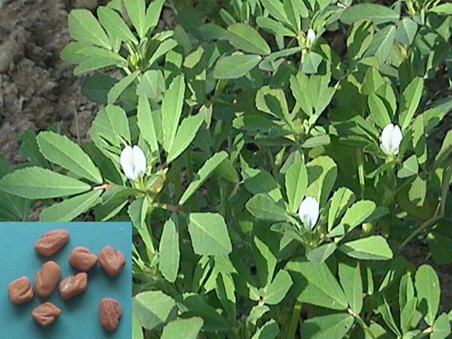
Fenugreek الحلبة
Trigonella foenum-graecum
Part used seeds
Uses:
Glucose lowering
Indigestion
Galactagogue (induces lactation)
Hypocholesterolemic

Slide 6
Cinnamomum cassia

Slide 7
Cinnamomum zeylanicum
The bark inner surface : yellowish brown, while the external bark surface dark brown

Slide 8
Cinnamon bark
Cinnamomum zeylanicum (Ceylon Cinnamon) (Srilanka)
Cinnamomum cassia (Chinese Cinnamon)
Family : Lauraceaea
Constituents :
1.Cinnamon oil (volatile oil ): Eugenol
2. Mucilage (mannitol)
3. Sugars
4. Starch
5. Tannins
Cinnamomum cassia has the same constituents except eugenol .

Slide 9
Cinnamon Uses
Carminative.
Flavoring agent.
Antiseptic.
Antidiarrheal.
Powerful germicide .
Hypoglycemic agent.

Slide 10
Phytoestrogens
Many plants contain estrogenic substances (phytoestrogens) and they act as mild estrogens or, in certain circumstances, as anti-estrogens
They generally have beneficial effects, including chemopreventive activity
Many legumes بقولياتcontain phytoestrogens, as do linseed and hops
The incidence of benign prostatic hyperplasia is lower in men, and menopausal symptoms in women, in societies consuming significant amounts of foods containing these substances in their normal diet

Slide 11
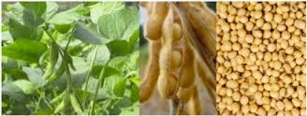
Soya beans,
Glycine soja
Family: Leguminosae (Fabaceae)
It is an important item of diet in many countries
Soya milk is used as a substitute for animal milk in allergic people
The protein is used as a meat substitute
Soya contains phytoestrogens such as isoflavones and coumestans
Uses
1. Nutritive: Proteins, carbohydrates.
2. Pharmaceutical uses : Soy oil used as base for ointments & lotions.
3. Cosmetics: as emollient for skin & hair

Slide 12
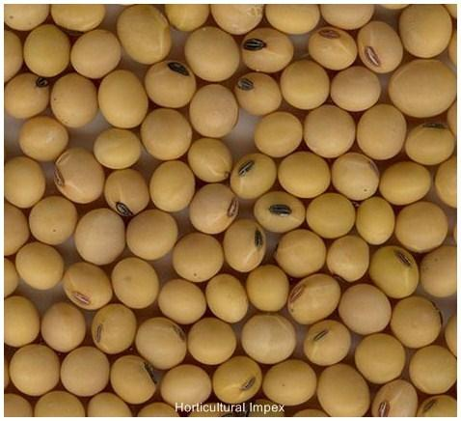
Soya (Cont’d)
Therapeutic uses:
Preparations containing the isolated isoflavones are used medicinally
High soya diet can reduce menopausal symptoms and prostate enlargement (Epidemiological data, not proven in clinical trials)
The isoflavones and coumestans are oestrogenic, and are now being used as a natural form of hormone replacement therapy

Slide 13
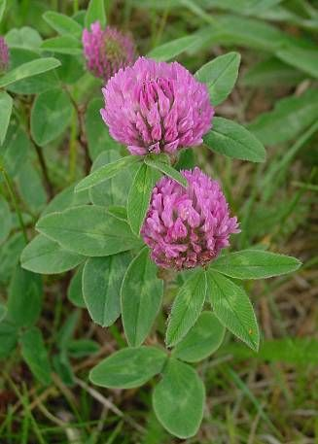
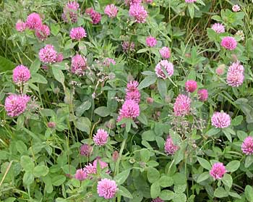
Red clover
Trifolium pratense
Part used: leaves
Uses:
Red clover was traditionally used for skin complaints such as psoriasis and eczema
Expectorant in coughs and bronchial conditions
Has recently been used as a source of the isoflavones, for a natural method of hormone replacement therapy
Not clinically proven except for marginally significant effect for treating hot flushes in menopausal women نبتة بأربع ورقات بالعادة نادر

Slide 14
Hormonal imbalance
Some herbal medicines have the capacity to regulate hormone levels without necessarily being estrogenic
Mechanism is unknown

Slide 15
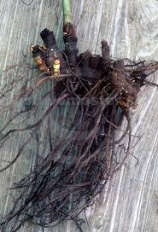
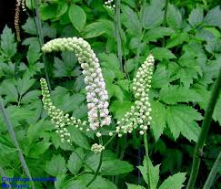
Hormonal imbalance in women
Black cohosh
Acteae racemosa
Parts used are the rhizomes and roots which are black
It has hormonal and anti-inflammatory effects
Modern use is focused on its use in treating menopausal symptoms
It should be avoided in pregnancy and lactation because of insufficient data

Slide 16
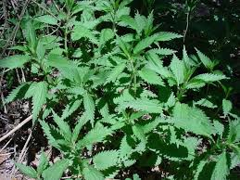
Benign Prostatic Hyperplasia
Nettle/ stinging nettle القريص
Urtica dioica
Modern uses: symptomatic relief of BPH and adjunctive treatment in arthritis and rheumatism
It has also been used as supportive therapy in rheumatic ailments
The herb and the roots are the parts used pharmaceutically

Slide 17
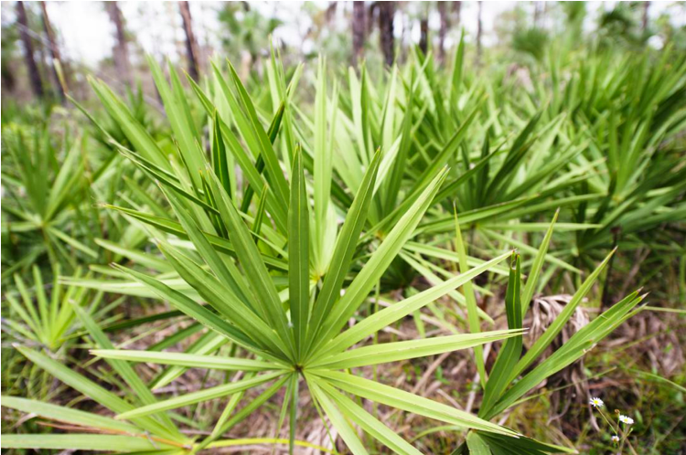
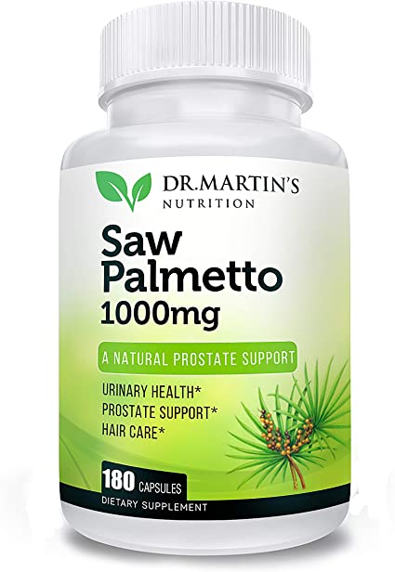
Benign Prostatic Hyperplasia
Saw Palmetto نوع من انواع شجر النخيل
Serenoa serrulata
Its use in treatment of BPH is supported by evidence from several controlled studies
Part used: Fruit alpha 1 blocker دوائياً يُستخدم لعلاج BPH

Slide 18
The reproductive system
Drugs used in obstetrics, including substance used in childbirth, and genitourinary disorders and erectile dysfunction in men

Slide 19
Ergometrine
An alkaloid extracted from ergot (Claviceps purpurea)
Used to manage the third stage of labor (in conjunction with oxytocin), and to control postpartum hemorrhage

Slide 20
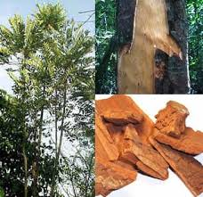
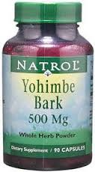
Male Sexual Dysfunction
Male impotence (failure to produce a satisfactory or sustainable erection) may result from psychogenic, vascular, neurologic or endocrine abnormalities or drug treatment
Yohimbine,
Pausinystalia yohimbe
part used: bark
Yohimbine is an alpha adrenergic blocker and has a wide reputation as a sexual stimulant
It should only be used under medical supervision اوكسيتوسن هي نفسها ابرة الطلق تدفع الطفل قديماً كان يصير مشاكل كالبتر الفا 2 لما يتسكر بزيد Sympathatic

Slide 21
Male Sexual Dysfunction
Papaverine
An alkaloid extracted from the opium poppy (Papaver somniferum)
Used for the treatment of impotence of neurological or psychogenic origin
It must be given by intracavernosal injection, it is normally only used as a last resort when less invasive treatments have failed

Slide 22
The musculoskeletal system

Slide 23
Inflammatory disorders are not normally treated with phytomedicines, but recently the use of some botanical preparations for chronic inflammatory conditions has become widespread Supportive

Slide 24
Drugs used in arthritis rheumatism and muscle pain
Bromelain (ananase)
Devil’s claw
Rosehip
Turmeric
Willow bark

Slide 25
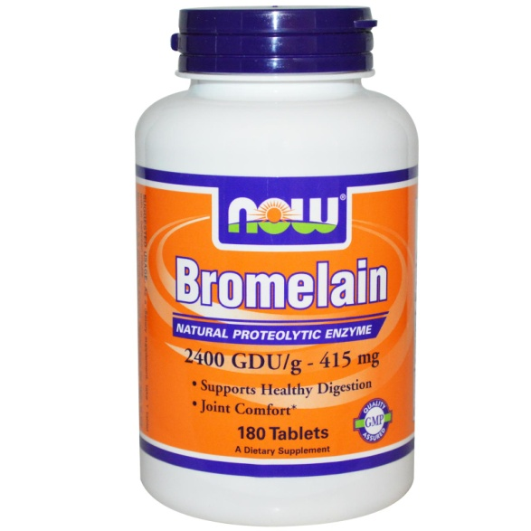
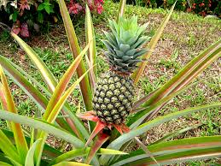
Bromelain (ananase)
Bromelain is a mixture of proteolytic enzymes extracted from the fruit and stem of the pineapple (Ananas comosus)
Family: Bromeliaceae
The active constituents are protease inhibiting enzymes
Bromelain has been proposed for the treatment of atherosclerosis, dysmenorrhoea, infection and sports injuries
Used clinically to treat bruising, arthritis, joint stiffness and pain, and to improve healing postoperatively, including after dental procedures
Effective alternative to NSAIDs, as shown by a number of clinical trials

Slide 26
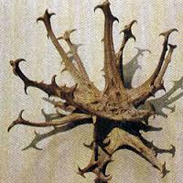
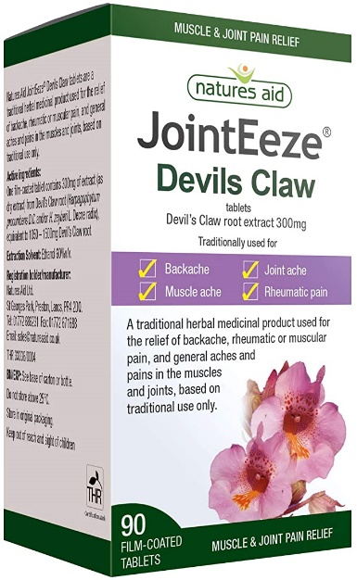
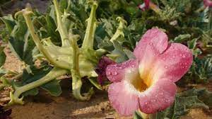
Devil’s claw
Harpagophytum radix
Part used: root
Used traditionally for fever, kidney and bladder problems, as an obstetric remedy –تسريع الولادةfor induction or acceleration of labor, as well as for expelling the retained placenta
The most important active constituents are considered to be the bitter iridoids like harpagoside
Other compounds present include polyphenolic acids (caffeic and cinnamic acids), and flavonoids

Slide 27
Devil’s claw (Cont’d)
Has been used for the treatment of dyspeptic disorders such as indigestion and lack of appetite, due to the presence of bitter glycosides (iridoids)
Treatment of rheumatic conditions and lower back pain
Devil’s claw is generally well tolerated and appears to be a suitable alternative to NSAIDs
Fractions of the extract containing the highest concentration of harpagoside inhibited COX-1 and COX-2 activity
Should be avoided in pregnant women
Side effects include minor GI upsets, should be avoided in patients with gastric or duodenal ulcers

Slide 28
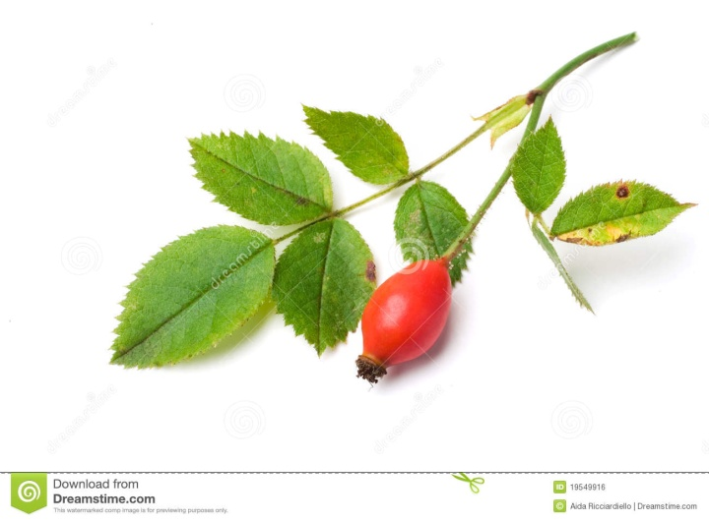
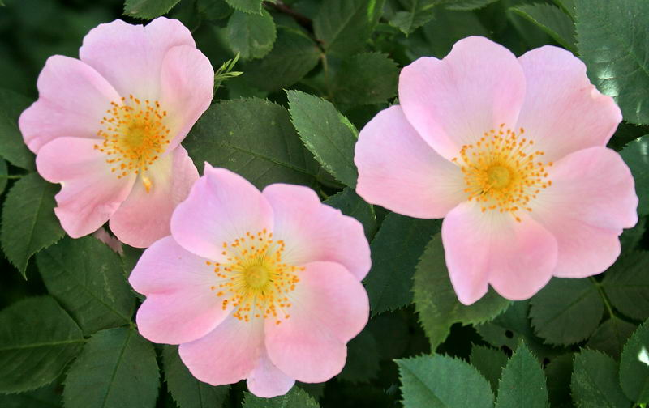
Rosehip
Also known as wild or dog rose
Family: Rosaceae
Rosa canina
Part used: fruit
Anti-inflammatory constituents isolated from rosehip extracts include the triterpene acids, oleanolic, oleic, and linoleic acids, and galactolipids

Slide 29
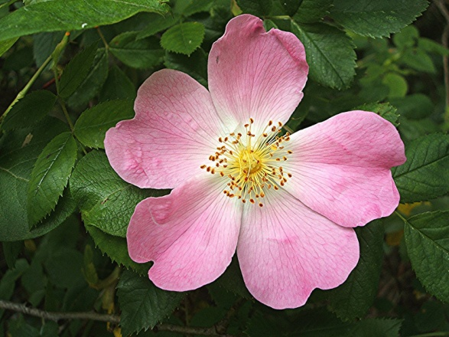
Rosehip (Cont’d)
Uses:
Traditionally used as a source of vitamin C
Anti-inflammatory for rheumatoid arthritis
Analgesic
Extracts derived from rose hip inhibit COX-1, COX-2 and 5-LOX-mediated leukotriene مزعج للأزمةB(4) formation, and have antioxidant capacity

Slide 30
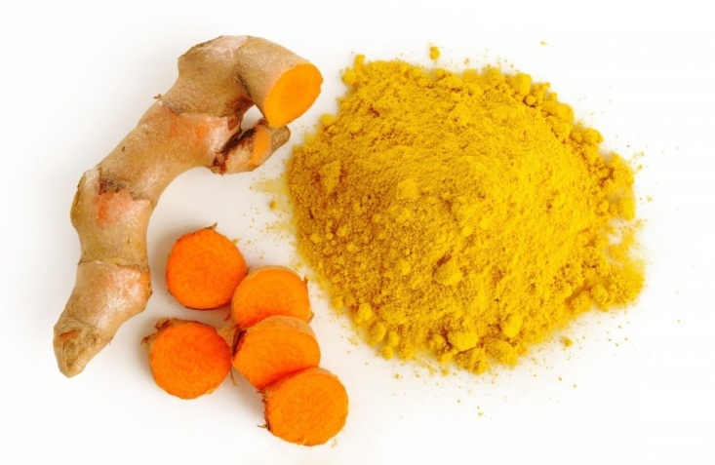
Turmeric (الكركم)
Curcumae domesticae
Family: Zingiberaceae
Part used: Rhizome
Increasingly being used as a coloring agent because of the increased use of natural ingredients in foods
Active ingredients:
Curcuminoids such as curcumin (mixture known as curcumin)
Essential oil: zingberene, eugenol

Slide 31
Turmeric (Cont’d)
Antiinflammatory
Atihepatotoxic
Widely used in Asian medicine as an anti-inflammatory, digestive, blood purifier and general tonic
Given internally and also applied externally to wounds and insect bites
Most of the actions are attributable to the curcuminoids, although some of the essential oil components are also antiinflammatory
The efficacy of curcumin and its safety for human use has made it an interesting agent for the prevention and/or treatment of various malignant diseases, arthritis, allergies, Alzheimer’s disease and many other inflammatory illnesses Golden Milk

Slide 32
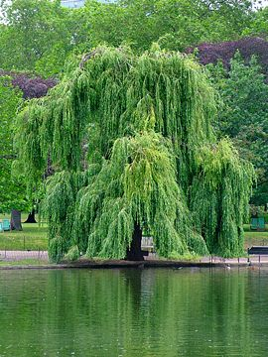
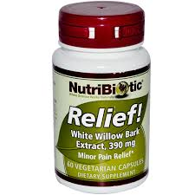
Willow bark
Salix genus
Salix fragilis
Salix alba
Family: Salicaceae
Traditionally used for chronic forms of pain, rheumatoid diseases, fever and headache
Salicin, one of its main compounds served as a lead molecule for the development of aspirin (acetylsalicylic acid) Low dose –Baby asbirin عشان هيك بسموه هيك
Also contains flavonoids

Slide 33
Topical anti-inflammatory agents
Most topical antirheumatics are تسبب حساسية العيون ومخاط الأنف ورفع درجة حرارةrubefacients
They are used for localized pain or when systemic drugs are not appropriate
Many contain salicylates, and capsaicinالفلفل الأحمر is used for severe pain (e.g. with shingles-الحزام الناري) نفس الفايروس لل Chicken box جذري المي ونفسه بسبب الحزام الناري يفضل انه الصغار يلي معهم جدري يبعدو عن كبار السن
They should not be used in children, pregnant or breastfeeding women or with occlusive dressings
Arnica is also widely employed, despite little clinical evidence to support its use

Slide 34
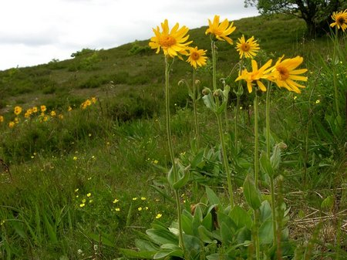
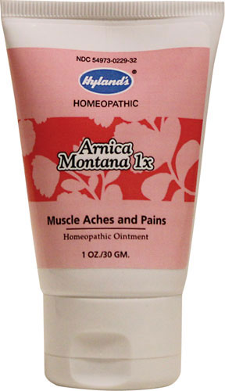
Arnica
Arnica montana
Family: Asteraceae
Widely used in many European countries, including the UK
The flower heads are the part used
Extracts and tinctures are applied topically, for bruising, sprains التواء , swellings and inflammation, usually in the form of a cream or gel.

Slide 35
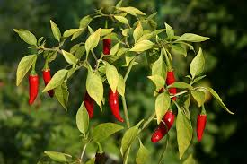
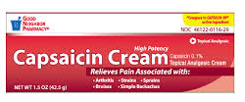
Topical anti-inflammatory agents
Capsaicin/ Capsicum
Capsaicin is the pungent oleo-resin of the fruit of the chilli pepper Capsicum frutescens
Family: Solanaceae
Constituents: capsaicin and other capsaicinoids such as dihydrocapsaicin
Capsaicin causes inflammation, but it also desensitizs sensory nerve endings to pain stimulation by depleting the neuropeptide Substance P
It is used as a local analgesic in the treatment of post-herpetic neuralgia (shingles), diabetic neuropathy, osteoarthritis
Capsaicin has long been used in cough and cold remedies
Capsaicin can produce severe irritation
It causes burning on initial application and should not be applied near the eyes, mucous membranes or to broken skin
It should be avoided in children and pregnant or breastfeeding women

Slide 36
Black Pepper fruits
Piper nigrum
Contains piperine
Uses:
1. Condiment
2. Stomachic : promoting the appetite or assisting digestion.
3. Relaxed sore throat.
4. Rubefacient in case of rheumatism.
بزيد اللعاب شوية فلفل أسود بخلي امتصاص الكركم 100% عملوا تجربة عشان يتخلصوا من الطعم الحار جربوا عدة أمور ونفع الحليب واللبن والبقدونس or oily base material

Slide 38
Black Mustard seedsخردل
Brassica nigra
Contains sinigrin (glycoside)
Uses:
1. Rubefacient بعمل dilation مثل حرارة وبعدها منبطل حاسين بالألم
2. Counter irritant
3. Emetic.
4. Condiment.
واله طعم لاذع برضو

Slide 41
Nocturnal leg cramps
Night cramps are common in elderly people, and particularly in patients with liver disease such as cirrhosis
Quinine
Isolated from the bark of Cinchona species
Quinine salts can be effective in reducing incidence of leg cramps
Should be avoided for routine use in the muscle cramps because of cardiac toxicity

Slide 42
Drugs used in gout
Gout is a very painful, localized inflammation of the joints (particularly those of the thumb and big toe)
Caused by hyperuricaemia and the consequent formation of needle-like crystals of uric acid in the joint
For prevention, the xanthine oxidase inhibitor allopurinol is the drug of choice أدوية ودايت Catabolism for meat داء الملوك
Acute gout is normally treated with indomethacin or other NSAIDs, but, if inappropriate, colchicine can be used النقرس مؤلم كثير مشكلة بتراكم اليوريك أسيد عادةً باصبع الرجل الكبير ممكن توصل المفاصل

Slide 43
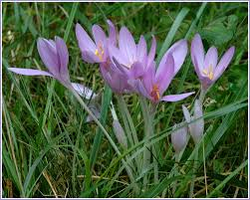
Drugs used in gout
Colchicine
Colchine is a pure alkaloid extracted from the corms and flowers of Colchicum autumnale
Family: Liliaceae
The plant extract is not used because colchicine is highly toxic and the dose must be rigorously controlled
Colchicine is used in the acute phase of gout, particularly when NSAIDs are either ineffective or contraindicated
Colchicine is occasionally also used as prophylaxis for Mediterranean familial fever
Colchicine causes gastrointestinal upsets such as nausea, vomiting, abdominal pain

