Slide 1
Eye

Slide 2
Ophthalmology is not an area where phytotherapy is important
Diagnosis of functional disorders of the eye (glaucoma, etc.) should always be carried out by a medical practitioner
The usual precautions when using extracts in the eye (e.g. sterility of eye drops, absence of irritation of solutions, etc.) must also be taken
Simple eye lotions containing mildly astringent and soothing plant products are popular

Slide 3
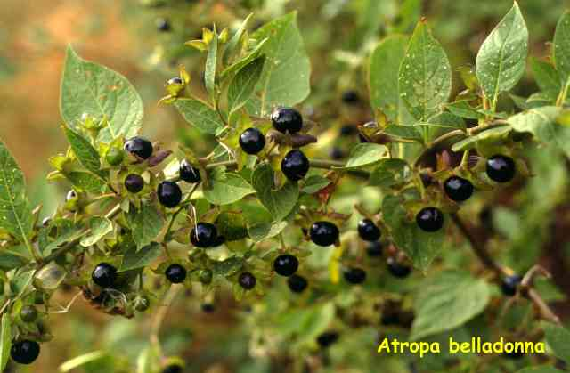
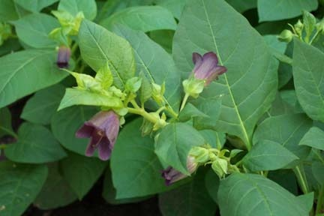
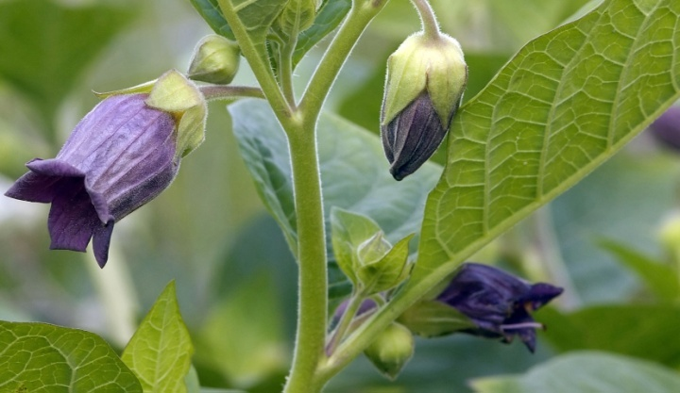
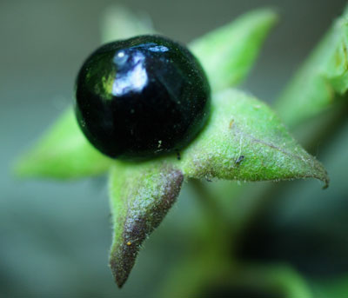
Atropine
A tropane alkaloid extracted from deadly nightshade (Atropa belladonna)
All parts of the plant contain tropane alkaloids
Family: Solanaceae
It is occasionally used as eye drops or ointment to open the iris for examination or surgical procedures

Slide 4
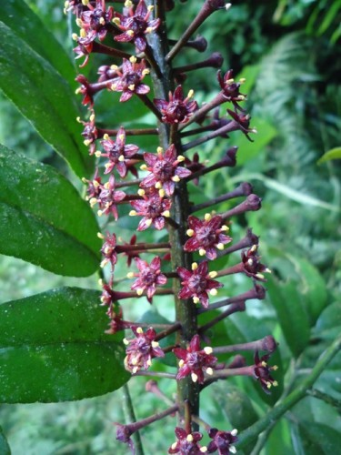
Glaucoma
Pilocarpine
An alkaloid obtained from Jaborandi leaf (Pilocarpus microphyllus)
Pilocarpine is a sympathomimetic
Used is in ophthalmic preparations as a miotic, in open-angle glaucoma and to contract the pupil after the use of atropine

Slide 5
Ear, nose, orthopharynx

Slide 6
Infections of the ear, nose and throat are treated under medical supervision with antibiotics
A number of soothing and antiseptic preparations from plant sources are available for use

Slide 7
Ear
Infections of the ear are treated with either topical or systemic antibiotics
The removal of wax from the ear is achieved with the aid of softening agents such as almond, arachis or olive oil sometimes followed by ear syringing يُفضل بين كل فترة والأُخرى نزور الطبيب لتنظيف الأُذن

Slide 8
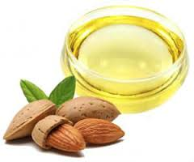
Almond oil
Obtained from the seed of Prunus amygdalus (bitter almond
Prunus communis (sweet almond)
Family: Rosaceae
It is a fixed oil, also known as sweet almond oil
Consists of triglycerides, mainly triolein together with fatty acids, including palmitic, lauric, myristic and oleic acids

Slide 9
Rose colour flowers
Cinnamon brown seed

Slide 10
Chemical constituents (Bitter)
Fixed oil 40 -55%
Proteins
Enzyme emulsin
Glycoside : Amygdalin.

Slide 11
Bitter almond Chemical constituents
Fixed oil 40 -55%
Proteins
Enzyme emulsin
Glycoside :Cyanogenic group – Amygdalin.
AmygdalinVB17 enzyme emulsin + H2O HCN!! toxic +
+ benzaldehyde (V.O) +glucose Amygdalin VB17 ليس من الفيتامينات ولكنه مفيد للسرطان وبنفس الوقت سام

Slide 12
Bitter almond uses
Demulcent .
Mild laxative .
Treatment of heart burn.
Toxic in large doses .
Almond oil uses :
Solvent for certain kinds of drugs (oily injections) .
Cosmetics – hair and skin creams and lotions .

Slide 13
Sweet Almond seeds
Prunus communis
Rosaceae الوردية
Contain : 1- fixed oil 40-55%
2- proteins
Uses : 1-Nutritive
2- Food industry بمنع حرقة المعدة ويحمي من القرحة

Slide 14
Almond flour is gluten-free and therefore a popular ingredient in cookery in place of wheat flour for gluten-sensitive people and people with wheat allergies
Almonds are a rich source of Vitamin E, containing 24 mg per 100 g
نقع، لمدة 8 ساعات، تصفية، وغلط بالخلاط حليب اللوز وبعلموا منه الخبز كثير لذيذ وغني بفيتامين اي وفيه ألياف

Slide 15
Olive oil
Expressed from the fruits of Olea europea
Family: Oleaceae
Olive oil is a fixed oil containing mainly glycerides of oleic acid أرجان من المغرب Argan oil

Slide 16
Orthopharynx
Simple oral and throat irritation can be treated with an anti-inflammatory and antiseptic mouthwash, including those containing thymol
Many essential oils are used as oral antiseptics and anti-inflammatory agents, including mint, clove, eucalyptus and lemon oils, as well as menthol and thymol

Slide 17
Thymol
Originally extracted from thyme (Thymus) and is present in many oils
It is antiseptic, deodorizing and antiinflammatory
Widely used in dental products
Thymol causes irritation in high concentrations when applied externally, and should not be swallowed in significant amounts
Normal doses associated with the herb do not normally cause problems

Slide 18
Peppermint oil
Found in Mentha species
Antiseptic, deodorizing and anti-inflammatory
Widely used in skin and dental products
The major constituents are menthol, menthone, cineole
Menthol can cause irritation in high concentrations

Slide 19
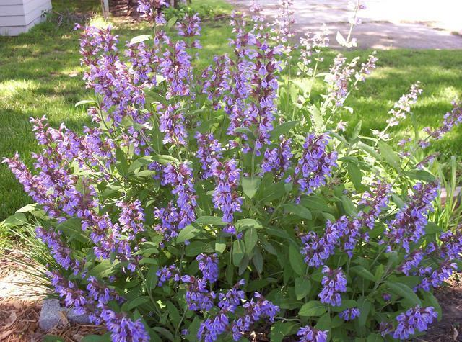
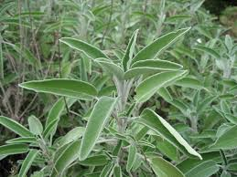
Sage
Salvia officinalis
Sage is a popular culinary herb
The leaves are rich in essential oil with α- and β-thujone as the major components, and cineole
Also contains rosmarinic acid, diterpenes and flavonoids
The use of sage leaf, in the form of a tea used as a gargle, is traditional for soothing inflammation of the mucous membranes of mouth and throat
Rosmarinic acid has antiviral and antiinflammatory effects
Sage essential oil is antibacterial and antifungal
An aqueous extract of sage leaf has been shown to have analgesic and anti-inflammatory effects

Slide 20
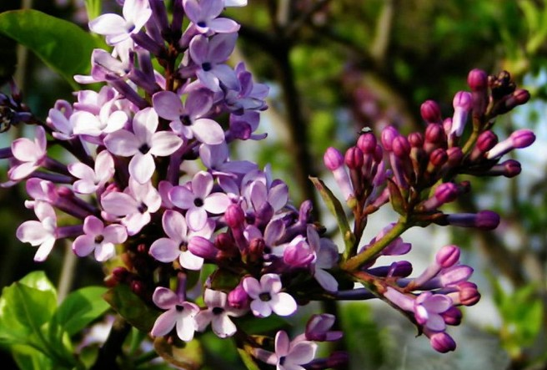
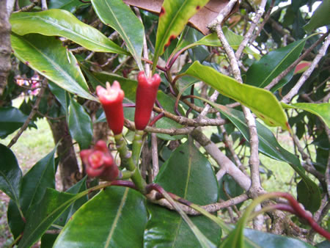
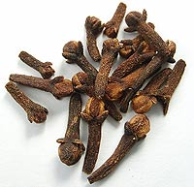
Cloves
Obtained from the flower buds of Eugenia caryophyllus
Family: Myrtaceae
Used as a culinary spice
The buds are rich in essential oil consisting mainly of eugenol
Also contain caryophyllene and methyl salicylate
Clove oil is used for the symptomatic relief of toothache and is a constituent of many dental preparations
The oil is useful in the treatment of inflammation of the mucous membranes of mouth and throat
The oil is antiseptic, antispasmodic, antihistaminic and anthelmintic
Many of these effects are due to the eugenol
Eugenol inhibits prostaglandin synthesis

Slide 21
Miscellaneous Supportive Therapies for Stress, Aging, Cancer and Debility

Slide 22
Preventive medicine is used to prevent degenerative conditions, aging and some forms of cancer
Most of such herbs originated in Asia and China
In traditional Chinese medicine they are used to treat ‘empty’ diseases, to restore ‘qi’ energy and tonify the organs, having a balancing effect on yin and yang rather than affecting only one

Slide 23
Supportive Therapies for Stress, Aging, Cancer and Debility
Strengthen the immune system, improve memory and alertness, enhance sexual performance, promote healing and stimulate the appetite
The most important Chinese herbs are ginseng, ginkgo and tea
Many of these herbs contain saponins or steroidal compounds
They might act in a similar way to corticosteroids or enhance the effect of naturally occurring steroid hormones in the body
This type of drug is known as an adaptogen, and is considered to be a substance helping the body to deal with, or adapt to, stress or other adverse conditions
There is very limited scientific evidence for their use

Slide 24
Cancer chemoprevention
Cancer chemoprevention: the prevention of cancer in human populations by ingestion of chemical agents that prevent carcinogenesis
Various compounds, especially from fruits and vegetables (indoles and isothiocyanates) could inhibit chemically induced tumors in laboratory animals
Chemoprophylaxis of carcinogenesis is of obvious benefit to maintenance of human health with enormous dietary significance

Slide 25
Cancer chemoprevention
It is important to differentiate between cancer prevention (e.g. cessation of cigarette smoking) and cancer chemotherapy (the use of cytotoxic drugs after cancer diagnosis)
Epidemiological studies يعني مثلاً بلاحظوا انه بالهند بيوكلوا شيء معين بشكل يومي وهذا بمنع أمراض معينة وهكذا بطولوا الدراسةmay help to find leads for chemopreventive agents, which can then be tested in laboratory experiments

Slide 26
Cancer chemoprevention
Several recent epidemiological studies have demonstrated that dietary factors may reduce the incidence of cancers
An inverse correlation was found between the incidence of lung cancer among people who smoke and consume carotene-rich foods
There was a similar finding for vitamin C and oesophageal and stomach cancers, and for vitamin E and lung cancer

Slide 27
Cancer chemoprevention
Almost 600 ‘chemopreventive’ agents are known and they are usually classified as:
Inhibitors of carcinogen formation (ascorbic acid, tocopherols, phenols)
Inhibitors of initiation (phenols, flavones)
Inhibitors of post-initiation events (β-carotene, retinoids, terpenes)
Many are items of food or beverages (e.g. tea) and are sometimes called ‘functional foods’ or ‘nutraceuticals’
Examples include ginger and garlic

Slide 28
Cancer chemoprevention
Chemopreventive agents may even work in synergy, with several components contributing to the overall effect, which may be the case with plant drugs
It is recommended that 5–7 servings of vegetables to be consumed daily to function as a source of cancer chemopreventive agents

Slide 29
Cancer chemoprevention
Chemopreventive agents can safeguard humans from known carcinogenic risks such as smoking
As knowledge of these agents increases they will play an increasing role in cancer prevention
Example on chemopreventive agents: tea, garlic, anthocyanins (bilberry) and others

Slide 30
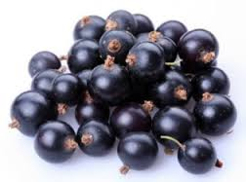
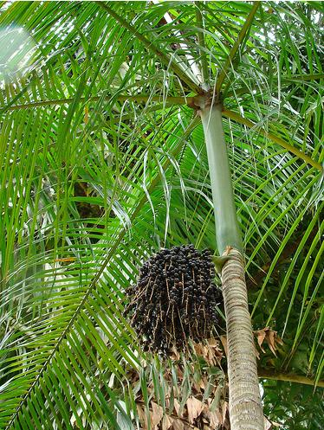
Acai berry
The part used: fruits
Have been acclaimed as having a wide range of health-promoting and therapeutic benefits due to high levels of antioxidants
Acai has a history of use as a medicinal plant and as food in Brazil
Traditionally, it has been used to treat fevers, skin complications, digestive disorders and parasitic infections

Slide 31
Acai berry (Cont’d)
Constituents: polyphenols, flavonoids, fatty acids
This botanical drug has become very popular despite a lack of scientific evidence
The high content of polyphenols has been linked to antioxidant, anti-inflammatory, antiproliferative and cardioprotective properties
Acai demonstrates promising potential with regard to antiproliferative activity and cardioprotection, but further studies are required

Slide 32
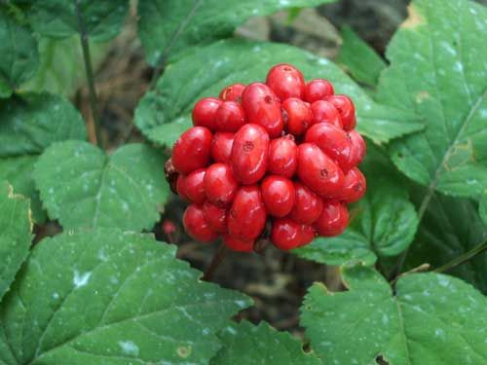
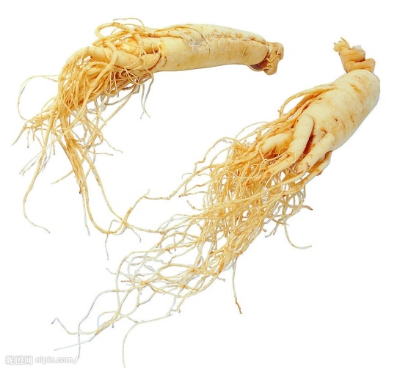
Ginseng
Panax Ginseng
Native to China but cultivated widely elsewhere
Part used: root
Ginseng products are liable to falsification as true ginseng is expensive

Slide 33
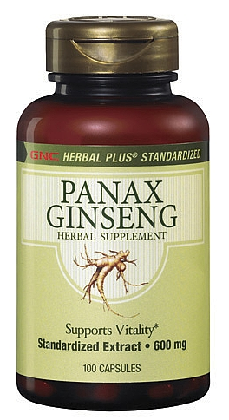
Ginseng (Cont’d)
Contains saponin glycosides (the ginsenosides)
Ginseng is taken as a tonic for debility, insomnia, natural and premature aging, to increase alertness and improve sexual inadequacy, and for diabetes, as well as an adaptogen to relieve stress and improve stamina and concentration
It has been suggested that these effects are due to changes in cholinergic activity, neuro-protection, and antioxidant activity

Slide 34
Ginseng (Cont’d)
The adaptogenic effect may be due to the elevation of serum levels of corticosteroids and the reduction of catecholamines which results in homoeostasis
Ginseng also has a traditional use in diabetes, and the glycans (panaxans A–E) are hypoglycaemic in mice
Immunomodulatory activity, potentiation of analgesia and anticancer effects (by ginsenosides)
Side effects include oestrogenic effects, hypertension and irritability

Slide 35
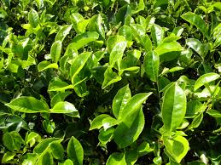
Tea
Camellia sinensis
Family: Theaceae
Green tea is not processed and thus differs from black tea, which is fermented
The leaf buds and very young leaves are used to prepare the beverage and extracts for medicinal use
Tea contains caffeine, and much smaller amounts of other xanthines such as theophylline and theobromine, polyphenols which are antioxidant

Slide 36
Tea uses
Antioxidant
Green tea is used medicinally more frequently than black tea
The stimulant and diuretic properties are due to caffeine
The astringency and antioxidant effects are due to polyphenols
Tea is useful in diarrhea, and in China is used for many types of dysentery
The polyphenols in green tea have cancer chemopreventive properties due to their antioxidant capacity
Habitual consumption of green tea is generally associated with a lower incidence of cancer
Black tea has similar health benefits, due to the tea pigments

Slide 37
Tea uses
Tea is drunk in nearly every country in the world for its refreshing, mildly stimulating and analgesic effects
Anti-inflammatory and antitumour effects have been described, due to inhibition of the transcription factor NF-kB
The risk of breast and stomach cancers appears to be lower for green tea drinkers
Black tea consumption is associated with a lower risk of death from ischaemic heart disease and has been shown to reverse endothelial dysfunction in coronary heart disease
Tea is antimicrobial and anticariogenic, and is even reputed to help weight loss

Slide 38
Tea safety issues
Tea as a beverage is non-toxic in the usual amounts ingested, although it can cause GI upsets and nervous irritability due to caffeine
Concerns about the safety of concentrated preparations or excessive consumption of green tea are present
Cases of hepatotoxicity have been associated with high doses of green tea-containing dietary supplements

Slide 39
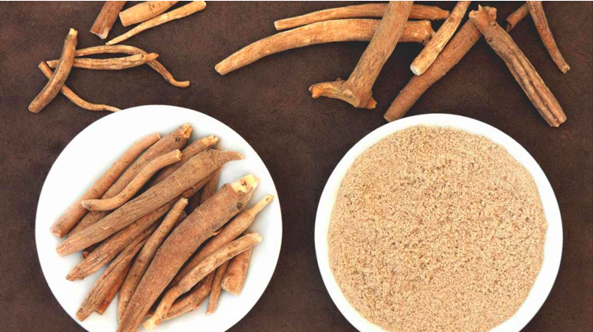
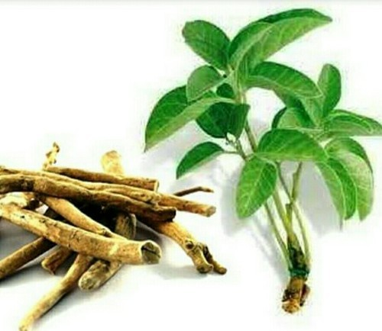
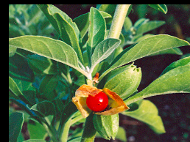
Ashwagandha للإطلاع
Withania somnifera
Family: Solanaceae
Part used: root
Adaptogen
Mild sedative
Antioxidant
Antiinflammatory
Arthritis
Antitumor

Slide 40
Anticancer Natural Products

Slide 41
Natural products from marine or plant sources have made an enormous impact on the discovery of compounds that kill cancer cells
60% of all cancer drugs that are used are either natural products or owe their origin to a natural source
The National Cancer Institute (NCI) in the US conducted studies on cytotoxic agents from nature that lead to the identification of a number of anticancer drugs الدراسة على البشر تأخذ وقت أطول من الدراسة على الحيوانات

Slide 42
نوعان عسل صدر وغيره

Slide 46
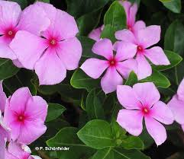
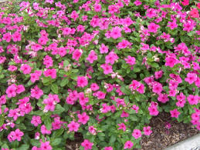
Vinca rosea (periwinkle)
The plant was used as a folk remedy for diabetes
In China, the plant has been used for its astringent and diuretic properties and as a cough remedy
The plant contains indole alkaloids (Referred to as vinca alkaloids) vincristine and vinblastine
Antitumor agents, used for treatment of leukemia
Used for lymphomas
Inhibit mitosis by binding to tubulin

Slide 47
The leaves have acute base , rounded apex and have entire margin
The flowers are rose or violet or white or white with red eyes .
Catharanthus - Vinca

Slide 48
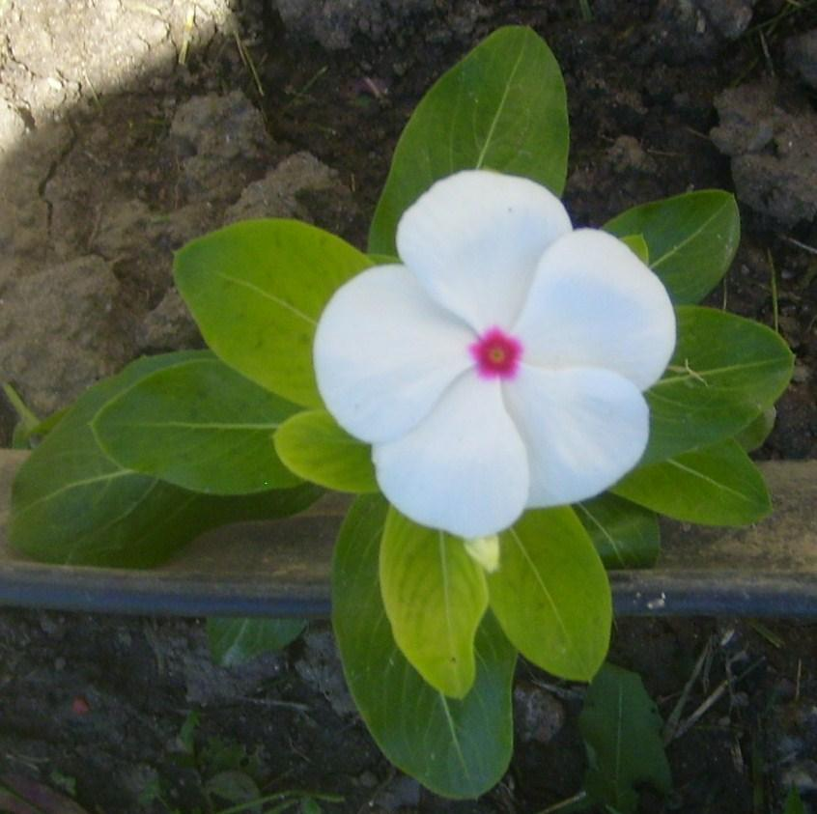

Slide 49
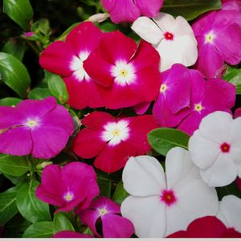

Slide 50
