Slide 1
Infectious diseases
Numerous natural products produced by plants have antiprotozoal and insecticidal activity بالعادة النبات عشان يحمي نفسه
They may be used internally (influenza or colds) or externally (for skin infections)
Many, especially those containing essential oils, are active against all of these
Intestinal worms can be treated with herbal materials such wormwood ممكن تكون سامة بكميات كبيرة (Artemisia), but the most effective and least toxic anthelmintic drugsطارد للديدان are synthetic أي شيء سخن منيح

Slide 2
Infectious diseases
Plants have been a central part of traditional medicines to cure topical and systemic infections caused by microbes, in particular bacteria
These preparations form the basis of many wound-healing materials in the developing world where the plant is prepared as a crude drug or an extract that is applied topically to improve the healing of a wound
These preparations may have antimicrobial properties and remove the microbes by an antiseptic mechanism and/or they may promote the ability of the wound to repair itself by stimulating cellular growth
Antimicrobial compounds include carvacrol in the essential oil of Thyme (Thymus vulgaris) which acts as antibacterial and antifungal

Slide 3
Infectious diseases الأمراض المُعدية
Antimicrobial compounds may be produced by the plant to protect itself from attack from plant pathogenic microbes and insects
Some plants produce antimicrobials when they are under microbial attack such as the antimicrobial scopoletin produced by potato when inoculated with a fungus
Plant antibacterials are very different in shape and chemistry to existing antibacterials like erythromycin and tetracycline
This may mean that plant-derived antibacterials could function through a different mechanisms and would make them valuable where bacterial resistance to conventional antibiotics has arisen
Some plants antimicrobials are already on the market such as Cranberry products which may be used in the management of urinary tract infections ممكن الخلية السرطانية تصيرمقاومة للدواء Ecoli أكثر شيء بتعمل التهابات مسالك بولية

Slide 4
Broad spectrum antimicrobials
Lemon balm
Garlic
Tea tree oil
Cranberry

Slide 5
Lemon balm leaves
Melissa officinalis
Family: Lamiaceae
It is antimicrobial, carminative and mild sedative
The polyphenolics like caffeic acid, rosmarinic acid and tannins, as well as the essential oil are responsible for the antimicrobial effects
Hot water extracts have antiviral properties, mainly due to the polyphenolic acids
Topical formulations are used for Herpes simplex virus skin lesions
Aqueous extracts also inhibit division of tumor cells
The herb is used as an ingredient of herbal teas, often with other herbs, for nervous disorders and insomnia فيتامين سي للرشح ولكن كوقاية وهو Antioxidant & immune sys.
Lemon balm is well tolerated, but should not be taken internally in high doses over a long period because of its antithyroid activity

Slide 6
Garlic
Allium sativum
Culinary herb
Bulbs have been historically used as topical and systemic material to treat various infections by bacteria, fungi and viruses
The antimicrobial constituents are the sulfur compounds, which include allicin and glycosides such as sativoside B1
Also contains flavonoids like quercetin
It is an antibiotic, expectorant and antithrombotic, used most frequently for respiratory infections such as colds, flu and bronchitis, and for its cardiovascular protection effect from blood clotting and atherosclerosis

Slide 7
Garlic (cont’d)
The allyl sulphides, such as allicin and ajoene, are strongly antimicrobial having activity against Staphylococcus aureus, Streptococcus species and even some Gram-negative bacteria, such as Helicobacter pylori
The allyl sulphides have antibacterial, antiviral and even more potent antifungal activity
Chemopreventive effect against carcinogens
Toxicity is not thought to be a problem, but interaction with antiplatelet drugs should be considered with long-term or high-dose therapy

Slide 8
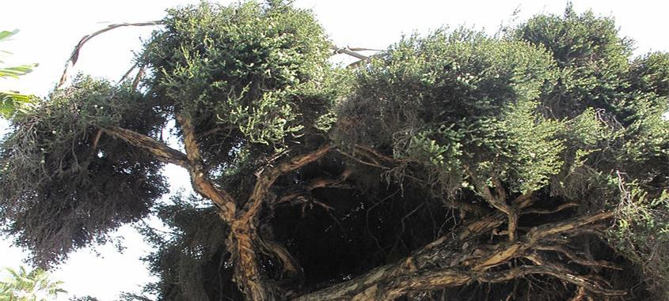
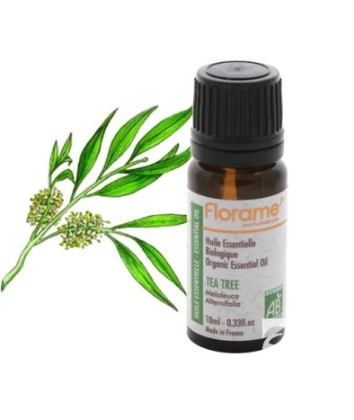
Tea tree and tea tree oil
Melaleuca alternifolia
Family: Myrtaceae
The tree is indigenous to Australia
Tea tree oil products include soaps, shampoos, creams, lotions and gels
The leaves and twigs أغصان صغيرة طالعة من الشجرة undergo distillation to produce the oil
Traditionally the oil is used topically as an antimicrobial for skin infections, to reduce bruising and for insect bites
Tea tree oil contains monoterpenes
The composition of the oil may also depend on the method of distillation

Slide 9
Tea tree and tea tree oil (Cont’d)
Tea tree oil is now used worldwide for its antiseptic qualities, in the form of skin creams for pimples البثورand acne, pessaries for vaginal thrush, as inhalation for respiratory disorders and pastilles for sore throat
Also found as a lotion for the treatment of lice and scabies جرب infestations, and for dandruff قشرةand other hair and scalp disorders
The oil has broad-spectrum antimicrobial activity against Staphylococcus aureus, Escherichia coli and various pathogenic fungi and yeasts including Candida albicans, and also against the protozoa Leishmania major and Trypanosoma brucei
Undiluted essential oils can cause skin irritation and tea tree oil should be used with care, it should only be taken internally in small doses علاج عطري نشا وجوز هند وزيت اله رائحة وبايكربونات وصفة للتعرق

Slide 10
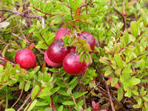
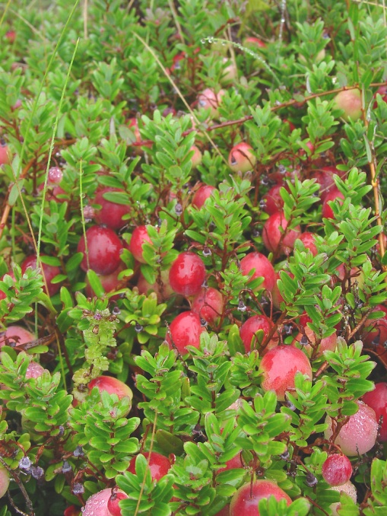
Cranberry fruit
Vaccinium macrocarpon
It is a small shrub which grows throughout North America
Cranberry juice in particular, and also crushed cranberriesالمجففة , have a long history in of traditional use in the treatment and prevention of UTIs
Also been used for kidney stones
The proanthocyanidin constitunets may be important for the antibacterial activity of cranberry, citric acid and many oligosaccharides are also present

Slide 11
Cranberry
Cranberry cocktail (containing cranberry juice, fructose and vitaminC) and proanthocyanidins markedly inhibit adhesion of E.coli to uroepithelial cells allowing its clearance
Bacterial adherence to mucosal surfaces is an important step in the development of UTI
The juice is also thought to increase urine acidity
Diabetic patients should use sugar-free preparations

Slide 12
Myristica seeds Nutmeg seeds جوزة الطيب
Myristica fragrans
Family Myristicaceae
Volatile oil contains Myristicin, Eugenol

Slide 13
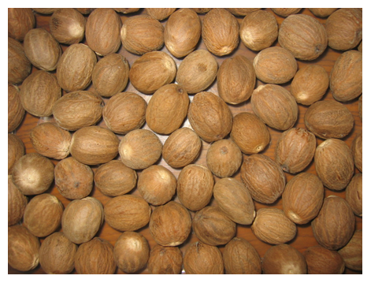

Slide 14
Uses of nutmeg
Flavoring agent (Coffee ,Cake ).
Condiment.
Carminative .
Aphrodisiac.زيادة الرغبة الجنسية
Stomachic.
Has antibacterial activity .
Astringent.
ما يوخذوها الحوامل لانه بعمل اجهاض –بكميات كبيرة-
Cause hallucination in large doses.

Slide 15
In large doses (more than one ground table spoon) may cause : 1.Nausea 2.Vomiting 3. Drowsiness 4. Stupor then death

Slide 16
يستخدم مع القهوة العربية وهذا بالعادة يميزها
Cardamom fruits
Main slide

Slide 17
brownish black
fruits

Slide 19
Main slide

Slide 20
Uses
Cardamom fruits:
Elettaria cardamomum
Family: Zingiberaceae
The volatile oil contains cineole and limonene
Flavoring agent.
Carminative.
Condiment.
Antibacterial activity .
Treatment of halitosisوالنعنع والبقدونس مناح نفس رائحته مش حلوة.

Slide 21
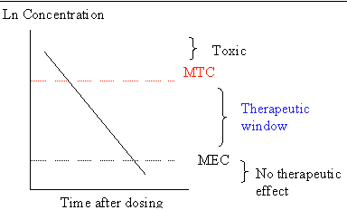
Single chemical entity and novel plant antibacterials
Random screening of single compounds from plants can yield novel antibacterials
Examples:
Tetrahydrocannabinol (THC) and cannabidiol
Hyperforin
Flavonoids
MEC: Minimum Effective Concentration
These plants could already have history of antimicrobial us, and isolation of potent compounds responsible for such activity is important مرات الخلايا السرطانية تقاوم الأدوية Resistance فهنا في مشكلة

Slide 22
Cannabis sativa leaves
Has a long history of use as a medicinal material having not only euphoriant, but also antiseptic properties
In Afghanistan cannabis resin was to treat plagueالطاعون and as a topical antimicrobial preparation
In vitro studies support the antibacterial properties of cannabis as the major components, tetrahydrocannabinol (THC) and cannabidiol are highly active against Gram-positive bacteria such as Staphylococcus aureus and its methicillin-resistant (MRSA) variants أسوأ انواع الالتهابات
Cannabidiol has the added advantage of also displaying anti-inflammatory activity and this would certainly be advantageous as a wound healing/ cleansing preparation
There is real opportunity to develop new cannabis-based antibacterials
In the UK and Canada a licensed cannabis-based medicine is used to ameliorate the pain and spasticity associated with multiple sclerosis (MS)

Slide 23
Hyperforin
A compound isolated from St John’s wort
Has excellent activity against penicillin- and methicillin-resistant Staphylococcus aureus strains (MRSA)

Slide 24
Flavonoids
Probably the most intensively studied natural products in terms of their antimicrobial activity
Some flavonoids are effective against MRSA

Slide 25
Some natural products such as sophoraflavanone G from Sophora genus have the ability to potentiate the action of existing antibacterial agents
Bacteria have the ability to remove antibiotics from their cells
Some natural products inhibit efflux transporters and restore antibiotic activity Penicillin – penicillinase inhibitor or beta lactamase لمنع الResistance
Plant natural products with the ability to inhibit these processes include tea catechins بالشايand some alkaloids such as reserpine and even complex resin oligosaccharides

Slide 26
There is great potential to discover new antimicrobial substances from plants and the chemistry presented by plant sources is very often highly functional and chiral
Studies on plant antibacterials require greater depth, particularly with respect to mammalian cytotoxicity (selectivity between microbial and mammalian toxicity) and mechanism of action

Slide 27
Antiprotozoals
The classical antiprotozoal drug used to treat malaria, is quinine, from Cinchona bark
Quinine is still occasionally used to treat malaria, and is also the template for the production of newer semi-synthetics such as chloroquine
Most of these are also used for malaria prophylaxis
The most recent antimalarial to be introduced clinically is artemisinin (from sweet wormwood, Artemisia annua)
Emetine, an alkaloid from Cephaelis ipecacuanha, is amoebicidal, but too toxic for clinical use and investigations continue for similar, semi-synthetic compounds
Many important protozoal diseases involve a non-human vector, which may be an insect and control of these diseases, includes pesticide use
In many developing countries, plant based anti-protozoals and insecticides are employed for disease control Malaria : Anopheles Mosquito اسم الحشرة

Slide 28
Cinchona
Cinchona officinalis
Part used: bark
Contains quinoline alkaloids, the major being quinine, along with quinidine, cinchonine, cinchonidine and others
Quinine (Anti arrhythmic) was primarily used as an antimalarial before the semi-synthetic compounds with improved efficacy and reduced toxicity were made
The bark was used as astringent, and spasmolytic
Both quinine and quinidine are antimalarial and anti-arrhythmic agents
Quinine is used in low doses as an ingredient in some analgesic and cold and flu remedies
Chronic overdose can result in the condition known as cinchonism, which is characterized by headache, abdominal pain, tinnitus rashes and visual disturbances
Cinchona and quinine should not be used in large doses during pregnancy, except for treating malaria المن التبغ هو قاتل للحشرات منخلطه مع ماء ثومة وفلفل وماء ونرش النباتات

Slide 29
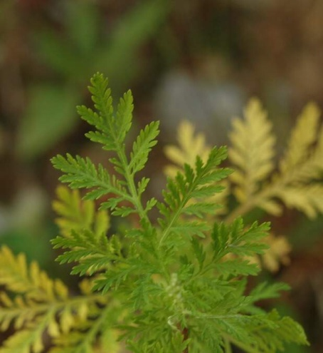
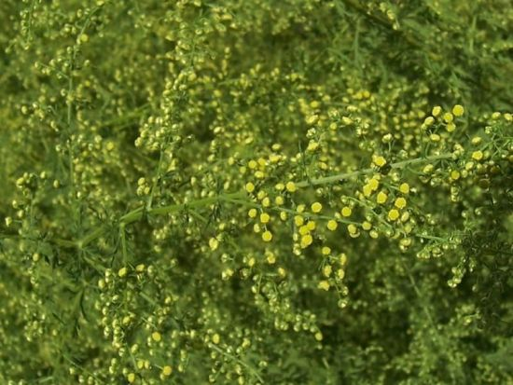
Sweet wormwood
Artemisia absinthium
Antiparasitic, anthelmentic
Artemisia annua
Highly effective for the treatment of malaria
Part used: leaves
Contains: artemisinin

Slide 30
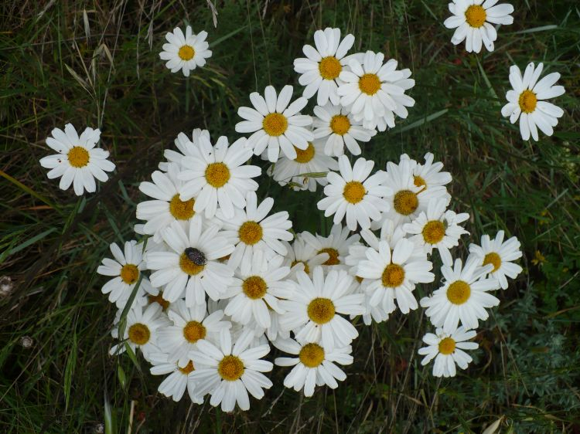
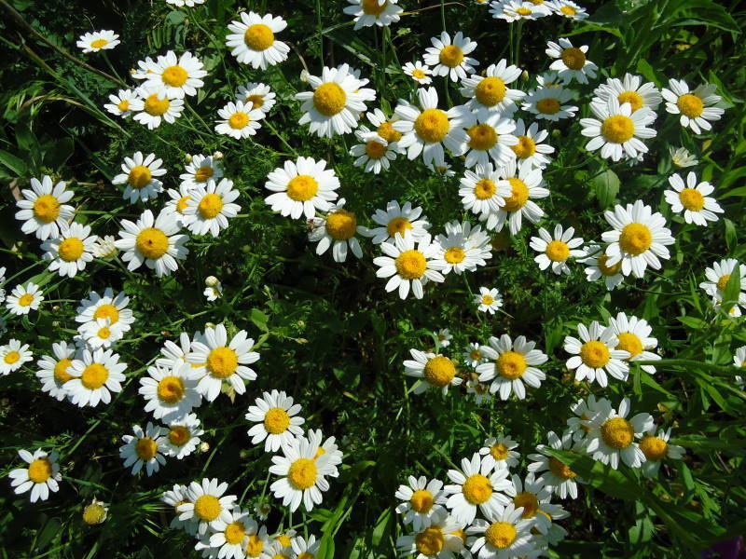
Insecticides
Pyrethrum (insect) flowers
Chrysanthemum
Family: Asteraceae
The unopened flower heads are used
Contain pyrethrins
The natural pyrethrins are used to treat lice and scabies infestations and to kill other types of insects
The natural products have been used to develop semi-synthetic derivatives such as permethrin which can be more potent
Pyrethrum is considered to be harmless to humans and animals, and maybe used as a spray, lotion or powder
Pyrethroids are much less toxic to humans than synthetic insectisides
Care should be taken as they can cause irritation or allergic reactions شامبو القمل DDT لغوه لانه بسبب سرطانات وبضل بالتربة لفترة يعني Dichlorodiphenyltrichloroethane كان يُستخدم الديديتي قبل كمضاد للحشرات

