Slide 1
Nigella seeds Black Cumin seeds حبة البركة
Nigella sativa
Contains Glycosides, Bitter principles: Nigellin

Slide 2
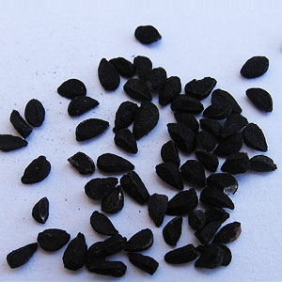

Slide 3
The uses of nigella oil
Treatment of Whopping cough.
Bronchitis.
Expectorant.
Treatment of hemorrhoids.
Demulcent.

Slide 4
The nigella seeds uses
Antispasmodic.
Improve memory.
Diuretic.
Lactogenic.

Slide 5
Sesame seeds
Sesamum indicum
Contains: Fixed oil, Phenolic substance (sesamol), Proteins, Mucilage.

Slide 6
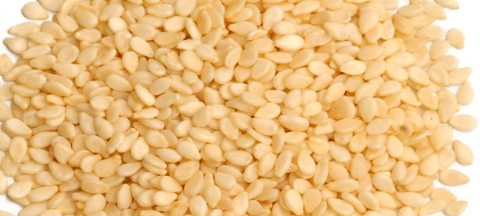

Slide 7
Uses of Sesame oil
1. As solvent for certain kinds of oily injections (hormones, steroids, antibiotics )
2. Industrial uses.
Uses of Sesame seeds
1.Mild laxative.
2.Demulcent.
3.Nutrient.
4.Lactogenic.

Slide 8
Sesame seeds are exceptionally rich in iron, magnesium, manganese, copper, and calcium) and contain vitamin B1 and vitamin E

