Slide 1
Skin

Slide 2
The skin
Inflammatory and infectious skin diseases have a high prevalence
Skin infections
Dry and itchy skin
Inflammation صدفية إكزيما

Slide 3
Dry/itchy skin conditions and eczema
Dry and scaly skin conditions are very common and can arise from many causes
Diagnosis should be carried out initially by a medical practitioner in order to exclude infection, infestation or other serious disorders
Emollients, such as oil-based preparations based on arachis oil, or oat extracts, are usually the first line of treatment أي زيت منيح ايورفيدا: تزيييت الجسم، بسحب السموم وبعدها بتحمم

Slide 4
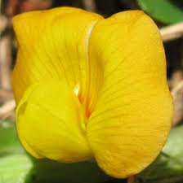
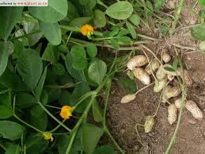
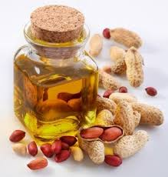
Arachis oil (peanut oil)
Expressed from Arachis hypogaea
The part used of the plant is the seed and its oil
The oil consists mainly of glycerides of oleic and linoleic acids
It is an ingredient of emollient creams and bath oils
Peanuts are dangerously allergenic to some individuals, and the oil should be avoided in these patients as a precaution

Slide 5
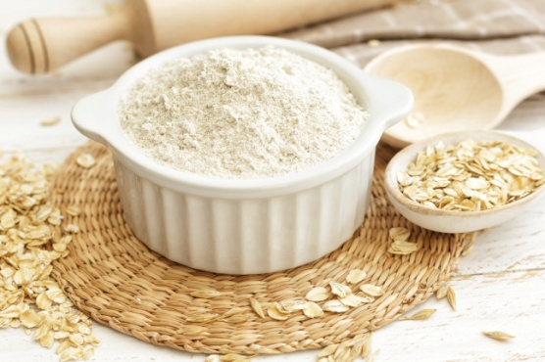
Oats
Avena sativa
A widely distributed cereal crop
The seeds are crushed to form a coarse powder, which is creamy white in color
Oats contain proteins like avenin, polyphenols known as avenanthramides, starch and soluble polysaccharides like beta-glucans, saponin glycosides including avenacosides A and B
The oil contains linoleic acids and vitamin E
Oats are externally emollient, and a colloidal fraction is used in bath preparations for eczema, and itchy or dry skin
Often successful especially if used regularly over a long period
Avenanthramides are the potent antiinflammatory agents that appear to mediate the anti-irritant effects of oats
Avenanthramides reduce interleukin-8 (IL-8) release
Topical application of avenanthramides mitigated inflammation in murine models of contact hypersensitivity Eczema tea tree oil treatment (Jony student)

Slide 6
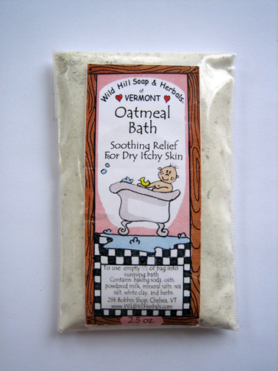
Oats (Cont’d)
Starches and beta-glucans are responsible for the protective and water-holding functions of oat الصفات المرطبة
The phenolics confer antioxidant and antiinflammatory activity
Some of the oat phenols are also strong ultraviolet absorbers
Cleansing activity of oat is mostly due to saponins
Oatmeal is a cleanser, moisturizer, soothing, protective anti-inflammatory agent
Ingestion of oats lowers cholesterol levels due to the saponins and polysaccharides

Slide 7
Inflammatory skin conditions
Allergic reactions, psoriasis الصدفية, burns, bruising and general inflammation of skin are common
Severe cases are treated with corticosteroids as well as emollient preparations, ideally under medical supervision
Minor disorders respond well to phytotherapy, with soothing and anti-inflammatory herbal products such as Aloe vera, evening primrose oil, marigold كل الزيوت حولنا هي مرطبة Emolient

Slide 8
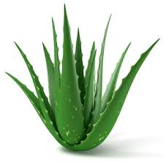
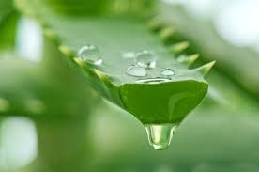
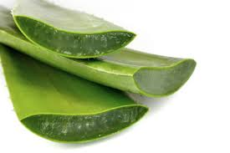
Aloe vera
The name ‘aloe vera’ is usually applied to the gel obtained from the centre of the fleshy leaves of various species of aloe
The gel and the leaves are used for burns and other inflammatory skin conditions
Aloe vera is added to shampoo, skin creams, ‘after sun’ preparations (and even washing powder), but normally in concentrations too low to have any therapeutic effect مفيد للشعر، وبنفع يتاكل لمشاكل المعدة وبنفع يكون Laxatives

Slide 9
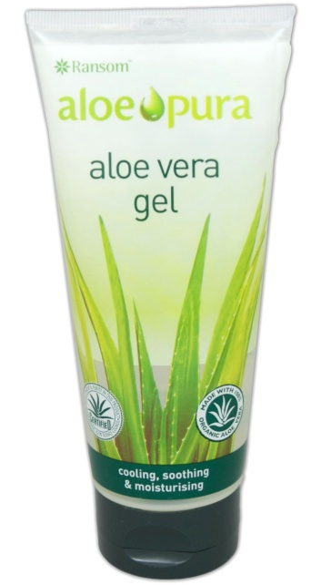
Aloe vera
For dermatological preparations, there is some evidence for antibacterial, anti-inflammatory, emollient and moisturizing effects
The polysaccharides are important as soothing and immunostimulating agents
The anthraquinone derivatives are antibacterial
Enzymes extracted from aloe vera gel have been shown to be analgesic
The gel has been reported to be effective in the treatment of stomach and aphthous (mouth) ulcers
Aloe vera gel seems to be helpful in the treatment of burns and to aid wound healing
Aloe vera cream was found to be at least as effective as 0.1% triamcinolone in reducing the clinical symptoms of psoriasis in a recent study

Slide 10
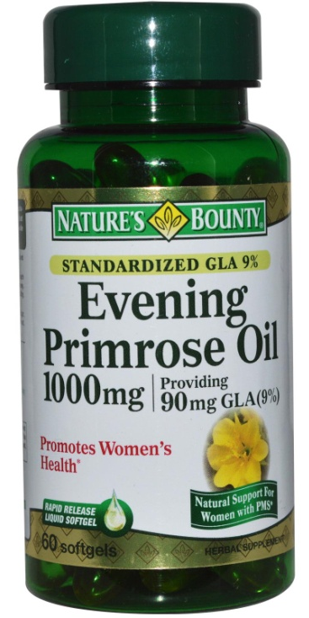
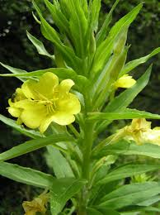
Evening primrose oil
Oenothera biennis
The seed oil is used in the treatment of eczema
The seed oil contains linoleic acid
The oil is taken internally as well as applied externally
Primrose oil has a beneficial effect on itching, crusting, edema and redness
The main indications are: atopic eczema (especially in infants), rheumatoid arthritis and premenstrual syndrome
Evening primrose oil is usually taken in conjunction with vitamin E to prevent oxidation

Slide 11
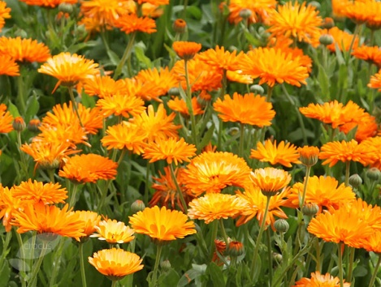
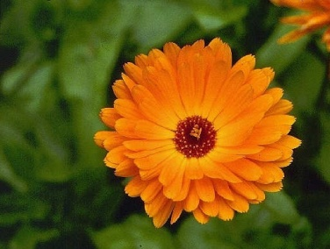
Marigold
Calendula officinalis
The flower heads and extracts from them are well known for their anti-inflammatory properties
Pharmaceutical uses include inflammatory skin conditions such as topical application for wound healing and after radiotherapy
Both oral and topical application of Calendula flower extract improved healing of wounds in rats and reduced the time needed for re-epithelization
Extracts stimulated proliferation and migration of fibroblasts at low concentrations
The essential oil exerts (in vitro) antibacterial and antifungal effects
Immunostimulant effects have been reported for polysaccharide fractions

