Slide 1
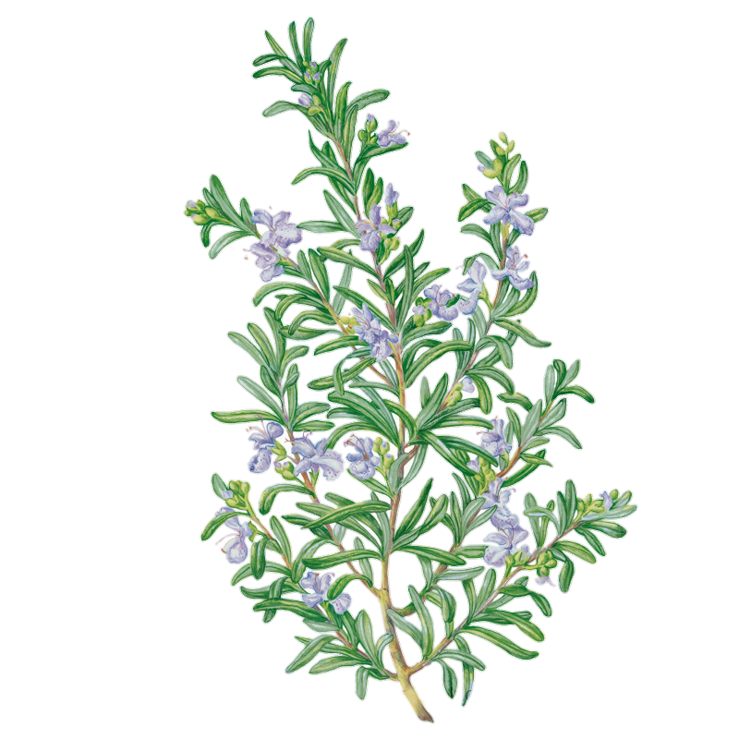
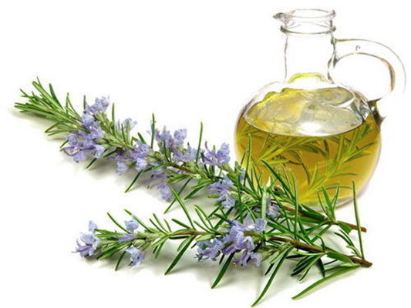
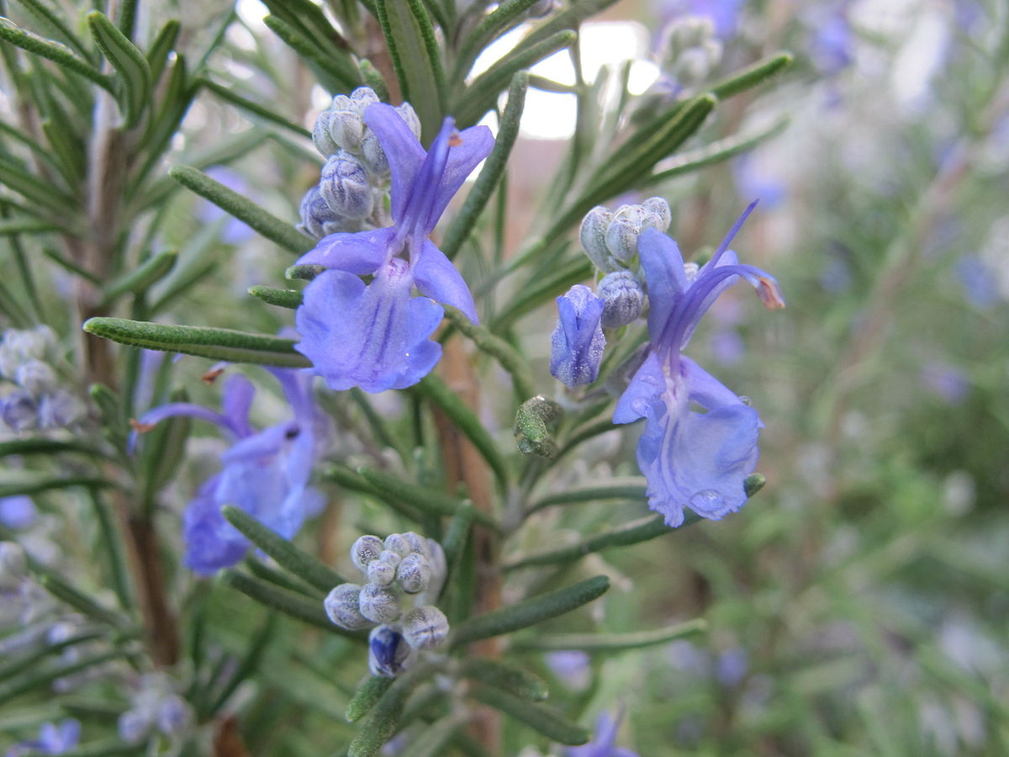
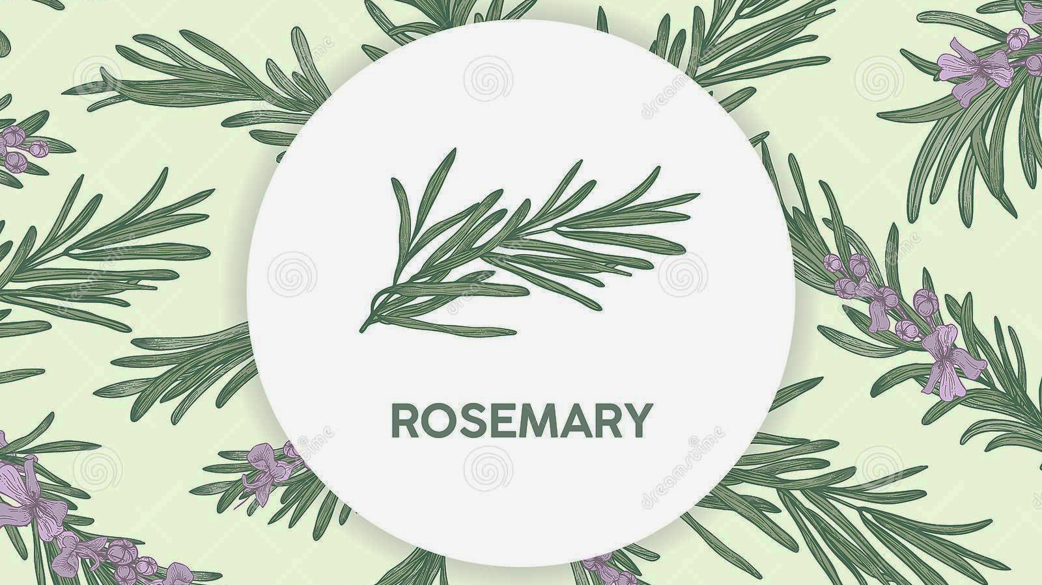
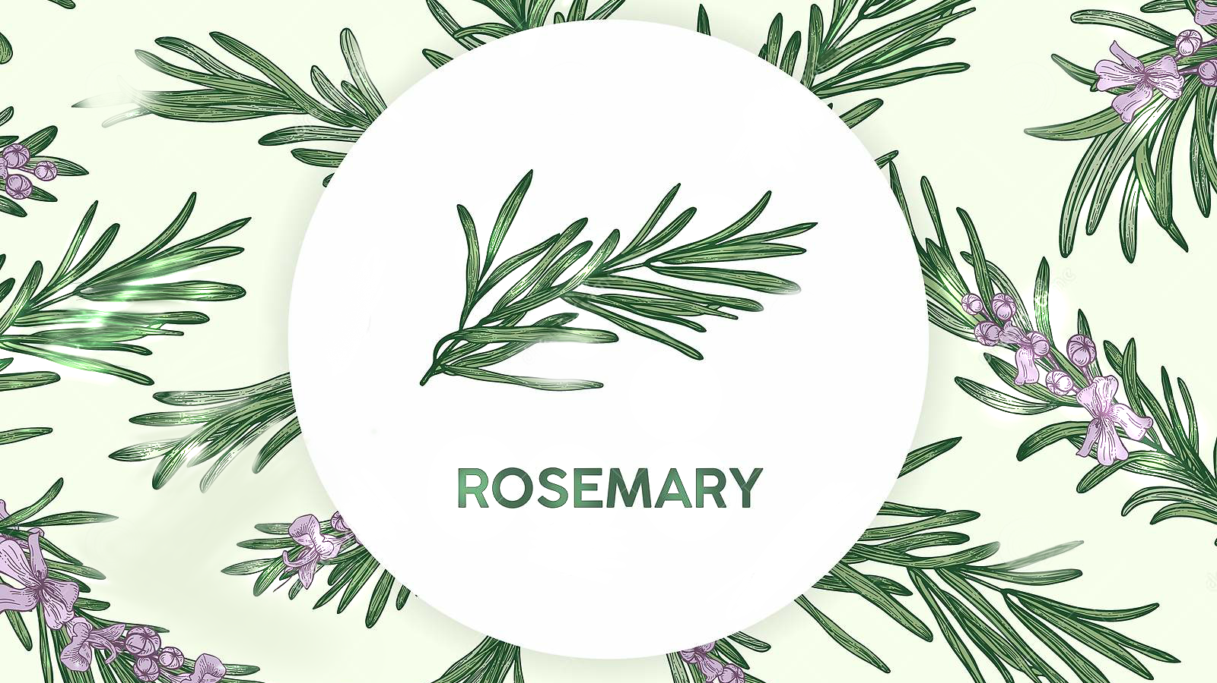
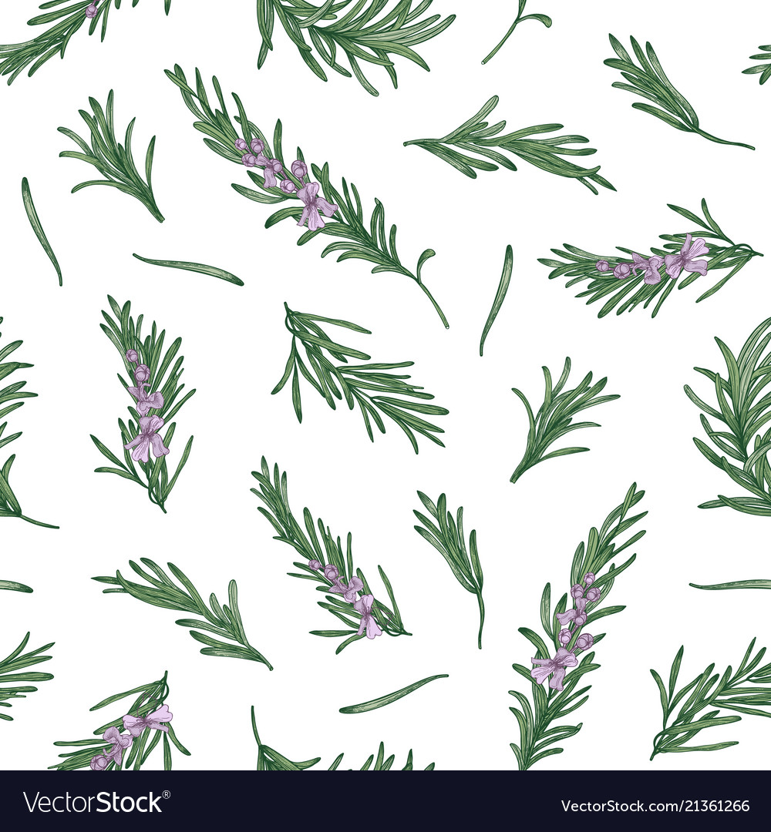
Rosemary
اكليل الجبل
Aseel
Aljamal
Israa
Mafarjeh
Jony
Bajjali
Muhammad
Musleh

Slide 2
Presenters ^_^
ASEEL
JONY
ISRAA
MUHAMMAD

Slide 3
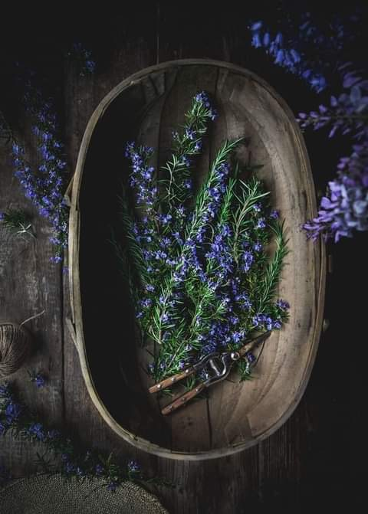
Pharmacognosy
Researches
About Rosemary
Contents
Interactions
Uses
Safety & Toxicity

Slide 4
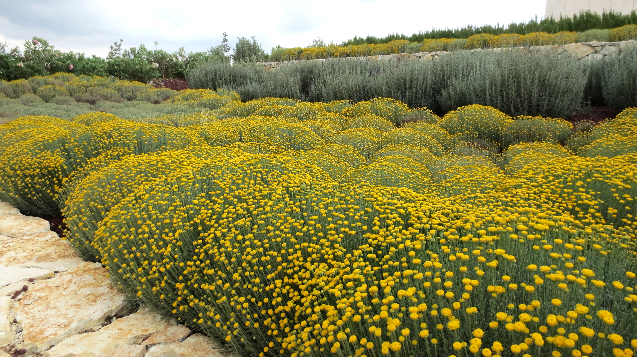
Pharmacognosy
Natural
Resources
Natural
Resources
Notes:
Herps and Animals Cat and Plants

Slide 5
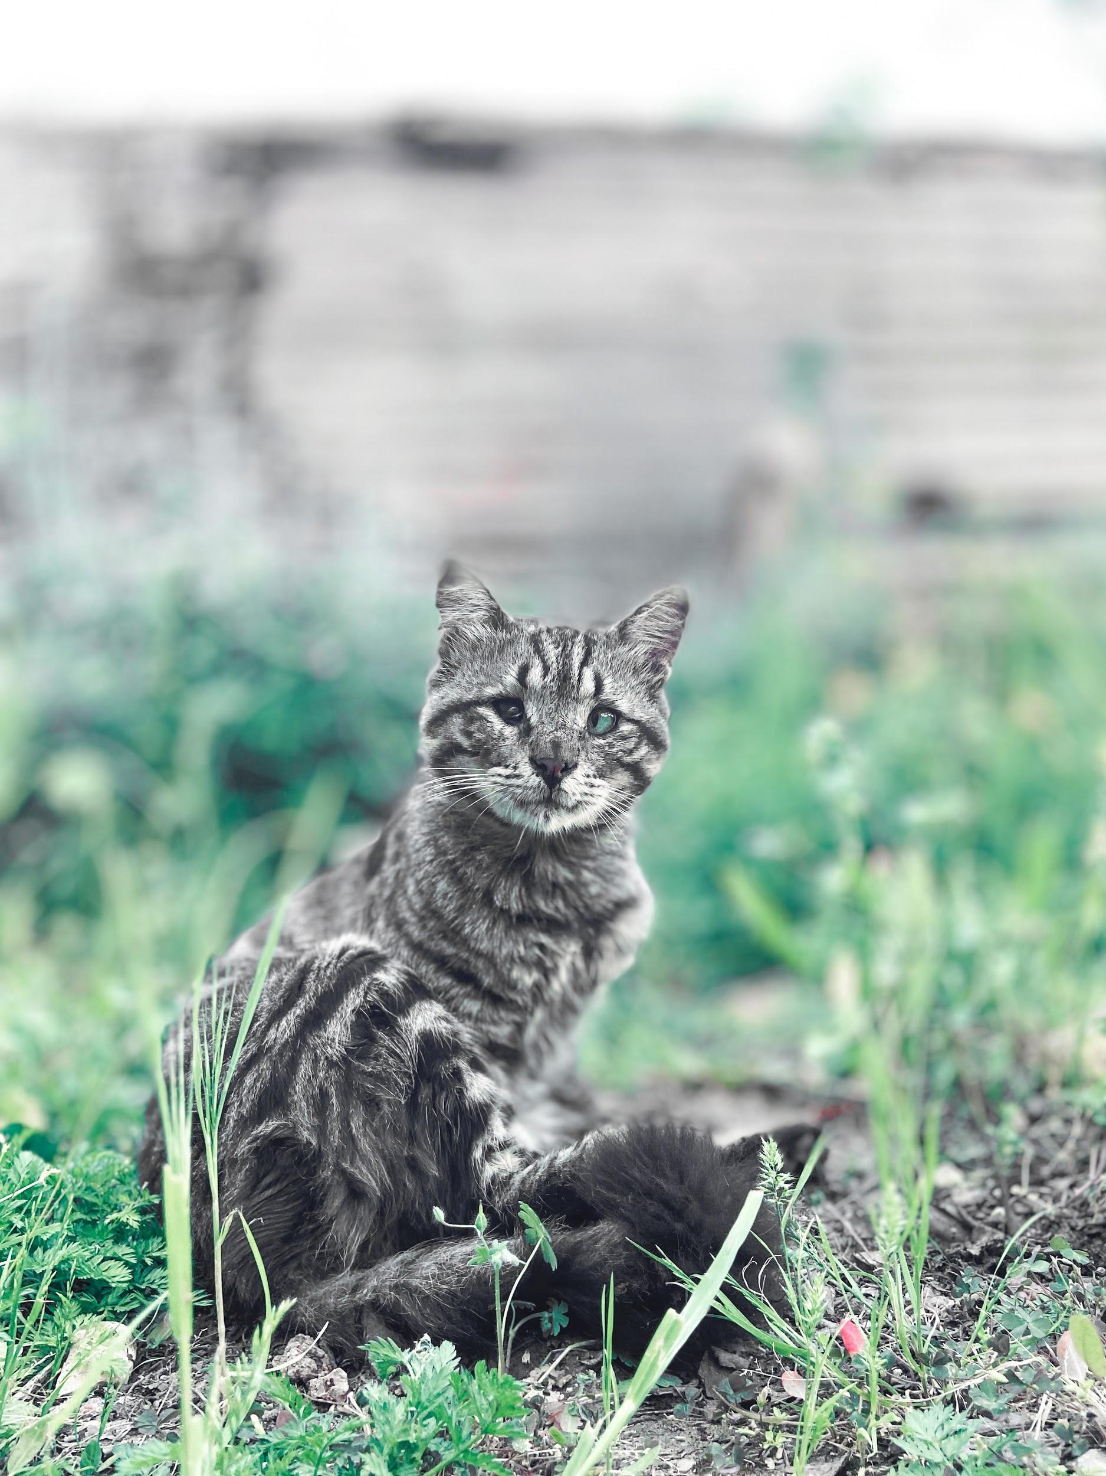
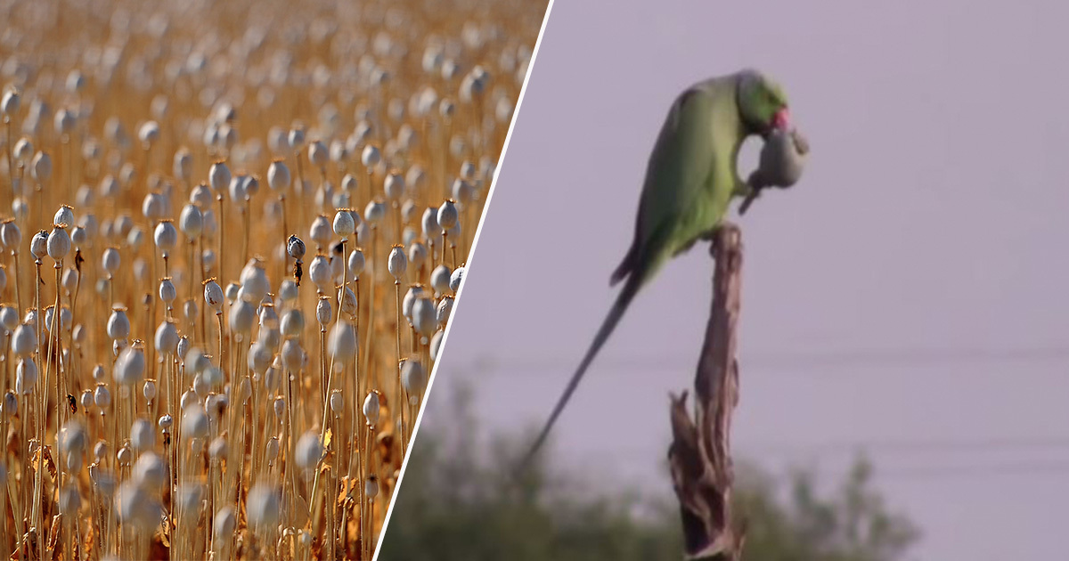

Slide 6
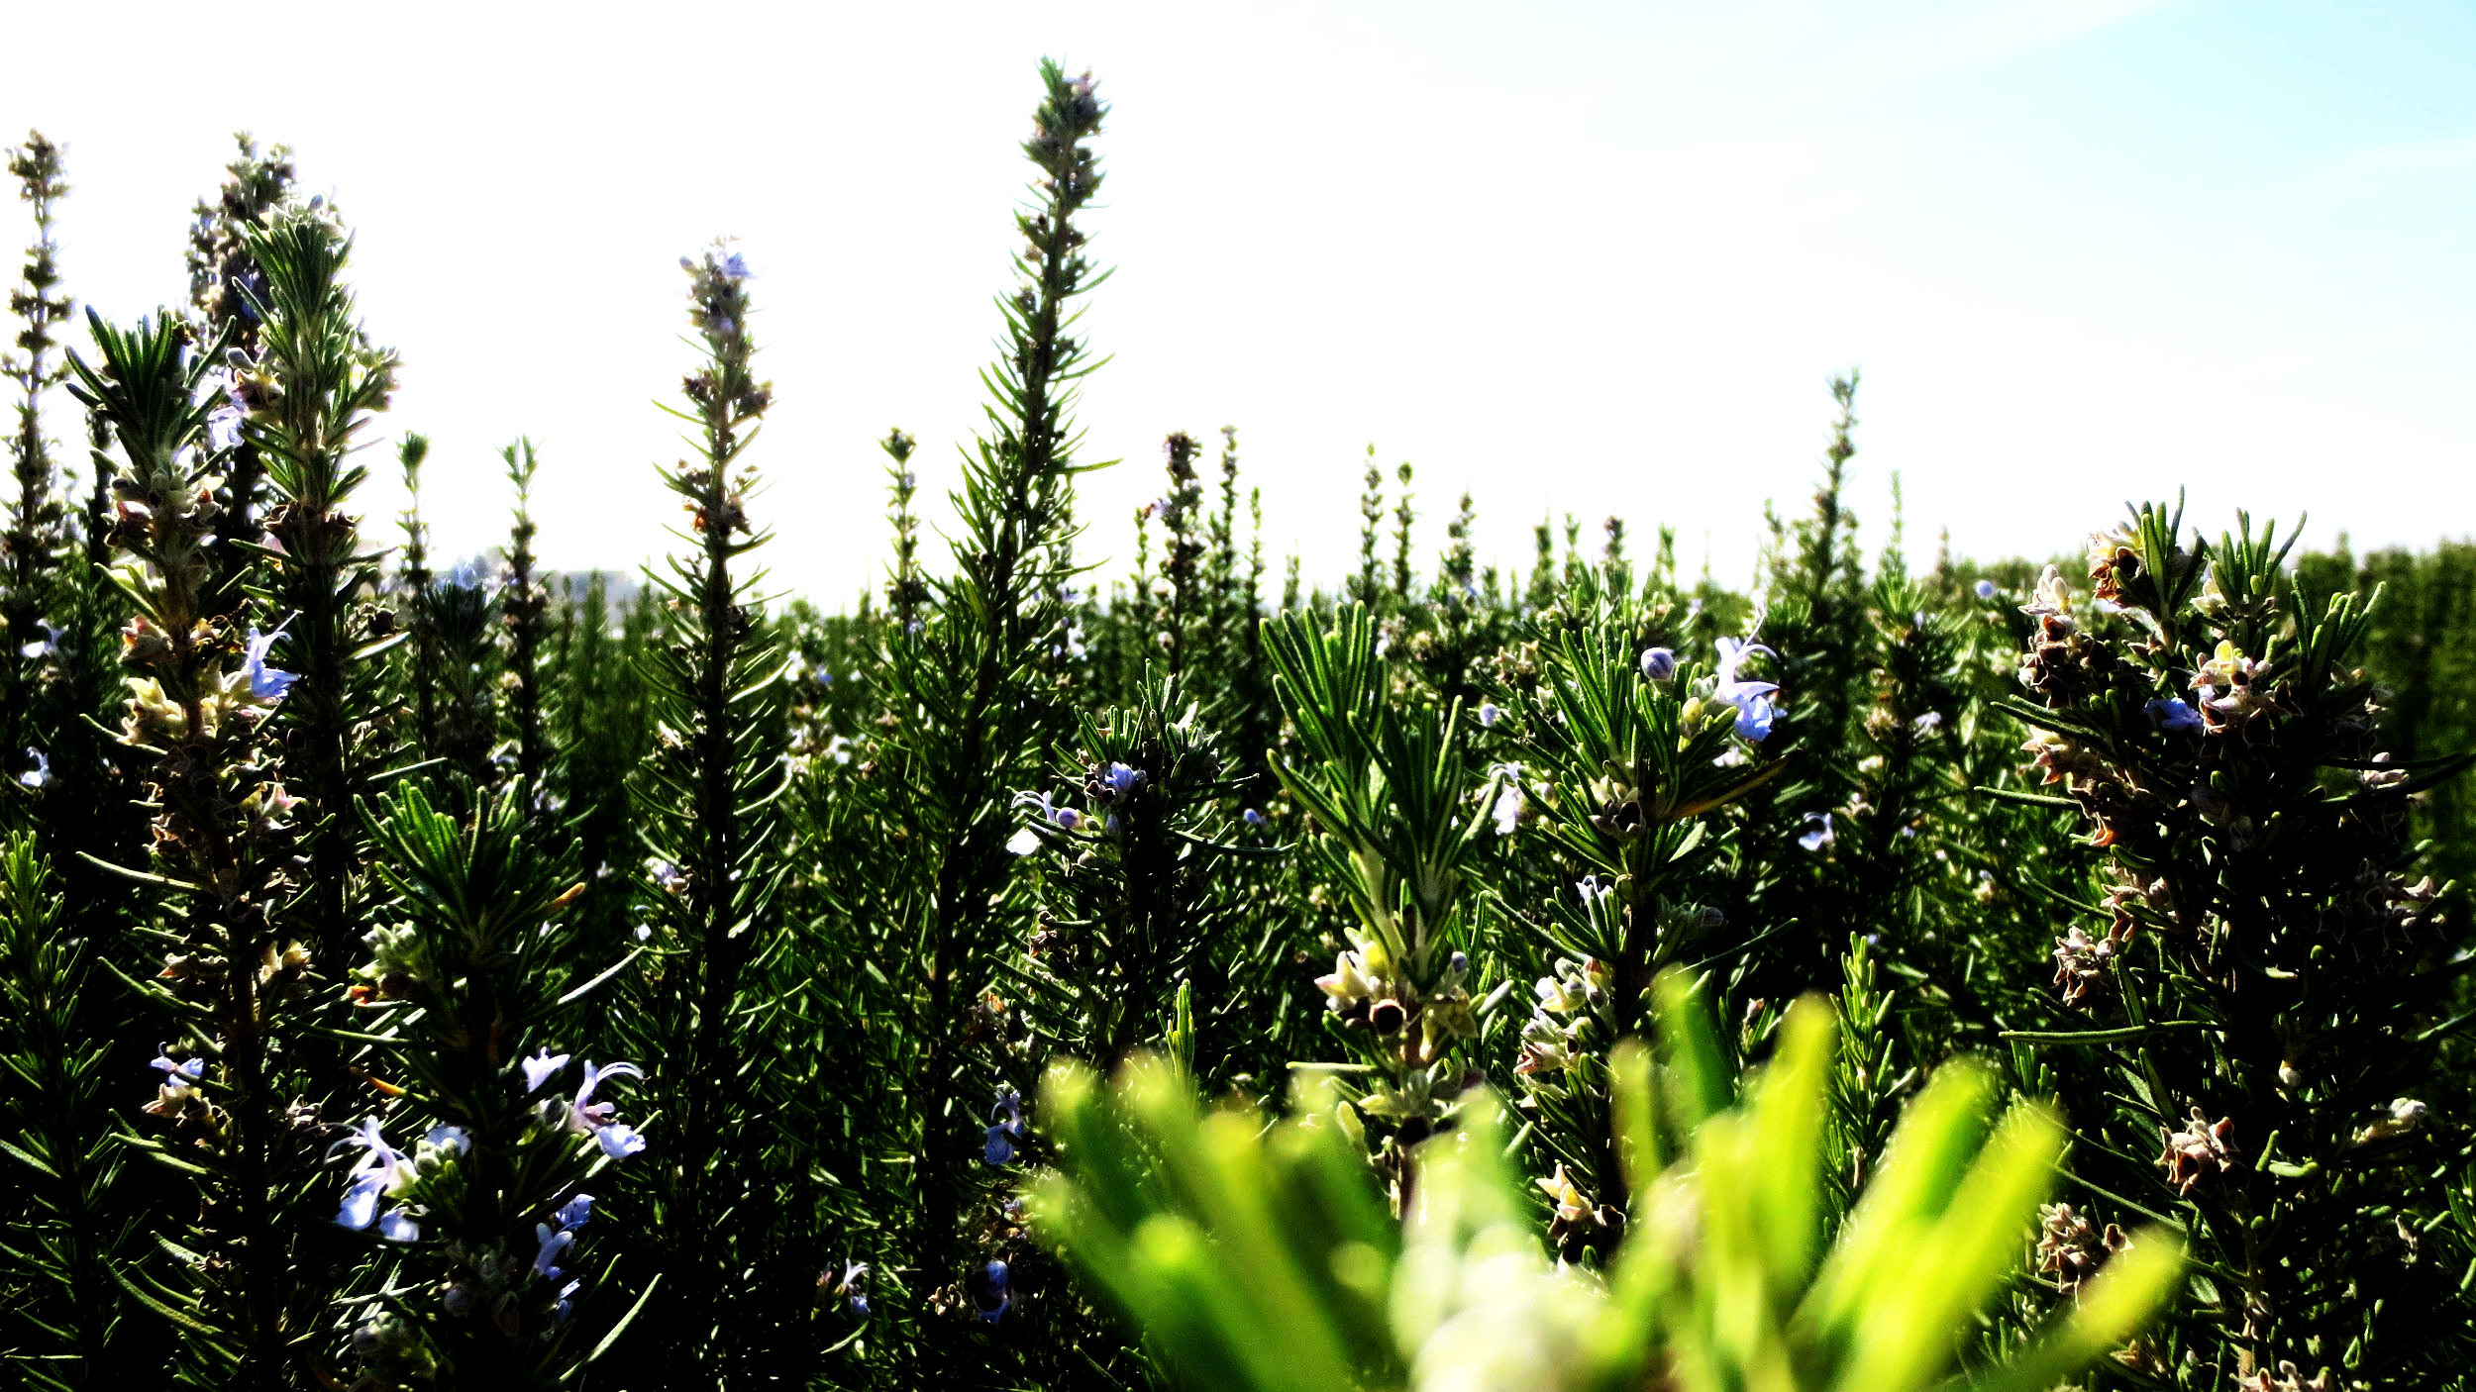
History
About
Distribution
Information

Slide 7
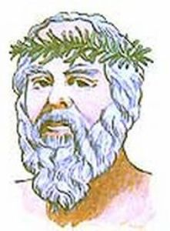
History
1- Latin (Rosmarinus)
2- Greek scholars 3- Napoleon Bonaparte 4- Symbols (Remembrance, Happiness)

Slide 8
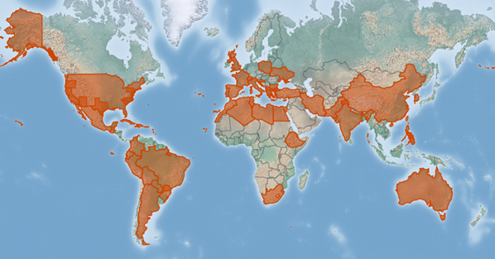
Origin
&
Distribution
Indigenous
Naturalized

Slide 9
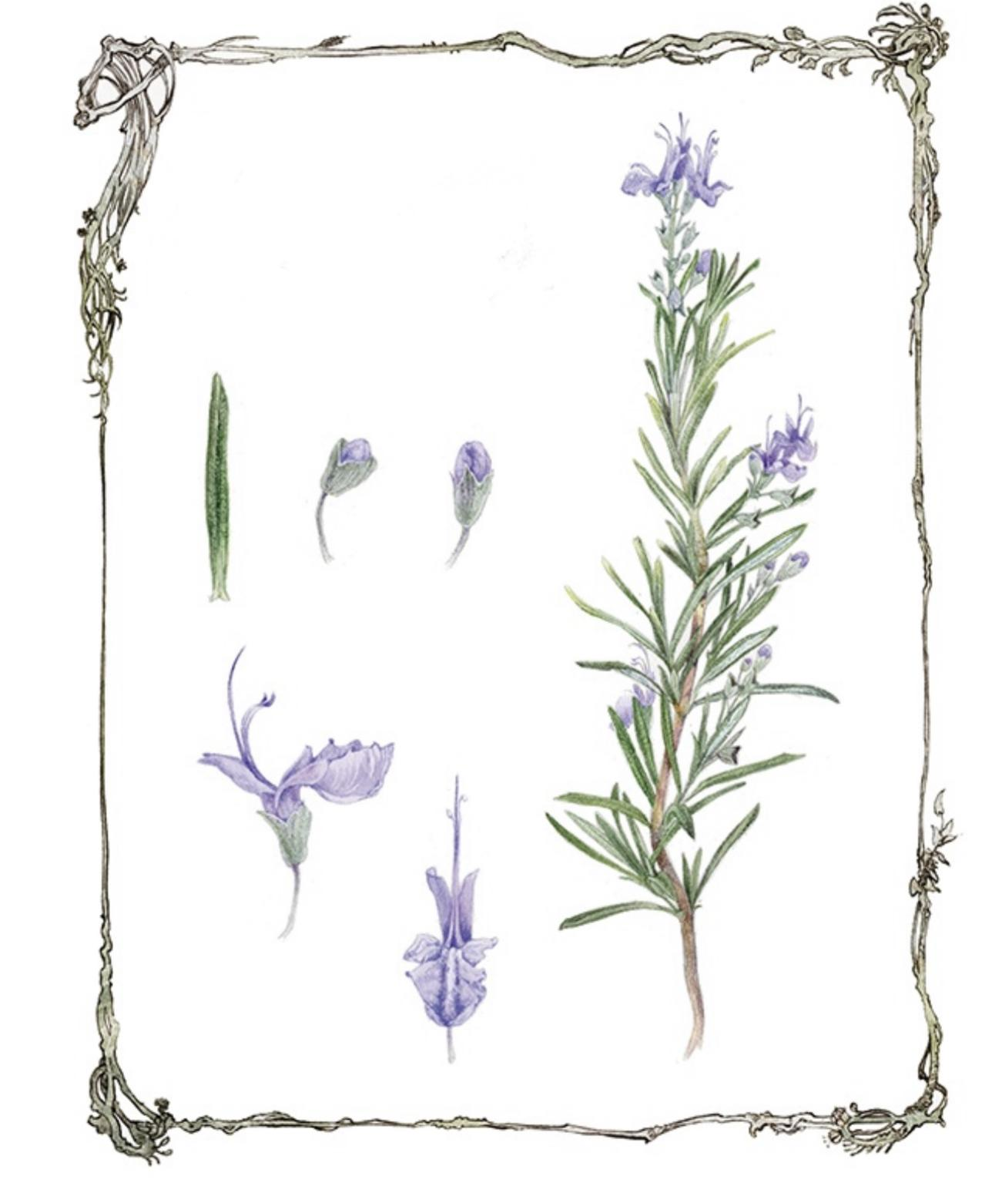
Information
Rosmarinus officinalis Part Used (Leaves, Flower)
Appearance
up to 2 metres high
w/ silvery green, needle-shaped leaves & pale blue flowers.

Slide 10
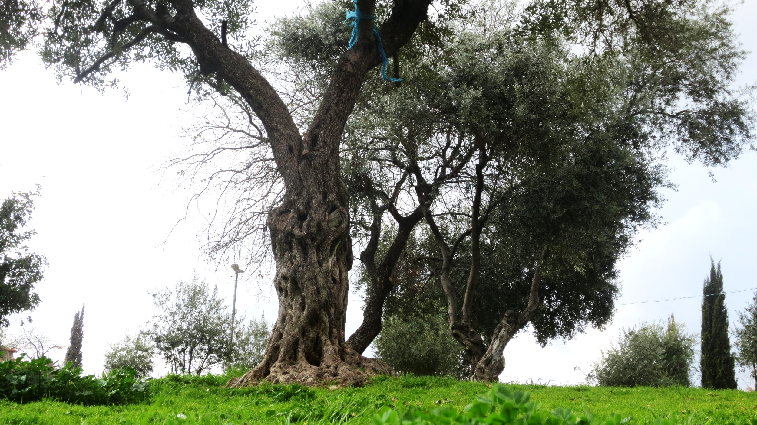
Species- Officinails
.
5
Genus-Rosmarinus
4
Family-Lamiacceae
3
Order-Lamiales
2
Kingdom-Plantae
1

Slide 11
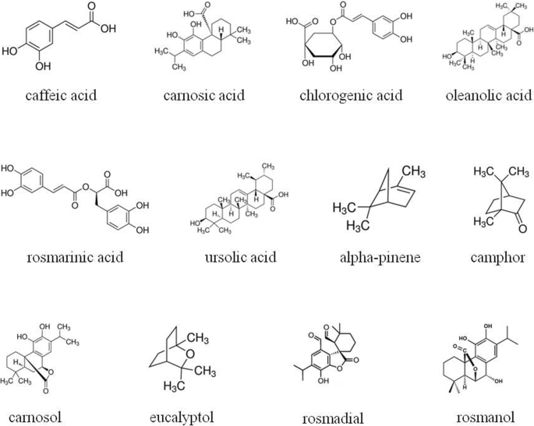
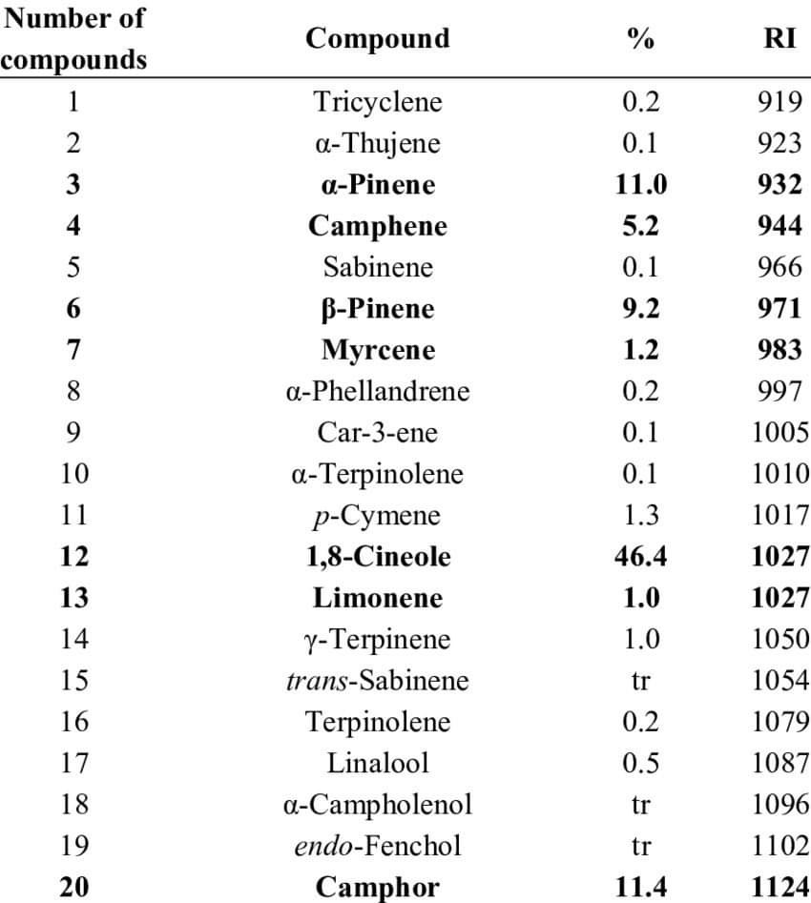
Active Ingredients
1-Cineol 2-Pinenes ( α, β) 3-Camphor 4- Camphene 5- Myrcene 6- Limonene 7-Linalol 8-Terpineol 9-Octanone 10-Bornyl acetate 11- Others

Slide 12
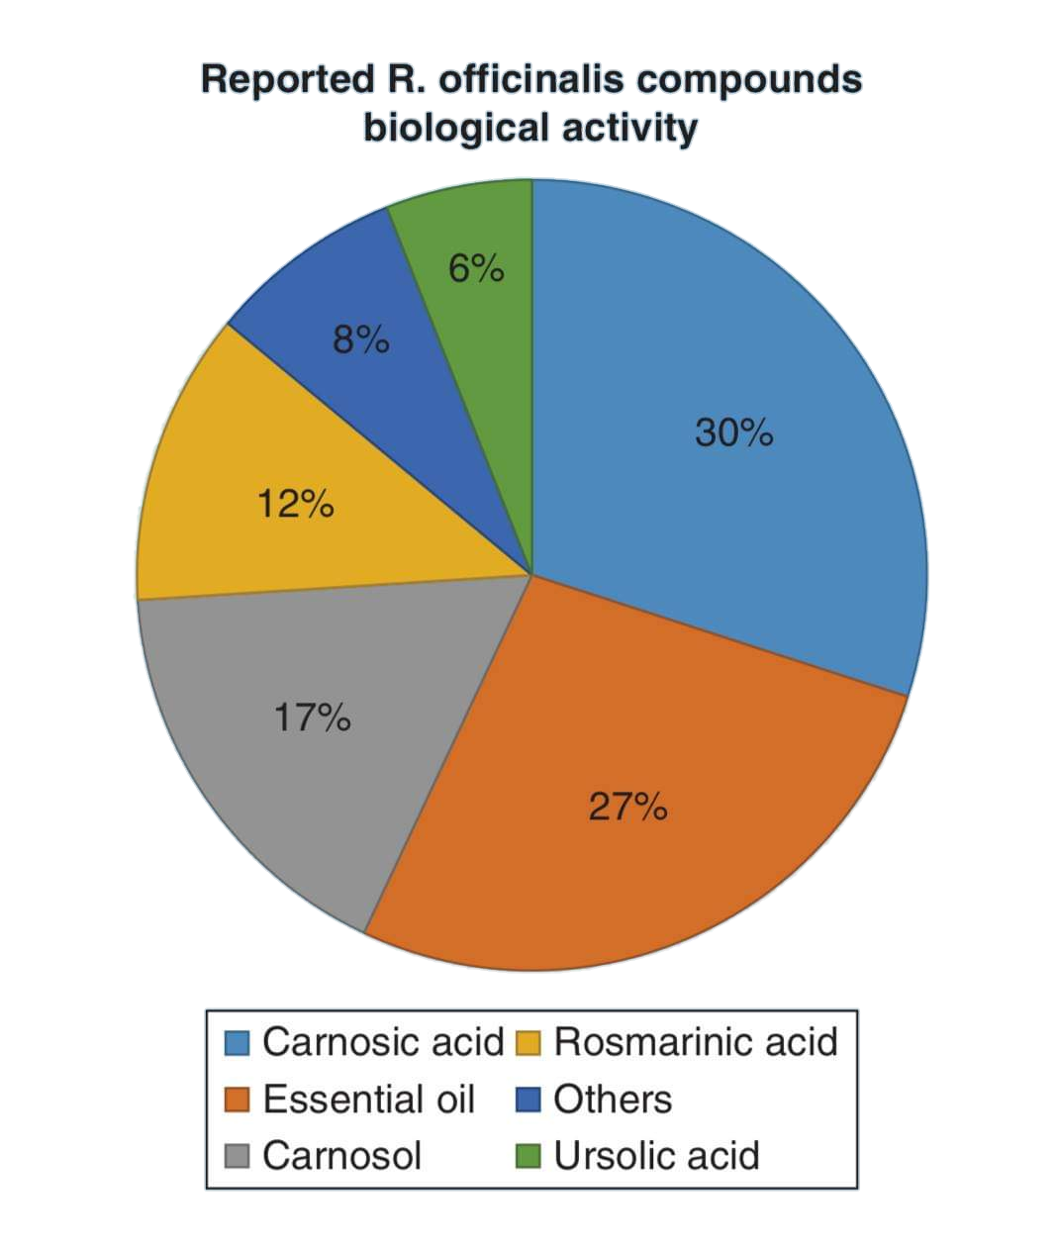
Reported R. Officinalis compounds
biological activity

Slide 13
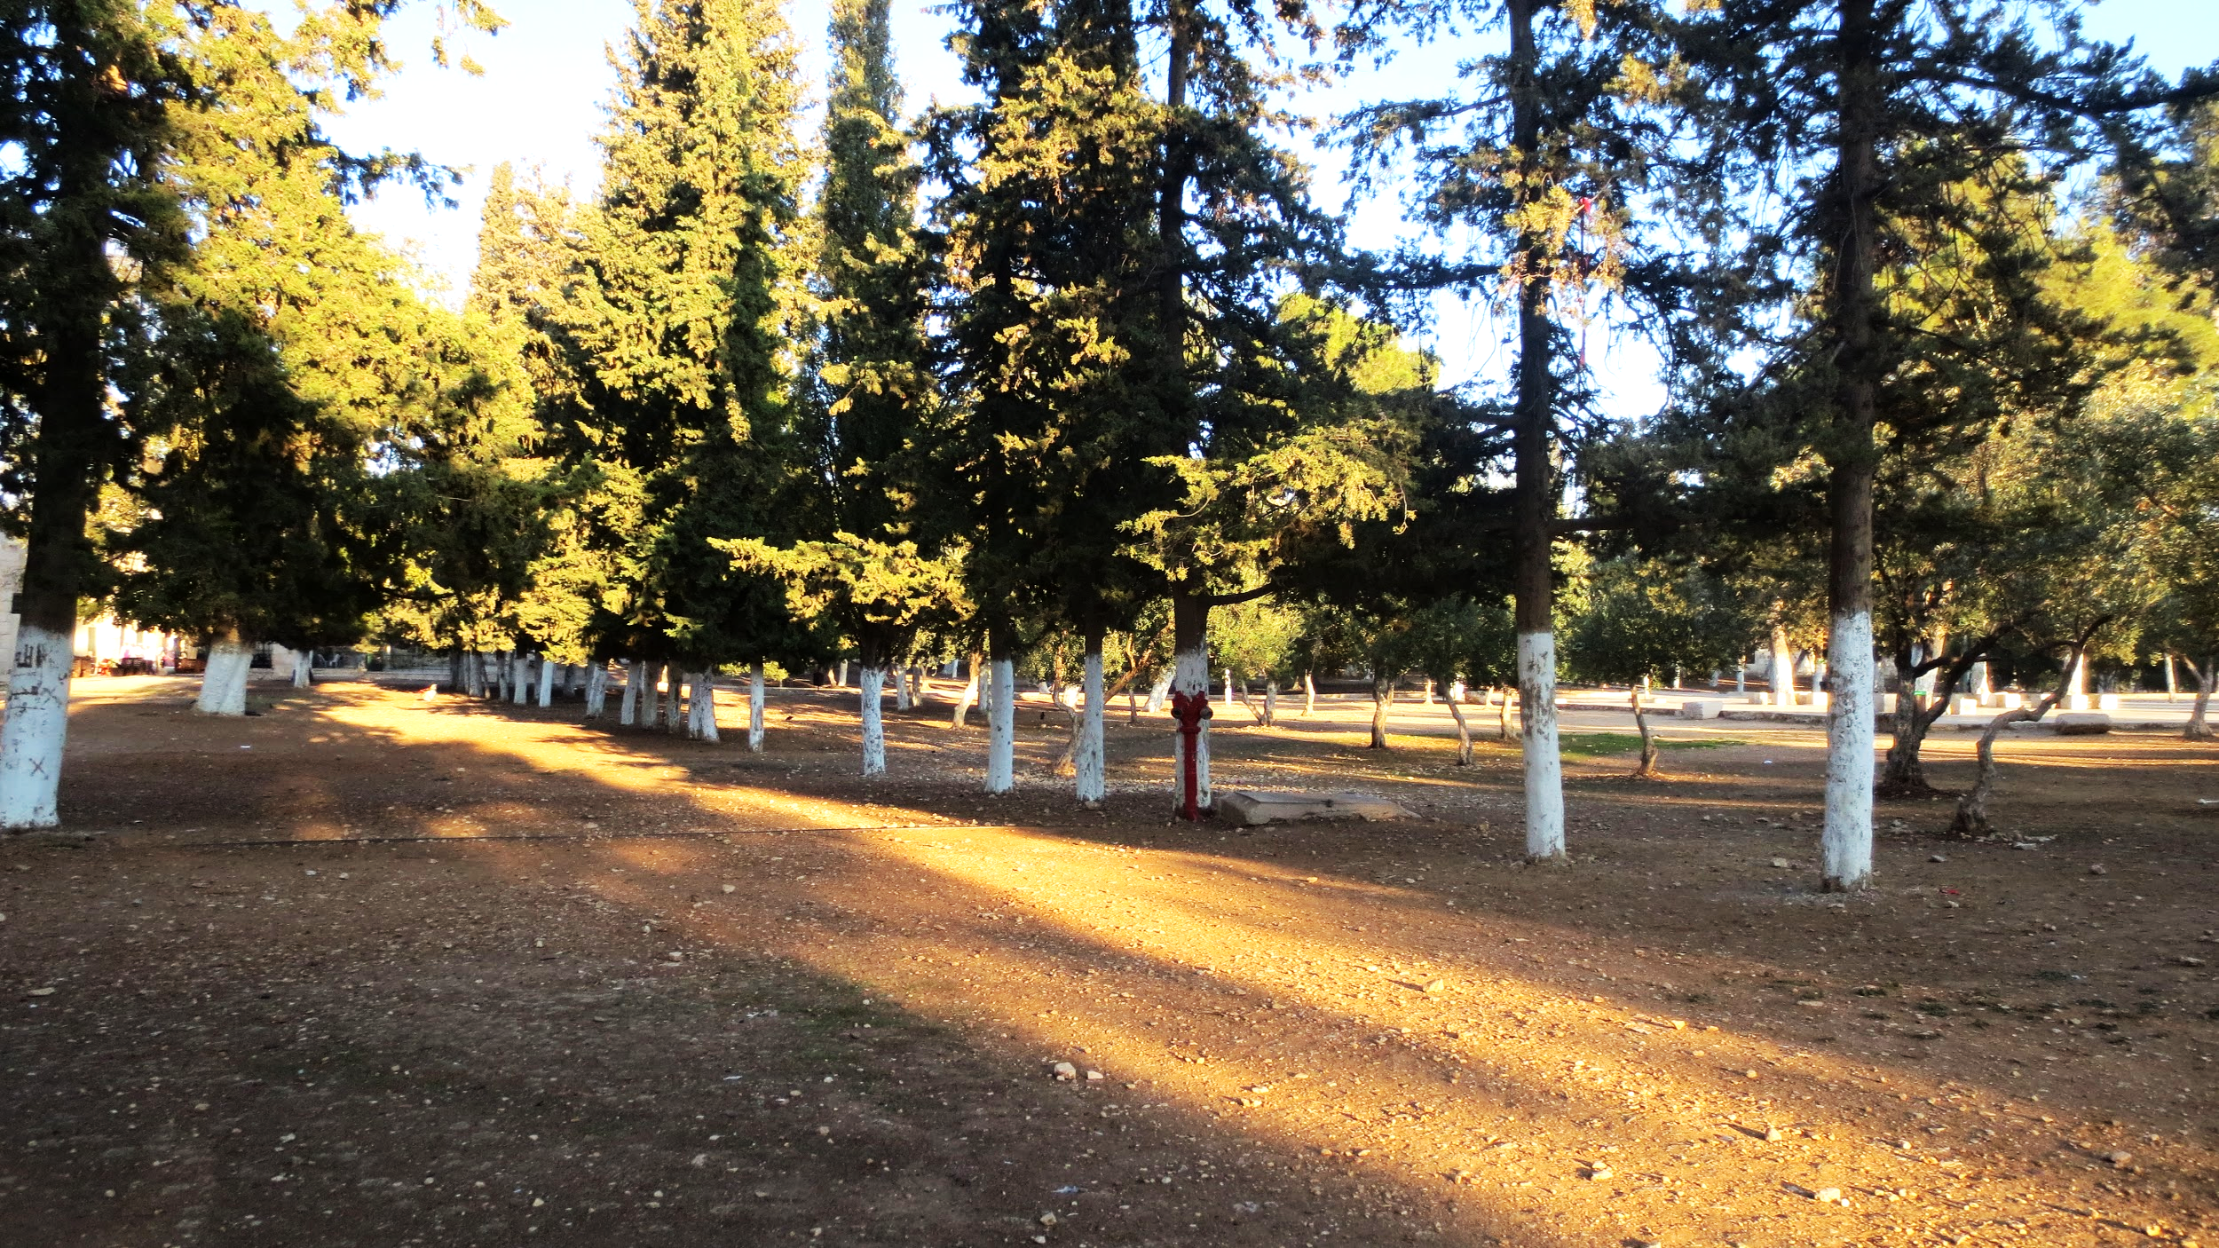
Uses
Medical
Cosmetics
Herbal Food Tea
Magic

Slide 14
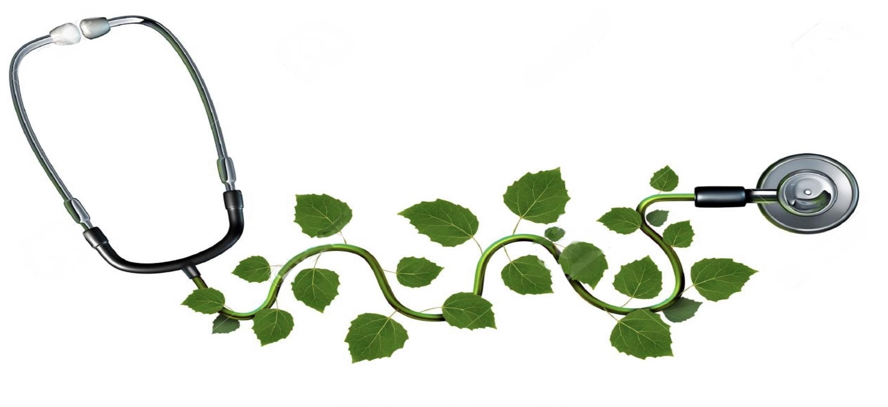
Medical
1- Anti-inflammatory 2- Analgesic (Management of Pain) 3- Antimicrobial and Antiseptic-Preservative 4- Antioxidant 5- Neuroprotective 6- Astringent 7- Improve memory and Concentration 8- Increase alertness 9- Improve Digestion

Slide 15
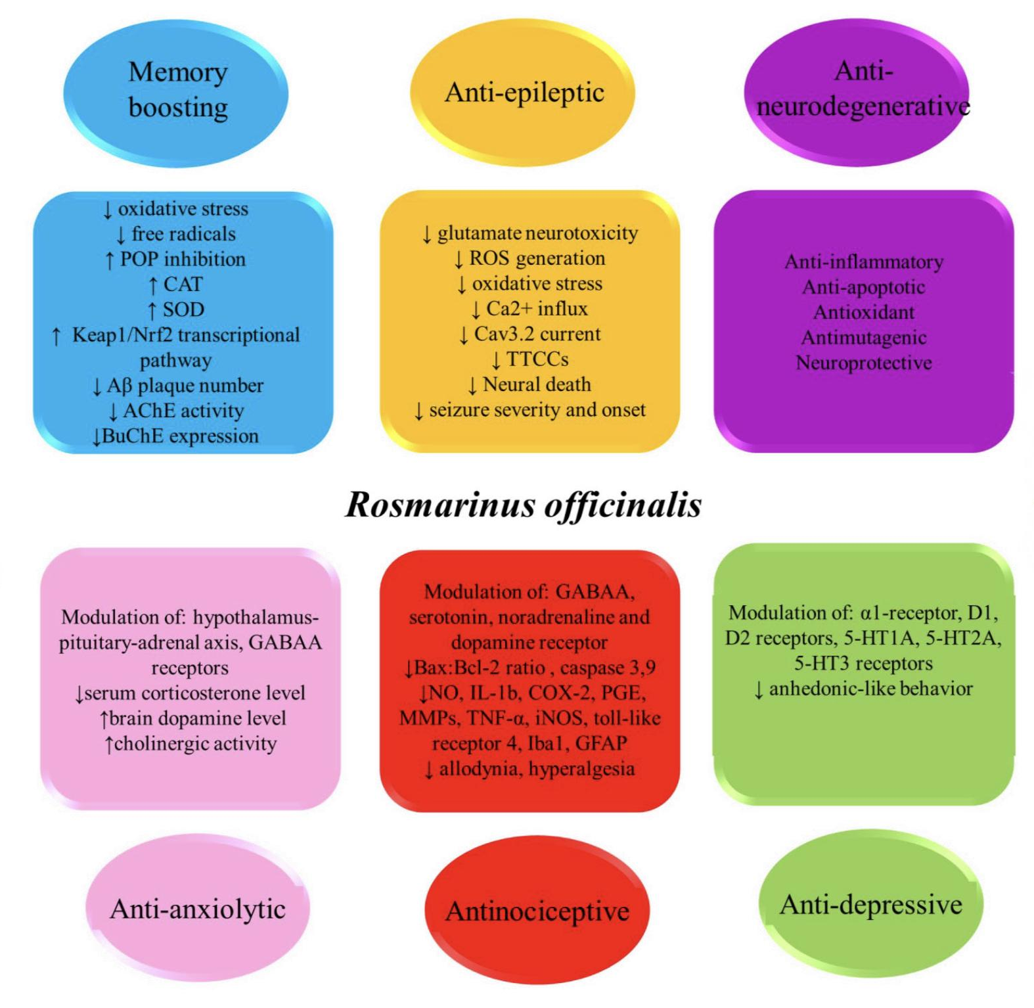

Slide 16
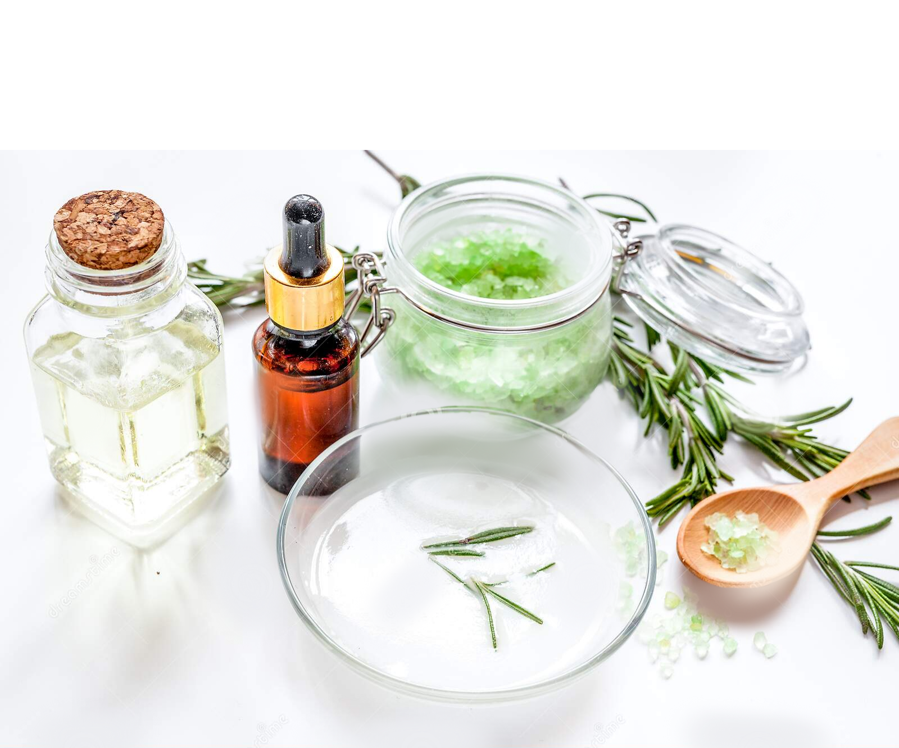
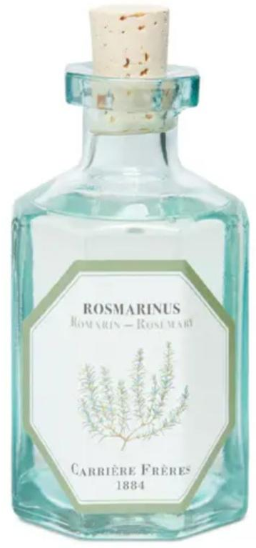
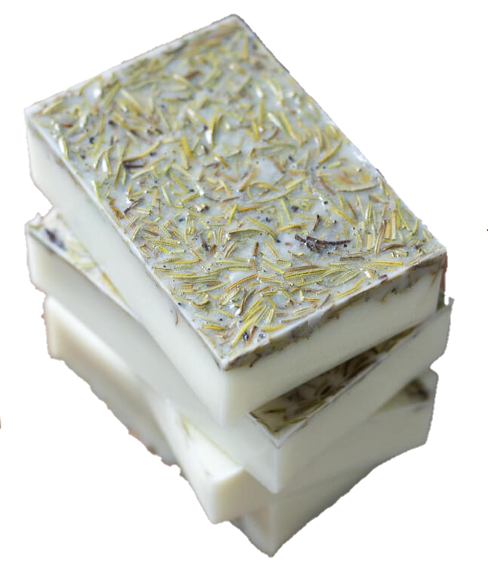
Cosmetics
1- Skin conditioning agents 2- Household sprays and Perfumes 3- Hand Products, Eye Shadow, Bath Soaps, Detergents (Leaf Extract) 4- Deodorant (Flower, Leaf, Stem) 5- Baby lotion (Leaf extract)

Slide 17
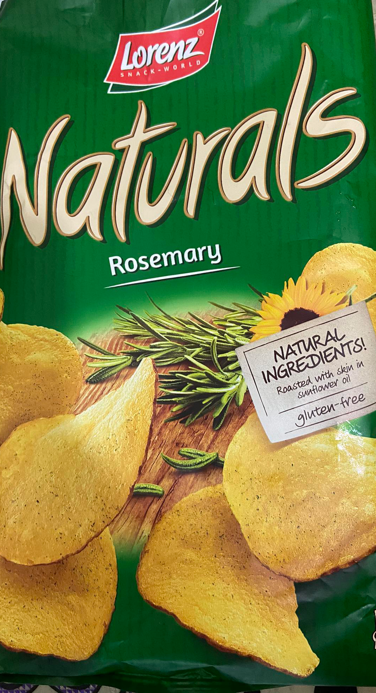
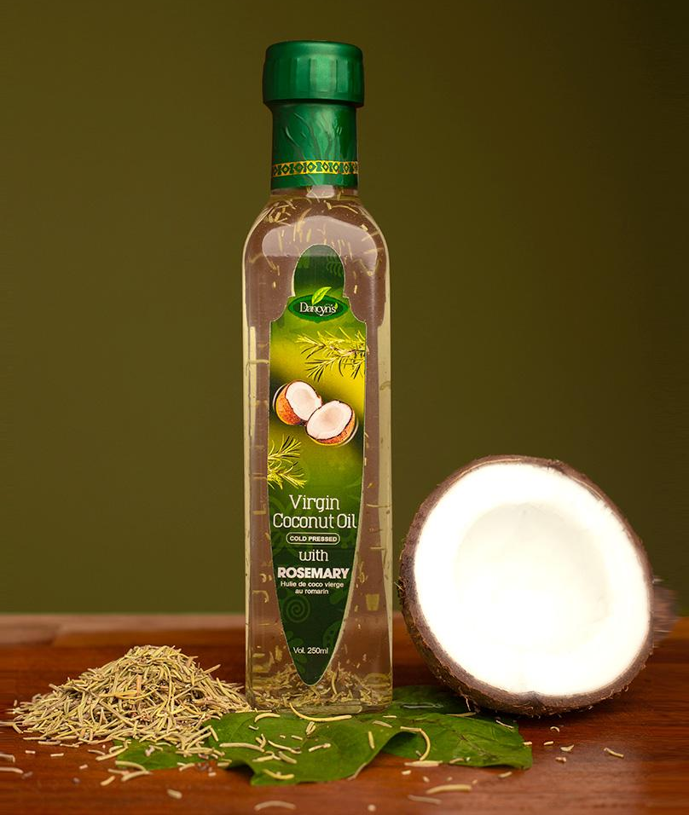
Herbal Food
1- With meat 2- Soups 3- Salads -Storage methods Freeze
Dry
Infusion
Fresh rosemary will keep for about 1 week in the refrigerator

Slide 18
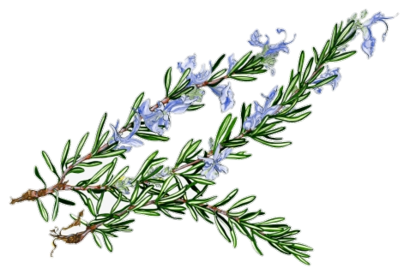
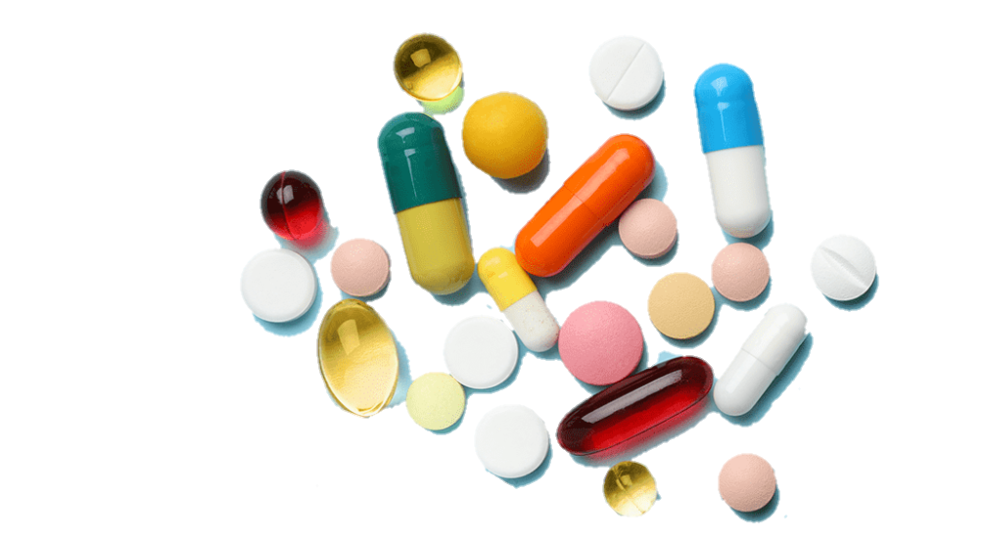
Drug
Interactions
Food

Slide 19
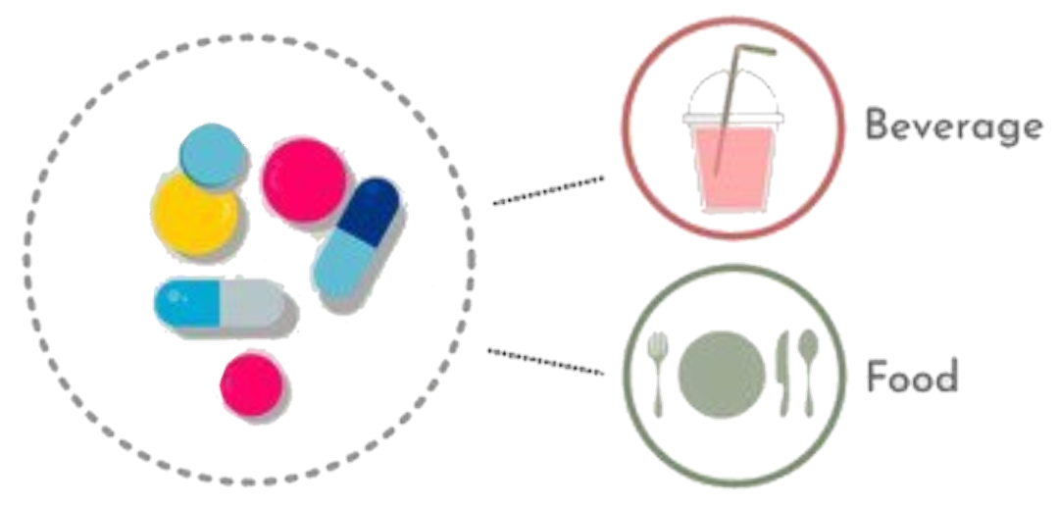
Drug & Food Interaction
Paracetamol ACEI Codeine
Antiplatelet Anticoagulants
Rosemary
Extract
Iron Absorption
Notes:
Warfarin , Aspirin, Clopidogrel

Slide 20
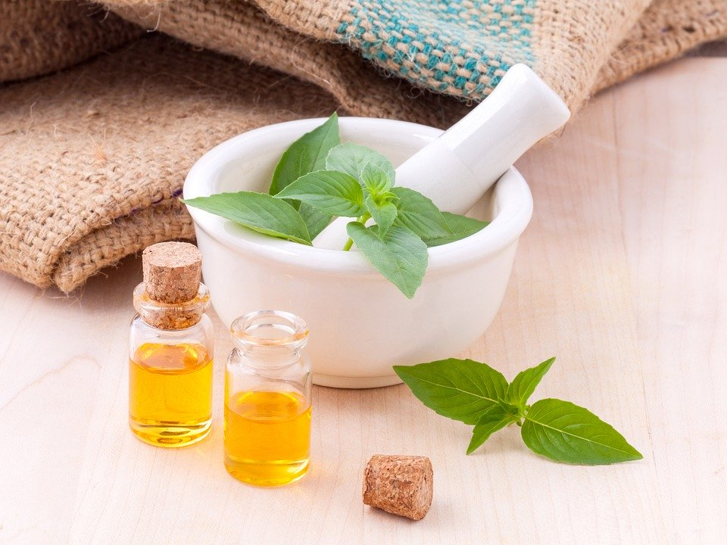
Safety
Non-toxic Non-irritant (Dilution only) Non-sensitizing

Slide 21
Non-Toxic Plant
High amount
1-Toxic
2- Abortigenic
3-Irritant (Camphor)

Slide 22
Contraindications
1- Some Diseases (Gastroenteritis, Prostatitis, Endometriosis, Epilepsy)
2- Constipation
3- Insomnia
4- Hypertension (HTN)
5- Pregnancy (Abortion) & Lactation
6- Hypersensitivity to Essential oil

Slide 23
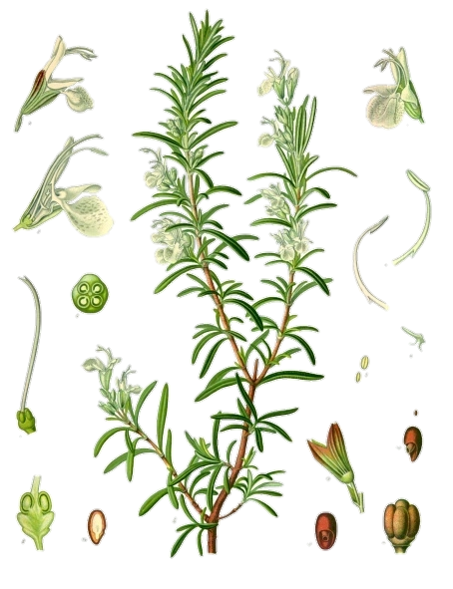
Amazing researches
1. Preservative (anti-microbial, antiseptic, fungicidal)
2. Anti-proliferative- prophylactic
3. Neuroprotective ( Carnosic acid, a catechol-type electrophilic compound, protects neurons through activation of the Keap1/Nrf2 pathway via S-alkylation of targeted cysteines)
4. Neurogenesis (Carnosic acid - promotes synthesis of nerve growth factor
Heals nerve endings\ may rejuvenate nerves) 5. Hypoglycemic
6. Hepatoprotective and Reno-protective

Slide 24
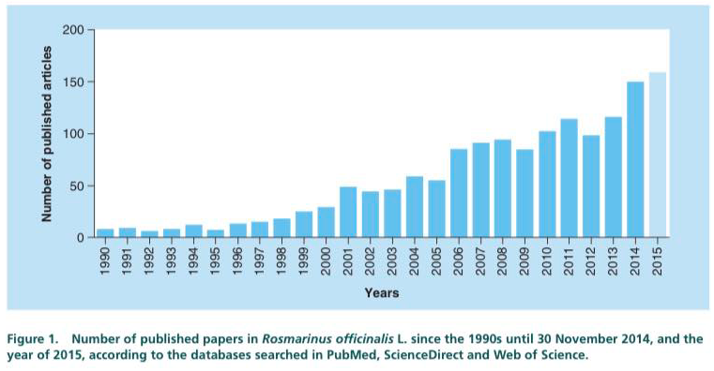

Slide 25
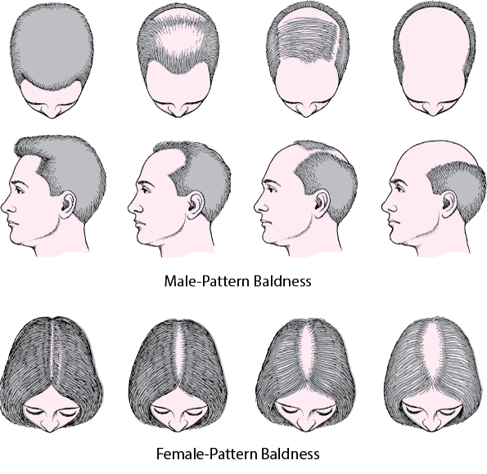
Androgenetic Alopecia (Baldness)

Slide 26
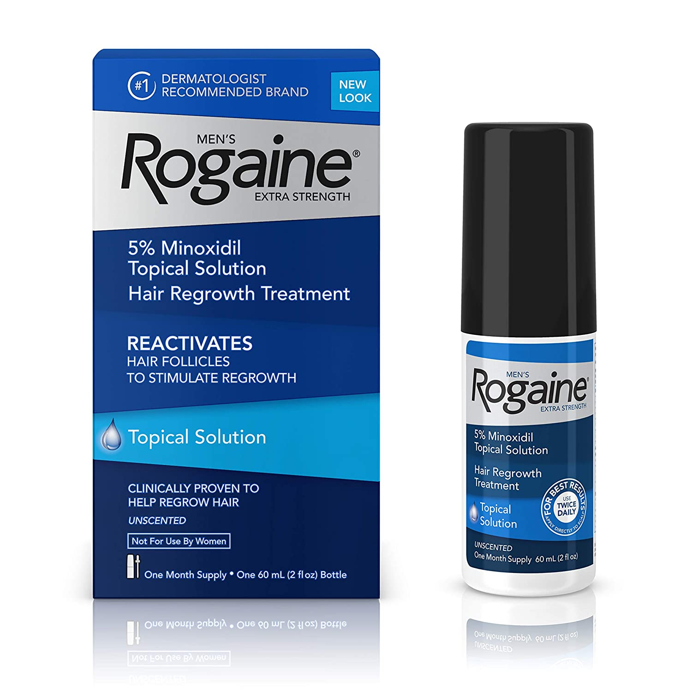
-Research Study :- - Rosemary Oil Vs Minoxidil 2%

Slide 28
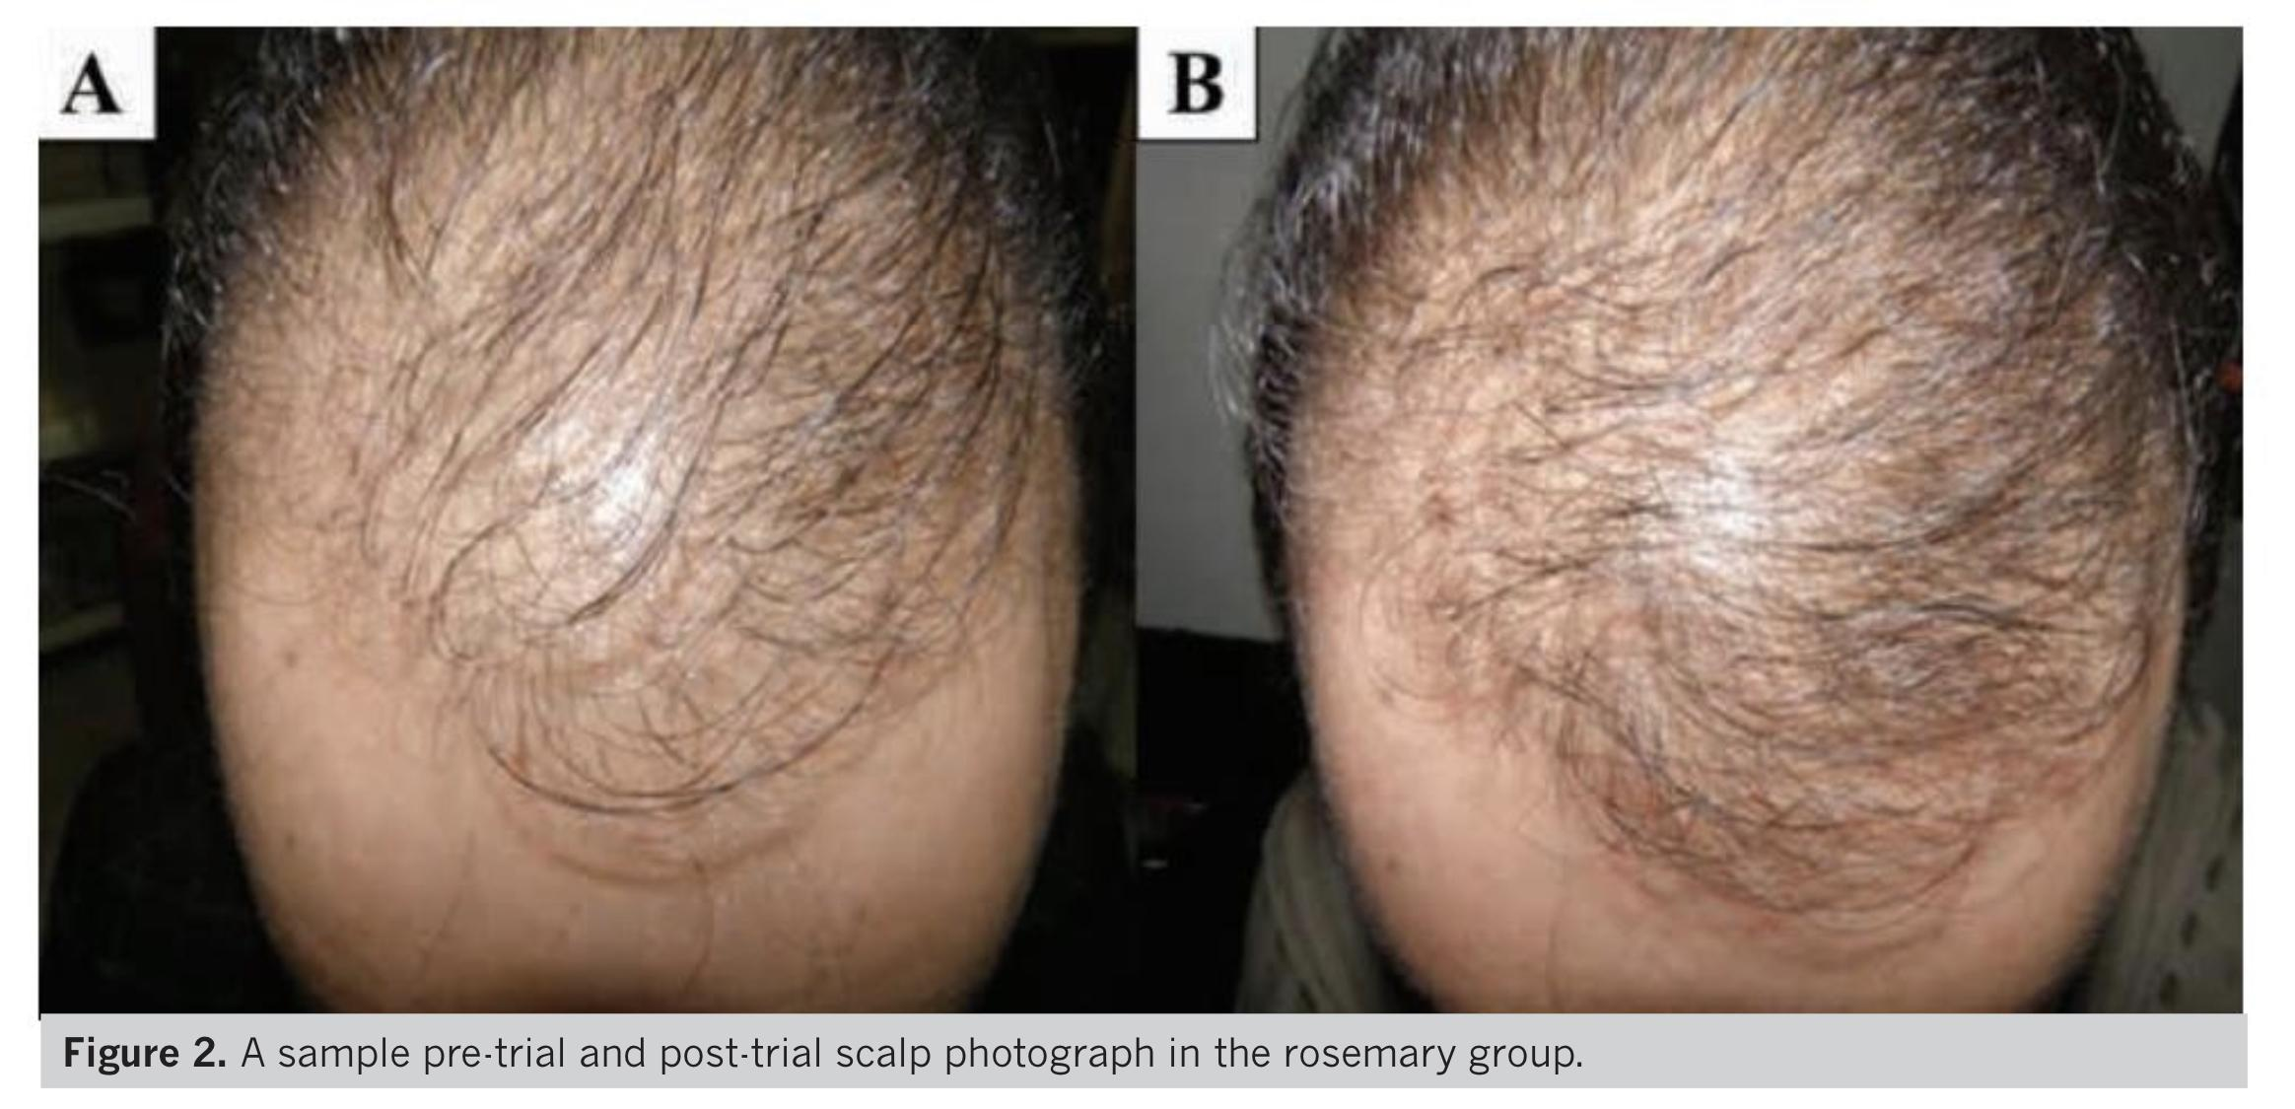

Slide 29
