Slide 1
Prepared by Muhammad Musleh Instructor Dr. Lina Adwan

Slide 2
CONTRACEPTIVES

Slide 3
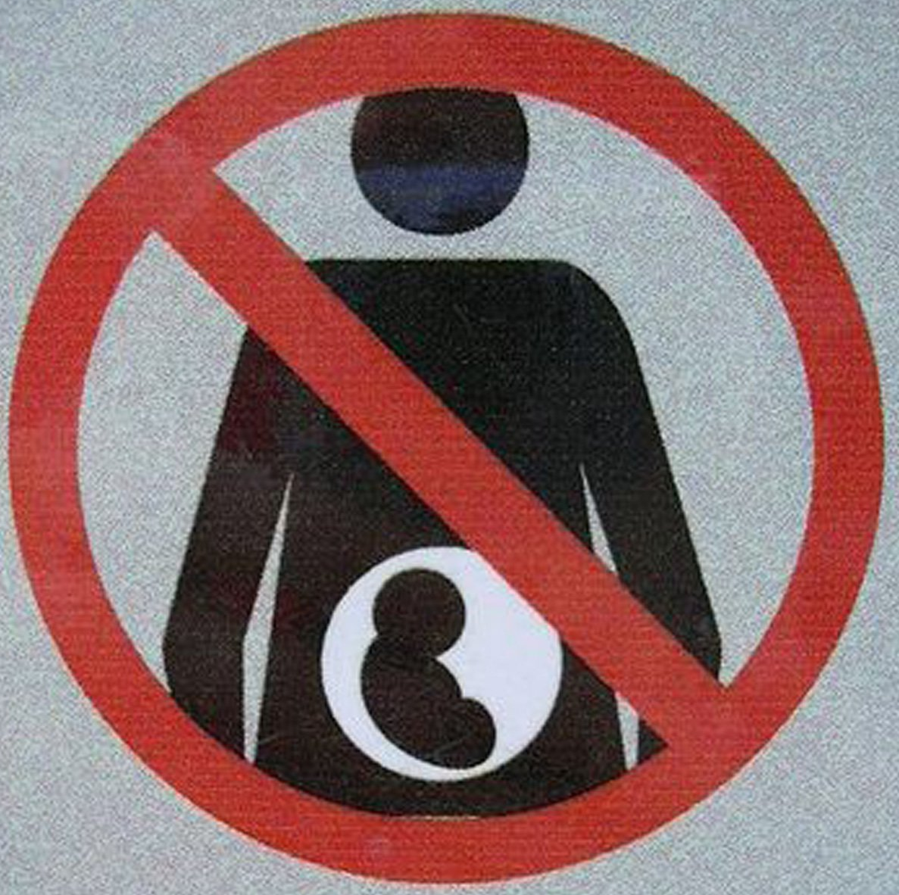
DEFINITION
Birth Control
Prevent Pregnancy

Slide 4
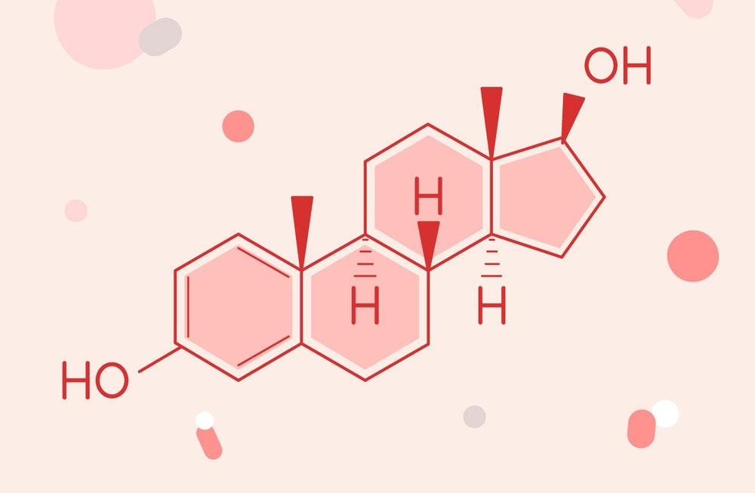
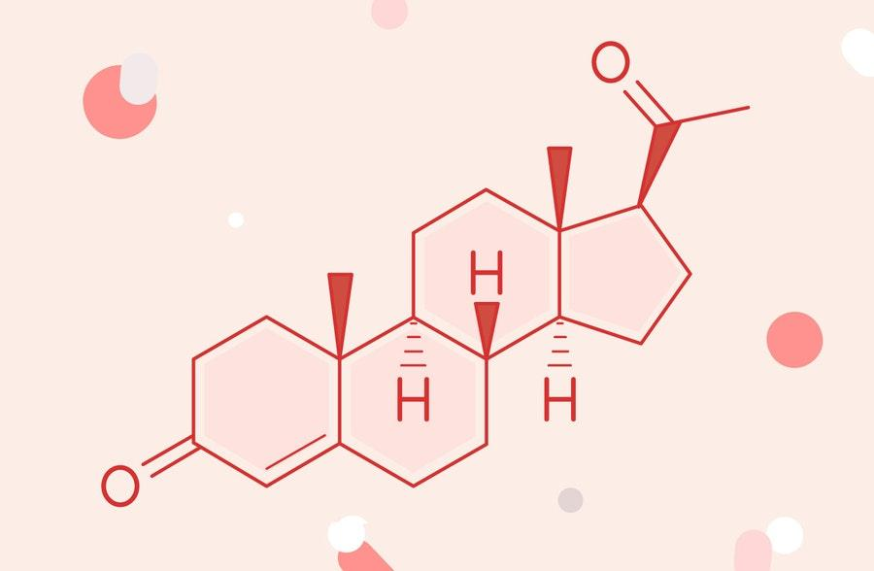
ESTROGEN & PROGESTIN
1- Estrogen Ex. Ethinyl estradiol
2- Progestin EX. Levonorgestrel, Desogestrel, etc.
Notes:
Sex Hormone - Women & Men
- Estrogen : Ovaries, Adrenal glands - Progesterone : Adrenal gland, Testes

Slide 5
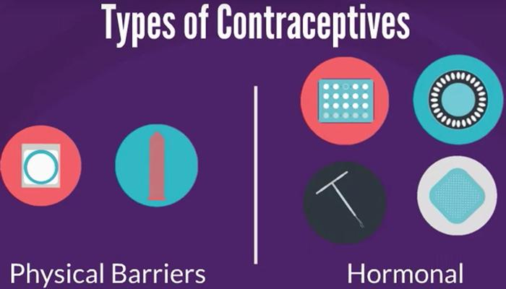
TYPES

Slide 6
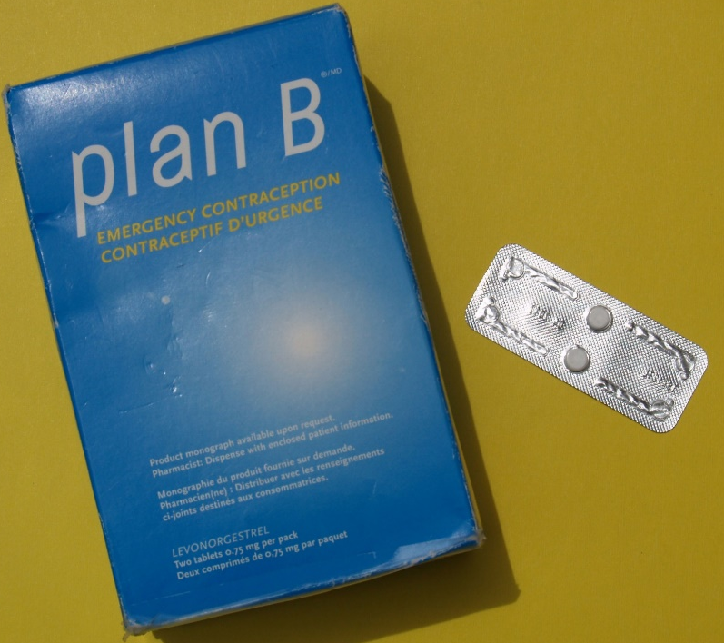
EMERGENCY –(MORNING AFTER) PILL
Progestins (Levonorgestrel)
Estrogen (Ethinyl Estradiol) + Levonorgestrel
2nd dose of it after 12 hours of 1st dose

Slide 7
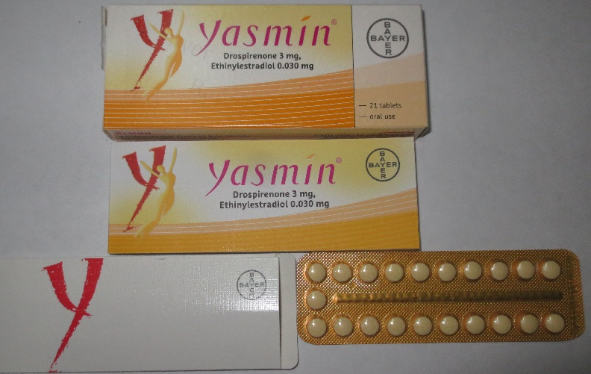
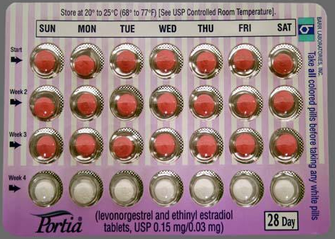
COMBINATION
Estrogen & Progestin
21 – day
28 – day
91 – day

Slide 8
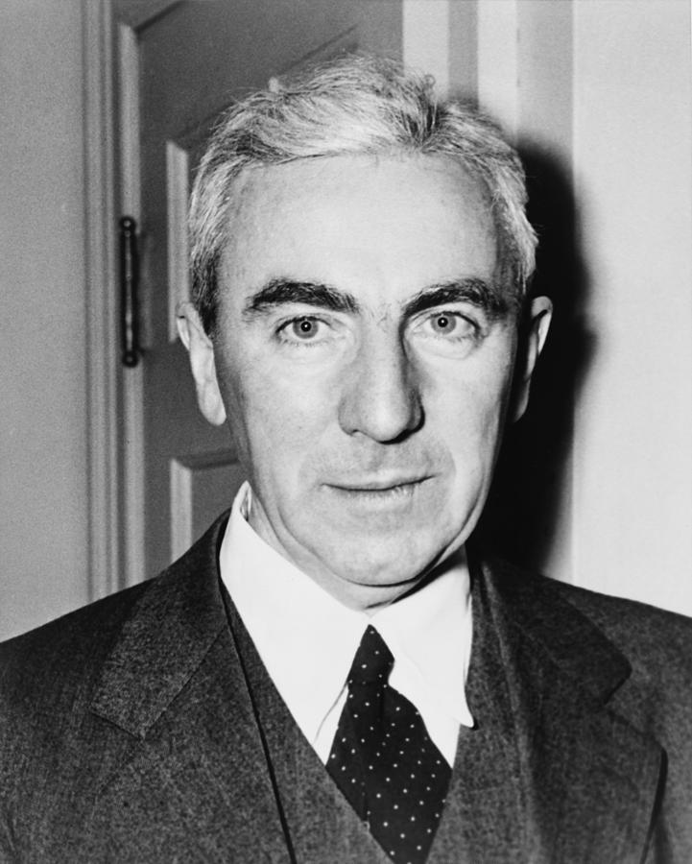
JOHN ROCK

Slide 9
MINI PILL – PROGESTIN-ONLY PILLS
Norethindrone

Slide 10
PROGESTIN INTRAUTERINE SYSTEM IUS
Levonorgestre
3 -10 years
Emergency contraception (Within 5 days)

Slide 12
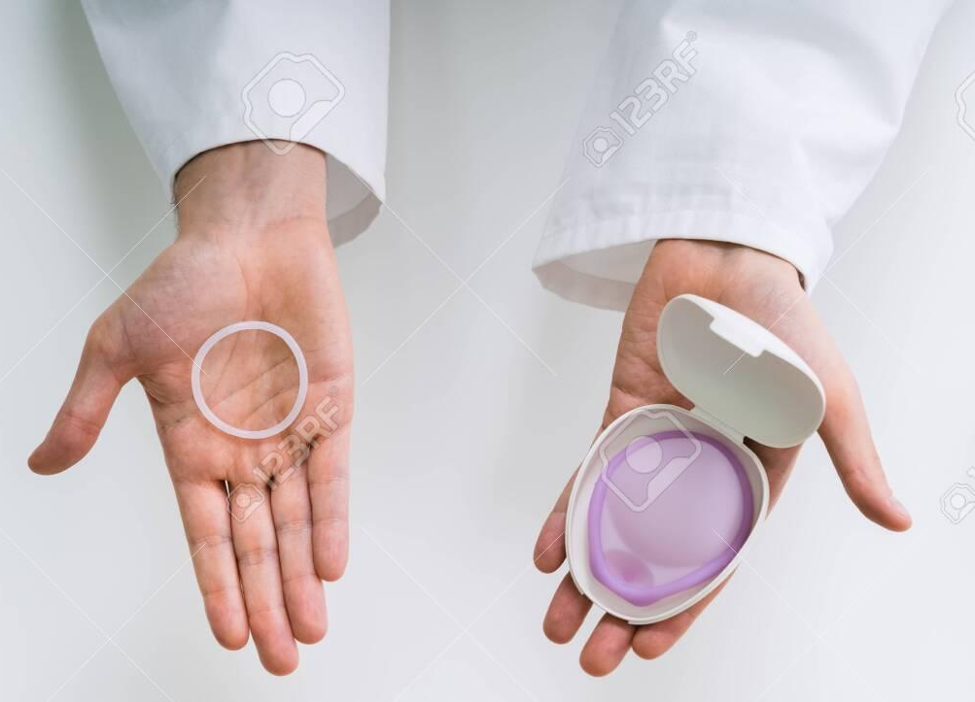
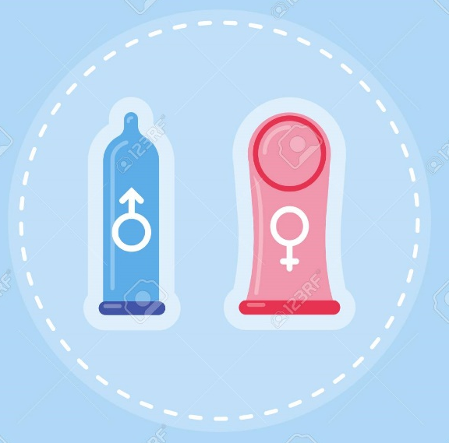
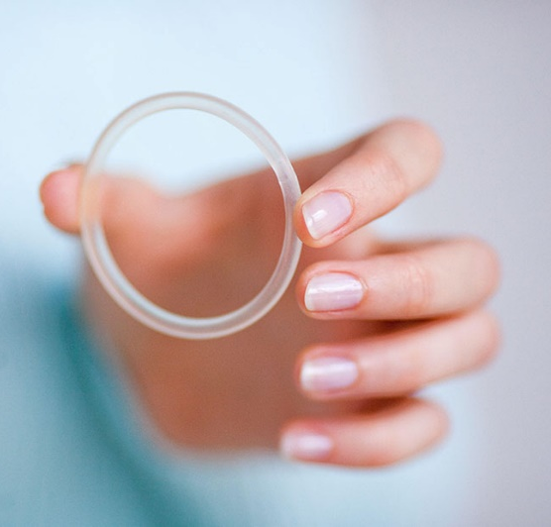
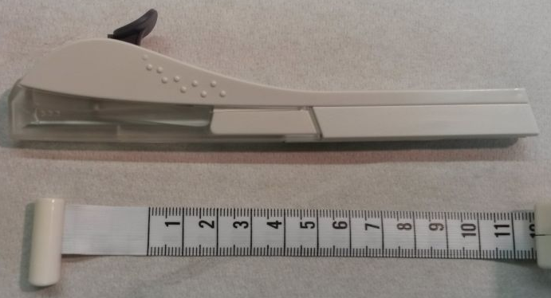
Others
Sterilization تعقيم
Withdrawal
Injection
Transdermal patch
Implant 3 year rod
Vaginal Ring - releasing hormones 3 weeks
Diaphragm- physical barrier
Condom
Spermicide
Phexxi (pH)

Slide 17
BIRTH CONTROL WITHDRAWAL SYMPTOMS
Notes:
Premenstrual Syndrome

Slide 18
MISSED DOSE
Once she remembers, Takes the pill, even though she takes two pill

Slide 19
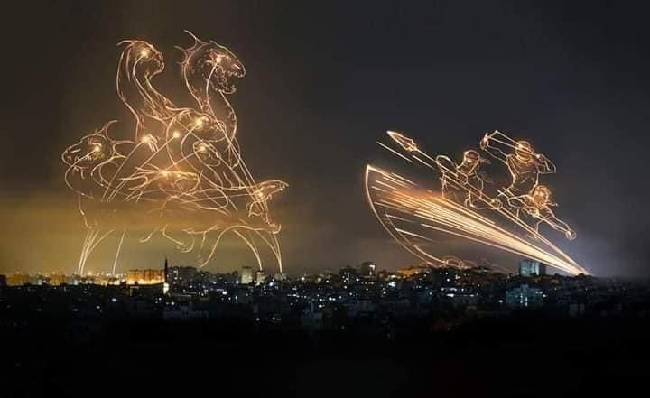

Slide 20
https://www.health.qld.gov.au/news-events/news/types-contraception-women-condoms-pill-iud-ring-implant-injection-diaphragm
https://byjus.com/questions/what-are-the-different-methods-of-contraception/
https://www.nhs.uk/conditions/contraception/which-method-suits-me/
https://www.slideshare.net/chaimingcheng/contraception-41950571
https://mg.co.za/article/2019-07-19-00-the-quest-for-the-vaginal-ring/
https://patient.info/news-and-features/whats-the-future-of-contraception
https://pubmed.ncbi.nlm.nih.gov/12345631/
https://www.plannedparenthood.org/learn/birth-control/birth-control-pill/how-do-i-use-the-birth-control-pill

