Slide 1
Cholinergic Acting Drugs Pharmaceutical Medicinal Chemistry-I
Dr. Bilal Al-Jaidi
Assistant Professor in Medicinal Chemistry and Drug Design
Faculty of Pharmacy, Philadelphia University-Jordan
Email: bjaidi@philadelphia.edu.jo

Slide 2
Learning Outcomes
At the end of this lesson, students will be able to:
Define the biochemistry of Parasympathetic system.
Classify the difference between agonist and antagonist agents
Outline the SAR of acetylcholine.
Demonstrate the different chemical modification of Acetylcholine.
Explain the importance of Cholinergic agonists and antagonists in disease management.
Demonstrate the action of AchE inhibitors in the management of Parkinson.

Slide 3
Overview of Nervous System

Slide 4
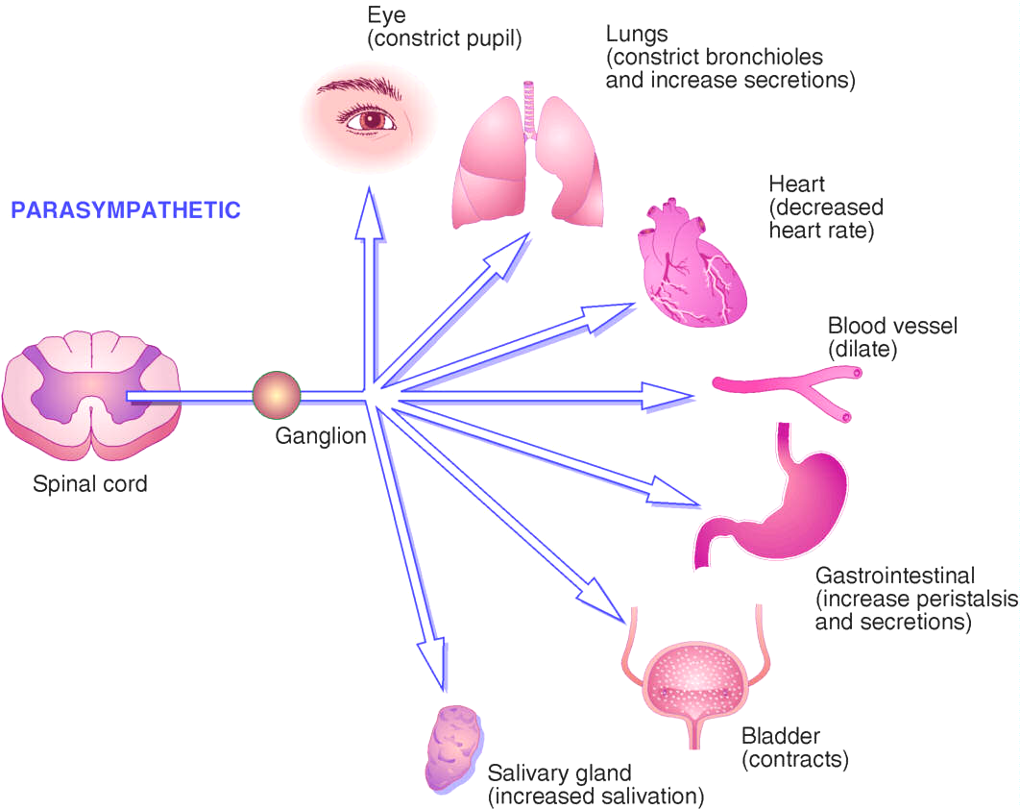
Parasympathetic Responses

Slide 5
Motor nerves
Without motor nerves:
No breathing.
Digestion.
Excretion.
Muscle movement.
Control of body temperature.
Heart problems.

Slide 6
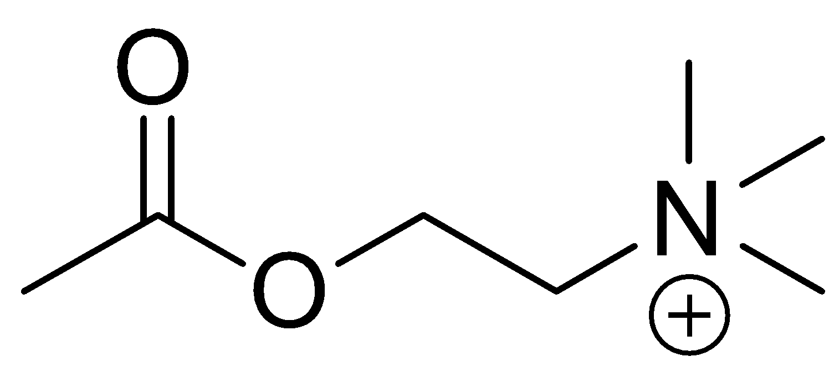
Motor nerves
Somatic motor NS:
carry messages from CNS to the skeletal muscles.
Acetylcholine is the neurotransmitter.
Lead to muscle contraction.

Slide 7
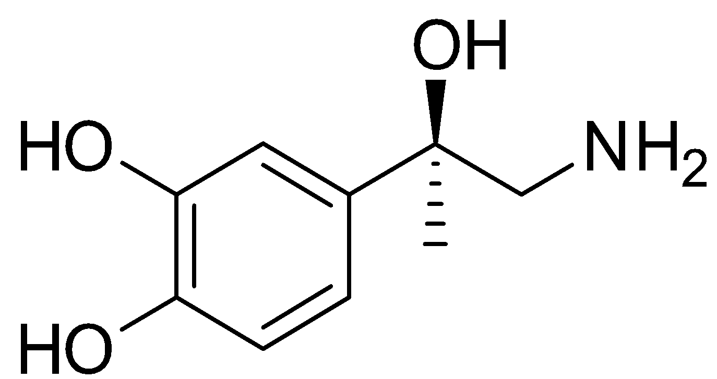
Motor nerves
Autonomic motor NS:
Carry messages from the CNS to smooth muscle, cardiac muscle and adrenal medulla.
Two subsystems:
1. Parasympathetic nerves:
From CNS to smooth muscles.
Acetylcholine is the N.T.
2. Sympathetic nerves:
To the cardiac muscles and most of internal organs.
Using Noradrenalin and Acetylcholine as N.T

Slide 8
Adrenaline action
increase heart rate.
Relax GIT and UT muscles.
Decrease salivation.
Vasoconstriction of peripheral blood vessels.
Fight or Flight

Slide 9
Motor nerves
Enteric NS:
Located in the wall of intestine.
Use serotonin, neuropeptide, Acetylcholine and Dopamine are among many other neurotransmitters take part in this system

Slide 10
Nerve Impulse Transmission

Slide 11
Nerve Impulse Transmission
Acetylcholine combines with cholinergic receptors
Nicotinic
Excitatory response
Muscarinic
Excites or inhibits
Notes:
Figure 8-3

Slide 12
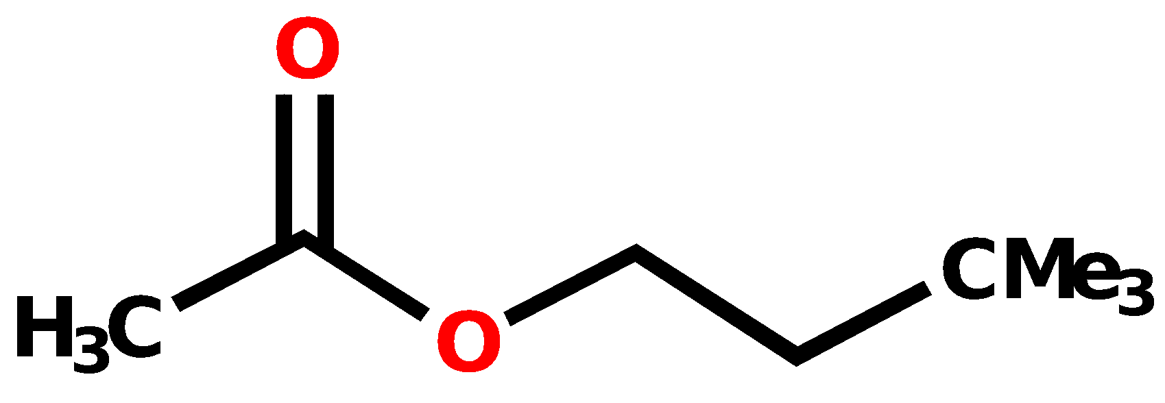
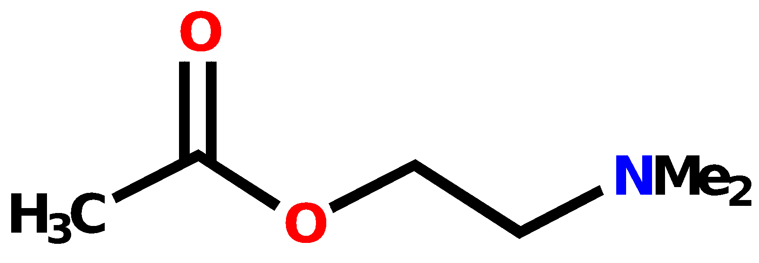
SAR for acetylcholine
Quaternary nitrogen is essential
Bad for activity

Slide 13
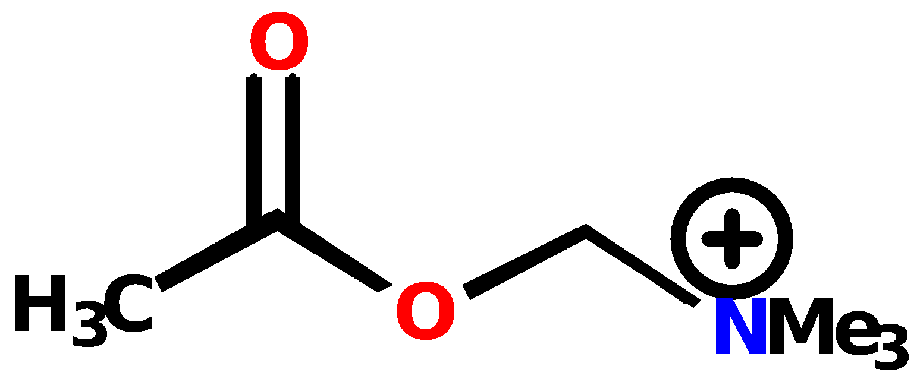
SAR for acetylcholine
Distance from quaternary nitrogen to ester is important
Ethylene bridge must be retained
Bad for activity

Slide 14
SAR for acetylcholine
Ester is important
Bad for activity

Slide 15
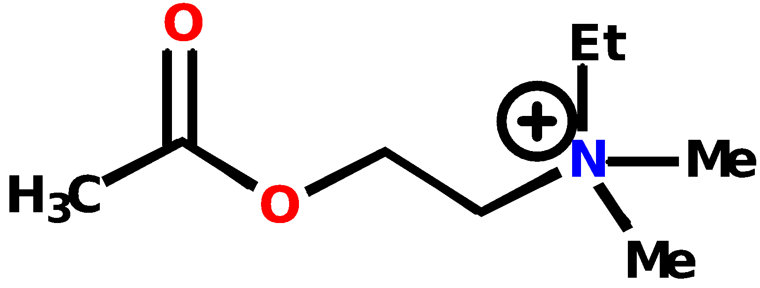
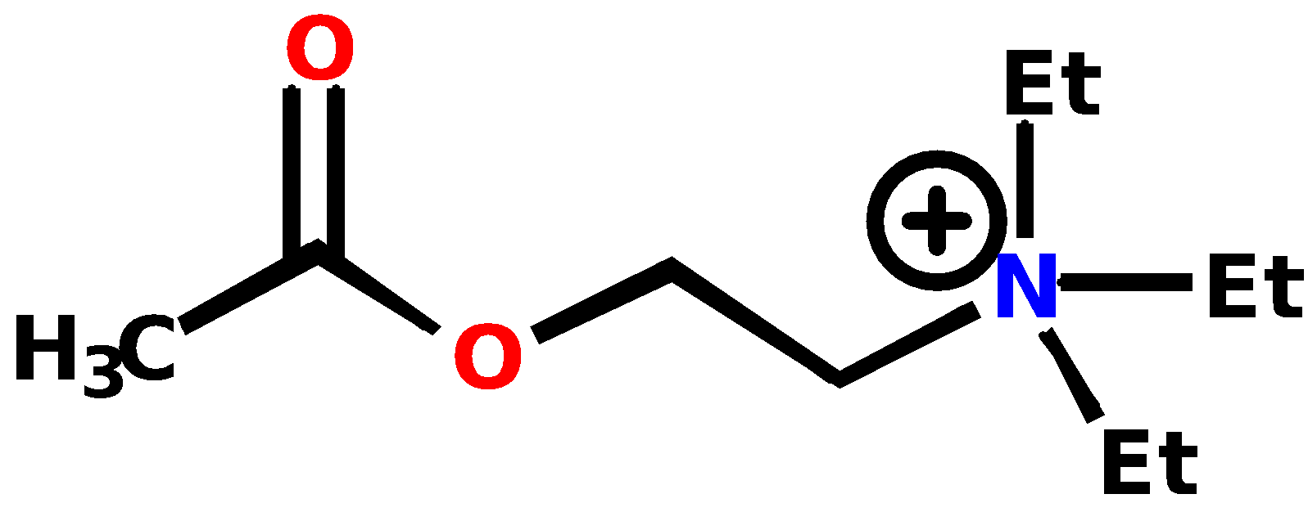
SAR for acetylcholine
Minimum of two methyl groups on quaternary nitrogen
Lower activity
Active

Slide 16
SAR for acetylcholine
Methyl group of acetoxy group cannot be extended
Much lower activity

Slide 17
SAR for acetylcholine
Conclusions:
Tight fit between Ach and binding site
Methyl groups fit into small hydrophobic pockets
Ester interacting by H-bonding
Quaternary nitrogen interacting by ionic bonding

Slide 18
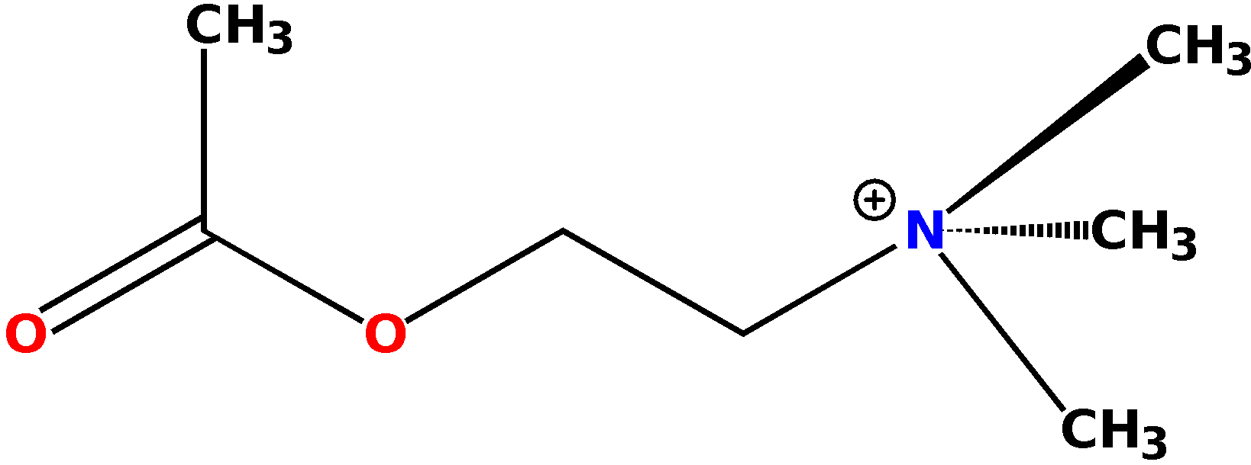
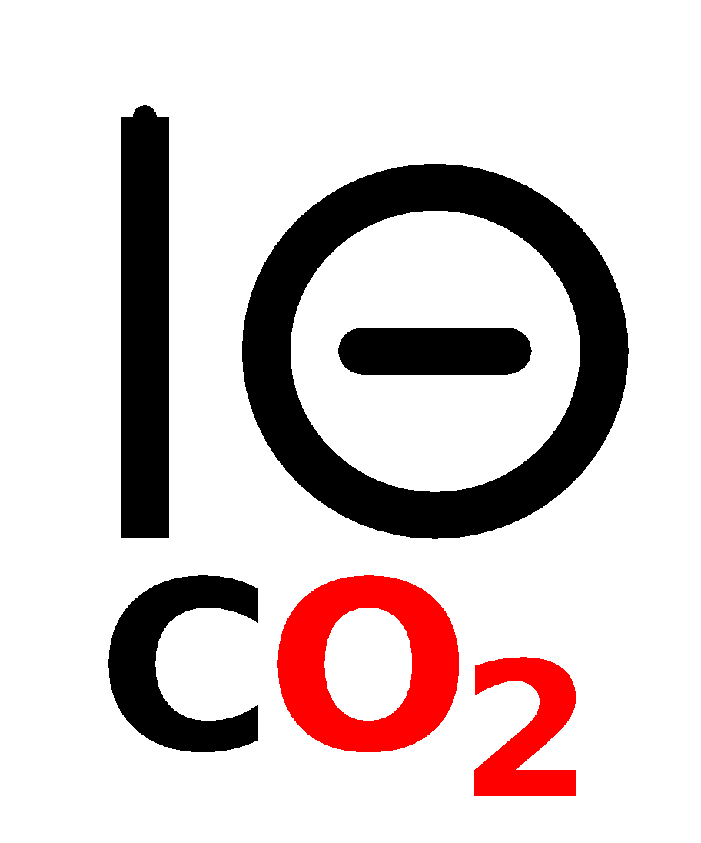
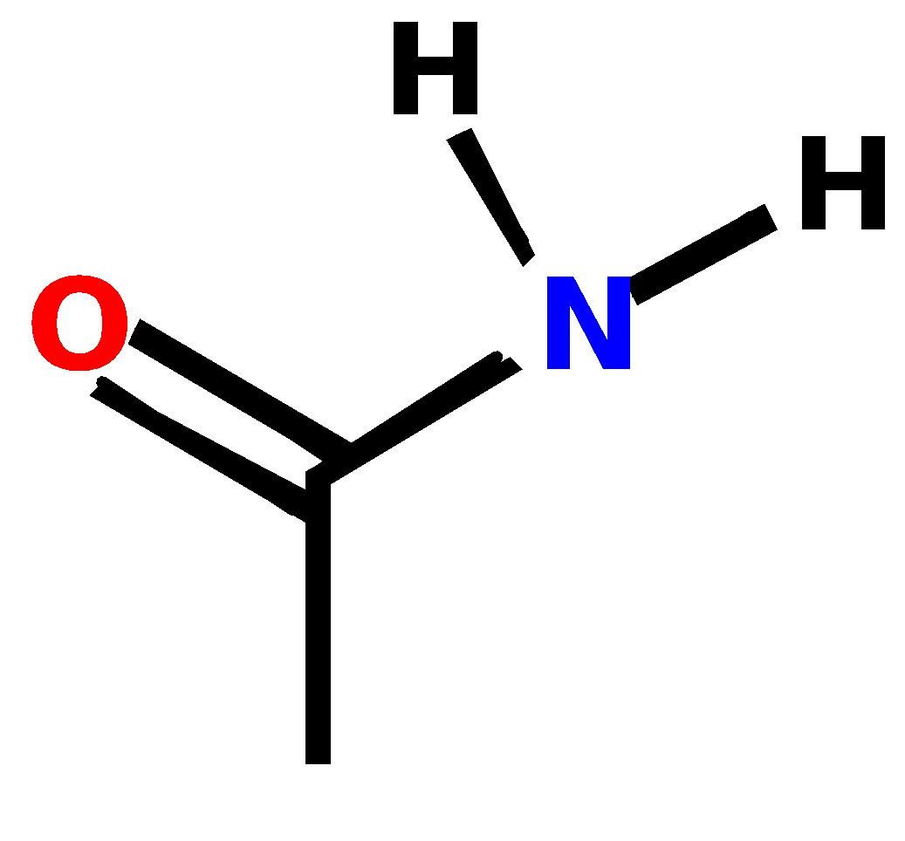
Binding site (muscarinic)
hydrophobic
pocket
Trp-307
Asp311
hydrophobic
pockets
Trp-616
Trp-613
hydrophobic
pocket
Asn-617

Slide 19
Binding site (muscarinic)
vdw
Trp-307
Asp311
Ionic bond
vdw
H-bonds
vdw
Trp-616
Trp-613
Asn-617

Slide 20
Cholinergic Agents
Direct acting - act on the receptors to activate a tissue response
Indirect acting - inhibit the action of the enzyme Acetylcholinesterase:
Major uses = Stimulate bladder & GI tone, constrict pupils (miosis), neuro-muscular transmission

Slide 21
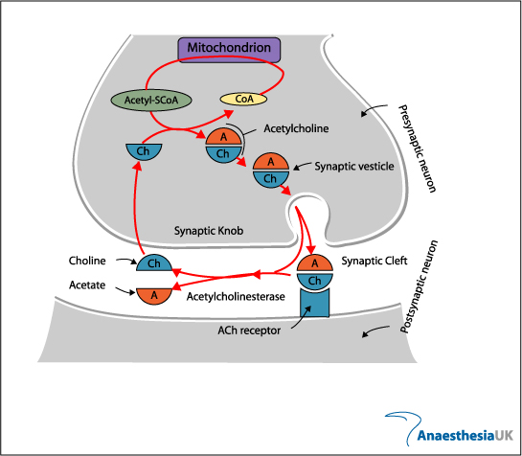

Slide 22
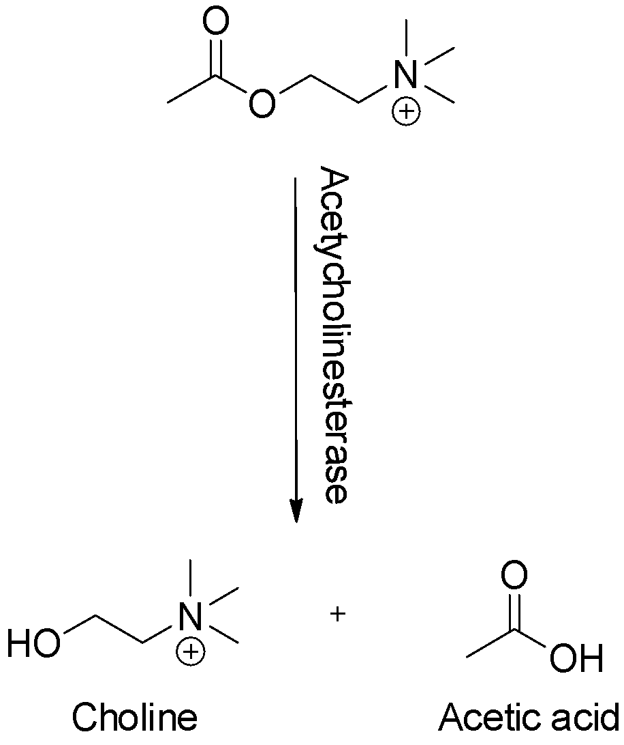
Hydrolysis of Acetylcholine

Slide 23
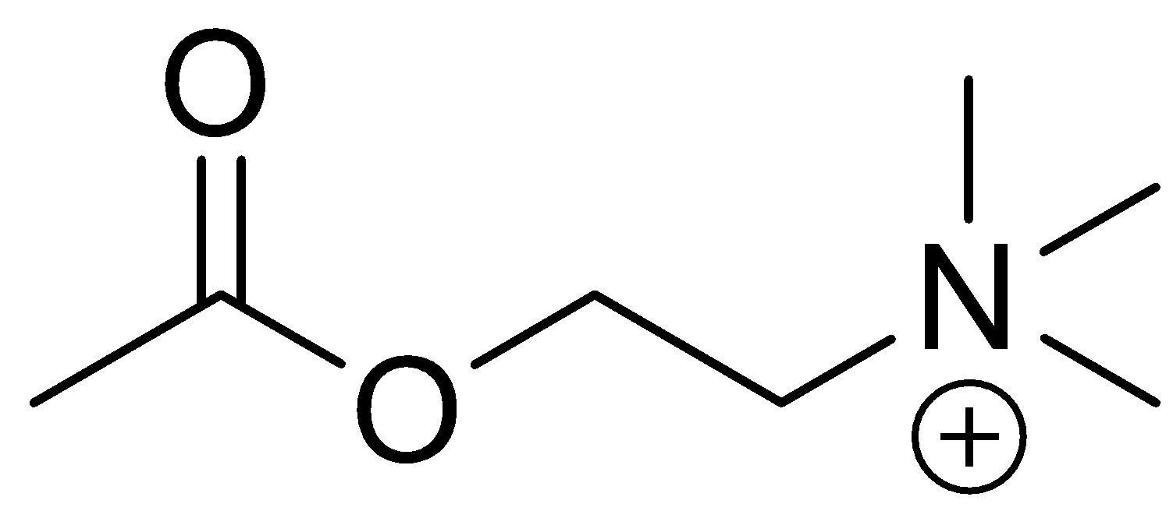
Acetylcholine (Ach)
Acetyl
Choline

Slide 24
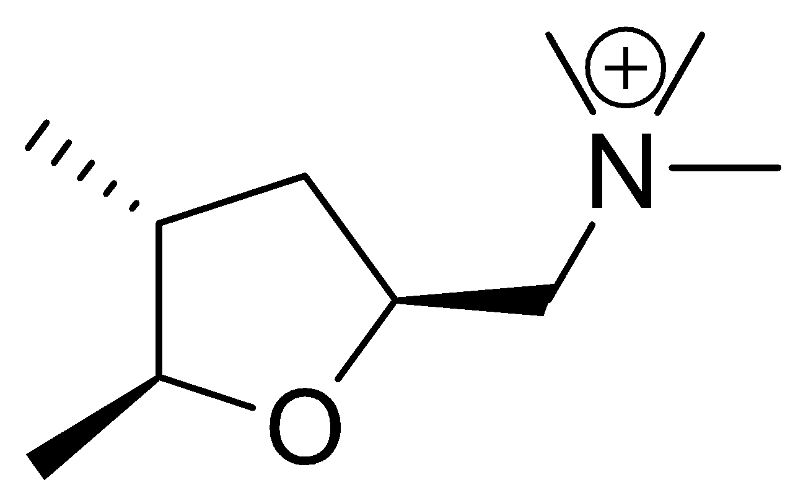
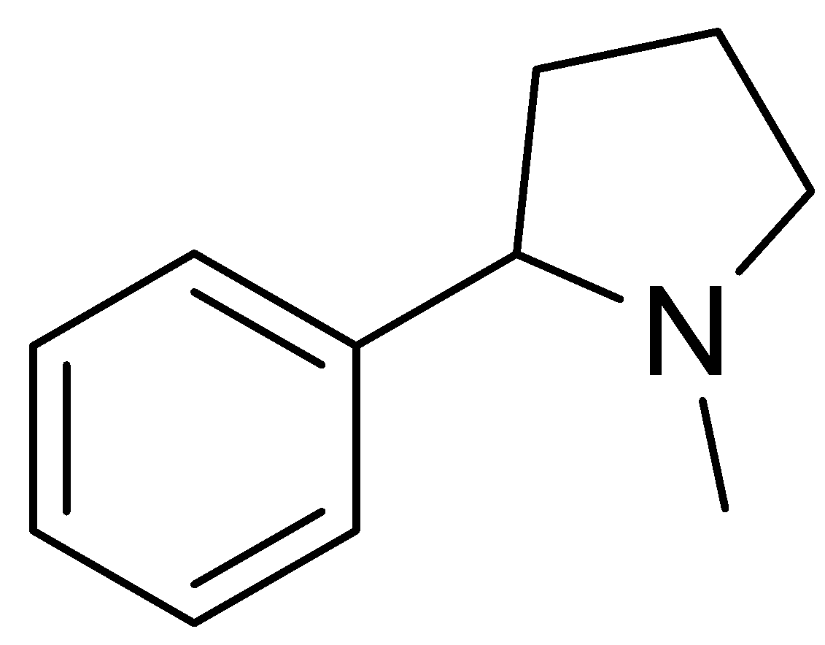
Cholinergic receptors
Muscarinic receptors:
Found in smooth muscles and cardiac muscles.
Related to muscarine.
Nicotinic receptors:
Found in skeletal muscles.
Related to nicotine.

Slide 25
Subtypes of M- receptor | M₁ Neural | M₂ Cardiac | M₃ Glandular, smooth muscles | M₄ | M₅
Main location | CNS, Gastric & salivary glands | Heart , GIT, CNS | Gastric & salivary glands, GIT, Eye | CNS | CNS
Cellular response | Increase IP₃, DAG, Depolarization, excitation, increase potassium conductance | Decrease in a) cAMP inhibition, b) Ca⁺⁺ conductance, Increase K⁺ conductance | Increase IP₃, Ca⁺⁺ conductance, | As M₂ | As M₃
Functional responses | CNS excitation, gastric secretion | Cardiac inhibition, neural inhibition | Gastric & saliva secretion, GI smooth muscle contraction, occular accomodation | Enhanced locomotion | Not known

Slide 26
Cholinergic agonists
Acetylcholine as an agonist
Advantages
Natural messenger
Easily synthesised
Disadvantages
Easily hydrolysed in stomach (acid catalysed hydrolysis)
Easily hydrolysed in blood (esterases)
No selectivity between receptor types
No selectivity between different target organs

Slide 27
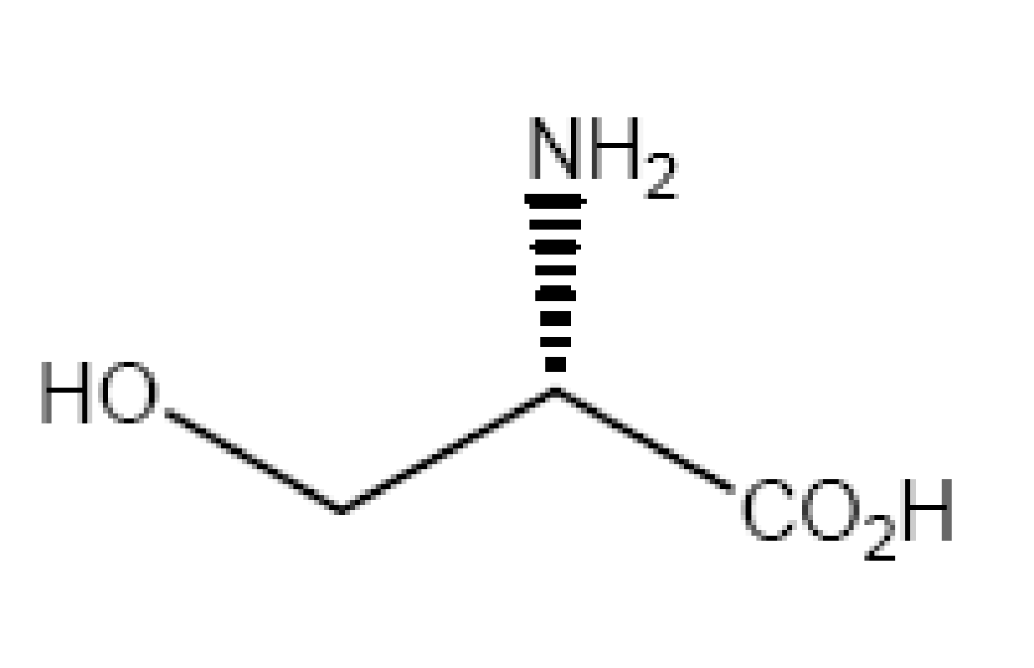
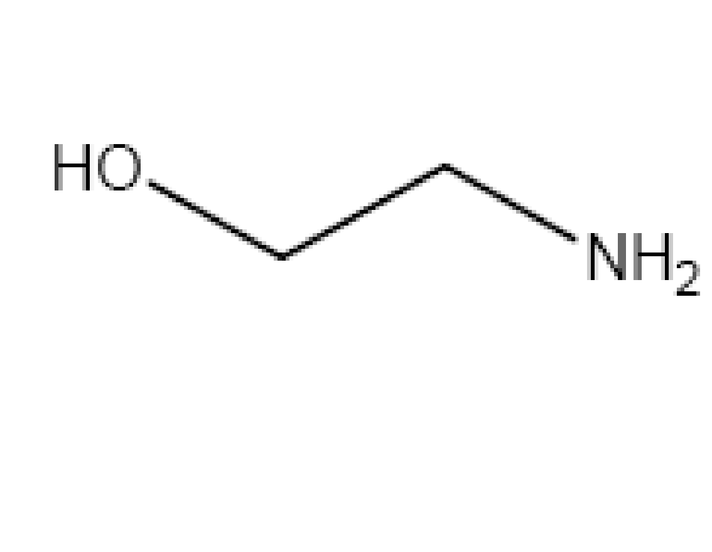
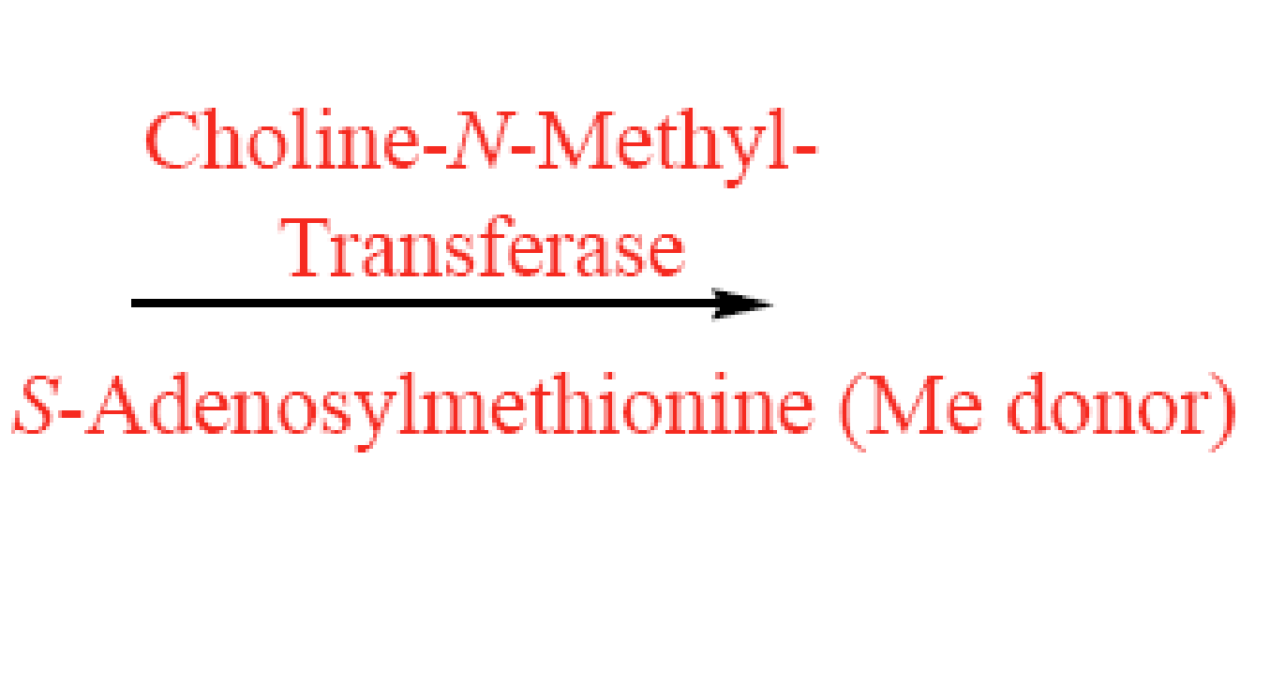
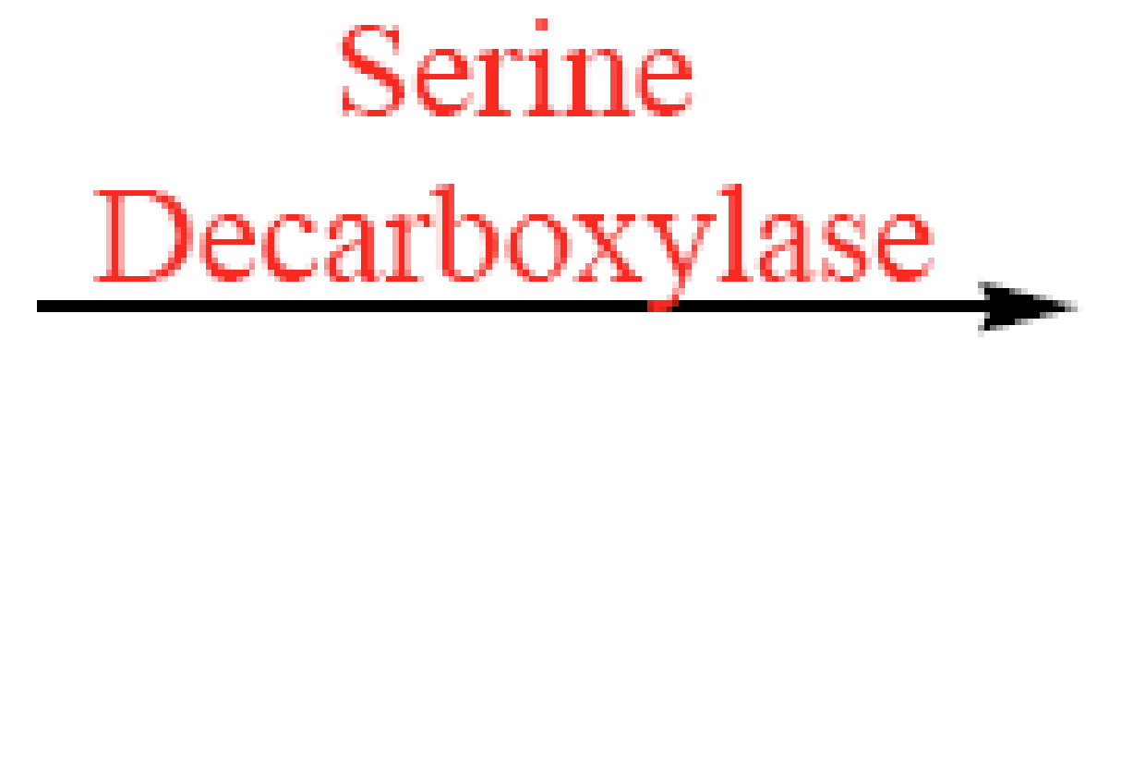
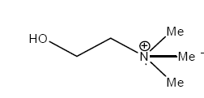
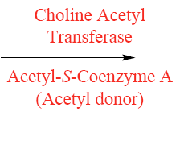
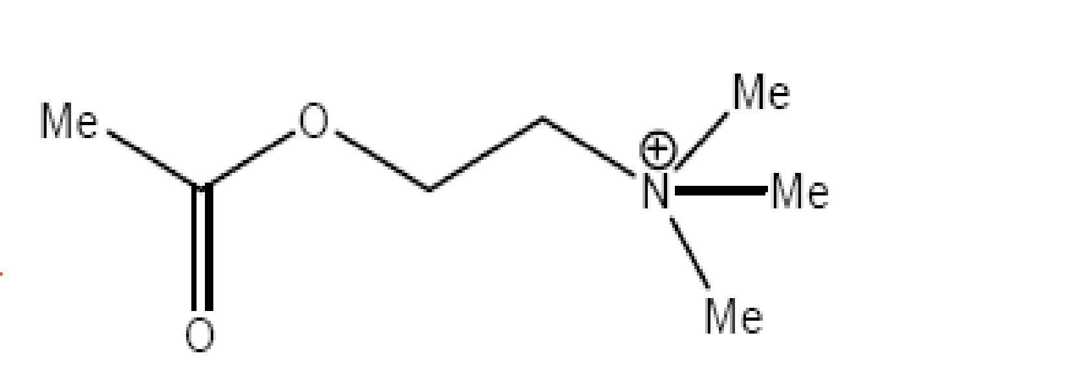
L-serine
ethanolamine
choline
Acetylcholine

Slide 28
Biological hydrolysis of Ach
What makes acetylcholine exceptionally prone to hydrolysis
is the possibility of folding to form an intramolecular dipole
bond that will increase the positive charge of the ester carbonyl

Slide 29
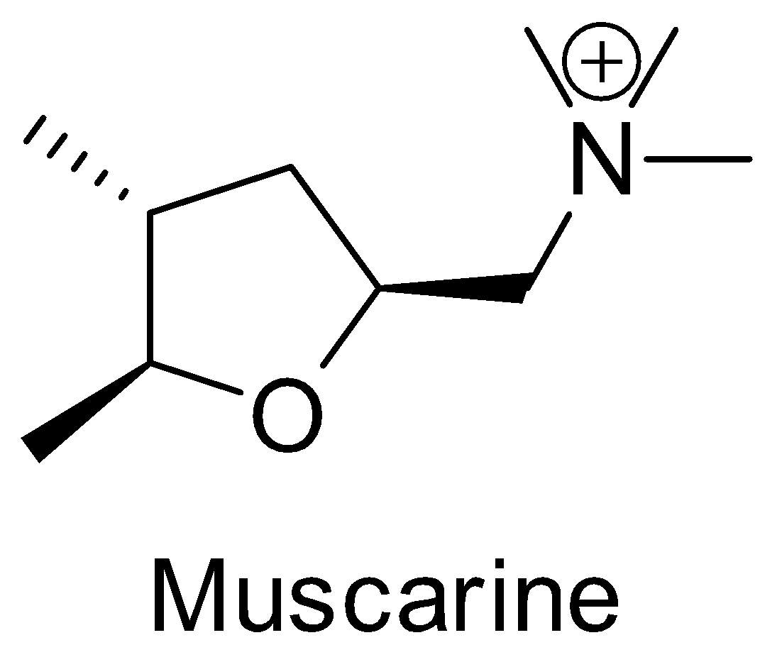
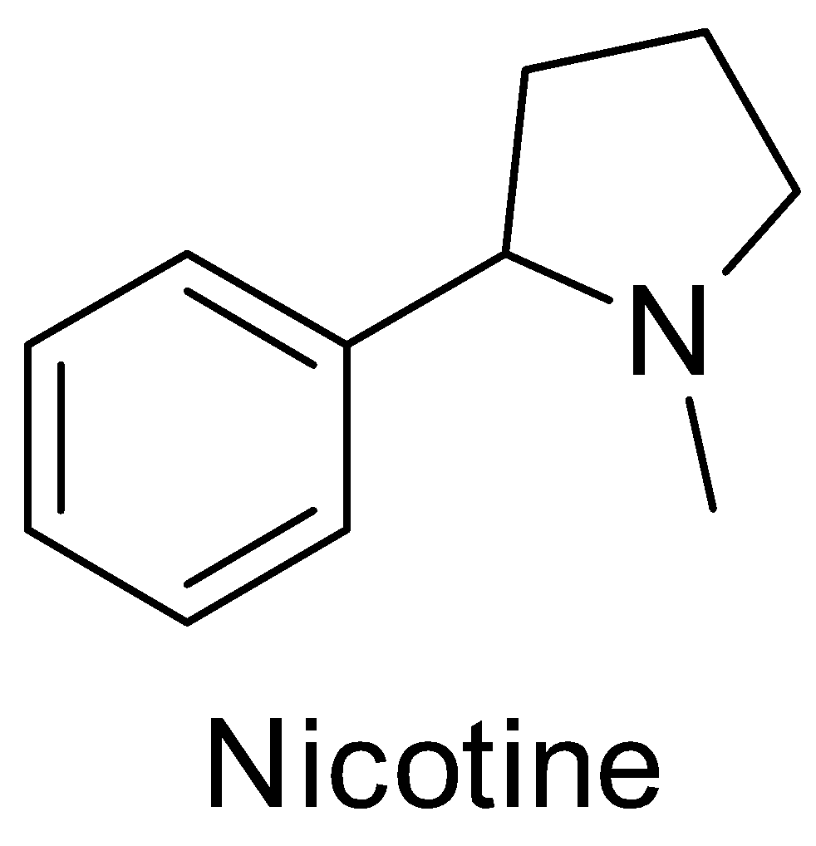
Cholinergic agonists
Nicotine and muscarine as cholinergic agonists
Advantages
More stable than Ach
Selective for main cholinergic receptor types
Selective for different organs
Disadvantages
Activate receptors for other chemical messengers
Side effects

Slide 30
Cholinergic agonists
Requirements for cholinergic agonists
Stability to stomach acids and esterases
Selectivity for cholinergic receptors
Selectivity between muscarinic and nicotinic receptors
Knowledge of binding site
SAR for acetylcholine

Slide 31
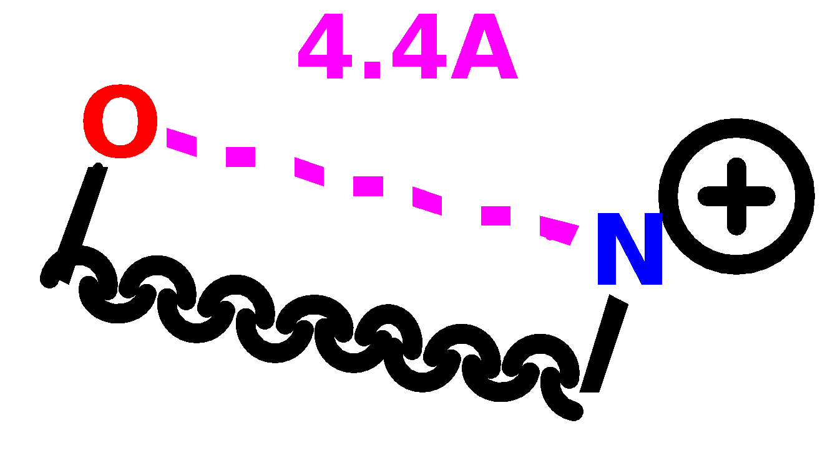
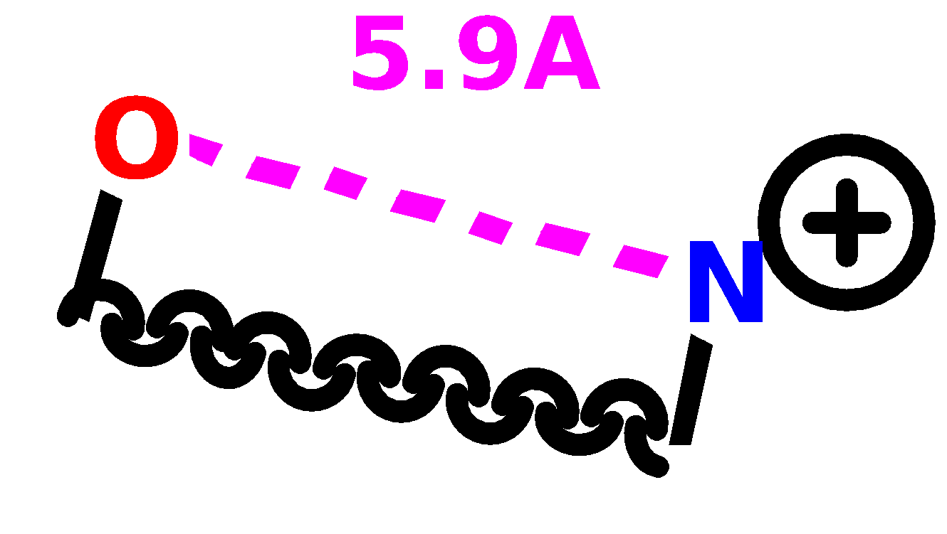
Active conformation of acetylcholine
Defines separation of ester and N
Muscarinic
receptor
Nicotinic
receptor

Slide 32
Uses of cholinergic agonists
Nicotinic selective agonists
Treatment of myasthenia gravis
- lack of acetylcholine at skeletal muscle causing weakness
Muscarinic selective agonists
Treatment of glaucoma
Switching on GIT and urinary tract after surgery
Treatment of certain heart defects. Decreases heart muscle activity and decreases heart rate

Slide 33
Design of cholinergic agonists
Use of steric shields
Bulky groups
Rationale
Shields protect ester from nucleophiles and enzymes
Shield size is important
Must be large enough to hinder hydrolysis
Must be small enough to fit binding site

Slide 34
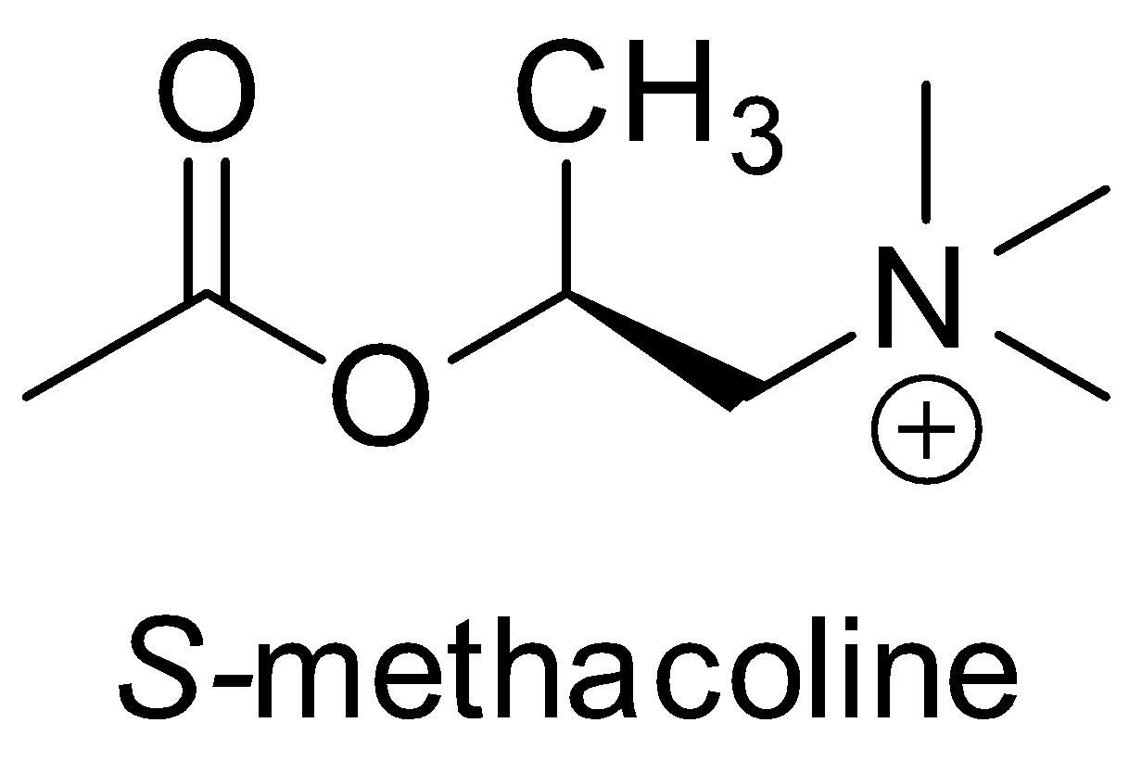
Acetylcholine analogues
To overcome the instability of Ach:
Steric shield: add large group to change the conformation of Ach:
3X more stable than Ach.
More selective on muscarinic over nicotinic receptors.
S-enantiomer is more active than the R-enantiomer

Slide 35
Design of cholinergic agonists
Use of electronic factors
Replace ester with urethane (Carbamate) group will stabilises
the carbonyl group

Slide 36
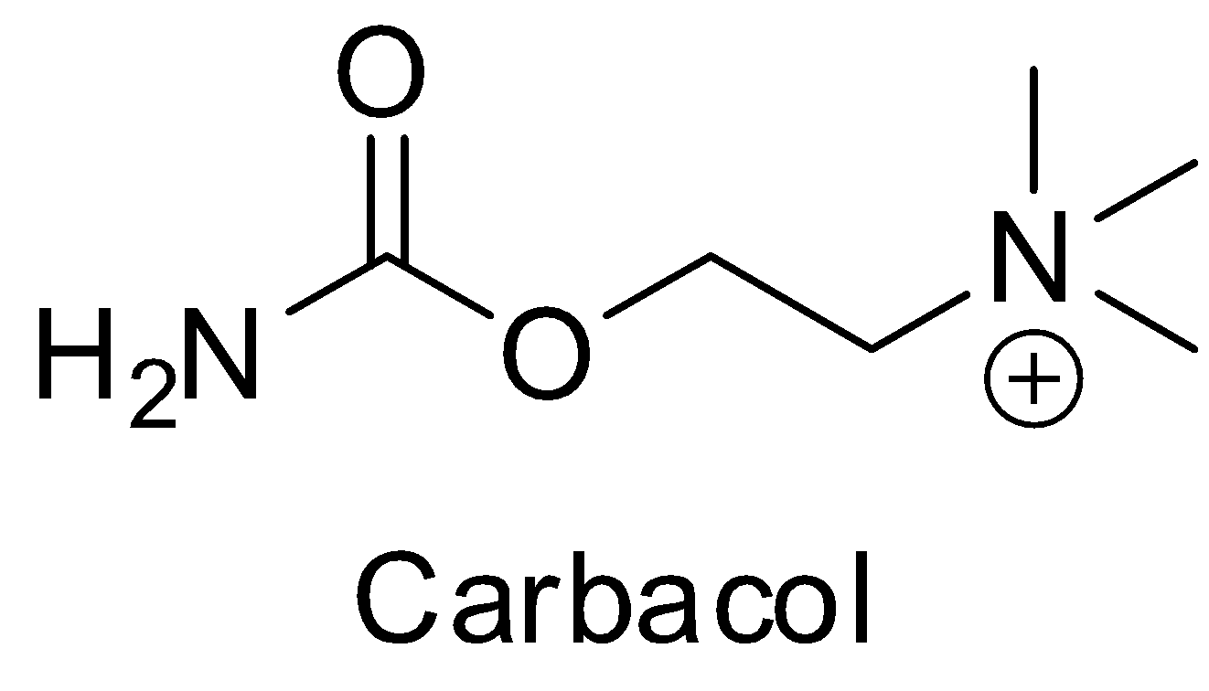
Acetylcholine analogues
Carbamate more stable ester toward hydrolysis (why?)
NH₂ and CH₃ are equal sizes. Both fit the hydrophobic pocket
Long acting cholinergic agonist.
Can be administered orally.
Not selective…… just used topically in glaucoma.

Slide 37
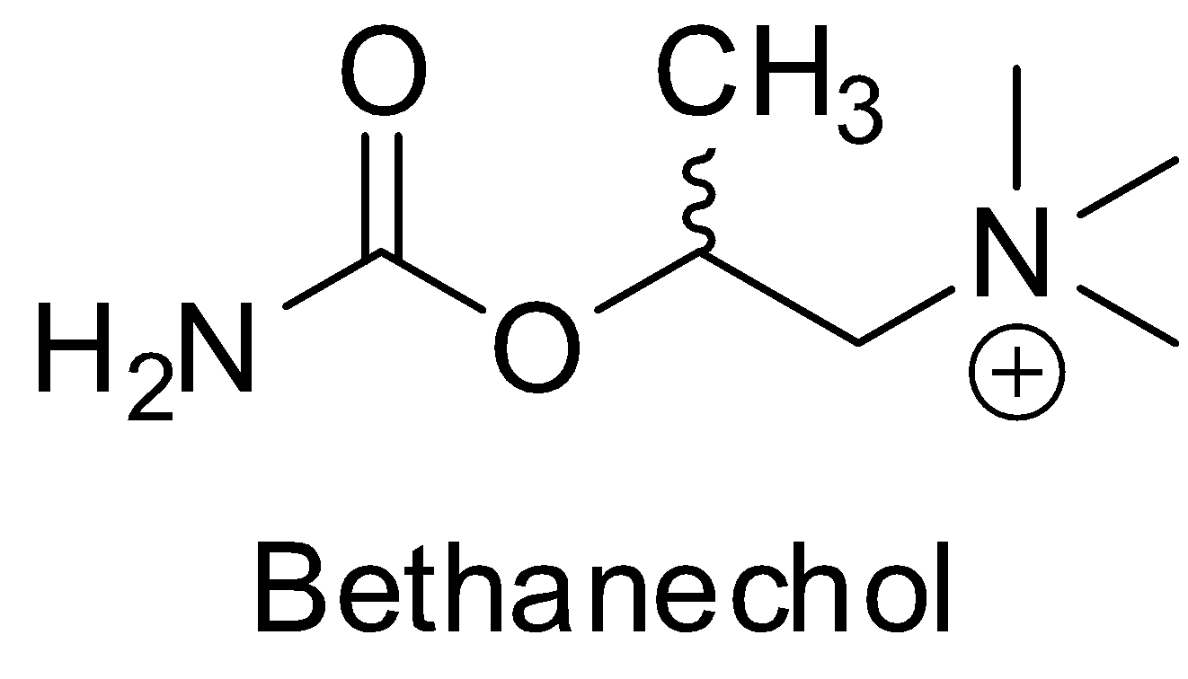
Acetylcholine analogues
More stable.
More selective on muscarinic receptor.
Used to stimulate GIT and urinary bladder after surgery.

Slide 38
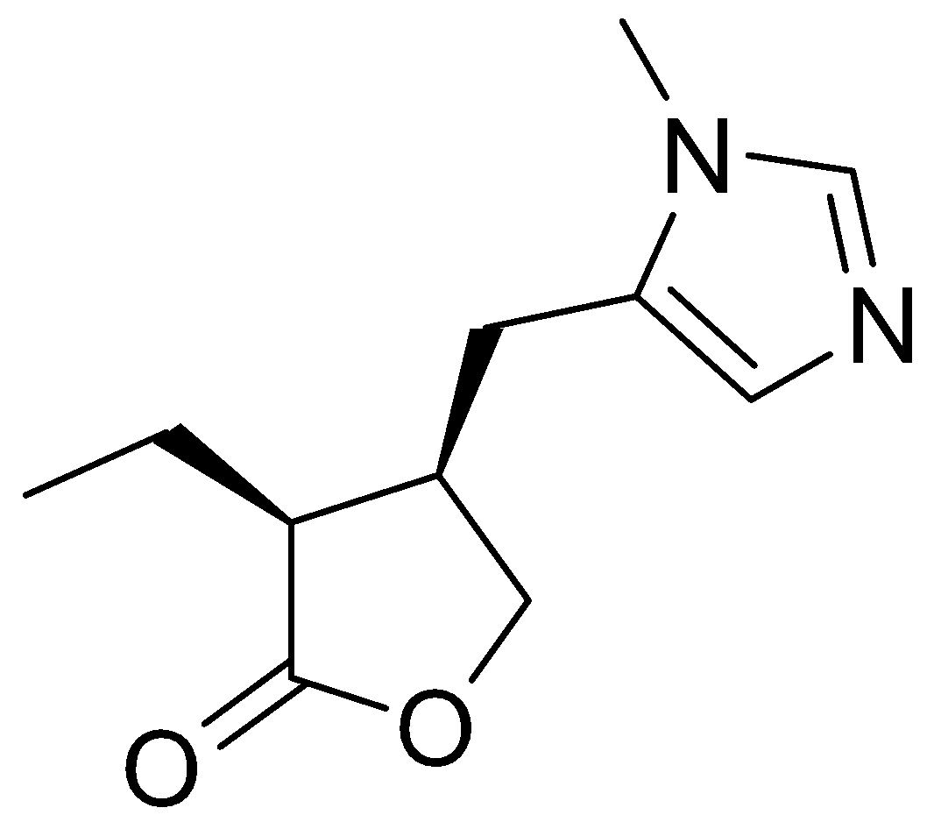
Muscarinic agonists
Clinical uses:
Treatment of glaucoma.
Stimulate GIT and UT after surgery.
In some heart defects.
Pilocarpine:
An alkaloids from Pilocarpus shrubs.
Used in glaucoma.
Topically only (why?)

Slide 39
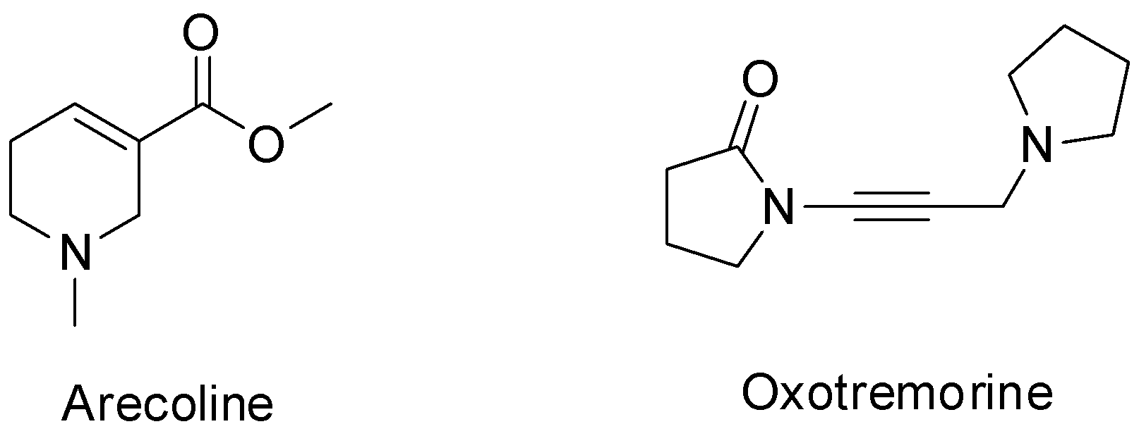
Muscarinic agonists
Oxotremorine and Arecoline:
Act on the muscarinic receptors in brain.
Used in Alzheimer’s disease.

Slide 40
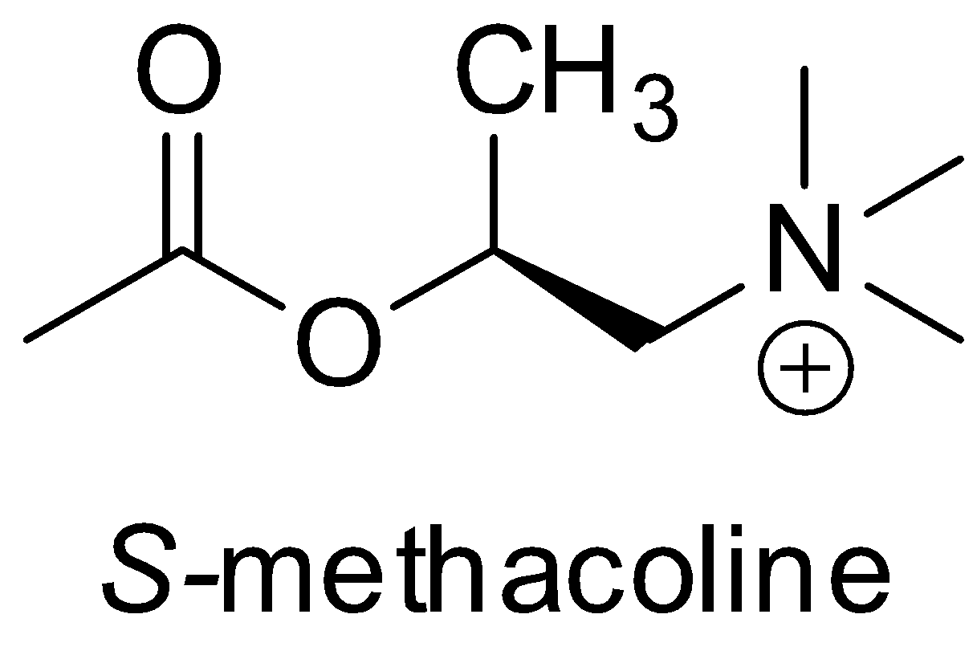
Nicotinic agonists
Mainly used in myasthenia gravis: an autoimmune disorder in which the body produce antibodies against cholinergic receptors.

Slide 41
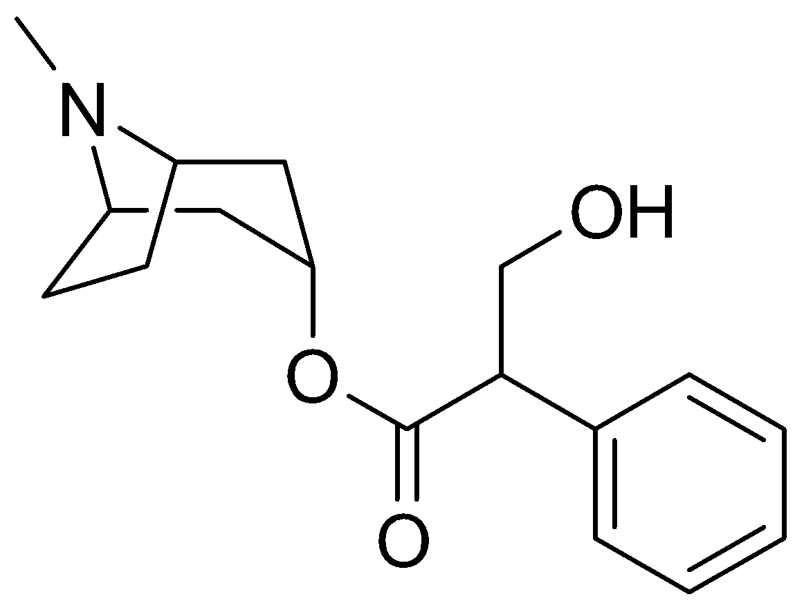
Cholinergic Antagonists
Of two types:
Muscarinic antagonists:
The prototype drug here is Atropine

Slide 42
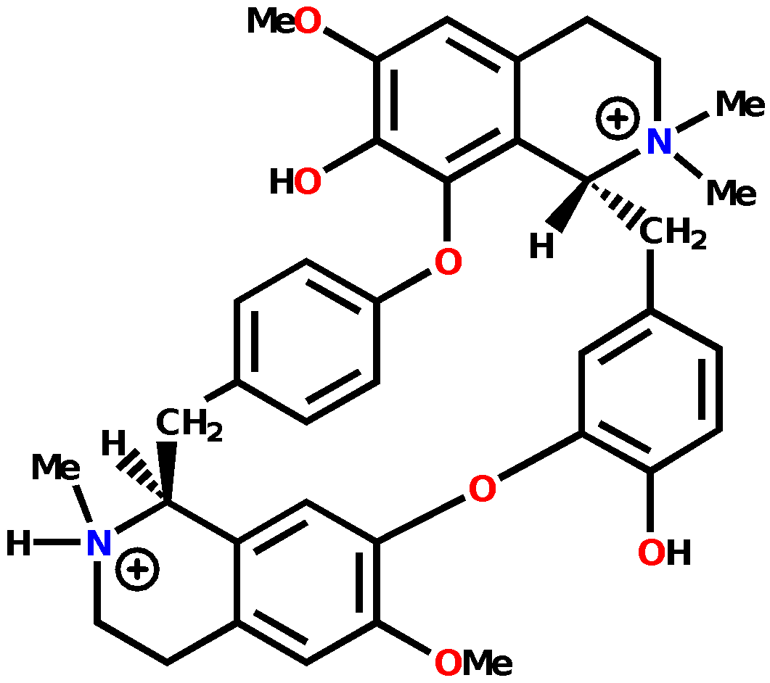
Cholinergic Antagonists
Nicotinic antagonists:
The prototype drug is tubocurarine

Slide 43
What do we mean by Antagonists
Antagonist is a molecule that can bind to a receptor without eliciting a response:
it does not activate the receptor
it will block the binding site
Prevents the entrance of the natural ligand of that receptor

Slide 44
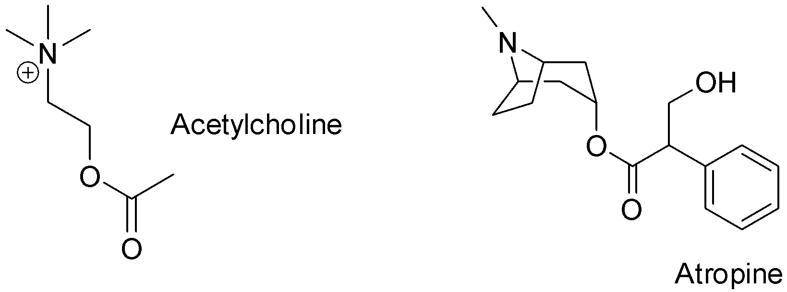
Based on this definition
The chemical structure of receptor antagonist does not necessarily mimic the natural ligand structure;

Slide 45
Antagonist is generally bulkier, having extra binding groups compared to the natural ligand
Different binding mode, means no formation of the receptor active conformer…no response

Slide 46
Muscarinic Antagonists
Clinical Effects
Decrease of saliva and gastric secretions
Relaxation of smooth muscle
Decrease in motility of GIT and urinary tract
Dilation of pupils

Slide 47
Muscarinic Antagonists
Uses
Shutting down digestion for surgery
Ophthalmic examinations
Relief of peptic ulcers
Treatment of Parkinson’s Disease
Anticholinesterase poisoning
Motion sickness

Slide 48
Nicotinic Antagonists
Normally used as muscle relaxant.
Clinical uses:
Neuromuscular blocker for surgical operations
Permits lower and safer levels of general anaesthetic

Slide 49
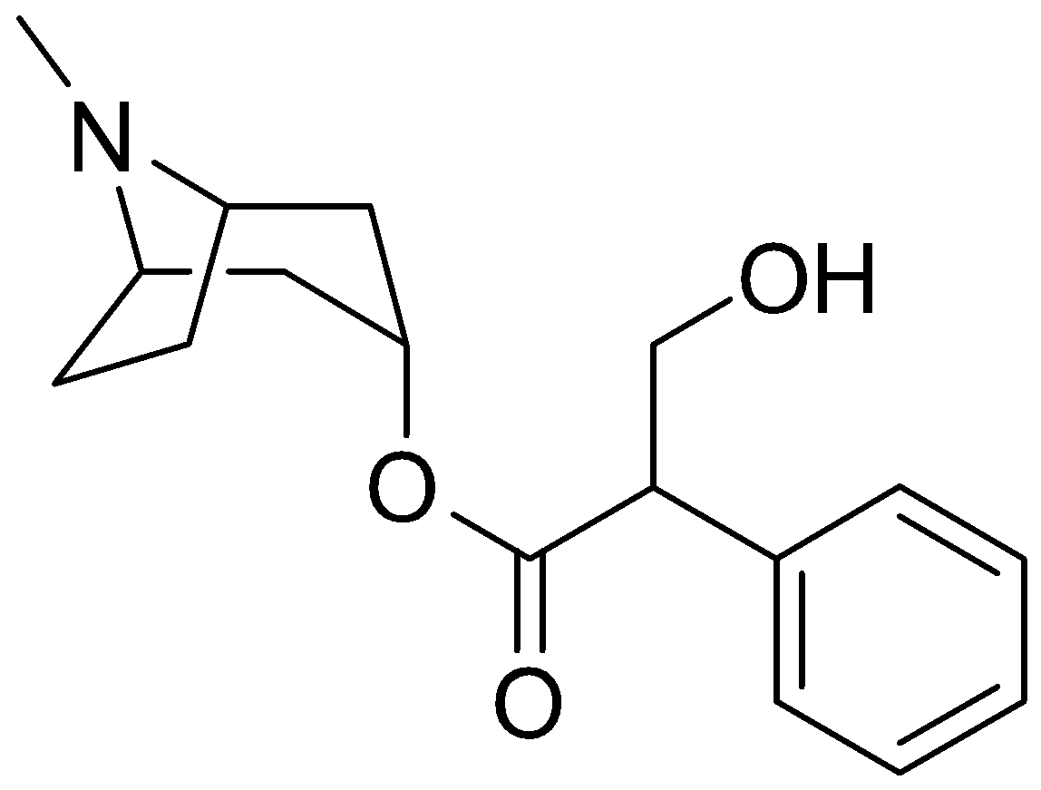
Muscarinic Antagonists
easily racemized
Atropine
Racemic form of hyoscyamine
Source - roots of belladonna
Used as a poison
Used as a medicine decreases GIT motility antidote for Anticholinesterase poisoning dilation of eye pupils
CNS side effects – hallucinations
Common side effects: urinary retention and blurred vision.

Slide 50
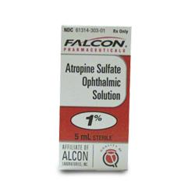
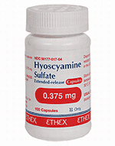
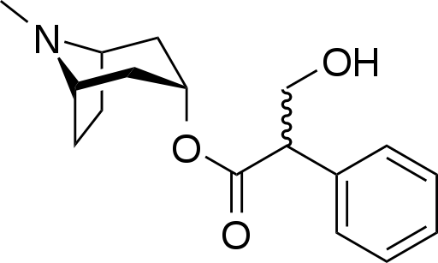
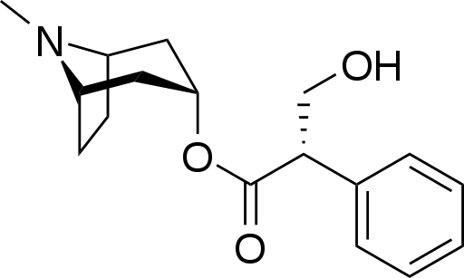
Muscarinic Antagonists
Ophthalmic use of atropine a as mydriatic (dilating) agent has been largely replaced by use of analogs tropicamide and cyclopenatolate.
However, atropine, and its chiral analog hyoscyamine, are utilized to treat gastrointestinal disorders
Also these antagonists can be used to treat the symptoms of an excess cholinergic activity, such as the exposure to an acetylcholinesterase inhibitor (such as a nerve gas).

Slide 51
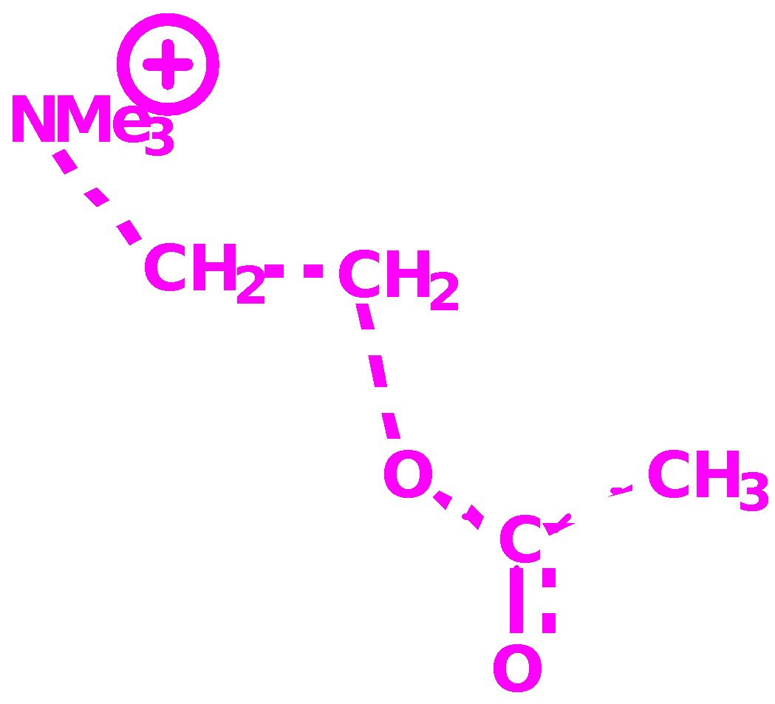
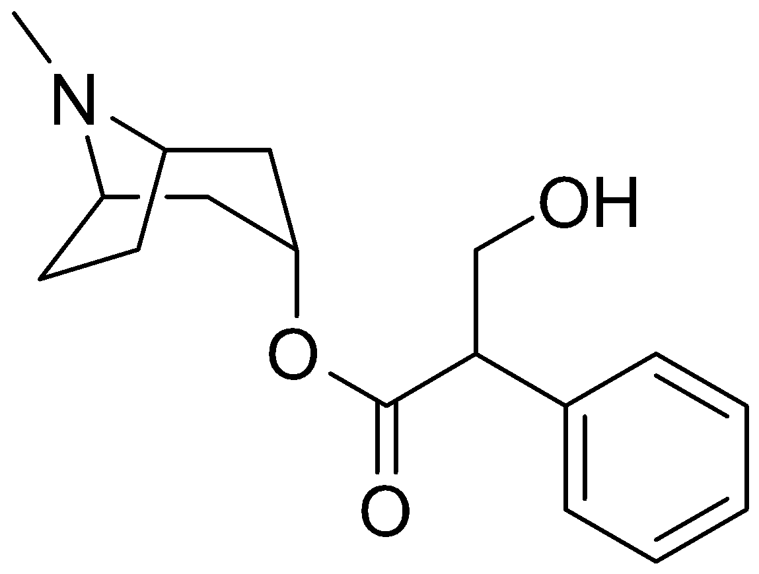
Atropine
Relative positions of ester and nitrogen similar in both molecules
Nitrogen in atropine is ionised
Amine and ester are important binding groups (ionic + H-bonds)
Aromatic ring of atropine is an extra binding group (vdW)
Atropine binds with a different induced fit - no activation
Atropine binds more strongly than acetylcholine

Slide 52
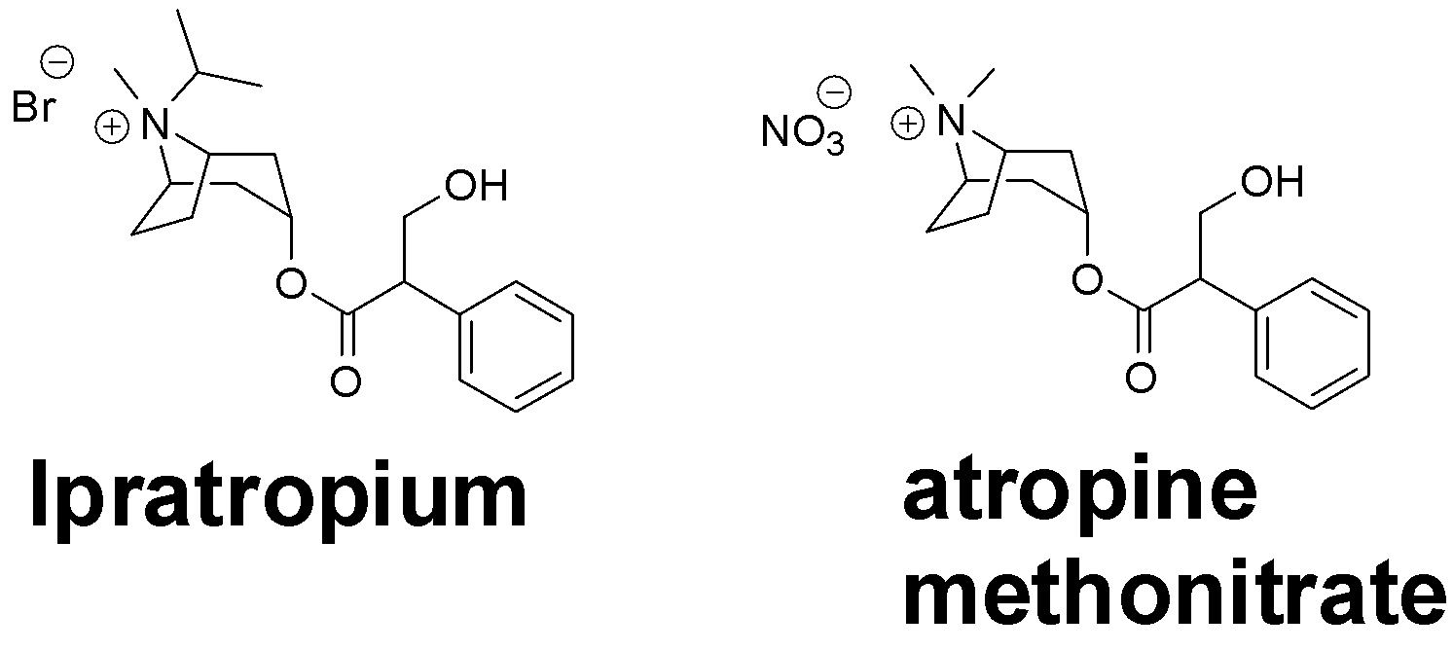
Analogues of atropine
Analogues are fully ionised
Analogues unable to cross the blood brain barrier
No CNS side effects

Slide 53
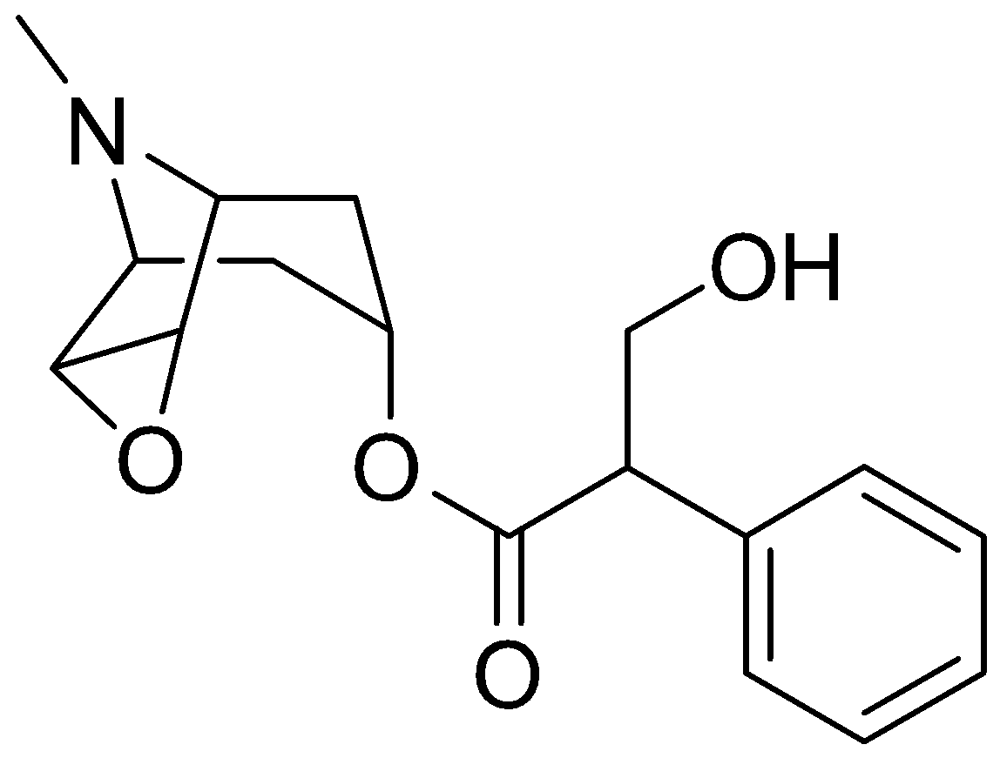
Muscarinic Antagonists
Hyoscine (scopolamine):
Used in motion sickness and as antispasmodic.
Same side effects as atropine.
Is it more toxic than atropine?

Slide 54
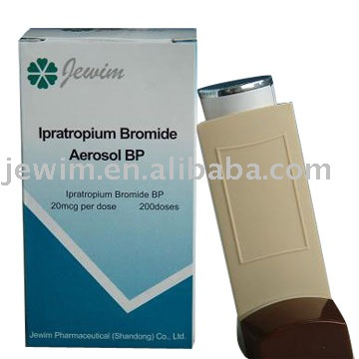
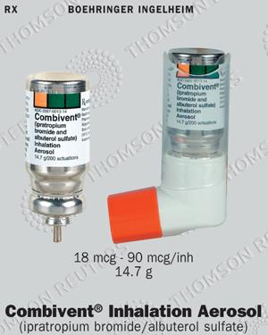
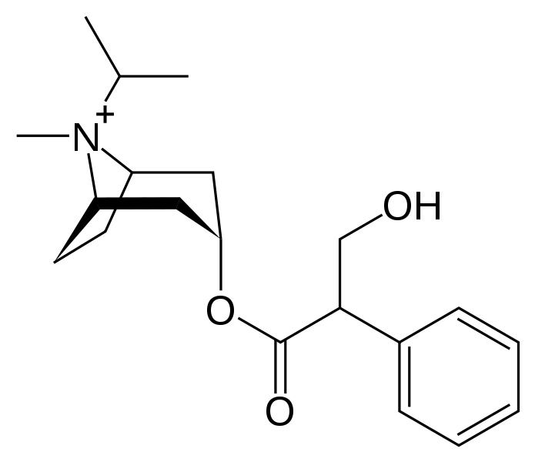
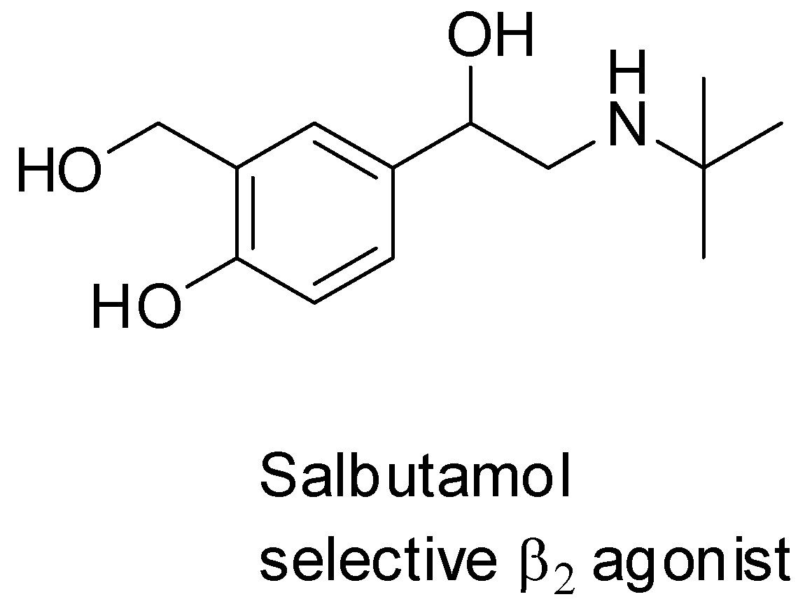
The combination preparation ipratropium/salbutamol is a formulation containing ipratropium bromide and salbutamol sulfate (albuterol sulfate) used in the management of chronic obstructive pulmonary disease (COPD) and asthma (Combivent®).

Slide 55
Muscarinic Antagonists
Pharmacophore = ester + basic amine + aromatic ring
Used in excessive sweating, spasms and nocturnal enuresis.

Slide 56
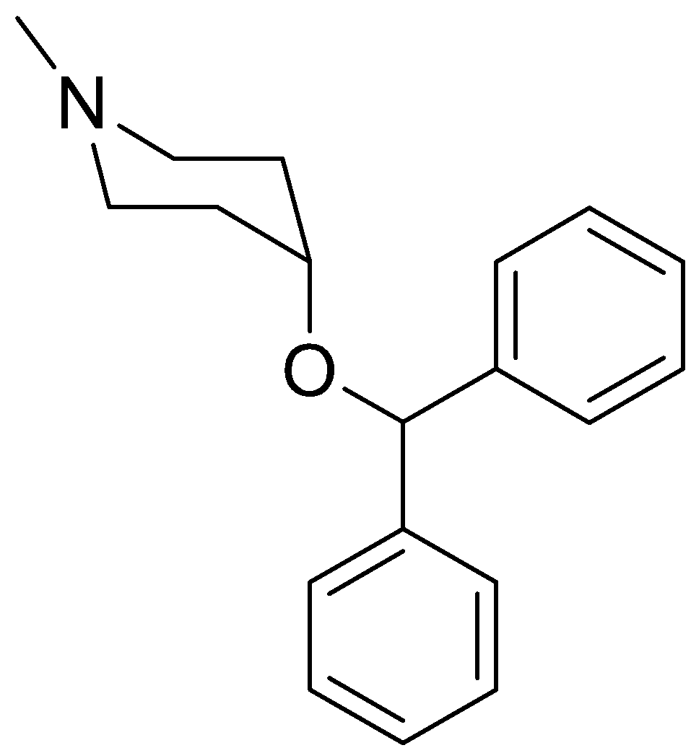
Muscarinic Antagonists
Simplified Analogues
Tropicamide
(opthalmics)
Cyclopentolate
(opthalmics)
Benztropine
(Parkinsons disease
and ulcer)
Benzhexol
(Parkinsons disease)
Pirenzepine
(anti-ulcer)

Slide 57
Tropicamide
Cyclopentolate
Tropicamide and Cyclopentolate are among the most commonly employed mydriatic (dilating) and cycloplegic (paralyzing) agents
Both function as antagonists at the muscarinic acetylcholine receptors

Slide 58
Muscarinic Antagonists
SAR for Antagonists
Important features
Tertiary amine (ionised) or a quaternary nitrogen
Aromatic ring
Ester
N-Alkyl groups (R) can be larger than methyl (unlike agonists)
Large branched acyl group
R’ = aromatic or heteroaromatic ring
Branching of aromatic/heteroaromatic rings is important

Slide 59
Muscarinic Antagonists
SAR for Antagonists
Active
Inactive

Slide 60
Proposed Binding Site for Antagonists

Slide 61
Nicotinic Antagonists
Curare
Extract from curare plant (Chondodendron tomentosum)
Used for poison arrows
Causes paralysis (blocks acetylcholine signals to muscles)
Active principle = tubocurarine
Tubocurarine

Slide 62
Native Indians hunting animals with this poison were able to eat the animal's contaminated flesh without being affected by the toxin because tubocurarine cannot easily cross mucous membranes and is thus inactive orally.

Slide 63
Nicotinic Antagonists
Pharmacophore
Two quaternary centres at specific separation (1.15nm)
Different mechanism of action from atropine based
antagonists
Different binding interactions
Clinical uses
Neuromuscular blocker for surgical operations
Permits lower and safer levels of general anaesthetic
Tubocurarine used as neuromuscular blocker

Slide 64
Nicotinic Antagonists
Analogues of tubocurarine
Long lasting
Long recovery times
Side effects on heart
No longer in clinical use

Slide 65
Esters incorporated
Shorter lifetime (5 min)
Fast onset and short duration
Frequently used during intubation
Side effects at autonomic ganglia

Slide 66
Nicotinic Antagonists
Analogues of tubocurarine
Steroid acts as a spacer for the quaternary centres (1.09nm)
Acyl groups are added to introduce the Ach skeleton
Faster onset than tubocurarine but slower than suxamethonium
Longer duration of action than suxamethonium (45 min)

Slide 67
Pancuronium is used to block the neuromuscular junction during surgery or intubation.
In the US, Pancuronium (Pavulon) is the second of three drugs used in execution by lethal injection

Slide 68
Nicotinic Antagonists
Analogues of tubocurarine
Design based on tubocurarine and suxamethonium
Lacks cardiac side effects
Rapidly broken down in blood both chemically and metabolically
Avoids patient variation in metabolic enzymes
Lifetime is 30 minutes (Self destruct system limits lifetime)
Administered as an i.v. drip

Slide 69
Atracurium instability
Atracurium is stable under acid pH
But unstable under blood pH due to
Hofmann elimination

Slide 70
Analogues of tubocurarine
Faster onset (2 min)
Shorter duration (15 min)

Slide 71
No chance for Hoffmann elimination (WHY?)

Slide 72
Anticholinesterase agents
Lead to Ach accumulation… have cholinergic effect.

Slide 73
Types of cholinesterase enzymes
Acetylcholinesterase
Located in synapses
Substrate selectivity:
Ach
Plasma cholinesterase
Located in plasma (non-neuronal)
Substrate selectivity:
Ach
Succinylcholine
Local anesthetics (procaine)

Slide 74
Anticholinesterase agents
R
CH₃
C₂H₅
C₃H₇
C₄H₉
Relative Potency
1.0
5.0
100
50
Tetraalkylammonium ion
Bind to anionic site and block Ach binding
Reversible

Slide 75
Anticholinesterase agents

Slide 76
Anticholinesterase agents
Either reversible or irreversible inhibition.
Carbamate:
Systemically toxic (why?).
Use in Glaucoma, myasthenia gravis and Alzheimer’s.
Used as antidote for atropine poisoning (why?)
SAR:
Carbamate is essential.
Benzene ring is important.
Pyrrolidine ring is important.
What are the possible side effects?

Slide 77
Anticholinesterase agents
Physostigmine analogues:
has CNS side effects.
Neostigmine has less CNS side effects and more stable than miotine (why).
Both used in myasthenia gravis.

Slide 78
Anticholinesterase agents
Same profile as neostigmine.
was used by troops to protect against nerve gases.
Is it orally available?
In which dosage form will be administered?

Slide 79
Irreversible Acetylcholinesterase inhibitors
Organophosphates
Irreversible binding to Cholinesterase active site
Longer acting
Used in the treatment of glaucoma

Slide 80
Irreversible Acetylcholinesterase inhibitors
Organophosphates Nerve gases
Irreversible binding to AchE

Slide 81
Irreversible Acetylcholinesterase inhibitors
Organophosphates Insecticides
Irreversible binding to AChE
Rapidly inactivated in mammals compared to insects

Slide 83
Carboxyesterase
Mammals, Birds

Slide 84
Antidote for AchE “poisoning”
Pralidoxime chloride (Protopam;PAM)
Antidote for pesticide or nerve gas poisoning
Most effective if given within a few hours of exposure

Slide 85
Clinical Uses of acetylcholinesterase inhibitors

Slide 87
An introduction to Medicinal Chemistry by Graham L. Patrick. 4th edition, Oxford, 2009
Wilson and Gisvolds text book of organic medicinal and pharmaceutical chemistry by John H. Black and John M. Beale, jr. 12th edition, Lippincott Williams and Wilkings 2011.
Foyes principle of medicinal chemistry by David H. Williams, Thomas L. Leuke, Williams O. Foye. Lippincott William and Wilkins. 7th edition, 2013.

Slide 88
The End

