Slide 1
Diuretics Potassium-Sparing, Loop Diuretics, and Miscellaneous
Instructor Amin Thawabteh Medicinal Chemistry 2
Student name and I.D Muhammad Musleh /1162595 Saleh Aqel / 1160596

Slide 2
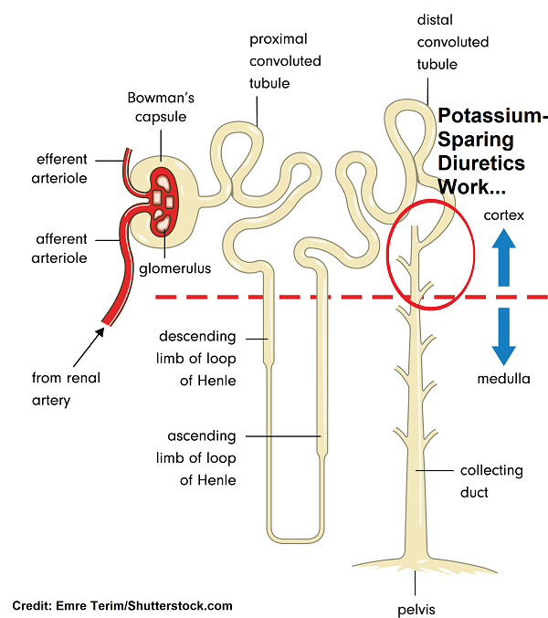
Potassium sparing diuretics
- Potassium- sparing diuretics act in the collecting tubule to inhibit Na reabsorption and k excretion .
- The major uses of potassium sparing diuretics :
1.Treatment of hypertension (usually in combination with thiazides).
2.Used in heart failure. (aldosterone antagoinsts) .
This type of drugs should be avoided in patients with renal dysfunction because of increasing the risk of hyperkalemia.

Slide 3
Within this class , there are drugs with two distinct mechanisms of action :
1.Aldosterone antagonist : Spironolactone
MOA : It is a specific pharmacologic antagonist of aldosterone, acting primarily through competitive binding of receptors at the aldosterone-dependent sodium-potassium exchange site in the distal convoluted renal tubule. it causes increased amounts of sodium and water to be excreted, while potassium is retained .
It has a slower onset of action than triamterene or amiloride, but its natriuretic effect is slightly greater during long-term therapy.
It is used in hypertension , congestive heart failure, hepatic cirrhosis and in hypokalemia.

Slide 4
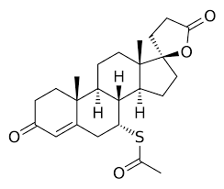
The structure of spironolactone :
It is steroidal structure with acetyl thio group .

Slide 5
2.Triamterene and amiloride :
Mechanism of action :
Triamterene and amiloride block Na transport channels, resulting in a decrease in Na/K exchange , although they have a K sparing diuretic action similar to the aldosterone antagonists, their ability to block Na/k exchange site in the collecting tubules does not depend on the presence of the aldosterone.
Amiloride is more potent than triamterene .

Slide 6
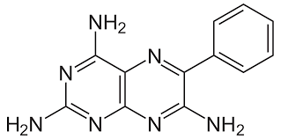
Triameterene structure :
Substitution at para postion of phenyl ring with OH group will increase the activity of the compound .
Substitution at para postion of phenyl ring with CH3 group will decrease the activity of the compound .
The amino groups must be present because it is essential for diuretic activity . The phenyl group can be replaced by small heterocyclic rings such as thiazole and pyridine that produce highly active compound .

Slide 7
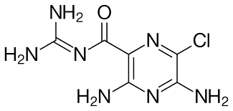
Amiloride structure :
The Cl atom is important for the activity of the drug .
The substituation on the two amino groups will reduce the activity of the drug.
Substituation with alkyl groups on gaunidine nitrogen leads to loss the diuretic activity.

Slide 8
Loop Diuretics
Classes, Uses, & MOA
Powerful type of Diuretic

Slide 9
About LH
Classes:- 1- Descending Loop of Henle 2- Ascending Loop of Henle
MOA:- Inhibit the cotransport of Na+/K+/2Cl- in the Ascending Loop of Henle Reduce Reabsorption of Ca, Mg.
Uses:- 1- Edema 2- Hypertension 3- Heart Failure 4- Hypercalcemia, and Hyperkalemia

Slide 10
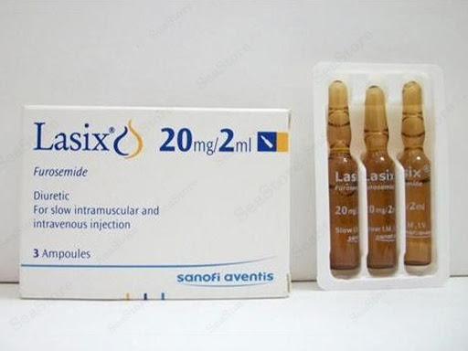
Furosemide C₁₂H₁₁ClN₂O₅S
About:- 1- High Dose May Cause Irreversible Hearing Loss 2- Brand Name Lasix 3- Injectable, Tablet and Oral Solution 4- Black Box Warning (Liver Function) 5- Category C -Pregnancy

Slide 11
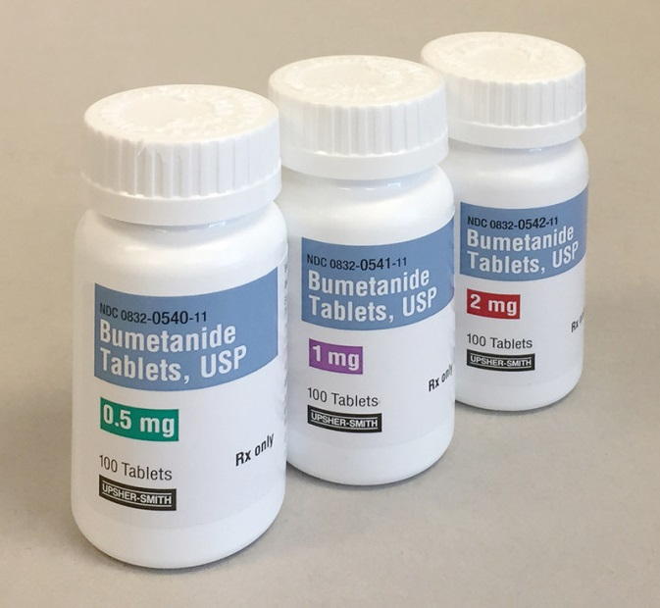
Bumetanide C₁₇H₂₀N₂O₅S
About:- 1- Injectable, and Tablet 2- Category C –Pregnancy 3-Black Box Warning (Depletion of Water and Electrolyte)

Slide 12
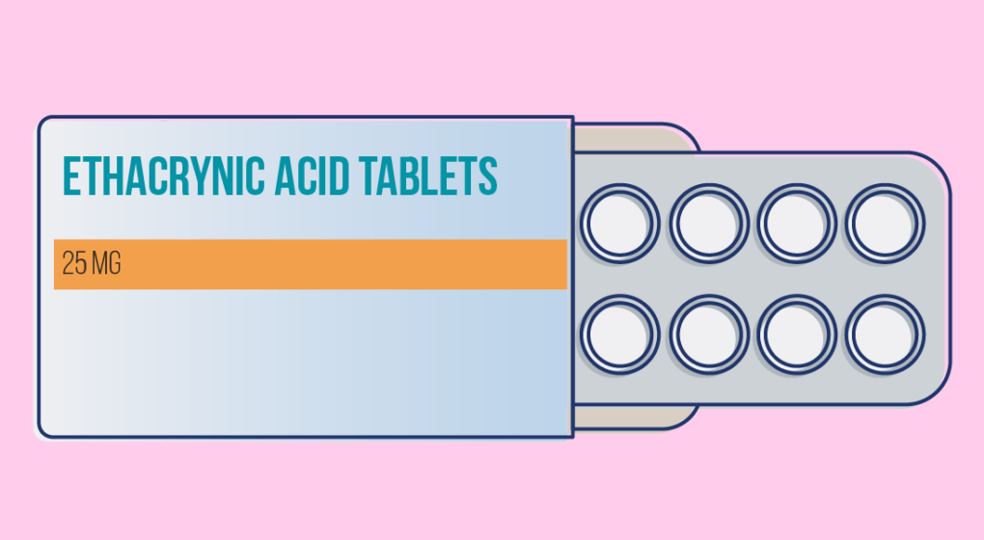
Ethacrynic-Acid C₁₃H₁₂Cl₂O₄
About:- 1- Shows greater side effects than other loop diuretics 2- Injectable and Oral 3- Category B -Pregnancy

Slide 13
Miscellaneous
MOA & Uses

Slide 14
Indapamide C₁₆H₁₆ClN₃O₃S
MOA:- It enhances Na, Cl, and Water excretion by intervening the transport of Na ion across tubular epithelium at Proximal Segment of distal Tuble Another Research said that it has two MOA one is Diuretic and another is Vascular action (Vasodilator)
Uses:- 1- Hypertension 2- Edema – Fluid Retention

Slide 15
Xipamide C₁₅H₁₅ClN₂O₄S
MOA:- It is Sulphonamide Based Diuretic, so it acts on the Distal Convoluted Tubules to reduce Na Reabsorption, so Increase Osmolality of the lumen, so reduce Water Reabsorbed by Collecting Ducts, and this in turn increase Urinary Output
Uses:- 1- Edema (Cardiac, Renal, Hepatic, Lympho) 2- Hypertension

Slide 16
Clopamide C₁₄H₂₀ClN₃O₃S
MOA:- Is a Piperidine Based Diuretic, Work by increase the volume in kidney, work at DCT (Distal Convoluted Tubule) then inhibit NaCl Cotransporter (NCC), it bids selectivity with chloride binding site and thus interferes with the Reabsorption of NaCl, thus excretion of Water with NaCl Notice:- Sodium-Chloride Symporter = Na-Cl Cotransporter (NCC)(NCCT)= Thiazide Sensitive Na-Cl Cotransporter (TSC) Its Function is to Reabsorb Na and Cl ions from Tubular Fluid to Distal Convoluted Tubule
Uses:- 1- Hypertension 2- Edema

Slide 17
Quinethazone C₁₀H₁₂ClN₃O₃S
MOA:- Its inhibits Chloride Reabsorption at the start of Distal Tubule by the NaCl Contransporter, and this in turn increase the excretion of Na, Cl, and Water. Also it Inhibit Na Transport across Renal Tubular Epithelium, and this in turn increase K excretion by Na-K Exchange Mechanism.
Uses:- 1- Hypertension

Slide 18
Metolazone C₁₆H₁₆ClN₃O₃S
MOA:- Causes the Kidneys to Reduce the Amount of Water and Salt (Na, K, and H ions) by Increase the amount of Urine. It inhibits Reabsorption of Na in Distal Tubules.
Uses:-
1- Edema (Reduce Swelling and Fluid Retention)
2- Hypertension 5,10,15 mg

Slide 19
Chlorthalidone C₁₄H₁₁ClN₂O₄S
MOA:- Prevent Reabsorption of Na and Cl by Inhibite the Na-Cl Symporter in loop of Henle (Ascending Limb), also it cause Osmotic Volume. Increase K by Na-K Exchange Machanism.
Uses:-
1- Hypertension 2- Decreasing Extra Salt and Water (Edema) 3- Kidney Stone Prevention (By Reduce Calcium in Body) 15,25,50,100 mg

Slide 20
Clorexolone C₁₄H₁₇ClN₂O₃S
MOA:- Increase the volume of Urine, by Inhibiting Reabsorption of Na, and Cl ions in the Distal Convoluted Tubules and this mean Block Na-Cl Symporter
Uses:- 1- Hypertention 2- Edema

Slide 21
Reference
https://www.drugs.com/drug-class/loop-diuretics.html
https://www.drugs.com/furosemide.html
https://www.healthline.com/health/furosemide-oral-tablet#interactions
https://www.drugbank.ca/drugs/DB00695 https://reference.medscape.com/drug/bumex-burinex-bumetanide-342421#4
https://reference.medscape.com/drug/lasix-furosemide-342423#5
https://reference.medscape.com/drug/edecrin-ethacrynic-acid-342422#5
https://www.drugbank.ca/drugs/DB00808
https://www.webmd.com/drugs/2/drug-12360/indapamide-oral/details
https://reference.medscape.com/drug/indapamide-342415
https://www.ncbi.nlm.nih.gov/pubmed/6653405
https://www.ncbi.nlm.nih.gov/pubmed/6352188 https://pubchem.ncbi.nlm.nih.gov/compound/xipamide#section=Pharmacology-and-Biochemistry
https://www.drugbank.ca/drugs/DB01325
https://www.pharmacompass.com/chemistry-chemical-name/quinethazone
https://medlineplus.gov/druginfo/meds/a682345.html
https://reference.medscape.com/drug/zaroxolyn-metolazone-342416#10
https://pubchem.ncbi.nlm.nih.gov/compound/Metolazone#section=InChI-Key
https://www.rxlist.com/consumer_chlorthalidone_thalitone/drugs-condition.htm
https://www.drugbank.ca/drugs/DB00310
https://pubchem.ncbi.nlm.nih.gov/compound/Chlorthalidone
https://pubchem.ncbi.nlm.nih.gov/compound/Clorexolone#section=3D-Conformer
https://www.rxwiki.com/clorexolone

