Slide 1
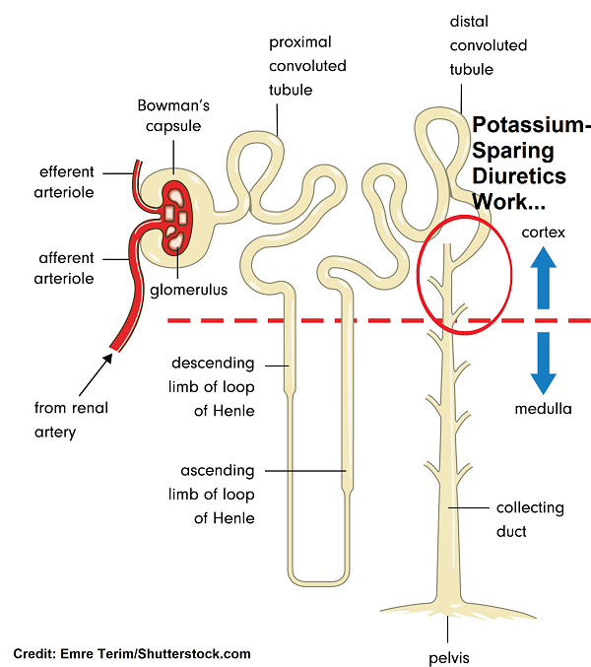
Potassium sparing diuretics :
Potassium- sparing diuretics act in the collecting tubule to inhibit Na reabsorption and k excretion .
The major uses of potassium sparing diuretics :
1.Treatment of hypertension (usually in combination with thiazides).
2.Used in heart failure. (aldosterone antagoinsts) .
This type of drugs should be avoided in patients with renal dysfunction because of increasing the risk of hyperkalemia.

Slide 2
Within this class , there are drugs with two distinct mechanisms of action :
1.Aldosterone antagonist : Spironolactone
MOA : It is a specific pharmacologic antagonist of aldosterone, acting primarily through competitive binding of receptors at the aldosterone-dependent sodium-potassium exchange site in the distal convoluted renal tubule. it causes increased amounts of sodium and water to be excreted, while potassium is retained .
It has a slower onset of action than triamterene or amiloride, but its natriuretic effect is slightly greater during long-term therapy.
It is used in hypertension , congestive heart failure, hepatic cirrhosis and in hypokalemia.

Slide 3
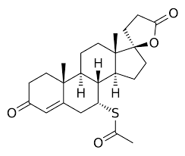
The structure of spironolactone :
It is steroidal structure with acetyl thio group .

Slide 4
2.Triamterene and amiloride :
Mechanism of action :
Triamterene and amiloride block Na transport channels, resulting in a decrease in Na/K exchange , although they have a K sparing diuretic action similar to the aldosterone antagonists, their ability to block Na/k exchange site in the collecting tubules does not depend on the presence of the aldosterone.
Amiloride is more potent than triamterene .

Slide 5
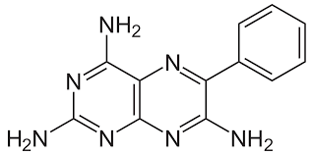
Triameterene structure :
Substitution at para postion of phenyl ring with OH group will increase the activity of the compound .
Substitution at para postion of phenyl ring with CH3 group will decrease the activity of the compound .
The amino groups must be present because it is essential for diuretic activity . The phenyl group can be replaced by small heterocyclic rings such as thiazole and pyridine that produce highly active compound .

Slide 6
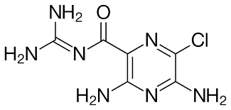
Amiloride structure :
The Cl atom is important for the activity of the drug .
The substituation on the two amino groups will reduce the activity of the drug.
Substituation with alkyl groups on gaunidine nitrogen leads to loss the diuretic activity.

