Slide 1
Atypical antipsychotic agents and New drugs.
Yaqeen Mutan 1162034
Israa Awesat 1162126

Slide 2
Atypical antipsychotic agents
D₄ receptor antagonist as Clozapine
Mixed D₂ and 5HT_{2A} antagonist:
risperidone,
quetiapine,
ziprasidone,
olanzapine,
iloperidone,
seretindole.

Slide 3
History
The first atypical antipsychotic discovered was clozapine in 1960s, it was effective in treating schizophrenia, but it was unfavorable because it induces agranulocytosis. It is still used for resistant schizophrenia.
During the 1990s, olanzapine, risperidone & quetiapine were introduced with a more favorable side-effect profile.
During the 2000s, ziprasidone & aripipirazole were introduced.
In 2006 the atypical antipsychotic paliperidone was approved by the FDA.

Slide 4
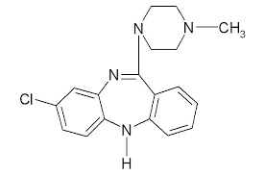
D₄ receptor antagonist
Clozapine
History:
The first atypical antipsychotic discovered was clozapine in 1960s, it was effective in treating schizophrenia, but it was unfavorable because it induces agranulocytosis . It is still used for resistant schizophrenia.
MOA
D4 receptor antagonist, low or no affinity for D2. Clozapine and quetiapine—have the lowest incidence of EPS/TD side effects because they have low affinity for D2.
Uses:
For use in patients with treatment-resistant schizophrenia.

Slide 5
Clozapine
20% of patients with schizophrenia will have an insufficient response to all first- and second generation antipsychotics and clozapine has shown to be effective for these patients
Clozapine use is limited to refractory patients because of serious side effects:
Bone marrow suppression
(frequent monitoring of white blood cell counts is required due to risk of severe agranulocytosis)
2. Seizures
3. Cardiovascular side effects

Slide 6
Mixed D₂ and 5HT_{2A} antagonist

Slide 7
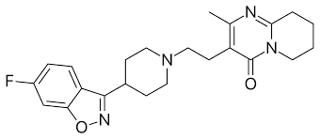
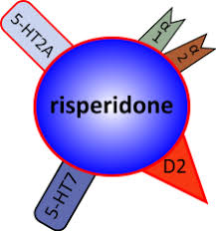
Risperidone
Uses:
For the treatment of schizophrenia, Autism, ADHD (Attention deficit hyperactivity disorder) , and Bipolar disorder.
MOA
It has antagonism effect on serotonin-2A (5HT2A), dopamine-2 (with high affinity for D2 receptors), alpha-1, alpha-2, and histamine H1 receptors.
The clinical effectivity of risperidone relies mainly in its potent serotonin-2A and dopamine-2 antagonism in the cerebral cortex and mesolimbic dopamine pathway.

Slide 8
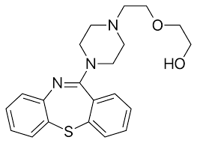
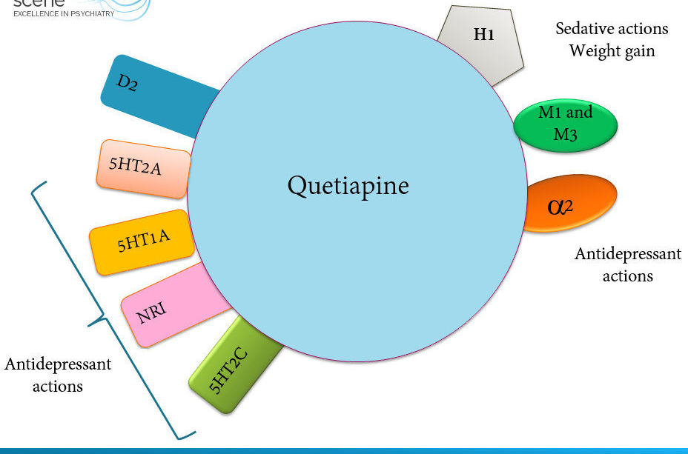
Quetiapine
Uses:
For schizophrenia, acute manic episodes, and adjunctive treatment for major depressive disorder
MOA:
Its action mainly on D2 receptors and 5-HT2 receptors antagonism. And blocks 5HT1A, 5-HT2, D1,D2,H1, A1, and A2 receptors Its metabolite norquetiapine, blocks M1 receptors.
It has partial agonist action on 5HT1A, which along with its action on 5-HT7, 5-HT2c contribute to its antidepressant effects.

Slide 9
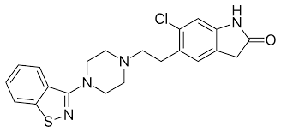
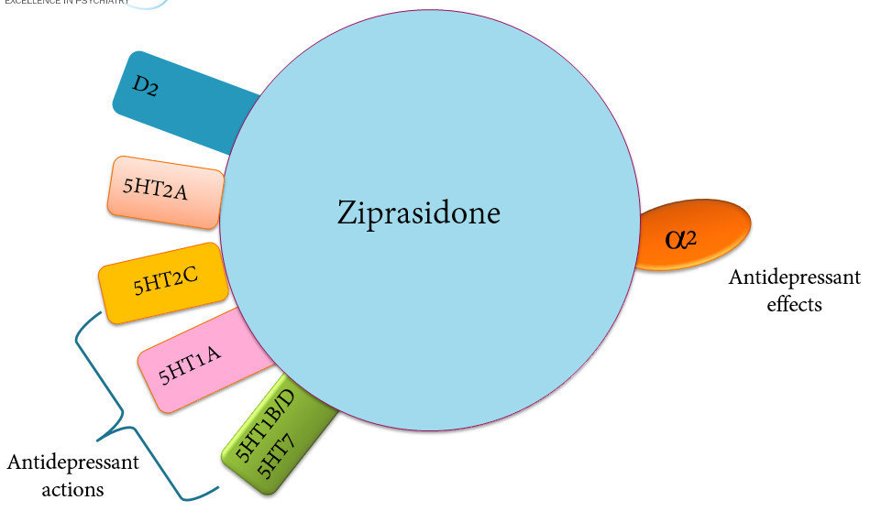
Ziprasidone
Uses: used to treat the symptoms of schizophrenia, episodes of mania, or mixed episodes in patients with bipolar disorder.
MOA:
functioned as an antagonist at the D2, 5HT2A, and 5HT1D receptors, and agonist at the 5HT1A receptor. It inhibited synaptic reuptake of serotonin and norepinephrine.
It also antagonism of histamine H1 receptors causing somnolence and α1-adrenergic receptors antagonism causing the orthostatic hypotension.

Slide 10
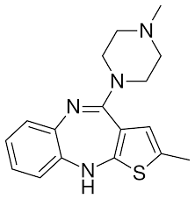
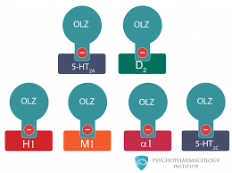
Olanzapine
Uses:
To treat the symptoms of schizophrenia and for bipolar disorder in adults and teenagers 13 years of age and older.
MOA:
Its effect for schizophrenia may results from its effect on dopamine and serotonin type 2 (5-HT2) receptors, It binds also to alpha-1, histamine H-1, and muscarinic receptors.

Slide 11
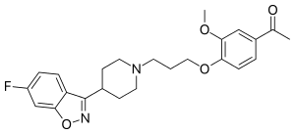
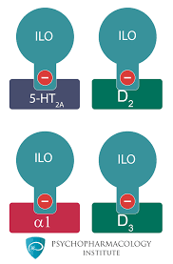
Iloperidone
Uses:
To treat the symptoms of schizophrenia.
MOA:
It is proposed that the efficacy of iloperidone is mediated through a combination of dopamine type 2 (D2) and serotonin type 2 (5-HT2) antagonisms, it also block alpha-1 and D3 receptors.

Slide 12
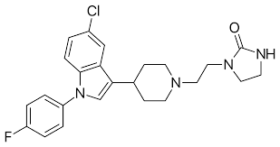
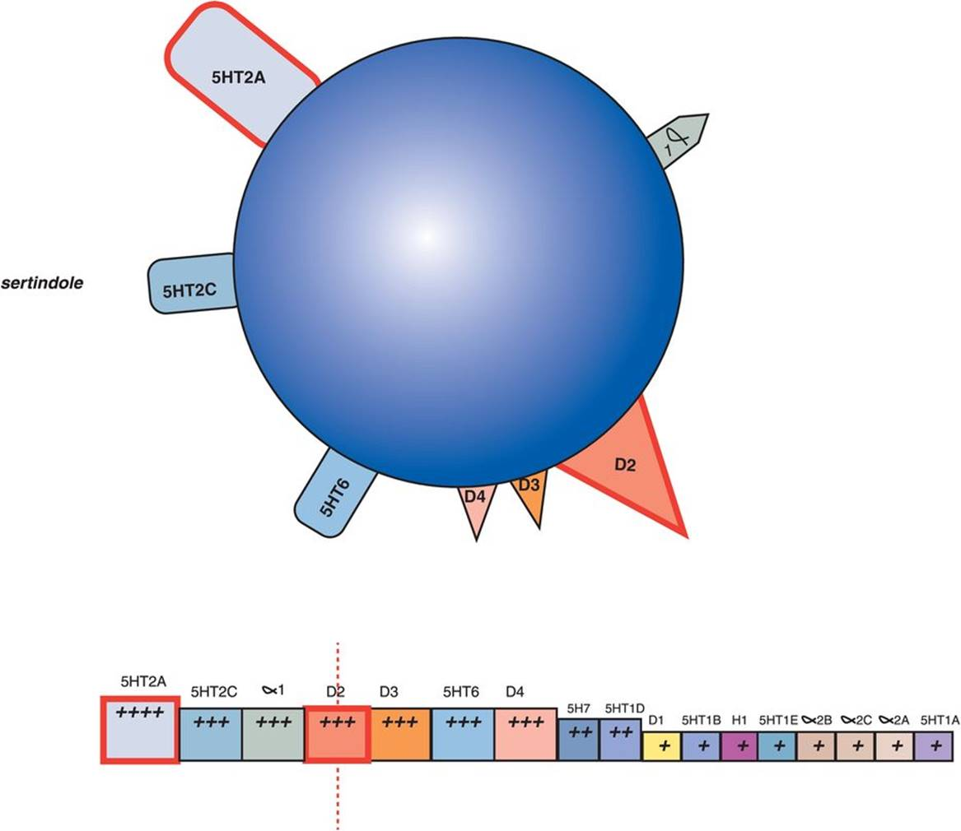
Sertindole
Uses:
For the treatment of schizophrenia.
MOA:
It bind to dopamine D2, serotonin 5-HT2A and 5-HT2C, and alpha1-adrenoreceptors. Preclinical studies suggest that sertindole acts preferentially on limbic and cortical dopaminergic neurons and clinical trials have confirmed that sertindole is effective at a low dopamine D2 occupancy level

Slide 13
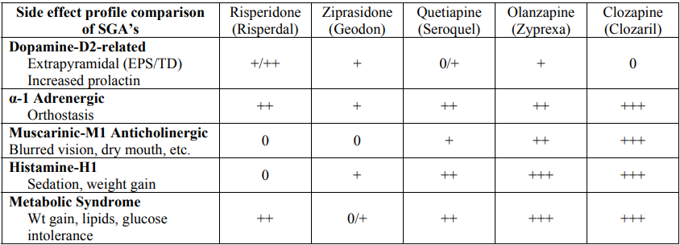
Receptor’s related Side effects of SGA’s

Slide 14
New drugs

Slide 15
New drugs
Amisulpride
Paliperidone
Aripiprazole

Slide 16
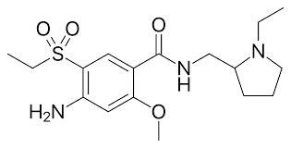
Amisulpride
Uses:
Investigated for use/treatment in schizophrenia and schizoaffective disorders, mania in bipolar disorder, and depression.
MOA:
Amisulpride binds selectively to dopamine D3 & D4, and antagonize its activity.

Slide 17
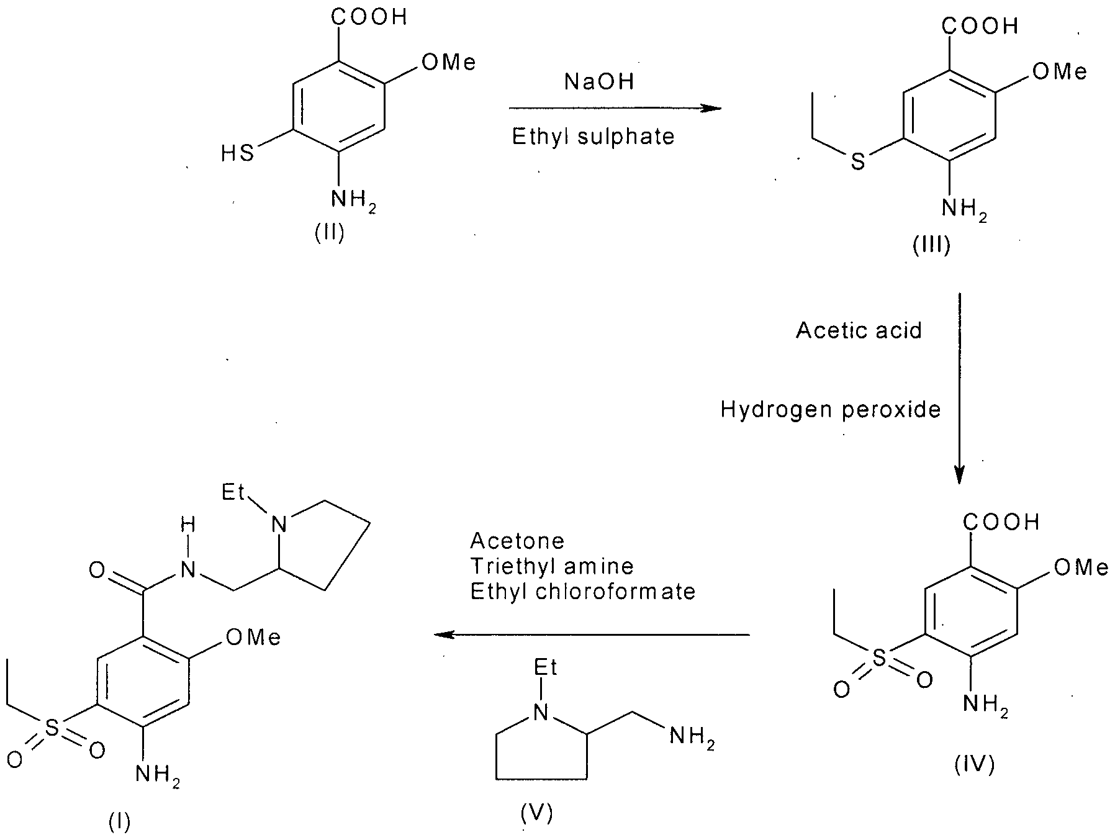
Synthesis:
Synthesis of Amisulpride includes methylation of 4-amino salicylic acid with dimethyl sulphate & base, following oxidation using acetic acid.

Slide 18
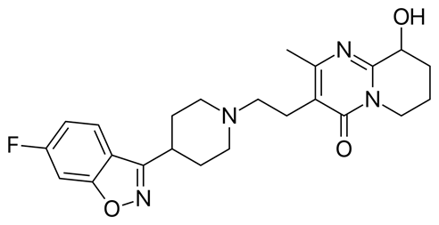
Paliperidone
Uses:
For the treatment of schizophrenia.
MOA Paliperidone is the major active metabolite of risperidone so it has been proposed that the drug's therapeutic activity in schizophrenia is mediated through a combination of central dopamine D2 & serotonin receptor antagonism as risperidone does.

Slide 19
Synthesis:
A very short synthesis of paliperidone via oxidation of risperidone with air oxygen under basic conditions.

Slide 20
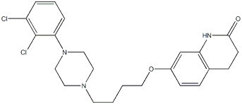
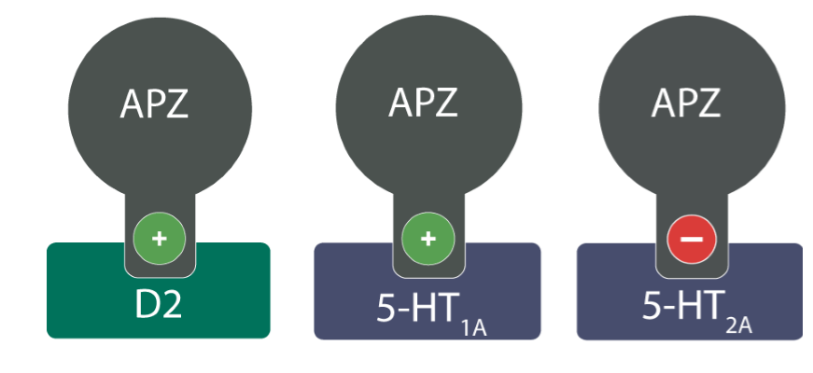
Aripiprazole
Uses: It is indicated for manic and mixed episodes associated with bipolar, autism spectrum disorder, treatment of schizophrenia, treatment of Tourette's disorder.
MOA:
It ia a dopamine D2 and serotonin 5-HT1A receptors partial agonist which is unique MOA among antipsychotics.The partial agonist sits on the receptor like an antagonist & blocks the receptor from other stimulation.
Also, it is 5-HT2A and alpha antagonist.

Slide 21
Synthesis:
Aripipirazole is prepared by condensing 2-bromobutoxy – 4- quinolinone with phenylpiperizines.

