Slide 1
MEDICINAL CHEMISTRY ANTIBIOTIC
Sireen Yahya 1151303 Israa Mafarjeh 1151683

Slide 2
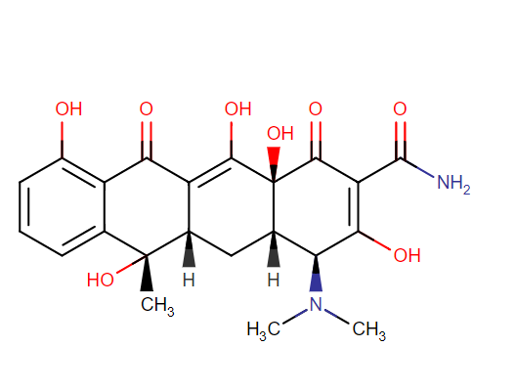
Tetracyclines :
Tetracycline is a broad spectrum antibiotic It exerts a bacteriostatic effect on bacteria .

Slide 3
Mechanism of action :
Tetracycline passively diffuses through porin channels in the bacterial membrane and reversibly binds to the 30S ribosomal subunit, preventing binding of tRNA to the mRNA-ribosome complex, and thus interfering with protein synthesis. Additionally tetracycline may alter the cytoplasmic membrane of bacteria causing leakage of intracellular contents, such as nucleotides, from the cell

Slide 4
SAR :
Tetracyclines are composed of a rigid skeleton of 4 fused rings .
The rings structure of tetracyclines is divided into an upper modifiable region and a lower non modifiable region .
An active tetracycline requires a C10 phenol as well as a C11-C12 keto-enol substructure in conjugation with a 12a-OH group and a C1-C3 diketo substructure.
Removal of the dimethylamine group at C4 reduces antibacterial activity.
Replacement of the carboxylamine group at C2 results in reduced antibacterial activity but it is possible to add substituents to the amide nitrogen to get more soluble analogs like the prodrug lymecycline.
The simplest tetracycline with measurable antibacterial activity is 6-deoxy-6-demethyltetracycline and its structure is often considered to be the minimum pharmacophore for the tetracycle class of antibiotics.
C5-C9 can be modified to make derivatives with varying antibacterial activity.

Slide 5
Macrolides :
Macrolides are a class of antibiotics derived from Saccharopolyspora erythraea (originally called Streptomyces erythreus), a type of soil-borne bacteria.
Macrolides inhibit protein synthesis in bacteria by reversibly binding to the P site of the 50S unit of the ribosome. Macrolides mainly affect gram-positive cocci and intracellular pathogens such as mycoplasma, chlamydia, and legionella. Erythromycin was the first macrolide discovered; other macrolides include azithromycin, clarithromycin, and roxithromycin.
Their action is primarily bacteriostatic but may be bactericidal at high concentrations, or depending on the type of microorganism.

Slide 6
The macrolides have three common chemical characteristics : 1. a large macrocyclic lactone ring ( the name macrolide ). 2. a ketone group. 3. a glycosidically linked amino sugar.

Slide 7
SAR of Microlide
• A number of strategies have been utilized to improve the acid stability of erythromycin. • The first approach involved the addition of hydroxylamine to the ketone to form oxime— e.g., roxithromycin. • The second approach involves an alteration of C-6 hydroxyl group, which is the nucleophilic functionality that initiates erythromycin degradation. Modification that removes the nucleophilic nature of this hydroxyl group can retain antibacterial properties if the size of the group is kept small so as not to affect the ribosomal binding —e.g., clarithromycin. • The azalides (e.g., azithromycin) are semi-synthetic 15-membered congeners in which a nitrogen atom has been introduced to expand a 14-membered precursor, and this leads to an extended spectrum of action.

Slide 8
Aminoglycosides :
They are protein synthesis inhibitor ( bacteriocidal rather than bacteriostatic ) They are carbohydrate structure which includes basic amine groups “ aminoglycoside” MOA : they bind to bacterial ribosomes specifically to 30S ribosome subunit and prevents the movement of the ribosome along mRNA so that the triple code on mRNA no longer be read .

Slide 9
Their chemical structure : _ All have at least one aminohexos. _ Some have a pentose without an amino group. Eg: Streptomycine, Neomycin. _ Some aminoglycosides contain a substituted 1,3-diaminocyclohexane( deoxystreptamine ) Eg: Kanamycin , Gentamycin and tobramycin. _ Streptomycin contains streptidine from which the name streptomycin comes.

Slide 10
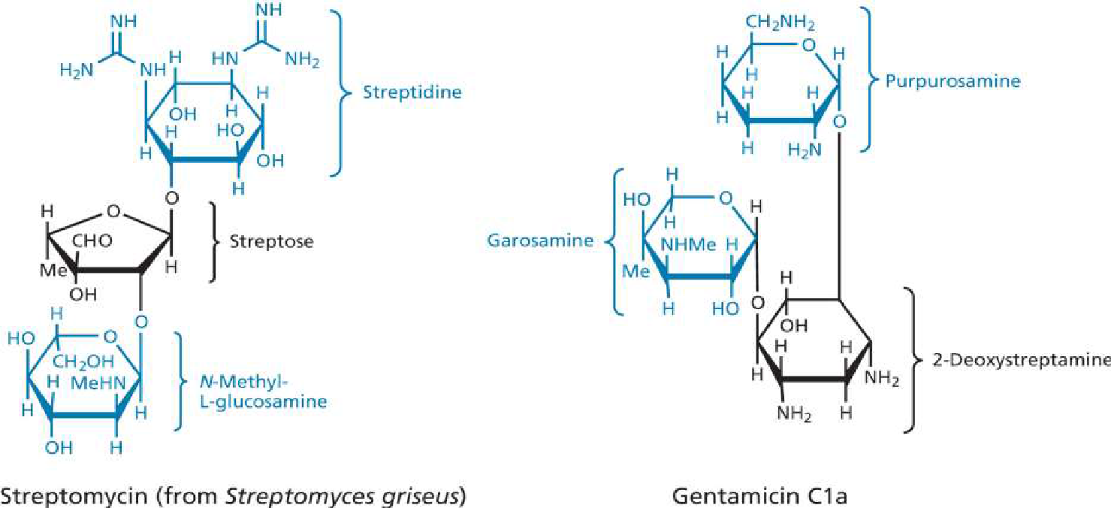
* Aminoglycosides include compounds closely related in structure to Streptomycin like : Kanamycin , Neomycin , Gentamycin , Tobramycin and Netilmicin

Slide 11
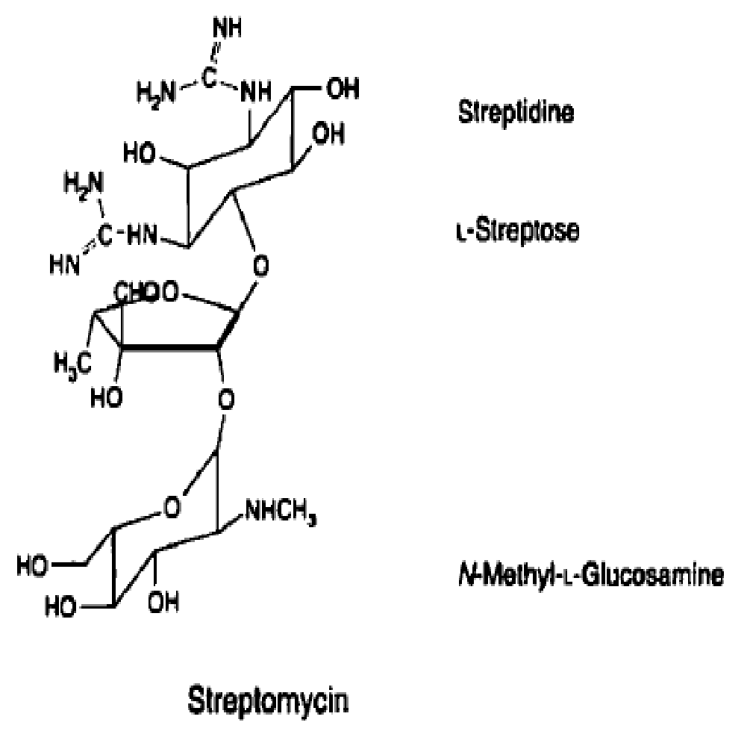
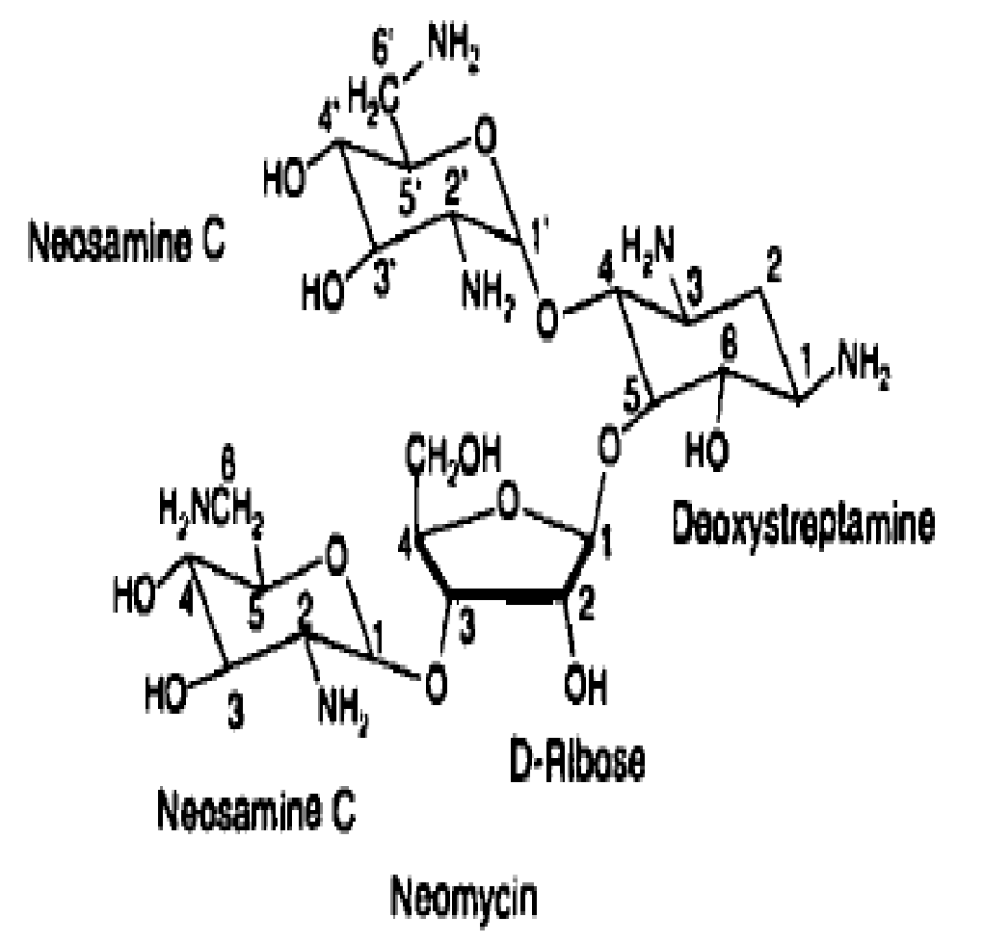

Slide 12
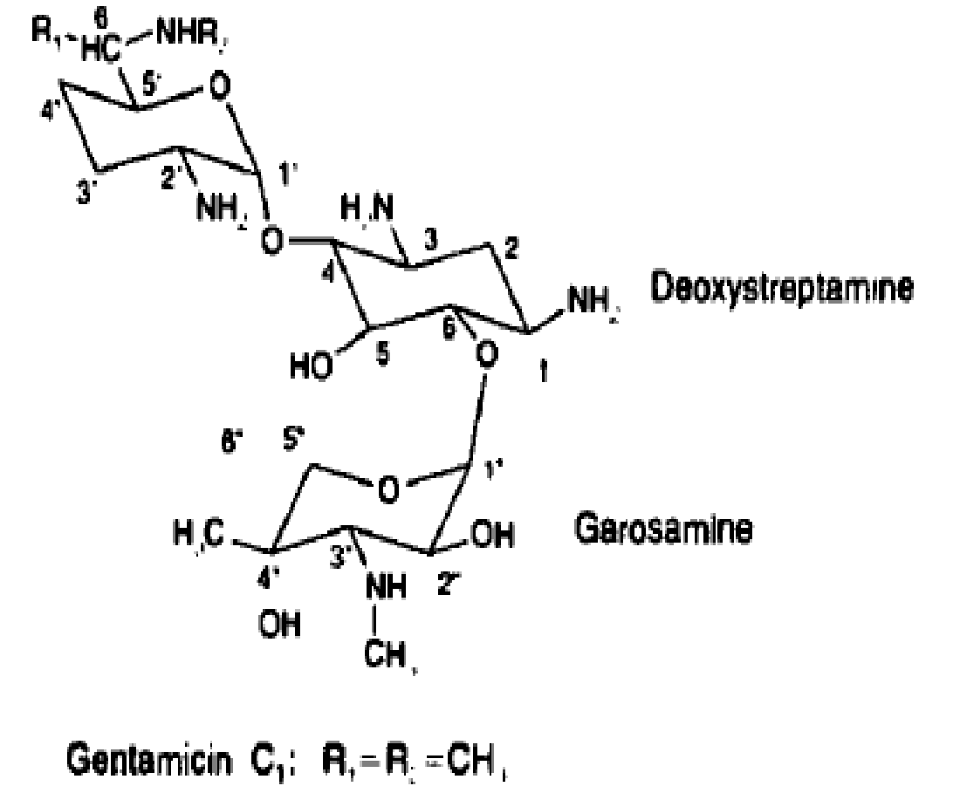
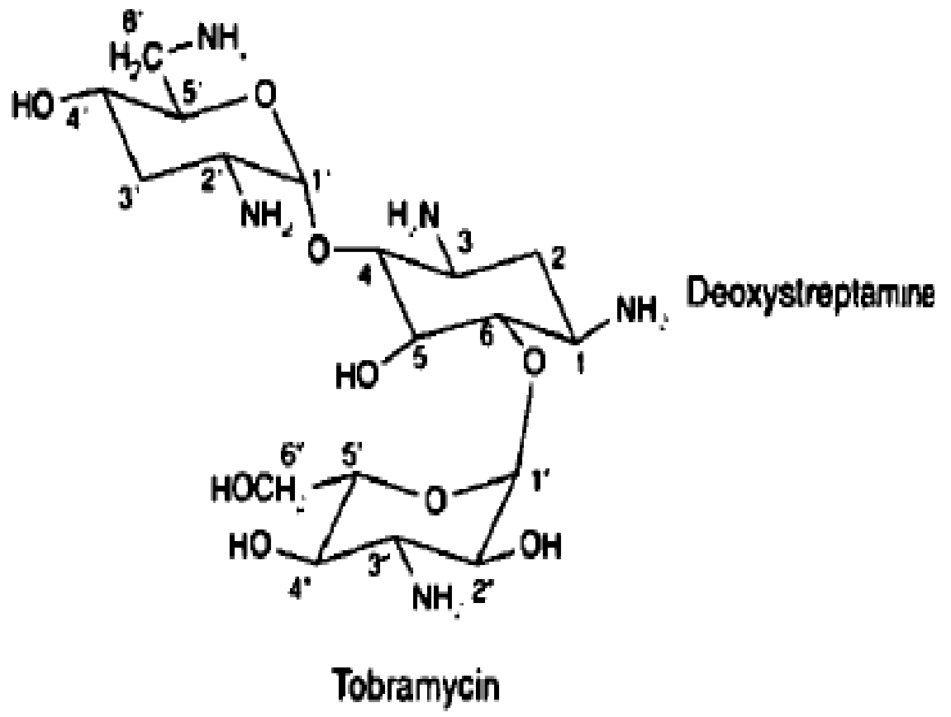

Slide 13
Newer antibiotics:
ANTIBIOTICS INHIBITING CELL WALL SYNTHESIS
GLYCOPEPTIDES-VANCOMYCIN, TECOPLANIN LIPOPEPTIDE-DAPTOMYCIN
POLYPEPTIDE- BACITRACIN
FOSFOMYCIN-a phosphonic acid derivative CYCLOSERINE-an analogue of D-alanine
OXAZOLIDINONES-LINEZOLID, RADEZOLID TOREZOLID
STREPTOGRAMINS-PRISTINAMYCIN
POLYMYXIN-B AND COLISTIN
MUPIROCIN
FUSIDIC ACID

