Slide 1
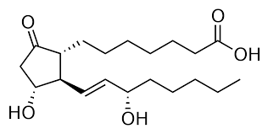
Medicinal chemistry
Instructor: Amin Thawabtheh
NSAIDs
Aseel Tlaib& Shayma Dawabsheh

Slide 2
NSAIDs are class of drugs that have these three properties:
Analgesic
Antipyretic
Anti-inflammatory

Slide 3
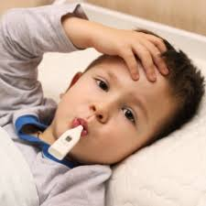
What is pyrexia?
An elevation in body temperature caused by cytokines that induce hypothalamus(thermo regulatory center) to increase temperature.
Fever in infection disorders
Fever in non-infection disorders
Neurogenic fever
Caused by microorganisms and pyrogens
Injured or abnormal cells such as MI, neoplasm
Caused by damage to hypothalamus from CNS trauma or intracranial pressure

Slide 4
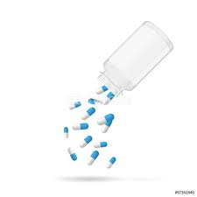
How NSAIDs reduce fever?
Inhibit cyclooxygenase enzyme (COX)
Reduce level of prostaglandin (PGE2)
No further hypothalamus stimulation
Other drugs have antipyretic effect:
1- paracetamol
2- phenazone
3- metamizol*

Slide 5
What is inflammation?
It’s the immune system response to infection and injuries. This process cause cardinal signs of acute inflammation include:
redness
heat
swelling
pain

Slide 6
Causes..
Physical
Burns
Trauma
Frostbite: injury to body tissues caused by exposure to extreme cold, typically affecting the nose, fingers, or toes and sometimes resulting in gangrene.
Ionizing radiation.
2. Biological
Infection by pathogen
3. Chemical
Toxins
alcohol

Slide 7
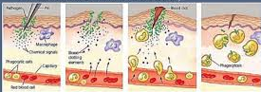
Inflammatory process..
1- initiated by resident immune cells already present in the involved tissue. (macrophages, dendritic cells, histiocytes, Kupffer cells and mast cells).
2- these cells undergo activation and release inflammatory mediators
( prostaglandin, bradykinin, histamine, ATP…)
3- PG bind to nerve ending called nociceptor which register pain.
4- PG is the main inflammatory mediator that cause amplification of the inflammation process, vasodilation, pain and fever.
5- this leading to eradicate the pyrogen and healing of wounds.

Slide 8
Eicosanoids…
Signaling, local hormones made by oxidation of fatty acid like arachidonic acid.
Fatty acid must be unsaturated. 3-5 double bonds. Consist of 20 carbon.
Eicosanoide group contains three major molecule:
PG
TXA2
LT

Slide 9
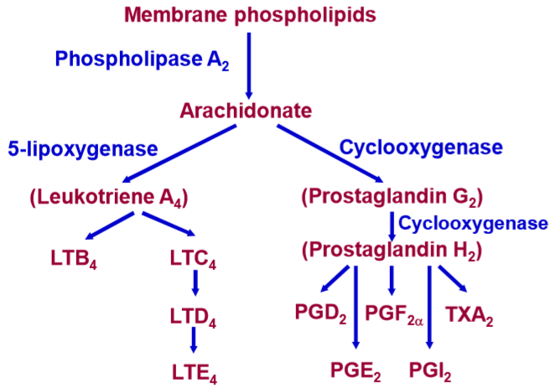
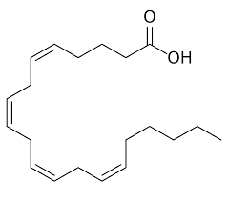
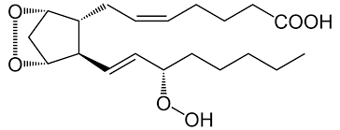

Slide 10
What cause chronic inflammation?
Untreated cause of acute inflammation
infection
injuries
Long term exposure to irritant
Pollen
Autoimmune disorders
Rheumatoid arthritis

Slide 11
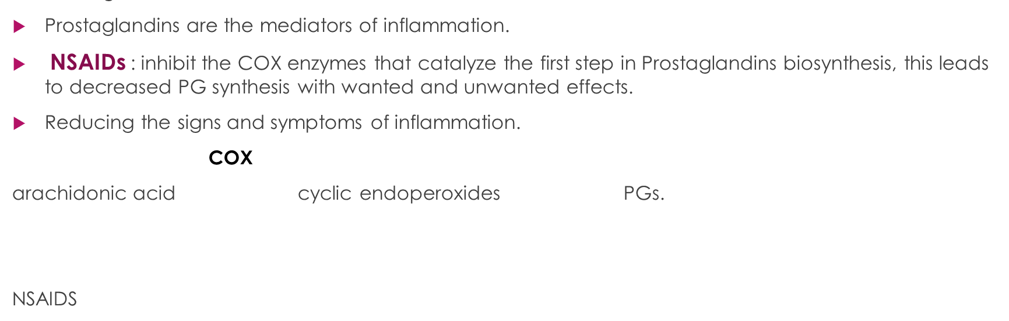
Mode of action..

Slide 12
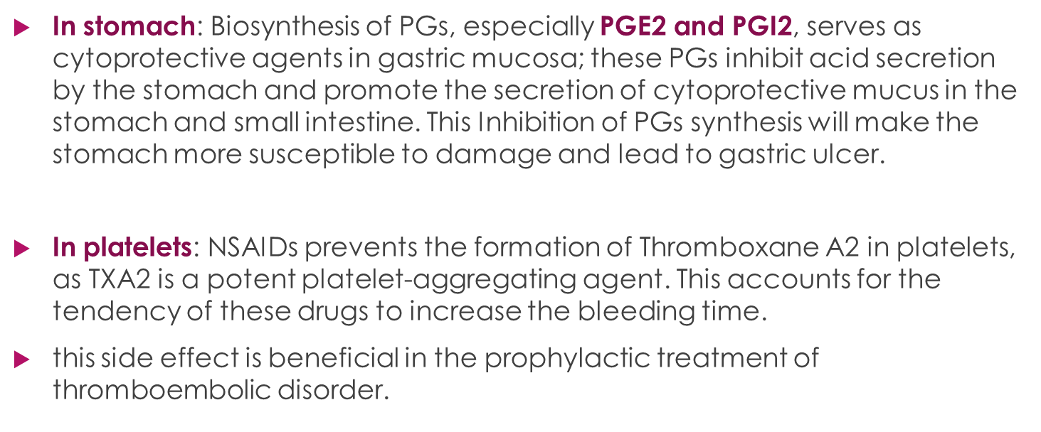
Side effects

Slide 14
The basic difference between traditional NSAIDs and COX-2 inhibitors

Slide 15
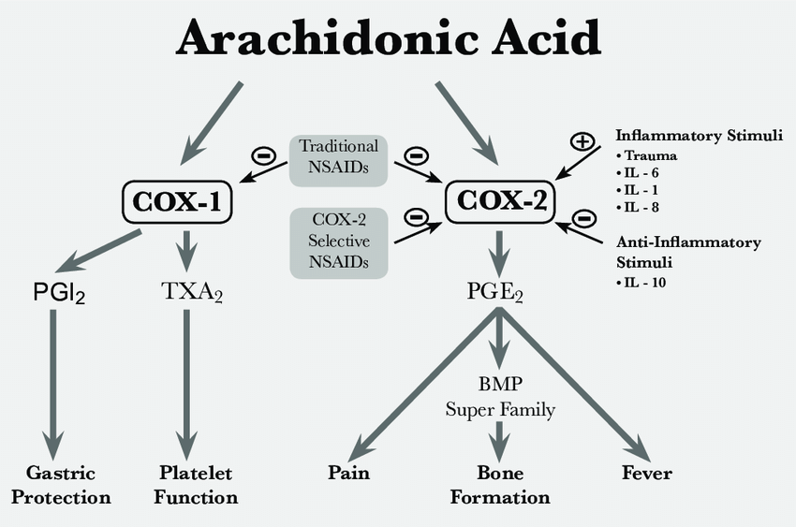

Slide 16
NSAIDs classification..
NSAIDs
Based on
Chemical structure
selectivity
Pyrazolidinedione derivative
Salicylic acid derivative
Arylalkanoic acid derivative
Non-selective
selective
Anthranilic acid derivative
P-aminophenol derivative
Diclofenac
Ibuprofen
naproxen
meloxicam
celecoxib

Slide 17
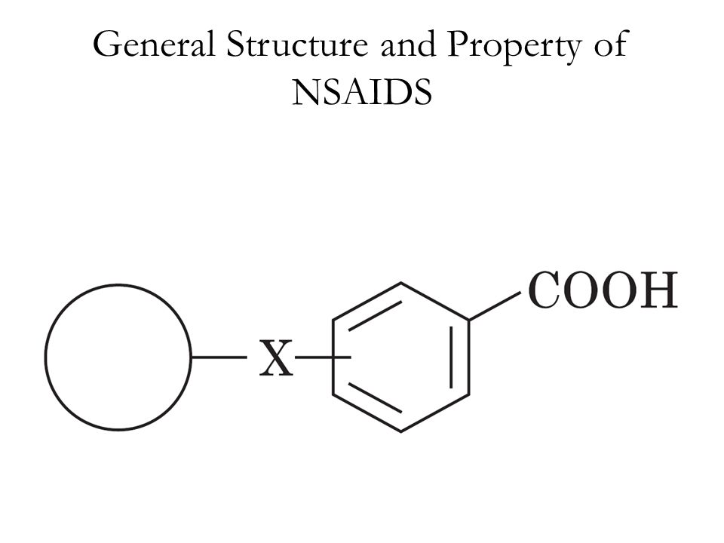
The general structure of NSAIDs

Slide 18
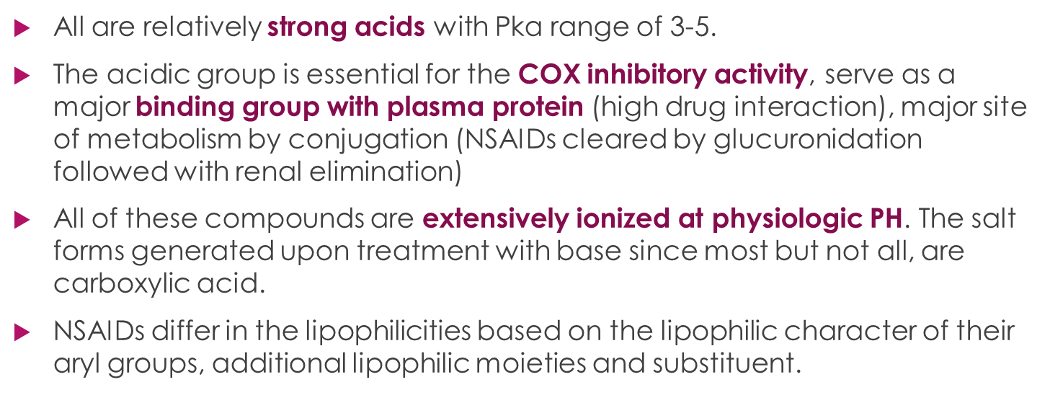
Properties of NSAIDs..

