Slide 1
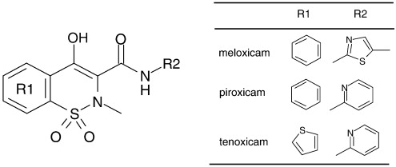
OXICAMS
They have anti-inflammatory and analgesic properties
New enolic acid class of NSAIDs of the chemical structure
(4-hydroxyl -1,2 benzothiazine carboxamide)
*R2 group should be an aryl or heteroaryl group

Slide 2
SAR OF OXICAMS
The analogues that have the highest activity have the following substituents
CH3 on the nitrogen
Electron withdrawing groups on the anilide phenyl groups, e.g. Cl and CF3.
Adding a heterocyclic ring in the amide chain increases the anti-inflammatory activity.
Enolic hydroxyl group is essential for activity
The benzothiazine with highest activity have the pKa range of 6–8.

Slide 3
MECHANISM OF ACTION (MOA)
Potent inhibitors of COX-1 and COX-2 enzymes 🡪 Prevent prostaglandins synthesis 🡪 Anti-inflammatory, Anti-pyretic and analgesic effects.
Selectivity to COX enzymes inhibition in Oxicams:
Piroxicam: Non-selective inhibitor
Meloxicam: Selective COX-2 inhibitor
Tenoxicam: Non-selective inhibitor

Slide 5
USES
ACUTE AND CHRONIC INFLAMMATORY CONDITIONS (ANTI-INFLAMMATORY)
ANTIPYRETIC
ANALGESIC
Rheumatoid arthritis
Gout
Menstrual pain
Fever
(Antipyretic activity may occur by central action on the hypothalamus, resulting in peripheral venous dilation, increased cutaneous blood flow, and subsequent heat loss.)
Headache
Toothache
Sprains and strains

Slide 6
SYNTHESIS OF OXICAMS
This reaction of the benzisothiazoline with sodium methoxide in dimethylsulfoxide gave a 3‐carboxylic ester of 4‐hydroxy‐2H−1,2‐benzothiazine 1,1‐dioxide. N‐Alkylation at position 2 of the benzothiazine nucleus followed by replacement of the ester with an amine under forcing conditions provided the desired 3‐carboxamides of 4‐hydroxy‐2‐alkyl‐2H−1,2‐benzothiazine 1,1‐dioxide.

Slide 7
OXICAM DERIVATIVES

Slide 8
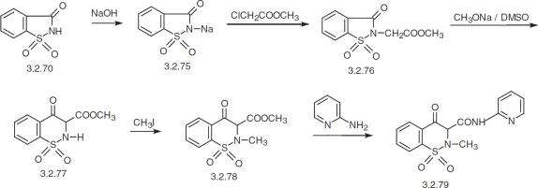
PIROXICAM
Synthesis of Piroxicam
Methyl-chloroacetate
saccharin
2-aminopyridine

Slide 9
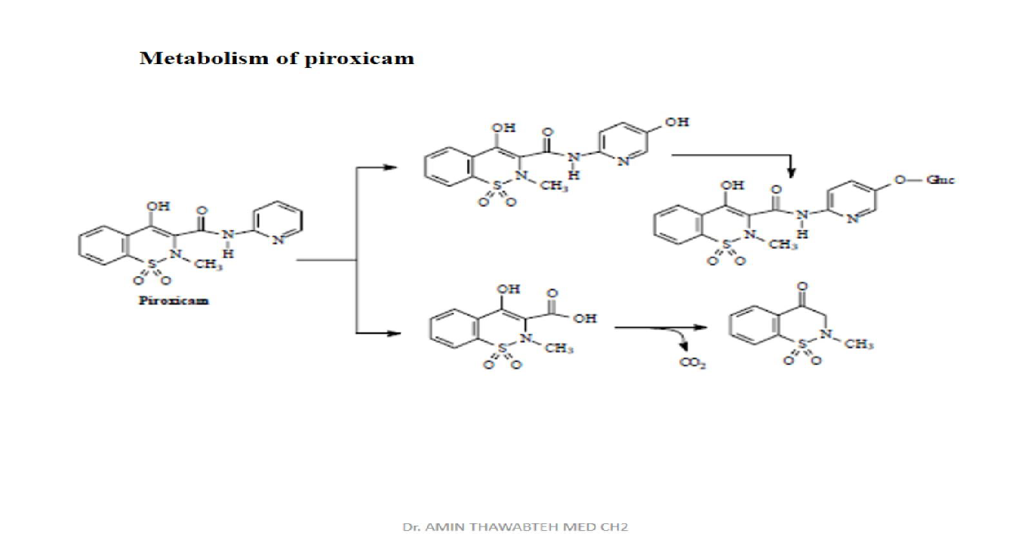
METABOLISM OF PIROXICAM
The bigger part of the drug gets hydroxylated followed by glucuronidation
A smaller fraction of the drug gets hydrolyzed

Slide 10
USES AND MOA
Uses: osteoarthritis and rheumatoid arthritis. It is also used in the treatment of acute gout as it increases release of uric acid in the urine.
Dose: 20mg QD for adults
MOA: COX-1 and COX-2 inhibitor.

Slide 11
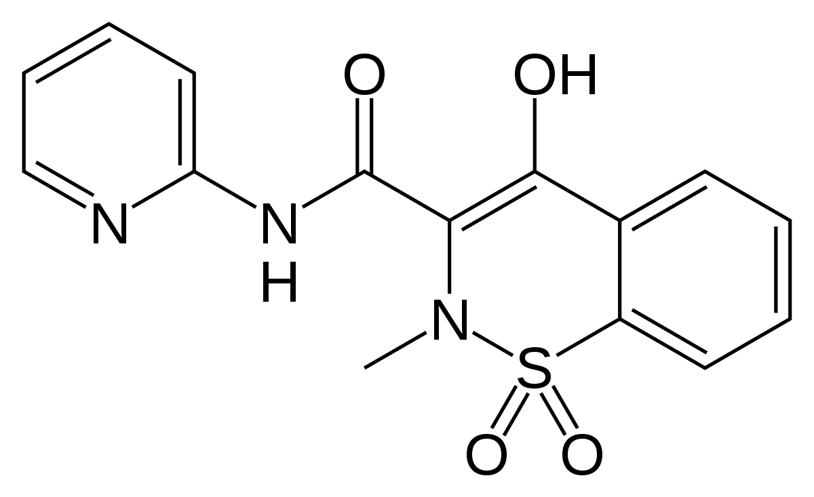
SAR OF PIROXICAM
It has the enolic hydroxyl group which gives it the required pKa for its action.
It has a pyridine ring as an R2 group
For best activity and safety: methyl group on the nitrogen
It has high potency as well as high GI side-effects (Non-selective inhibitor)
Sulfone group (Electron-withdrawing increases activity) it stabilizes nitrogen.
Heteroaryl group
(If replaced with an aliphatic group
anti-inflammatory activity decreases)
**Potency 200times aspirin because of enolic hydroxyl group due to keto-enol tautomerization and same potency as indomethacin

Slide 12
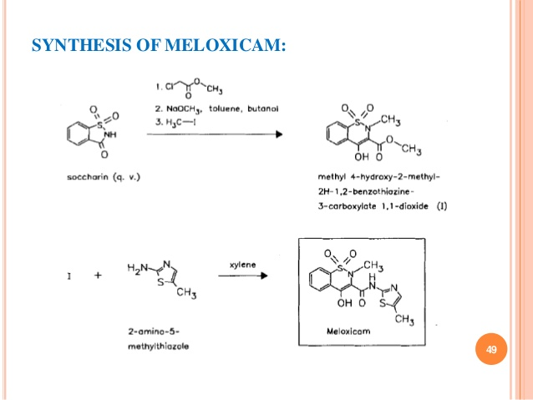
MELOXICAM
Synthesis of meloxicam

Slide 13
MOA, USES AND METABOLISM
USES: It’s exceptionally effective in treatment of arthritis as it accumulates (40 to 50% in synovial fluid to plasma levels)
MOA: Selectively inhibits COX-2 enzyme, but at higher doses it loses its selectivity
Metabolized through hydroxylation

Slide 14
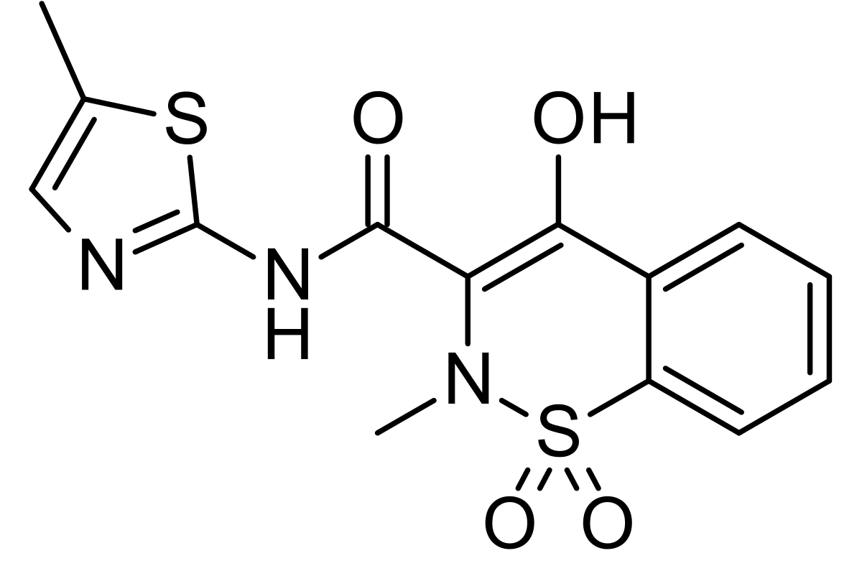
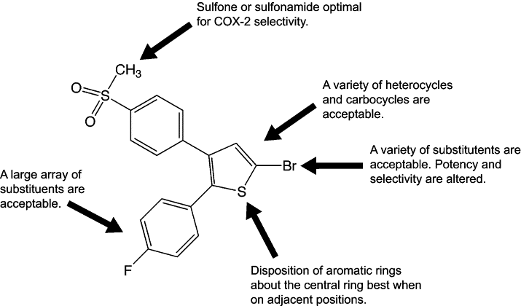
SAR OF MELOXICAM
It has a CH3 group on the nitrogen
Has a heterocyclic ring in the amide chain
Has a benzothiazine ring of required pKa (6-8)
Selective on COX-2 enzyme

Slide 15
TENOXICAM SYNTHESIS
Ethyl-N-methyl glycinate
Ethyl 4-(chlorosulfonyl) thiophene-2-carboxylate
Claisen condensation

Slide 16
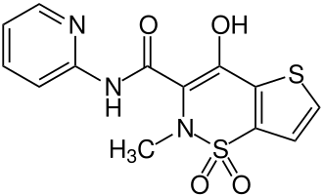
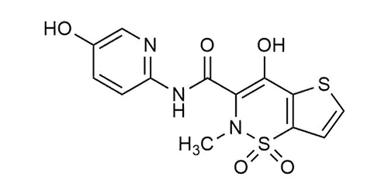
TENOXICAM METABOLISM
It occurs by hydroxylation of the drug through CYP450 2C9 enzyme in the liver
CYP 2C9
Tenoxicam
5-hydroxytenoxicam

Slide 17
MOA AND USES
Uses: pain, swelling and joint stiffness associated with rheumatoid arthritis, osteoarthritis, and other inflammatory conditions including ankylosing spondylitis, tendinitis, bursitis.
In acute cases: 20 mg as a single daily dose given for 7 days.
For musculoskeletal disorders in severe cases: maximum of 4 mg QD maximum for 14 days.
MOA: COX-1 and COX-2 inhibitor

Slide 18
SAR OF TENOXICAM
Thiophen + Oxicam = Tenoxicam
It has a CH3 group on the nitrogen
It has a heterocyclic ring in the amide chain
It has a benzothiazine ring of required pKa (6-8)
Benzene ring is replaced with a thiophen group
that is biologically active

Slide 19
REFERENCES
https://www.drugbank.ca/reactions/307
https://newdrugapprovals.org/2016/02/12/17505/
https://europepmc.org/article/med/30846979
Olkkola, K. T., Brunetto, A. V., & Mattila, M. J. (1994). Pharmacokinetics of oxicam nonsteroidal anti-inflammatory agents. Clinical pharmacokinetics, 26(2), 107-120.
https://iubmb.onlinelibrary.wiley.com/doi/10.1002/iub.1334
Alagarsamy, V. (2010). Textbook of Medicinal Chemistry Vol II-E-Book (Vol. 2). Elsevier Health Sciences.

Slide 20
Done by: Dana Sadaqa, 1160832

