Slide 1
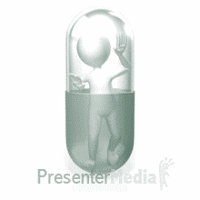
Bilayer tablet technology
Logo here
Aseel Taleeb
Shayma Dawabsheh
7-11-2019

Slide 2
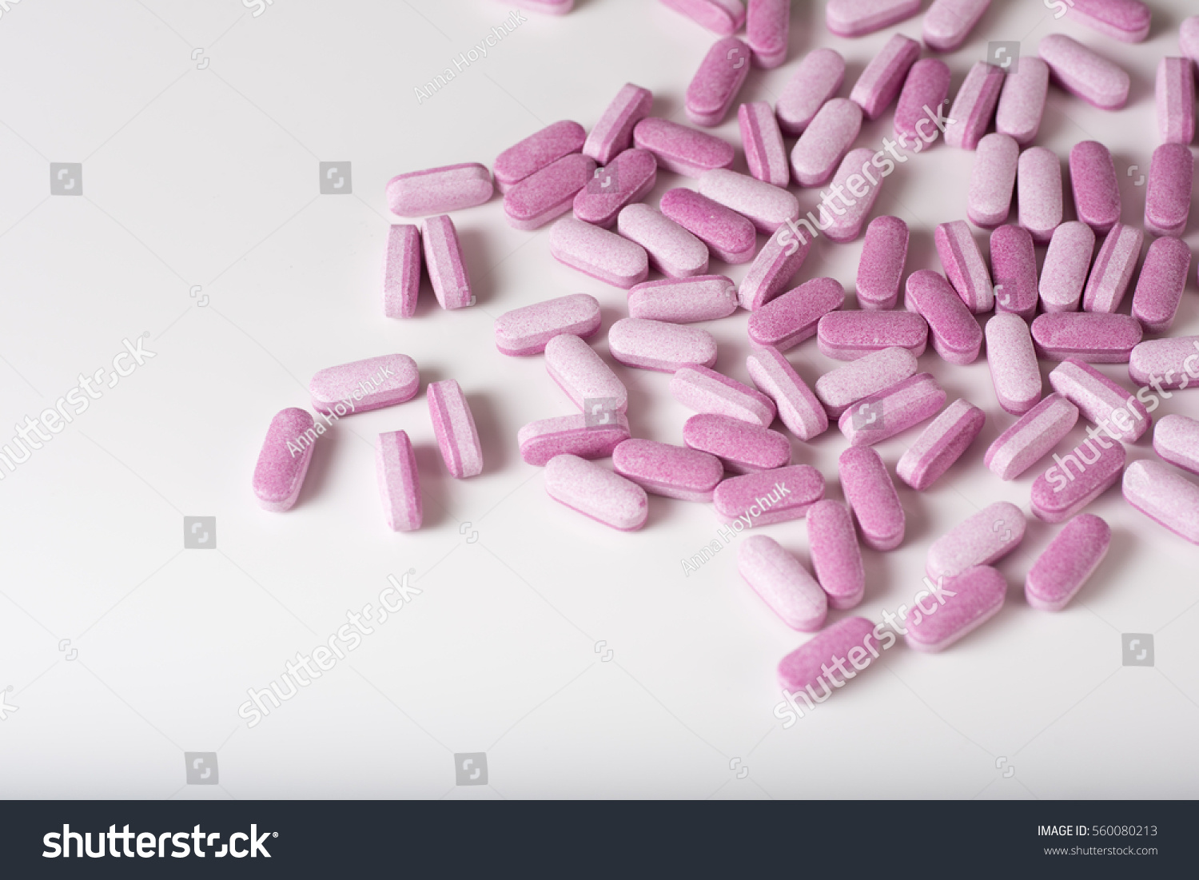
contents
Introduction
What is bilayer tablet?
Types
Advantages
Manufacturing
Challenges
GMP requierment
example

Slide 3
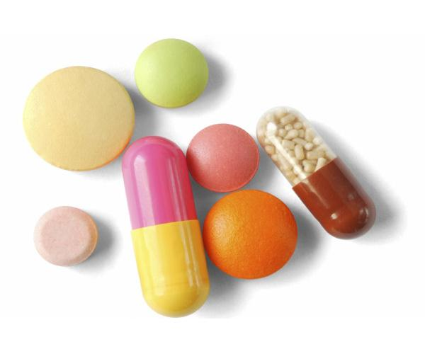
introduction
Solid oral dosage forms are the preferred route for many drugs and are still the most widely used formulation for new and existing complex configuration dosage forms.
Over the past 30 years, grater attention has been focused on development of sustained or controlled release drug delivery system.
.

Slide 4
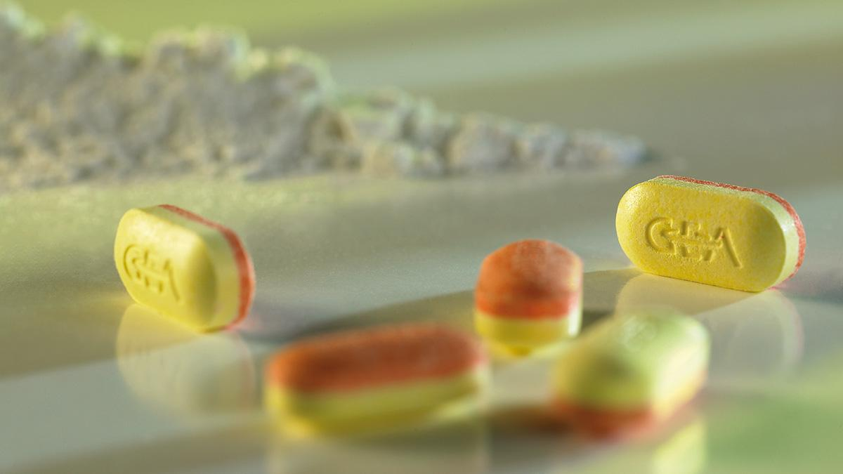
What's bilayer tablet ?
Bilayer tablet is the novel technology for the development of controlled release formulation. Developing a combination of two or more active pharmaceutical ingredients in a single dosage form is known as a bilayer tablet.

Slide 5
Types of bilayer tablet ?

Slide 6
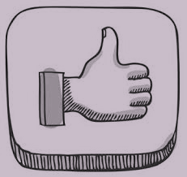
advantages
decrease the dosing unit burden.
Different release profile.
Synergistic effect.
Prolong the patent life of a drug product.
Formulation of incompatible drugs.
Reduced side effect.(layer with the needed drug and the other layer contain a drug to cancel a first layer drug side effect)
Advantages

Slide 7
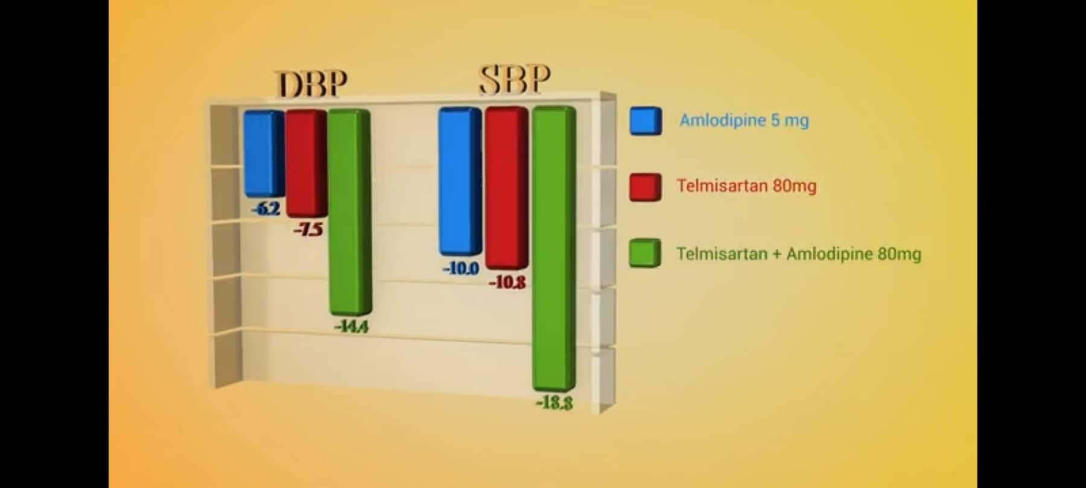
syn
Synergistic effect
!!

Slide 8
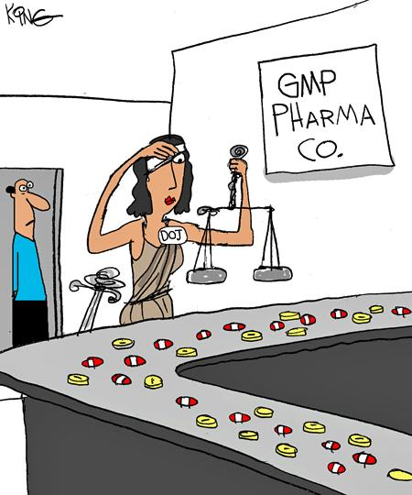
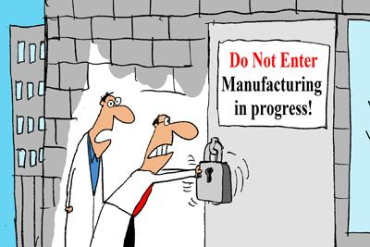
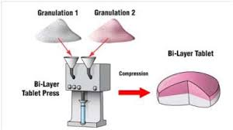
Manufacturing
Manufacturing
https://www.youtube.com/watch?v=8jB0OfK0c4g

Slide 9
GMP REQUIERMENT
Preventing capping and separation of the two layer
Providing sufficient tablet hardness.
Preventing cross-contamination between the two layers. (two types: between the two layers or between the tablet and machine)
Producing a clear visual separation between the two layers. ( it can be done by coloring the layers with two different colors)
Accurate and individual weight control of the two layers

Slide 10
CHALLENGES
Challenges

Slide 11
1. material properties
Young modulus “ avicel 13.2, lactose 53”. (we should have closer values to prevent the difference between bong strength in layer Vs interfacial strength(between layers) to prevent separation).
Compressibility
2. compression force
First layer alone “aim of compression is to prevent Mixing between the two layers, and it should be pre or soft compression to conserve the surface Roughness in order to be able to adhere to the second layer.”
Second layer with the first layer( to have the final shape)
3. lubricants
Interfacial strength decreased with high amount of lubricant.

Slide 12
4. layer ratio
Not always 1:1 (the layer with the large size should be the first layer (in the die bottom) to easy compress the second layer above it)
5. environmental conditions
Hygroscopic? (Will reduce the bond strength between the two layers)
Humidity and moisture.
6.layer weight control
System to measure it using the compression force.( we determine specific weight and its needed compression force, if the compression force increase or decrease this means that tablet weight increase or decrease, so I can control it)

Slide 13
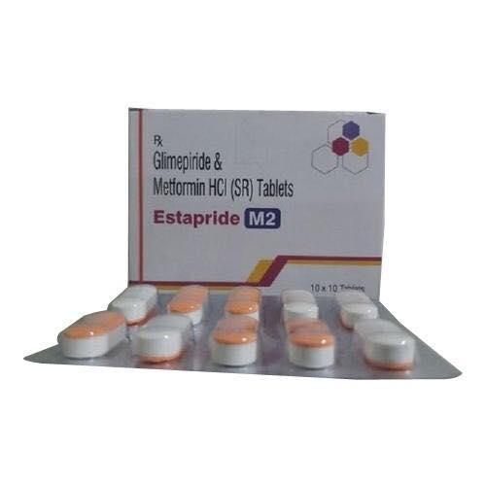
Example
Glimepiride & Metformin HCl

Slide 14
THANK YOU
Any Questions?

