Slide 1
Excipients stability in oral solid dosage forms.

Slide 2
Major content .
Definition .
Classifications
guidelines on excipient usage

Slide 3
They are deﬁned by IPEC America and IPEC Europe :
“These are the substance(s)other than the API in ﬁnished dosage form , which have been appropriately evaluated for safety and are included in a drug delivery system to either aid the processing or to aid manufacture, protect, support, enhance stability, bioavailability or patient acceptability, assist in product identiﬁcation,or enhance any other attributes of the overall safety and effectiveness of the drug delivery system during storage or use“ .

Slide 4
Excipients are classified by IPEC .
New chemical excipients
New modifications or combinations
based on saftey
Existing chemical
Existing chemical
(first use in human)

Slide 5
Excipients classification based on their origin :
Animal source : - Lactose, Gelatin
Vegetable source: - Starch, Peppermint.
Mineral source: - Calcium phosphate, Silica,
Synthetic: - Polyethylene

Slide 6

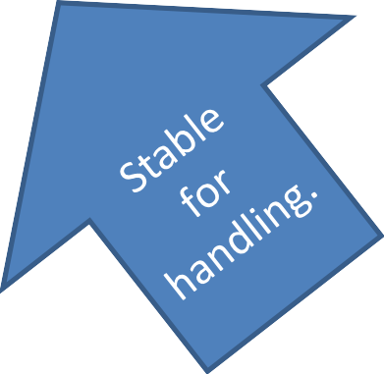
Ideal properties of Excipients:
Feasible .
No interaction with
drug.
Pharmacologically inert.
Excipients

Slide 7
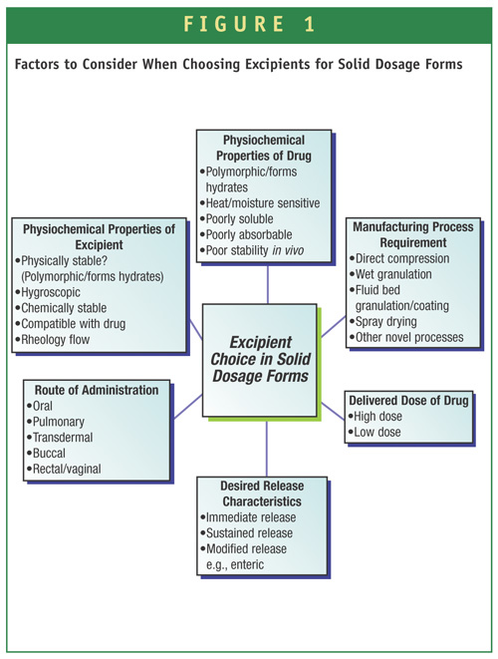
guidelines on excipient usage of FDA & EMA :

Slide 8
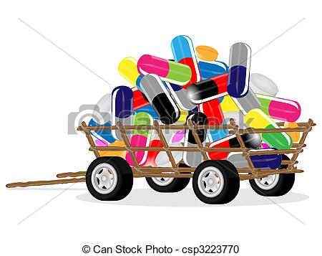
new excipients
Demand of excipient Need
The development of a new Excipients is market driven with an ever-increasing demand for excipients with improved physicochemical and stability properties.

Slide 9
Types of Instabilit
Physical instability phase transformation which may be due to polymorphic changes, hydration and dehydration, precipitation .
Chemical instability thermolytic, oxidative, or photolytic degradation. Hydrolysis, a type of thermolytic degradation, and oxidation, which is usually mediated by peroxides, are the major causes of excipient degradation.
Microbiological instability failure ofpreservative in the formulation due to interaction, degradation, or loss from the system.

Slide 10
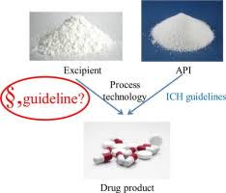
Solid Oral Dosage Forms
Most patient-compliant.
conventional route of drug administration.

Slide 11
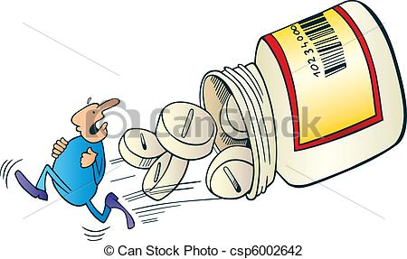
Tablets are the most preferred oral dosage forms. Depending on various factors such as dose, release rate, and drug and excipient properties and variations in the shape, size, weight, and appearance ,
produced, handled, and packaged more easily

Slide 12
Classification based on functions
Fillers. Binders. Disintegants. Coatings.
Sorbents. AntiadherentLubricants.
Glidants. Preservatives. Antioxidants. Flavoring Agents. Sweeting Agents. Coloring Agents.
Solvent & Co-solvent.
Buffering Agents.
Chelating Agents.
Viscosity imparting Agents. Surface Active Agents.
Humectants .

Slide 13
Diluents
Diluents are soluble substances
Usage to increase the bulk volume of solid dosage forms when the drug itself is inadequate to produce a solid dosage form of sufﬁcient weight and size, s are often added to tablet formulations for improving cohesion, allowing direct compression manufacturing, enhancing ﬂow, and adjusting the tablet weight as per the die capacity
Typical features of fillers A good filler should typically be inert, compatible with the other components of the formulation, non-hygroscopic, relatively cheap, and preferably tasteless or pleasant tasting.

Slide 14
Example : lactose, directly compressible starches, dextrose, Sorbitol, silicified microcrystalline cellulose, dibasic calcium phosphate dihydrate.

Slide 15
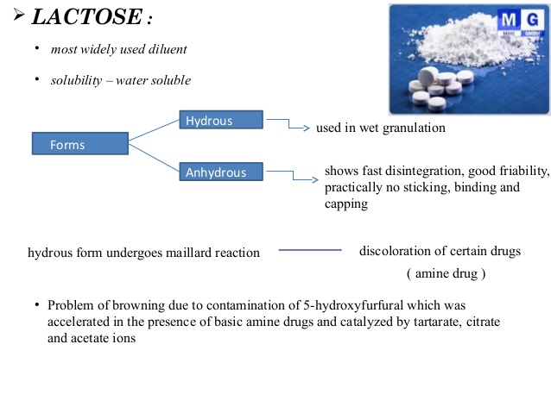
The crystallization of lactose occurs with the increase in water content during storage over time,which leads to caking and clumping of the powder

Slide 16
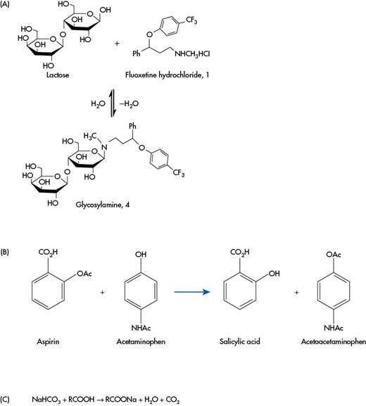
Maillard reaction
is a chemical reaction between amino acids and reducing sugars that gives browned food its distinctive flavor.
(a) Maillard reaction between lactose and fluoxetine hydrochloride

Slide 17
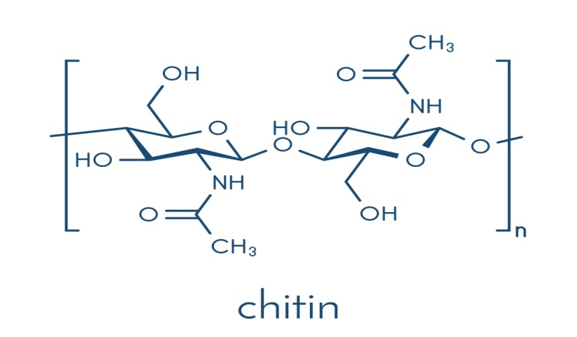
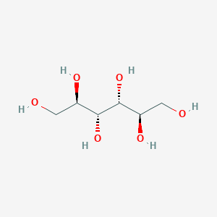
Co-processing of diluents .
has poor flow If use alone . undesired compaction if alone
fragile tablets upon compression. causes tablet capping

Slide 18
Binders
Binders are commonly used in tablet formulations to impart cohesion on the powder mix and hence, improve the ﬂow properties of the granules.
Action : causing aggregation of powders, resulting in the formation of granules through the process of granulation
Example : Natural polysaccharides, starch, PVP.
( low toxicity , biodegradability, biocompetitiveness, availability and low cost )

Slide 19
Starch : one of the most excipients widely used in solid oral dose formulation such as tablets and capsules. It functions as a ﬁller, binder, and superdisintegrant. Modiﬁed starch along with other excipients can also be adapted for other applications such as direct compressibility.
Starch have some reactive impurities lead to chemical incompatibilities with the API as Aldehyde impurities that associated with the forms of starch, if used in the hydralazine hydrochloride (HCl) a reaction which forms a degradative by-products.

Slide 20
Disintegrants
Disintegrants are used in solid dosage forms to counteract the action of lubricants.
Swelling
heat of interaction
interruption of particle-particle bonds
Mechanisms of disintegrants
Wicking
strain recovery

Slide 21
Carboxymethyl cellulose, croscarmellose sodium and starch , are used as disintegrants in concentration range of 2–10% w/w ,2–5% and 5-10% w/w, respectively.
We should be careful when we use croscarmellose because it is reported to cause a binding interaction that delay the dissolution of drugs.
If croscarmellose sodium and crospovidone are used intragranularly and recompressed into tablets, the rate of dissolution of that tablet is found to be decreased.
Also,it exhibits poor ﬂow, which affects the ﬁlling of powder blends in capsule shells or the powder ﬂow during tableting

Slide 22
Superdisintegrants
Superdisintegrants are used in mouth-dissolving or orodispersible tablets for immediate drug release from the oral drug delivery systems.
They are hydrophilic substances that absorb water and swell, resulting in the leakage of the drug from the solid dosage form.
Some of the commonly used superdisintegrants are sodium starch glycolate (SSG), crosslinked polyvinyl N-pyrrolidone, and cross-linked carboxymethylcellulose sodium (CCS).

Slide 23
CCS is an anionic compound that shows drug-excipient interaction with cationic drugs like phenylpropanolamine .
Dissolution studies performed with water as the dissolution medium have shown that CCS causes a delay in the release of phenylpropanolamine.
CCS also interacts with alkaline excipients such as calcium carbonate and magnesium oxide.
Under basic pH conditions, the ester bonds in CCS are hydrolyzed resulting in the formation of a more water-soluble compound .
In the presence of moisture, CCS causes layer formation on the tablet, which ultimately delays the drug release.

Slide 24
Lubricants
Use to:
reduce friction at the interface between the surface of a tablet and the die wall
prevent the sticking of tablets to the punch faces,
facilitating easy ejection of tablets from the die cavity and thus, reducing the wear on the punches and dies of the tablet compression machine.
Lubricants are also added as glidants when they are used to increase the powder flow by reducing the inter-particle friction.

Slide 25
Metallic salts of fatty acids, such as magnesium stearate, calcium stearate, and zinc stearate, fatty acids such as stearic acid, talc, glyceryl monostearate, and sorbitan monostearate are widely used lubricants in the pharmaceutical industry.
Magnesium Stearate: it is used with an optimum conc. range of 0.5-1.0%(w/w) .
It is incompatible with strong oxidizing agent, strong acids, alkalis and iron salt.
The chemical impurities of Mg Stearate as MgO. These impurities varies between batch, causing variation in the physical properties of Mg Stearate. This may be responsible for the unpredictable difficulties in tablet compression.
MgO reacts with ibuprofen at 40°C forming the magnesium salt of ibuprofen and thus significantly degrading ibuprofen.

Slide 26
Glidants
Usage: to improve the flow characteristic of the powder by reducing interparticle friction and cohesion. They are added in the dry state, prior to compression
- They are used with lubricant because they do not have the ability to reduce die wall friction.
Example: Most commonly used glidents are colloidal silicon dioxide(CSD), asbestos-free starch , Fumed silica, talc, and magnesium carbonate.

Slide 27
Colloidal silicon dioxide(CSD):
Hydrophilic CSD it is an excellent glident for solid dosage form, and excellent moisture scavenger that improve storage stability of tablets.
Hydrophobic CSD does not absorb moisture and provide excellent flow and stability performance

