Slide 1
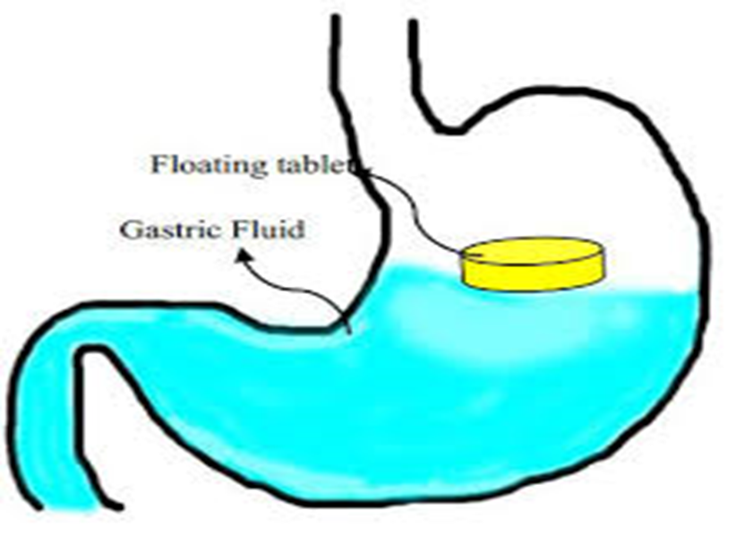
Floating drug delivery system(FDDS)

Slide 2
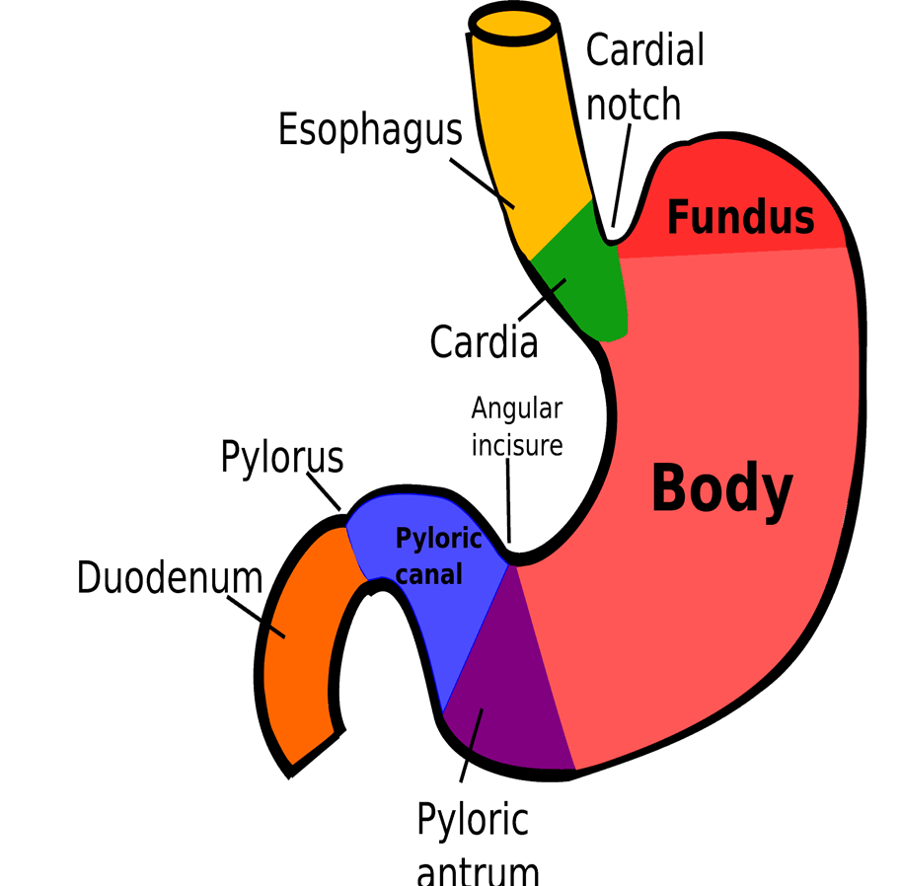
Anatomy of the stomach:
Fundus
Body
Antrum

Slide 3
migrating myloelectric cycle (MMC)
1. Phase I (basal phase) lasts from 40 to 60 minutes with rare contractions.
2. Phase II (preburst phase) lasts for 40 to 60 minutes with intermittent action potential and contractions. As the phase progresses the intensity and frequency also increases gradually.
3. Phase III (burst phase) lasts for 4 to 6 minutes. It includes intense and regular contractions for short period. It is due to this wave that all the undigested material is swept out of the stomach down to the small intestine. It is also known as the housekeeper wave.
4. Phase IV lasts for 0 to 5 minutes and occurs between phases III and I of 2 consecutive cycles.

Slide 4
Factors affecting gastroretensive time
Density
Size
Fed or unfed state
Nature of meal(caloric content)
Frequency of feed
Gender
Age
Posture
Diseased state
Stress & depression

Slide 5
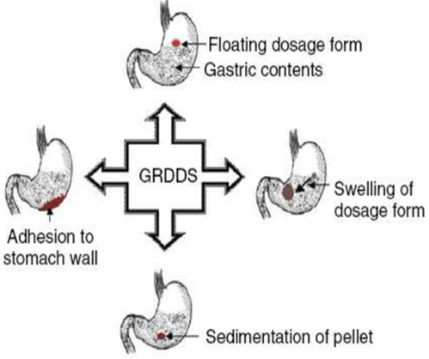
Gastrorenentive drug delivery system (GRDDS)
Approaches to increase gastroretentive time:
Flotation
Mucoadhesion
Sedimentation
Swelling dosage form

Slide 6
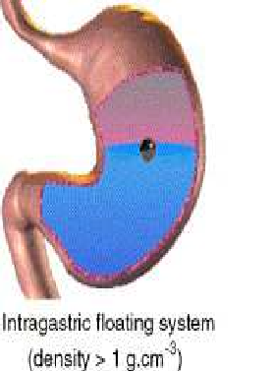
Floating drug delivery system(FDDS)
Definition:
Are drug delivery systems that can remain floated in the gastric region for several hours and hence significantly prolong the gastric residence time of drugs.

Slide 7
Advantages and applications of FDDS:
Prolonged gastric retention improves bioavailability
improves solubility for drugs that are less soluble in a high pH environment
reduces drug waste
Serve local drug delivery to the stomach and proximal small intestines.
For the drugs affect the normal colonic microbes.

Slide 8
Approaches to design FDDS
Single- unit dosage forms
multiple- unit dosage forms

Slide 9
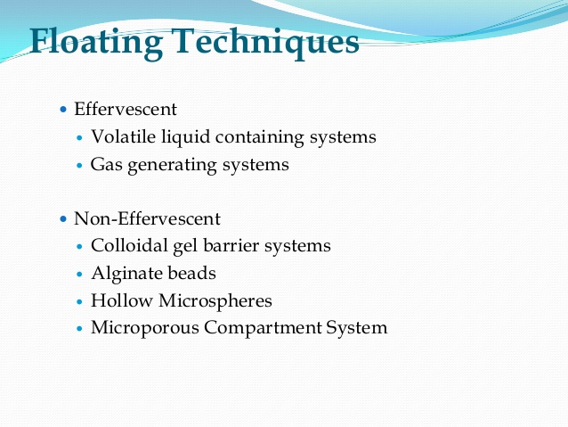

Slide 10
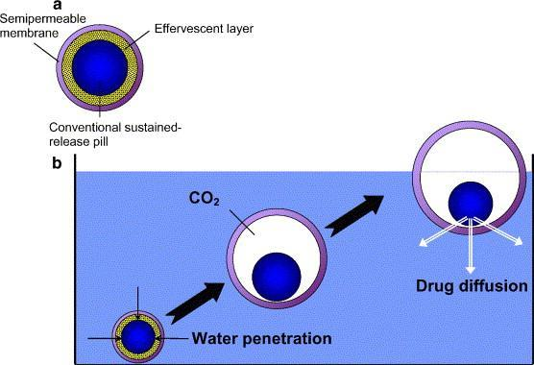
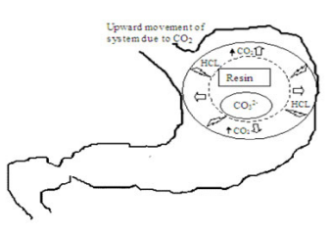
Effervescent
Gas generating systems:
Effervescent: tartaric acid, citric acid
Polymers: methylcellulose, chitosan
- Ion exchange resin
Volatile liquid containing systems:
Oils or light fatty materials that vaporize
upon contacting with the gastric fluid.
E.g: cyclopentane, ether

Slide 11
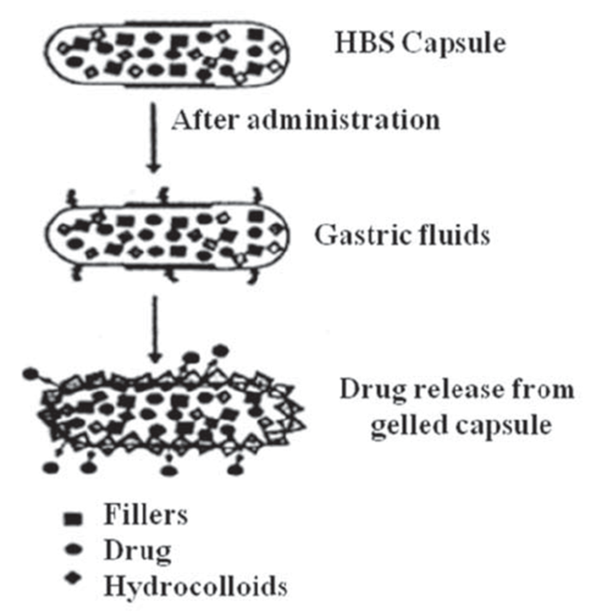
Non effervescent
Colloidal gel barrier system:
Alginate beads:
Hollow microspheres
Microporous compartment systems.

Slide 12


