Slide 1
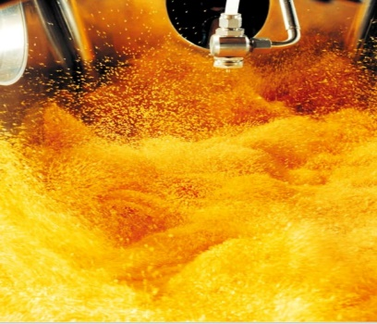

AHLAM ALI 1161673
ROLLA ALI 1160539

Slide 2
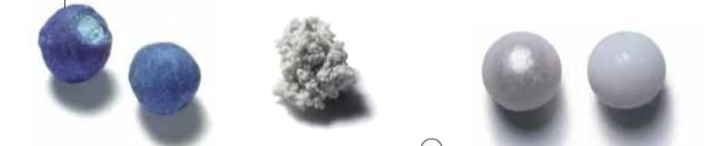
Principle Of Fluidization
The basic concept in granulation (also known as agglomeration) involves suspending particulates in an air stream and spraying a liquid from the top on to the fluidized bed. Particles in the path of the spray get slightly wetted and become tacky. The tacky particles collide with other particles and adhere to them to form a granule.
Gas + solid -------> mixture of fluidization
(high velocity ) (solid + gas)

Slide 3
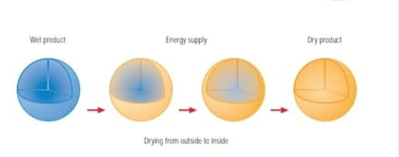
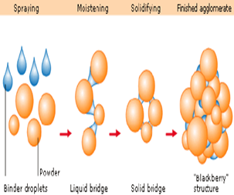
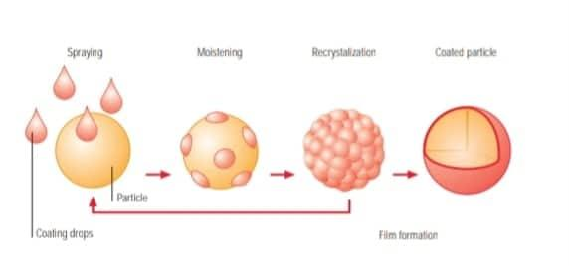
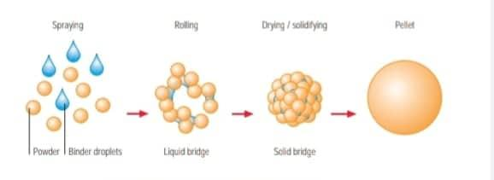
Range of applications :
Drying
Fluid bed drying is an effective way of drying solids. During fluidization, liquid is withdrawn from the entire surface of every single particle. The advantages: excellent heat exchange, ideal drying time. The product is also dried gently
Granulation
may consider as a size enlargement process during which primary particles are formed into larger physically strong agglomerate by creating bonds between them, wherein the primary particle can still be identified
Coating
The coating must provide an absolute seal – without mechanical damage or tears also to be uniform, types: 1-Film coating using wax, aqueous or organic coating system) ,2-substrate layering produces pellets by layering it, in powder or liquid form.
Pelletizing
During pelletizing, powder is mixed and moistened. At the same time, a solvent or binding agent can be added. The centrifugal motion produces agglomerates, which are spheronized into uniform, dense pellets.

Slide 4
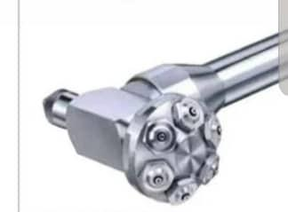
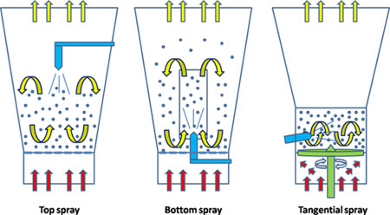
Types of spraying in Fluid bed
Depending on the position of the spray nozzle fluid bed process are characterized by :
1. Top spray
2. Bottom Spray (Wurster)
3. Tangential Spray( Rotary/side)

Slide 5
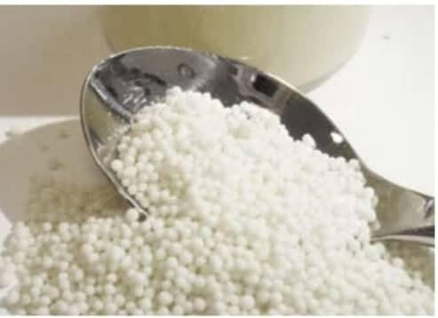
1- Top spray :
Spray nozzle is located above the expansion chamber.
In this process, there is a counter current (opposite direction) movement of powder particles
or pellets and liquid spray.
(liquid is sprayed down onto a bed of fluidized particle)
Under normal circumstances, we use the top spray in the following key applications:
1. Drying wet granules and powder
2. Granulation
3. Coating (not very common)
Ex: Hot melting coating by Appling molten coating material(wax, fat) onto particle.
https://www.youtube.com/watch?v=9GN2R8nglWc

Slide 6
Application of top spray process :
Granulation with a binder
2. granulation with water ( Instantizing)
This method can be used for both water-soluble and
water-insoluble compounds
the formation of granules depend on the type and concentration of the binder.
This process is used where the choice of binders is limited,
the water consider as the spray medium to dissolve a binder or be a binder to improve granule strength .

Slide 7
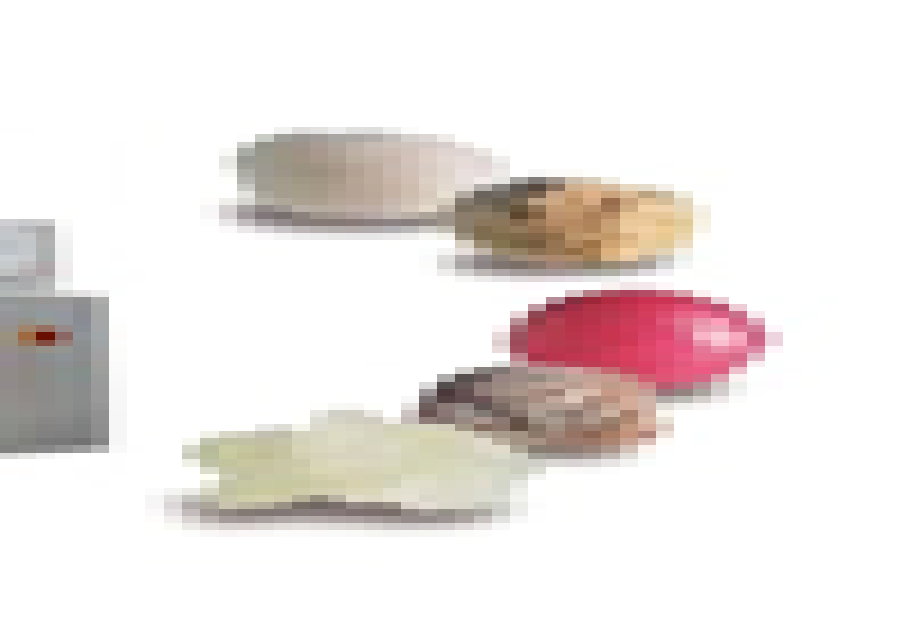
Table1: process variables for the top-spray :
Effect | Intensity | Parameters
Small size of granules | High | Atomization air pressure
Large size of granules | Low
Large and less friable | High | Liquid addition rate
Smaller and less friable | Low
Small size of granules | High | Inlet air temperature
Large size of granules | Low
Other parameters include : Inlet air humidity and Inlet air volume which have less effect on the granulation process. However good control of these parameters is important to avoid variations between batches.

Slide 8
2. Tangential spray fluid bed
The nozzle is introduced at the
side of a product container and is imbedded in the substrate during processing
In this process, the powder particles or pellets move in a helical fashion due to spinning rotor disk on the bottom of the equipment. The
liquid is sprayed within the
moving powder or pellets.
Forces affecting the process
1. centrifugal force. Generated by the spinning of the disk
2. lifting force generated by the process air volume that passes through the adjustable disk gap.
3. Gravity force that causes material to fall down onto the disk.
These forces, resembling a spiraling helix, provide good mixing and result in granules with good content uniformity(ensure homogenous granulation.)
https://www.youtube.com/watch?v=QYFe0SAbvH0

Slide 9
Tangential application
Under normal circumstances, we use the Tangential spray in the following key applications:
1- granulation :(not very common)
2- coating :
It’s a good choice for producing granules that are to be coated as both process can be done in the same machine
- Mainly for the layering and subsequent film coating of pellets
- Side spray fluid bed coater has a high kinetic energy that makes it difficult to coat small particles and the non-spherical products; there is a high chance of destroying them.

Slide 10
In addition to the variables described for top-spraying, process variables for the rotor include
Parameters for tangential
Disk speed
  which controls centrifugal force
Disk gap
  the distance from the disk to the wall of the processor, which controls the air volume and velocity responsible for the lifting of particles.

Slide 11
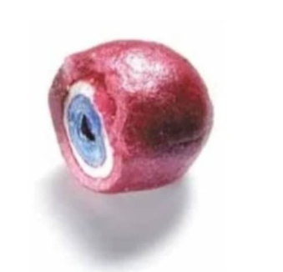
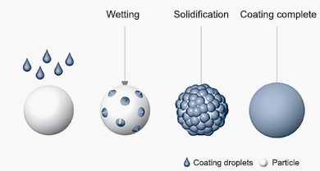
3. Bottom spray fluid bed
here a spraying nozzle is in the bottom section.
In this machine, hot air flows through the bottom section of its column, blowing all powders/granules upwards.
As these materials move upwards, the bottom nozzle sprays them homogeneously.
Under normal circumstances, we use the Tangential spray in the following key applications:
    Granulation (uncommon)
    coating
to modify or control drug release
https://www.youtube.com/watch?v=snLEMu1NAdM

Slide 12
Parameters for bottom
In addition to the variables described for top-spraying, process variables for the rotor include
Partition height
  Determined by the particle size, the substrate density & the desired velocity of particles passing to the coating zone
Type of air distribution plate
  Available in various sizes (from 50mcq particle to pellets and tablets )

Slide 13
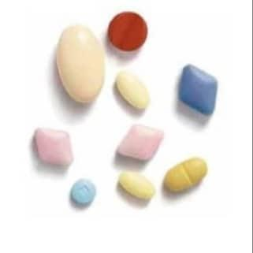
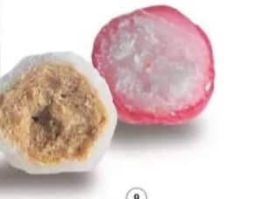
Typical application | Limitation | Advantage | Processing method
- granulation. -hot melt coating. -coating is used for taste masking, enteric release and barrier films | -Take longer to achieve the target coating Use of organic solvent produce inefficient film quality | -Large capacity -Simplest and cost low | Top spray
- coating for sustained release and control release . - taste mask. | - Nozzle access. -Space requirement. | -efficacy coating (smooth and more uniform) | Bottom spray
- pellitazation. - layering . - for SR and enteric coating products | - No possibility of particles granulating due to high rolling motion - Expensive and low capacity . | -several ingredients with significant differences in bulk densities. -high-dose loading applications Granules are denes and less friable, large particle size | Tangential spray

Slide 14

Direct pelletizing
Is the manufacturing of pellets directly from powder
Pellets can be automatically dosed and filled into capsules or compressed to form tablets using a suitable formulation.
The even shape and surface provide ideal conditions for application of a precise film, in order to achieve controlled release.
Direct pelletizing is performed in three steps:
1-The powder mixture is moistened
2-The moist mass is rounded into pellets
3-The finished product is dried

Slide 15
Pelletizing by Layering
For layering, one or more substances are applied in layers to a starter pellet. The layering process is similar to a film coating process. Often the applied layers are significantly thicker – the weight can increase up to several hundred percent.
Substances can be applied in layers to the core as a solution, suspension or powder. By adding suitable supplementary materials, different characteristics in the active substance layer can be achieved. As a carrier material, neutral pellets of 100 micrometers or larger are used.

Slide 16
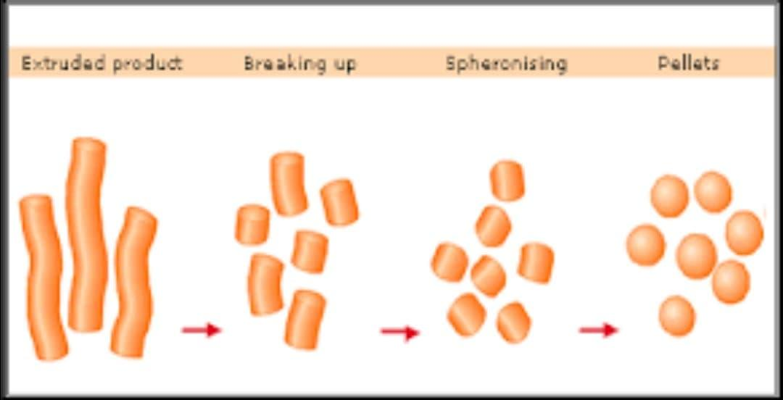
Pelletizing by Spheronization
Agglomeration through extrusion and spheronization is one of the oldest techniques for manufacturing pellets.
For many pharmaceutical applications, extruded pellets are achieved in suitable quality if a sufficient portion of microcrystalline cellulose is added.
Spheronization is performed in four steps:
1-Moistening the powder mixture
2-forming cylinder-shaped agglomerate through extrusion
3-breaking and rounding the extrudate to round pellets through spheronization
4-drying the finished product. (ensures the pellet hardness)

Slide 17
Reference :
http://oaji.net/articles/2014/364-1402036210.pdf
http://www.ijprbs.com/issuedocs/2015/8/IJPRBS%201095.pdf?fbclid=IwAR3NQSxwAlTCh3RvN_qrutve5g2jkWhe-UBl_YC9F7MX5X8EivYLf37AlJw
https://www.glatt.com/fileadmin/user_upload/content/pdf_downloads/WS_EN_7221_301.pdf?fbclid=IwAR1eoXO2zWSRMOGqfU_8XU3nBrGxc_q3y6rk9-IZjBzgVhqRCgm51UgITZo
https://www.saintytec.com/spray-systems-in-fluid-bed-equipment/?fbclid=IwAR2duW8k6OP0b0cZlSuUUC6S3s_yL55l_0ldsLaTZVbsYLZh6hWvtE-ztVw
https://www.colorcon.com/products-formulation/process/fluid-bed-coating?fbclid=IwAR1HjYx9lQtA40HXKaR91iVC3Sf3MZFqhaVZry-8NcT2Qk0aKtSaBASxKEs

Slide 18
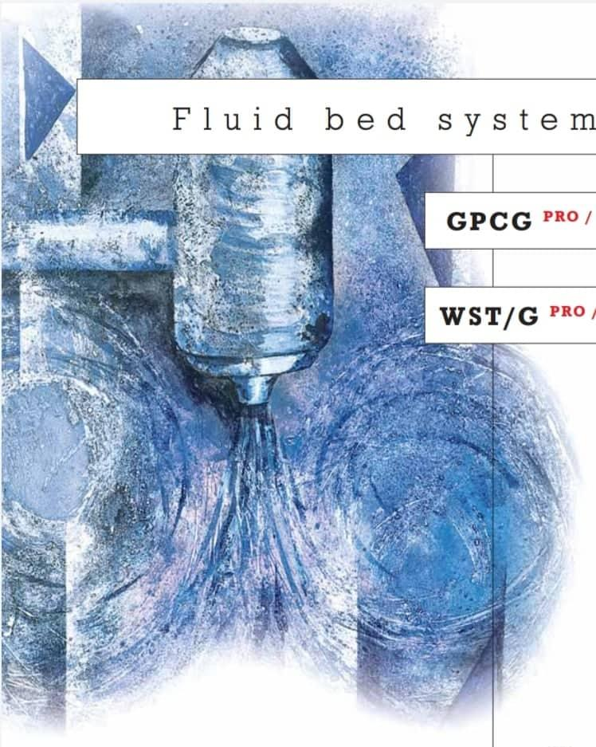
Thank you
Any questions???

