Slide 1
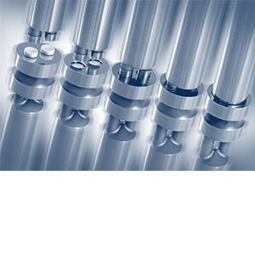
Table Compression Technology
Dr.Hani Sh
Zeinah Bazzar
Sabreen Salah
Dr. Hani Shtaya
Zeinah Bazzar 1162167
Sabreen Saleh 1150543

Slide 2
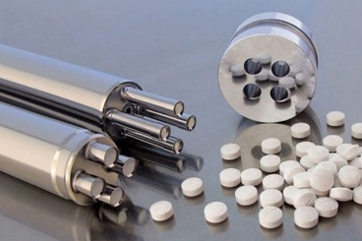
Table Compression Technology
The most common method of drug delivery is oral dosage form of which tablet and capsule are predominant. So it is defined as the reduction in volume of a powder (or granules) owing to the application of a forces. Because of the increased proximity of particle surfaces accomplished during compression, bonds are formed between particles which provide coherence to the powder i.e. compact is formed
Tablet is more accepted as compared to capsule due to many reason such as cost, tamper resistance, ease of handling, ease of identification and manufacturing efficiency.

Slide 3
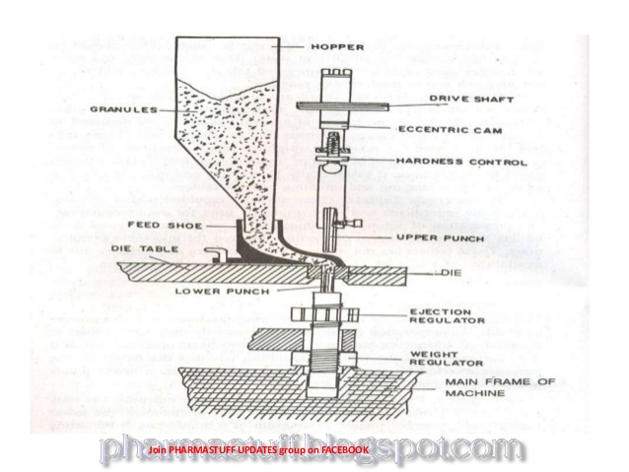
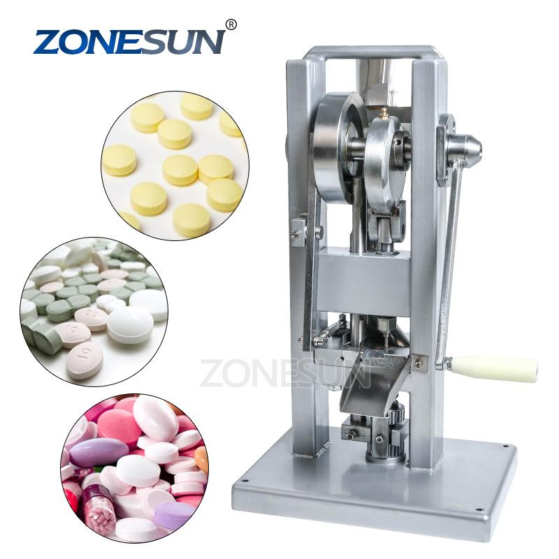
TYPES OF COMPRESSION MACHINES
SINGLE PUNCH/SINGLE STATION PRESSES

Slide 4
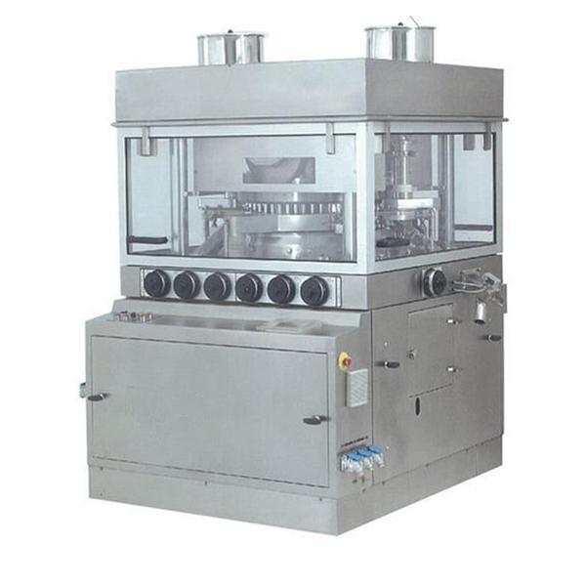
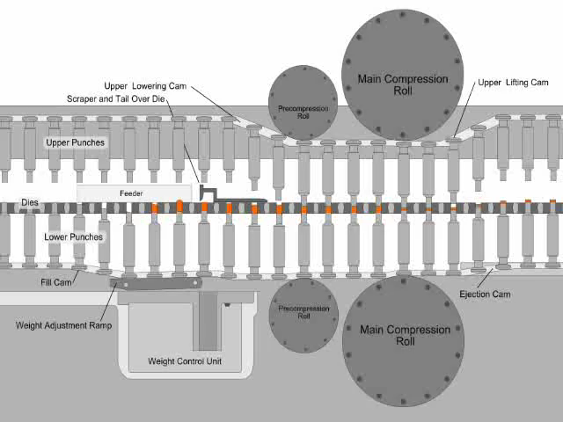
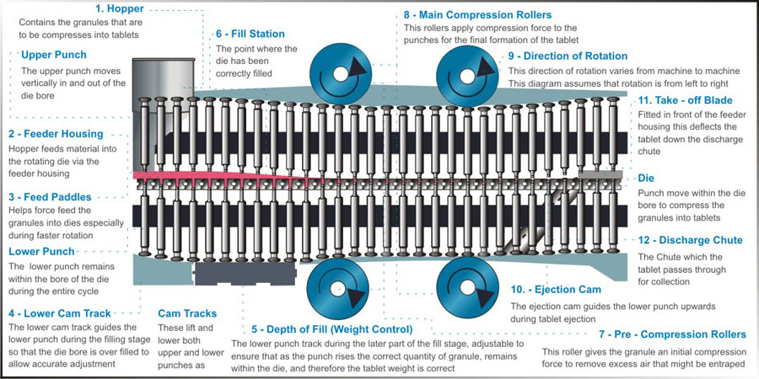
MULTI-STATION/ROTARY PRESSES

Slide 5
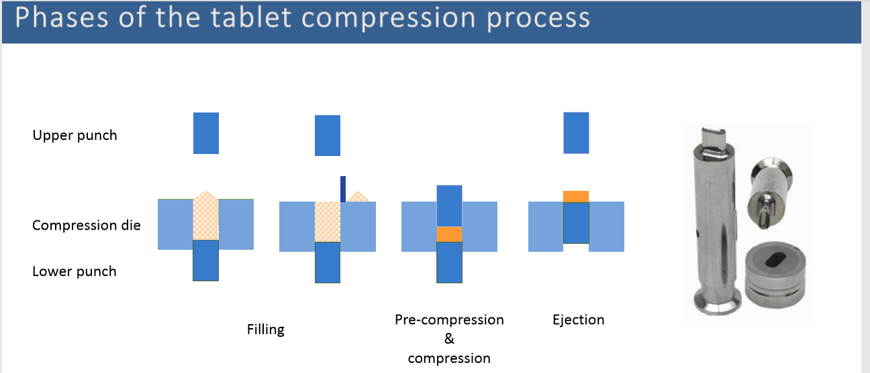
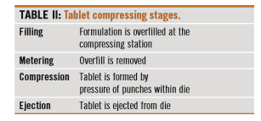

Slide 6
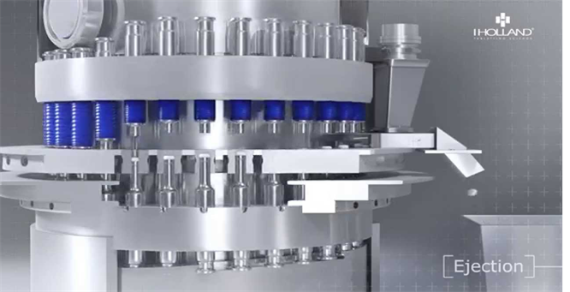
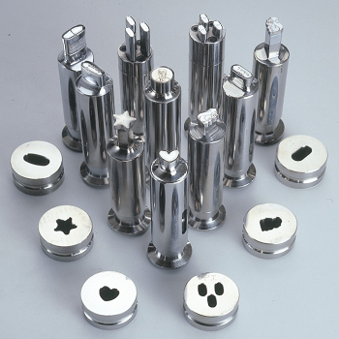
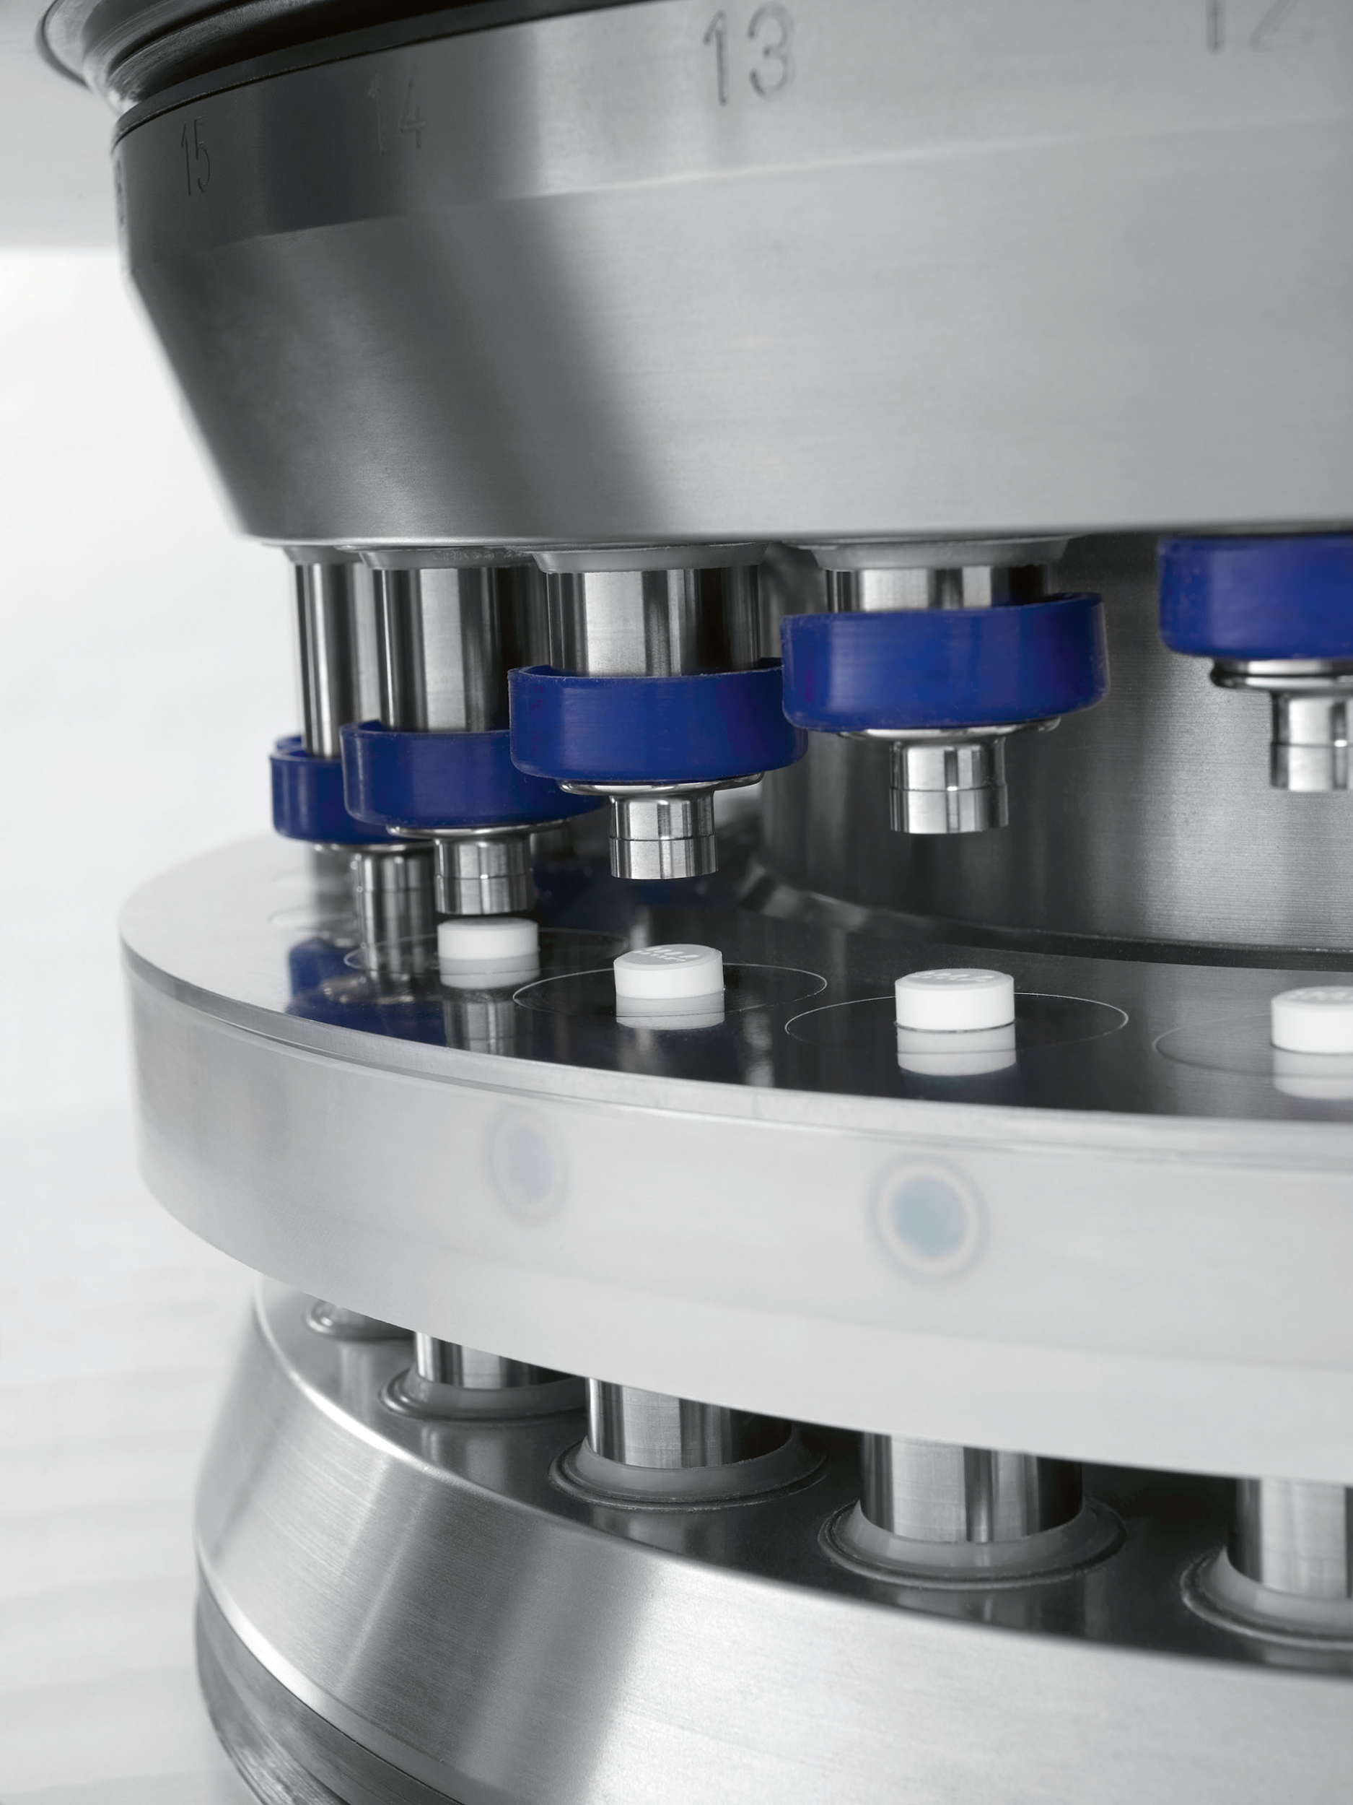
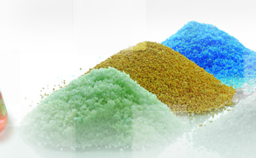
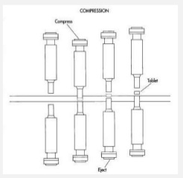
What are the characteristics of an efficient compression process??
Compression Machine Assembly and operation
Characteristics of drug (API) & excipient
Compressing machine setup
Control of tablet weight

Slide 7
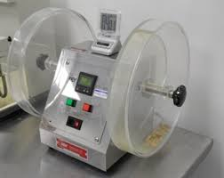
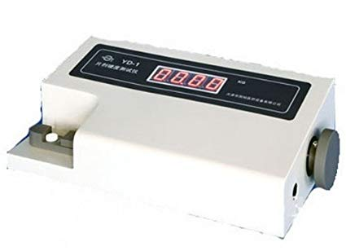
*Compression Machine Assembly and operation *
1-Clean from prior product
2-Lubricated
*Compressing machine setup *
Thickness
Hardness
Friability
  The distance between upper and lower punch
  Speed of compression
  Binder
  Compression time
  Pre compression
  Diameter of roller
  Speed of compression
  Force of compression

Slide 8
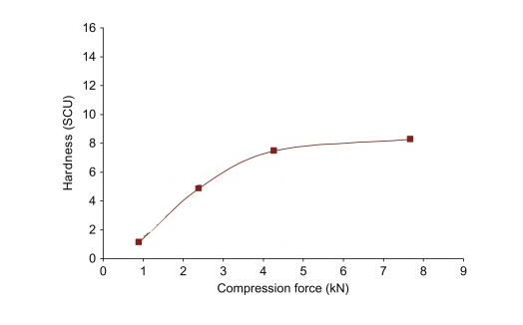
*Important NOTE *
The relationship between the compression force and hardness not linearly relation always
Mannitol

Slide 9

*Control of tablet weight *
The relative speeds of automated feeding system
Speed of compressing machine
The highet of the lower punch in the die
Control the tablet weight
Flowability of material

Slide 10
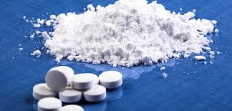
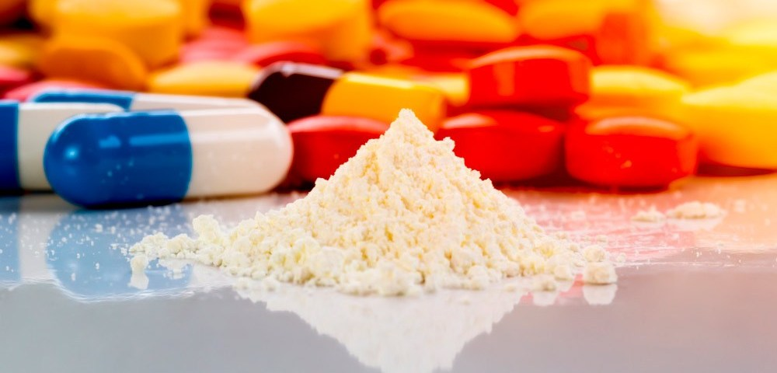
*Characteristics of drug (API) & excipient *
Excipient
API
Glidant
Compersiabilty
Binder
Moisture
Particle size
Lubricant
Flowability

Slide 11
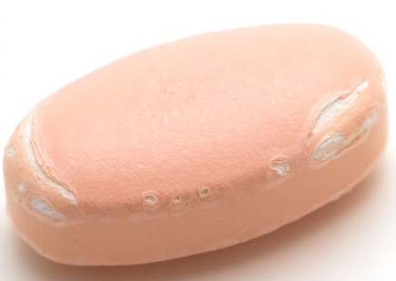
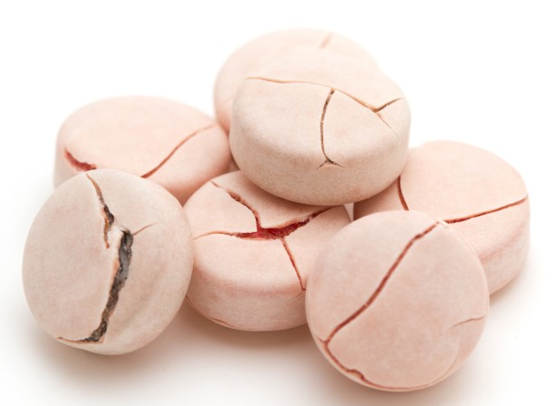

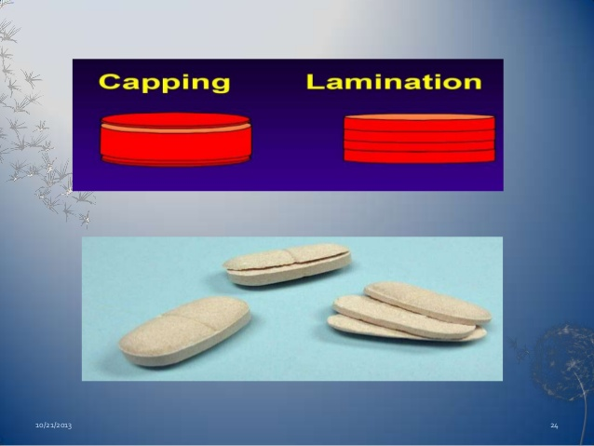
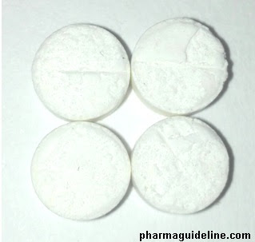
*Tablet Compression Problem*
Excipient
Machine
Tableting Process
Chipping
Double impression
Cracking
Capping
sticking
Lamination

Slide 12
In process monitoring
Monitoring the overall time required to complete a batch or a lot of compressed tablets insight in to efficiency of operation
Production halts for cleaning , weight adjustment , hardness fluctuation indicate the need for additional sampling or test to ensure high quality product .

Slide 13
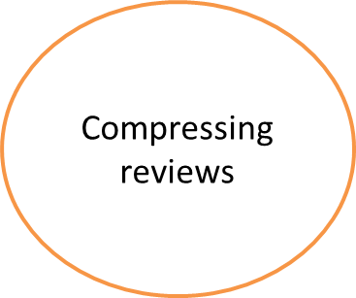
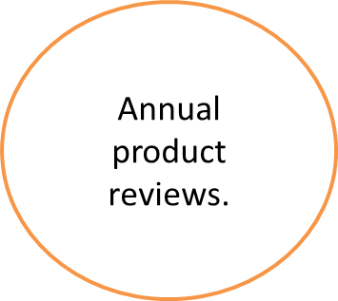
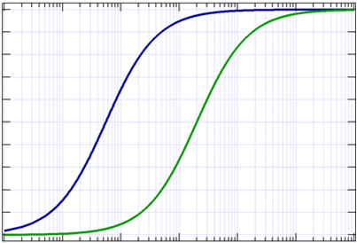
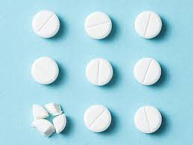
Process monitoring

Slide 14
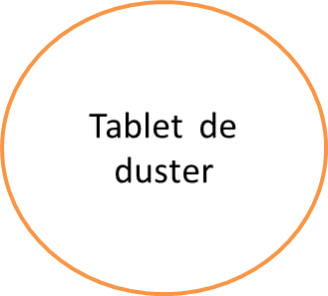
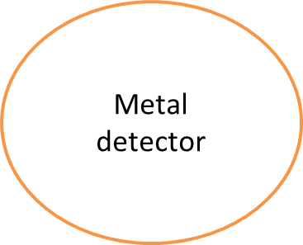
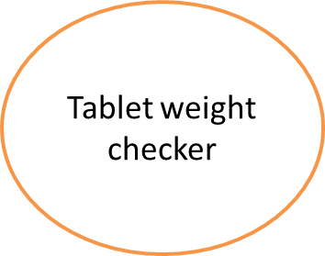
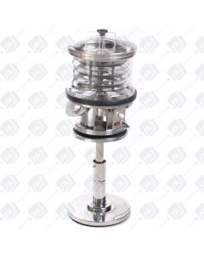
Post compression equipment

Slide 15


Slide 16
REFERANCES
https://pharmaceuticalguidebook.blogspot.com/2010/12/problems-in-tablet-manufacturing.html?m=1&fbclid=IwAR1QIkt8Ifp6EEeck6eP0z8ghPzP1kuRKcYc5Ej_fshlpQhNeplEjMY2oDs,
Pharmaceuticalguide Monday, December 13, 2010, OPEN 10TH .DECEMBER.2019
https://drug-dev.com/tablet-formulation-reformulation-of-tablets-to-resolve-sticking-picking-issues-faced-on-compression-a-case-study/?fbclid=IwAR28WArKj9W1ZiYmtqCdY20bb-TH6KnVjPjwwCFrY_t-ejksOQ81Dw6un04, TABLET FORMULATION – Reformulation of Tablets to Resolve Sticking & Picking Issues Faced on Compression: A Case Study,OCTOBER,2017.OPEN AT :10TH DECEMBER
Petr Zámostný University of Chemistry and Technology Prague, Faculty of Chemical Technology, Department of Organic Technology Laboratory of Drug Manufacturing Processes, Workshop On Tablet Compression, 25.-26.1.2017, Department of Organic Technology, Faculty of Chemical Technology, UCT Prague.OPEN 11th December
Fundamentals of Tablet Compression,Armin H. Gerhardt,Winter 2010 Volume 14 Number 1
Effect of compression force on tablet hardness,by Shipar MAH,Ashish W,Narinder K, Niranjani T 2013-2014
https://www.youtube.com/watch?v=g0-nEs8ydJw&list=WL&index=85
https://www.youtube.com/watch?v=4xggZRckfTE&list=WL&index=86

