Slide 1
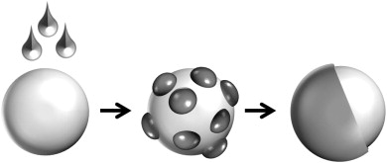
EXCIPIENTS FOR TABLET COATING

Slide 2
Two Major Coating Processes
Sugar
Sealing process
Subcoating
Smoothing
Polishing
Film Coating
Film Formers
Solvents
Plasticizers
Opacifiers

Slide 3
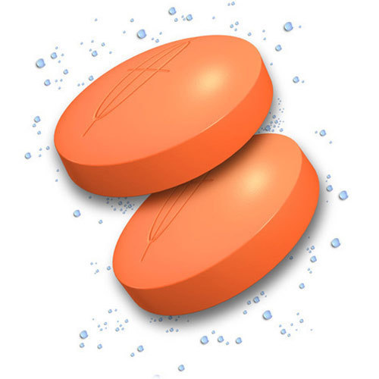
WHY TO COAT TABLETS ??
Taste, Odor or Color Masking
2) Protection of API degradation by oxygen, humidity & stomach acid
3) Controlling Drug Release – Functional Coating

Slide 4
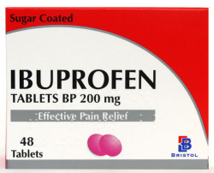
SUGAR COATING
ADVANTAGES
DISADVANTAGES
UNIQUE TASTE
ELEGANT APPEARANCE
CONSIDERED OLD TECHNIQUE THAT IS TIME CONSUMING AND COSTY
REQUIRES HIGHLY-SKILLED EXPERTS.
TABLETS MAY VARY SLIGHTLY FROM BATCH TO BATCH
COATED TABLET MAY BE TWICE THE SIZE AND WEIGHT.

Slide 5
1.1 SEALING (WATERPROOFING) EXCIPIENTS
SHELLAC
A water-insoluble natural material composed of esters and polyesters of polyhydroxy acids.
Nonirritant and nontoxic material at the levels employed as an excipient.
Shellac in the form of its alcoholic solution (pharmaceutical glaze) has been used for many years as an enteric coating for pharmaceutical application
Sources of Instability:
Self-esterification upon extended storage 🡪 Solubility Less acid Value Tg
Stability Enhancement:
The addition of antioxidants and organic salts and storage below 27C away from light.
ZEIN
A water-insoluble natural protein (prolamine) obtained from corn.
Sources of Instability:
Prone to oxidation
Prone to degradation due to gelation promoted by: Water, Temp. , pH & mechanical stress

Slide 6
1.2 SUB-COATING EXCIPIENTS
GELATINE & ACACIA
Are natural materials that are used as binders to cover the edges of the tablet and to build its weight
Gelatine (2-10% w/w)
PVAP
1.3 SMOOTHING OR SYRUPING EXCIPIENTS
SUCROSE SYRUP
Typically composed of 50-67% of sucrose in purified water.
Sources of Instability: Hygroscopic (fine), themal degradation (160 C), hydrolysis in the presence of acid, invension at high conc.
Incompatible with APIs - with heavy metals and Ascorbic acid.
Incompatible container – Aluminum closure

Slide 8
1.4 POLISHING
CARNAUBA WAX
It is a hard material with a relatively high melting point. Typically in the form of 10% w/v aqueous emulsion
BEES WAX
Sources of Instability:
Self-esterification above (150 C) 🡪 less acid Value & increasing melting point
Prone to oxidation
Notice that the two waxes can be mixed and used together.

Slide 9
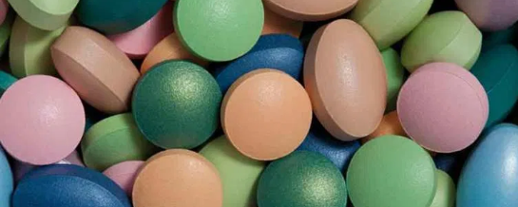
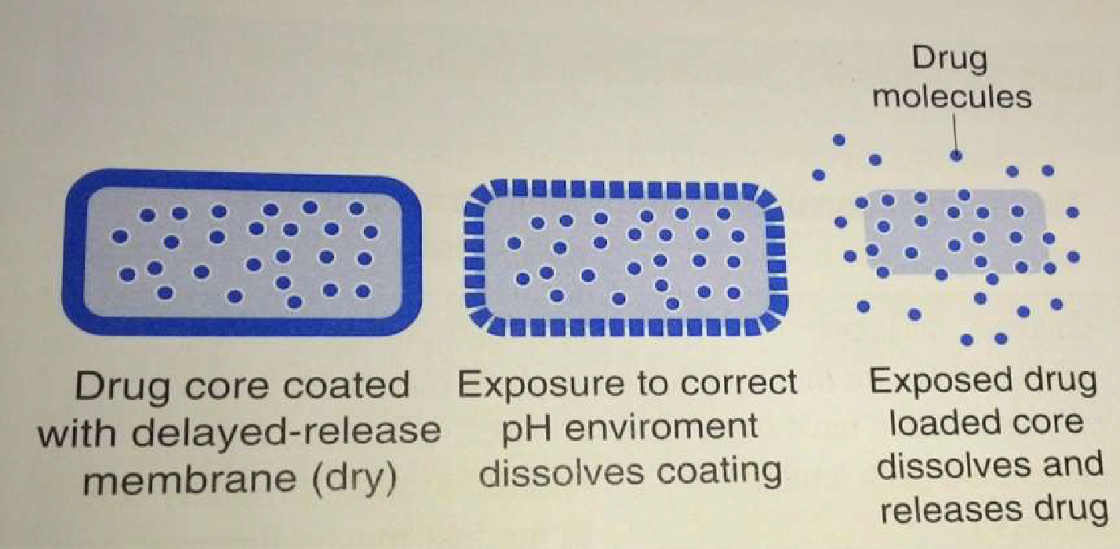
FILM COATING
ENTERIC & NON-ENTERIC
PLACES A THIN PLASTIC-LIKE FILM ON THE UNCOATED TABLET (SAME WEIGHT, SIZE & SHAPE)
MORE RESISTANT TO DESTRUCTION BY ABRASION THAN SUGAR-COATED TABLETS

Slide 10
2.1 FILM FORMERS
2.1.1 NON-ENTERIC FILM FORMERS
HYDROXYPROPYL METHYL CELLULOSE (HPMC)
HYDROXYETHYL METHYL CELLUSOLE

Slide 11
2.1 FILM FORMERS
2.1.1 NON-ENTERIC FILM FORMERS
Ethyl Cellusole (EC)

Slide 12
2.1 FILM FORMERS
2.1.1 NON-ENTERIC FILM FORMERS
POLYVINYL PYRROLIDONE (PVP)

Slide 13
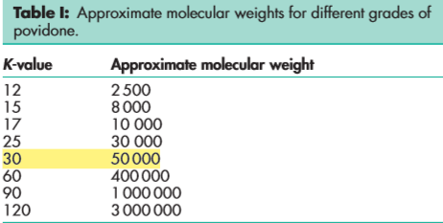

Slide 14
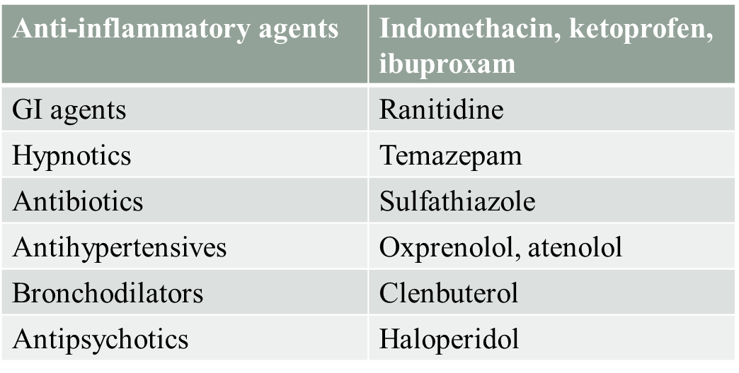
PVP-API INCOMPATIBILITY

Slide 15
2.1 FILM FORMERS
2.1.1 NON-ENTERIC FILM FORMERS
SODIUM CARBOXYMETHYLCELLULOSE (NA-CMC)

Slide 16
2.1 FILM FORMERS
2.1.1 NON-ENTERIC FILM FORMERS
ACRELATE POLYMERS (BRAND: EUDRAGIT®)

Slide 17
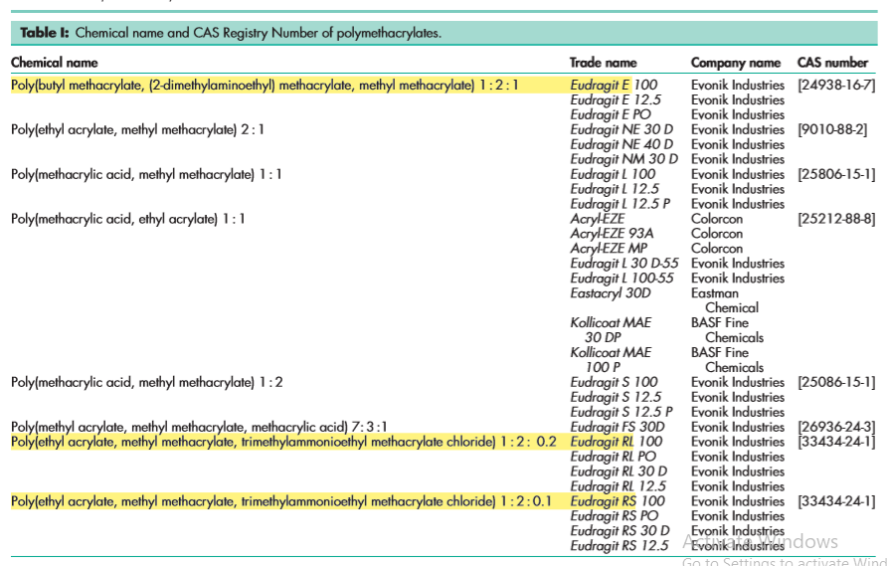
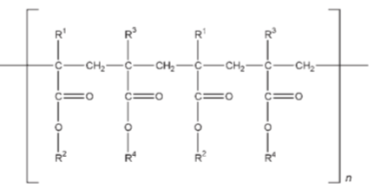

Slide 18
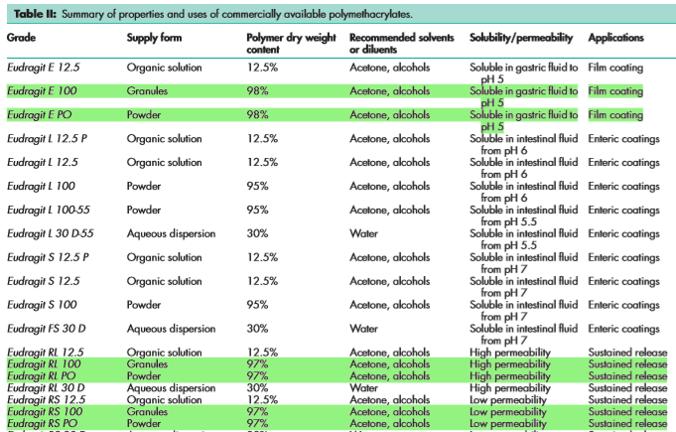

Slide 19
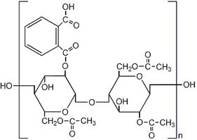
2.1 FILM FORMERS
2.1.2 ENTERIC FILM FORMERS
CELLULOSE ACETATE PHTHALATE (CAP)

Slide 20
2.1 FILM FORMERS
2.1.2 ENTERIC FILM FORMERS
ACRYLATE POLYMERS (EUDRAGIT L ) (EUDRAGET S )

Slide 21
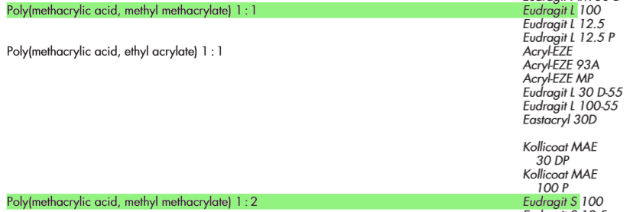

Slide 22
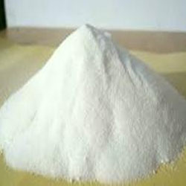
2.1 FILM FORMERS
2.1.2 ENTERIC FILM FORMERS
HYDROXYPROPYL METHYLCELLULOSE PHTHALATE (HPMCP)
HYDROXYPROPYL METHYLCELLULOSE ACETATE SUCCINATE (HPMCAS)

Slide 23
For Aqueous Film Coating:
A dispersion of hypromellose acetate succinate fine powder and triethyl citrate (as a plasticizer) in water is commonly utilized

Slide 24
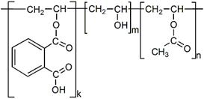
2.1 FILM FORMERS
2.1.2 ENTERIC FILM FORMERS
POLYVINYL ACETATE PHTHALATE (PVAP)
Is similar to HP-55 in terms of stability and pH-dependent solubility. Also shows cracking and plasticizers used are: triethyl citrate, acetyl triethyl citrate, glyceryltriacetate & Carbowax™40.
Advantage: Less prone to hydrolysis compared to CAP & HPMCP.

Slide 25
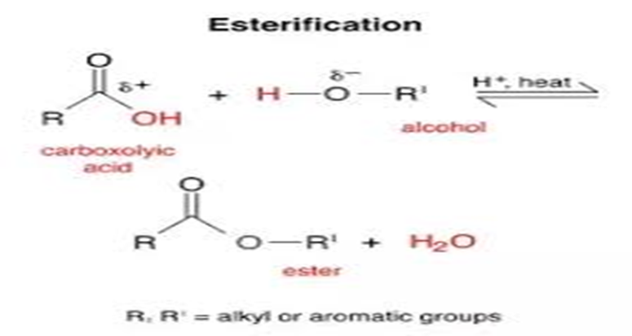
2.2 SOLVENTS OF FILM COATING
Solvents serve as a medium for the dispersion or dissolution of the polymers and other additives. They should be non-toxic, non-flammable, inert, odorless and colorless.
Examples of organic solvents: ethanol , isopropanol, acetone, choloroform , methyl chloride , and methyl ethyl ketone
ETHANOL
NOTICE
Any change in the solvent composition has been observed to cause roughness of the coating surface or formation of gaps and cracks.

Slide 26
2.3 PLASTICIZERS OF FILM COATING
Plasticizers are added at very low concentration in film coating to modify the physical properties of the coating polymers mainly to decrease film brittleness.
Examples: glycerol, castor oil , low m.wt PEG , propylene glycol, and benzyl benzoate & others.
NOTICE
low molecular weight of PEG (PEG200) is used as plasticizer in tablets, granules and microcapsules that are ultimately punched into tablets , if used with iron . It shows some discoloration from its original yellowish color.
Sorbitol , which is generally used as plasticizer in gelatin films, crystallizes in the film if improperly stored .
2.4 OPACIFIRES OF FILM COATING
Opacifires are extremely fine in-organic powders added to the coating solution to increase the film coverage and providing a white coating. They are less expensive than colorants.
Examples : TiO2, Silicates (aluminum silicate, talc ) , calcium sulfate , magnesium carbonate, aluminum hydroxide, and magnesium oxide.

Slide 27
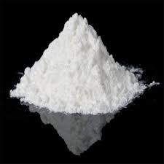
TITANIUM DIOXIDE
TiO2 is widely used in oral pharmaceutical preparations, cosmetics, and food.
Owing to its high refractive index, titanium dioxide has lights cattering properties that may be exploited in its use as a white pigment and opacifier. The range of light that is scattered can be altered by varying the particle size of the titanium dioxide powder. For example, titanium dioxide with an average particle size of 230 nm scatters visible light, while titanium dioxide with an average particle size of 60 nm scatters ultraviolet light and reflects visible light.
Incomptibility:
observed to consistently degrade the mechanical properties of the film at increasing the concentrations.
API incompatibility with famotidine >> Discoloration.

