Slide 1
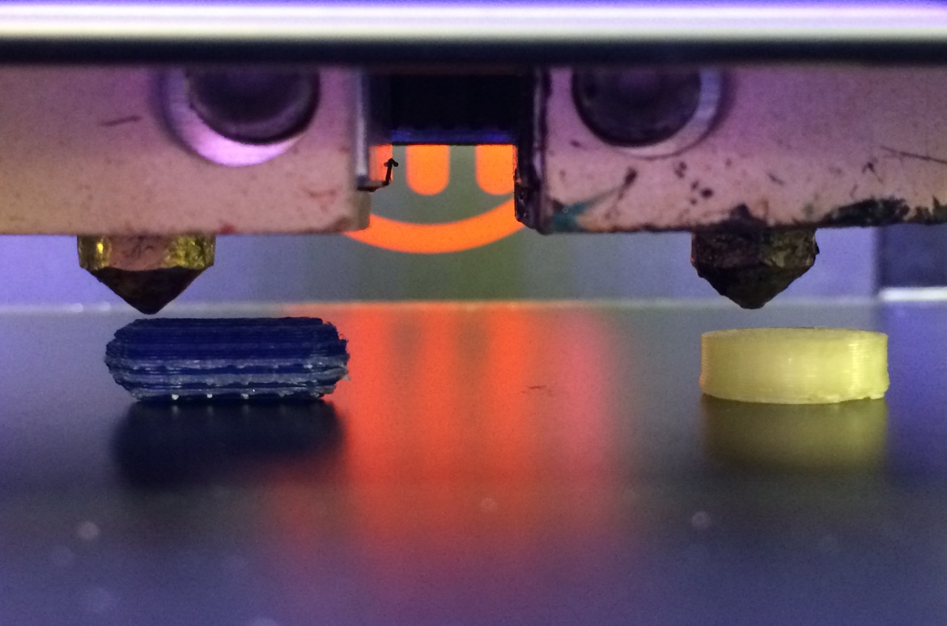
3D-Printing Technology In Pharmaceutical Industry
Israa Mafarjeh
Muhammad Musleh

Slide 2
As the pharmaceutical industry shifts from mass manufacture towards personalized medicine, 3D printing could become part of the drug production line.

Slide 3
Contents
1- Definition.
2- Technologies.
3- Challenges and Solutions.
4- Conclusion.

Slide 4
Definition
3D printing or additive manufacturing is a process of making three dimensional solid objects from a digital file . It is a process of making 3 dimensional solid object from a digital file by making thousands of horizontal layers.
The creation of a 3D printed object is achieved using additive processes. In an additive process an object is created by laying down successive layers of material until the object is created. Each of these layers can be seen as a thinly sliced horizontal cross-section of the eventual object .

Slide 5
How 3D Printing Works ? It all starts with making a virtual design of the object you want to create. This virtual design is for instance a CAD (Computer Aided Design) file. This CAD file is created using a 3D modeling application or with a 3D scanner (to copy an existing object). A 3D scanner can make a 3D digital copy of an object. https://www.youtube.com/watch?v=Vx0Z6LplaMU

Slide 7
3D PRINTING IN PHARMACEUTICALS
Imagine a pediatrician talking to a four-year-old child who is having trouble adjusting to taking daily doses of steroids after being diagnosed with Duchene muscular dystrophy the previous month. “What’s your favorite animal?” she asks. “A zebra,” quietly replies the child, who we will call Sam. The pediatrician smiles as she makes a note on her office computer. “But not a black and white one, a blue and green one,” adds Sam, with a little more confidence. Later, the toddler watches with wide eyes as the uniquely colored, zebra-like tablets appear from a three-dimensional (3D) printer in the hospital pharmacy.

Slide 8
A doctor or a pharmacist would be able to use each patient’s individual information such as age, race and gender to produce their optimal medication dose, rather than relying on a standard set of dosages 3D printing may also allow pills to be printed in a complex construct of layers, using a combination of drugs to treat multiple ailments at once. The idea is to give patients one single pill that offers treatment for everything they need

Slide 9
Technologies

Slide 10
FDM and HME
Fused Deposition Modeling (FDM) combined with Hot Melt Extrusion(HME) — to produce drug-loaded filaments — represents one promising technique for 3D printing drugs. The major challenge is that the temperatures needed during printing might degrade active pharmaceutical ingredients (APIs). FDM printers are much more common and inexpensive than the SLS type.¹¹ An FDM printer uses a printhead similar to an inkjet printer. However, instead of ink, beads of heated plastic are released from the printhead as it moves, building the object in thin layers.This process is repeated over and over, allowing precise control of the amount and location of each deposit to shape each layer. Since the material is heated as it is extruded, it fuses or bonds to the layers below. As each layer of plastic cools, it hardens, gradually creating the solid object as the layers build. Depending on the complexity and cost of an FDM printer, it may have enhanced features such as multiple printheads. FDM printers can use a variety of plastics.¹¹ In fact, 3D FDM printed parts are often made from the same thermoplastics that are used in traditional injection molding or machining, so they have similar stability, durability, and mechanical properties. https://www.youtube.com/watch?v=7px1fl41cA4&fbclid=IwAR1zT8EsbZjfg1XIEgRn4T4aLGsMYPKj88fX-1UFQLPpb_03-ms-BFwy7Lk

Slide 11
Inkjet Printing
In inkjet printing, different combinations of active ingredients and excipients (inks) are sprayed through a nozzle to deposit three-dimensional structures in solid dosage forms. This layer-by-layer deposition of the drug ingredient gives rise to a three-dimensional tablet . Inkjet printing is a “noncontact” technique that uses thermal, electromagnetic, or piezoelectric technology to deposit tiny droplets of “ink” (actual ink or other materials) onto a substrate according to digital instructions. In inkjet printing, droplet deposition is usually done by using heat or mechanical compression to eject the ink drops. In TIJ printers, heating the printhead creates small air bubbles that collapse, creating pressure pulses that eject ink drops from nozzles in volumes as small as 10 to 150 picoliters. Droplet size can be varied by adjusting the applied temperature gradient, pulse frequency, and ink viscosity.
TIJ printers are particularly promising for use in tissue engineering and regenerative medicine. Because of their digital precision, control, versatility, and benign effect on mammalian cells, this technology is already being applied to print simple 2D and 3D tissues and organs (also known as bioprinting). TIJ printers may also prove ideal for other sophisticated uses, such as drug delivery and gene transfection during tissue construction

Slide 12
SLA
This technique involves the curing of photosensitive material/s to produces a 3D object. Scanning a focused Ultraviolet (UV) laser over the top of a photopolymerizable liquid in a layer by layer fashion, SLA employs a digital mirroring device to initiate a chemical reaction in the photopolymer which causes the gelation of the exposed area. This process is repeated layer after layer to build the entire parts of the object. This occurs as unreacted functional groups on the solidified structure in the first layer polymerises with the illuminated resin in the next layer ensuring adhesion and therefore, layer formation. Post printing processing is usually required to further cure the final product, to improve its mechanical integrity and to polish or remove the attached supports to the fabricated object . This technique however possesses a health hazard in the form of potential carcinogenic resins. This is also a very slow process. SLA printers are composed of an ultraviolet light beam, in the form of a laser, which transfers the energy into a liquid photopolymerizable resin. The ultraviolet light beam is aided by baffles, axes x and y, to traverse the surface of the liquid resin, in order tovaccurately represent the 3D model, previously designed. When a layer solidifies, the lifting platform descends its position to the height of a new layer of liquid resin, again beginning the procedure, until the manufacture of the 3D product is finished in a layer-by-layer way. Here thickness of the cured layers depends upon the energy of the UV light to which resin is exposed. The resin should be FDA approved for human use with the ability to solidify upon exposure to laser beam.
https://www.youtube.com/watch?v=vuauCJIXpzo&fbclid=IwAR1gCEnk7qLcNdeihoskGC9_8Axb5bKz3LU_sKyDyjgm-DMbDwmfgBCWlFs

Slide 13
SLS
Selective Laser Sintering has been used to fabricate dosages with accelerated drug release. This is achieved by mixing active ingredients with certain copolymers and fusing the resulting powders with a laser
An SLS printer uses powdered material as the substrate for printing new objects. A laser draws the shape of the object in the powder, fusing it together. Then a new layer of powder is laid down and the process repeats, building each layer, one by one, to form the object. Laser sintering can be used to create metal, plastic, and ceramic objects. The degree of detail is limited only by the precision of the laser and the fineness of the powder, so it is possible to create especially detailed and delicate structures with this type of printer

Slide 14
Advantages
1. Personalized drug dosing 2. Enhanced Productivity 3. Increased Cost Efficiency 4. Unique dosage forms . 5. Decrease adverse effects 6. Commercial advantages. 7. Complex release profile

Slide 15
Challenges and Solutions
1- When a given printer is unable to print a given design, software controls should be employed
2- Variability in layer thickness has to be controlled by real – time layer thickness monitoring
3- Improper layering due to environmental conditions should be dealt with controlling the temperature and humidity of the manufacturing area.
4- Inaccurate position during printing can be avoided by monitoring print head height and print head speed.
5- Uneven layers can be avoided by checking powder water content and powder particle size distribution
6- Print head clogging can be prevented by ensuring particle size distribution and monitoring inkjet flow.
7- Inconsistent agglomeration or binding can be due to variations in binder viscosity or binder surface tension

Slide 16
Example
1. Spritam, which treats Epilepsy. This is the world’s first 3D printed drug approved by the FDA https://www.spritam.com/#/patient

Slide 17
Example
2.Polypill concept:-
The concept of “polypill” refers to a single tablet that includes the combination of several drugs.This concept is highly beneficial for geriatric population, as patients of this age category are prone to multiple disorders and hence multiple therapy. The technology has been realized through the research of Khalid et al (28), where five different active pharmaceutical ingredients with different release profiles have been formulated in a single 3D dosage form. Three drugs (pravastatin, atenolol, and ramipril) were printed in the extended release compartment. The drugs were physically separated by a permeable membrane of hydrophobic cellulose acetate. An immediate release compartment containing aspirin and hydrochlorothiazide was deposited on top of the extended release compartment

Slide 18
Poly-pills :-

Slide 19
Questions?

Slide 20
