Slide 1
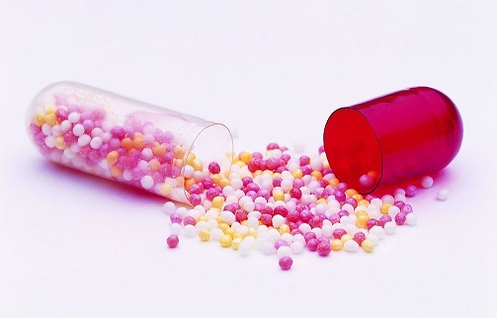
PELLETIZATION MANUFACTURING TECHNIQUES

Slide 2
DEFINITION
Small agglomerates of powder/granules that have a spherical shape, high flowability and a size range from (0.5mm-2mm), less dose dumping and GIT irritation.
Pellets release mechanism | Drugs
Sustained release | Decongex
Sustained release | Omeprazole
Colon targetting | Ibuprofen
Immediate-release | Tramadol
Enteric-coated | Omeprazole

Slide 3
Advantages and disadvantages?

Slide 4
MAIN MANUFACTURING TECHNIQUES
Freeze pelletization
Layering
Extrusion-spheronization
Cryopelletization

Slide 5
FREEZE PELLETIZATION

Slide 6
Parameters?
The liquid in the column?

Slide 7
Nozzles
Column
Droplets
Height
Temperature
Miscibility
Number
Inert
Density

Slide 8
LAYERING
Powder layering

Slide 10
PARAMETERS AFFECTING LAYERING
Rate of addition
Binder
Water solubility

Slide 11
EXTRUSION-SPHERONIZATION
Dry mixing
Drying and screening
Wet massing
Spheronization
Extrusion

Slide 12
EXTRUDER

Slide 13
SPHERONIZER

Slide 15
FACTOR AFFECTING EXTRUSION-SPHERONIZATION
Rate of drying
Porosity
Density
Diameter of extrudate
Size of pellets

Slide 16
CRYOPELLETIZATION
Solution, suspension or emulsion droplets of drug and excipients
Liquid nitrogen (-160Cº) the solidifying medium
Rapid heat transfer from droplets to liquid nitrogen

Slide 17
FACTORS AFFECTING CRYOPELLETIZATION
Formulation variables
Equipment variables
Process variables
Surface tension
Distance between plate and reservoir
Diameter
Amount of liquid nitrogen
Agitation

Slide 18
FACTORS AFFECTING PALLETIZATION TECHNIQUE
Moisture content
Rheological characteristics
Solubility of excipients and API
Pelletizing fluid
Physical properties of starting material
Speed of spheronizer
Extrusion screen

Slide 19
REFERENCES
Amita A. Ahir1, Sachin S. Mali2, Ashok A. Hajare1, Durgacharan A. Bhagwat1, Prasad V. Patrekar, Pelletization Technology: Methods and Applications – research journal of pharmacy and technology. 2015
K. Srinivasarao*, K. Sai Lakshmi Jyothirmai and N. Rama Rao, PELLETS AND PELLETIZATION TECHNIQUES, international journal of research in pharmacy and chemistry. 2017
K.Suresh2, K.Vijayasree3,Devanna Murthy V. R. Sirisha. Recent Advances in Pelletization Techniques. Internatiol journal of pharmaceutical sciences review and research. 2014

