Slide 1
Acute Gastoenteritis

Slide 2
The term gastroenteritis denotes infections of the gastrointestinal tract caused by bacterial, viral, or parasitic pathogens.
Many of these infections are foodborne illnesses. The most common manifestations are diarrhea and vomiting, which can also be associated with systemic features such as abdominal pain and fever.

Slide 3
EPIDEMIOLOGY OF CHILDHOOD DIARRHEA
Diarrheal disorders in childhood account for a large proportion (9%) of childhood deaths, with an estimated 0.71 million deaths per year globally, making it the second most common cause of child deaths worldwide.
Almost 1.731 billion episodes of diarrhea occurred in 2010 in children younger than 5yr of age in developing countries, with more than 80% of the episodes occurring in Africa and South Asia (50.5% and 32.5%, respectively) and 36 million of the total episodes progress to severe episodes.
Global mortality may be declining rapidly, but the overall incidence of diarrhea has only declined from 3.4 to approximately 2.9 episodes per child-year in the past 2 decades.
The decline in diarrheal mortality, despite the lack of significant changes in incidence, is the result of preventive rotavirus vaccination and improved case management of diarrhea, as well as improved nutrition of infants and children.
Diarrheal illnesses, especially early and repeated episodes among young children can be associated with malnutrition, micronutrient deficiencies, and significant deficits in psychomotor and cognitive development.

Slide 4
ETIOLOGY OF DIARRHEA
Gastroenteritis is the result of infection acquired through the fecal–oral route or by ingestion of contaminated food or water. Gastroenteritis is associated with poverty, poor environmental hygiene, and development indices.
Enteropathogens that are infectious in a small inoculum (Shigella,enterohemorrhagic Escherichia coli, Campylobacter jejuni,noroviruses, rotavirus, Giardia lamblia, Cryptosporidium parvum, Entamoeba histolytica) can be transmitted by person-to-person contact, whereas others, such as cholera, are generally a consequence of contamination of food or water supply
In the United States, rotavirus and the noroviruses (small round viruses such as Norwalk-like virus and caliciviruses) are the most common viral agents, followed by sapoviruses, enteric adenoviruses, and astroviruses.

Slide 5
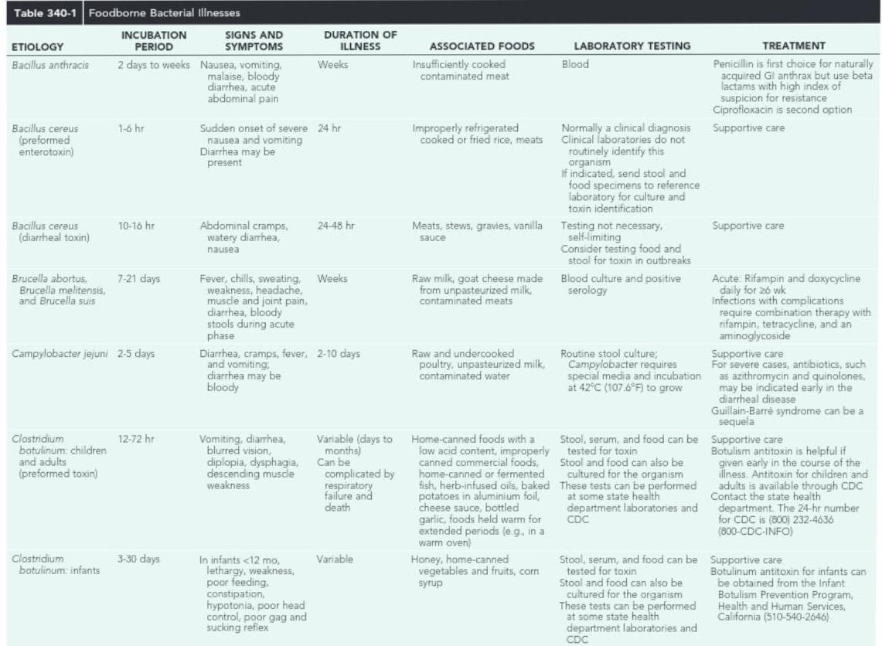

Slide 6
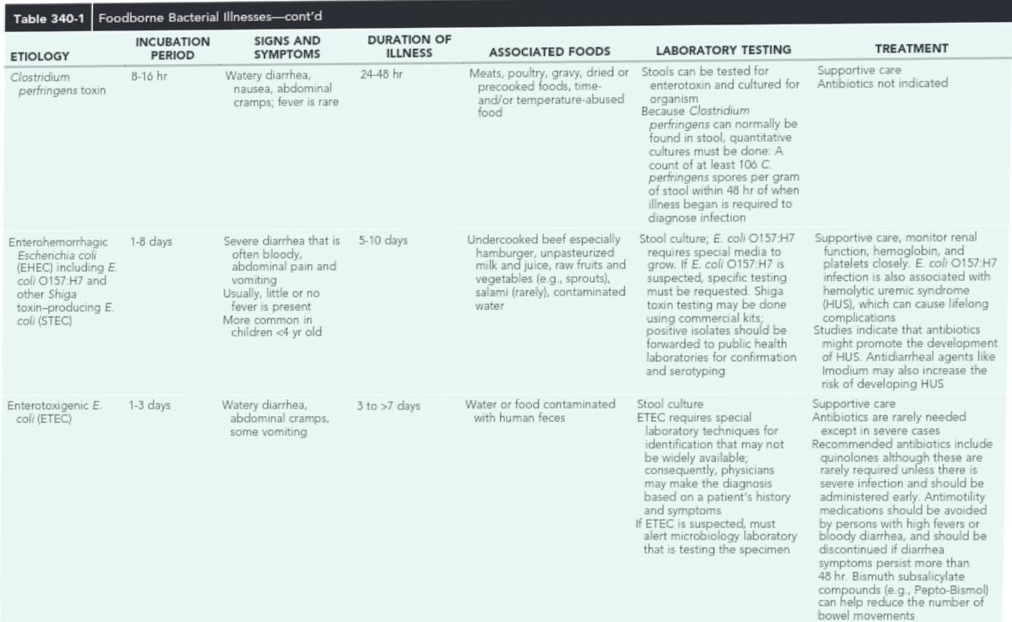

Slide 14
PATHOGENESIS OF INFECTIOUS DIARRHEA
Pathogenesis and severity of bacterial disease depend on whether organisms have preformed toxins (S. aureus, Bacillus cereus),produce secretory (cholera, E. coli, Salmonella, Shigella) or cytotoxic (Shigella, S. aureus, Vibrio parahaemolyticus,C. difficile, E. coli, C. jejuni) toxins, or are invasive, and on whether they replicate in food.
Enteropathogens can lead to either an inflammatory or noninflammatory response in the intestinal mucosa

Slide 16
PATHOGENESIS OF INFECTIOUS DIARRHEA
Enteropathogens elicit noninflammatory diarrhea through enterotoxin production by some bacteria, destruction of villus (surface) cells by viruses, adherence by parasites, and adherence and/or translocation by bacteria.
Inflammatory diarrhea is usually caused by bacteria that directly invade the intestine or produce cytotoxins with consequent fluid, protein, and cells (erythrocytes, leukocytes) that enter the intestinal lumen.
Some viruses, such as rotavirus, target the microvillus tips of the enterocytes and can enter the cells by direct invasion or calcium-dependent endocytosis. This can result in villus shortening and loss of enterocyte absorptive surface through cell shortening and loss of microvilli.
the rotavirus protein NSP4 acts as a viral enterotoxin

Slide 17
PATHOGENESIS OF INFECTIOUS DIARRHEA
Bacterial enterotoxins can selectively activate enterocyte intracellular signal transduction and can also affect cytoskeletal rearrangements with subsequent alterations in the water and electrolyte fluxes across enterocytes.
In toxigenic diarrhea, enterotoxin produced by Vibrio cholerae, increased mucosal levels of cyclic adenosine monophosphate, inhibit electroneutral NaCl absorption but have no effect on glucose-stimulated Na+absorption.
In inflammatory diarrhea (e.g., Shigellaspp. or Salmonellaspp.) there is extensive histologic damage, resulting in altered cell morphology and reduced glucose-stimulated Na+and electroneutral NaCl absorption.
In secretory cells from crypts, Cl secretion is minimal in normal subjects and is activated by cyclic adenosine monophosphate in toxigenic and inflammatory diarrhea

Slide 18
PATHOGENESIS OF INFECTIOUS DIARRHEA
ETEC colonizes and adheres to enterocytes of the small bowel via its surface fimbriae (pili) and induces hypersecretion of fluids and electrolytes into the small intestine through 1 of 2 toxins: the heat-labile enterotoxin or the heat-stable enterotoxin.
Heat-labile enterotoxin is structurally similar to the V. choleraetoxin, and activates adenylate cyclase, resulting in an increase in intracellular cyclic guanosine monophosphate. In contrast, Shigellaspp. Cause gastroenteritis via a superficial invasion of colonic mucosa, which they invade through M cells located over Peyer patches.
After phagocytosis, a series of events occurs, including apoptosis of macrophages, multiplication and spread of bacteria into adjacent cells, release of inflammatory mediators (interleukin-1 and -8), transmigration of neutrophils into the lumen of the colon, neutrophil necrosis and degranuation, further breach of the epithelial barrier, and mucosal destruction

Slide 19
RISK FACTORS FOR GASTROENTERITIS
Major risks include environmental contamination and increased exposure to enteropathogens. Additional risks include young age, immunodeficiency, measles, malnutrition, and lack of exclusive or predominant breastfeeding.
Malnutrition increases the risk of diarrhea and associated mortality, the fraction of such infectious diarrhea deaths that are attributable to nutritional deficiencies varies with the prevalence of deficiencies; the highest attributable fractions are in sub-Saharan Africa, south Asia, and Andean Latin America.
The risks are particularly higher with micronutrient malnutrition; in children with vitamin A deficiency, and accounts for 157,000 deaths from diarrhea, measles, and malaria. Zinc deficiency is estimated to cause 116,000 deaths from diarrhea and pneumonia.

Slide 20
RISK FACTORS FOR GASTROENTERITIS
The majority of cases of diarrhea resolve within the 1st wk of the illness. A smaller proportion of diarrheal illnesses fail to resolve and persist for longer than 2wk.
Persistent diarrhea is defined as episodes that began acutely but last for 14 or more days. Such episodes account for 3-19% of all diarrheal episodes in children younger than 5yr of age and up to 50% of all diarrhea-related deaths; persistent diarrhea has a case fatality rate of 60%. Many children (especially infants and toddlers) in developing countries have frequent episodes of acute diarrhea. Although few individual episodes persist beyond 14 days, frequent episodes of acute diarrhea, as well as prolonged diarrhea (lasting between 7-13 days of age), can result in nutritional compromise and can predispose these children to develop persistent diarrhea, protein-calorie malnutrition, and secondary infections

Slide 21
CLINICAL MANIFESTATION OF DIARRHEA
Most of the clinical manifestations and clinical syndromes of diarrhea are related to the infecting pathogen and the dose or inoculum and the nature of the infecting pathogen.

Slide 22
CLINICAL MANIFESTATION OF DIARRHEA
Usually the ingestion of preformed toxins (e.g., those of S. aureus) is associated:
with the rapid onset of nausea and vomiting within 6hr,
with possible fever, abdominal cramps, and diarrhea within 8-72hr.
Watery diarrhea and abdominal cramps after an 8-16hr incubation period are associated with enterotoxin-producing C. perfringensand B. cereus.
Abdominal cramps and watery diarrhea after a 16-48hr incubation period can be associated with noroviruses, several enterotoxin-producing bacteria, Cryptosporidium,and Cyclospora,and also have been a notable feature of influenza virus H1N1 infections.Several organisms, including Salmonella, Shigella, C. jejuni, Yersinia enterocolitica,
Enteroinvasive or hemorrhagic (Shigatoxin-producing) E. coli,and V. parahaemolyticus,produce diarrhea that can contain blood as well as fecal leukocytes in association with abdominal cramps, tenesmus, and fever; these features suggest bacterial dysentery and fever

Slide 23
CLINICAL MANIFESTATION OF DIARRHEA
Bloody diarrhea and abdominal cramps after a 72-120hr incubation period are associated with infections from Shigella and also Shigatoxin-producing E. coli,such as E. coli O157:H7.
Organisms associated with dysentery or hemorrhagic diarrhea can also cause watery diarrhea alone without fever or that precedes a more complicated course that results in dysentery

Slide 24
COMPLICATIONS
Dehydration
Malnutrition
secondary infections and micronutrient deficiencies (iron, zinc, vitamin A)
Bacteremias in developing countries and HIV-infected populations

Slide 26
DIAGNOSIS
Clinical Evaluation of Diarrhea:
Assessing the degree of dehydration and acidosis and provide rapid resuscitation and rehydration with oral or intravenous fluids as required.
Obtaining appropriate contact, travel, or exposure history. This includes information on exposure to contacts with similar symptoms, intake of contaminated foods or water, child-care center attendance, recent travel of patient or contact with a person who traveled to a diarrhea-endemic area, and use of antimicrobial agents.

Slide 27
DIAGNOSIS
Nausea and vomiting are nonspecific symptoms, they indicate infection in the upper intestine.
nausea and vomiting and absent or low-grade fever with mild to moderate periumbilical pain and watery diarrhea indicate small intestine involvement and also reduce the likelihood of a serious bacterial infection
Fever suggests an inflammatory process but also occurs as a result of dehydration or coinfection (e.g., urinary tract infection, otitis media).
Fever is common in patients with inflammatory diarrhea.
Severe abdominal pain and tenesmus indicate involvement of the large intestine

Slide 28
DIAGNOSIS
Stool Examination:
stool specimens could be examined for mucus, blood, and leukocytes.
Fecal leukocytes indicate bacterial invasion of colonic mucosa, although some patients with shigellosis have minimal leukocytes at an early stage of infection, as do patients infected with Shigatoxin-producing E. coli and E. histolytica.
Stool cultures should be obtained as early in the course of disease as possible from children with bloody diarrhea in whom stool microscopy indicates fecal leukocytes,in outbreaks with suspected hemolytic-uremic syndrome,and in immunosuppressed children with diarrhea.
The yield and diagnosis of bacterial diarrhea is improved by using molecular diagnostic procedures such as real-time polymerase chain reaction.
In most previously healthy children with uncomplicated watery diarrhea, no laboratory evaluation is needed except for epidemiologic purposes

Slide 29
TREATMENT
The broad principles of management of acute gastroenteritis in children include oral rehydration therapy, enteral feeding and diet selection, zinc supplementation, and additional therapies such as probiotics

Slide 30
1- Oral Rehydration Therapy
Dehydration must be evaluated rapidly and corrected in 4-6hr according to the degree of dehydration and estimated daily requirements. A small minority of children, especially those in shock or unable to tolerate oral fluids, require initial intravenous rehydration, but oral rehydration is the preferred mode of rehydration and replacement of ongoing losses.
Risks associated with severe dehydration that might necessitate intravenous resuscitation include: age <6mo; prematurity; chronic illness; fever >38°C (100.4°F) if younger than 3mo or >39°C (102.2°F) if 3-36mo of age; bloody diarrhea; persistent emesis; poor urine output; sunken eyes; and a depressed level of consciousness.

Slide 31
1- Oral Rehydration Therapy
The low-osmolality World Health Organization (WHO) oral rehydration solution (ORS) containing:
75mEq of sodium
64mEq of chloride
20mEq of potassium
75mmol of glucose per liter
with total osmolarity of 245mOsm/L
It is now the global standard of care and more effective than home fluids, including decarbonated soda beverages, fruit juices, and tea (which are not suitable for rehydration or maintenance therapy because they have inappropriately high osmolalities and low sodium concentrations)

Slide 32
1- Oral Rehydration Therapy
Oral rehydration should be given to infants and children slowly, especially if they have emesis. It can be given initially by a dropper, teaspoon, or syringe, beginning with as little as 5mL at a time. The volume is increased as tolerated. Replacement for emesis or stool losses.
Oral rehydration can also be given by a nasogastric tube if needed; this is not the usual route.
Limitations to oral rehydration therapy include shock, an ileus, intussusception, carbohydrate intolerance (rare), severe emesis, and high stool output (>10mL/kg/hr).
Ondansetron (oral mucosal absorption preparation) reduces the incidence of emesis, thus permitting more effective oral rehydration and is well established in emergency management of acute gastroenteritis in developed countries

Slide 35
2- Enteral Feeding and Diet Selection
Continued enteral feeding in diarrhea aids in recovery from the episode, and a continued age-appropriate diet after rehydration is the norm.
Once rehydration is complete, food should be reintroduced while oral rehydration is continued to replace ongoing losses from emesis or stools and for maintenance.
Breastfeeding or nondiluted regular formula should be resumed as soon as possible.
Foods with complex carbohydrates (rice, wheat, potatoes, bread, and cereals), lean meats, yogurt, fruits, and vegetables are also tolerated.
Fatty foods or foods high in simple sugars (juices, carbonated sodas) should be avoided.

Slide 36
2- Enteral Feeding and Diet Selection
The usual energy density of any diet used for the therapy of diarrhea should be around 1kcal/g, aiming to provide an energy intake of a minimum of 100kcal/kg/day and a protein intake of 2-3g/kg/day. In selected circumstances when adequate intake of energy-dense food is problematic, the addition of amylase to the diet through germination techniques can also be helpful.

Slide 37
Lactose
With the exception of acute lactose intolerance in a small subgroup, most children with diarrhea are able to tolerate milk and lactose-containing diets. Withdrawal of milk and replacement with specialized (and expensive) lactose-free formulations are unnecessary.
Although children with persistent diarrhea are not lactose intolerant, administration of a lactose load exceeding 5g/kg/day may be associated with higher purging rates and treatment failure.
Alternative strategies for reducing the lactose load while feeding malnourished children who have prolonged diarrhea include addition of milk to cereals and replacement of milk with fermented milk products such as yogurt.

Slide 38
Lactose
Rarely, when dietary intolerance precludes the administration of cow’s milk–based formulations or whole milk it may be necessary to administer specialized milk-free diets such as a comminuted or blenderized chicken-based diet or an elemental formulation.
Although effective in some settings, the latter are unaffordable in most developing countries. In addition to rice-lentil formulations, the addition of green banana or pectin to the diet has also been shown to be effective in the treatment of persistent diarrhea.

Slide 39
Zinc Supplementation
Zinc supplementation in children with diarrhea in developing countries leads to:
reduced duration and severity of diarrhea
could potentially prevent a large proportion of cases from recurring.
Zinc administration for diarrhea management can significantly reduce all-cause mortality by 46% and hospital admission by 23%.
Increase use of ORS and reduction in the inappropriate use of antimicrobials.
All children older than 6mo of age with acute diarrhea in at-risk areas should receive oral zinc (20mg/day) in some form for 10-14 days during and continued after diarrhea.

Slide 40
Additional Therapies
Brobiotics:
The use of probiotic nonpathogenic bacteria for prevention and therapy of diarrhea has been successful in some settings although the evidence is inconclusive to recommend their use in all settings.
In addition to restoring beneficial intestinal flora, probiotics can enhance host protective immunity such as downregulation of proinflammatory cytokines and upregulation of anti inflammatory cytokines.
A variety of organisms (Lactobacillus, Bifidobacterium)have a good safety record; therapy has not been standardized and the most effective (and safe) organism has not been identiied.
Saccharomyces boulardiiis effective in antibiotic-associated and in C. difficile diarrhea, and there is some evidence that it might prevent diarrhea in daycare centers.
Lactobacillus rhamnosus GGis associated with reduced diarrheal duration and severity, which reduction is more evident in cases of childhood rotavirus diarrhea.

Slide 41
Additional Therapies
Antimotility agents (loperamide): are contraindicated in children with dysentery and probably have no role in the management of acute watery diarrhea in otherwise healthy children.
Racecadotril, an enkephalins inhibitor, has inconsistently been shown to reduce stool output in patients with diarrhea. Experience with this drug in children is limited, and for the average child with acute diarrhea it may be unnecessary
Antiemetic agents: such as the phenothiazines, are of little value and are associated with potentially serious side effects (lethargy, dystonia, malignant hyperpyrexia).
ondansetron is an effective and less-toxic antiemetic agent and as indicated previously, is a useful adjunct to the treatment of vomiting in ambulatory settings with reduced risk of intravenous fluid requirements and hospitalization. Because persistent vomiting can limit oral rehydration therapy, a single sublingual dose of an oral dissolvable tablet of ondansetron (4mg 4-11yr and 8mg for children older than 11yr [generally 0.2mg/kg]) may be given.
However, most children do not require speciic antiemetic therapy; careful oral rehydration therapy is usually suficient.

Slide 42
Antibiotic therapy
Timely antibiotic therapy in select cases of diarrhea related to bacterial infections can reduce the duration and severity of illness and prevent complications.
Although these agents are important to use in specific cases, their widespread and indiscriminate use leads to the development of antimicrobial resistance.
No need for empirical therapy.
Treat in case of: immuncompramised pt, < 3 mo pt, bacteremia.
Nitazoxanide, an antiinfective agent, is effective in the treatment of a wide variety of patho-gens, including C. parvum, G. lamblia, E. histolytica, Blastocystis hominis, C. difficile, and rotavirus

Slide 44
PREVENTION
Promotion of Exclusive Breastfeeding: Exclusive breastfeeding protects very young infants from diarrheal disease through the promotion of passive immunity and through reduction in the intake of potentially contaminated food and water.
Improved Complementary Feeding Practices: should be introduced at 6mo of age, and breastfeeding should continue for up to 2yr, Improved vitamin A status has been shown to reduce the frequency of severe diarrhea. Vitamin A supplementation reduces all-cause childhood mortality by 25%
Rotavirus Immunization: The institution of large-scale rotavirus vaccination programs has led to major reduction in the burden of disease and associated mortality. In an evaluation of large-scale rotavirus vaccine introduction, coverage rate of 74% was achieved in infants younger than 12mo of age, with 41% reduction (95% CI, 36-47%) in diarrhea-related mortality.
Vaccines against cholera, Shigella, and ETEC. Preventive use of cholera vaccines in endemic countries can reduce the risk of developing cholera by 52% (95% CI, 36-65%).

Slide 45
PREVENTION
5. Improved Water and Sanitary Facilities and Promotion of Personal and Domestic Hygiene: an estimated 88% of all diarrheal deaths worldwide can be attributed to unsafe water, inadequate sanitation, and poor hygiene
6. Improved Case Management of Diarrhea: mproved management of acute diarrhea is a key factor in reducing the burden of prolonged episodes and persistent diarrhea. The WHO/UNICEF recommendations to use low-osmolality ORS and zinc supplementation for the management of diarrhea, coupled with selective and appropriate use of antibiotics, have the potential to reduce the number of diarrheal deaths among children through Community Case Management and Integrated Management of Childhood Illnesses.

Slide 47
Thank you

