Slide 1
Community acquired
Pneumonia
(CAP)

Slide 2
Epidemiology:
Pneumonia is inflammation of the lung parenchyma,
Is the leading cause of death globally among children younger than age 5 yr,
accounting for an estimated 1.2 million (18% total) deaths annually
The incidence of pneumonia is more in developing than in developed countries. Fifteen countries account for more than three-fourths of all pediatric deaths from pneumonia.

Slide 3
There is decline in pneumonia mortaliy in US. It is probable that this decline results from the introduction of antibiotics, vaccines, and the expansion of medical insurance coverage for children.
Haemophilus influenzae type b was an important cause of bacterial pneumonia in young children but became uncommon with the routine use of effective vaccines, while measles vaccine greatly reduced the incidence of measles-related pneumonia deaths in developing countries. Improved access to healthcare in rural areas of developing countries and the introduction of pneumococcal conjugate vaccines were also important contributors to the further reductions in pneumonia-related deaths achieved over the past decade

Slide 4
Etiology:
most cases of pneumonia are caused by :
Microorganisms
noninfectious causes include aspiration (of food or gastric acid, foreign bodies, hydrocarbons, and lipoid substances), hypersensitivity reactions, and drug- or radiation-induced pneumonitis.
The cause of pneumonia in an individual patient is often difficult to determine because direct culture of lung tissue is invasive and rarely performed. Cultures performed on specimens in children obtained from the upper respiratory tract or sputum typically do not accurately reflect the cause of lower respiratory tract infection. With the use of molecular diagnostic testing, a bacterial or viral cause of pneumonia can be identified in 40-80% of children with community-acquired pneumonia.

Slide 5
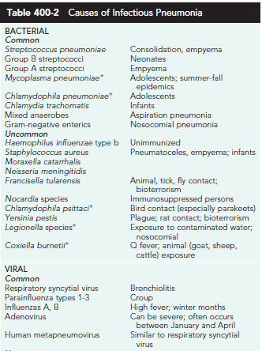

Slide 6
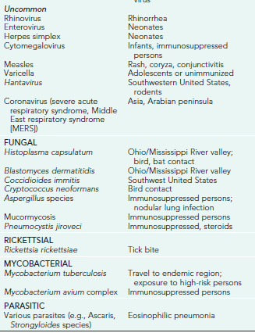

Slide 7
Streptococcus pneumoniae (pneumococcus) is the most common bacterial pathogen in children 3 wk to 4 yr of age.
Mycoplasma pneumoniae and Chlamydophila pneumoniae are the most frequent bacterial pathogens in children age 5 yr and older.
Other bacterial causes of pneumonia in previously healthy children in the United States include group A streptococcus (Streptococcus pyogenes) and Staphylococcus aureus. (S. aureus pneumonia often complicates an illness caused by influenza viruses).

Slide 8
Major causes of hospitalization and death from bacterial pneumonia among children in developing countries:
S. pneumoniae
H. influenzae
and S. aureus .
although in children with HIV infection, Mycobacterium tuberculosis, atypical mycobacteria, Salmonella, Escherichia coli and Pneumocystis jiroveci must be considered.

Slide 9
The incidence of pneumonia caused by H. influenzae or S. pneumoniae has been significantly reduced in areas where routine immunization has been implemented.

Slide 10
Viral pathogens are a prominent cause of lower respiratory tract infections in infants and children older than 1 mo but younger than 5 yr of age.
Viruses can be detected in 40-80% of children with pneumonia using molecular diagnostic methods.

Slide 11
Of the respiratory viruses,
respiratory syncytial virus (RSV) and rhinoviruses are the most commonly identified pathogens, especially cildren younger than 2 yr of age.
the role of rhinoviruses in sever lower respiratory tract infection remains poorly defined as these viruses are frequently detected in infections with 2 or more pathogens and among asymptomatic children.
Other common viruses causing pneumonia include influenza virus, parainfluenza viruses, adenoviruses, enteroviruses, and human metapneumovirus.
Infection with more than 1 respiratory virus occurs in up to 20% of cases. The age of the patient may help identify possible pathogens (Table 400-3).

Slide 12
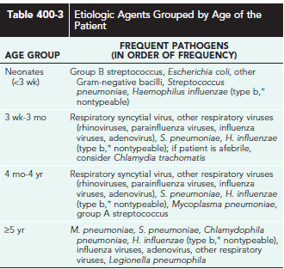

Slide 13
Lower respiratory tract viral infections are much more common in the fall and winter in both the northern and southern hemispheres in relation to the seasonal epidemics of respiratory viral infection that occur each year.

Slide 14
The typical pattern of these epidemics usually begins in the fall, when parainfluenza infections appear and most often manifest as croup.
Later in winter, RSV, human metapneumovirus, and influenza viruses cause widespread infection, including upper respiratory tract infections, bronchiolitis, and pneumonia.
RSV is particularly severe among infants and young children, whereas influenza virus causes disease and excess hospitalization for acute respiratory illness in all age groups. Knowledge of the prevailing viral epidemic may lead to a presumptive initial diagnosis.

Slide 15
Immunization status is relevant because children fully immunized against H. influenzae type b and S. pneumoniae are less likely to be infected with these pathogens.
Children who are immunosuppressed or who have an underlying illness may be at risk for specific pathogens,such as Pseudomonas spp. in patients with cystic fibrosis.

Slide 16
PATHOGENESIS:
The lower respiratory tract is normally kept sterile by physiologic defense mechanisms, including mucociliary clearance, the properties of normal secretions such as secretory immunoglobulin (Ig) A, and clearing of the airway by coughing.
Immunologic defense mechanisms of the lung that limit invasion by pathogenic organisms include macrophages that are present in alveoli and bronchioles, secretory IgA, and other immunoglobulins.
Trauma, anesthesia, and aspiration increase the risk of pulmonary infection.
Viral pneumonia usually results from spread of infection along the airways, accompanied by direct injury of the respiratory epithelium, which results in airway obstruction from swelling, abnormal secretions, and cellular debris. The small caliber of airways in young infants makes such patients particularly susceptible to severe infection. Atelectasis, interstitial edema, and ventilation–perfusion mismatch causing significant hypoxemia often accompany airway obstruction. Viral infection of the respiratory tract can also predispose to secondary bacterial infection by disturbing normal host defense mechanisms, altering secretions, and modifying the bacterial flora.

Slide 17
Bacterial pneumonia most often occurs when respiratory tract organisms colonize the trachea and subsequently gain access to the lungs, but pneumonia may also result from direct seeding of lung tissue after bacteremia. When bacterial infection is established in the lung parenchyma, the pathologic process varies according to the invading organism.

Slide 18
M. pneumoniae attaches to the respiratory epithelium, inhibits ciliary action, and leads to cellular destruction and an inflammatory response in the submucosa. As the infection progresses, sloughed cellular debris, inflammatory cells, and mucus cause airway obstruction, with spread of infection occurring along the bronchial tree, as it does in viral pneumonia.

Slide 19
S. pneumoniae produces local edema that aids in the proliferation of organisms and their spread into adjacent portions of lung, often resulting in the characteristic focal lobar involvement.
Group A streptococcus infection of the lower respiratory tract results in more diffuse infection with interstitial pneumonia. The pathology includes necrosis of tracheobronchial mucosa; formation of large amounts of exudate, edema, and local hemorrhage, with extension into the interalveolar septa; and involvement of lymphatic vessels and the increased likelihood of pleural involvement.

Slide 20
S. aureus pneumonia manifests in confluent bronchopneumonia, which is often unilateral and characterized by the presence of extensive areas of hemorrhagic necrosis and irregular areas of cavitation of the lung parenchyma, resulting in pneumatoceles, empyema, or, at times, bronchopulmonary fistulas.

Slide 21
Recurrent pneumonia is defined as 2 or more episodes in a single year or 3 or more episodes ever, with radiographic clearing between occurrences. An underlying disorder should be considered if a child experiences recurrent pneumonia (Table 400-4).

Slide 22
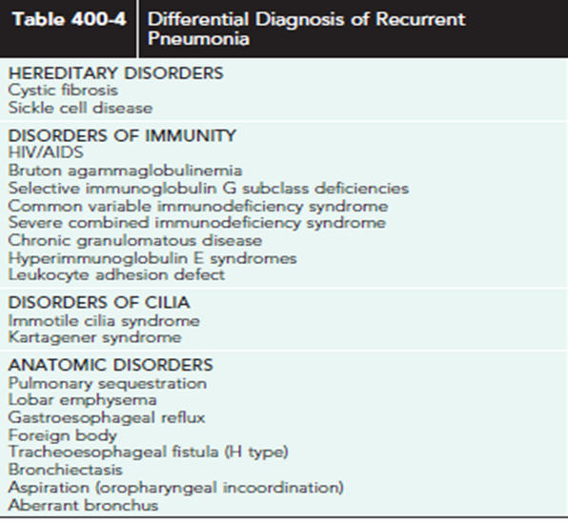

Slide 23
CLINICAL MANIFESTATIONS:
Pneumonia is frequently preceded by several days of symptoms of an upper respiratory tract infection, typically rhinitis and cough.
In viral pneumonia, fever is usually present but temperatures are generally lower than in bacterial pneumonia. Tachypnea is the most consistent clinical manifestation of pneumonia. Increased work of breathing accompanied by intercostal, subcostal, and suprasternal retractions, nasal flaring, and use of accessory muscles is common. Severe infection) may be accompanied by cyanosis and lethargy, especially in infants.
Auscultation of the chest may reveal crackles and wheezing, but it is often difficult to localize the source of these adventitious sounds in very young children with hyper resonant chests. It is often not possible to distinguish viral pneumonia clinically from disease caused by Mycoplasmaand other bacterial pathogens.

Slide 24
Bacterial pneumonia in adults and older children typically begins suddenly with high fever, cough, and chest pain.
Other symptoms that may be seen include drowsiness with intermittent periods of restlessness; rapid respirations; anxiety; and, occasionally, delirium.
In many children, splinting on the affected side to minimize pleuritic pain and improve ventilation is noted; such children may lie on one side with the knees drawn up to the chest.

Slide 25
Physical findings depend on the stage of pneumonia.
Early in the course of illness, diminished breath sounds, scattered crackles, and rhonchi are commonly heard over the affected lung field. With the development of increasing consolidation or complications of pneumonia such as pleural effusion or empyema, dullness on percussion is noted and breath sounds may be diminished.
A lag in respiratory excursion often occurs on the affected side.
Abdominal distention may be prominent because of gastric dilation from swallowed air or ileus.
Abdominal pain is common in lower-lobe pneumonia.
The liver may seem enlarged because of downward displacement of the diaphragm secondary to hyperinflation of the lungs or superimposed congestive heart failure.

Slide 26
Symptoms described in adults with pneumococcal pneumonia may be noted in older children but are rarely observed in infants and young children, in whom the clinical pattern is considerably more variable.
In infants, there may be a prodrome of upper respiratory tract infection and diminished appetite, leading to the abrupt onset of fever, restlessness, apprehension, and respiratory distress.
These infants appear ill, with respiratory distress manifested as grunting; nasal flaring; retractions of the supraclavicular, intercostal, and subcostal areas; tachypnea; tachycardia; air hunger; and often cyanosis.

Slide 27
Results of physical examination may be misleading, particularly in younginfants, with meager findings disproportionate to the degree of tachypnea.
Some infants with bacterial pneumonia may have associated gastrointestinal disturbances characterized by vomiting, anorexia, diarrhea, and abdominal distention secondary to a paralytic ileus. Rapid progression of symptoms is characteristic in the most severe cases of bacterial pneumonia.

Slide 28
Diagnosis:
An infiltrate on chest radiograph (posteroanterior and lateral views) supports the diagnosis of pneumonia; the film may also indicate a complication such as a pleural effusion or empyema.
Viral pneumonia is usually characterized by hyperinflation with bilateral interstitial infiltrates and peribronchial cuffing.
Confluent lobar consolidation is typically seen with pneumococcal pneumonia .
The radiographic appearance alone is not diagnostic, and other clinical features must be considered. Repeat chest radiographs are not required for proof of cure for patients with uncomplicated pneumonia.
Some experts suggest that a chest radiograph may not be necessary for older children with suspected pneumonia (cough, fever, localized crackles,or decreased breath sounds) who are well enough to be managed as outpatients.

Slide 29
Point-of-care use of portable or handheld ultrasonography is highly sensitive and specific in diagnosing pneumonia in children by determining lung consolidations and air bronchograms or effusions.
The peripheral white blood cell (WBC) count can be useful in differentiating viral from bacterial pneumonia.
In viral pneumonia, the WBC count can be normal or elevated but is usually not higher than 20,000/mm3, with a lymphocyte predominance.
Bacterial pneumonia is often associated with an elevated WBC count, in the range of 15,000- 40,000/mm3, and a predominance of granulocytes.
A large pleural effusion, lobar consolidation, and a high fever at the onset of the illness are also suggestive of a bacterial etiology.
Atypical pneumonia caused by C. pneumoniae or M. pneumoniae is difficult to distinguish from pneumococcal pneumonia on the basis of radiographic and laboratory findings.
although pneumococcal pneumonia is associated with a higher WBC count, erythrocyte sedimentation rate, procalcitonin, and C-reactive protein level, there is considerable overlap, particularly with adenoviruses and enteroviruses.

Slide 30
The definitive diagnosis of a viral infection rests on the isolation of a virus or detection of the viral genome or antigen in respiratory tract secretions.
Reliable DNA or RNA tests for the rapid detection of many respiratory pathogens, such as mycoplasma, pertussis, and viruses, including RSV, parainfluenza, influenza, and adenoviruses, are available and accurate. Serologic techniques can also be used to diagnose a recent respiratory viral infection but generally require testing of acute and convalescent serum samples for a rise in antibodies to a specific viral agent.
This diagnostic technique is laborious, slow, and not generally clinically useful because the infection usually resolves by the time it is confirmed serologically. Serologic testing may be valuable as an epidemiologic tool to define the incidence and prevalence of the various respiratory viral pathogens.
Patient peripheral cell gene expression patterns determined by microarray reverse transcription polymerase chain reaction is an emerging technology that may help differentiate viral from bacterial causes of pneumonia.

Slide 31
The definitive diagnosis of a bacterial infection requires isolation of an organism from the blood, pleural fluid, or lung.
Culture of sputum is of little value in the diagnosis of pneumonia in young children, while percutaneous lung aspiration is invasive and not routinely performed.
Blood culture results are positive in only 10% of children with pneumococcal pneumonia and are not recommended for nontoxic appearing children treated as an outpatient. Blood cultures are recommended for those who fail to improve or have clinical deterioration, in those with complicated pneumonia and those requiring hospitalization.

Slide 32
Cold agglutinins at titers >1 : 64 are found in the blood in ≈50% of patients with M. pneumoniae infections. Cold agglutinin findings are nonspecific because other pathogens such as influenza viruses may also cause increases. Acute infection caused by M. pneumoniae can be diagnosed on the basis of a positive polymerase chain reaction test result or seroconversion in an IgG assay. Serologic evidence, such as the antistreptolysin O titer, may be useful in the diagnosis of group A streptococcal pneumonia.

Slide 33
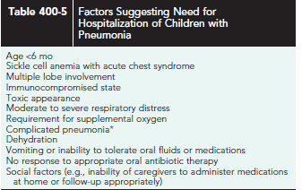
Pleural effusion, empyema, abscess, bronchopleural fistula, necrotizing pneumonia, acute respiratory distress syndrome, extrapulmonary infection
(meningitis, arthritis, icarditis, osteomyelitis, endocarditis), hemolytic uremic syndrome.

Slide 34
treatment
Treatment of suspected bacterial pneumonia is based on the presumptive
cause and the age and clinical appearance of the child.
Neonate:
In early onset empirically treat with ampicillin and gentamicin.
In late : vancomycin and gentamicin.

Slide 35
Treatment
For mildly ill children who do not require hospitalization, amoxicillin is recommended.
With the emergence of penicillin-resistant pneumococci, high doses of amoxicillin (80-90 mg/kg/24 hr) should be prescribed unless local data indicate a low prevalence of resistance.
Therapeutic alternatives include cefuroxime axetil and amoxicillin/clavulanate.
For school-age children and in children in whom infection with M. pneumoniae or C. pneumoniae is suggested, a macrolide antibiotic such as azithromycin is an appropriate choice.
In adolescents, a respiratory fluoroquinolone (levofloxacin, moxifloxacin) may be considered as an alternative.

Slide 36
amoxicillin
Suspension:
Reconstitute powder for oral suspension with adequate water, and vigorously Shake.
oral:
give on empty or full , may be mixed with formula, milk., juice.
Store powder at room temperature .
when reconstitute stable for 14 days at room temperature or preferred )refrigerated.

Slide 37
Amoxicillin/clavulanate
Suspension:
Reconstitute powder for oral suspension with water, and vigourisly Shake.
Oral, iv :
Oral : can be given no regard to meals.
Suspension: Administer at the start of a meal to decrease the frequency or severity of GI side effet: may mix with milk.
Store dry powder at or below 25.
reconstituted oral suspension stored in the refrigerator. For 10 day.

Slide 38
Azithromycine
Suspension: Reconstitute powder for oral suspension with adequate water, and vigouresly Shake
Oral, parenteral (iv )
Oral: may be administer with meal or not.
Store below 30.
Store constituted at 5 to 30 within 10 days

Slide 39
The empiric treatment of suspected bacterial pneumonia in a hospitalized child requires an approach based on the clinical manifestations at the time of presentation.
In areas without substantial high-level penicillin resistance among S. pneumoniae, children who are fully immunized against H. influenzae type b and S. pneumoniae and are not severely ill should receive ampicillin or penicillin G.
For children who do not meet these criteria, ceftriaxone or cefotaxime should be used.
If clinical features suggest staphylococcal pneumonia (pneumatoceles, empyema), initial antimicrobial therapy should also include vancomycin or clindamycin.

Slide 40
If viral pneumonia is suspected, it is reasonable to withhold antibiotic therapy, especially for those patients who are mildly ill, have clinical evidence suggesting viral infection, and are in no respiratory distress. However, up to 30% of patients with known viral infection, particularly influenza viruses, may have coexisting bacterial pathogens.
Therefore, if the decision is made to withhold antibiotic therapy on the basis of presumptive diagnosis of a viral infection, deterioration in
clinical status should signal the possibility of superimposed bacterial infection, and antibiotic therapy should be initiated.

Slide 41
The optimal duration of antibiotic treatment for pneumonia has not been well-established in controlled studies. However, antibiotics should generally be continued until the patient has been afebrile for 72 hr, and the total duration should not be less than 10 days (or 5 days if azithromycin is used).
Shorter courses (5-7 days) may also be effective, particularly for children managed on an outpatient basis, but further study is needed.
Available data do not support prolonged courses of treatment for uncomplicated pneumonia.
In developing countries, oral zinc (10 mg/day for <12 mo, 20 mg/day for ≥12 mo) reduces mortality among children with clinically defined severe pneumonia.

Slide 42
Prognosis:
Typically, patients with uncomplicated community-acquired bacterial pneumonia show response to therapy, with improvement in clinical symptoms (fever, cough, tachypnea, chest pain), within 48-96 hr of initiation of antibiotics.
Radiographic evidence of improvement lags substantially behind clinical improvement.

Slide 43
A number of possibilities must be considered when a patient does not improve with appropriate antibiotic therapy:
(1) complications, such as empyema ( Table 400- 5)
(2) bacterial resistance;
(3) nonbacterial etiologies such as viruses or fungi and aspiration of foreign bodies or food;
(4) bronchial obstruction from endobronchial lesions, foreign body, or mucous plugs;
(5) preexisting diseases such as immunodeficiencies, ciliary dyskinesia, cystic fibrosis, pulmonary sequestration, or congenital pulmonary airway malformation, formerly called cystic adenomatoid malformation
and (6) other noninfectious causes (including bronchiolitis obliterans, hypersensitivity pneumonitis, eosinophilic pneumonia, aspiration, and granulomatosis with polyangiitis, formerly called Wegener granulomatosis).

Slide 44
A repeat chest radiograph is the first step I determining the reason for delay in response to treatment. Bronchoalveola lavage may be indicated in children with respiratory failure; high-resolution CT scans may better identify complications or an anatomic reason for a poor response to therapy.

Slide 45
Mortality from community-acquired pneumonia in developednations is rare, and most children with pneumonia do not experiencelong-term pulmonary sequelae. Some data suggest that up to 45% of children have symptoms of asthma 5 yr after hospitalization for pneumonia; this finding may reflect either undiagnosed asthma at the timeof presentation or a propensity for development of asthma after pneumonia.

Slide 46
COMPLICATIONS
Complications of pneumonia are usually the result of direct spread of bacterial infection within the thoracic cavity (pleural effusion, empyema, and pericarditis) or bacteremia and hematologic spread.
Meningitis, suppurative arthritis, and osteomyelitisare rare complications of hematologic spread of pneumococcal or H. influenzae type b infection.
S. aureus, S. pneumoniae, and S. pyogenes are the most common causes of parapneumonic effusions and empyema
Nonetheless many effusions that complicate bacterial pneumonia are sterile.
Universal 16S ribosomal RNA gene polymerase chain reaction identifies the bacterial genome and can determine the bacterial etiology of the effusion if the culture is negative.
The treatment of empyema is based on the stage (exudative, fibrinopurulent, organizing). Imaging studies including ultrasonography and CT are helpful in determining the stages

Slide 47
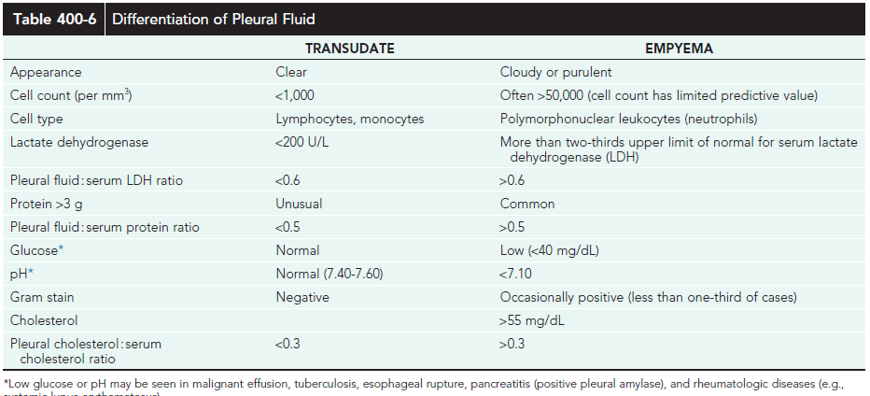

Slide 48
The mainstays of therapy include antibiotic therapy and drainage with tube thoracostomy. Additional effective approaches include the use of intrapleural fibrinolytic therapy (urokinase, streptokinase, tissue plasminogen activator) and selected videoassisted thoracoscopy to debride or lyse adhesions and drain loculated areas of pus. Early diagnosis and intervention, particularly with fibrinolysis or less often video-assisted thoracoscopy, may obviate the need for thoracotomy and open debridement. Fibrinolysis is more costeffective than video-assisted thoracoscopy

Slide 49
Prevent:
Some evidence exists to suggest that vaccination has reduced the incidence of pneumonia hospitalizations.
7-valent pneumococcal conjugate vaccine (PCV7): they do suggest that vaccination has resulted in a sustained benefit in
preventing hospitalization for young children with pneumonia.
13-valent pneumococcal conjugate vaccine (PCV13): it may prevent even more cases of pneumococcal disease not covered by the PCV7 vaccine.
The influenza vaccine recommendations to include all
children >6 mo of age might be expected to affect pneumonia
hospitalization rates in a similar fashion.

