Slide 1
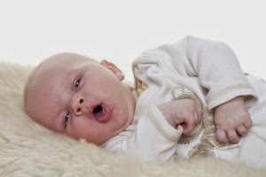
bronchiolitis
By Alaa Sandouka
Notes:
NOTE: To change images on this slide, select a picture and delete it. Then click the Insert Picture icon
in the placeholder to insert your own image.

Slide 2
Acute bronchiolitis
Bronchiolitis is an acute inflammatory injury of the bronchioles that is usually caused by a viral infection
It is predominantly a viral disease. and It is generally a self-limiting
RSV is responsible for more than 50% of cases.
Other agents include parainfluenza, adenovirus, rhinovirus
Emerging pathogens include human metapneumovirus and human bocavirus, which may be a primary cause of viral respiratory infection or occur as a coinfection with RSV.
there is no evidence of a bacterial cause for bronchiolitis and bronchiolitis is rarely followed by bacterial superinfection. Concurrent infection with viral bronchiolitis and pertussis has been described.

Slide 3
Bronchiolitis Infection is spread by direct contact with respiratory secretions
is more common in boys, a pattern similar to other respiratory viral infections. The exact reason for this difference is unknown.
in those who have not been breastfed,
and in those who live in crowded conditions.
Risk is higher for infants with mothers who smoked during pregnancy.

Slide 4
risk factors for severe disease include :
Age < 12 wk
preterm birth
or underlying comorbidity such as cardiovascular, pulmonary, neurologic, or immunologic disease.
Infants with acute bronchiolitis who are experiencing respiratory distress (hypoxia, inability to take oral feedings, apnea, extreme tachypnea) should be hospitalized.
Other Considerations for hospital admission may include the following: prematurity, Age younger than 3 months, Dyspnea, Persistent resting oxygen saturation below 90% in room air ,Markedly elevated respiratory rate (>70-80 breaths/min), Inability to maintain oral hydration and difficulty feeding, comorbidities.

Slide 5
Older family members are a common source of infection; they might only experience minor upper respiratory symptoms. The clinical manifestations of lower respiratory tract illness seen in young infants may be minimal in older patients, in whom bronchiolar edema is better tolerated.
What may affect this developing of lower respiratory tract illness? (increase chance)
Host anatomic and immunologic factors play a significant role in the severity of the clinical syndrome (Infants with preexistent smaller airways and diminished lung function have a more severe course)
the nature of the viral pathogen (RSV infection incites a complex immune response)
Eosinophils degranulate and release eosinophil cationic protein, which is cytotoxic to airway epithelium. Innate immunity plays a significant role and can depend on interferons, interleukins. Chemokines and cytokines, such as tumor necrosis factor α, may be diferentially expressed, depending on the inciting virus.
Coinfection with more than 1 virus can also alter the clinical manifestations and/ or severity of presentation.

Slide 6
Acute bronchiolitis is characterized by bronchiolar obstruction with edema, mucus, and cellular debris
Resistance in the small air passages is increased during both inhalation and exhalation, but because the radius of an airway is smaller during expiration, the resultant respiratory obstruction leads to early air trapping and overinflation.
Hypoxemia is a consequence of ventilation–perfusion mismatch early in the course. With severe obstructive disease and tiring of respiratory effort, hypercapnia can develop.

Slide 7
CLINICAL MANIFESTATIONS
  The infant first develops a mild upper respiratory tract infection with sneezing and clear rhinorrhea (one to three days)
  Diminished appetite and fever of 38.5-39°C .
  Respiratory distress , with wheezing (last for 7 days), cough and irritability.
  Breathing rapidly (60 to 80 times per minute) which can interfere with feeding , which can result in dehydration .
  Hypoxia and cyanosis can develop as the illness progresses.
  the child does not usually have diarrhea or vomiting.
*Apnea may be more prominent than wheezing early in the course of the disease, particularly with very young infants (<2 mo old) or former premature infants
So Apnea occurs early in the course of the disease and may be the presenting symptom, especially in those younger than 2 months of age or those born prematurely.

Slide 8
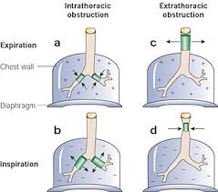
*wheezing
Wheezing : the production of a musical and continuous sound that originates from oscillations in narrowed airways, is heard mostly on expiration as a result of critical airway obstruction.
Monophonic wheezing refers to a single-pitch sound that is produced in the larger airways during expiration, as in bronchomalacia
polyphonic wheezing when there is widespread narrowing of the airways, causing various pitches as air moves through different levels of obstruction to flow, as seen in asthma
Stridor When obstruction occurs in the extrathoracic airways during inspiration .

Slide 9
Infants are more likely to wheeze than older children and adults as a result of a differing set of lung mechanics.
Differences in tracheal cartilage composition and airway smooth muscle tone increase the collapsibility of the infant airways in comparison to older children. So additional narrowing can cause further flow limitation and a subsequent wheeze.
In children younger than 5 yr old, small-caliber peripheral airways can contribute up to 50% of the total airway resistance.
very compliant newborn chest wall
infants tend to have higher levels of lymphocytes and neutrophils, rather than mast cells and eosinophils , in bronchoalveolar lavage fluid. This immunologic factor can affect the infant propensity to wheeze. Also a variety of inflammatory mediators have also been implicated in the wheezing infant such as histamine, cytokines, leukotrienes, and interleukins.
The childhood wheezing phenotype has been linked to many early exposures including fetal nutrition, maternal smoking, prenatal and neonatal exposure to antibiotics, exposure to high levels of environmental allergens, and high infant adiposity.

Slide 10
Other causes of wheezing
Although wheezing in infants most frequently results from inflammation (generally bronchiolitis), there are many causes of wheezing
- Chronic infectious causes of wheezing should be considered in infants who seem to fall out of the range of a normal clinical course. Cystic fibrosis is one such entity.
- Allergy and asthma are important causes of wheezing
- Foreign-body aspiration: misleading clinical and radiologic findings can receive a misdiagnosis of asthma or another obstructive disorder as inflammation and granulation develop around the foreign body. An esophageal foreign body can transmit pressure to the membranous trachea, causing compromise of the airway lumen.

Slide 11
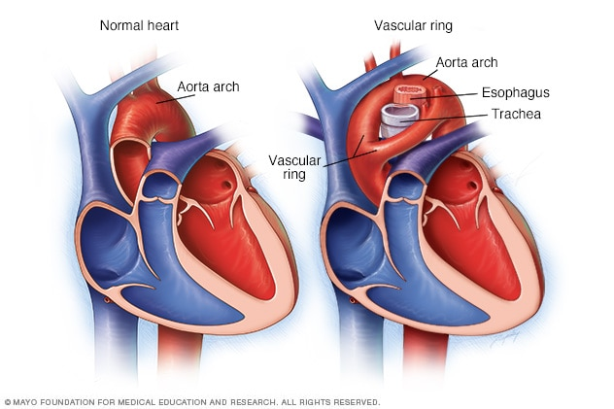
Congenital malformations of the respiratory tract cause wheezing in early infancy.
These findings can be from an external compression or an intrinsic abnormality.
External vascular compression includes a vascular ring, in which the trachea and esophagus are surrounded completely by vascular structures, or a vascular sling, in which the trachea and esophagus are not completely encircled .

Slide 12
Cardiovascular causes of wheezing include dilated chambers of the heart including massive cardiomegaly, left atrial enlargement, and dilated pulmonary arteries.
Pulmonary edema caused by heart failure
Gastroesophageal reflux can cause wheezing with or without direct aspiration into the tracheobronchial tree.* Without aspiration, the reflux is thought to trigger a vagal or neural reflex, causing increased airway resistance and airway reactivity. *Aspiration from gastroesophageal reflux or from the direct aspiration from oral liquids can also cause wheezing.
Trauma and tumors are much rarer causes of wheezing in infants. Trauma of any type to the tracheobronchial tree can cause an obstruction to airflow. Aspirations and burns of the tracheobronchial tree can cause inflammation of the airways and subsequent wheezing.

Slide 13
History
-The initial history of a wheezing infant should describe the recent event including onset, duration, and associated factors.
-Birth history includes: weeks of gestation, neonatal intensive care unit admission and history of intubation or oxygen requirement.
  maternal complications
    infection with herpes simplex virus or HIV
    prenatal smoke exposure.
  Past medical history
  Family history of
    cystic fibrosis,
    immunodeficiencies,
    asthma in a 1st-degree relative, or any other recurrent respiratory conditions in children. or any other recurrent respiratory conditions in children should be obtained.
  Social history should include an environmental history including any smokers at home, home environment, pets ,daycare exposure.

Slide 14
physical examination
  Hypoxia is the best predictor of severe illness and correlates best with the degree of tachypnea
  evaluation of the patient’s vital signs with special attention to the respiratory rate and the pulse oximetry reading for oxygen saturation is an important initial step. The exam is often dominated by wheezing. Auscultation might reveal fine crackles or overt wheezes, with prolongation of the expiratory phase of breathing

Slide 15
Diagnosis
The diagnosis of bronchiolitis is based on clinical presentation, the patient’s age, seasonal occurrence, and findings from the physical examination.
Although the use of diagnostic tests is common, several investigators argue that these should not be routinely performed. Some hospitals have developed their own protocols or guidelines for testing and management, whereas others have left the decision entirely to the treating physician.
Testing for RSV
Nasopharyngeal aspirate or swab
- Rapid Antigen Detection Tests /False-negative results are possible)
Direct Fluorescent Antibody recommended for infants and children due to high sensitivity in this patient population shorter turnaround time than viral culture or PCR, Lower sensitivity than PCR. Adequate specimen influences sensitivity of the assay
PCR
*is not indicated in uncomplicated bronchiolitis. Because concurrent bacterial infection (sepsis, pneumonia, meningitis) is highly unlikely

Slide 16
In previously healthy children with viral bronchiolitis, chest radiography, complete blood count (CBC), or blood culture are usually unnecessary. However, these tests should be carefully considered in persons with severe disease or a very ill appearance, preexisting cardiac or pulmonary disease, a markedly elevated temperature, or other risk factors for more severe disease
Chest radiography can reveal hyperinflated lungs with patchy atelectasis but is not indicated in all patients with bronchiolitis.
The white blood cell and differential counts may be normal.

Slide 17
treatment
Hypoxemic children should receive humidified oxygen
Suctioning of secretions is an essential part of the treatment of bronchiolitis.
Sedatives are to be avoided because they can depress respiratory drive
The infant is sometimes more comfortable if sitting with head and chest elevated at a 30-degree angle with neck extended. There is a small risk of aspiration of oral feedings
If there is any risk for further respiratory decompensation potentially necessitating tracheal intubation, the infant should not be fed orally but be maintained with parenteral fluids.
Systematic reviews and meta-analyses of randomized controlled trials have failed to show a benefit from bronchodilators in uncomplicated bronchiolitis.

Slide 18
hydration
Infants with bronchiolitis are mildly dehydrated because of decreased fluid intake and increased fluid losses from fever and tachypnea. Accordingly, it is vital to maintain adequate hydration. The goal of fluid therapy is to replace deficits and to provide maintenance requirements. Avoid excessive fluid administration, because this may promote interstitial edema formation, particularly if a component of inappropriate antidiuretic hormone release is present.
Oral therapy is preferred. Parenteral therapy may be necessary in those patients who are unable to take fluids by mouth or who have a respiratory rate higher than 70 breaths/min.

Slide 19
Cont..
Corticosteroids, whether parenteral, oral, or inhaled, have been used for bronchiolitis despite conflicting and often negative studies. Corticosteroids are not recommended in previously healthy infants with RSV
Ribavirin, an antiviral agent administered by aerosol, has been used for infants with RSV who have congenital heart disease or chronic lung disease. There is no convincing evidence of a positive impact on clinically important outcomes such as mortality and duration of hospitalization
Antibiotics have no value unless there is coexisting bacterial infection
there is no support for RSV immunoglobulin administration during acute episodes of RSV bronchiolitis in previously healthy children

Slide 20
Combined therapy with nebulized epinephrine and dexamethasone has been used with some success, but additional studies are needed to confirm its efficacy and investigate the long-term adverse effects in infants before this combination can be recommended.
Nebulized hypertonic saline has been reported to have some benefit, and may shorten hospital length of stay
But one study suggested that on demand therapy with inhaled epinephrine or saline was more effective than scheduled fixed dosing
Heliox delivery has been of some benefit in moderately to severely affected patients with bronchiolitis
Chest physiotherapy does not improve disease course in hospitalized infants with bronchiolitis who are not mechanically ventilated.

Slide 21
Infants should not be exposed to passive smoking, and clinicians should inquire about parental smoking and encourage cessation.
Breastfeeding is recommended

Slide 22
Certain (10%) low risk patients with bronchiolitis and an oxygen requirement may be discharged from the emergency department to receive home oxygen therapy.
Criteria for home oxygen therapy includes:
-typical clinical features (no apnea);
-2 mo-2 yr of age
-first episode of wheezing
- illness during RSV season
-secretions managed by parents with bulb suctioning
-smoke free home
-reliable family with good access to healthcare

Slide 23
-altitude ≤6,000 feet;
-absence of toxic appearance or proven bacterial disease; apparent life-threatening event; cardiac, pulmonary, immunodefciency, or neuromuscular disorders;
-baseline oxygen requirement prior to current illness;
-mild illness as evident by feeding well and alert and active;
-minimal retractions
-respiratory rate <50%
Oxygenation >90%
All patients must have follow-up within 24 hr of discharge

Slide 24
prevention
Palivizumab monoclonal antibody to the RSV F protein, before and during RSV season. Palivizumab should be considered for infants younger than 2 yr of age with chronic lung disease, a history of prematurity, and some forms of congenital heart disease.
Hand decontamination is indicated to prevent nosocomial spread

Slide 25
Infants with acute bronchiolitis are at highest risk for further respiratory compromise in the 1st 48-72 hr after onset of cough and dyspnea
The median duration of symptoms in ambulatory patients is approximately 14 days; 10% may be symptomatic at 3 wk

Slide 26
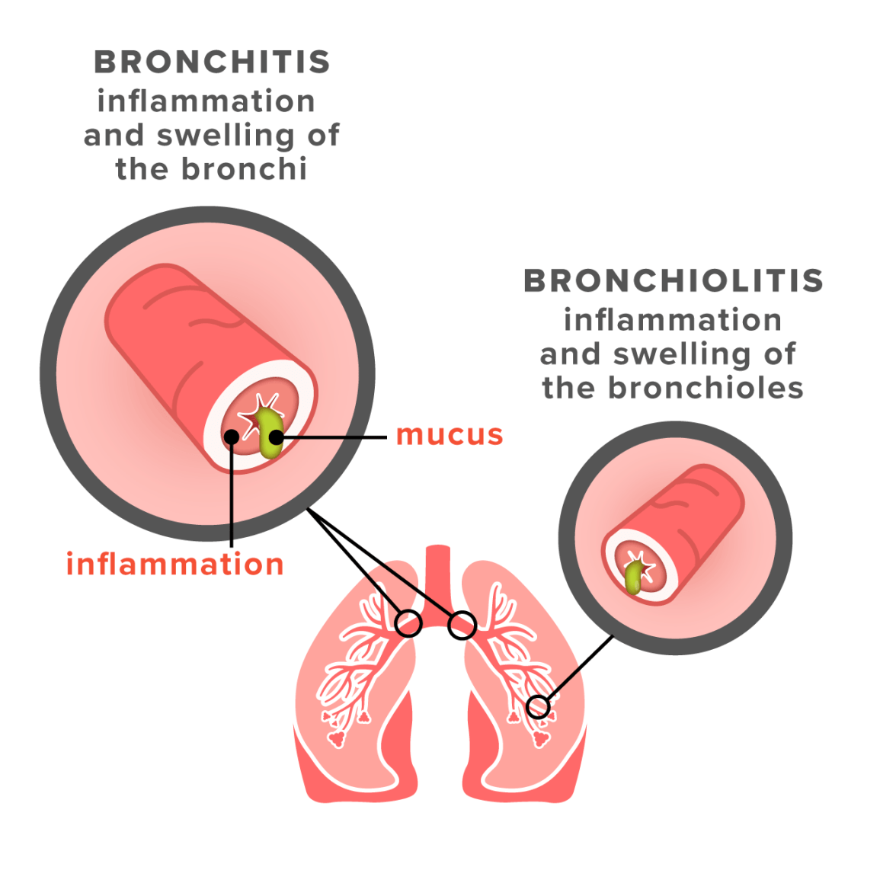
Acute bronchitis often follows a viral upper respiratory tract infection.
It is more common in the winter when respiratory viral syndromes predominate.
The tracheobronchial epithelium is invaded by the infectious agent, leading to activation of inflammatory cells and release of cytokines.
The tracheobronchial epithelium can become signifcantly damaged or hypersensitized, leading to cough lasting 1-3 wk.

Slide 27
Findings on physical examination vary with the age of the patient and stage of the disease.
Early findings are absent or include low-grade fever and upper respiratory signs such as nasopharyngitis, conjunctivitis, and rhinitis.
As the syndrome progresses and cough worsens, breath sounds become coarse, with coarse and fine crackles, wheezing.
Chest radiographs are normal or can have increased bronchial markings. The principal objective of the clinician is to exclude pneumonia, which is more likely caused by bacterial agents requiring antibiotic therapy. Absence of abnormality of vital signs (tachycardia, tachypnea, fever) and a normal physical examination of the chest reduce the likelihood of pneumonia.

Slide 28
The child first presents with non-specifc upper respiratory infectious symptoms, such as rhinitis. 3 to 4 days later, a frequent, dry, hacking cough develops, which may or may not be productive. After several days, the sputum can become purulent, indicating leukocyte migration but not necessarily bacterial infection. Chest pain may be a prominent complaint in older children and is exacerbated by coughing. The mucus gradually thins, usually within 5-10 days, and then the cough gradually abates. The entire episode usually lasts about 2 wk

Slide 29
There is no specific therapy for acute bronchitis.
The disease is self-limited, and antibiotics, do not hasten improvement
Nonprescription cough and cold medicines should not be used in children younger than 2 yr of age and their use is cautioned in children age 2-11 yr
Antihistamines dry secretions and are not helpful
expectorants are likewise not indicated.

Slide 30
Thank you

