Slide 1
CYSTIC FIBROSIS

Slide 2
Cystic fibrosis (CF) is an inherited multisystem disorder of children and adults; it is the most common life-limiting recessive genetic trait among whites.
Dysfunction of the cystic fibrosis transmembrane conductance regulator protein(CFTR), the primary defect, leads to a wide and variable array of presenting manifestations and complications.
CF is responsible for most cases of exocrine pancreatic insufficiency in early life and is the major cause of severe chronic lung disease in children. It is also responsible for many cases of hyponatremic salt depletion, nasal polyposis, pansinusitis, rectal prolapse, pancreatitis, cholelithiasis, and nonautoimmune insulin-dependent hyperglycemia.

Slide 3
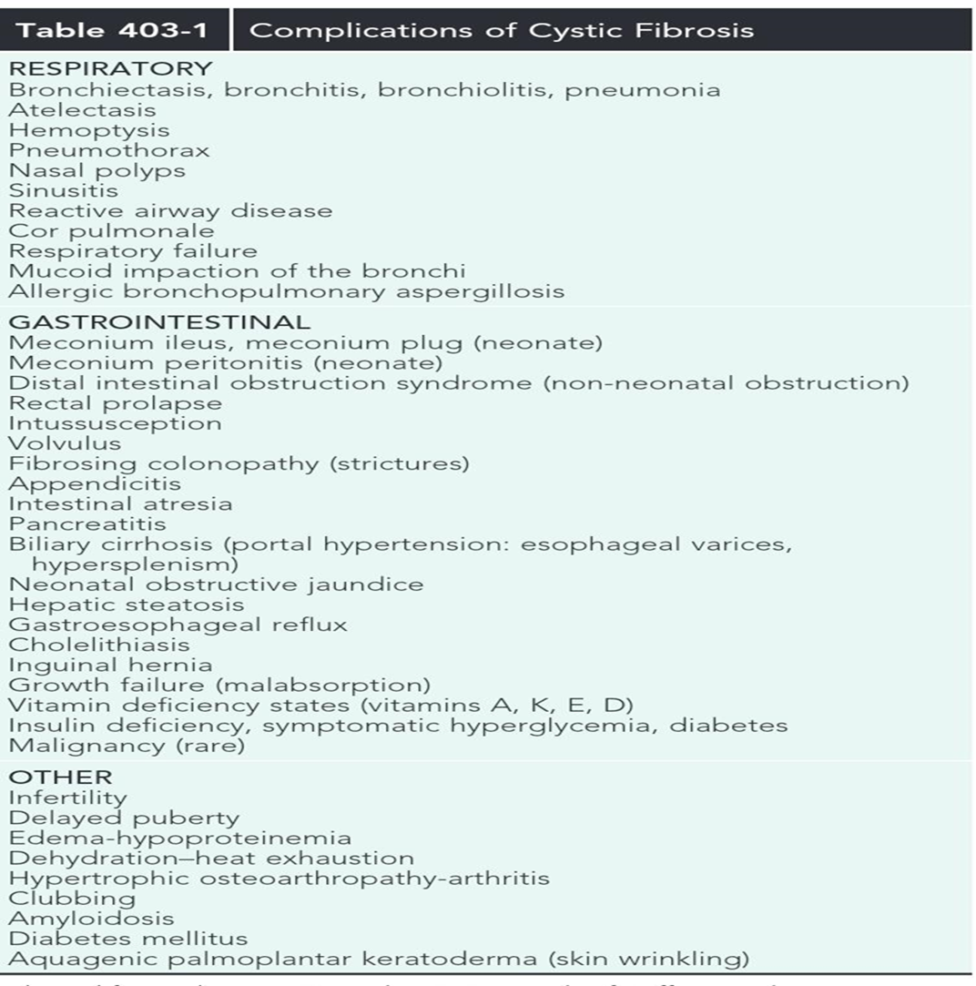

Slide 4
Statistics:
CF occurs most frequently in white populations of northern Europe, North America, and Australia/New Zealand.
The prevalence in these populations varies but approximates 1 in 3,500 live births (1 in 9,200 individuals of Hispanic descent and 1 in 15,000 African-Americans).
Although less frequent in African, Hispanic, Middle Eastern, SouthAsian, and eastern Asian populations, the disorder does exist in these populations as well

Slide 5
GENETICS
The CF gene (on 7th chromosome) codes for the CFTR protein, which is 1,480 amino acids
CFTR is expressed largely in epithelial cells of airways, the gastrointestinal tract (including the pancreas and biliary system), the sweat glands, and the genitourinary system.
CFTR is a member of the adenosine triphosphate–binding cassette superfamily of proteins. It functions as a chloride channel and has other regulatory functions that are perturbed variably by the different mutations. More than 1,900 CFTR polymorphisms grouped into 5 main classes of mutations that affect protein function are associated with the CF syndrome

Slide 6
The most prevalent mutation of CFTR is the deletion of a single phenylalanine residue at amino acid 508 (F508del).
This mutation is responsible for the high incidence of CF in northern European populations and is considerably less frequent in other populations, such as those of southern Europe and Israel.
Approximately 50% of individuals with CF who are of northern European ancestry are homozygous for F508del, and more than 80% carry at least 1 F508del gene. Remaining patients have an extensive array of mutations, none of which has a prevalence of more than several percentage points, except in certain populations; for example, the W1282X mutation occurs in 60% of Ashkenazi Jews with CF.

Slide 7
Mutations categorized as “severe” are associated almost uniformly with pancreatic insufficiency but only in general with more rapid progression of lung disease.
A few mutations, such as 3849+10kbC→T, are found in patients with normal sweat chloride concentrations.Some individuals with polymorphisms of both CFTR genes have few or no CF manifestations until adolescence or adulthood, when they present with pancreatitis, sinusitis, diffuse bronchiectasis, or male infertility.

Slide 9
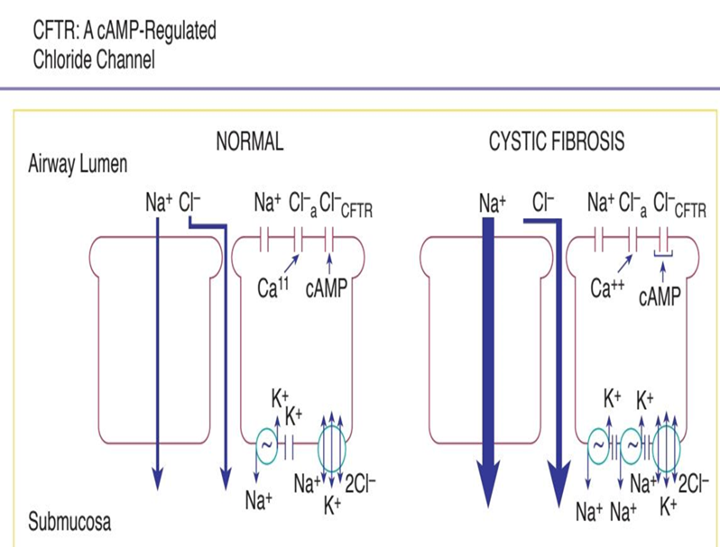
PATHOGENESIS
A number of long-standing observations of CF are of fundamental pathophysiologic importance; they include failure to clear mucous secretions, a paucity of water in mucous secretions, an elevated salt content of sweat and other serous secretions, and chronic infection limited to the respiratory tract.

Slide 10
Respiratory tract
the epithelial pathophysiology in airways involves an inability to secrete salt and secondarily to secrete water in the presence of excessive reabsorption of salt and water.
The proposed outcome is insufficient water on the airway surface to hydrate secretions. Desiccated secretions become more viscous and elastic (rubbery) and are harder to clear by mucociliary and other mechanisms.
In addition it has been suggested that CFTR dysfunction results in an altered microenvironment with low HCO3 and a more acidic pH, thus altering mucus rheology and aggravating poor mucociliary clearance. The result is that these secretions are retained and obstruct airways, starting with those of the smallest caliber, the bronchioles.
Airflow obstruction at the level of small airways is the earliest observable physiologic abnormality of the respiratory system.

Slide 11
Similar pathophysiologic events take place in the pancreatic and biliary ducts (and in the vas deferens), leading to desiccation of proteinaceous secretions and obstruction.
Because the function of sweat gland duct cells is to absorb rather than secrete chloride, salt is not retrieved from the isotonic primary sweat as it is transported to the skin surface; chloride and sodium levels are consequently elevated.
Chronic infection in CF is limited to the airways. Due to failure to clear inhaled bacteria promptly and then proceeding to persistent colonization and an inflammatory response in airway walls

Slide 12
high prevalence in patients with CF of airway colonization with Staphylococcus aureus Pseudomonas aeruginosa and Burkholderia cepacia complex organisms that rarely infect the lungs of other individuals.
CF airway epithelium may be compromised in its innate defenses against these organisms, through either acquired or genetic alterations. Antimicrobial activity is diminished in CF secretions; this dimintion may be related to hyperacidic surface liquids or other effects on innate immunity.

Slide 13
The Pancreas
The extent of involvement varies at birth. In infants, the acini and ducts are often distended and filled with eosinophilic material.
In 85-90% of patients, the lesion progresses to complete or almost complete disruption of acini and replacement with fibrous tissue and fat. Infrequently, foci of calcification may be seen on radiographs of the abdomen.
The islets of Langerhans contain normal-appearing β-cells, although they may begin to show architectural disruption by fibrous tissue in the 2nd decade of life.

Slide 14
The paranasal sinuses are uniformly filled with secretions containing inflammatory products, and the epithelial lining displays hyperplastic and hypertrophied secretory elements . Polypoid lesions within the sinuses and erosion of bone have been reported.
The nasal mucosa may form large or multiple polyps, usually from a base surrounding the ostia of the maxillary and ethmoidal sinuses
The intestinal tract shows only minimal changes. Esophageal and duodenal glands are often distended with mucous secretions.
Concretions may form in the appendiceal lumen or cecum. Crypts of the appendix and rectum may be dilated and filled with secretions

Slide 15
Focal biliary cirrhosis secondary to blockage of intrahepatic bile ducts is uncommon in early life, although it is responsible for occasional cases of prolonged neonatal jaundice.
This lesion becomes much more prevalent and extensive with age and is found in 70% of patients at postmortem examination.
Approximately 30-70% of patients have fatty infiltration of the liver, in some cases despite apparently adequate nutrition.
At autopsy, hepatic congestion secondary to cor pulmonale is frequently observed.
The gallbladder may be hypoplastic and filled with mucoid material and often contains stones. The epithelial lining often displays extensive mucous metaplasia.
Atresia of the cystic duct and stenosis of the distal common bile duct have been observed

Slide 16
Glands of the uterine cervix are distended with mucus.
In >95% of males, the body and tail of the epididymis, the vas deferens, and the seminal vesicles are obliterated or atretic, resulting in male infertility

Slide 17
CLINICAL MANIFESTATIONS
Respiratory Tract
Cough at first, the cough may be dry and hacking, eventually it becomes loose and productive, expectorated mucus is usually purulent.
Some patients remain asymptomatic for long periods or seem to have prolonged but intermittent acute respiratory infections.
Others acquire a chronic cough in the 1st few wk of life, or they have pneumonia repeatedly.
Extensive bronchiolitis accompanied by wheezing is a frequent symptom during the 1st few yr of life.
Exercise intolerance, shortness of breath, and failure to gain weight or grow are noted.

Slide 18
CLINICAL MANIFESTATIONS
Cor pulmonale, respiratory failure, and death eventually supervene unless lung transplantation is accomplished.
Colonization with B. cepacia and other multidrug-resistant organisms may be associated with particularly rapid pulmonary deterioration and death.
Early physical findings include increased anteroposterior diameter of the chest, generalized hyperresonance, scattered or localized coarse crackles, and digital clubbing.
Expiratory wheezes may be heard, especially in young children. Cyanosis is a late sign.
Common pulmonary complications include atelectasis, hemoptysis, pneumothorax, and cor pulmonale; these usually appear beyond the 1st decade of life.

Slide 19
CLINICAL MANIFESTATIONS
Even though the paranasal sinuses are virtually always opacified radiographically, acute sinusitis is infrequent. Nasal obstruction and rhinorrhea are common, caused by inflamed, swollen mucous membranes or, in some cases, nasal polyposis. Nasal polypsare most troublesome between 5 and 20yr of age.

Slide 20
Intestinal Tract
In 10-15% of newborn infants with CF, the ileum is completely obstructed by meconium (meconium ileus), dilated loops of bowel with air–fluid levels and acollection of granular “ground-glass” material in the lower central abdomen. Rarely, meconium peritonitis.
Ileal obstruction with fecal material
protein and fat malabsorption from exocrine pancreatic insufficiency. Symptoms include frequent, bulky, greasy stools and failure to gain weight
Subacute appendicitis and periappendiceal abscess have been encountered
Deficiency of other fat-soluble vitamins is occasionally symptomatic

Slide 21
Biliary Tract
Manifestations can include icterus, ascites, hematemesis from esophageal varices, and evidence of hypersplenism. A neonatal hepatitis-like picture and massive hepatomegaly owing to steatosis have been reported. Biliary colic secondary to cholelithiasis may occur in the 2nd decade or later. Liver disease occurs independent of genotype but is associated with meconium ileus and pancreatic insufficiency.

Slide 22
OTHER MANIFISTATIONS
In addition to exocrine pancreatic insufficiency, evidence for hyperglycemia and glucosuria, including polyuria and weight loss, may appear, especially in the 2nd decade of life.
Sexual development is often delayed but only by an average of 2 yr. Delayed puberty
Excessive loss of salt in the sweat predisposes young children to salt depletion episodes, especially during episodes of gastroenteritis and during warm weather. Hypochloremic alkalosis..Hyponatremia.Dehydration(IV fluid)
liver dysfunction is most often deteced in the 1st 15 yr of life and can be found in up to 30% of individuals

Slide 23
DIAGNOSIS AND ASSESSMENT
Positive quantitative sweat test (Cl− ≥60 mEq/L) in conjunction with 1 or more of the following features:
Typical chronic obstructive pulmonary disease
Documented exocrine pancreatic insufficiency
Positive family history
Intermediate values of 40-60 mEq/L require further testing.
DNA Testing, nasal potential difference, Pancreatic Function, Radiology, Pulmonary Function, Microbiologic Studies, Heterozygote Detection and Prenatal Diagnosis and Newborn Screening

Slide 24
Microbiologic Studies
The finding of S. aureus or P. aeruginosa on culture of the lower airways (sputum) strongly suggests a diagnosis of CF. In particular, mucoid forms of P. aeruginosa
B. cepacia complex recovery also suggests CF.
A wide range of other organisms are frequently recovered, particularly in advanced lung disease; they include a variety of Gram-negative rods: Stenotrophomonas maltophilia, and Achromobacter xylosoxidans, fungi, and nontuberculous mycobacterial species.
Failure of respiratory symptom flares to respond to usual antibiotics triggers testing for Mycoplasma and viruses.

Slide 25
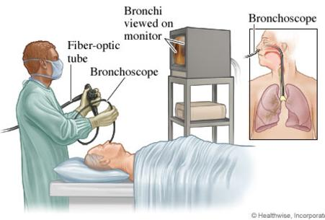
Microbiologic Studies
Fiberoptic bronchoscopy is used to gather lower respiratory tract secretions of infants and young children who do not expectorate.

Slide 26
Heterozygote Detection and
Prenatal Diagnosis
Mutation analysis should be fully informative for testing of potential carriers or a fetus, provided that mutations within the family have been previously identified.
Testing a spouse of a carrier with a standard panel of probes is ≈90% sensitive, and full CFTR sequence analysis is commercially available if further testing is warranted.
Prenatal testing should be offered to all couples planning to have children in addition to individuals with a family history of CF and partners of CF women.
Screening of the siblings of an affected child is also suggested

Slide 27
Newborn Screening
A variety of newborn screening algorithms are in place to identify infants with CF.
Most algorithms utilize a combination of immunoreactive trypsinogen results and limited DNA testing on blood spots; all positive screens are followed by a confirmatory sweat analysis.
This screening test is ≈95% sensitive.

Slide 28
Newborn Screening
Newborn diagnoses can prevent early nutritional deficiencies and improve long-term growth and may improve cognitive function.
Importantly, good nutritional status (50% weight for height or 50% body mass index) is associated with better lung function at 6 yr of age

Slide 29
Newborn Screening
There is a subset of infants with a positive newborn screen for CF, elevated immunoreactive trypsinogen and 1 or 2 copies of a CFTR mutation, but who have an initial negative sweat test and are asymptomatic.
These infants have CFTR metabolic syndrome and should be followed in a CF center annually to ensure that they do not develop CF symptoms.
Indeed, in some the sweat test becomes abnormal over time; nonetheless if they develop CF the manifestations are mild.

Slide 30
TREATMENT
The goal of therapy is to maintain a stable condition for prolongedperiods.
This can be accomplished for most patients by interval evaluation (are scheduled every 1-3 months, depending on the age at diagnosis) and adjustments of the home treatment program.
Improvement is most reliably accomplished in a hospital setting; selected patients have demonstrated successful outcomes while completing these treatments at home.
The major components of this care are pulmonary and nutritional therapies.

Slide 31
TREATMENT
Some children have episodic acute or low-grade chronic lung infection that progresses. For these patients, intensive inhalation and airway clearance and intravenous antibiotics are indicated
Intravenous antibiotics may be required infrequently or as often as every 2-3 months
A sputum sample or, if that is not available, a lower pharyngeal swab taken during or after a forced cough is obtained for culture and antibiotic susceptibility studies.
Because irreversible loss of pulmonary function from low-grade infection can occur gradually and without acute symptoms, emphasis is placed on a thorough pulmonary history.

Slide 32
Treatment
Because secretions of CF patients are not adequately hydrated, attention in early childhood to oral hydration, especially during warm weather or with acute gastroenteritis, may minimize complications associated with impaired mucus clearance.

Slide 33
Pulmonary Therapy
Mucolytic agents:
Human recombinant DNase (2.5 mg), given as a single daily aerosol dose, improves pulmonary function, decreases the number of pulmonary exacerbations, and promotes a sense of well-being in patients who have moderate disease and purulent secretions. Improvement is sustained for12 mo or longer with continuous therapy.
N-acetylcysteine, nebulized as a 5-10% solution following β2-agonist nebulization, is useful for airway clearance and may potentially increase airway levels of the antioxidant, glutathione

Slide 34
Pulmonary Therapy
Mucolytic agents:
7% hypertonic saline nebulized 2-4 times daily, acting as a hyperosmolar agent, is believed to draw water into the airway and rehydrate mucus resulting in in increased mucus clearance and improved pulmonary function

Slide 35
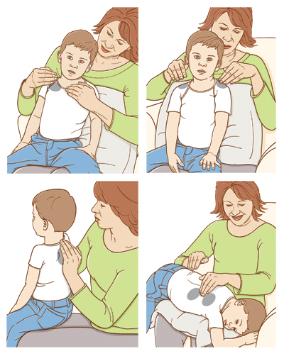
Airway Clearance Therapy
Airway clearance treatment usually consists of chest percussion combined with postural drainage
Produced chest vibrations move secretions from small airways to large airways which then could be cleared by cough, huffing, or forced expirations, which are encouraged after each lung segment is “drained.”

Slide 36
Airway Clearance Therapy
Chest physical therapy (PT) can be particularly useful for patients with CF because they accumulate secretions in small airways first, even before the onset of symptoms.
Although immediate improvement of pulmonary function generally cannot be demonstrated after PT, cessation of chest PT in children with mild to moderate airflow limitation results in deterioration of lung function within 3 weeks
Chest PT is recommended 1-4 times a day, depending on the severity of lung dysfunction

Slide 37
Airway Clearance Therapy
Voluntary coughing, repeated forced expiratory maneuvers with and without positive expiratory pressure, patterned breathing, and use of handheld oscillatory devices are additional aids to clearance of mucus.
Routine aerobic exercise appears to slow the rate of decline of pulmonary function, and benefit has also been documented with weight training.
No one airway clearance technique is superior to any other

Slide 38
Antibiotic therapy
The usual guidelines for acute chest infections, such as fever, tachypnea, or chest pain, are often absent.
Patient’s history and examination, including anorexia, weight loss, and diminished activity, must be used to guide the frequency and duration of therapy.
Antibiotic treatment varies from intermittent short courses of 1 antibiotic to nearly continuous treatment with 1 or more antibiotics.

Slide 39
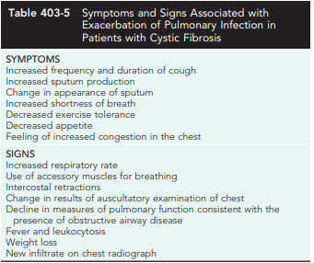
TREATMENT
Table 403-5 lists symptoms and signs that suggest the need for more intensive antibiotic and physical therapy.
Protection against exposure to methicillin-resistant S. aureus, P. aeruginosa, B. cepacia, and other resistant Gram-negative organisms is essential, including isolation procedures and careful attention to sterilization of inhalation therapy equipment.

Slide 40
Antibiotic therapy
Dosages for some antibiotics are often 2-3 times the amount recommended for minor infections because:
Patients with CF have proportionately more lean body mass (fat-free mass)
Higher clearance rates for many antibiotics than other individuals.
It is difficult to achieve effective drug levels of many antimicrobials in respiratory tract secretions.

Slide 41
Oral Antibiotic therapy
Indications for oral antibiotic therapy in a patient with CF include the
1- Presence of respiratory tract symptoms
2- Identification of pathogenic organisms in respiratory tract cultures.
Common organisms, including S. aureus, nontypeable Haemophilus infuenzae, P. aeruginosa; B. cepacia and other Gram-negative rods, are encountered with increasing frequency.
S. aureus, nontypeable H. infuenzae can be eradicated with use of oral antibiotics, but Pseudomonas is more difficult to treat.
The usual course of therapy is ≥2 wk, and maximal doses are recommended

Slide 42
Oral Antibiotic therapy
Quinolones are the only broadly effective oral antibiotics for Pseudomonas infection, but resistance against these agents emerges rapidly.
Infection with mycoplasma or chlamydial organisms has been documented, providing a rationale for the use of macrolides on an empirical basis for fare of symptoms.
Macrolides may reduce the virulence properties of P. aeruginosa, such as biofilm production, and contribute anti-inflammatory effects.
Long-term therapy with azithromycin 3 times a week improves lung function in patients with chronic P. aeruginosa infection.

Slide 43
Aerosolized Antibiotic Therapy
P. aeruginosa and other Gram-negative organisms are frequently resistant to all oral antibiotics
Aerosol delivery of antibiotics has been used as an option for home delivery of additional agents, such as tobramycin, colistin, and gentamicin.
Aerosolized antibiotics such as tobramycin, aztreonam, are often used when the airways are chronically colonized with Pseudomonas as long-term suppressive daily therapy.
When tobramycin is given at a dose of 300 mg twice daily on alternate months for 6 mo, Pseudomonas density in sputum decreases, fewer hospitalizations are required, and pulmonary function can improve by ≥10%.

Slide 44
Aerosolized Antibiotic Therapy
Aztreonam was also approved for 75mg 3 times daily therapy on alternate months
Toxicity is negligible.
Aerosolized antibiotic therapy is recommended in patients with chronic colonization with P. aeruginosa, in patients with moderate to severe disease.
Evidence is limited for an acute pulmonary exacerbation.
Another indication for aerosolized antibiotic therapy is to eradicate P. aeruginosa in the airways after initial colonization.
Early infection may be cleared for months to several years by oral ciprofloxacin and/or aerosolized colistin or tobramycin.
However, once chronically established, P. aeruginosa infection is rarely eradicated

Slide 45
Intravenous Antibiotic Therapy
Indicated for the patient who has progressive or unrelenting symptoms and signs despite intensive home measures
This therapy is usually initiated in the hospital but may be completed on an ambulatory (outpatient) basis.
Although many patients show improvement within 7 days, it is usually advisable to extend to at least 14 days.
Permanent intravenous access can be provided for long-term or frequent courses of therapy in the hospital or at home.
Thrombophilia screening should be considered before the use of totally implantable intravenous devices or for recurring problems with venous catheters
In general, treatment of Pseudomonas infection requires 2-drug therapy. A third agent may be required for optimal coverage of S. aureus or other organisms

Slide 46
Intravenous Antibiotic Therapy
Aminoglycosides have a relatively short half-life in many patients with CF.
The initial parenteral dose, generally given every 8 hr. After blood levels have been determined, the total daily dose should be adjusted.
Peak levels of 10-15 mg/L are desirable, and trough levels should be kept at <2 mg/L to minimize the risk of ototoxicity and nephrotoxicity.
The regimen of once-daily tobramycin dosing had equivalent efficacy and decreased toxicity over dosing every 8 hr.
For once daily dosing of tobramycin, peak levels should be between 20 and 30 mg/L and trough levels should be 1 mg/L or less.
In toddlers, older children, and adults, once-daily intravenous tobramycin therapy is becoming the standard of care

Slide 47
Intravenous Antibiotic Therapy
If patients do not show improvement, complications such as heart failure and reactive airways or infection with viruses, Aspergillus fumigatus, nontuberculous mycobacteria (acid-fast organisms) , or other unusual organisms should be considered.
B. cepacia complex is the most frequent of a growing list of Gram-negative rods that may be particularly refractory to antimicrobial therapy.

Slide 48
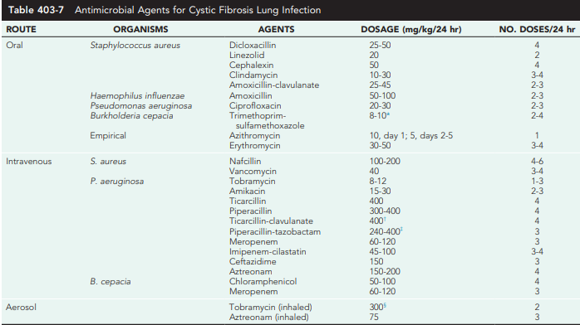

Slide 49
Bronchodilator Therapy
Reversible airway obstruction, defined as improvement of ≥12% in flow rates after inhalation of a bronchodilator, occurs in many children with CF, sometimes in conjunction with frank asthma or acute bronchopulmonary aspergillosis. (a hypersensitivity response to the fungus Aspergillus)
In many patients with CF, flow rates may improve by only 5-10%, however. Nevertheless, subjective benefit is claimed by many following use of a β-adrenergic agonist aerosol.
In some patients β-agonists may decrease Pao2 acutely by increasing ventilation-perfusion mismatch, a concern if the Pao2 is low
Cromolyn sodium (mast cell stabilizer) and ipratropium hydrochlorides (anticholinergic agents) are alternative agents, but there is no evidence to support their use

Slide 50
Anti-inflammatory Agents
Corticosteroids are useful for the treatment of :
1-allergic bronchopulmonary
2- severe reactive airway disease occasionally encountered in children with CF
Studies showed that prolonged treatment in patients with mild to moderate lung disease found only modest efficacy but caused cataracts, and abnormalities of glucose tolerance at a dose of 2 mg/kg and growth retardation at 1 mg/kg.

Slide 51
Anti-inflammatory Agents
There are few data documenting the efficacy and safety of Inhaled corticosteroids and there discontinuation had no effect on lung function, antibiotic use, or bronchodilator use.
Ibuprofen, given long term (dose adjusted to achieve a peak serum concentration of 50-100 μg/mL) for 4 yr, is associated with a slowing of disease progression, particularly in younger patients with mild lung disease.
However due to side effects this therapy has not gained broad acceptance

Slide 52
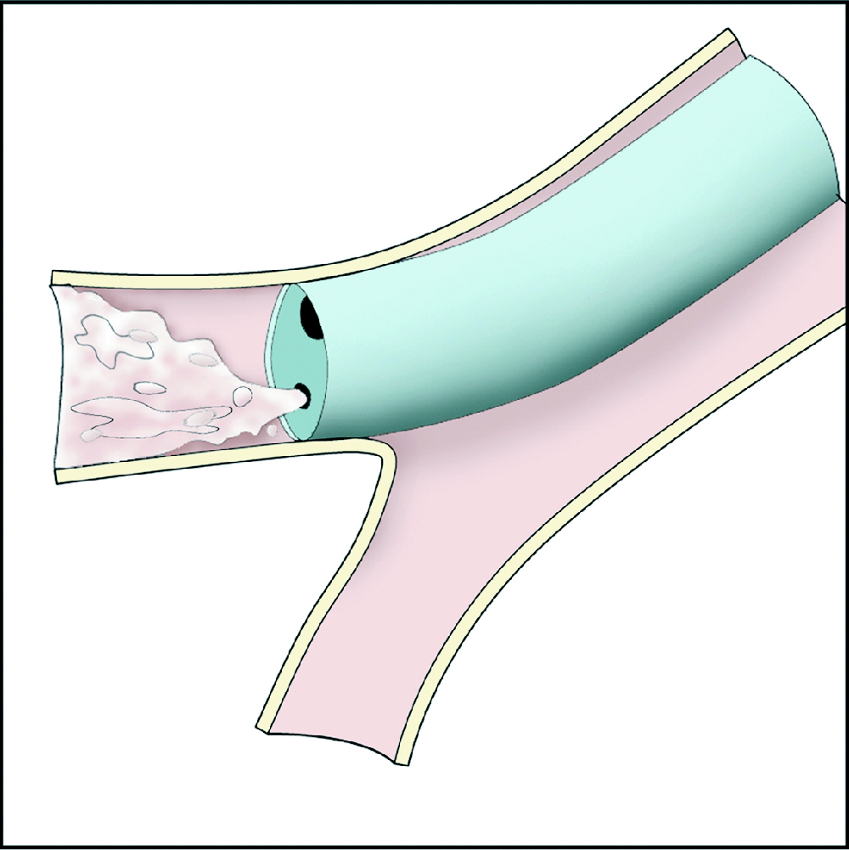
Endoscopy and Lavage
Treatment of obstructed airways sometimes includes tracheobronchial suctioning or lavage, especially in atelectasis or mucoid impaction
Bronchopulmonary lavage can be performed by the instillation of saline or a mucolytic agent through a fiberoptic bronchoscope.
Antibiotics (usually gentamicin or tobramycin) can also be instilled directly at lavage and achieve a much higher endobronchial concentration than intravenous therapy.
There is no evidence for sustained benefit from repeated endoscopic or lavage procedures.

Slide 53
Other Therapies
Expectorants such as iodides and guaifenesin do not effectively assist with the removal of secretions from the respiratory tract.
Inspiratory muscle training can enhance maximum oxygen consumption during exercise as well as FEV1.

Slide 54
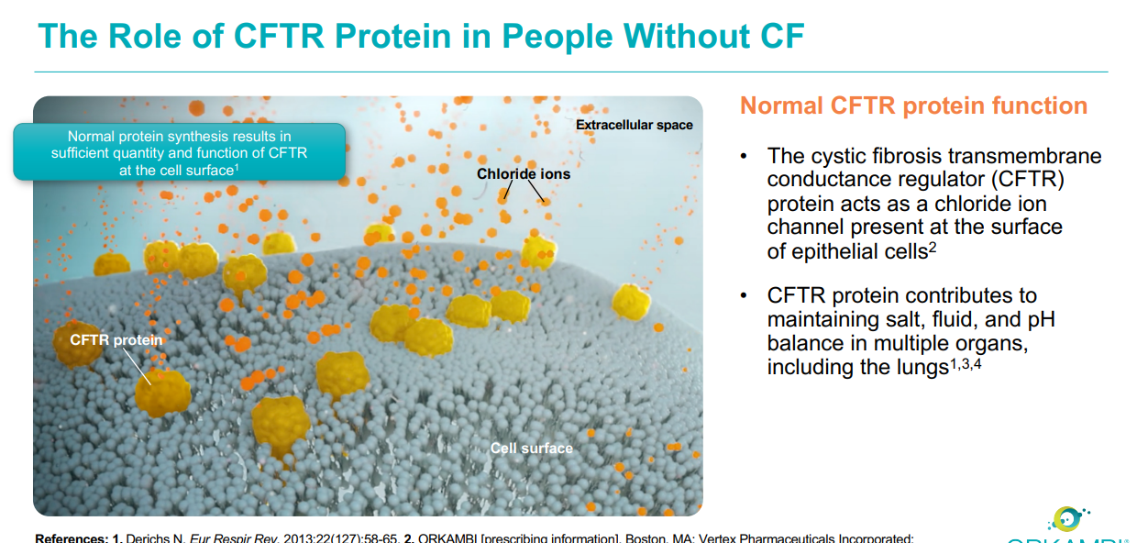
Emerging therapy

Slide 55
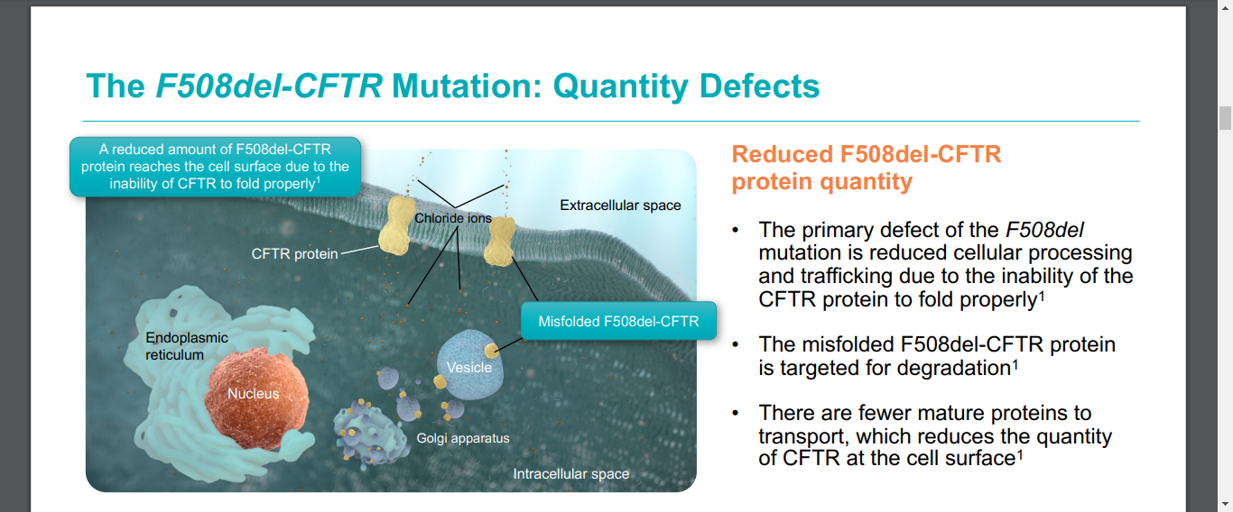
Emerging therapy

Slide 56
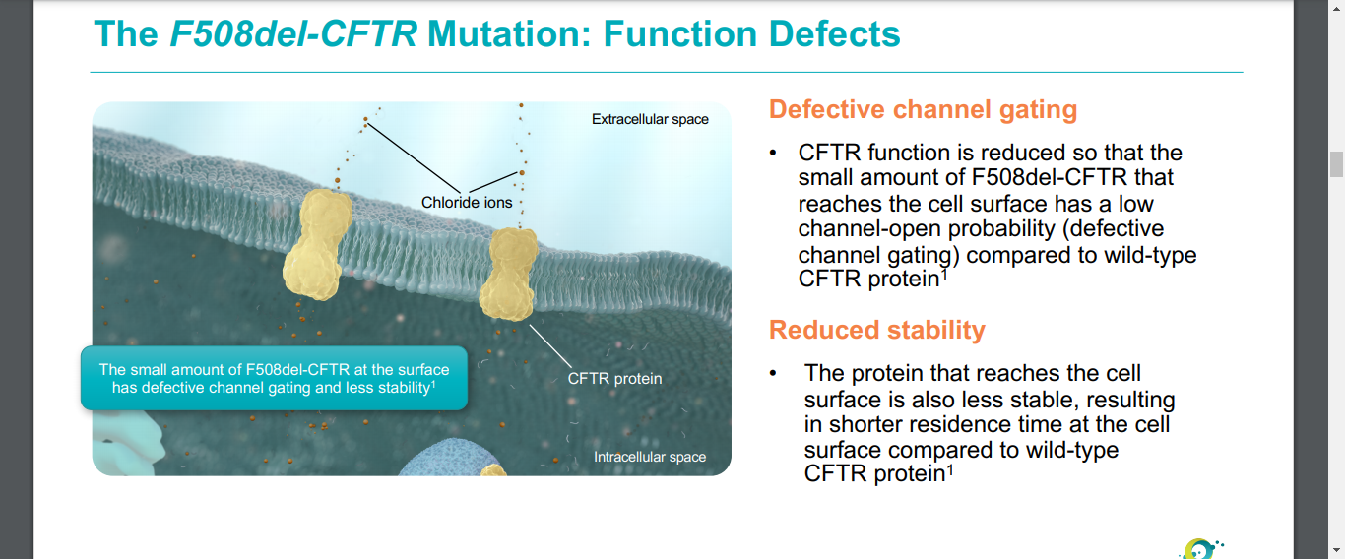
Emerging therapy

Slide 57
Emerging Therapies
A major breakthrough in CF therapy is ivacaftor, a potentiator of the CFTR mutation, G551D (present in ~5% of patients).
Ivacaftor activates the CFTR-G551D mutant protein, a class III CFTR mutation that results in protein localized to the plasma membrane but loss of chloride channel function. This allows more chloride ions to pass into and out of the cells
Ivacaftor therapy resulted in improvement in FEV1 by an average of 10.6%, decreased the frequency of pulmonary exacerbations by 55%, decreased sweat chloride by an average of 48 mEq/L, and increased weight gain by an average of 2.7 kg.
Ivacaftor is approved for CFTR-G551D patients ≥6 yr old, as a 150 mg, twice per day, oral therapy. Lexi: FDA approved in ages 4 months and older

Slide 58
Emerging therapy
Additional small molecule correctors are being tested for use in combination with Ivacafor to correct the processing of the most common CFTR mutation, F508del.
The goal of this strategy is to correct the localization of the protein to the apical membrane of the cell and then to potentiate its function.

Slide 59
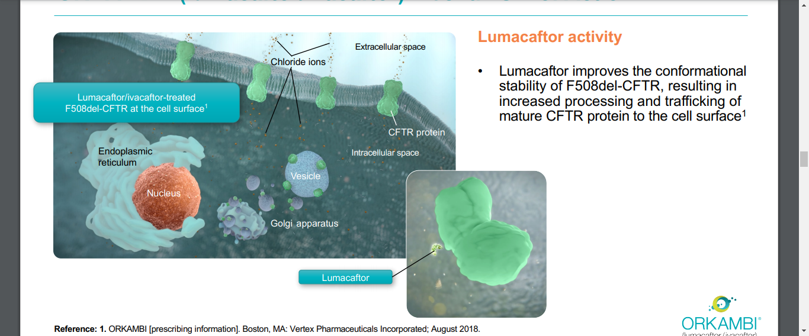
Emerging therapy

Slide 60
Emerging therapy
lumacaftor/ivacaftor combination is indicated for the treatment of cystic fibrosis (CF) in patients age 2 years and older who are homozygous for the F508del mutation in the CFTR gene.
If the patient’s genotype is unknown, an FDA-cleared CF mutation test should be used to detect the presence of the F508del mutation on both alleles of the CFTR gene

Slide 61
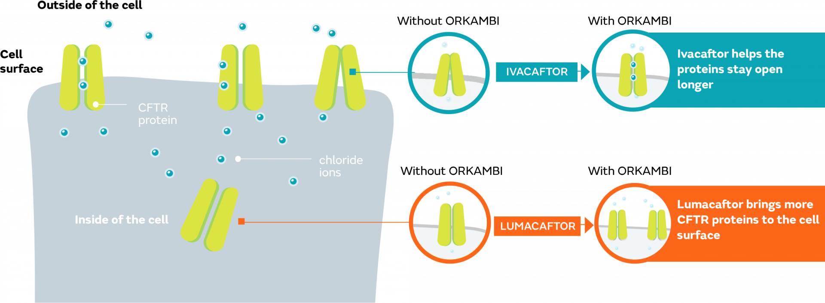
Emerging therapy

Slide 62
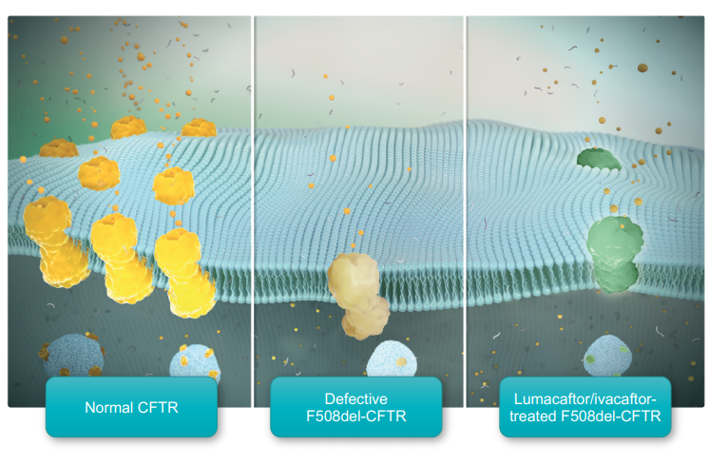
Emerging therapy

Slide 63
Nutritional Therapy
Up to 90% of patients with CF have loss of exocrine pancreatic function as well as inadequate digestion and absorption of fats and proteins.
Most individuals with CF have a higher-than-normal caloric need because of increased work of breathing and perhaps because of increased metabolic activity related to the basic defect.
Encouragement to eat high-calorie foods is important, but weight gain is not generally realized unless lung infection is controlled
Recombinant growth hormone therapy (3 times per week) has improved nutritional outcomes.

Slide 64
Pancreatic Enzyme Replacement
Pancreatic exocrine replacement therapy given with ingested food reduces but does not fully correct stool fat and nitrogen losses.
Enzyme dosage and product should be individualized for each patient.
Enteric-coated, pH-sensitive enzyme microspheres are most often prescribed.
Several strengths up to 25,000 IU of lipase/capsule are available.
Administration of excessive doses has been linked to colonic strictures requiring surgery.
Enzyme replacement should not exceed 2,500 lipase units/kg/meal in most circumstances.

Slide 65
Pancreatic Enzyme Replacement
In general, infants need 2,000-4,000 lipase units per feeding, which is most easily given mixed with applesauce on a spoon at room temperature.
Applesauce is acidic and helps prevent early release followed by inactivation by gastric enzymes
Snacks should also be covered
The dose of enzymes required usually increases with age,
Some individuals require proton pump inhibitor therapy to correct acid pH in the duodenum which is due to lack of exocrine pancreatic secretions;
Neutralization of duodenal pH permits activation of enteric coated pancreatic exocrine replacement therapy granules.

Slide 66
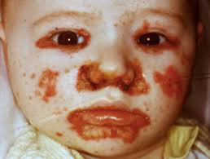
Vitamin and Mineral Supplements
Because pancreatic insufficiency results in malabsorption of fat-soluble vitamins (A, D, E, K), vitamin supplementation is recommended
Several vitamin preparations containing all 4 vitamins are available
They should be taken daily.
Replacement doses may be required when low serum levels are documented or the patient is symptomatic.
Infants with zinc deficiency and an
acrodermatitis enteropathica–like rash have been described.
Almost 30% of children with CF had low serum ferritin

Slide 67
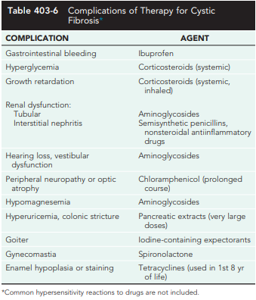
Because therapy is medication intensive, iatrogenic problems frequently arise.
Monitoring for these complications is also an important part of management

Slide 68
Allergic Bronchopulmonary Aspergillosis
Allergic bronchopulmonary aspergillosis occurs in 5-10% of patients with CF
Presence of rust-colored sputum, of Aspergillus organisms in the sputum, or the presence of eosinophils in a fresh sputum sample supports the diagnosis
Also a positive skin test for A. fumigatus, and the demonstration of specific immunoglobulin (Ig) E and IgG antibodies against A. fumigatus.
The serum IgE level is usually high.
Treatment is directed at controlling the inflammatory reaction with oral corticosteroids. For refractory cases, oral antifungals may be required.

Slide 69
Distal Intestinal Obstruction Syndrome
(Meconium Ileus Equivalent) and Other Causes of Abdominal Symptoms
Despite appropriate pancreatic enzyme replacement, 2-5% of patients accumulate fecal material in the terminal portion of the ileum and in the cecum, which may result in partial or complete obstruction.
For intermittent symptoms, pancreatic enzyme replacement should be continued or even increased, and stool sofeners (polyethylene glycol or docusate sodium) given.
Increased fluid intake is also recommended

Slide 70
Hepatobiliary Disease
Liver function abnormalities associated with biliary cirrhosis can be improved by treatment with ursodeoxycholic acid, secondary bile acid
The ability of bile acids to prevent progression of cirrhosis has not been clearly documented.
Portal hypertension with esophageal varices, hypersplenism, or ascites occurs in ≤8% of children with CF
Acute management of bleeding esophageal varices includes nasogastric suction and cold saline lavage. Sclerotherapy is recommended after an initial hemorrhage.

Slide 71
PROGNOSIS
CF remains a life-limiting disorder, although survival has improved dramatically in the past 30-40 yr.
Infants with severe lung disease occasionally succumb, but most children survive this difficult period
Life table data now indicate a median cumulative survival of 37 yr.
Male survival is somewhat better than female survival for reasons that are not readily apparent.

