Slide 1
Febrile seizures

Slide 2
A seizure is a transient occurrence of signs and/or symptoms resulting from abnormal excessive or synchronous neuronal activity in the brain.
epileptic seizures into 2 large categories:
In focal (formerly known as partial) seizures, initial activation of a system of neurons limited to part of 1 cerebral hemisphere.
In generalized seizures, the first clinical and EEG changes indicate synchronous involvement of all of both hemispheres

Slide 3
Focal and generalized motor seizures may be tonic–clonic, tonic, clonic, myoclonic, or atonic.
Tonic seizures are characterized by increased tone or rigidity
Atonic seizures are characterized by lack of movement during a convulsion.
Clonic seizures consist of rhythmic fast muscle contrac- tions and slightly longer relaxations;
myoclonus is a “shock-like” contraction of a muscle of <50 msec that is often repeated.

Slide 4
Febrile seizures are seizures that occur between the age of 6 and 60 months with a temperature of 38°C or higher
they are not the result of :
central nervous system infection (meningitis, encephalitis)
any metabolic imbalance
Seizures with fever in children who have history of non-febrile seizure are excluded from this definition

Slide 5
Febrile seizures are further divided into :
A simple febrile seizure is a primary generalized, usually tonic–clonic, attack associated with fever, lasting for a maximum of 15 min, and not recurrent within a 24-hr period.
A complex febrile seizure is more prolonged (>15 min), is focal, and/or reoccurs within 24 hr.
Febrile status epilepticus is a febrile seizure lasting longer than 30 min. Some use the term simple febrile seizure plus for those with recurrent febrile seizures within 24 hr.

Slide 6
Febrile seizures are not considered a form of epilepsy, which is characterized by recurrent non-febrile seizures
Most patients with simple febrile seizures have a very short postictal state (altered state of consciousness) and usually return to their baseline normal behavior and consciousness within minutes of the seizure.

Slide 7
Between 2% and 5% of neurologically healthy infants and children experience at least 1, usually simple, febrile seizure.
Simple febrile seizures do not have an increased risk of mortality. There are no long-term adverse effects of having 1 or more simple febrile seizures.
Complex febrile seizures may have an approximately 2-fold long-term increase in mortality, as compared to the general population, over the subsequent 2 years, probably secondary to coexisting pathology

Slide 8
Febrile seizures recur in approximately 30% of those experiencing a first episode, in 50% after 2 or more episodes, and in 50% of infants younger than 1 yr old at febrile seizure onset.
Risk Factors for Recurrence of Febrile Seizures:
MAJOR: Age <1 yr, Duration of fever <24 hr ,Fever 38-39°C
MINOR: Family history of febrile seizures, Family history of epilepsy, Complex febrile seizure, Daycare, Male gender, Lower serum sodium at time of presentation
Having no risk factors carries a recurrence risk of approximately 12%; 1 risk factor, 25-50%; 2 risk factors, 50-59%; 3 or more risk factors, 73-100%

Slide 9
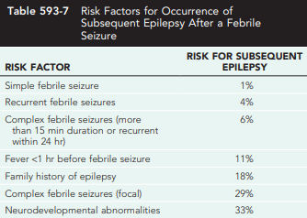
Although approximately 15% of children with epilepsy have had febrile seizures, only 2-7% of children who experience febrile seizures proceed to develop epilepsy later in life.

Slide 10
GENETIC FACTORS
The genetic contribution to the incidence of febrile seizures is manifested by a positive family history for febrile seizures in many patients.
In some families, the disorder is inherited as an autosomal dominant trait, in most cases the disorder appears to be polygenic, and the genes predisposing to it remain to be identified.
Identified single genes include FEB 1, 2, 3, 4, 5, 6, 7, 8, 9, and 10 genes on chromosomes 8q13-q21, 19p13.3, 2q24, 5q14-q15, 6q22-24, 18p11.2, 21q22, 5q34, 3p24.2-p23, and 3q26.2-q26.33.
Only the function of FEB 2 is known: it is a sodium channel gene, SCN1A.

Slide 11
febrile seizure-associated epilepsies
A few epilepsy syndromes typically start with febrile seizures. These are:
Generalized epilepsy with febrile seizures plus (GEFS+): s an autosomal dominant syndrome .Onset is usually in early childhood and remission is usually in mid-childhood. It is characterized by multiple febrile seizures and by several subsequent types of afebrile generalized seizures
Severe myoclonic epilepsy of infancy (also called Dravet syndrome) e is the most severe of the phenotypic spectrum of febrile seizure-associated epilepsies. It constitutes a distinct entity in the onset of which is in infancy. Its onset is characterized by febrile and afebrile unilateral clonic seizures recurring every 1 or 2 mo.
These early seizures are typically induced by fever, but they differ from the usual febrile convulsions in that they are more prolonged, are more frequent, are focal and come in clusters

Slide 12
The majority of patients who had prolonged febrile seizures and encephalopathy after vaccination and who had been presumed to have suffered from vaccine encephalopathy (seizures and psychomotor regression occurring after vaccination and presumed to be caused by it) turn out to have Dravet syndrome mutations, indicating that their disease is caused by the mutation and not secondary to the vaccine. This has raised doubts about the very existence of the entity termed vaccine encephalopathy

Slide 13
EVALUATION
Each child who presents with a febrile seizure requires a
detailed history and a thorough general and neurologic examination.
Febrile seizures often occur in the context of:
otitis media, roseola (caused by a type of herpes virus, marked by several days of high fever followed by rash) and human herpesvirus (HHV) 6 infection, shigella (anaerobic bacteria), or similar infections.
In patients with febrile status, HHV-6B (more frequently) and HHV-7 infections were found to account for one-third of the cases.

Slide 14
Lumbar Puncture
Meningitis should be considered in the differential diagnosis
lumbar puncture should be performed for : 1- all infants younger than 6 mo of age who present with fever and seizure, 2- if the child is ill appearing 3- at any age if there are clinical signs or symptoms of concern
A lumbar puncture is an option in: 1- a child 6-12 mo of age who is deficient in Haemophilus influenza type b and Streptococcus pneumoniae immunizations or for whom immunization status is unknown. 2- children who have been pretreated with antibiotics

Slide 15
Electroencephalogram
If the child is presenting with the first simple febrile seizure and is otherwise neurologically healthy, an EEG is not normally performed as part of the evaluation.
An EEG would not predict the future recurrence of febrile seizures or epilepsy even if the result is abnormal
An EEG should generally be restricted to special cases in which epilepsy is highly suspected, and should be used to define the type of epilepsy rather than to predict its occurrence.

Slide 16
Blood Studies
Blood studies (serum electrolytes, calcium, phosphorus, magnesium, and complete blood count) are not routinely recommended in the work-up of a child with a first simple febrile seizure.
Blood glucose should be determined in children with prolonged postictal obtundation or with poor oral intake (prolonged fasting). Serum electrolyte
A low sodium level is associated with higher risk of recurrence of the febrile seizure within the following 24 hr

Slide 17
Neuroimaging
A CT or MRI is not recommended in evaluating the child afer a first simple febrile seizure.
The work-up of children with complex febrile seizures needs to be individualized. This can include an EEG and neuroimaging, particularly if the child is neurologically abnormal.
Approximately 11% of children with febrile status epilepticus are reported to have (usually) unilateral swelling of their hippocampus acutely, which is followed by subsequent long-term hippocampal atrophy. Whether these patients will ultimately develop temporal lobe epilepsy remains to be determined.

Slide 18
TREATMENT
In general, antiepileptic therapy, continuous or intermittent, is not recommended for children with 1 or more simple febrile seizures.
If the seizure lasts for longer than 5 min, acute treatment with diazepam, lorazepam, or midazolam is needed
Rectal diazepam is often prescribed to be given at the time of reoccurrence of a febrile seizure lasting longer than 5 min
Alternatively, buccal or intranasal midazolam may be used and is often preferred by parents (Respiratory complications requiring assisted ventilation are similar, regardless of administration route).

Slide 19
TREATMENT
Febrile status epilepticus rarely stops spontaneously and often requires more than one medication to control
Intravenous benzodiazepines, phenobarbital, phenytoin, or valproate may be needed in the case of febrile status epilepticus.

Slide 20
TREATMENT
If the parents are very anxious concerning their child’s seizures, intermittent oral diazepam (0.33 mg/kg every 8 hr during fever) or intermittent rectal diazepam (0.5 mg/kg administered as a rectal suppository every 8 hr), can be given during febrile illnesses.
Intermittent oral nitrazepam, clobazam, and clonazepam (0.1 mg/kg/day) have also been used.
Such therapies help reduce, but do not eliminate, the risks of recurrence of febrile seizures

Slide 21
TREATMENT
Lorazepam: is distributed to the brain very quickly and exerts its anti- consultant effect in <5 min. It is not very lipophilic and does not clear out from the brain very rapidly. Its action can last 6-24 hr. Usually, it does not cause hypotension or respiratory depression. he dose is 0.05 mg/kg (range: 0.02-0.10 mg/kg) every 4-8 hr.
Diazepam: is highly lipophilic, so it distributes very rapidly into the brain and then is cleared very quickly out, carrying the risk of recurrence of seizures. Like other intravenous benzodiazepines, it carries a risk of apnea and hypotension, so patients need to be observed for 3-8 hr after administration. he usual dose is 0.1-0.3 mg/kg IV over 3-5 min, given every 15-30 min to a maximum total dose of 2 mg. sodium benzoate and benzoic acid, it is currently not recommended as a first-line agent.

Slide 22
TREATMENT
Other therapies have included continuous phenobarbital (4-5 mg/kg/day in 1 or 2 divided doses), and continuous valproate (20-30 mg/kg/day in 2 or 3 divided doses).
In the vast majority of cases, it is not justified to use continuous therapy owing to the risk of side effects and lack of demonstrated long-term benefits, even if the recurrence rate of febrile seizures is expected to be decreased by these drugs.

Slide 23
TREATMENT
Antipyretics can decrease the discomfort of the child but do not reduce the risk of having a recurrent febrile seizure, probably because the seizure often occurs as the temperature is rising or falling.
Chronic antiepileptic therapy may be considered for children with a high risk for later epilepsy. Currently available data indicate that the possibility of future epilepsy does not change with or without antiepileptic therapy.
Iron deficiency is associated with an increased risk of febrile seizures, and thus screening for that problem and treating it appears appropriate.

Slide 24
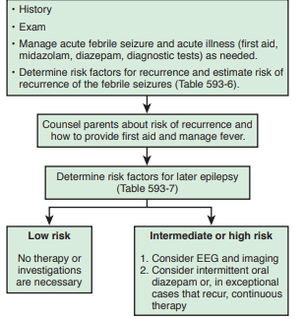
general approach to the patient with febrile seizures

Slide 25
TREATMENT of status epilepticus
Status epilepticus is defined as continuous seizure activity or recurrent seizure activity without regaining of consciousness lasting for more than 5 min
It is a medical emergency that requires initial and continuous attention to securing airway, breathing, and circulation (with continuous monitoring of vital signs including ECG) and determination and management of the underlying etiology (e.g., hypoglycemia).
Laboratory studies, including glucose, sodium, calcium, magnesium, complete blood count, basic metabolic panel, CT scan, and continuous EEG, are needed for all patients.
Blood and spinal fluid cultures, toxic screens, and tests for inborn errors of metabolism are often needed. AED levels need to be determined in all patients known already to be taking these drugs

Slide 26
TREATMENT of status epilepticus
The initial emergent therapy usually involves intravenous diazepam, lorazepam, or midazolam. Diazepam is at least as effective as intravenous lorazepam but has fewer side effects
The use of midazolam injection as initial therapy for acute seizures was found to be at least as useful and safe as the use intravenous lorazepam and results in earlier response.
If intravenous access is not available, buccal or intranasal midazolam, intranasal lorazepam, or rectal diazepam are effective options. Intramuscular midazolam is equally effective as intravenous lorazepam.
With all options, respiratory depression is a potential side effect for which the patient should be monitored and managed as needed.

Slide 27
TREATMENT of status epilepticus
In some infants, a trial of pyridoxine may be warranted (in people with pyridoxine-dependent epilepsy, which is typically prolonged seizure that can't be controlled by medicines).
After the emergent therapy usually with a benzodiazepine, the subsequent urgent therapy medication is usually fosphenytoin, and the loading dose is usually 15-20 PE/kg. A level is usually taken 2 hr later to ensure achievement of a therapeutic concentration. Depending on the level, maintenance dose can be started right away or, more commonly, in 6 hr

Slide 28
TREATMENT of status epilepticus
With phenytoin and phenobarbital, each 1 mg/kg (1 PE/kg for fosphenytoin) increases the serum concentration by approximately 1 μg/mL; for valproate, each 1 mg/kg increases the serum concentration by approximately 4 μg/mL.
Precautions about the rate of infusion of fosphenytoin and phenytoin (not >0.5-1.0 mg/kg/min) to prevent cardiac problems, and the medication needs to be avoided in patients with significant heart disease. Heart rate should be monitored while administrating the drug?
The subsequent medication is often phenobarbital. The dose used in neonates is usually 20 mg/kg loading dose, but in infants and children the dose is ofen 5-10 mg/kg (to avoid respiratory depression), with the dose repeated if there is not an adequate response

Slide 29
TREATMENT of status epilepticus
After the second or third medication is given, and sometimes before that, the patient might need to be intubated.
All patients with status epilepticus, even the ones who respond, need to be admitted to the ICU for completion of therapy and monitoring.
Ideally, emergent and urgent therapies should have been received within less than 30 min so as to initiate the subsequent therapy soon, thus reducing the chances of sequelae

Slide 30
TREATMENT of status epilepticus
For refractory status epilepticus treatment (persists for 30 minutes after initial measures are instituted), an intravenous bolus followed by continuous infusion of midazolam, propofol, pentobarbital, or thiopental is used
Midazolam probably has fewer side effects, but is less effective,
barbiturate coma is more effective, but carries a higher risk of side effects. It is not unusual for patients put into pentobarbital coma to have to be on multiple pressors to maintain their blood pressure during therapy
On propofol, some patients develop a propofol infusion syndrome with lactic acidosis, hemodynamic instability, and rhabdomyolysis with higher infusion rates (>67 μg/kg/min).
Thus blood pressure, electrolytes, creatine phosphokinase, and organ function studies need to be monitored.

Slide 31
TREATMENT of status epilepticus
The goal is to stop electrographic seizure activity before reducing the therapy. Usually this implies achievement of complete flattening of the EEG
Often, barbiturate coma and similar therapies are maintained for 1 or more days before it is possible to gradually taper the therapy, usually over a few days.
However, in some cases, including cases of new-onset refractory status epilepticus (new-onset refractory status epilepticus), such therapies need to be maintained for several weeks or even months.
Even though the prognosis in new-onset refractory status epilepticus cases is often poor and many patients do not survive, meaningful recovery despite a prolonged course is still possible

Slide 32
TREATMENT of status epilepticus
The strongest evidence for initial and emergent therapy is for diazepam or lorazepam, followed by phenytoin/fosphenytoin and phenobarbital, then valproate and levetiracetam
Current evidence for the urgent therapy is strongest for valproate, followed by phenytoin/fosphenytoin and midazolam continuous infusion, followed by phenobarbital and levetiracetam, the last of which are currently being increasingly used.
Currently, the level of the evidence for refractory treatment is strongest for midazolam and valproate, followed by propofol and pentobarbital/thiopental, followed by levetiracetam, phenytoin/fosphenytoin, lacosamide, topiramate, and phenobarbital.

Slide 33
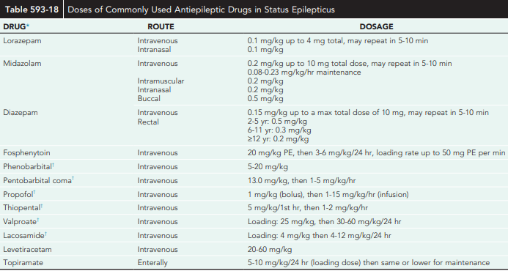

Slide 34
TREATMENT of status epilepticus
Occasionally, inhalational anesthetics are useful. Probably isofurane is preferable because halothane can increase intracranial pressure and enfurane can induce seizures. Other therapies have included ketamine, corticosteroids (e.g., for Rasmussen encephalitis, Hashimoto encephalopathy, or other

Slide 35
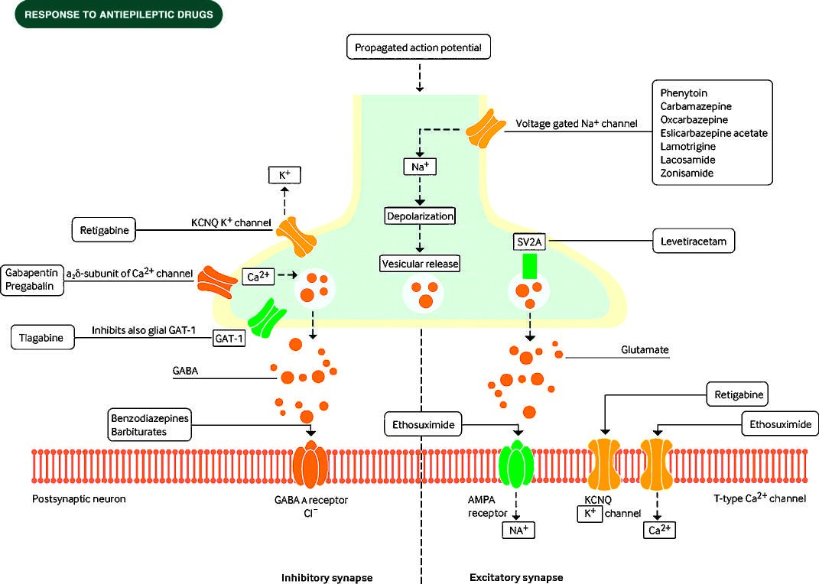
Antiepileptic therapy
MOA: reduce excitability by interfering with the sodium, potassium or calcium ion channels, by reducing excitatory neurotransmitter release or function, or by enhancing GABAergic inhibition

Slide 36
Antiepileptic therapy
Comparative tolerability: the most prominent example is the increased risk of liver toxicity for valproate therapy in children who are younger than 2 yr of age, on poly-therapy, and/or have metabolic disorders. valproate should not be started until the metabolic disorders are ruled out by normal amino acids, organic acids, acyl-carnitine profile, lactate pyruvate, liver function tests, and perhaps other tests.
the choice of an AED can also be influenced by the likelihood of occurrence of nuisance side effects such as weight gain (valproate, carbamazepine), gingival hyperplasia (phenytoin), alopecia (valproate), hyperactivity (benzodiazepines, barbiturates, levetiracetam, valproate, gabapentin)GABAergic drugs

Slide 37
Antiepileptic therapy
AEDs have a narrow therapeutic range and thus switching from brand name to generic formulations, or from one generic to another, can result in changes in levels that could result in breakthrough seizures or side effects.
Thus, generic substitution is generally best avoided, particularly in fragile patients, if a brand name drug has already proved efficacious

Slide 38
Antiepileptic therapy
Drug interactions and presence of background medications: An example is the potential interference of enzyme-inducing drugs with many chemotherapeutic agents. In those cases, medications like gabapentin or levetiracetam are used.
Also, valproate inhibits the metabolism and increases the levels of lamotrigine, phenobarbital, and felbamate. It also displaces protein-bound phenytoin from protein-binding sites, increasing the free fraction, and, thus, the free and not the total level needs to be checked when both medications are being used together.
Enzyme inducers like phenobarbital, carbamazepine, phenytoin, and primidone reduce levels of lamotrigine, valproate, and, to a lesser extent, topiramate and zonisamide. Medications exclusively excreted by the kidney like levetiracetam and gabapentin are not subject to such interactions

Slide 39
Antiepileptic therapy
Ability to monitor the medication and adjust the dose: Some medications are difficult to adjust and to follow, requiring frequent blood levels. such medications is phenytoin, but many of the older medications also require blood level monitoring for optimal titration such as phenytoin, carbamazepine, valproate,phenobarbital,and ethosuximide
Genetics and genetic testing: there is a strong association between the human leukocyte antigen HLA-B*1502 allele and severe cutaneous reactions induced by carbamazepine, phenytoin, or lamotrigine in Chinese Han patients and, to a lesser extent, South East Asian populations.
Teratogenic profiles: Some AEDs, including valproate and to a lesser extent carbamazepine, phenobarbital, and phenytoin, are associated with teratogenic effect

Slide 40
Antiepileptic therapy
Titration:
After starting the maintenance dosage or after any change in the dosage, a steady state is not reached until 5 half-lives have elapsed, which, for most AEDs, is 2-7 days (half- life: 6-24 hr). For phenobarbital, it is 2-4 wk (mean half-life: 69 hr).
If a therapeutic level has to be achieved faster, a loading dose may be used for some drugs, usually with a single dose that is twice the average maintenance dose per half-life. For valproate it is 25 mg/kg, for phenytoin it is 20 mg/kg, and for phenobarbital it is 10-20 mg/kg. A lower loading dosage of phenobarbital is sometimes given in older children (5 mg/kg, which may be repeated once or more in 24 hr), to avoid excessive sedation.

Slide 41
Antiepileptic therapy
Discontinuation: ED therapy should be discontinued gradually; often over a period of 3-6 mo. Abrupt discontinuation can result in withdrawal seizure or status epilepticus. Withdrawal seizures are especially common with phenobarbital and benzodiazepines; consequently, special attention must be given to a prolonged tapering schedule during the withdrawal of these AEDs. Seizures that occur more than 2-3 mo ater AEDs are completely discontinued indicate relapse, and resumption of treatment is usually warranted.

