Slide 1
jaundice

Slide 2
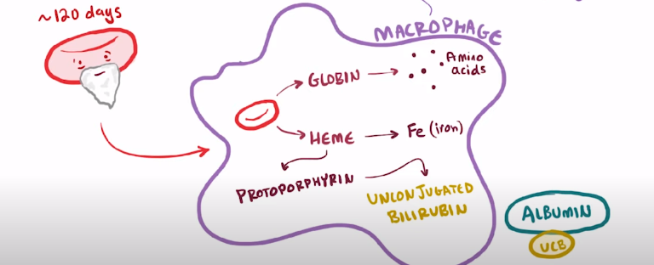
Bilirubin metabolism
Bilirubin is a breakdown product of heme catabolism.
In its unconjugated form, bilirubin is water-insoluble and binds avidly to tissues such as brain, conjunctiva, and mucous membranes. This is minimized by its binding to albumin in the plasma, which keeps it confined to the vascular space.

Slide 3
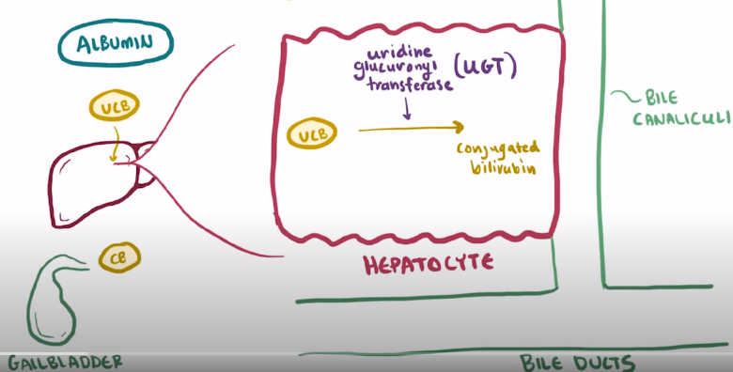
Bilirubin metabolism
the albumin-bilirubin complex dissociates, and it is taken up by the hepatocytes. It is conjugated via uridine diphosphoglucuronate glucuronosyltransferase (UGT) into its water-soluble form.
Conjugated bilirubin is excreted into bile and delivered to the small intestine

Slide 4
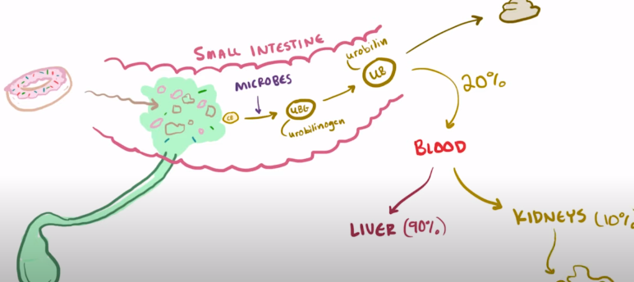
Bilirubin metabolism
Intestinal bacteria convert bilirubin into urobilinogen, which then are reabsorbed by the intestine and circulated back to the liver in a process called enterohepatic circulation.
A small portion of urobilinogen is excreted from the body through the urine, while most is excreted in the stool. They give urine and stool their characteristic yellow and brown colors, respectively

Slide 5
In the serum, bilirubin is usually measured as both direct bilirubin and total-value bilirubin
Direct bilirubin correlates with conjugated bilirubin
Indirect bilirubin correlates with unconjugated bilirubin
Normal findings
Adult/elderly/child
Total bilirubin: 0.3-1.0 mg/dL
Indirect bilirubin: 0.2-0.8 mg/dL
Direct bilirubin: 0.1-0.3 mg/dL
Newborn:
Total bilirubin: 1.0-12.0 mg/dL

Slide 6
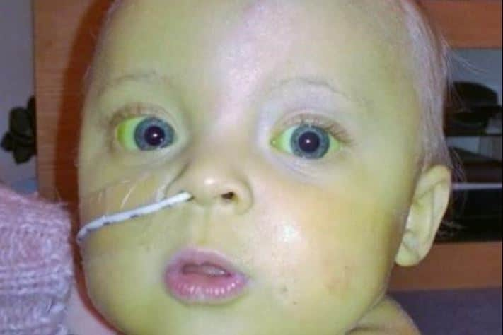
Jaundice, the yellow coloration of the skin and/or conjunctiva, is caused by the accumulation of bilirubin in the blood.
The hyperbilirubinemia can be either unconjugated or conjugated
jaundice and can be classified into different anatomical sites of pathology: prehepatic (increased bilirubin production), hepatic (liver dysfunction), or posthepatic (duct obstruction).

Slide 7
Jaundice usually becomes clinically apparent when the serum total bilirubin concentration is greater than 2 to 3 mg/dL and usually appears first in the face may progress down to the chest, abdomen, arms, and then finally to the legs,
The entire body including palms and soles, can appear at TB >15 mg/dL
However, the presence or absence of jaundice is not a reliable method to assess total serum bilirubin (TB) concentration or identify infants at risk for rapidly rising bilirubin, especially in those with dark skin

Slide 8
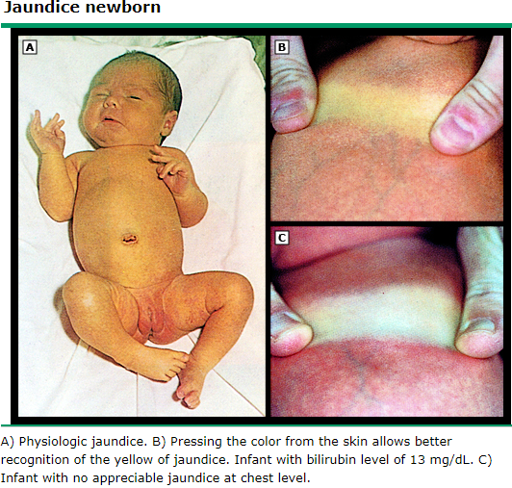

Slide 9
Unconjugated and conjugated hyperbilirubinemia
Conjugated hyperbilirubinemia is defined as serum conjugated bilirubin concentration >0.4 mg/dL
Unconjugated hyperbilirubinemia is defined as hyperbilirubinemia without an increase in the conjugated component. Thus, it is hyperbilirubinemia in which conjugated bilirubin is <1 mg/dL (17 micromol/L) if the total bilirubin is <5 mg/dL, or less than 20 percent of the total bilirubin if the total bilirubin is >5 mg/dL (85 micromol/L)

Slide 10
Unconjugated hyperbilirubinemia
Three basic pathophysiologic mechanisms, overproduction of bilirubin, reduced bilirubin uptake, and impaired bilirubin conjugation, are mainly responsible for unconjugated hyperbilirubinemia.
Increased bilirubin production :
Hemolysis due to: sickle cell disease, thalassemia, hematomas, hereditary spherocytosis (defect in the erythrocyte membrane, which leads to an increased permeability for sodium and water, giving the erythrocyte a spherical form), G6PD deficiency or Rh/ABO incompatibility especially in second pregnancy; Rh-negative mothers create antibodies and attack the baby's Rh-positive blood. (The administration of Rh(D) immunoglobulin to (Rh)-negative mothers dramatically decreased the incidence of neonatal Rh isoimmune hemolytic disease). Infections that may also trigger hemolysis include bacterial sepsis and malaria
Dyserythropoiesis : incorporation of hemoglobin into erythrocytes is defective and happen in a variety of diseases including megaloblastic and sideroblastic anemias, severe iron deficiency anemia, lead poisoning, and others.

Slide 11
Unconjugated hyperbilirubinemia
Impaired hepatic bilirubin uptake
Congestive heart failure
Surgical/naturally occurring shunts
Drugs/contrast agents resolves within 48 hours of discontinuing the drug; agents that can cause the condition include rifampicin, rifamycin, probenecid for gout, and bunamiodyl (cholecystographic agent).
Impaired conjugation of bilirubin: The following inherited defects:
Crigler-Najjar syndrome types 1 and 2: absence or deficiency of the enzyme bilirubin-UGT, respectively.
Gilbert syndrome: reduced bilirubin-UGT activity, often triggered by an infection, stress, physical exertion, or fasting.

Slide 12
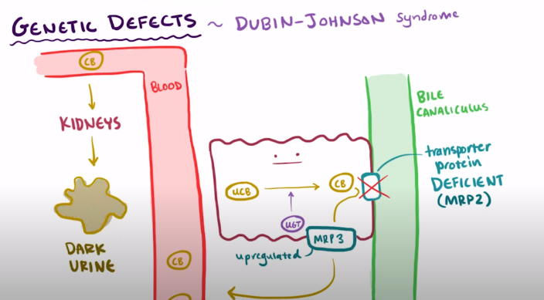
Conjugated hyperbilirubinemia
Inherited disorders: Dubin-Johnson syndrome
DJS is an autosomal-recessive disease characterized by a mutation in the gene responsible for the multidrug resistance protein 2 (MRP2). This mutation results in the impaired transport of nonbile salt organic anions across the canalicular membrane of the hepatocyte, resulting in conjugated hyperbilirubinemia

Slide 13
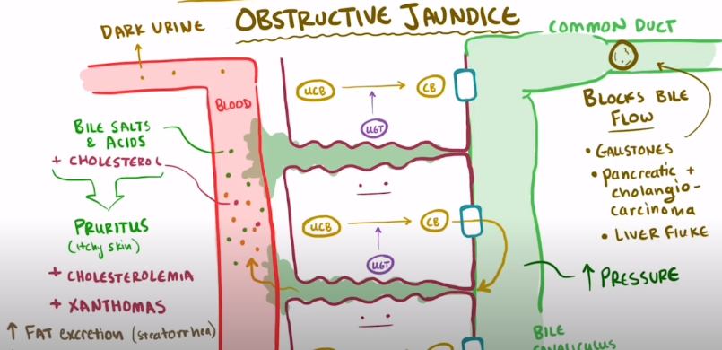
Conjugated hyperbilirubinemia
Biliary obstruction — In biliary obstruction, both conjugated and unconjugated bilirubin accumulate in serum. Bilirubin may be transported back to the plasma via an MRP group of ATP-consuming pumps. Obstruction of biliary flow causes retention of conjugated bilirubin within the hepatocytes, where reversal of glucuronidation may take place. The serum concentrations of conjugated bilirubin and alkaline phosphatase can be used as markers for hepatobiliary obstruction

Slide 14
Conjugated hyperbilirubinemia
The differential diagnosis of conjugated hyperbilirubinemia due to biliary obstruction is age dependent.
In adults, it includes cholelithiasis, intrinsic and extrinsic tumors, primary sclerosing cholangitis (PSC), parasitic infections, lymphoma, AIDS cholangiopathy, acute and chronic pancreatitis, and strictures after invasive procedures.
In children, choledochal cysts and cholelithiasis are most common.
In neonates and young infants, important obstructive processes include biliary atresia and choledochal cysts, which are congenital conditions causing defects in biliary tract
In both cases surgical therapy is indicated

Slide 15
Unconjugated and conjugated hyperbilirubinemia
Liver diseases cause hyperbilirubinemia through several different mechanisms, which may include disruption of bilirubin conjugation. Examples include chronic persistent hepatitis, advanced cirrhosis, and Wilson disease, in which excessive copper accumulation causes hepatocyte injury and neuropsychiatric disease.
Many drugs can cause liver injury that results in hyperbilirubinemia associated with elevated liver enzymes. some drugs are known to do this, as follows: Isoniazid, Chlorpromazine, Erythromycin, and anabolic steroids such as Alkylated testosterone derivatives: methyltestosterone and ethyltestosterone derivatives

Slide 16
Benign/ physiological newborn jaundice
Benign newborn jaundice, which affects nearly all newborns, is caused by a mild to moderate elevation of bilirubin and is not usually harmful to infants. It develops between 72 and 96 hours after birth, and usually goes away by one to two weeks after birth
It is primarily caused by the following alterations in bilirubin metabolism compared with adults:
Increased bilirubin production (two to three times) because of increased red blood cell (RBC) breakdown (turnover). The lifespan of fetal erythrocytes 60 to 90 days
Decreased bilirubin clearance and conjugation (immature liver): low concentrations of the binding protein ligandin needed for uptake of bilirubin into hepatocytes) and because of low activity of UGT
Increased enterohepatic circulation of bilirubin because nutrient intake is limited at first, which may limit intestinal flow and bacterial colonization

Slide 17
Breastfeeding jaundice vs breast milk jaundice
breastfeeding jaundice: breastfeeding failure due to insufficient production or intake of breast milk which causes inadequate fluid and nutrient intake often leads to significant postnatal weight loss in the infant. Such infants have an increased risk of developing jaundice through increased enterohepatic circulation. It manifests in the first 3 days of life, disappears by week 3 of life.
Breast milk jaundice: develops after the first 4-7 days of life, persists longer than physiologic jaundice. Although the mechanism that causes this phenomenon is not yet agreed on β-glucuronidase present in the breast milk of some mothers may play a role by uncoupling bilirubin from its binding to glucuronic acid, thus making it available for reabsorption and increasing enterohepatic circulation of bilirubin. Data suggest that the risk of breast milk jaundice is significantly increased in infants who have genetic polymorphisms in the coding sequences of the UDPGT1A1 [8] or OATP2 genes.

Slide 18
Pathological jaundice
However, in some infants, serum bilirubin levels may rise excessively, and cause Neonatal hyperbilirubinemia, defined as total serum bilirubin (TB) >95th percentile on the hour-specific Bhutani nomogram in infants ≥35 weeks gestational age
bilirubin may get into the brain and cause reversible damage (called acute bilirubin encephalopathy) or permanent damage (called kernicterus or chronic bilirubin encephalopathy)
Signs of worsening jaundice:
If the yellow coloring is at the knee or lower, if the yellow color is more intense (lemon yellow to orange yellow) or if the "whites" of the eyes appear yellow
If the baby has any difficulty in feeding
If it is hard to wake up the infant
If the infant is irritable and is difficult to console
If the infant arches his/her neck or body backwards
Jaundice during the first 24 hours after birth or the presence of yellowing of palms and soles is a medical emergency.

Slide 20
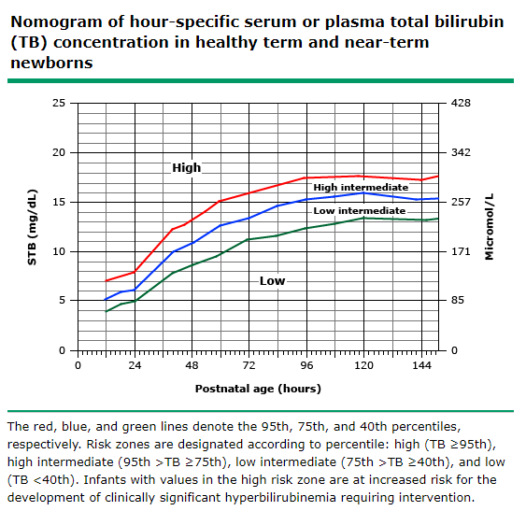
Risk assessment:
In this group of infants with a 95th percentile values for TB were as follows
8 mg/dL (137 micromol/L) at 24 hours of age
11 mg/dL (188 micromol/L) at 36 hours of age
13 mg/dL (222 micromol/L) at 48 hours of age
16 mg/dL (274 micromol/L) at 72 hours of age
Infants with hour-specific values ≥95th percentile are at increased risk for the development of severe hyperbilirubinemia that can evolve to bilirubin-induced neurologic dysfunction (BIND).

Slide 21
Screening
Universal bilirubin screening before discharge has been recommended by an expert panel of neonatologists and pediatricians to identify infants at high risk for the development of severe hyperbilirubinemia
universal bilirubin screening is performed at the time of routine metabolic screening (24 to 48 hours old earlier in those with risk factors) in all infants prior to discharge.
TcB measurements are used for screening for term and late preterm infants prior to discharge. Of note, TcB may not be a good substitute for TB measurement in very preterm neonates or term infants who are >7 days of age
Appropriate follow-up after discharge is essential. In general, the younger the patient age at the time of discharge, the earlier follow-up is required
Infants who are discharged prior to 72 hours should be seen within two days of discharge, and evaluated for jaundice and the need for additional bilirubin measurements.

Slide 23
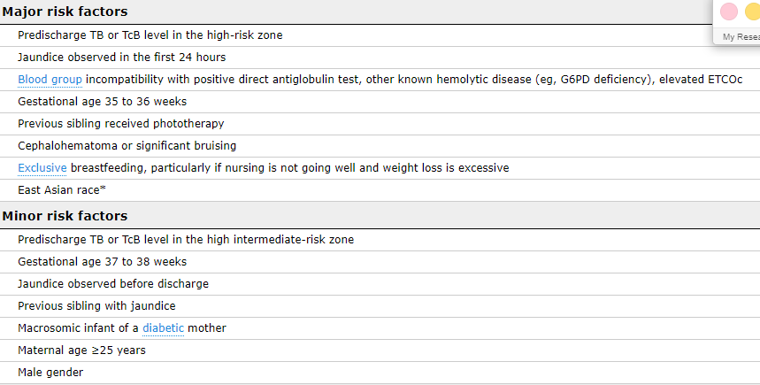
Risk factors for development of severe hyperbilirubinemia in infants of 35 or more weeks gestation

Slide 24
treatment
Reduction of TB in infants with hyperbilirubinemia using the following interventions:
Phototherapy is the initial intervention to reduce TB levels.
Exchange transfusion
The decision of when to initiate therapy and the choice of intervention are based on the probability of developing severe hyperbilirubinemia, defined as TB >25 mg/dL (428 micromol/L), using hour-specific TB values, GA, and the presence or absence of risk factors that increase the risk of brain damage
These factors include isoimmune hemolytic disease, glucose-6-phosphate dehydrogenase (G6PD) deficiency, asphyxia (suffocation), lethargy, temperature instability, sepsis, acidosis, or albumin <3 g/dL (if measured)

Slide 25
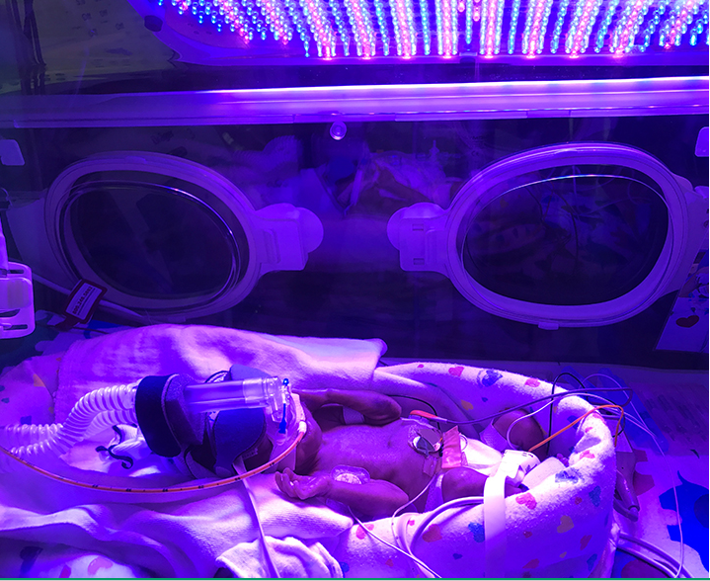
Phototherapy
The principal mechanism by which phototherapy reduces the TB concentration is by converting bilirubin into lumirubin via structural isomerization that is not reversible. Lumirubin, a more soluble substance than bilirubin, is excreted without conjugation into bile and urine.
Phototherapy is less effective in infants whose hyperbilirubinemia is due to cholestasis or hemolysis with a positive direct antiglobulin test (positive DAT; Coombs test means The infants have antibodies attached to the RBCs. This may be due to: Autoimmune hemolytic anemia)
The eyes should be shielded with an opaque blindfold cause animal studies indicate that retinal degeneration may occur after 24 hours of continuous exposure

Slide 26
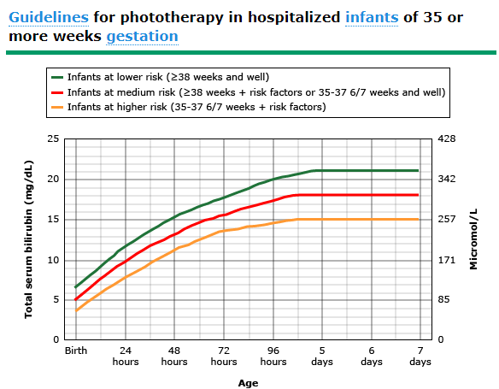
Infants in who have TB levels 2 to 3 mg/dL (34 to 51 micromol/L) below the recommended levels may be treated at home with fiberoptic, blue light-emitting diodes (LEDs), or conventional phototherapy. but home phototherapy should not be used in any infant with risk factors, only for older than 38wk and well
For TB levels ≥20 mg/dL (342 micromol/L), phototherapy should be administered continuously, until the TB falls below 20 mg/dL (342 micromol/L). Once this occurs, phototherapy can be interrupted for feeding and parental visits.

Slide 27
Phototherapy Response to therapy
With conventional phototherapy, a decline of 6 to 20 percent can be expected in the first 18 to 24 hours. Intensive phototherapy results in a decline of TB of at least 2 to 3 mg/dL (34 to 51 micromol/L) within four to six hours
When infants are discharged and readmitted with TB values exceeding the 95th percentile for hour-specific TB levels, the TB measurement should be repeated two to three hours after initiation of phototherapy to assess the response
When phototherapy is started for a rising TB during the birth hospitalization, TB should be measured after 4 to 6 hours and then within 8 to 12 hours, if TB continues to fall.

Slide 28
Phototherapy Discontinuation
For infants who have been readmitted for phototherapy, we discontinue phototherapy when the TB has reached 12 to 14 mg/dL (205 to 239 micromol/L).
For those who required phototherapy during the birth hospitalization, phototherapy is started at a significantly lower level and, therefore, is stopped at a lower level. For these infants, we generally discontinue phototherapy when the TB has fallen to, or below, the level at which phototherapy was initiated because, by this time, the infant is significantly older and the level for initiation of phototherapy has, consequently, increased.
TB is best measured 18 to 24 hours after phototherapy is terminated. This is important in infants who need phototherapy during their birth hospitalization, but might not be necessary in those who have been readmitted where the risk of rebound is much lower.
Risk factors for rebound include GA less than 38 weeks, Asian ethnicity, breastfeeding, a positive DAT test, and the use of early phototherapy

Slide 29
Phototherapy side effects
Short-term effects —include transient, benign, erythematous rashes, hyperthermia, and interruption of breastfeeding. Increased insensible water loss may lead to dehydration with use of halogen or fluorescent light sources. So, It is important to maintain adequate hydration and urine output during phototherapy since urinary excretion of lumirubin is the principal mechanism by which phototherapy reduces TB.
Bronze baby syndrome has been described in infants with cholestatic jaundice (conjugate bilirubin >2 mg/dL) treated with phototherapy. This uncommon complication is manifested by a transient dark, grayish-brown discoloration of the skin, serum, and urine. it is proposed that the syndrome is the result of impaired biliary excretion of bile pigment photoproducts due to cholestasis. The condition usually resolves without sequelae within weeks after discontinuation of phototherapy.
Potential long-term effects — Although unlikely, it remains uncertain whether neonatal phototherapy is associated with long-term complications, such as increased risk for childhood cancer and melanocytic nevi.

Slide 30
EXCHANGE TRANSFUSION
Although exchange transfusion is rare, expensive, time-consuming, and requires clinical expertise, it is the most effective method for removing bilirubin rapidly
The procedure involves central catheter placement, and removing and replacing blood in aliquots that are approximately 10 percent or less of the infant's blood volume. Exchange transfusion usually reduces TB by approximately 50 percent
Exchange transfusion is especially useful for infants with increased bilirubin production resulting from isoimmune hemolysis because circulating antibodies and sensitized red blood cells also are removed.
Following exchange transfusion, phototherapy is initiated. TB is measured within two hours following the procedure and management decision are made dependent on the level of TB.

Slide 31
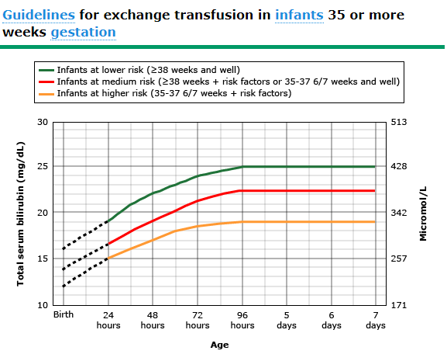
Indication
Immediate exchange transfusion is recommended if the infant shows signs of acute bilirubin encephalopathy (hypertonia, arching, retrocollis, opisthotonos, fever, high-pitched cry)
or if TB is ≥5 mg/dL (85 micromol/L) above these lines.
The dashed lines for the first 24 hours indicate uncertainty due to a wide range of clinical circumstances and a range of responses to phototherapy.

Slide 32
EXCHANGE TRANSFUSION
During birth hospitalization, exchange transfusion is recommended if the TB rises to these levels despite intensive phototherapy.
For readmitted infants, if the TB level is above the hour-specific threshold for exchange transfusion, and the patient has no additional clinical risk factors, repeat TB measurement every two to three hours and consider exchange if the TB remains above the levels indicated after intensive phototherapy for six hours
The bilirubin/albumin (B/A) ratio can be used as an additional factor in determining the need for exchange transfusion; it should not be used alone, but in conjunction with TB values. In term neonates, B/A ratio >7.0 (bilirubin mg/dL to albumin g/dL) indicates that all bilirubin binding sites on albumin are occupied.

Slide 33
EXCHANGE TRANSFUSION complications
Blood-borne infections
Thrombocytopenia and coagulopathy
Graft versus host disease: use Irradiated blood products, which are cellular blood components which have been exposed to irradiation to inactivate lymphocytes
Necrotizing enterocolitis
Portal vein thrombosis
Electrolyte abnormalities (eg, hypocalcemia and hyperkalemia)
Cardiac arrhythmias

Slide 34
Pharmacological agents
IVIG (dose 0.5 to 1 g/kg over two hours) is recommended in infants with isoimmune hemolytic disease if the total serum or plasma bilirubin (TB) is rising despite intensive phototherapy or is within 2 or 3 mg/dL (34 to 51 micromol/L) of the threshold for exchange transfusion [1,9]. The dose may be repeated in 12 hours if necessary
US box warning: thrombosis and acute renal failure
Ursodeoxycholic acid (UDCA) increases bile flow by decreasing cholesterol content of bile and bile stones and helps to lower TB levels . It is useful in the treatment of cholestatic jaundice. However, data are limited on the safety and overall efficacy of UDCA as adjunctive therapy to phototherapy. As a result, it is not routinely recommend as an addition to phototherapy

Slide 35
Pharmacological agents
Phenobarbital — Phenobarbital increases the conjugation (induce the expression of UGT) and excretion of bilirubin (increase uptake of bilirubin into hepatocytes) and decreases postnatal TB levels when given to pregnant women or infants. However, prenatal administration of phenobarbital may adversely affect cognitive development and reproduction.
Used in hyperbilirubinemia (conjugated): Infants and Children: Oral: Usual range: 3 to 8 mg/kg/day in 2 to 3 divided doses; doses up to 10 mg/kg/day in divided doses have been used in case reports
Phenobarbital is not routinely used to treat indirect neonatal hyperbilirubinemia.
Contraindicated in marked hepatic impairment

Slide 36
Individuals with type I Crigler-Najjar syndrome usually present with very high levels of unconjugated hyperbilirubin at birth, resulting in kernicterus. Treatment involves emergent plasma exchange to treat kernicterus followed by regular phototherapy. If left untreated, type I is fatal by about age two years.
Patients with type II may not require any therapy or may be treated with phenobarbital (5 mg/kg/day)
Patients with type I do not respond to phenobarbital, as the mutation is a loss-of-function mutation
Gilbert syndrome is completely benign and has no effect on life expectancy. Therefore, management is centered on reassurance, and no medical therapy is indicated.

Slide 37
Treatment for breast milk jaundice
healthy term infants: Increase breastfeeding to 8-12 times per day, and recheck the serum bilirubin level in 12-24 hours. Reassure the mother about the relatively benign nature of breast milk jaundice .
Continue breastfeeding and supplement with formula.
The most rapid way to reduce the bilirubin level is to interrupt breastfeeding for 24 hours, feed with formula, and use phototherapy; however, in most infants, interrupting breastfeeding is is rarely needed and is not recommended unless serum bilirubin levels reach 20 mg/dL (340 µmol/L

