Slide 1
Pertussis
Whooping cough
Alaa Sandouka

Slide 2
Pertussis is an acute respiratory tract infection .
Bordetella pertussis is the most common causative organism
Bordetella parapertussis is an occasional cause of sporadic pertussis
Bordetella holmesii, first identified as a cause of bacteremia in immunocompromised hosts, is also reported to cause pertussis-like cough illness in healthy persons
Bordetella bronchiseptica is a common animal pathogen. Occasional reports in humans and cases typically occur in
immunocompromised persons
young children with intense exposure to animals
Bordetella organisms are small, Gram-negative coccobacilli that colonize only ciliated epithelium.

Slide 3
PATHOGENESIS
B pertussis spreads via aerosolized droplets produced by the cough of infected individuals
The exact mechanism of disease symptomatology remains unknown.
Only B. pertussis expresses pertussis toxin (PT), the major virulence protein. PT has numerous proven biologic activities (e.g., histamine sensitivity, insulin secretion, leukocyte dysfunction).
PT appears to have a central, but not a singular, role in pathogenesis. B. pertussis produces an array of other biologically active substances, many of which are postulated to have a role in disease and immunity.

Slide 4
After aerosol acquisition, filamentous hemagglutin, some agglutinogens (especially fimbriae types 2 and 3), and a 69-kDa nonfimbrial surface protein called pertactin (Prn) are important for attachment to ciliated respiratory epithelial cells.
Tracheal cytotoxin inhibits DNA synthesis and promotes cell death , adenylate cyclase inhibits phagocytosis.
Tracheal cytotoxin and adenylate cyclase are postulated to be predominantly responsible for the local epithelial damage that produces respiratory symptoms and facilitates absorption of PT.
Pertussis is extremely contagious.
Survival outside host for 3-5 days

Slide 5
CLINICAL MANIFESTATIONS
Classically, pertussis is a prolonged disease, divided into catarrhal, paroxysmal, and convalescent stages.
The catarrhal stage (1-2 wk) begins insidiously after an incubation period ranging from 3-12 days with non-distinctive symptoms of congestion and rhinorrhea variably accompanied by low-grade fever, sneezing, lacrimation, and conjunctival suffusion
As initial symptoms wane, coughing marks the onset of the paroxysmal stage (2-6 wk). The cough begins as a dry, intermittent and evolves into paroxysmal cough that are the hallmark of pertussis.
A well-appearing, playful toddler suddenly expresses an anxious aura and may clutch a parent or comforting adult before beginning a machine-gun burst of uninterrupted cough on a single exhalation, chin and chest held forward, tongue protruding maximally, eyes bulging and watering, face red, until coughing ceases and a loud whoop follows as inspired air traverses the still partially closed airway. Posttussive emesis is common, and exhaustion is universal. The number and severity of paroxysms escalate over days to a week and remain at that plateau for days to weeks. At the peak of the paroxysmal stage, patients may have more than 1 episode hourly

Slide 7
As the paroxysmal stage fades into the convalescent stage (≥2 wk), the number, severity, and duration of episodes diminish.
Infants younger than 3 mo of age do not display the classic stages.
- The catarrhal phase lasts only a few days or is unnoticed, and then, after the most insignificant startle from light, sound, a well-appearing young infant begins to choke, gasp, gag with face reddened.
Cough may not be prominent, especially in the early phase. Whoop infrequently occurs in infants younger than 3 mo of age who at the end of a paroxysm lack stature or muscular strength to create sudden negative intrathoracic pressure.
Apnea and cyanosis can follow a coughing paroxysm, or apnea can occur without a cough. Apnea may be the only symptom.
Apnea and cyanosis both are more common with pertussis than with neonatal infections from viruses, including respiratory syncytial virus.
The paroxysmal and convalescent stages in young infants are lengthy. Paradoxically, in infants, cough and whooping may become louder and more classic in convalescence

Slide 8
Adolescents and previously immunized children have foreshortening of all stages of pertussis.
Adults have no distinct stages. Classically, adolescents and adults describe a sudden feeling of strangulation followed by uninterrupted coughs, feeling of suffocation, bursting headache, diminished awareness, and then a gasping breath.
At least 30% of older individuals with pertussis have nonspecifc cough illness, distinguished only by duration, which usually is longer than 21 days.

Slide 9
DIAGNOSIS
Pertussis should be suspected in any individual who has a predominant complaint of cough, especially if the following features are absent: fever, myalgia, exanthem ,sore throat, hoarseness, tachypnea, wheezes, and rales.
a clinical case definition of cough of 14 days or longer duration with at least 1 associated symptom of
-paroxysms
whoop,
- or posttussive vomiting
*has a sensitivity of 81% and a specificity of 58% for confirmation of pertussis.

Slide 10
Pertussis should be suspected in older children whose cough illness is escalating at 7-10 days and whose coughing episodes are not continuous.
Pertussis should be suspected in infants younger than 3 mo of age with gagging, gasping, apnea, cyanosis, or an apparent life-threatening event. Sudden infant death occasionally is caused by B. pertussis.
Leukocytosis (15,000-100,000 cells/μL) caused by absolute lymphocytosis is characteristic in the catarrhal stage. Lymphocytes are of T and B-lymphocyte origin and are normal small cells, rather than the large atypical lymphocytes seen with viral infections.
Absolute increase in neutrophils suggests a different diagnosis or secondary bacterial infection.
Eosinophilia is not a manifestation of pertussis

Slide 11
Adenoviral infections usually are distinguishable by associated features, such as fever, sore throat, and conjunctivitis.
Also purulent conjunctivitis, tachypnea, rales or wheezes that typify infection by Chlamydia trachomatis
predominant lower respiratory tract signs typify infection by respiratory syncytial virus.

Slide 12
Chest radiographic findings are only mildly abnormal in the majority of hospitalized infants, showing infiltrate or edema (sometimes with a butterfly appearance) and variable atelectasis.
For culture, careful attention must be directed to specimen collection, transport, and isolation technique.
The specimen is obtained with deep nasopharyngeal aspiration or with the use of a flexible swab
held in the posterior nasopharynx for 15-30 sec (or until cough occurs)
Cultures are incubated at 35-37°C in a humid environment and examined daily for 7 days for slow-growing, tiny, glistening colonies

Slide 13
*Direct fluorescent antibody testing of potential isolates using specific antibody for B. pertussis and B. parapertussis .
*PCR testing has a sensitivity similar to that of culture.
*Serologic tests for detection of change in antibodies to B. pertussis antigens in acute and convalescent samples are the most sensitive tests in immunized individuals and are useful epidemiologically
The CDC recommends a combination of culture and PCR assay if a patient has a cough lasting longer than 3 weeks.

Slide 14
Infants younger than 3 months of age with suspected pertussis usually are admitted to hospital
Many of between 3 and 6 months of age with severe paroxysms.
as well as are patients of any age if significant complications occur
Many infants have marked improvement upon hospitalization and antibiotic therapy, especially if they are hospitalized early in the course of disease or have been removed from aggravating environmental smoke, excessive stimulation, or a dry or polluting heat source

Slide 15
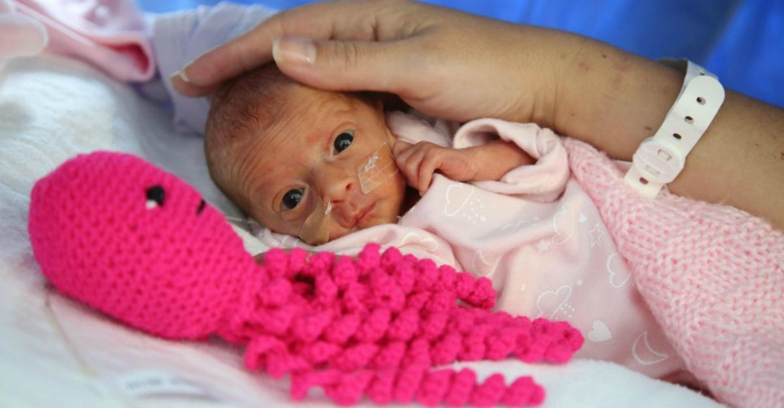
Suspected poor outcome in
Prematurely born young infants have a high risk for severe, potentially fatal disease
children with underlying cardiac, pulmonary, muscular, or neurologic disorders have increased risk of poor outcome beyond infancy.

Slide 16
TREATMENT
The specific, limited goals of hospitalization are to:
Assess progression of disease and likelihood of life-threatening events at peak of disease
Maximize nutrition
Prevent or treat complications

Slide 17
Assessment
Heart rate, respiratory rate, and pulse oximetry are monitored continuously with alarm settings so that paroxysms can be witnessed and recorded by healthcare personnel
documentation of feeding, vomiting, and weight change provide data to assess severity
Typical paroxysms that are not life threatening have the following features: duration <45 sec, red but not blue color change, tachycardia, bradycardia (not <60 beats/mins in infants) , or oxygen desaturation that spontaneously resolves at the end of the paroxysm, whooping or strength for brisk self-rescue at the end of the paroxysm; self-expectorated mucus plug; and posttussive exhaustion but not unresponsiveness.

Slide 18
Assessing the need to provide oxygen or suctioning requires skilled personnel who can watchfully observe an infant’s ability for self-rescue but who will intervene rapidly and expertly when necessary.
The benefit of a quiet, dimly lighted, undisturbed, comforting environment cannot be overestimated or forfeited in a desire to monitor and intervene.
Feeding children with pertussis is challenging. The composition or thickness of formula does not affect the quality of secretions, cough, or retention. Large volume feedings are avoided.

Slide 19
Hospital discharge is appropriate if
over a 48-hr period disease severity is unchanged or diminished
nutrition is adequate
intervention is not required during paroxysms
No complication has occurred and parents are adequately prepared for care at home . Portable oxygen, monitoring, or suction apparatus should not be needed at home.

Slide 20
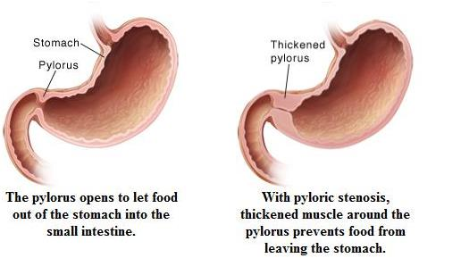
Antibiotics
An antimicrobial agent always is given when pertussis is suspected or confirmed, primarily to limit the spread of infection and secondarily for possible clinical benefit.
Macrolides are preferred agents, Resistance has been reported rarely
Azithromycin is the preferred agent in all age groups; rare cases of infantile hypertrophic pyloric stenosis have followed its use in neonates. Infantile hypertrophic pyloric stenosis disorder of young infants caused by hypertrophy of the pylorus, which can progress to near-complete obstruction of the gastric outlet, leading to forceful vomiting.
The FDA also warns of risk of fatal heart rhythms with use of azithromycin in patients already at risk for cardiovascular events, especially those with prolongation of the QT interval.

Slide 21
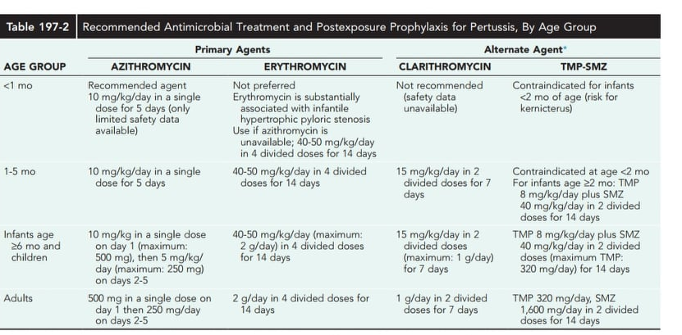

Slide 22
Adjunct therapies
No rigorous clinical trial has demonstrated a beneficial effect of β2-adrenergic stimulants such as albuterol.
Corticosteroids clinical use is not warranted
Study of the benefit of intravenous immunoglobulin had stopped and there was no indication of clinical benefit also should not be used for treatment or prophylaxis.
Infants who cannot tolerate oral feedings may require intravenous fluids.

Slide 23
Isolation
Patients with suspected pertussis are placed in isolation .To reduce close contact with respiratory secretions, All healthcare personnel should wear a mask upon entering the room. Screening for cough should be performed upon entrance of patients to emergency departments and clinics to begin isolation immediately and until 5 days after initiation of macrolide therapy

Slide 24
Care of Household and Other Close Contacts
A macrolide agent should be given promptly to all household contacts and other close contacts, such as those in daycare, regardless of age, history of immunization, and symptoms.
In close contacts younger than 7 yr of age who have received fewer than 4 doses of pertussis-containing vaccines, DTaP should be initiated or continued to complete the recommended series.
Children younger than 7 yr of age who received a 3rd dose more than 6 mo before exposure or a 4th dose 3 yr or more before exposure should receive a DTaP booster dose.
Individuals 9 yr of age or older should be given Tdap if they have not received Tdap previously.

Slide 25
PREVENTION
DTaP Vaccines :diphtheria and tetanus toxoids combined with acellular pertussis vaccines
Acellular pertussis vaccines all contain inactivated PT and 2 or more other bacterial components (filamentous hemagglutinin, Prn, and Fim 2 and 3).
Clinical efficacy against severe pertussis, defined as paroxysmal cough for longer than 21 days, is approximately 85%.
Mild local and systemic adverse events as well as more serious events (including high fever, persistent crying for 3 hr or longer, hypotonic hyporesponsive episodes, and seizures) occur significantly less frequently among infants who receive DTaP than in those who receive DTP vaccine.

Slide 26
Four doses of DTaP should be administered during the 1st 2 yr of life, generally at ages 2, 4, 6, and 15-18 mo of age. The 4th dose may be administered as early as 12 mo of age, provided that 6 mo have elapsed since the 3rd dose. The 5th dose of DTaP is recommended for children at 4-6 yr of age; a 5th dose is not necessary if the 4th dose in the series is administered on or after the 4th birthday. Swelling of the entire thigh or upper arm, sometimes accompanied by pain, erythema, and fever, has been reported in 2-3% of vaccines after the 4th or 5th dose of a variety of DTaP products. Although well documented pertussis confers short-term protection, the duration of protection is unknown; immunization should be completed on schedule in children diagnosed with pertussis.

Slide 27
Tdap vaccine
Two tetanus toxoid, reduced-diphtheria toxoid, and acellular pertussis antigen vaccine (Tdap) products.
The preferred age for Tdap vaccination is 11-12 yr.
older individuals can receive a single-dose booster vaccine to provide protection against tetanus, diphtheria, and pertussis.
Pregnant women should be given Tdap during every pregnancy to provide passive antibody protection to the infant until administration of DTaP. Optimal timing of maternal Tdap is 26 through 37 wk of gestation .
A single dose of Tdap is recommended for children 7-10 yr old who had incomplete pertussis vaccination prior to age 7 yr.

Slide 28
complications
Infants younger than 6 mo of age have excessive mortality and morbidity
Infants younger than 4 mo of age account for 90% of cases of fatal pertussis.
infants younger than 2 mo of age have the highest reported rates of pertussis-associated hospitalization (82%), pneumonia ,seizures , encephalopathy and death.
Preterm birth and young maternal age are significantly associated with fatal pertussis.
The principal complications of pertussis are apnea, secondary infections (such as otitis media and pneumonia)
Increased intrathoracic and intraabdominal pressure during coughing can result in conjunctival and scleral hemorrhages, petechiae on the upper body, epistaxis, hemorrhage in the central nervous system and retina, pneumothorax and umbilical hernias

Slide 29
Progressive pulmonary hypertension in very young infants and secondary bacterial pneumonia are severe complications of pertussis and are the usual causes of death.
Central nervous system abnormalities
Bronchiectasis has been reported rarely after pertussis. Children who have pertussis before the age of 2 yr may have abnormal pulmonary function into adulthood.

Slide 30
Thank you

