Slide 1
Urinary tract infection and vesicoureteral reflux (VUR)
In pediatrics

Slide 2
PREVALENCE of UTI
During the 1st yr of life, the
male :female ratio is 2.8-5.4 : 1
Beyond 1-2 yr, there is a female preponderance,
with a male :female ratio of 1 : 10.
In boys, most UTIs occur during the 1st yr of life; UTIs are much more common in uncircumcised boys, especially in the 1st yr of life. In girls, the first UTI usually occurs by the age of 5 yr, with peaks during infancy and toilet training

Slide 3
Etiology
UTIs are caused primarily by colonic bacteria. In girls, 75-90% of all infections are caused by E.coli, followed by Klebsiella spp. and Proteus spp.
Although E. coli is also the most common organism in males, some series report that in boys older than 1 yr of age, Proteus is as common a cause as E. coli;
others report a preponderance of Gram-positive organisms in boys.
Staphylococcus saprophyticus and enterococcus are pathogens in both sexes
Adenovirus and other viral infections also can occur, especially as a cause of cystitis with gross hematuria.
UTIs have been considered a risk factor for the development of renal insufficiency or end-stage renal disease in children

Slide 4
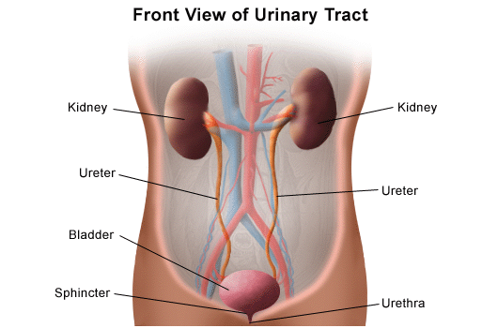
CLINICAL MANIFESTATIONS AND CLASSIFICATION
The 3 basic forms of UTI are
pyelonephritis
cystitis,
and asymptomatic bacteriuria.
Focal pyelonephritis (“nephronia”) and renal abscesses are less common.

Slide 5
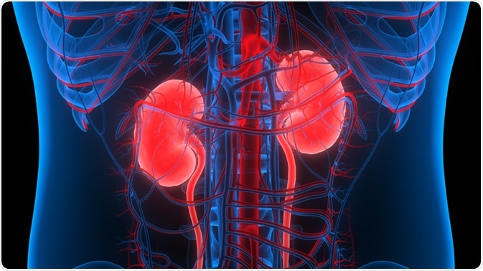
Pyelonephritis
Clinical pyelonephritis is characterized by any or all of the following:
abdominal, back, or flank pain; fever; malaise; nausea; vomiting; and, occasionally, diarrhea. Fever may be the only manifestation. Newborns can show nonspecific symptoms such as poor feeding, irritability, jaundice, and weight loss.
Pyelonephritis is the most common serious bacterial infection in infants younger than 24 mo of age who have fever without an obvious focus.
Involvement of the renal parenchyma is termed acute pyelonephritis, whereas if there is no parenchymal involvement, the condition may be termed pyelitis. Acute pyelonephritis can result in renal injury, termed pyelonephritic scarring

Slide 6
Cystitis
Cystitis indicates that there is bladder involvement; symptoms include dysuria, urgency, frequency, suprapubic pain, incontinence, and malodorous urine. Cystitis does not cause fever and does not result in renal injury.
Acute hemorrhagic cystitis often is caused by E. coli; it also has been attributed to adenovirus types 11 and 21. Adenovirus cystitis is more common in boys; it is self-limiting, with hematuria lasting approximately 4 days.
Eosinophilic cystitis is a rare form of cystitis of obscure origin that occasionally is found in children. The usual symptoms are those of cystitis with hematuria
Interstitial cystitis is characterized by irritative voiding symptoms such as urgency, frequency, and dysuria, and bladder and pelvic pain relieved by voiding with a negative urine culture. The disorder is most likely to affect adolescent girls and is idiopathic

Slide 7
Asymptomatic bacteriuria
Asymptomatic bacteriuria refers to a condition in which there is a positive urine culture without any manifestations of infection. It is most common in girls. The incidence is <1% in preschool and schoolage girls and is rare in boys. This condition is benign and does not cause renal injury, except in pregnant women, in whom asymptomatic bacteriuria, if left untreated, can result in a symptomatic UTI. Some girls are mistakenly identified as having asymptomatic bacteriuria, whereas they actually are experiencing day or night incontinence or perineal discomfort secondary to UTI; these patients should undergo antibiotic therapy.

Slide 8
PATHOGENESIS AND PATHOLOGY
Nearly all UTIs are ascending infections. The bacteria arise from the fecal flora, colonize the perineum, and enter the bladder via the urethra.
In uncircumcised boys, the bacterial pathogens arise from the flora beneath the prepuce.
In some cases, the bacteria causing cystitis ascend to the kidney to cause pyelonephritis. Rarely, renal infection occurs by hematogenous spread,
If bacteria ascend from the bladder to the kidney, acute pyelonephritis can occur. Normally the simple and compound papillae in the kidney have an antireflux mechanism that prevents urine in the renal pelvis from entering the collecting tubules. However, some compound papillae, allow intrarenal reflux. Infected urine then stimulates an immunologic and inflammatory response. The result can cause renal injury and scarring

Slide 9
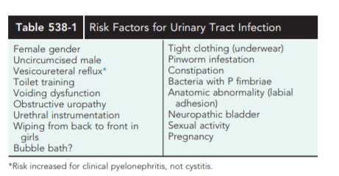
Children of any age with a febrile UTI can have acute pyelonephritis and subsequent renal scarring, but the risk is highest in those younger than 2 yr of age.

Slide 10
The pathogenesis of UTI is based in part on the presence of bacterial pili or fimbriae on the bacterial surface. There are 2 types of fimbriae, type I and type II.
Type I fimbriae are found on most strains of E. coli. Because attachment to target cells can be blocked by d-mannose, these fimbriae are referred to as mannose sensitive. They have no role in pyelonephritis.
The attachment of type II fimbriae is not inhibited by mannose, and these are known as mannose resistant. These fimbriae are expressed by only certain strains of E. coli.
The receptor for type II fimbriae is a glycosphingolipid that is present on both the uroepithelial cell membrane and red blood cells. Because these fimbriae can agglutinate by P blood group erythrocytes, they are known as P fimbriae. Bacteria with P fimbriae are more likely to cause pyelonephritis

Slide 11
DIAGNOSIS
UTI may be suspected based on symptoms or findings on urinalysis, or both; a urine culture is necessary for confirmation and appropriate therapy
There are several ways to obtain a urine sample; some are more accurate than others. In toilet-trained children, a midstream urine sample usually is satisfactory
in children who are not toilet trained, a catheterized or suprapubic aspirate urine sample should be obtained. Alternatively, the application of an adhesive, sealed, sterile collection bag after disinfection of the skin of the genitals can be useful only if the culture is negative or if a single uropathogen is identified. However, a positive culture can result from skin contamination, particularly in girls and uncircumcised boys. If treatment is planned immediately after obtaining the urine culture, a bagged specimen should not be the method because of a high rate of contamination, often with mixed organisms. A suprapubic aspirate generally is unnecessary

Slide 12
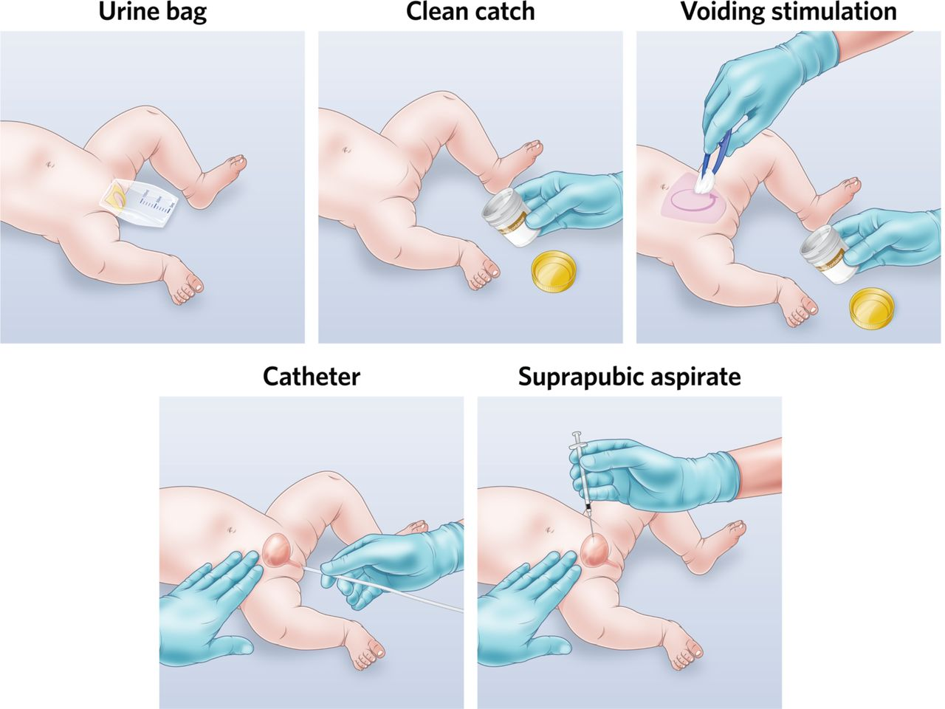

Slide 13
Nitrites and leukocyte esterase usually are positive in infected urine.
Microscopic hematuria is common in acute cystitis, but microhematuria alone does not suggest UTI. WBC casts in the urinary sediment suggest renal involvement, but in practice these are rarely seen.
If the child is asymptomatic and the urinalysis result is normal, it is unlikely that there is a UTI. However, if the child is symptomatic, a UTI is possible, even if the urinalysis result is negative

Slide 14
Pyuria (leukocytes on urine microscopy) suggests infection, but infection can occur in the absence of pyuria; this finding is more confirmatory than diagnostic. Conversely, pyuria can be present without UTI
Sterile pyuria (positive leukocytes, negative culture) may occur in partially treated bacterial UTIs, viral infections, renal tuberculosis, renal abscess, UTI in the presence of urinary obstruction, urethritis as a consequence of a sexually transmitted infection

Slide 15
If the culture shows >50,000 colonies of a single pathogen (suprapubic or catheter sample), or if there are 10,000 colonies and the child is symptomatic, the child is considered to have a UTI.
In a bag sample, if the urinalysis result is positive, the patient is symptomatic, and there is a single organism cultured with a colony count >100,000, there is a presumed UTI. If any of these criteria are not met, confirmation of infection with a catheterized sample is recommended
With acute renal infection, leukocytosis, neutrophilia, and elevated serum erythrocyte sedimentation rate, procalcitonin, and C-reactive protein are common. However these are all nonspecific markers of inflammation, and their elevation does not prove that the child has acute pyelonephritis. With a renal abscess, the WBC count is markedly elevated to >20,000-25,000/mm3 . An elevated serum procalcitonin level is associated with pyelonephritis and a high risk of renal scarring.
Because sepsis is common in pyelonephritis, particularly in infants and in any child with obstructive uropathy, blood cultures should be drawn before starting antibiotics if possible

Slide 16
TREATMENT
Treatment with IV broad-spectrum antimicrobial agents should be initiated as soon as cultures of urine, blood, and cerebrospinal fluid (if indicated) have been obtained. The effectiveness of antimicrobial therapy for pediatric UTIs is demonstrated by the change in mortality between the pre- and post-antibiotic eras.
when UTIs are appropriately treated with antibiotics, acute complications (eg, renal abscess, death) are uncommon.
Choice of agent and dosing — Antibiotic therapy includes initial parenteral empiric antibiotic therapy pending culture results, and organism-specific therapy based on the isolated organism and its antibiotic susceptibility.
Empiric therapy — The choice and dosing of empiric antibiotic therapy is generally the same as for the treatment of neonatal sepsis. This is because the causative agents are similar in neonatal sepsis and UTI, it is difficult to differentiate between the two based on presentation, and there is risk of concurrent infection
The combination of parenteral ampicillin and gentamicin provides coverage for the most common bacterial pathogens.

Slide 17
Recommendations for ampicillin and gentamicin dosing in neonates vary Doses are dependent on the weight and chronologic age of the infant :
Weight >2 kg : ≤7 days old, ampicillin is given at a dose of 50 mg/kg per dose IV every 8 hours and gentamicin is given at a dose of 4 mg/kg per dose IV every 24 hours. For infants >7 days old, the dose of ampicillin is 50 mg/kg per dose IV every 6 hours; gentamicin dosing is the same as in younger neonates.
Weight ≤2 kg : ≤7 days old, the dose of ampicillin is 50 mg/kg per dose IV every 12 hours and gentamicin is 5 mg/kg per dose IV every 48 hours. For infants >7 days old with community-acquired UTI, the dose of ampicillin is 50 mg/kg per dose IV every 8 hours and gentamicin dosing is 5 mg/kg per dose IV every 36 hours.
However, most late UTIs in low birth weight neonates are hospital-acquired, and vancomyin is suggested rather than ampicillin in this setting, The choice of empiric regimen also depends on the clinical setting:
For hospital-acquired infections, vancomyin is substituted for ampicillin since the predominant organisms include coagulase-negative staphylococci, Staphylococcus aureus, and Enterococcus species
Organism-specific therapy — Antimicrobial therapy is altered based upon the isolation of a pathogen, its pattern of antimicrobial susceptibility, and if there are concurrent infections (eg, sepsis or meningitis

Slide 18
Acute cystitis
trimethoprim-sulfamethoxazole (TMP-SMX) or trimethoprim is effective against many strains of E. coli.
Oral: Infants and Children 2 to 24 months: 6 to 12 mg TMP/kg/day in divided doses every 12 hours for 7 to 14 days
Children >24 months and Adolescents: 8 mg TMP/kg/day in divided doses every 12 hours for 3 days; longer duration may be required in some patients; maximum single dose: 160 mg TMP
IV: Infants ≥2 months, Children, and Adolescents: 8 to 10 mg TMP/kg/day in divided doses every 6, 8, or 12 hours for up to 14 days with serious infections
Prophylaxis: Infants ≥2 months, Children, and Adolescents: Oral: 2 mg TMP/kg/dose once
Nitrofurantoin (5-7 mg/ kg/24 hr in 3-4 divided doses) also is effective and has the advantage of being active against Klebsiella and Enterobacter organisms.
Amoxicillin (50 mg/kg/24 hr) also is effective as initial treatment but has a high rate of bacterial resistance

Slide 19
Pyelonephritis
In acute febrile infections suggesting clinical pyelonephritis, a 7-14 day course of broad-spectrum antibiotics capable of reaching significant tissue levels is preferable. Children who are dehydrated, are vomiting, are unable to drink fluids, are 1 mo of age or younger, have complicated infection, or in whom urosepsis is a possibility should be admitted to the hospital for IV rehydration and IV antibiotic therapy.
Parenteral treatment with ceftriaxone (50-75 mg/kg/24 hr, not to exceed 2 g) or cefotaxime (100 mg/kg/24 hr), or ampicillin (100 mg/ kg/24 hr) with an aminoglycoside such as gentamicin (3-5 mg/kg/24 hr in 1-3 divided doses) is preferable

Slide 20
Oral third-generation cephalosporins such as cefxime are as effective as parenteral ceftriaxone against a variety of Gram-negative organisms other than Pseudomonas, and these medications are considered by some authorities to be the treatment of choice for oral outpatient therapy.
Nitrofurantoin should not be used routinely in children with a febrile UTI because it does not achieve significant renal tissue levels. The oral fluoroquiniolone ciprofloxacin is an alternative agent for resistant microorganisms, particularly Pseudomonas, in patients older than age 17 yr. It also has been used on occasion for short-course therapy in younger children with Pseudomonas UTI.

Slide 21
Levofloxacin is an alternative quinolone with a good safety profile in children. However, the clinical use of fluoroquiniolones in children should be used with caution because of potential cartilage damage. In some children with a febrile UTI, intramuscular injection of a loading dose of ceftriaxone followed by oral therapy with a third-generation cephalosporin is effective. A urine culture 1 wk after the termination of treatment of a UTI ensures that the urine is sterile but is not routinely needed. A urine culture during treatment almost invariably is negative.
Children with a renal or perirenal abscess or with infection in obstructed urinary tracts can require surgical or percutaneous drainage in addition to antibiotic therapy and other supportive measures Small abscesses may initially be treated without drainage.

Slide 22
Duration of therapy — The optimal duration of treatment for neonatal UTI is uncertain and decisions are based on clinical judgment and experience. the duration of antibiotic therapy is 10 to 14 days for neonates with uncomplicated bacterial UTI.

Slide 23
recurrent UTIs
In a child with recurrent UTIs, identification of predisposing factors is beneficial. Many school-age girls have bladder–bowel dysfunction treatment of this condition often reduces the likelihood of recurrent UTI. Behavioral modification, with treatment of constipation, often is effective.
Antimicrobial prophylaxis using trimethoprim or nitrofurantoin at 30% of the normal therapeutic dose once a day is another approach to this problem but is unnecessary in most children with recurrent UTIs in the absence of severe reflux.
Prophylaxis with TMP-SMZ, amoxicillin, or cephalexin can also be effective, but the risk of breakthrough UTI may be higher because bacterial resistance may be induced

Slide 24
Urologic conditions for recurrent UTIs that might benefit from long-term prophylaxis include neuropathic bladder, urinary tract stasis and obstruction, severe VUR and urinary calculi.
The main consequences of chronic renal damage caused by pyelonephritis are arterial hypertension and end-stage renal insufficiency; when they are found they should be treated appropriately

Slide 25
IMAGING STUDIES IN CHILDREN WITH A FEBRILE UTI
The goal of imaging studies in children with a UTI is to identify anatomic abnormalities that predispose to infection, determine whether there is active renal involvement, and to assess whether renal function is normal or at risk. There are 2 historical approaches to imaging, the traditional “bottom-up” and the “top-down” approaches.
Renal ultrasonography
Voiding cystourethrogram — A VCUG should be performed in neonates with abnormal ultrasound findings.
Renal cortical scintigraphy (with Tc99m-dimercaptocuccinic acid [DMSA]) may be used to identify renal scarring and acute changes due to pyelonephritis.

Slide 26
vesicoureteral reflux
VUR is the retrograde passage of urine from the bladder into the upper urinary tract. The clinical significance of VUR has been based on the premise that VUR predisposes patients to acute pyelonephritis by transporting bacteria from the bladder to the kidney and recurrent urinary tract infection, which may lead to renal scarring, hypertension, and end-stage renal disease (ESRD)
In children with a febrile UTI, those with VUR are 3 times more likely to develop renal injury compared to those without VUR
CLASSIFICATION:
VUR severity is graded using the International Reflux Study Classification of I-V and is based on the appearance of the urinary tract on a contrast voiding cystourethrogram (VCUG)
The higher the VUR grade the greater the likelihood of renal injury.
It is divided into two categories: primary and secondary based on the underlying pathogenesis.

Slide 28
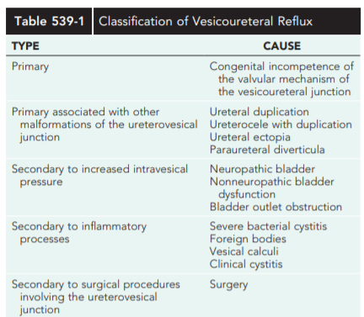

Slide 29
Approximately 1 in 125 children have a duplication of the upper urinary tract, in which 2 ureters rather than 1 drain the kidney
With a duplication anomaly, some patients have an ectopic ureter, in which the upper pole ureter drains outside the bladder. If the ectopic ureter drains into the bladder neck, typically it is obstructed and refluxes.
VUR with increased intravesical pressure can result in renal injury because of increased intravesical pressure transmitted to the upper urinary tract, even in the absence of infection.

Slide 30
VUR (idiopathic) appears to be an autosomal dominant inherited trait
Approximately 35% of siblings of children with VUR also have VUR, and VUR is found in nearly half of newborn siblings. The likelihood of a sibling having VUR is independent of the grade of VUR or sex of the index child..

Slide 31
CLINICAL MANIFESTATIONS
CLINICAL PRESENTATION
Prenatal presentation — The presence of VUR is suggested by the finding of hydronephrosis on prenatal ultrasonography.
prenatal hydronephrosis was defined by the American Urological Association (AUA), as a renal pelvic diameter (RPD) ≥4 mm during the second trimester and ≥7 mm during the third trimester
Postnatal presentation :VUR usually is discovered during evaluation for a UTI . The UTI may be symptomatic, an isolated febrile event, or more often both febrile and .Bladder and bowel dysfunction (constipation) may be present in 50% of children with reflux and a UTI

Slide 32
DIAGNOSIS
The diagnosis of VUR is based upon the demonstration of reflux of urine from the bladder to the upper urinary tract by either contrast voiding cystourethrogram (VCUG) or radionuclide cystogram (RNC).
The bladder and upper urinary tracts are imaged during bladder filling and voiding. VUR occurring during bladder filling is termed low-pressure VUR; VUR during voiding is termed high-pressure VUR. VUR in children with low-pressure VUR is significantly less likely to resolve spontaneously than in children who exhibit only high-pressure VUR. Radiation exposure during a RNC is significantly less than that from a contrast VCUG. However, the contrast VCUG provides more anatomic information, For follow-up evaluation, some prefer the RNC because of the lower radiation exposure

Slide 33
Indirect cystography is a technique of detecting VUR without catheterization that involves injecting an intravenous radiopharmaceutical that is excreted by the kidneys, waiting for it to be excreted into the bladder, and imaging the lower urinary tract while the patient voids. This technique detects only 75% of VUR cases.
Another technique, which avoids radiation exposure, involves instilling sonographic contrast medium through a urethral catheter. The kidneys are imaged sonographically to determine whether any of the material refluxes. This technique is investigational.
After VUR is diagnosed, assessment of the upper urinary tract is important. The goal of upper tract imaging is to assess whether renal scarring and associated urinary tract anomalies are present.
After diagnosis, the child’s height, weight, and blood pressure should be measured and monitored. If upper tract imaging shows renal scarring, a serum creatinine measurement should be obtained. The urine should be assessed for infection and proteinuria.

Slide 34
With bladder growth and maturation, the VUR grade often resolves or improves.
Lower grades of VUR are much more likely to resolve than are higher grades. For grades I and II VUR, the likelihood of resolution is similar regardless of age at diagnosis and whether it is unilateral or bilateral.
For grade III, a younger age at diagnosis and unilateral VUR usually are associated with a higher rate of spontaneous resolution
Bilateral grade IV VUR is much less likely to resolve than is unilateral grade IV VUR.
Grade V VUR rarely resolves. The mean age at VUR resolution is 6 yr.
VUR does not usually cause renal injury in the absence of infection, but in situations with high-pressure VUR, as in children with posterior urethral valves, neuropathic bladder, and nonneurogenic neurogenic bladder can cause significant renal damage. Children with high-grade VUR who acquire a UTI are at significant risk for acute and recurrent pyelonephritis and new renal scarring

Slide 35
TREATMENT
The goals of treatment are to prevent pyelonephritis, VUR-related renal injury, and other complications of VUR. Medical therapy is based on the principle that VUR often resolves over time and that if UTIs can be prevented, the morbidity or complications of VUR may be avoided without surgery. Medical therapy includes observation with behavioral modification or behavioral modification with antimicrobial prophylaxis in some patients. The basis for surgical therapy is that in selected children, ongoing VUR has caused or has significant potential for causing renal injury or other VUR-related complications, and that elimination of VUR minimizes the risk of these problems. Therapy for VUR should be individualized based on a particular patient’s risk factors.
Observation : In children undergoing observation, therapeutic emphasis is directed to minimizing the risk of UTI by behavioral modification. These methods include timed voiding during the day, ensuring regular fecal elimination, increased fluid intake, periodic assessment of satisfactory bladder emptying, and prompt assessment and treatment of UTIs, particularly febrile UTIs. This approach is most appropriate for children with grades I and II VUR, and perhaps older children with persistent VUR and normal kidneys who have not experienced clinical pyelonephritis

Slide 36
In 1997 American Urological Association (AUA) Reflux Guidelines, daily prophylaxis was recommended as initial therapy for most children with VUR.
Currently, many families express concern regarding the safety and benefit of prophylaxis. In addition, as a result of several prospective clinical trials, the benefit of prophylaxis has been questioned in children with VUR. The risk of recurrent UTI is highest in patients with grade III or IV reflux, those with bowel and bladder dysfunction, and those whose first reflux associated UTI was febrile rather than just symptomatic without fever. Antibiotic prophylaxis after a reflux associated UTI decreases the risk of recurrent UTI but increases the risk of developing resistant bacteria.

Slide 37
Current VUR Guidelines In 2010 the AUA provided updated evidence-based guidelines regarding VUR management, and in 2012 the European Association of Urology published expert opinion based guidelines. Both society recommendations were based on risk assessment of children with VUR. The long-standing belief regarding the benefit of antibiotic prophylaxis in children with VUR has been questioned. Multiple randomized controlled prospective trials suggested that the risk of UTI in children with VUR is not reduced by prophylaxis. In contrast, the PRIVENT (Prevention of Recurrent Urinary Tract Infection in Children with Vesicoureteric Refux and Normal Renal Tracts) trial from Australia showed significant benefit to prophylaxis in children with VUR.

Slide 38
The largest randomized trial (RIVUR [Randomized Intervention for Children with Vesicoureteral Refux]) enrolled more than 600 children and demonstrated a reduction in the recurrence rate of UTIs but no reduction of the occurrence of renal scarring with antibiotic prophylaxis. Prophylaxis is recommended by the AUA in children at greatest risk for VUR-related renal injury (i.e., those younger than 1 yr of age). In addition, evaluation for bladder and bowel dysfunction is considered a standard part of initial and ongoing patient evaluation in children with VUR. Because children with bladder and bowel dysfunction and VUR are much more likely to have recurrent UTIs and renal scarring, prophylaxis is recommended for these children.

Slide 39
In children with VUR who are being managed by surveillance, if a febrile UTI occurs, prophylaxis is recommended. The decision whether to recommend observation, medical therapy, or surgery is based on the risk of VUR to the patient, the likelihood of spontaneous resolution, and the parents’ and patient’s preferences.
Another aspect of VUR management pertains to screening. VUR is known to be a familial disorder with autosomal dominant transmission with variable penetrance. The advantage of early VUR detection is to implement treatment before a potentially damaging episode of clinical pyelonephritis. In siblings of an index patient with VUR, optional management includes screening of asymptomatic siblings or offspring with a renal ultrasound or VCUG. The AUA recommends that a VCUG should be obtained if a screening ultrasound demonstrated a renal abnormality or if the sibling had a UTI

Slide 40
Antibiotic prophylaxis — Medical therapy for VUR consists of daily prophylactic administration of an antibiotic agent. It is based on the assumptions that use of continuous antibiotics results in sterile urine and the continued reflux of sterile urine does not cause renal damage, and the observation that reflux spontaneously resolves in most cases.
Indications —
All patients who are not toilet-trained regardless of the severity of VUR
All patients with bladder and bowel dysfunction (BBD) regardless of the severity of VUR
All patients with high-grade reflux (Grade III to IV)

Slide 41
Agents and dosing — Antimicrobial agents most commonly used for prophylaxis include TMP-SMZ, TMP alone, or nitrofurantoin . One daily dose is administered at bedtime.
The following are single daily prophylactic doses of commonly used antimicrobial agents:
●TMP-SMX or TMP alone − Dosing is based on TMP at 2 mg/kg
●Nitrofurantoin − 1 to 2 mg/kg
Amoxicillin, ampicillin, and cephalosporins are not generally recommended because of the increased likelihood of resistant organisms . However, these agents are used in infants below two months of age, because sulfonamides, trimethoprim, or nitrofurantoin are associated with serious adverse effects (eg, hyperbilirubinemia) in this age group and should be avoided. The following are single daily prophylactic doses for these agents:
●Cephalexin − 10 mg/kg
●Ampicillin − 20 mg/kg
●Amoxicillin − 10 mg/kg

Slide 42
Discontinuation — Antibiotic prophylaxis is discontinued when VUR resolves spontaneously or is surgically corrected, which is documented by contrast voiding cystourethrogram (VCUG) or radionuclide cystogram (RNC). Although the evidence is not conclusive, some experts stop prophylaxis therapy in select older children with persistent VUR, because the risk of recurrent urinary infection diminishes with age
Surgical treatment — Surgical treatment corrects the anatomy at the refluxing ureterovesical junction. The surgical approaches used are open surgical or robotic-assisted laparoscopic reimplantation and endoscopic correction

Slide 43
Indications :
Children with Grade IV/V reflux that persists beyond two or three years of age. Surgery is delayed until this age because VUR may spontaneously resolve during the first two or three years of age, and is less likely to resolve beyond this age range.
Children with Grade III to IV reflux:
Who cannot tolerate prophylactic antibiotic therapy.
Who are not compliant with medical management (eg, prophylactic antibiotic therapy or follow-up after a febrile illness).
With breakthrough infections on prophylactic antibiotic therapy.

