Slide 1
infancy: let the language achievements begin

Slide 2
What major Language-DeveLOpment milestones Occur In Infancy?
What do we mean by milestones ?

Slide 3
What major Language-DeveLOpment milestones Occur In Infancy?
Infant Speech Perception
Awareness of Actions and Intentions
Category Formation
Early Vocalizations

Slide 4
Infant speech perception
Infants’ speech perception ability: ability to devote attention to the prosodic and phonetic regularities of .

Slide 5
Infant speech perception
Attention to Prosodic Regularities
Attention to Phonetic Regularities
Categorical Perception of Speech

Slide 6
Attention to Prosodic Regularities
Prosodic characteristics
frequency, or pitch, of sounds.
The duration, or length, of sounds.
Intensity, or loudness, of sounds.
Stress is the prominence placed on certain syllables of multisyllabic words.
Intonation is the prominence placed on certain syllables, but it also applies to entire phrases and sentences.

Slide 7
Attention to Prosodic Regularities
Stress is the prominence placed on certain syllables of multisyllabic words.
Intonation is the prominence placed on certain syllables, but it also applies to entire phrases and sentences.
You are happy.
Are you happy ?

Slide 8
By age 9 months, infants learning English prefer to listen to words containing strong–weak stress patterns (jusczyk, cutler, & redanz, 1993).
How does this help infants begin to isolate words in continuous speech?

Slide 9
Attention to Phonetic Regularities
The phonetic details of speech include phonemes, or speech sounds, and combinations of phonemes.
According to stager and Werker (1997), infants (8months old) devote much attention to the phonetic details of speech, whereas older children ( 14 months) concentrate their efforts on word learning at the expense of fine phonetic details

Slide 10
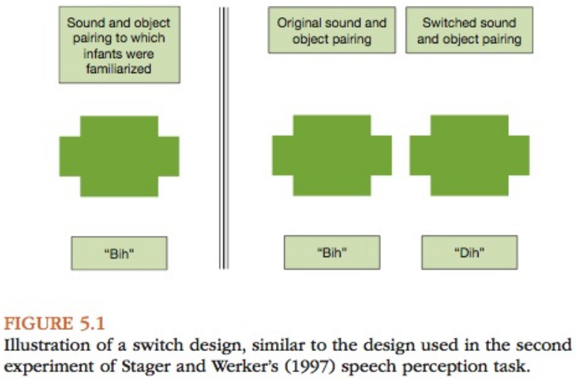
Attention to Phonetic Regularities

Slide 11
Detection of Nonnative Phonetic Differences.
up to about 6 months of age, infants learning English can distinguish between two different sounds in the Hindi language that would both sound like “da” to older English-speaking children and adults.
the process by which infants start to focus more on perceptual differences that are relevant to them is called perceptual narrowing.

Slide 12
Detection of Phonotactic Regularities.
As infants hear their native language more and more, they also develop the ability to recognize permissible combinations of phonemes in their language, or phonotactic regularities.
Infants’ ability to differentiate between permissible and impermissible sound sequences in their native language is present by about age 9 months (jusczyk, Luce, & charles-Luce, 1994).
Some research suggests phonotactic regularities may play a role in later-developing skills, such as word learning. HOW?

Slide 13
Categorical Perception of Speech
We categorize input in ways that highlight differences in meaning. This develops gradually:
infants categorize incoming sounds into speech and nonspeech sounds.
then infants learn to categorize speech sounds according to the particular features of the sounds( voice/voiceless).
without special training, people cannot distinguish between allophones.
of the same phoneme. al- lophones of a phoneme are measurably different from one another (such as in the amount of aspiration they contain), but they do not signal a difference in meaning between two words, as phonemes do.

Slide 14
awareness of actions and Intentions
By age 4 months, infants can distinguish between purposeful and accidental actions, and they appear to focus on the intentions underlying actions rather than the physical details of the actions.
Woodward (1998) experiment: details are in the book.

Slide 15
category Formation
The ability to form categories, or to group items and events according to the perceptual and conceptual features they share, is crucial for language development.
Hierarchical Structure of Categories

Slide 16
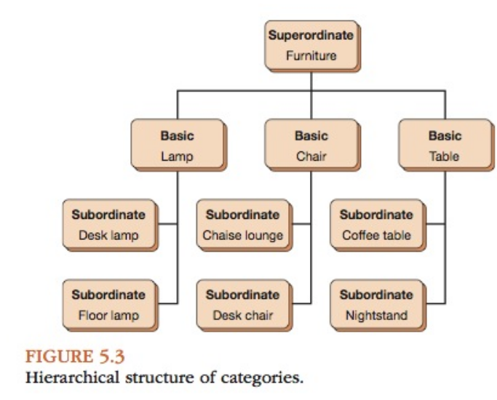
Hierarchical Structure of Categories

Slide 17
Basic Categories at Each Hierarchical Level
Infants form perceptual categories on the basis of similar-appearing features, including color, shape, texture, size, and so forth. They use perceptual categories to recognize and identify objects around them.
Conceptual categorization requires infants to know what an object does. Infants learn that balls roll, dogs bark, and air- planes fly.

Slide 18
early vocalizations
These can be distinguished according to a stage model like the stark assessment of early vocal Development—revised (saevD-r; nathani, ertmer, & stark, 2006)
Reflexive (0–2 months).
Control of phonation (1–4 months)
Expansion (3–8 months).
Basic canonical syllables (5–10 months).
Advanced forms (9–18 months).

Slide 19
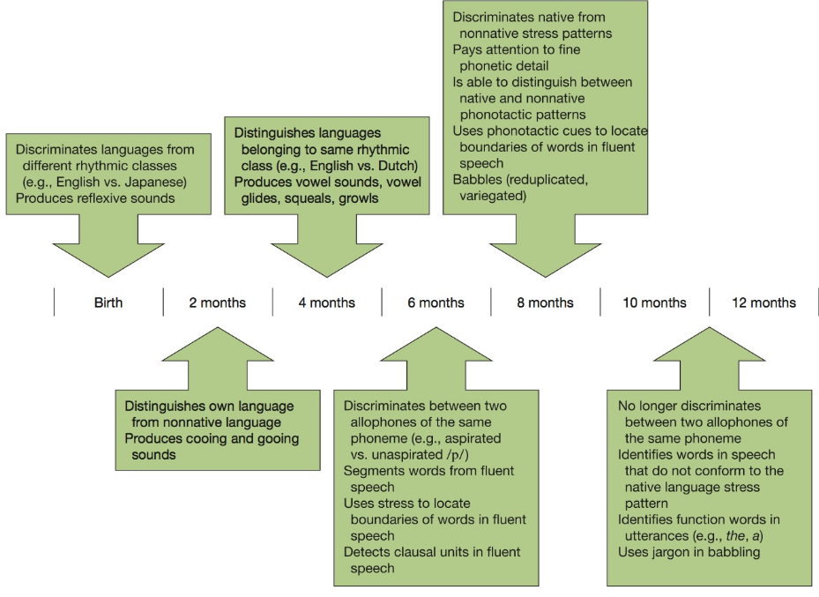
Developmental timeline : Phonology

