Slide 1
Chapter 17
From Gene to Protein

Slide 2
Overview: The Flow of Genetic Information
The information content of DNA is in the form of specific sequences of nucleotides
The DNA inherited by an organism leads to specific traits by dictating the synthesis of proteins
Proteins are the links between genotype and phenotype
Gene expression, the process by which DNA directs protein synthesis, includes two stages: transcription and translation
© 2011 Pearson Education, Inc.
Notes:
2

Slide 3
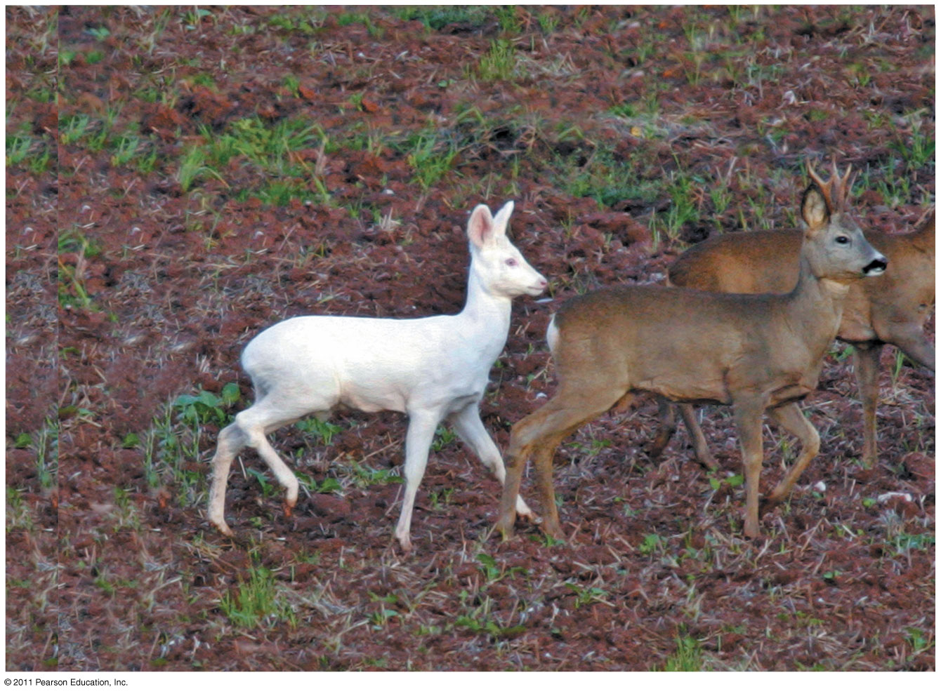
Figure 17.1
Notes:
Figure 17.1 How does a single faulty gene result in the dramatic appearance of an albino deer?

Slide 4
Concept 17.1: Genes specify proteins via transcription and translation
How was the fundamental relationship between genes and proteins discovered?
© 2011 Pearson Education, Inc.
Notes:
4

Slide 5
Evidence from the Study of Metabolic Defects
In 1902, British physician Archibald Garrod first suggested that genes dictate phenotypes through enzymes that catalyze specific chemical reactions
He thought symptoms of an inherited disease reflect an inability to synthesize a certain enzyme
Linking genes to enzymes required understanding that cells synthesize and degrade molecules in a series of steps, a metabolic pathway
© 2011 Pearson Education, Inc.
Notes:
5

Slide 6
Nutritional Mutants in Neurospora: Scientific Inquiry
George Beadle and Edward Tatum exposed bread mold to X-rays, creating mutants that were unable to survive on minimal media
Using crosses, they and their coworkers identified three classes of arginine-deficient mutants, each lacking a different enzyme necessary for synthesizing arginine
They developed a one gene–one enzyme hypothesis, which states that each gene dictates production of a specific enzyme
© 2011 Pearson Education, Inc.
Notes:
6

Slide 7
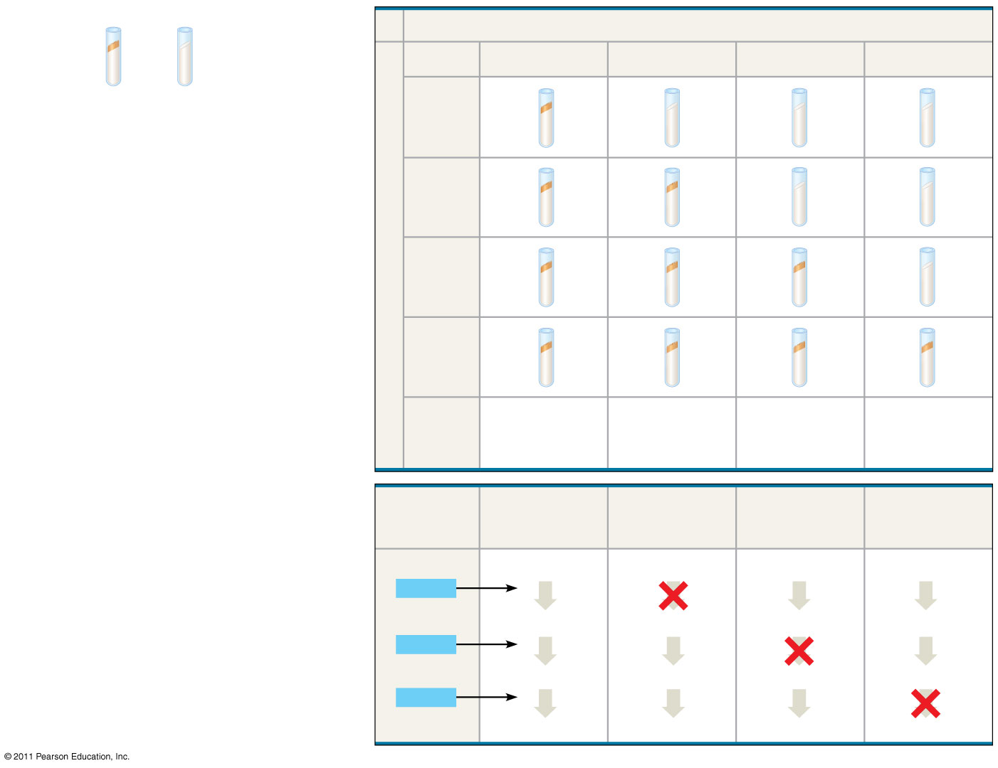
Figure 17.2
EXPERIMENT
RESULTS
Classes of Neurospora crassa
Growth: Wild-type cells growing and dividing
No growth: Mutant cells cannot grow and divide
Wild type
Class I mutants
Class II mutants
Class III mutants
Minimal medium (MM)
(control)
Minimal medium
MM + ornithine
Condition
MM + citrulline
MM + arginine (control)
Summary of results
Can grow with or without any supplements
Can grow on ornithine, citrulline, or arginine
Can grow only on citrulline or arginine
Require arginine to grow
CONCLUSION
Gene (codes for enzyme)
Class I mutants (mutation in gene A)
Class II mutants (mutation in gene B)
Class III mutants (mutation in gene C)
Wild type
Precursor
Precursor
Precursor
Precursor
Gene A
Enzyme A
Enzyme A
Enzyme A
Enzyme A
Ornithine
Ornithine
Ornithine
Ornithine
Gene B
Enzyme B
Enzyme B
Enzyme B
Enzyme B
Citrulline
Citrulline
Citrulline
Citrulline
Gene C
Enzyme C
Enzyme C
Enzyme C
Enzyme C
Arginine
Arginine
Arginine
Arginine
Notes:
Figure 17.2 Inquiry: Do individual genes specify the enzymes that function in a biochemical pathway?

Slide 8
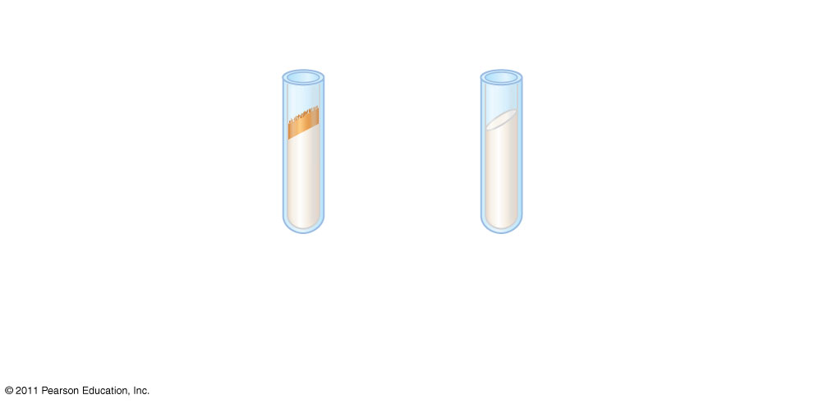
Figure 17.2a
EXPERIMENT
Growth: Wild-type cells growing and dividing
No growth: Mutant cells cannot grow and divide
Minimal medium
Notes:
Figure 17.2 Inquiry: Do individual genes specify the enzymes that function in a biochemical pathway?

Slide 9
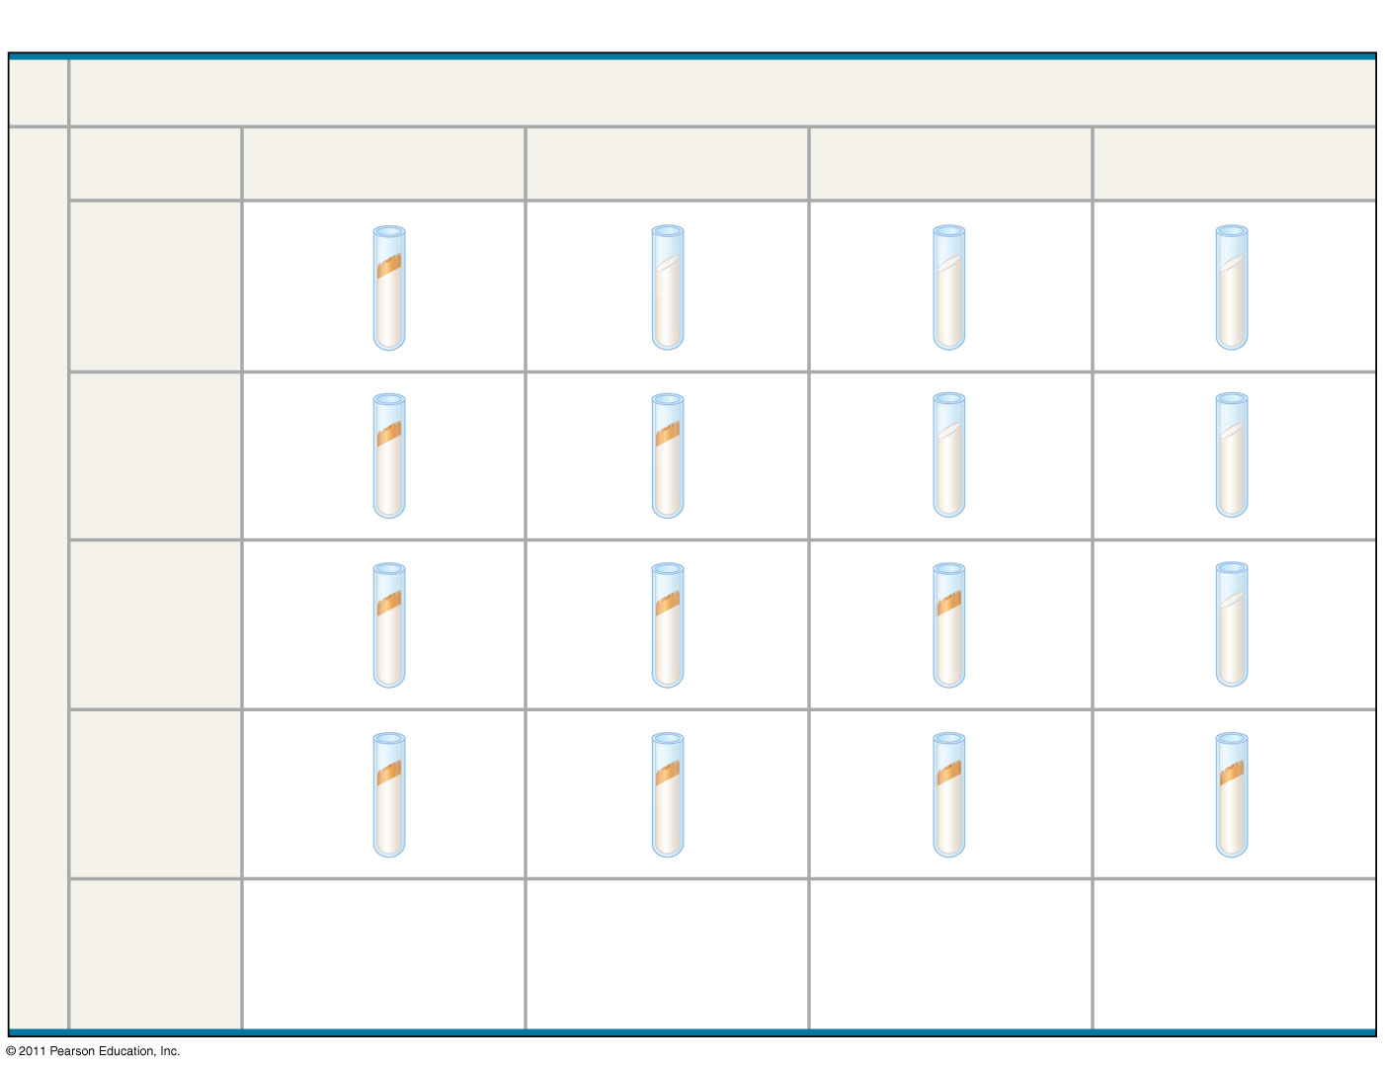
Figure 17.2b
RESULTS
Classes of Neurospora crassa
Wild type
Class I mutants
Class II mutants
Class III mutants
Minimal medium (MM)
(control)
Growth
No growth
MM + ornithine
Condition
MM + citrulline
MM + arginine (control)
Can grow with or without any supplements
Can grow on ornithine, citrulline, or arginine
Can grow only on citrulline or arginine
Require arginine to grow
Summary of results
Notes:
Figure 17.2 Inquiry: Do individual genes specify the enzymes that function in a biochemical pathway?

Slide 10
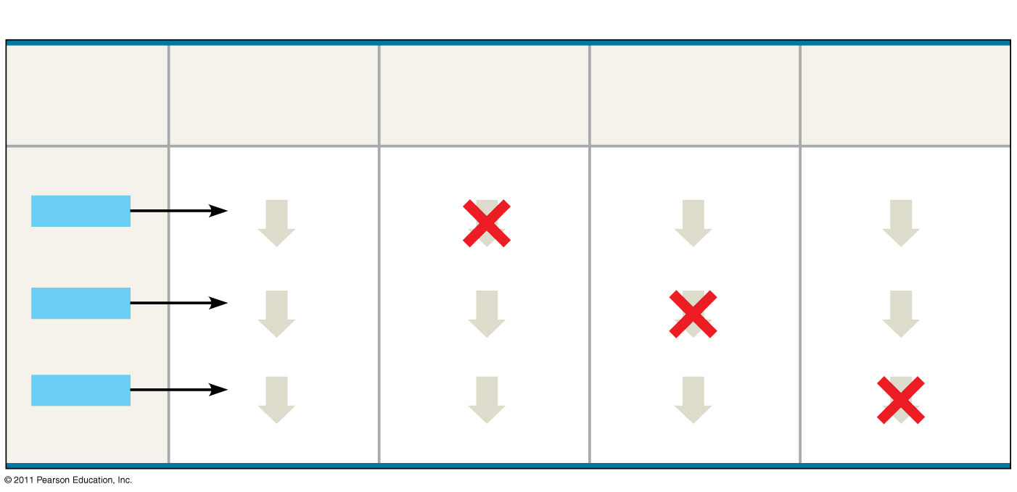
Figure 17.2c
CONCLUSION
Gene (codes for enzyme)
Class I mutants (mutation in gene A)
Class II mutants (mutation in gene B)
Class III mutants (mutation in gene C)
Wild type
Precursor
Precursor
Precursor
Precursor
Gene A
Enzyme A
Enzyme A
Enzyme A
Enzyme A
Ornithine
Ornithine
Ornithine
Ornithine
Gene B
Enzyme B
Enzyme B
Enzyme B
Enzyme B
Citrulline
Citrulline
Citrulline
Citrulline
Gene C
Enzyme C
Enzyme C
Enzyme C
Enzyme C
Arginine
Arginine
Arginine
Arginine
Notes:
Figure 17.2 Inquiry: Do individual genes specify the enzymes that function in a biochemical pathway?

Slide 11
The Products of Gene Expression: A Developing Story
Some proteins aren’t enzymes, so researchers later revised the hypothesis: one gene–one protein
Many proteins are composed of several polypeptides, each of which has its own gene
Therefore, Beadle and Tatum’s hypothesis is now restated as the one gene–one polypeptide hypothesis
Note that it is common to refer to gene products as proteins rather than polypeptides
© 2011 Pearson Education, Inc.
Notes:
11

Slide 12
Basic Principles of Transcription and Translation
RNA is the bridge between genes and the proteins for which they code
Transcription is the synthesis of RNA using information in DNA
Transcription produces messenger RNA (mRNA)
Translation is the synthesis of a polypeptide, using information in the mRNA
Ribosomes are the sites of translation
© 2011 Pearson Education, Inc.
Notes:
12

Slide 13
In prokaryotes, translation of mRNA can begin before transcription has finished
In a eukaryotic cell, the nuclear envelope separates transcription from translation
Eukaryotic RNA transcripts are modified through RNA processing to yield the finished mRNA
© 2011 Pearson Education, Inc.
Notes:
13

Slide 14
A primary transcript is the initial RNA transcript from any gene prior to processing
The central dogma is the concept that cells are governed by a cellular chain of command: DNA → RNA → protein
© 2011 Pearson Education, Inc.
Notes:
14

Slide 15
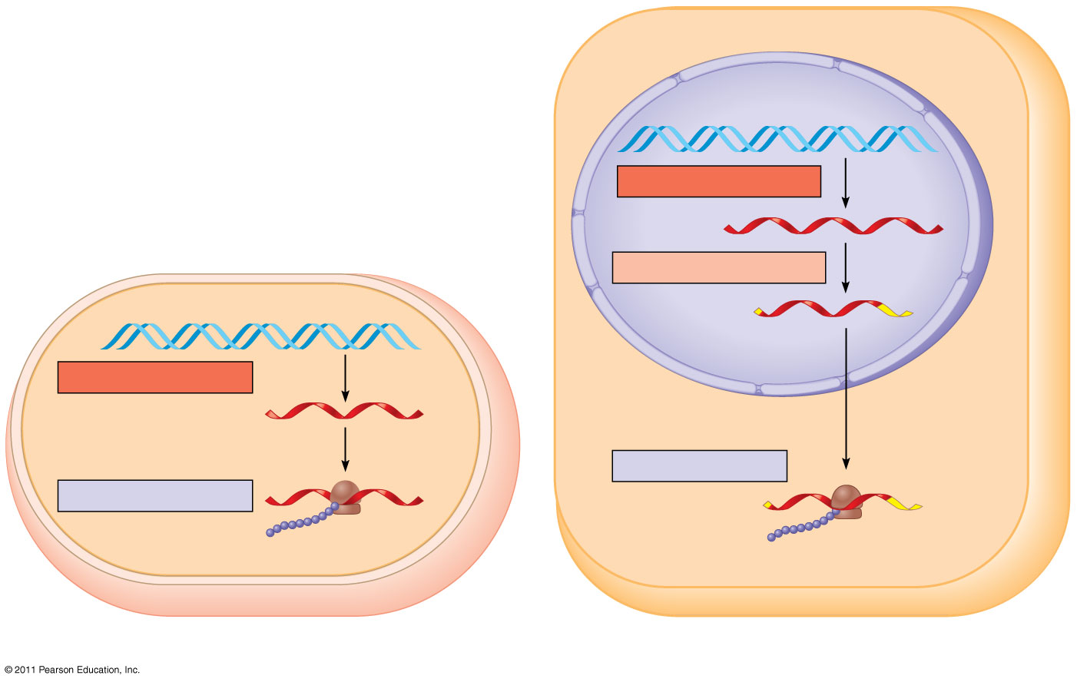
Figure 17.3
Nuclear envelope
TRANSCRIPTION
DNA
RNA PROCESSING
Pre-mRNA
mRNA
TRANSCRIPTION
DNA
mRNA
Ribosome
TRANSLATION
Ribosome
TRANSLATION
Polypeptide
Polypeptide
(a) Bacterial cell
(b) Eukaryotic cell
Notes:
Figure 17.3 Overview: the roles of transcription and translation in the flow of genetic information.

Slide 16
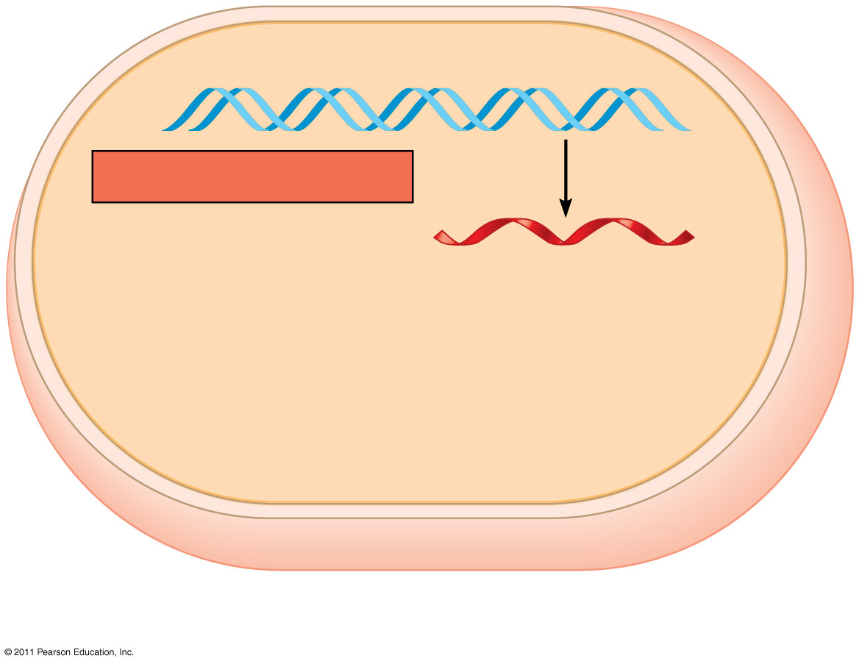
Figure 17.3a-1
DNA
TRANSCRIPTION
mRNA
(a) Bacterial cell
Notes:
Figure 17.3 Overview: the roles of transcription and translation in the flow of genetic information.

Slide 17
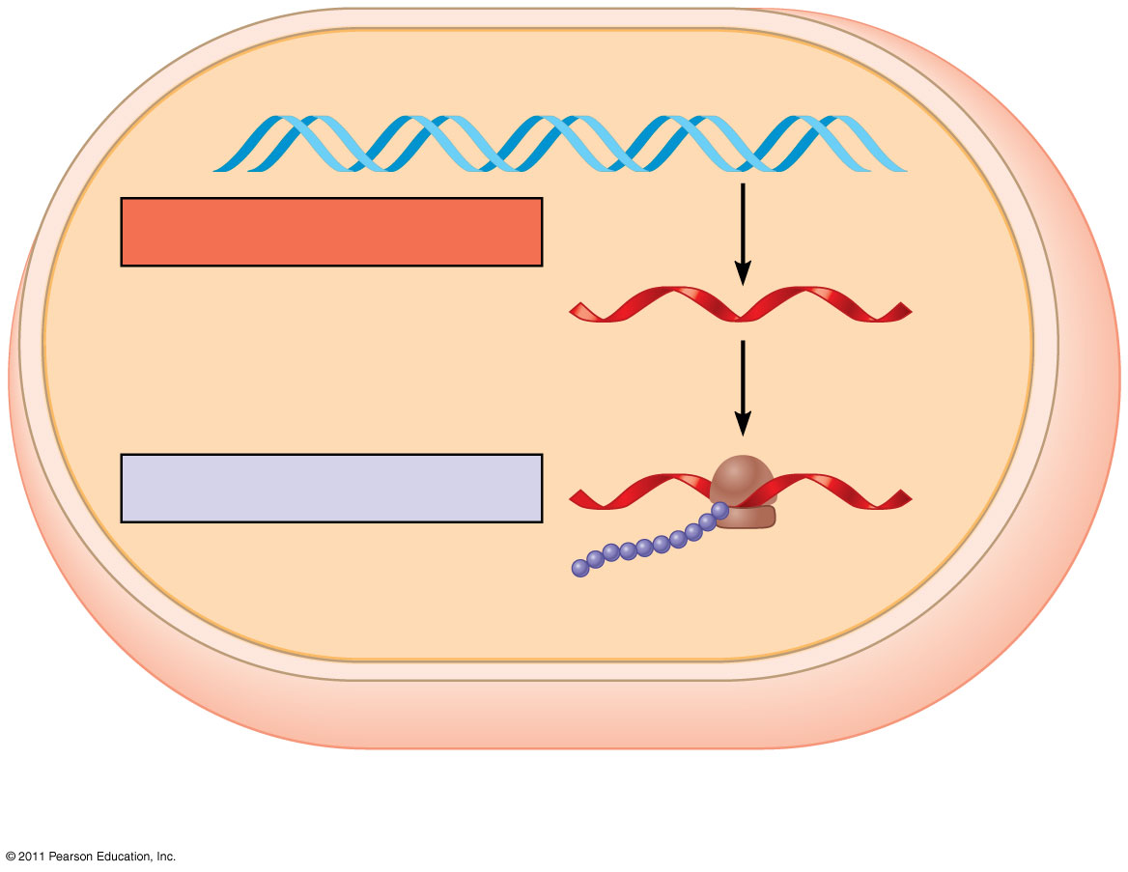
Figure 17.3a-2
DNA
TRANSCRIPTION
mRNA
Ribosome
TRANSLATION
Polypeptide
(a) Bacterial cell
Notes:
Figure 17.3 Overview: the roles of transcription and translation in the flow of genetic information.

Slide 18
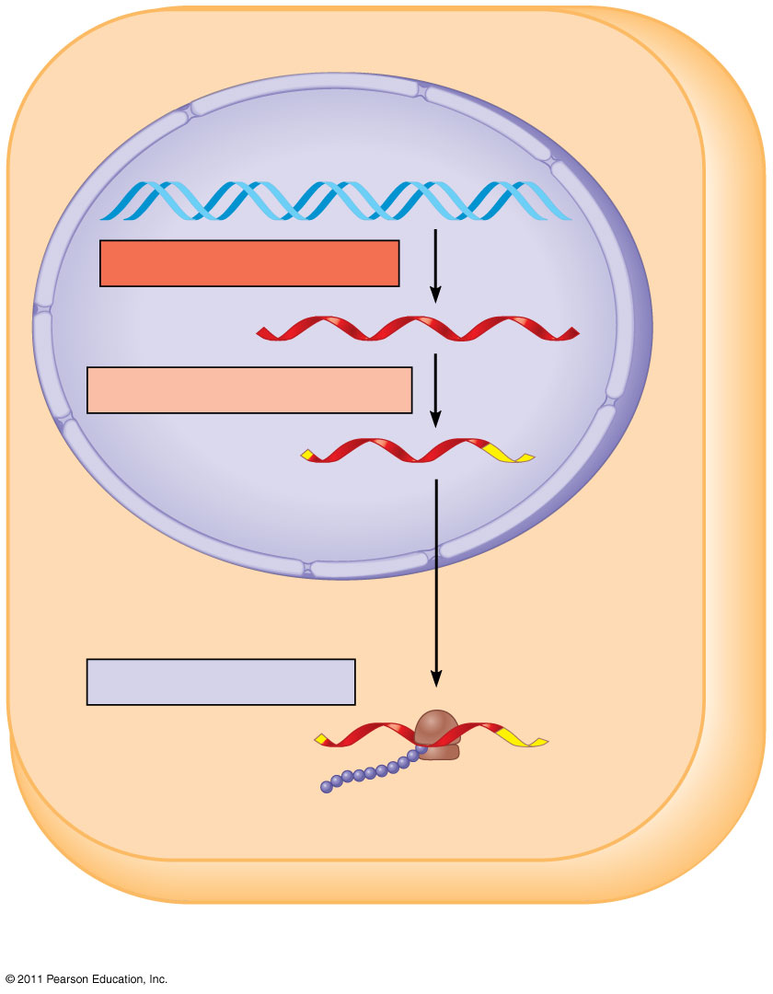
Figure 17.3b-3
Nuclear envelope
DNA
TRANSCRIPTION
Pre-mRNA
RNA PROCESSING
mRNA
TRANSLATION
Ribosome
Polypeptide
(b) Eukaryotic cell
Notes:
Figure 17.3 Overview: the roles of transcription and translation in the flow of genetic information.

Slide 19
The Genetic Code
How are the instructions for assembling amino acids into proteins encoded into DNA?
There are 20 amino acids, but there are only four nucleotide bases in DNA
How many nucleotides correspond to an amino acid?
© 2011 Pearson Education, Inc.
Notes:
19

Slide 20
Codons: Triplets of Nucleotides
The flow of information from gene to protein is based on a triplet code: a series of nonoverlapping, three-nucleotide words
The words of a gene are transcribed into complementary nonoverlapping three-nucleotide words of mRNA
These words are then translated into a chain of amino acids, forming a polypeptide
© 2011 Pearson Education, Inc.
Notes:
20

Slide 21
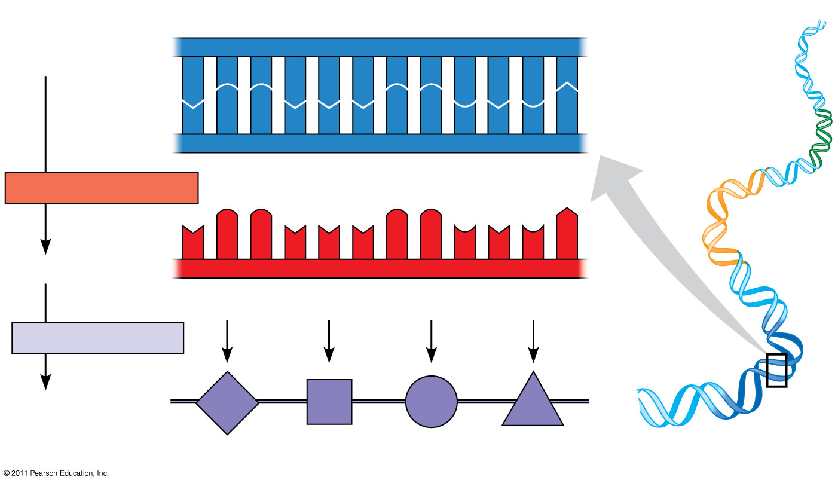
Figure 17.4
DNA template strand
3′
5′
DNA
A
C
C
A
A
A
C
C
G
A
G
T
molecule
T
G
G
T
T
T
G
G
C
T
C
A
Gene 1
5′
3′
TRANSCRIPTION
Gene 2
U
G
G
U
U
U
G
G
C
U
C
A
5′
3′
mRNA
Codon
TRANSLATION
Protein
Trp
Phe
Gly
Ser
Gene 3
Amino acid
Notes:
Figure 17.4 The triplet code.

Slide 22
During transcription, one of the two DNA strands, called the template strand, provides a template for ordering the sequence of complementary nucleotides in an RNA transcript
The template strand is always the same strand for a given gene
During translation, the mRNA base triplets, called codons, are read in the 5′ to 3′ direction
© 2011 Pearson Education, Inc.
Notes:
22

Slide 23
Codons along an mRNA molecule are read by translation machinery in the 5′ to 3′ direction
Each codon specifies the amino acid (one of 20) to be placed at the corresponding position along a polypeptide
© 2011 Pearson Education, Inc.
Notes:
23

Slide 24
Cracking the Code
All 64 codons were deciphered by the mid-1960s
Of the 64 triplets, 61 code for amino acids; 3 triplets are “stop” signals to end translation
The genetic code is redundant (more than one codon may specify a particular amino acid) but not ambiguous; no codon specifies more than one amino acid
Codons must be read in the correct reading frame (correct groupings) in order for the specified polypeptide to be produced
© 2011 Pearson Education, Inc.
Notes:
24

Slide 25
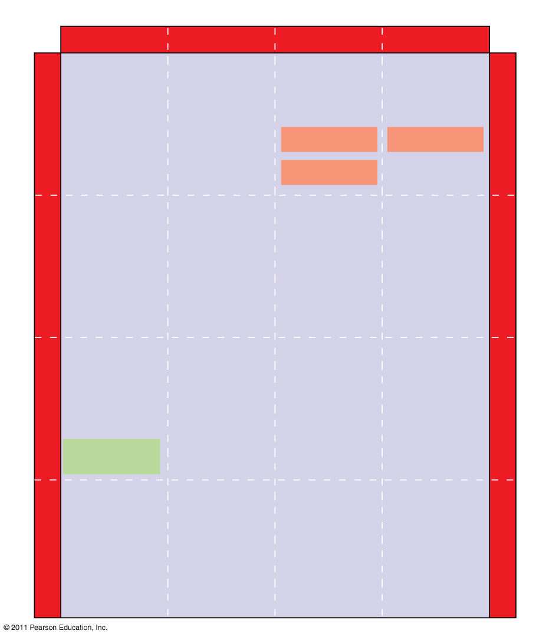
Figure 17.5
Second mRNA base
U
C
A
G
UUU
UCU
UAU
UGU
U
Phe
Tyr
Cys
U
UUC
UCC
UAC
UGC
C
Ser
UUA
UCA
UAA Stop
UGA Stop
A
Leu
UUG
UCG
UAG Stop
UGG
Trp
G
CUU
CCU
CAU
CGU
U
His
C
CUC
CCC
CAC
CGC
C
Leu
Pro
Arg
CUA
CCA
CAA
CGA
A
Gln
CUG
CCG
CAG
CGG
G
First mRNA base (5′ end of codon)
Third mRNA base (3′ end of codon)
AUU
ACU
AAU
AGU
U
Asn
Ser
A
AUC
Ile
ACC
AAC
AGC
C
Thr
AUA
ACA
AAA
AGA
A
Lys
Arg
AUG
Met or start
ACG
AAG
AGG
G
GUU
GCU
GAU
GGU
U
Asp
G
GUC
GCC
GAC
GGC
C
Val
Ala
Gly
Gly
GUA
GCA
GAA
GGA
A
Glu
GUG
GCG
GAG
GGG
G
Notes:
Figure 17.5 The codon table for mRNA.

Slide 26
Evolution of the Genetic Code
The genetic code is nearly universal, shared by the simplest bacteria to the most complex animals
Genes can be transcribed and translated after being transplanted from one species to another
© 2011 Pearson Education, Inc.
Notes:
26

Slide 27
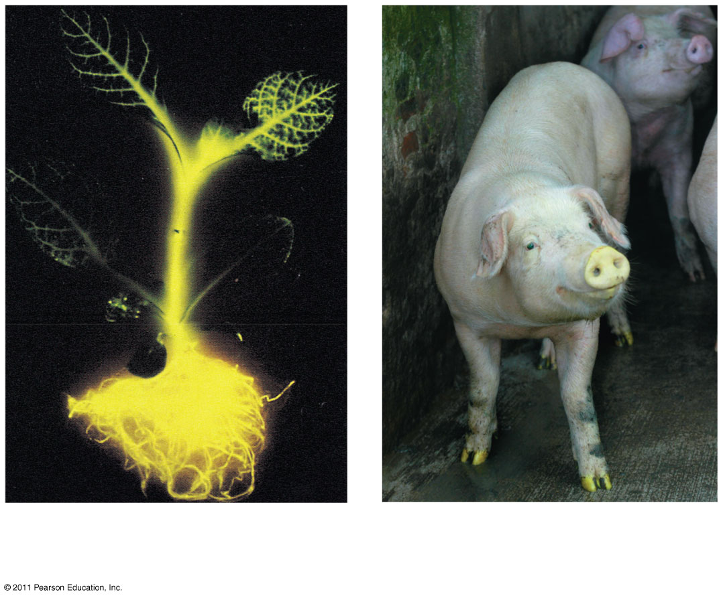
Figure 17.6
(a) Tobacco plant expressing
(b) Pig expressing a jellyfish
a firefly gene
gene
Notes:
Figure 17.6 Expression of genes from different species.

Slide 28
Concept 17.2: Transcription is the DNA-directed synthesis of RNA: a closer look
Transcription is the first stage of gene expression
© 2011 Pearson Education, Inc.
Notes:
28

Slide 29
Molecular Components of Transcription
RNA synthesis is catalyzed by RNA polymerase, which pries the DNA strands apart and hooks together the RNA nucleotides
The RNA is complementary to the DNA template strand
RNA synthesis follows the same base-pairing rules as DNA, except that uracil substitutes for thymine
© 2011 Pearson Education, Inc.
Notes:
29

Slide 30
The DNA sequence where RNA polymerase attaches is called the promoter; in bacteria, the sequence signaling the end of transcription is called the terminator
The stretch of DNA that is transcribed is called a transcription unit
© 2011 Pearson Education, Inc.
Notes:
30

Slide 31
Figure 17.7-1
Promoter
Transcription unit
5′
3′
3′
DNA
5′
Start point
RNA polymerase
Notes:
Figure 17.7 The stages of transcription: initiation, elongation, and termination.

Slide 32
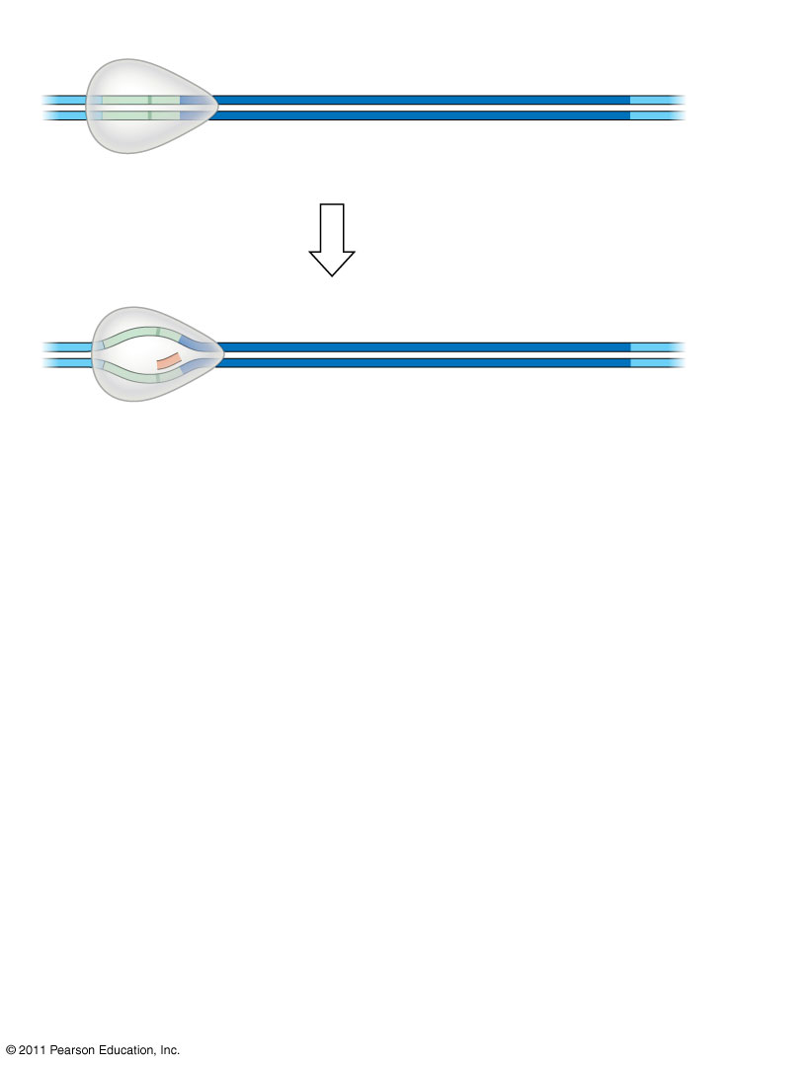
Figure 17.7-2
Promoter
Transcription unit
5′
3′
3′
DNA
5′
Start point
RNA polymerase
1
Initiation
Nontemplate strand of DNA
5′
3′
3′
5′
RNA transcript
Template strand of DNA
Unwound DNA
Notes:
Figure 17.7 The stages of transcription: initiation, elongation, and termination.

Slide 33
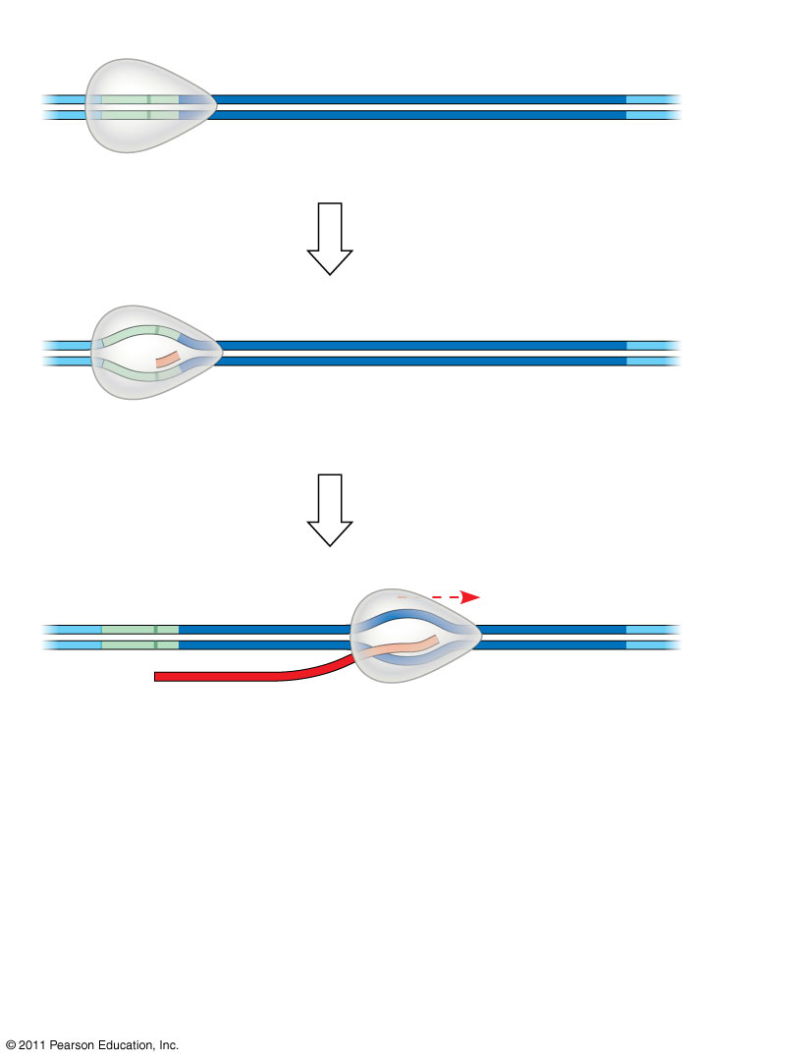
Figure 17.7-3
Promoter
Transcription unit
5′
3′
3′
DNA
5′
Start point
RNA polymerase
1
Initiation
Nontemplate strand of DNA
5′
3′
3′
5′
RNA transcript
Template strand of DNA
Unwound DNA
2
Elongation
Rewound DNA
5′
3′
3′
3′
5′
5′
RNA transcript
Notes:
Figure 17.7 The stages of transcription: initiation, elongation, and termination.

Slide 34
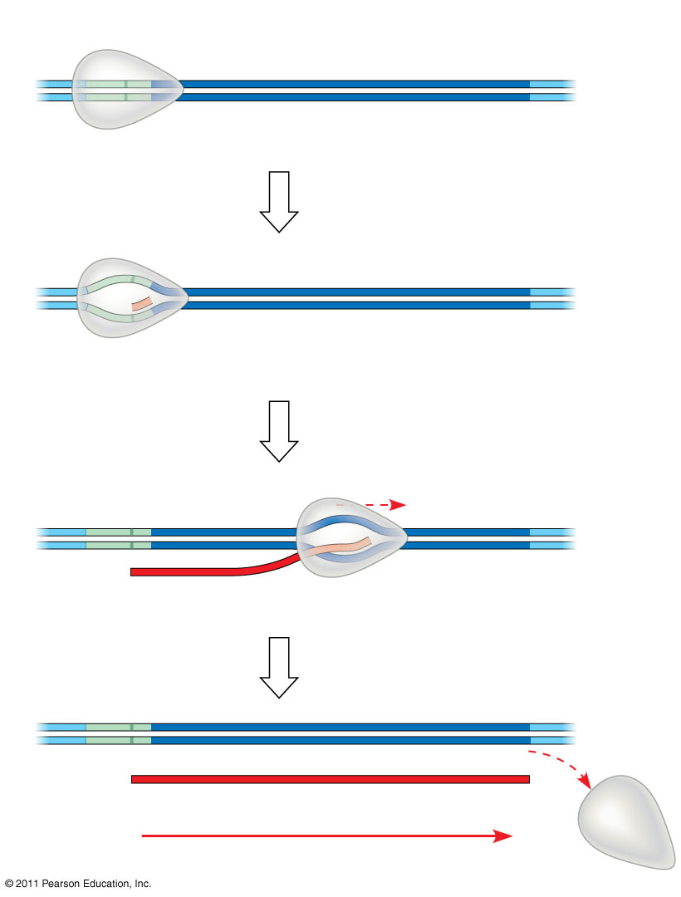
Figure 17.7-4
Promoter
Transcription unit
5′
3′
3′
DNA
5′
Start point
RNA polymerase
1
Initiation
Nontemplate strand of DNA
5′
3′
3′
5′
RNA transcript
Template strand of DNA
Unwound DNA
2
Elongation
Rewound DNA
5′
3′
3′
3′
5′
5′
RNA transcript
3
Termination
5′
3′
3′
5′
5′
Completed RNA transcript
3′
Direction of transcription (“downstream”)
Notes:
Figure 17.7 The stages of transcription: initiation, elongation, and termination.

Slide 35
Synthesis of an RNA Transcript
The three stages of transcription
Initiation
Elongation
Termination
© 2011 Pearson Education, Inc.
Notes:
35

Slide 36
RNA Polymerase Binding and Initiation of Transcription
Promoters signal the transcriptional start point and usually extend several dozen nucleotide pairs upstream of the start point
Transcription factors mediate the binding of RNA polymerase and the initiation of transcription
The completed assembly of transcription factors and RNA polymerase II bound to a promoter is called a transcription initiation complex
A promoter called a TATA box is crucial in forming the initiation complex in eukaryotes
© 2011 Pearson Education, Inc.
Notes:
36

Slide 37
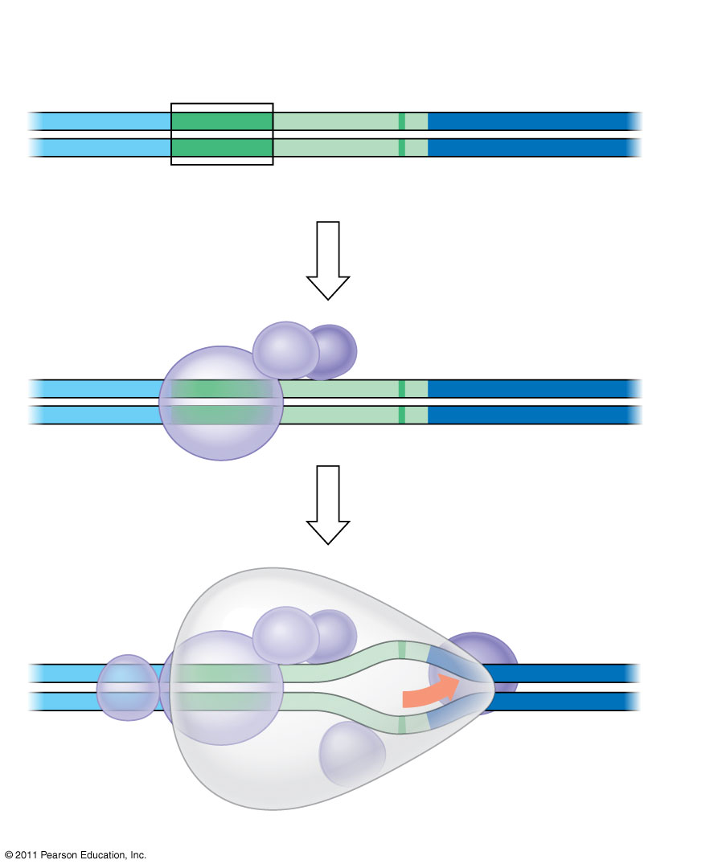
Figure 17.8
1
A eukaryotic promoter
Promoter
Nontemplate strand
DNA
5′
T
A
T
A
A
A
A
3′
3′
A
T
A
T
T
T
T
5′
TATA box
Start point
Template strand
2
Several transcription factors bind to DNA
Transcription factors
5′
3′
3′
5′
3
Transcription initiation complex forms
RNA polymerase II
Transcription factors
5′
3′
3′
3′
5′
5′
RNA transcript
Transcription initiation complex
Notes:
Figure 17.8 The initiation of transcription at a eukaryotic promoter.

Slide 38
Elongation of the RNA Strand
As RNA polymerase moves along the DNA, it untwists the double helix, 10 to 20 bases at a time
Transcription progresses at a rate of 40 nucleotides per second in eukaryotes
A gene can be transcribed simultaneously by several RNA polymerases
Nucleotides are added to the 3′ end of the growing RNA molecule
© 2011 Pearson Education, Inc.
Notes:
38

Slide 39
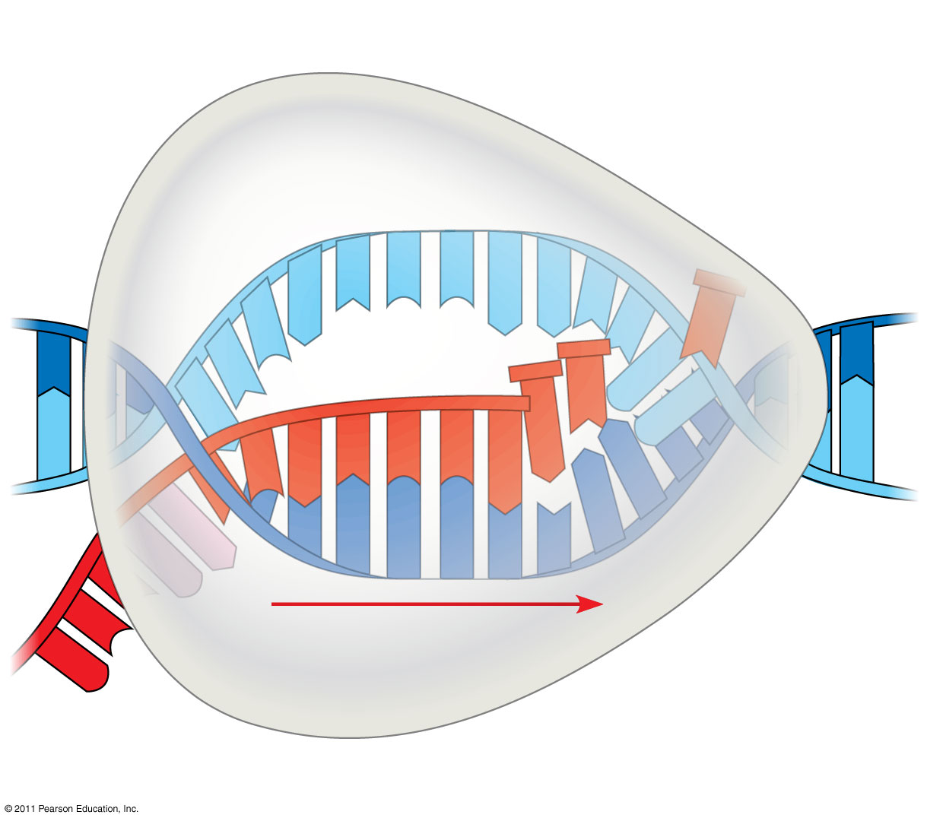
Figure 17.9
Nontemplate strand of DNA
RNA nucleotides
RNA polymerase
A
T
C
C
A
A
3′
T
5′
C
T
U
3′
end
G
T
A
U
G
A
C
C
A
U
C
C
A
C
A
5′
A
3′
T
A
G
G
T
T
5′
Direction of transcription
Template strand of DNA
Newly made RNA
Notes:
Figure 17.9 Transcription elongation.

Slide 40
Termination of Transcription
The mechanisms of termination are different in bacteria and eukaryotes
In bacteria, the polymerase stops transcription at the end of the terminator and the mRNA can be translated without further modification
In eukaryotes, RNA polymerase II transcribes the polyadenylation signal sequence; the RNA transcript is released 10–35 nucleotides past this polyadenylation sequence
© 2011 Pearson Education, Inc.
Notes:
40

Slide 41
Concept 17.3: Eukaryotic cells modify RNA after transcription
Enzymes in the eukaryotic nucleus modify pre-mRNA (RNA processing) before the genetic messages are dispatched to the cytoplasm
During RNA processing, both ends of the primary transcript are usually altered
Also, usually some interior parts of the molecule are cut out, and the other parts spliced together
© 2011 Pearson Education, Inc.
Notes:
41

Slide 42
Alteration of mRNA Ends
Each end of a pre-mRNA molecule is modified in a particular way
The 5′ end receives a modified nucleotide 5′ cap
The 3′ end gets a poly-A tail
These modifications share several functions
They seem to facilitate the export of mRNA to the cytoplasm
They protect mRNA from hydrolytic enzymes
They help ribosomes attach to the 5′ end
© 2011 Pearson Education, Inc.
Notes:
42

Slide 43
Figure 17.10
Protein-coding segment
Polyadenylation signal
5′
3′
G
P
P
P
AAUAAA
AAA
…
AAA
Cap
5′
Start codon
Stop codon
5′
UTR
3′
UTR
Poly-A tail
Notes:
Figure 17.10 RNA processing: Addition of the 5′ cap and poly-A tail.

Slide 44
Split Genes and RNA Splicing
Most eukaryotic genes and their RNA transcripts have long noncoding stretches of nucleotides that lie between coding regions
These noncoding regions are called intervening sequences, or introns
The other regions are called exons because they are eventually expressed, usually translated into amino acid sequences
RNA splicing removes introns and joins exons, creating an mRNA molecule with a continuous coding sequence
© 2011 Pearson Education, Inc.
Notes:
44

Slide 45
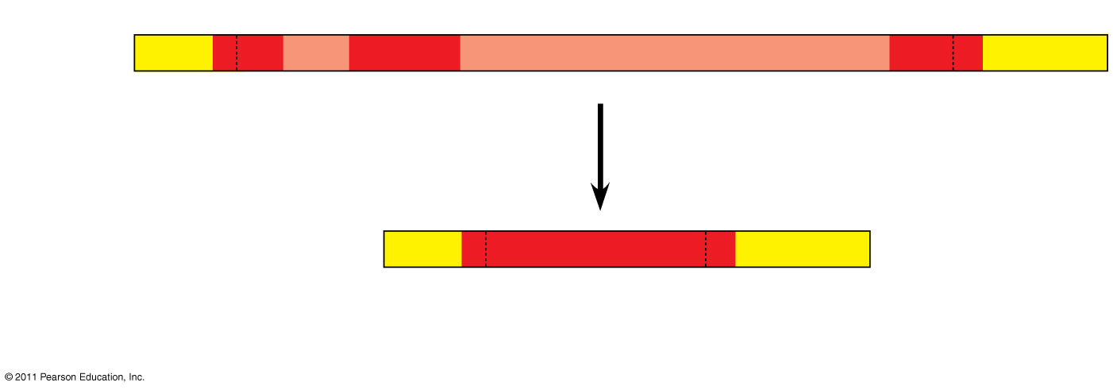
Figure 17.11
5′
Exon Intron
Exon
Intron
Exon
3′
Pre-mRNA Codon numbers
5′
Cap
Poly-A tail
1−30
31−104
105− 146
Introns cut out and exons spliced together
mRNA
5′
Cap
Poly-A tail
1−146
5′
UTR
3′
UTR
Coding segment
Notes:
Figure 17.11 RNA processing: RNA splicing.

Slide 46
In some cases, RNA splicing is carried out by spliceosomes
Spliceosomes consist of a variety of proteins and several small nuclear ribonucleoproteins (snRNPs) that recognize the splice sites
© 2011 Pearson Education, Inc.
Notes:
46

Slide 47
Figure 17.12-1
RNA transcript (pre-mRNA)
5′
Exon 1
Intron
Exon 2
Protein
Other proteins
snRNA
snRNPs
Notes:
Figure 17.12 The roles of snRNPs and spliceosomes in pre-mRNA splicing.

Slide 48
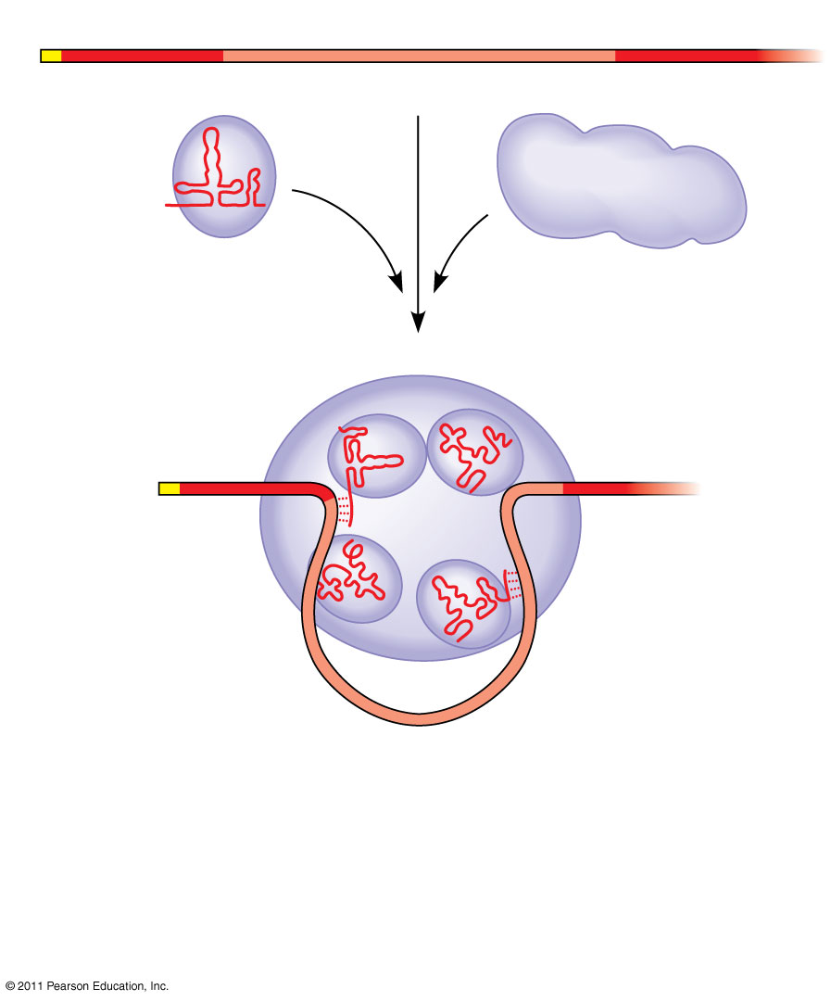
Figure 17.12-2
RNA transcript (pre-mRNA)
5′
Exon 1
Intron
Exon 2
Protein
Other proteins
snRNA
snRNPs
Spliceosome
5′
Notes:
Figure 17.12 The roles of snRNPs and spliceosomes in pre-mRNA splicing.

Slide 49
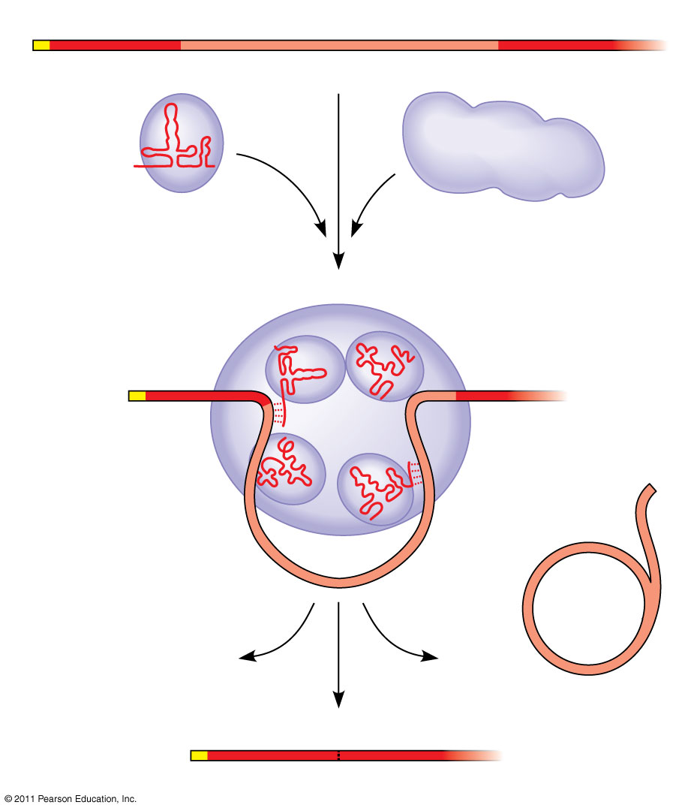
Figure 17.12-3
RNA transcript (pre-mRNA)
5′
Exon 1
Intron
Exon 2
Protein
Other proteins
snRNA
snRNPs
Spliceosome
5′
Spliceosome components
Cut-out intron
mRNA
5′
Exon 1
Exon 2
Notes:
Figure 17.12 The roles of snRNPs and spliceosomes in pre-mRNA splicing.

Slide 50
Ribozymes
Ribozymes are catalytic RNA molecules that function as enzymes and can splice RNA
The discovery of ribozymes rendered obsolete the belief that all biological catalysts were proteins
© 2011 Pearson Education, Inc.
Notes:
50

Slide 51
Three properties of RNA enable it to function as an enzyme
It can form a three-dimensional structure because of its ability to base-pair with itself
Some bases in RNA contain functional groups that may participate in catalysis
RNA may hydrogen-bond with other nucleic acid molecules
© 2011 Pearson Education, Inc.
Notes:
51

Slide 52
The Functional and Evolutionary Importance of Introns
Some introns contain sequences that may regulate gene expression
Some genes can encode more than one kind of polypeptide, depending on which segments are treated as exons during splicing
This is called alternative RNA splicing
Consequently, the number of different proteins an organism can produce is much greater than its number of genes
© 2011 Pearson Education, Inc.
Notes:
52

Slide 53
Proteins often have a modular architecture consisting of discrete regions called domains
In many cases, different exons code for the different domains in a protein
Exon shuffling may result in the evolution of new proteins
© 2011 Pearson Education, Inc.
Notes:
53

Slide 54
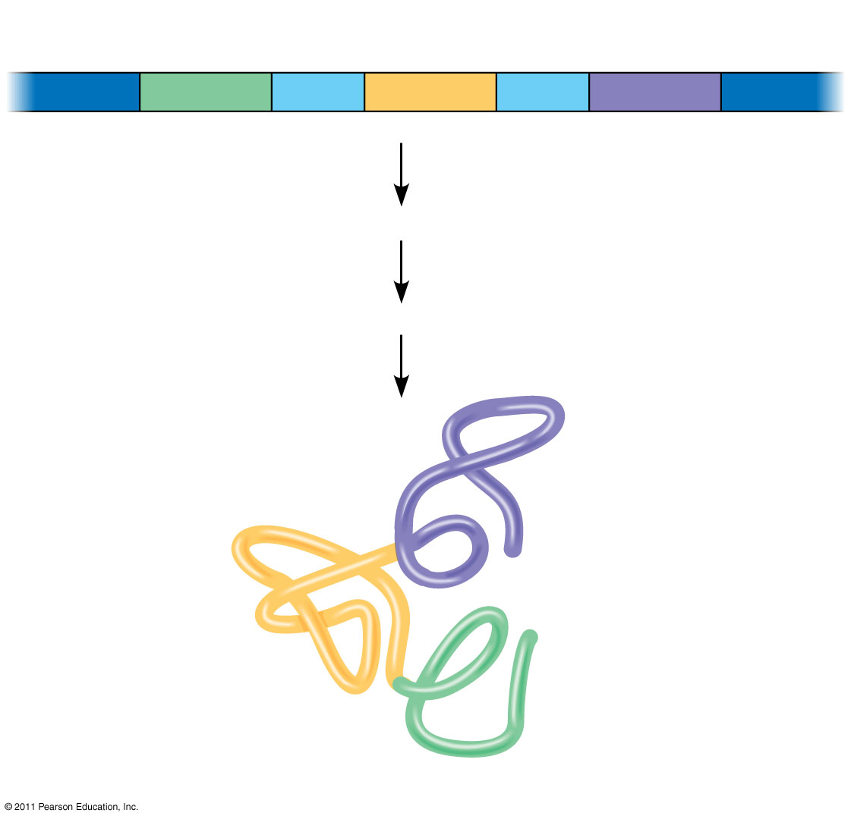
Figure 17.13
Gene
DNA
Exon 1
Intron
Exon 2
Intron
Exon 3
Transcription
RNA processing
Translation
Domain 3
Domain 2
Domain 1
Polypeptide
Notes:
Figure 17.13 Correspondence between exons and protein domains.

Slide 55
Concept 17.4: Translation is the RNA-directed synthesis of a polypeptide: a closer look
Genetic information flows from mRNA to protein through the process of translation
© 2011 Pearson Education, Inc.
Notes:
55

Slide 56
Molecular Components of Translation
A cell translates an mRNA message into protein with the help of transfer RNA (tRNA)
tRNAs transfer amino acids to the growing polypeptide in a ribosome
Translation is a complex process in terms of its biochemistry and mechanics
© 2011 Pearson Education, Inc.
Notes:
56

Slide 57
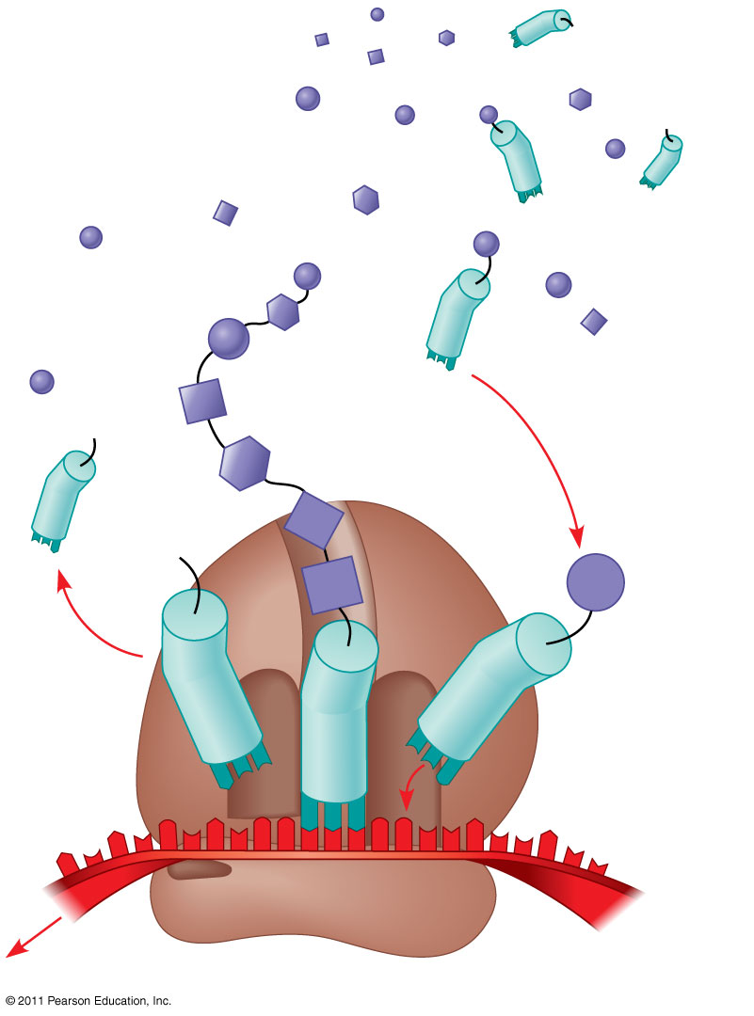
Figure 17.14
Amino acids
Polypeptide
tRNA with amino acid attached
Ribosome
Trp
Phe
Gly
tRNA
C
C
C
C
C
G
Anticodon
A
C
G
A
A
A
G
U
G
G
U
U
U
G
G
C
5′
Codons
3′
mRNA
Notes:
Figure 17.14 Translation: the basic concept.

Slide 58
The Structure and Function of Transfer RNA
Molecules of tRNA are not identical
Each carries a specific amino acid on one end
Each has an anticodon on the other end; the anticodon base-pairs with a complementary codon on mRNA
© 2011 Pearson Education, Inc.
Notes:
58

Slide 59
A tRNA molecule consists of a single RNA strand that is only about 80 nucleotides long
Flattened into one plane to reveal its base pairing, a tRNA molecule looks like a cloverleaf
© 2011 Pearson Education, Inc.
Notes:
59
For the Cell Biology Video A Stick and Ribbon Rendering of a tRNA, go to Animation and Video Files.

Slide 60
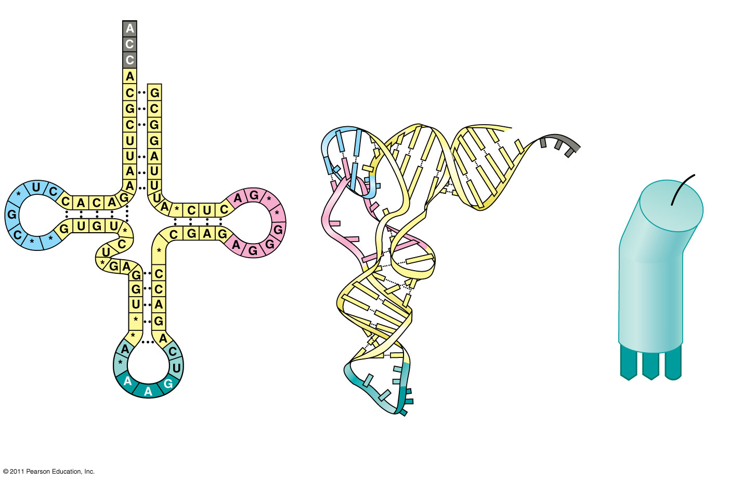
Figure 17.15
3′
Amino acid attachment site
5′
Amino acid attachment site
5′
3′
Hydrogen bonds
Hydrogen bonds
A
A
G
3′
5′
Anticodon
Anticodon
Anticodon
(c) Symbol used
(a) Two-dimensional structure
(b) Three-dimensional structure
in this book
Notes:
Figure 17.15 The structure of transfer RNA (tRNA).

Slide 61
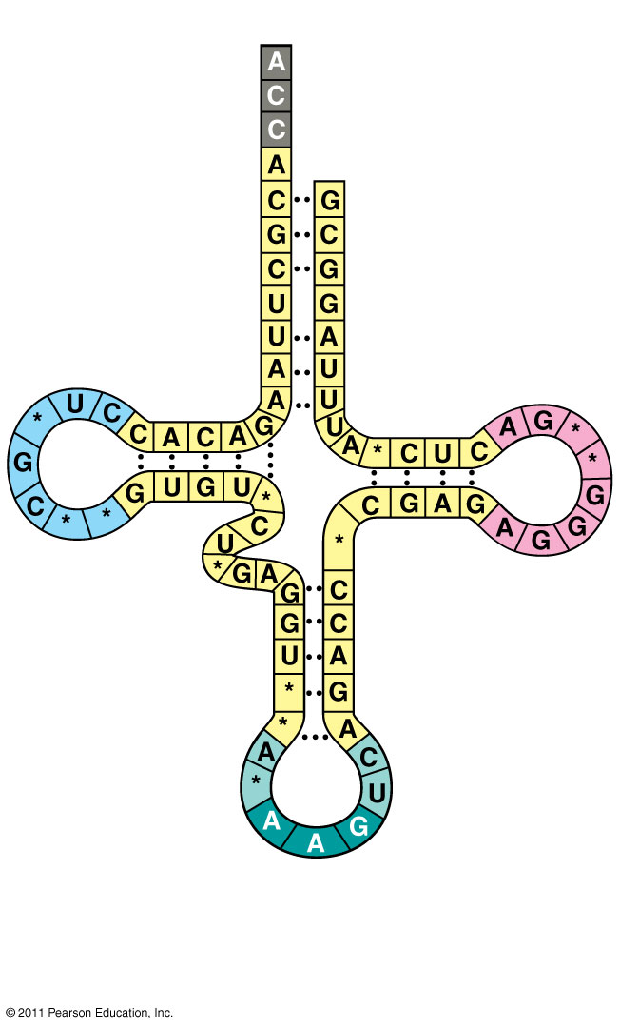
Figure 17.15a
3′
Amino acid attachment site
5′
Hydrogen bonds
Anticodon
(a) Two-dimensional structure
Notes:
Figure 17.15 The structure of transfer RNA (tRNA).

Slide 62
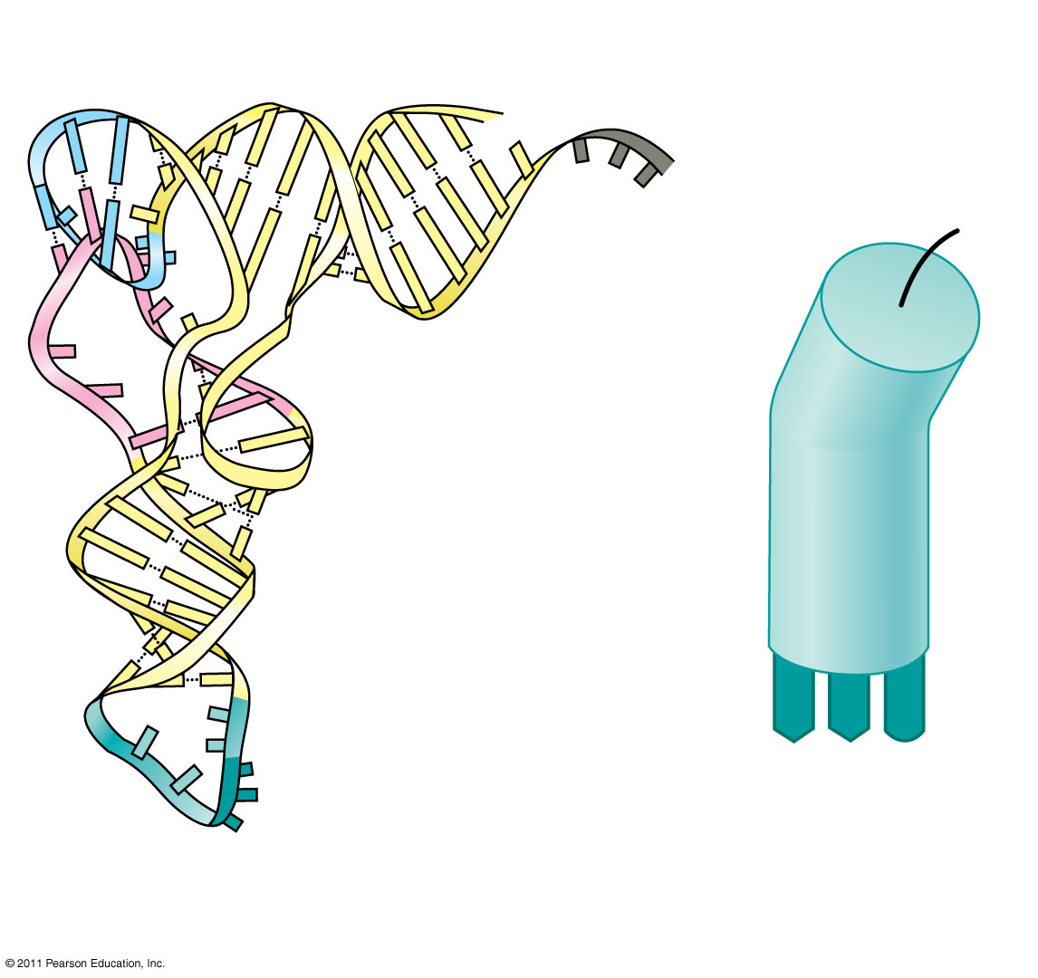
Figure 17.15b
Amino acid attachment site
5′
3′
Hydrogen bonds
A
A
G
3′
5′
Anticodon
Anticodon
(c) Symbol used
(b) Three-dimensional structure
in this book
Notes:
Figure 17.15 The structure of transfer RNA (tRNA).

Slide 63
Because of hydrogen bonds, tRNA actually twists and folds into a three-dimensional molecule
tRNA is roughly L-shaped
© 2011 Pearson Education, Inc.
Notes:
63

Slide 64
Accurate translation requires two steps
First: a correct match between a tRNA and an amino acid, done by the enzyme aminoacyl-tRNA synthetase
Second: a correct match between the tRNA anticodon and an mRNA codon
Flexible pairing at the third base of a codon is called wobble and allows some tRNAs to bind to more than one codon
© 2011 Pearson Education, Inc.
Notes:
64

Slide 65
Figure 17.16-1
Aminoacyl-tRNA synthetase (enzyme)
Amino acid
P
P
P
Adenosine
ATP
Notes:
Figure 17.16 An aminoacyl-tRNA synthetase joining a specific amino acid to a tRNA.

Slide 66
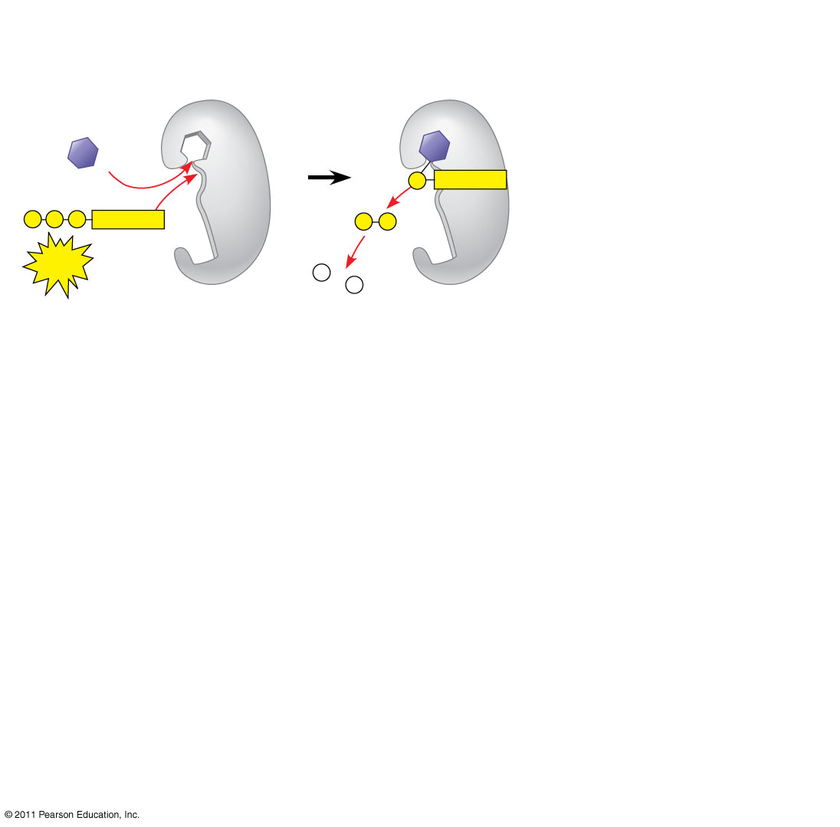
Figure 17.16-2
Aminoacyl-tRNA synthetase (enzyme)
Amino acid
P
Adenosine
P
P
P
Adenosine
P
P
i
ATP
P
i
P
i
Notes:
Figure 17.16 An aminoacyl-tRNA synthetase joining a specific amino acid to a tRNA.

Slide 67
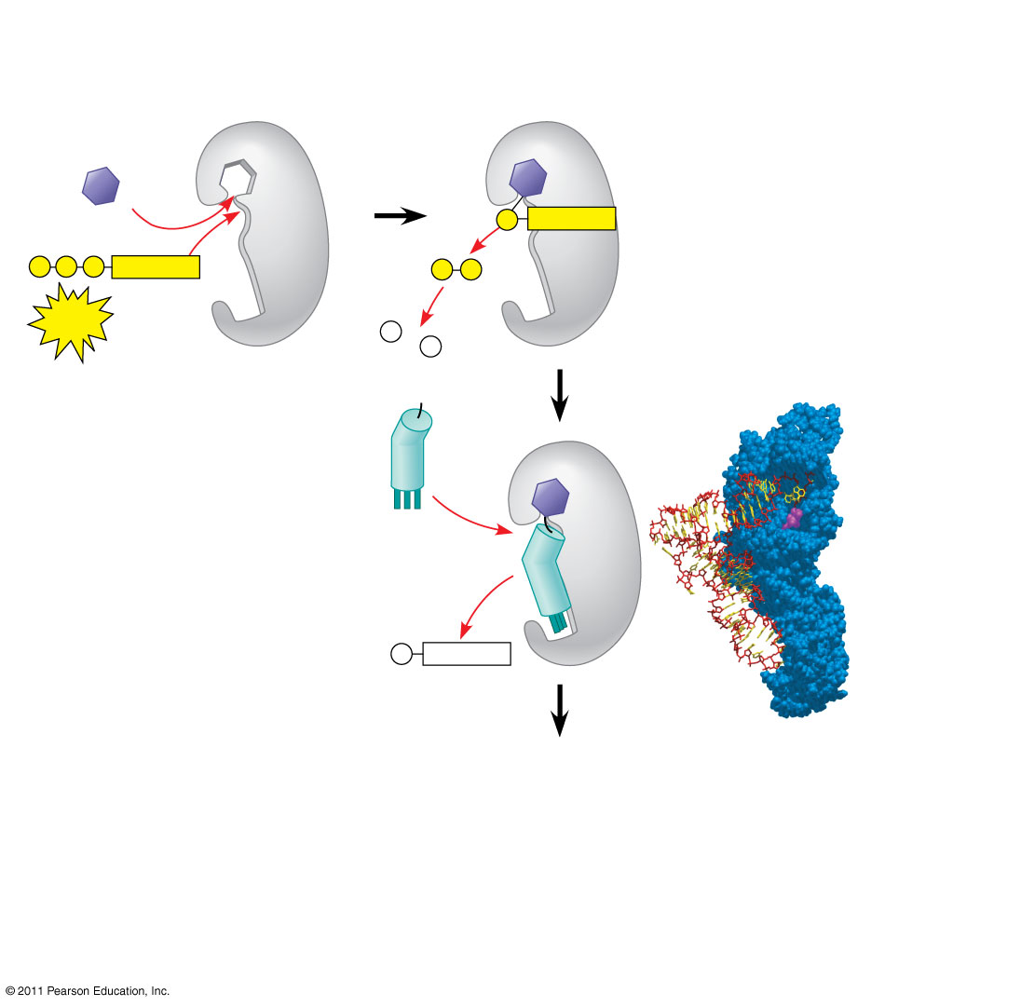
Figure 17.16-3
Aminoacyl-tRNA synthetase (enzyme)
Amino acid
P
Adenosine
P
P
P
Adenosine
P
P
i
ATP
Aminoacyl-tRNA synthetase
P
i
P
tRNA
i
tRNA
Amino acid
P
Adenosine
AMP
Computer model
Notes:
Figure 17.16 An aminoacyl-tRNA synthetase joining a specific amino acid to a tRNA.

Slide 68
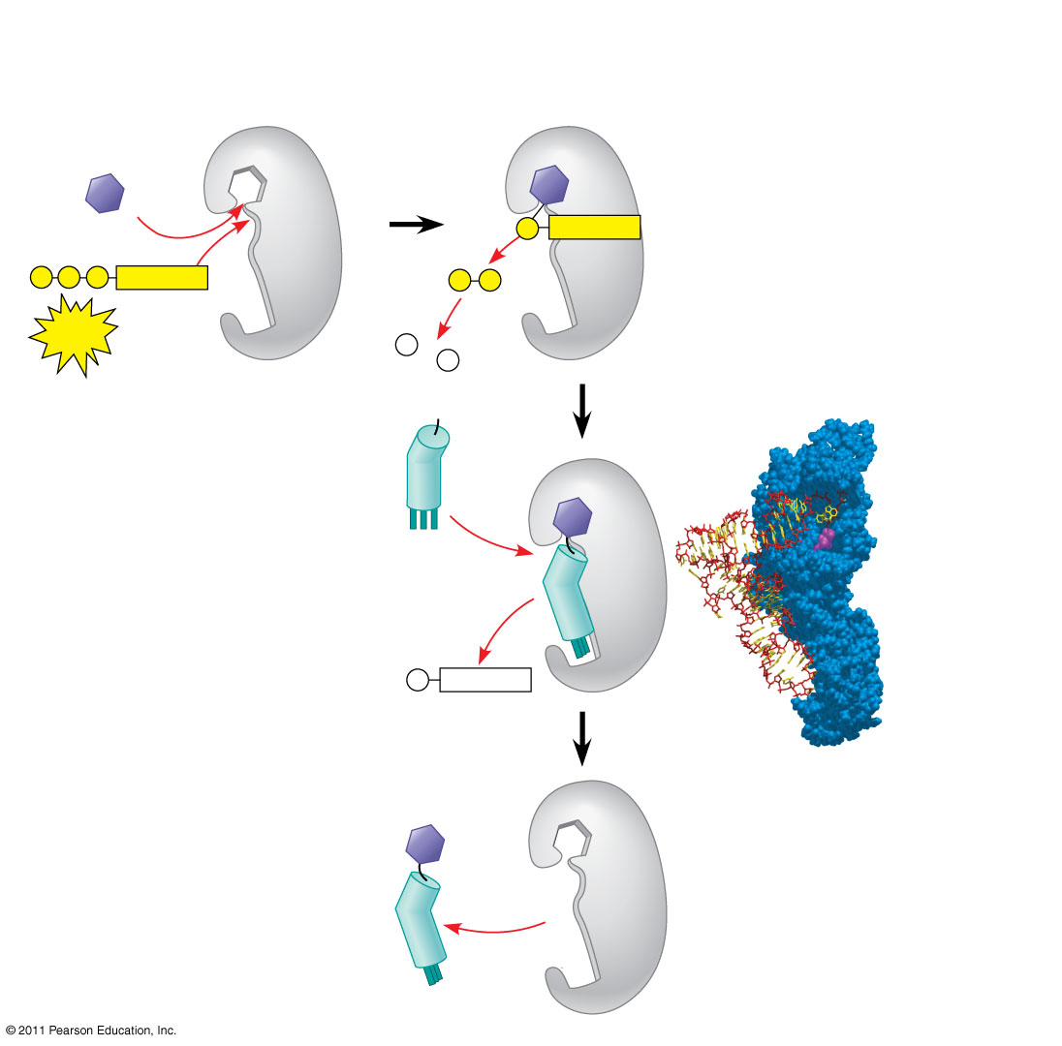
Figure 17.16-4
Aminoacyl-tRNA synthetase (enzyme)
Amino acid
P
Adenosine
P
P
P
Adenosine
P
P
i
ATP
Aminoacyl-tRNA synthetase
P
i
P
tRNA
i
tRNA
Amino acid
P
Adenosine
AMP
Computer model
Aminoacyl tRNA (“charged tRNA”)
Notes:
Figure 17.16 An aminoacyl-tRNA synthetase joining a specific amino acid to a tRNA.

Slide 69
Ribosomes
Ribosomes facilitate specific coupling of tRNA anticodons with mRNA codons in protein synthesis
The two ribosomal subunits (large and small) are made of proteins and ribosomal RNA (rRNA)
Bacterial and eukaryotic ribosomes are somewhat similar but have significant differences: some antibiotic drugs specifically target bacterial ribosomes without harming eukaryotic ribosomes
© 2011 Pearson Education, Inc.
Notes:
69

Slide 70
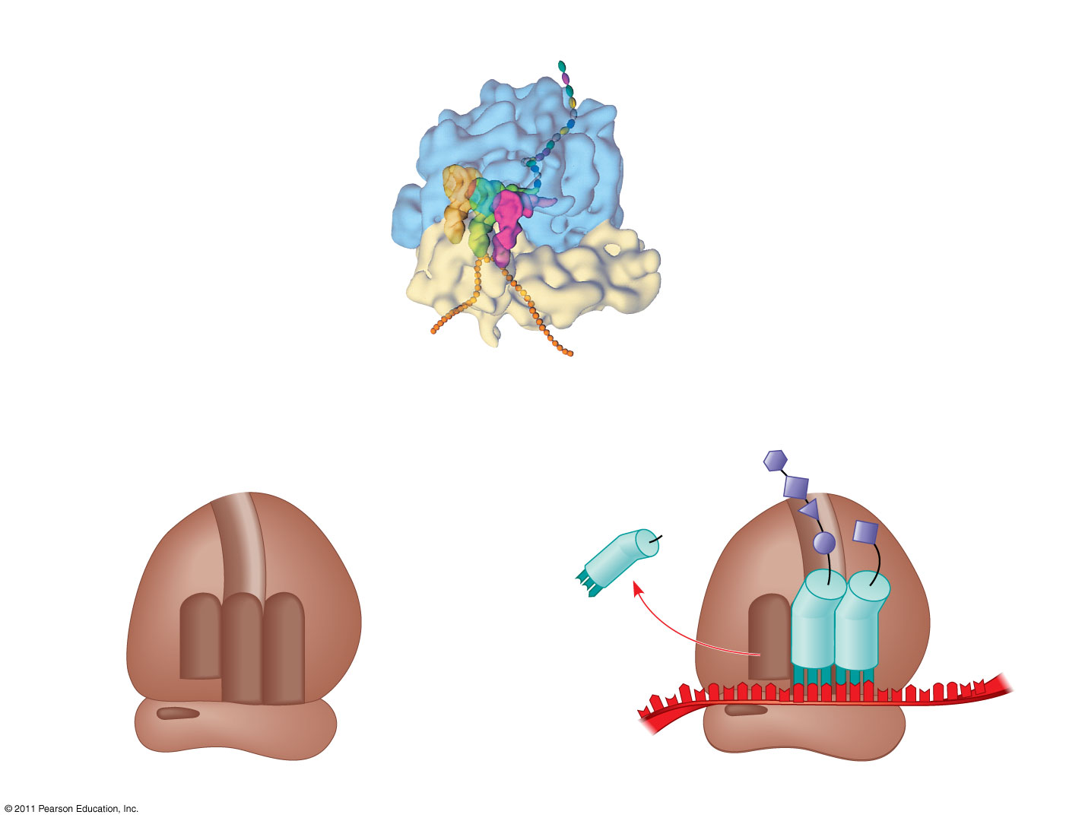
Figure 17.17
Growing polypeptide
tRNA molecules
Exit tunnel
Large subunit
E
P
A
Small subunit
5′
3′
mRNA
(a) Computer model of functioning ribosome
Growing polypeptide
P site (Peptidyl-tRNA binding site)
Exit tunnel
Amino end
Next amino acid to be added to polypeptide chain
A site (Aminoacyl- tRNA binding site)
E site (Exit site)
E
P
A
E
tRNA
Large subunit
mRNA
3′
mRNA binding site
Small subunit
5′
Codons
(b) Schematic model showing binding sites
(c) Schematic model with mRNA and tRNA
Notes:
Figure 17.17 The anatomy of a functioning ribosome.

Slide 71
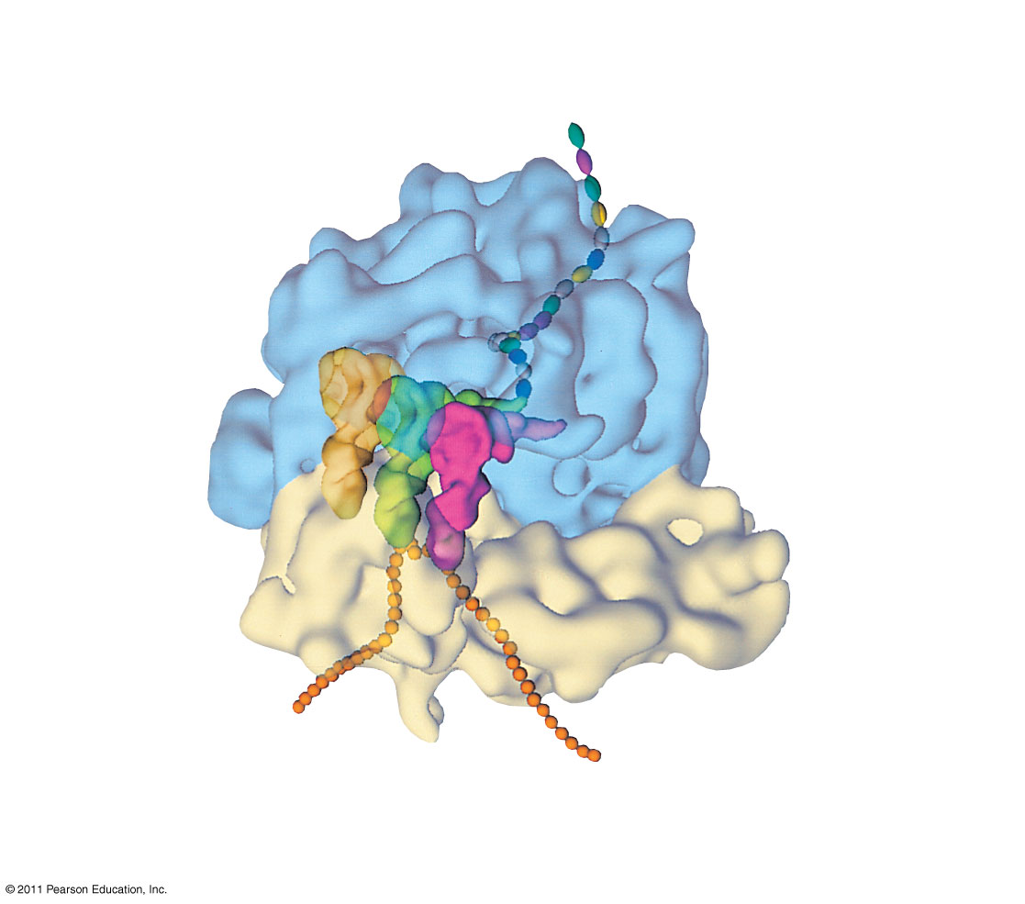
Figure 17.17a
Growing polypeptide
Exit tunnel
tRNA molecules
Large subunit
E
P
A
Small subunit
5′
mRNA
3′
(a) Computer model of functioning ribosome
Notes:
Figure 17.17 The anatomy of a functioning ribosome.

Slide 72
Figure 17.17b
P site (Peptidyl-tRNA binding site)
Exit tunnel
A site (Aminoacyl- tRNA binding site)
E site (Exit site)
E
P
A
Large subunit
mRNA binding site
Small subunit
(b) Schematic model showing binding sites
Notes:
Figure 17.17 The anatomy of a functioning ribosome.

Slide 73
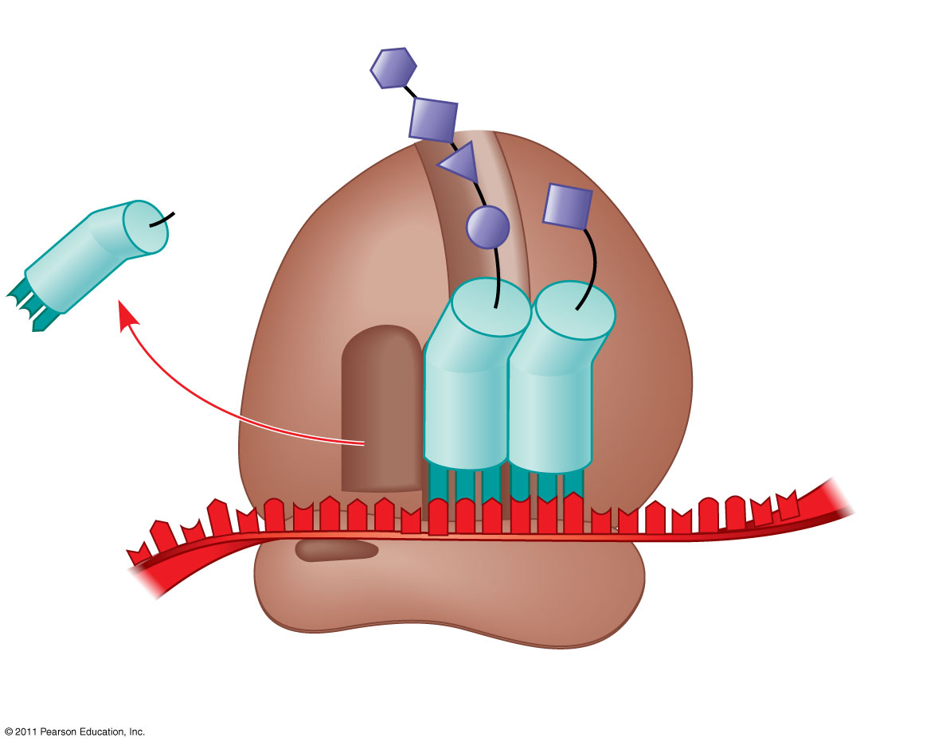
Figure 17.17c
Growing polypeptide
Amino end
Next amino acid to be added to polypeptide chain
E
tRNA
mRNA
3′
5′
Codons
(c) Schematic model with mRNA and tRNA
Notes:
Figure 17.17 The anatomy of a functioning ribosome.

Slide 74
A ribosome has three binding sites for tRNA
The P site holds the tRNA that carries the growing polypeptide chain
The A site holds the tRNA that carries the next amino acid to be added to the chain
The E site is the exit site, where discharged tRNAs leave the ribosome
© 2011 Pearson Education, Inc.
Notes:
74

Slide 75
Building a Polypeptide
The three stages of translation
Initiation
Elongation
Termination
All three stages require protein “factors” that aid in the translation process
© 2011 Pearson Education, Inc.
Notes:
75

Slide 76
Ribosome Association and Initiation of Translation
The initiation stage of translation brings together mRNA, a tRNA with the first amino acid, and the two ribosomal subunits
First, a small ribosomal subunit binds with mRNA and a special initiator tRNA
Then the small subunit moves along the mRNA until it reaches the start codon (AUG)
Proteins called initiation factors bring in the large subunit that completes the translation initiation complex
© 2011 Pearson Education, Inc.
Notes:
76

Slide 77
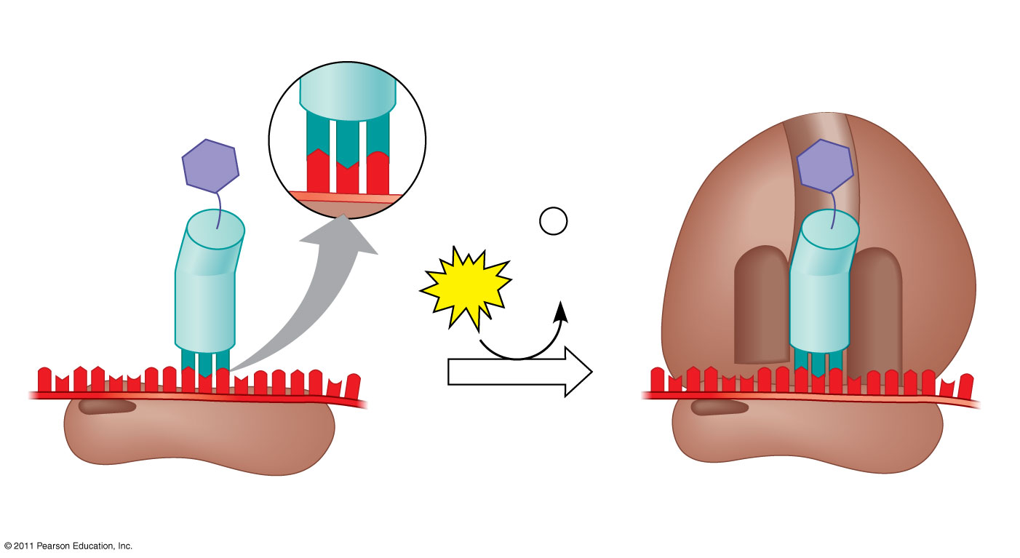
Figure 17.18
Large ribosomal subunit
3′
U
A
C
5′
P site
Met
5′
A
U
G
3′
Met
P
i
Initiator tRNA
+
GTP
GDP
E
A
mRNA
5′
5′
3′
3′
Start codon
Small ribosomal subunit
mRNA binding site
Translation initiation complex
Notes:
Figure 17.18 The initiation of translation.

Slide 78
Elongation of the Polypeptide Chain
During the elongation stage, amino acids are added one by one to the preceding amino acid at the C-terminus of the growing chain
Each addition involves proteins called elongation factors and occurs in three steps: codon recognition, peptide bond formation, and translocation
Translation proceeds along the mRNA in a 5′ to 3′ direction
© 2011 Pearson Education, Inc.
Notes:
78

Slide 79
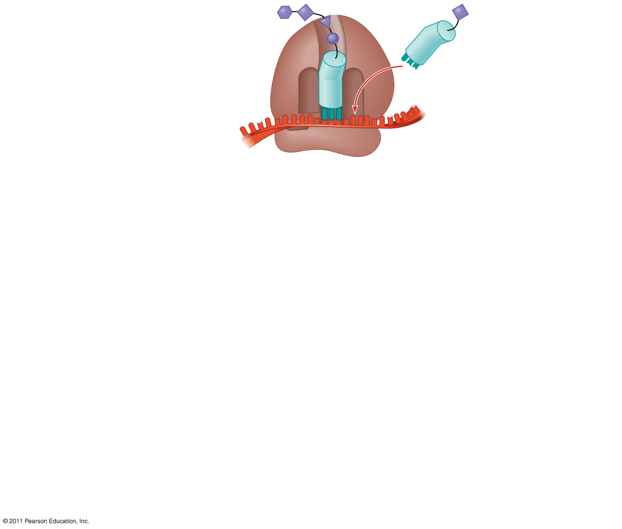
Figure 17.19-1
Amino end of polypeptide
E
3′
mRNA
P site
A site
5′
Notes:
Figure 17.19 The elongation cycle of translation.

Slide 80
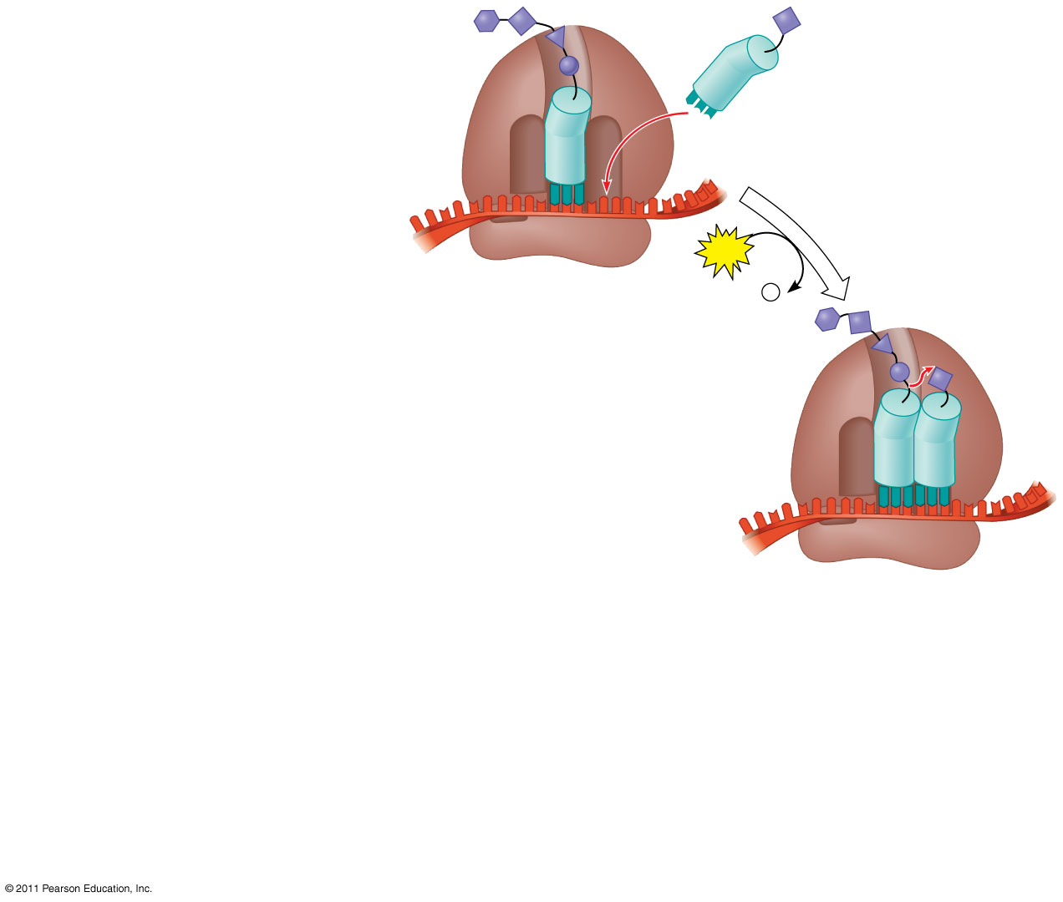
Figure 17.19-2
Amino end of polypeptide
E
3′
mRNA
P site
A site
5′
GTP
GDP
+
P
i
E
P
A
Notes:
Figure 17.19 The elongation cycle of translation.

Slide 81
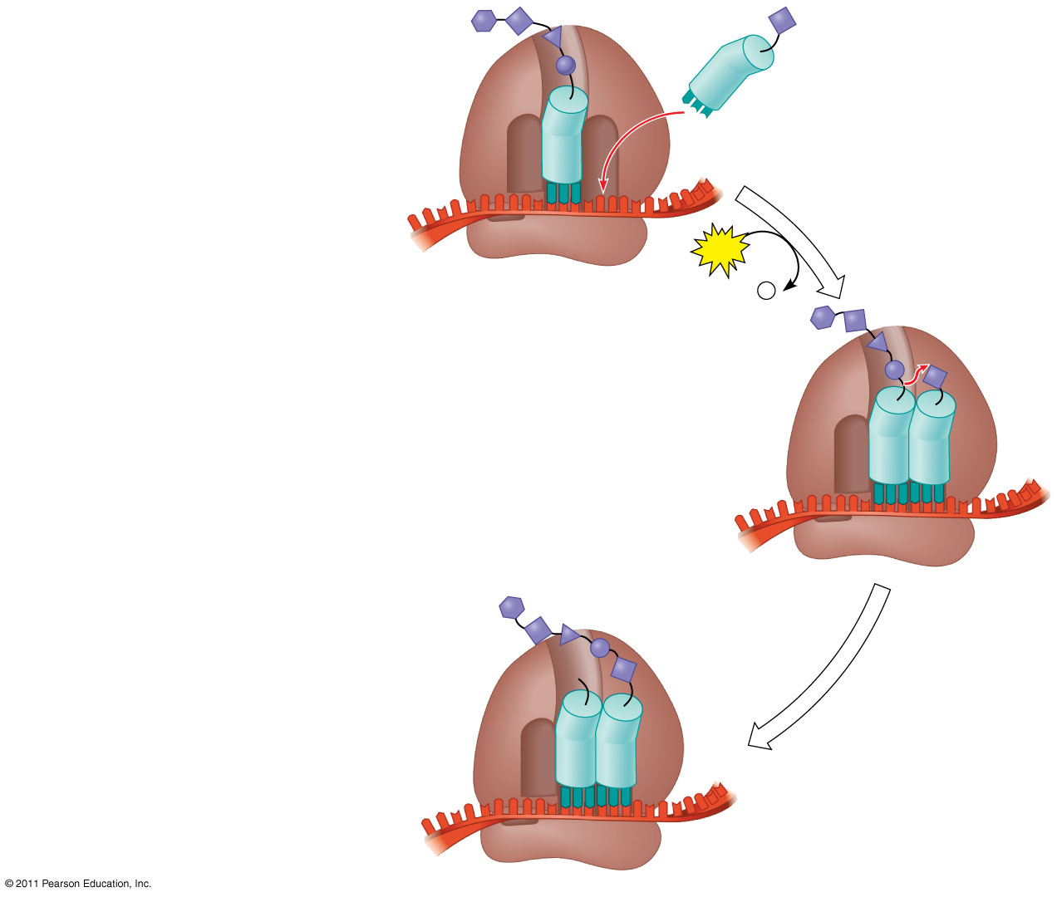
Figure 17.19-3
Amino end of polypeptide
E
3′
mRNA
P site
A site
5′
GTP
GDP
+
P
i
E
P
A
E
P
A
Notes:
Figure 17.19 The elongation cycle of translation.

Slide 82
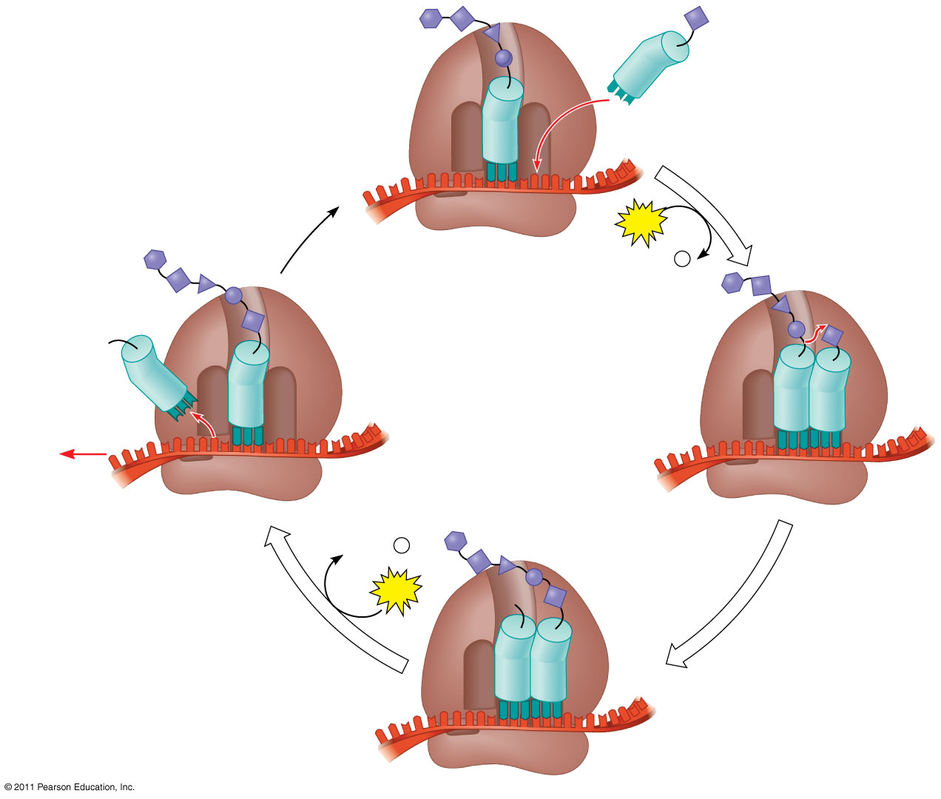
Figure 17.19-4
Amino end of polypeptide
E
3′
mRNA
Ribosome ready for next aminoacyl tRNA
P site
A site
5′
GTP
GDP
+
P
i
E
E
P
A
P
A
GDP
+
P
i
GTP
E
P
A
Notes:
Figure 17.19 The elongation cycle of translation.

Slide 83
Termination of Translation
Termination occurs when a stop codon in the mRNA reaches the A site of the ribosome
The A site accepts a protein called a release factor
The release factor causes the addition of a water molecule instead of an amino acid
This reaction releases the polypeptide, and the translation assembly then comes apart
© 2011 Pearson Education, Inc.
Notes:
83

Slide 84
Figure 17.20-1
Release factor
3′
5′
Stop codon
(UAG, UAA, or UGA)
Notes:
Figure 17.20 The termination of translation.

Slide 85
Figure 17.20-2
Release factor
Free polypeptide
3′
3′
5′
5′
2
GTP
Stop codon
2
GDP
+
2
P
i
(UAG, UAA, or UGA)
Notes:
Figure 17.20 The termination of translation.

Slide 86
Figure 17.20-3
Release factor
Free polypeptide
5′
3′
3′
5′
5′
2
GTP
3′
Stop codon
2
GDP
+
2
P
i
(UAG, UAA, or UGA)
Notes:
Figure 17.20 The termination of translation.

Slide 87
Polyribosomes
A number of ribosomes can translate a single mRNA simultaneously, forming a polyribosome (or polysome)
Polyribosomes enable a cell to make many copies of a polypeptide very quickly
© 2011 Pearson Education, Inc.
Notes:
87

Slide 88
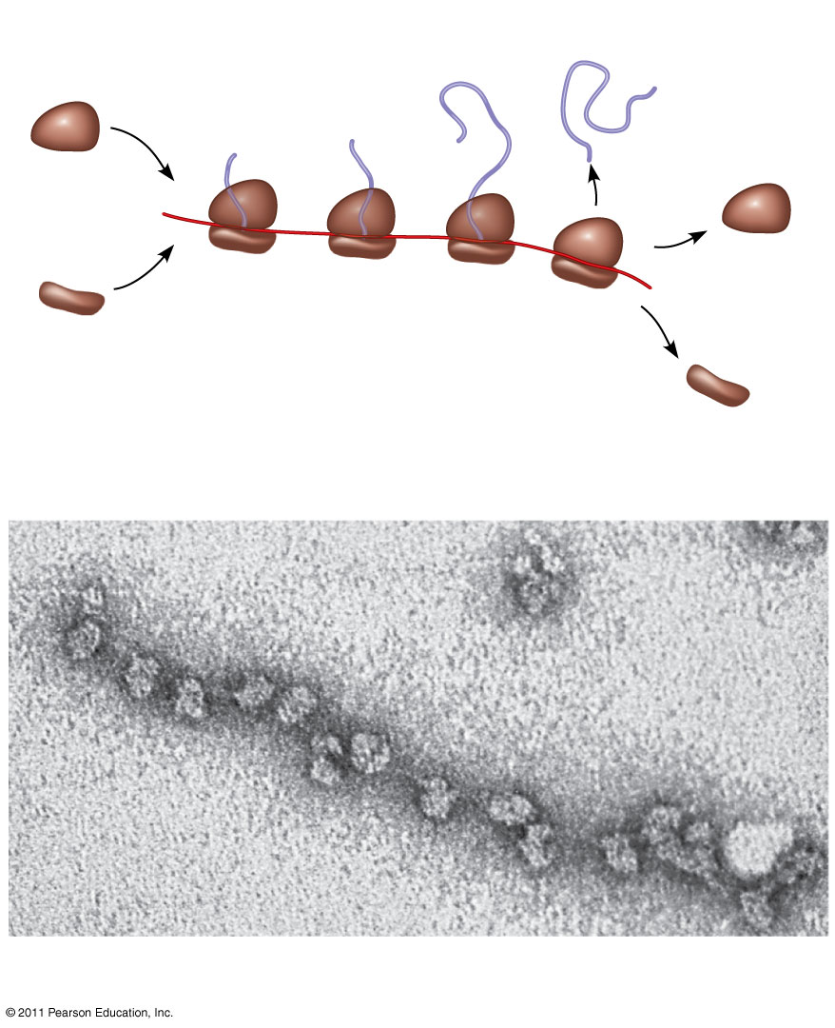
Figure 17.21
Completed polypeptide
Growing polypeptides
Incoming ribosomal subunits
Polyribosome
Start of mRNA (5′ end)
End of mRNA (3′ end)
(a)
Ribosomes
mRNA
(b)
0.1 μm
Notes:
Figure 17.21 Polyribosomes.

Slide 89
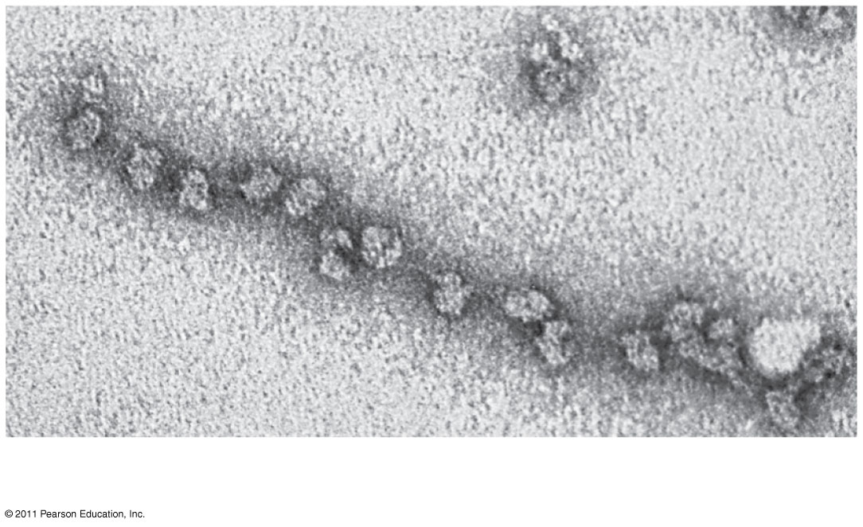
Figure 17.21a
Ribosomes
mRNA
0.1 μm
Notes:
Figure 17.21 Polyribosomes.

Slide 90
Completing and Targeting the Functional Protein
Often translation is not sufficient to make a functional protein
Polypeptide chains are modified after translation or targeted to specific sites in the cell
© 2011 Pearson Education, Inc.
Notes:
90

Slide 91
Protein Folding and Post-Translational Modifications
During and after synthesis, a polypeptide chain spontaneously coils and folds into its three-dimensional shape
Proteins may also require post-translational modifications before doing their job
Some polypeptides are activated by enzymes that cleave them
Other polypeptides come together to form the subunits of a protein
© 2011 Pearson Education, Inc.
Notes:
91

Slide 92
Targeting Polypeptides to Specific Locations
Two populations of ribosomes are evident in cells: free ribsomes (in the cytosol) and bound ribosomes (attached to the ER)
Free ribosomes mostly synthesize proteins that function in the cytosol
Bound ribosomes make proteins of the endomembrane system and proteins that are secreted from the cell
Ribosomes are identical and can switch from free to bound
© 2011 Pearson Education, Inc.
Notes:
92

Slide 93
Polypeptide synthesis always begins in the cytosol
Synthesis finishes in the cytosol unless the polypeptide signals the ribosome to attach to the ER
Polypeptides destined for the ER or for secretion are marked by a signal peptide
© 2011 Pearson Education, Inc.
Notes:
93

Slide 94
A signal-recognition particle (SRP) binds to the signal peptide
The SRP brings the signal peptide and its ribosome to the ER
© 2011 Pearson Education, Inc.
Notes:
94

Slide 95
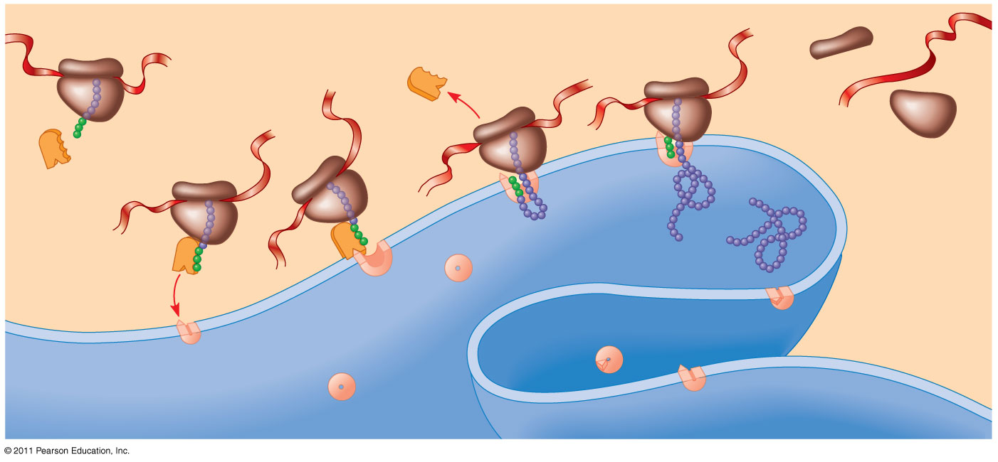
Figure 17.22
1
Ribosome
5
mRNA
4
Signal peptide
ER membrane
3
Signal peptide removed
SRP
Protein
6
2
SRP receptor protein
CYTOSOL
ER LUMEN
Translocation complex
Notes:
Figure 17.22 The signal mechanism for targeting proteins to the ER.

Slide 96
Concept 17.5: Mutations of one or a few nucleotides can affect protein structure and function
Mutations are changes in the genetic material of a cell or virus
Point mutations are chemical changes in just one base pair of a gene
The change of a single nucleotide in a DNA template strand can lead to the production of an abnormal protein
© 2011 Pearson Education, Inc.
Notes:
96

Slide 97
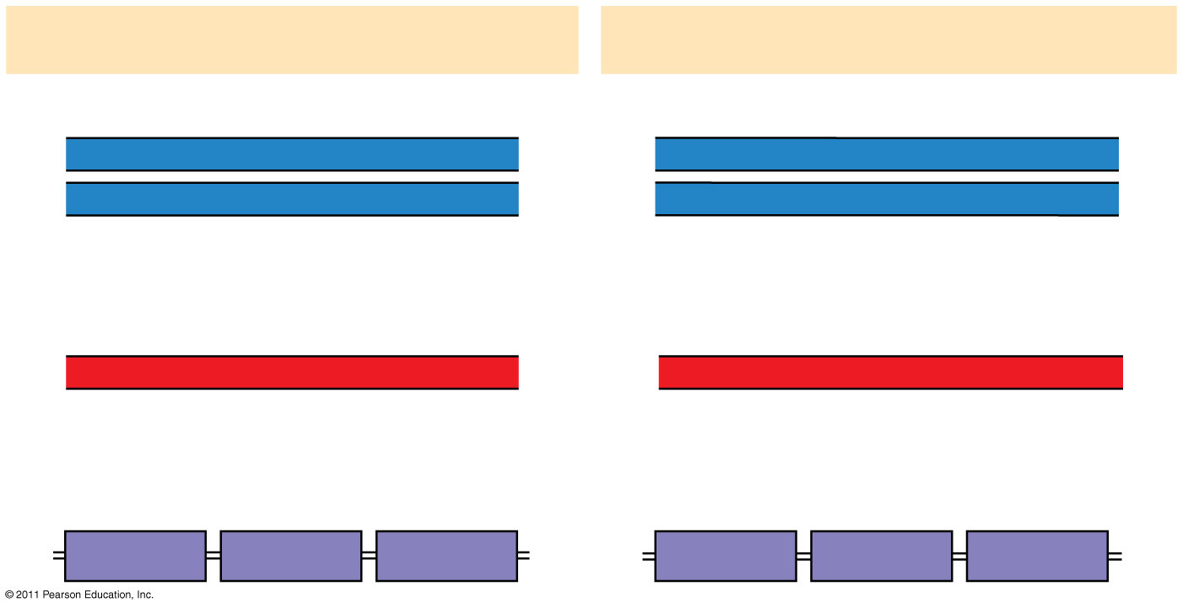
Figure 17.23
Wild-type hemoglobin
Sickle-cell hemoglobin
Wild-type hemoglobin DNA
Mutant hemoglobin DNA
3′
C
T
T
5′
3′
C
A
T
5′
5′
G
A
A
3′
5′
G
T
A
3′
mRNA
mRNA
5′
G
A
A
3′
5′
G
U
A
3′
Normal hemoglobin
Sickle-cell hemoglobin
Glu
Val
Notes:
Figure 17.23 The molecular basis of sickle-cell disease: a point mutation.

Slide 98
Types of Small-Scale Mutations
Point mutations within a gene can be divided into two general categories
Nucleotide-pair substitutions
One or more nucleotide-pair insertions or deletions
© 2011 Pearson Education, Inc.
Notes:
98

Slide 99
Substitutions
A nucleotide-pair substitution replaces one nucleotide and its partner with another pair of nucleotides
Silent mutations have no effect on the amino acid produced by a codon because of redundancy in the genetic code
Missense mutations still code for an amino acid, but not the correct amino acid
Nonsense mutations change an amino acid codon into a stop codon, nearly always leading to a nonfunctional protein
© 2011 Pearson Education, Inc.
Notes:
99

Slide 100
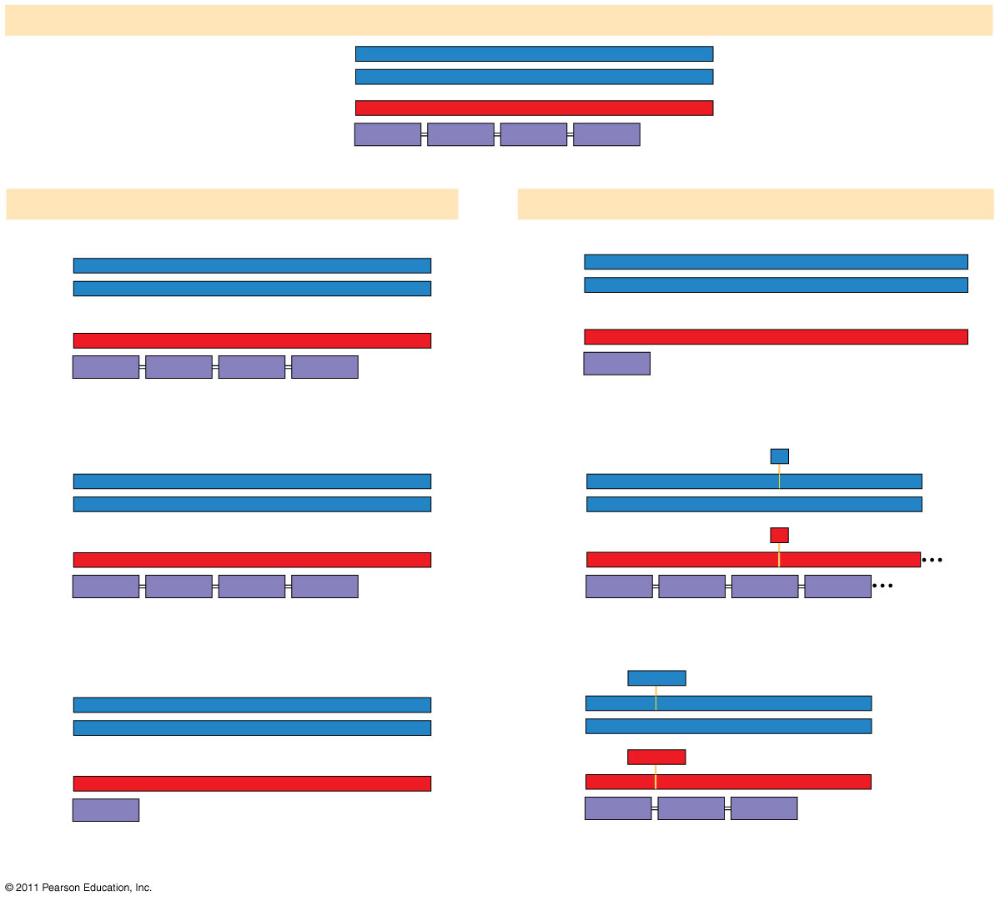
Figure 17.24
Wild type
DNA template strand
3′
T
A
C
T
T
C
A
A
A
C
C
G
A
T
T
5′
5′
A
T
G
A
A
G
T
T
T
G
G
C
T
A
A
3′
mRNA5′
A
U
G
A
A
G
U
U
U
G
G
C
U
A
A
3′
Protein
Met
Lys
Phe
Gly
Stop
Amino end
Carboxyl end
(a) Nucleotide-pair substitution
(b) Nucleotide-pair insertion or deletion
A instead of G
Extra A
3′
T
A
C
T
T
C
A
A
A
C
C
A
A
T
T
5′
3′
T
A
C
A
T
T
C
A
A
A
C
C
G
A
T
T
5′
5′
A
T
G
A
A
G
T
T
T
G
G
T
T
A
A
3′
5′
A
T
G
T
A
A
G
T
T
T
G
G
C
T
A
A
3′
U instead of C
Extra U
5′
A
U
G
A
A
G
U
U
U
G
G
U
U
A
A
3′
5′
A
U
G
U
A
A
G
U
U
U
G
G
C
U
A
A
3′
Met
Lys
Phe
Gly
Stop
Met
Stop
Silent (no effect on amino acid sequence)
Frameshift causing immediate nonsense
(1 nucleotide-pair insertion)
T instead of C
A
missing
3′
T
A
C
T
T
C
A
A
A
T
C
G
A
T
T
5′
3′
T
A
C
T
T
C
A
A
C
C
G
A
T
T
5′
T
C
3′
A
5′
A
T
G
A
A
G
T
T
T
A
G
T
A
A
5′
A
T
G
A
A
G
T
T
G
G
C
T
A
A
3′
A instead of G
U
missing
5′
A
U
G
A
A
G
U
U
U
A
G
C
U
A
A
3′
5′
A
U
G
A
A
G
U
U
G
G
C
U
A
A
3′
Met
Lys
Phe
Ser
Stop
Met
Lys
Leu
Ala
Missense
Frameshift causing extensive missense
(1 nucleotide-pair deletion)
A instead of T
T
T
C
missing
3′
T
A
C
A
T
C
A
A
A
C
C
G
A
T
T
5′
3′
T
A
C
A
A
A
C
C
G
A
T
T
5′
5′
A
T
G
T
A
G
T
T
T
G
G
C
T
A
A
3′
5′
A
T
G
T
T
T
G
G
C
T
A
A
3′
U instead of A
A
A
G
missing
5′
U
G
U
U
U
G
U
A
3′
5′
G
3′
A
G
C
A
U
A
A
A
U
U
A
G
U
U
U
G
G
C
U
A
A
3′
Met
Stop
Met
Phe
Gly
Stop
Nonsense
No frameshift, but one amino acid missing (3 nucleotide-pair deletion)
Notes:
Figure 17.24 Types of small-scale mutations that affect mRNA sequence.

Slide 101
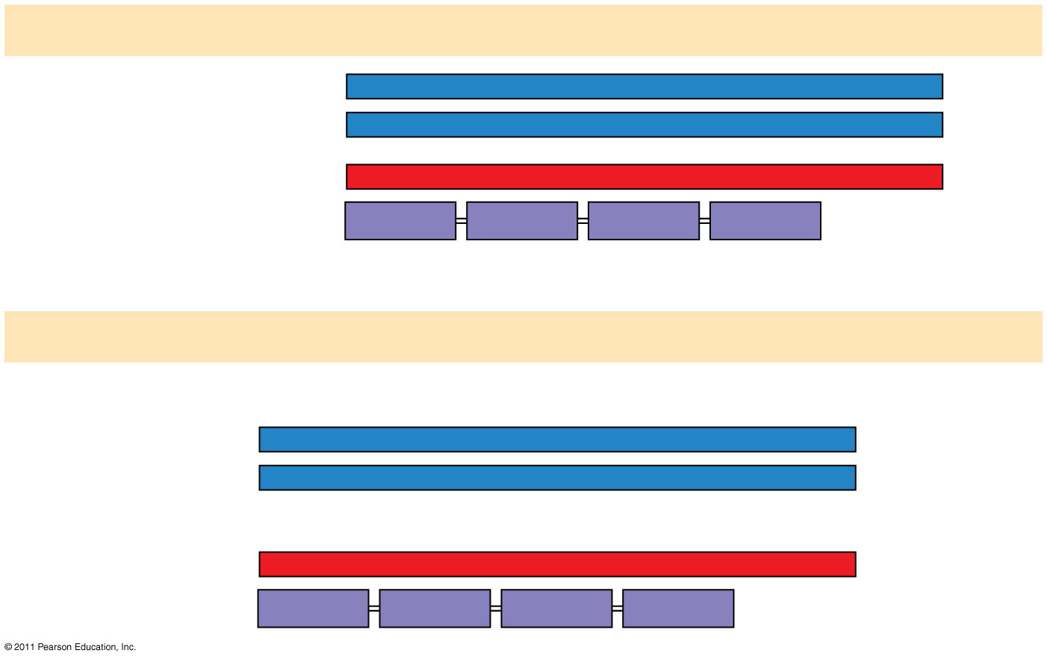
Figure 17.24a
Wild type
DNA template strand
3′
T
A
C
T
T
C
A
A
A
C
C
G
A
T
T
5′
5′
A
T
G
A
A
G
T
T
T
G
G
C
T
A
A
3′
mRNA5′
A
U
G
A
A
G
U
U
U
G
G
C
U
A
A
3′
Protein
Met
Lys
Phe
Gly
Stop
Amino end
Carboxyl end
(a) Nucleotide-pair substitution: silent
A instead of G
3′
T
A
C
T
T
C
A
A
A
C
C
A
A
T
T
5′
5′
A
T
G
A
A
G
T
T
T
G
G
T
T
A
A
3′
U instead of C
5′
A
U
G
A
A
G
U
U
U
G
G
U
U
A
A
3′
Met
Lys
Phe
Gly
Stop
Notes:
Figure 17.24 Types of small-scale mutations that affect mRNA sequence.

Slide 102
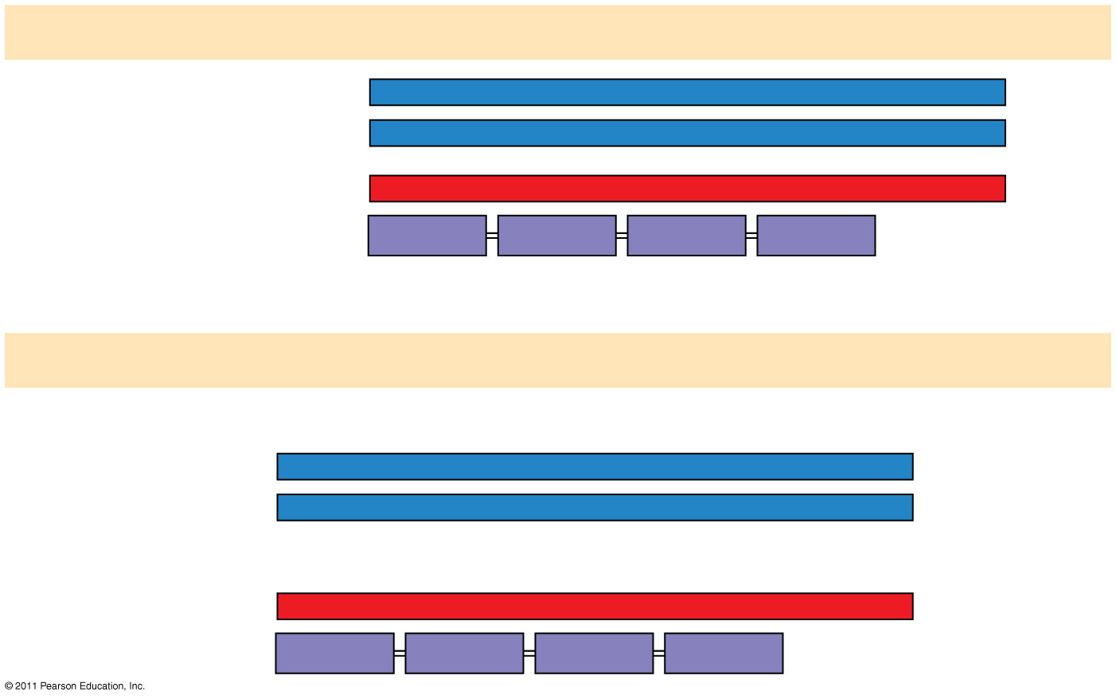
Figure 17.24b
Wild type
DNA template strand
3′
T
A
C
T
T
C
A
A
A
C
C
G
A
T
T
5′
5′
A
T
G
A
A
G
T
T
T
G
G
C
T
A
A
3′
mRNA5′
A
U
G
A
A
G
U
U
U
G
G
C
U
A
A
3′
Protein
Met
Lys
Phe
Gly
Stop
Amino end
Carboxyl end
(a) Nucleotide-pair substitution: missense
T instead of C
3′
T
A
C
T
T
C
A
A
A
T
C
G
A
T
T
5′
5′
A
T
G
A
A
G
T
T
T
A
G
C
T
A
A
3′
A instead of G
5′
A
U
G
A
A
G
U
U
U
A
G
C
U
A
A
3′
Met
Lys
Phe
Ser
Stop
Notes:
Figure 17.24 Types of small-scale mutations that affect mRNA sequence.

Slide 103
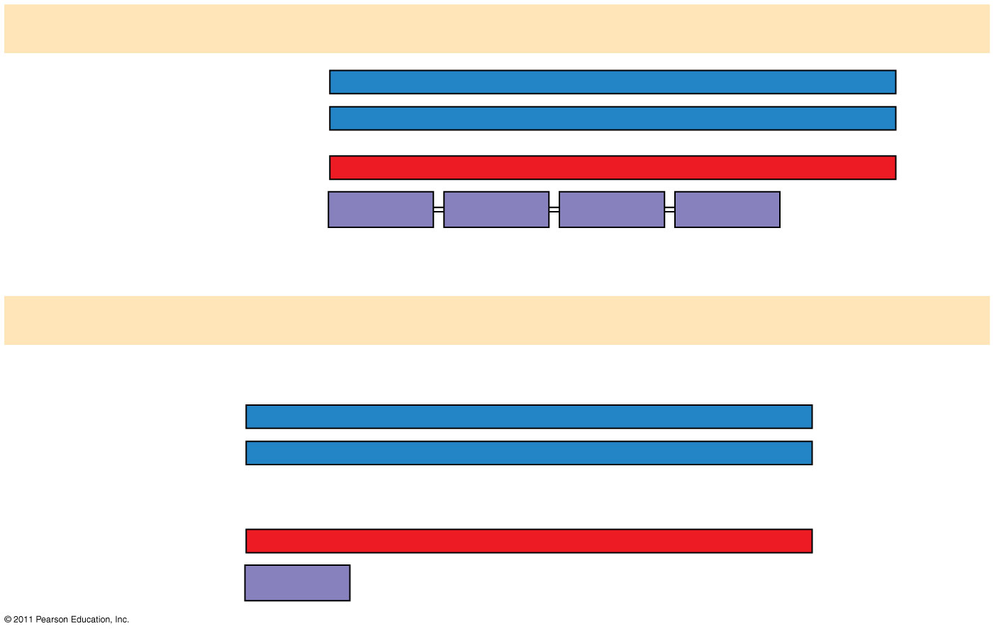
Figure 17.24c
Wild type
DNA template strand
3′
T
A
C
T
T
C
A
A
A
C
C
G
A
T
T
5′
5′
A
T
G
A
A
G
T
T
T
G
G
C
T
A
A
3′
mRNA5′
A
U
G
A
A
G
U
U
U
G
G
C
U
A
A
3′
Protein
Met
Lys
Phe
Gly
Stop
Amino end
Carboxyl end
(a) Nucleotide-pair substitution: nonsense
A instead of T
T instead of C
3′
T
A
C
A
T
C
A
A
A
C
C
G
A
T
T
5′
5′
A
T
G
T
A
G
T
T
T
G
G
C
T
A
A
3′
U instead of A
5′
A
U
G
U
A
G
U
U
U
G
G
C
U
A
A
3′
Met
Stop
Notes:
Figure 17.24 Types of small-scale mutations that affect mRNA sequence.

Slide 104
Insertions and Deletions
Insertions and deletions are additions or losses of nucleotide pairs in a gene
These mutations have a disastrous effect on the resulting protein more often than substitutions do
Insertion or deletion of nucleotides may alter the reading frame, producing a frameshift mutation
© 2011 Pearson Education, Inc.
Notes:
104

Slide 105
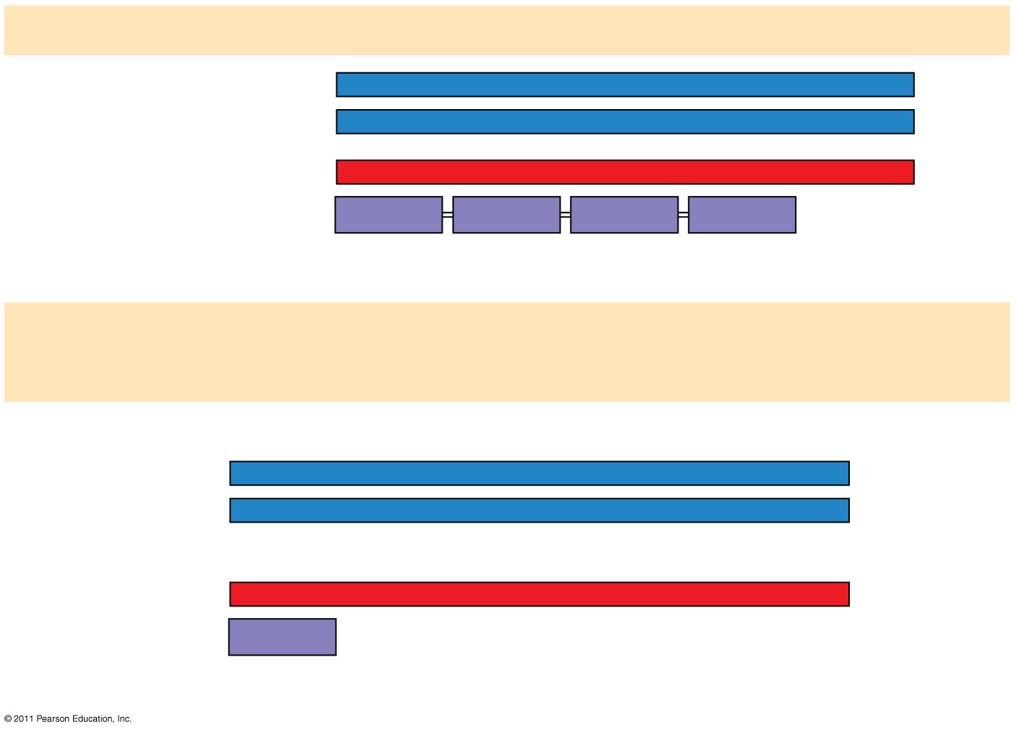
Figure 17.24d
Wild type
DNA template strand
3′
T
A
C
T
T
C
A
A
A
C
C
G
A
T
T
5′
5′
A
T
G
A
A
G
T
T
T
G
G
C
T
A
A
3′
mRNA5′
A
U
G
A
A
G
U
U
U
G
G
C
U
A
A
3′
Protein
Met
Lys
Phe
Gly
Stop
Amino end
Carboxyl end
(b) Nucleotide-pair insertion or deletion: frameshift causing
immediate nonsense
Extra A
3′
T
A
C
A
T
T
C
A
A
A
C
G
G
A
T
T
5′
5′
A
T
G
T
A
A
G
T
T
T
G
G
C
T
A
A
3′
Extra U
5′
A
U
G
U
A
A
G
U
U
U
G
G
C
U
A
A
3′
Met
Stop
1 nucleotide-pair insertion
Notes:
Figure 17.24 Types of small-scale mutations that affect mRNA sequence.

Slide 106
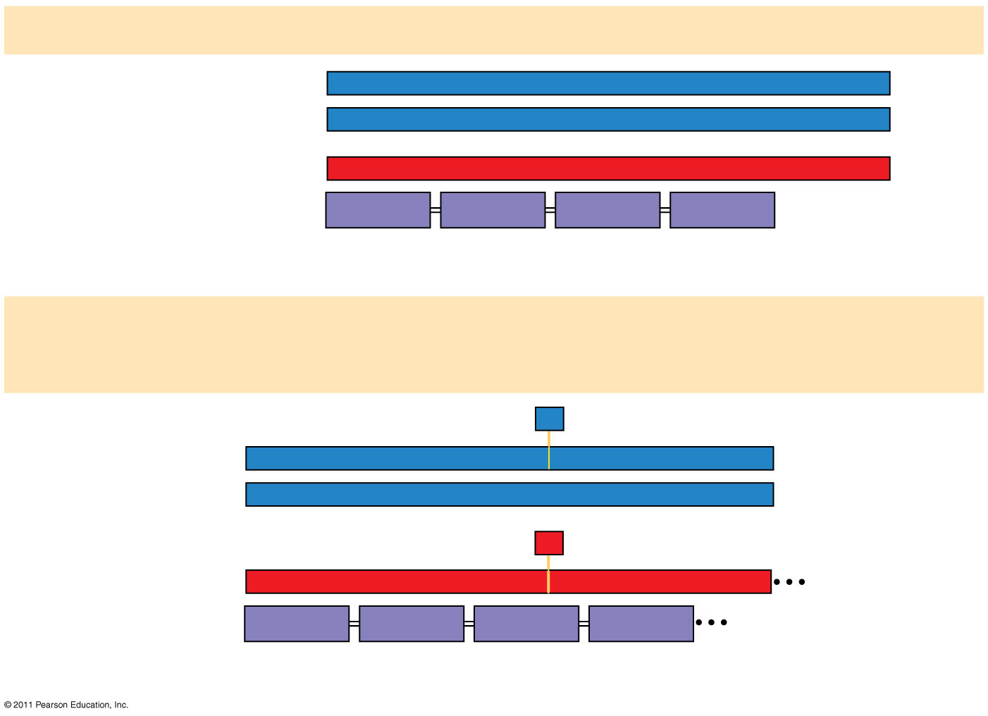
Figure 17.24e
Wild type
DNA template strand
3′
T
A
C
T
T
C
A
A
A
C
C
G
A
T
T
5′
5′
A
T
G
A
A
G
T
T
T
G
G
C
T
A
A
3′
mRNA5′
A
U
G
A
A
G
U
U
U
G
G
C
U
A
A
3′
Protein
Met
Lys
Phe
Gly
Stop
Amino end
Carboxyl end
(b) Nucleotide-pair insertion or deletion: frameshift causing
extensive missense
A
missing
3′
T
A
C
T
T
C
A
A
C
C
G
A
T
T
5′
5′
A
T
G
A
A
G
T
T
G
G
C
T
A
A
3′
U
missing
5′
A
U
G
A
A
G
U
U
G
G
C
U
A
A
3′
Met
Lys
Leu
Ala
1 nucleotide-pair deletion
Notes:
Figure 17.24 Types of small-scale mutations that affect mRNA sequence.

Slide 107
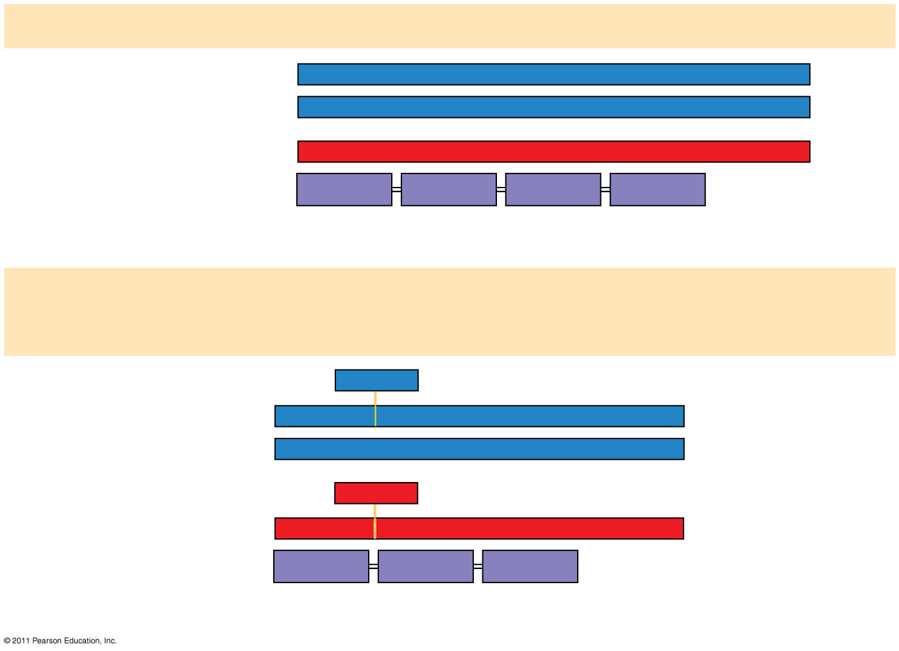
Figure 17.24f
Wild type
DNA template strand
3′
T
A
C
T
T
C
A
A
A
C
C
G
A
T
T
5′
5′
A
T
G
A
A
G
T
T
T
G
G
C
T
A
A
3′
mRNA5′
A
U
G
A
A
G
U
U
U
G
G
C
U
A
A
3′
Protein
Met
Lys
Phe
Gly
Stop
Amino end
Carboxyl end
(b) Nucleotide-pair insertion or deletion: no frameshift, but one
amino acid missing
T
T
C
missing
3′
T
A
C
A
A
A
C
C
G
A
T
T
5′
5′
A
T
G
T
T
T
G
G
C
T
A
A
3′
A
A
G
missing
5′
A
U
G
U
U
U
G
G
C
U
A
A
3′
Met
Phe
Gly
Stop
3 nucleotide-pair deletion
Notes:
Figure 17.24 Types of small-scale mutations that affect mRNA sequence.

Slide 108
Mutagens
Spontaneous mutations can occur during DNA replication, recombination, or repair
Mutagens are physical or chemical agents that can cause mutations
© 2011 Pearson Education, Inc.
Notes:
108

Slide 109
Concept 17.6: While gene expression differs among the domains of life, the concept of a gene is universal
Archaea are prokaryotes, but share many features of gene expression with eukaryotes
© 2011 Pearson Education, Inc.
Notes:
109

Slide 110
Comparing Gene Expression in Bacteria, Archaea, and Eukarya
Bacteria and eukarya differ in their RNA polymerases, termination of transcription, and ribosomes; archaea tend to resemble eukarya in these respects
Bacteria can simultaneously transcribe and translate the same gene
In eukarya, transcription and translation are separated by the nuclear envelope
In archaea, transcription and translation are likely coupled
© 2011 Pearson Education, Inc.
Notes:
110

Slide 111
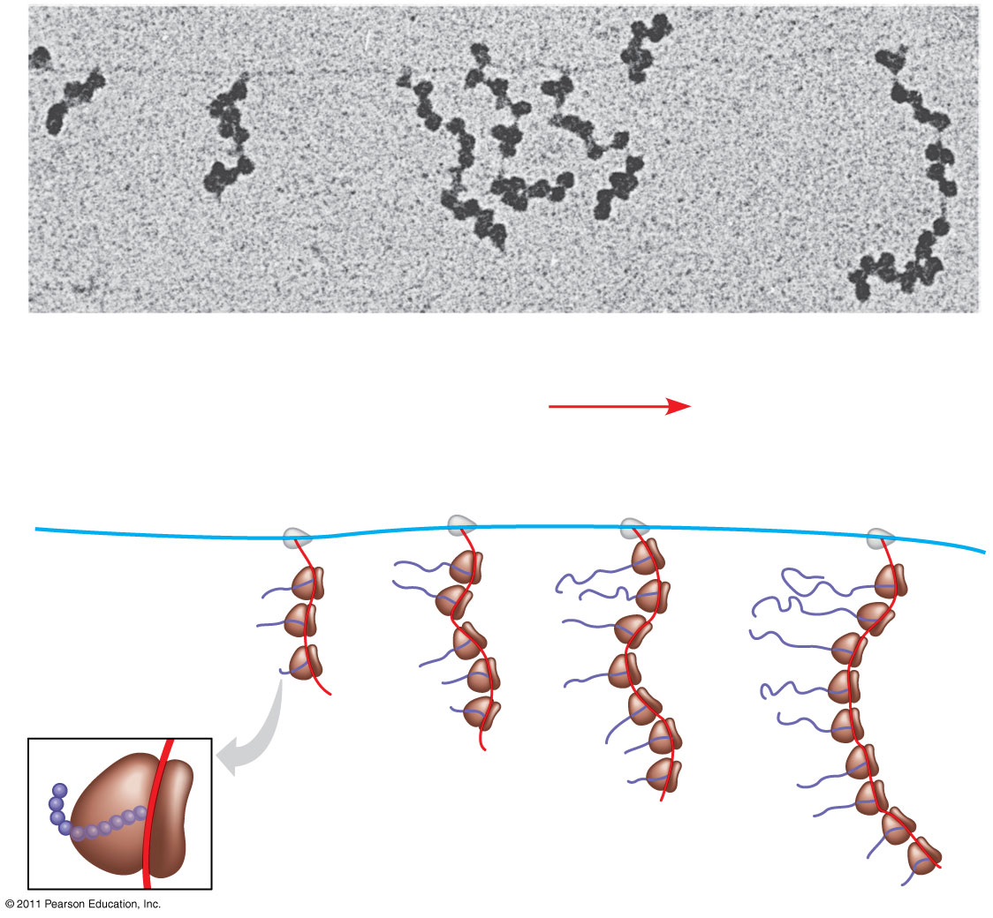
Figure 17.25
RNA polymerase
DNA
mRNA
Polyribosome
Direction of transcription
0.25 μm
RNA polymerase
DNA
Polyribosome
Polypeptide (amino end)
Ribosome
mRNA
(5′ end)
Notes:
Figure 17.25 Coupled transcription and translation in bacteria.

Slide 112
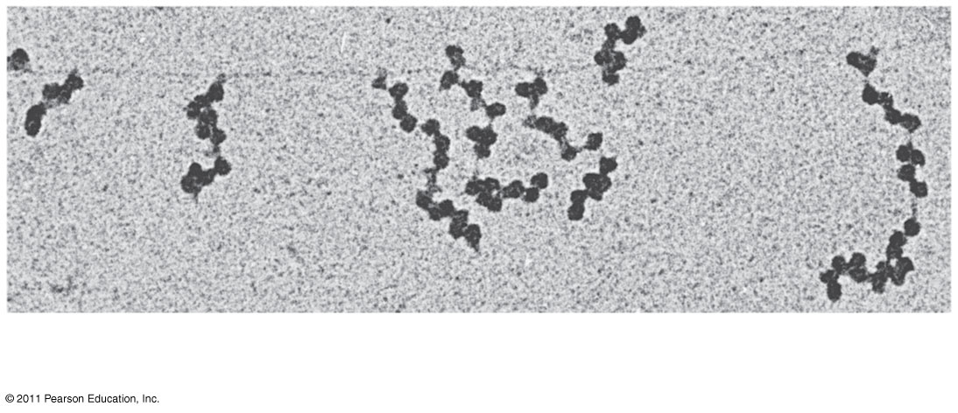
Figure 17.25a
RNA polymerase
DNA
mRNA
Polyribosome
0.25 μm
Notes:
Figure 17.25 Coupled transcription and translation in bacteria.

Slide 113
What Is a Gene? Revisiting the Question
The idea of the gene has evolved through the history of genetics
We have considered a gene as
A discrete unit of inheritance
A region of specific nucleotide sequence in a chromosome
A DNA sequence that codes for a specific polypeptide chain
© 2011 Pearson Education, Inc.
Notes:
113

Slide 114
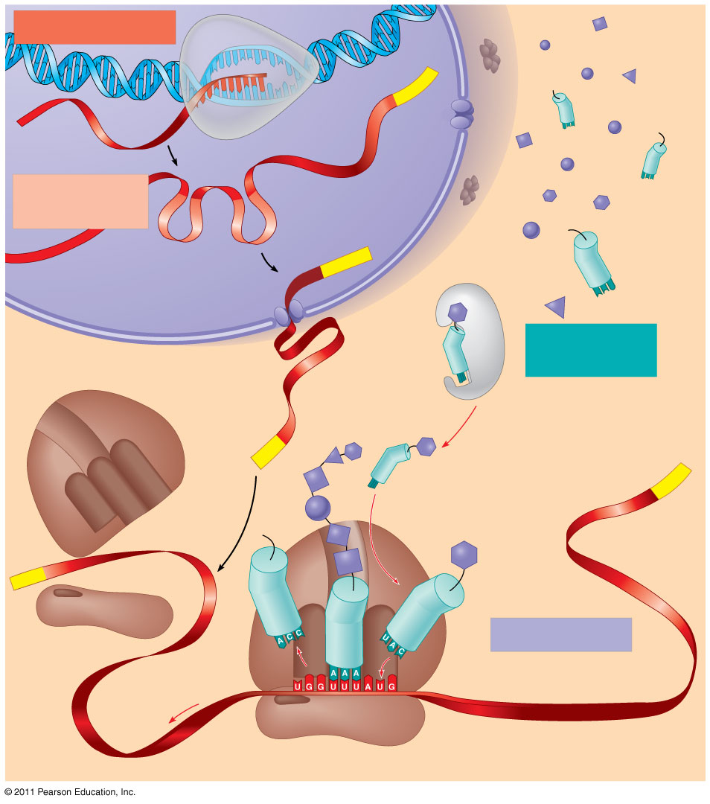
Figure 17.26
TRANSCRIPTION
DNA
3′
Poly-A
RNA
5′
RNA
polymerase
transcript
Exon
RNA
RNA transcript
PROCESSING
(pre-mRNA)
Intron
Aminoacyl-
Poly-A
tRNA synthetase
NUCLEUS
Amino acid
tRNA
AMINO ACID
CYTOPLASM
ACTIVATION
mRNA
Growing polypeptide
5′ Cap
3′
A
Aminoacyl (charged) tRNA
Poly-A
P
E
Ribosomal
subunits
5′ Cap
TRANSLATION
E
A
Anticodon
Codon
Ribosome
Notes:
Figure 17.26 A summary of transcription and translation in a eukaryotic cell.

Slide 115
In summary, a gene can be defined as a region of DNA that can be expressed to produce a final functional product, either a polypeptide or an RNA molecule
© 2011 Pearson Education, Inc.
© 2011 Pearson Education, Inc.
Notes:
115

Slide 116
Figure 17.UN02
Transcription unit
Promoter
5′
3′
3′
3′
5′
5′
Template strand of DNA
RNA polymerase
RNA transcript
Notes:
Figure 17.UN02 Summary figure, Concept 17.2

Slide 117
Figure 17.UN03
Pre-mRNA
5′ Cap
Poly-A tail
mRNA
Notes:
Figure 17.UN03 Summary figure, Concept 17.3

Slide 118
Figure 17.UN04
Polypeptide
tRNA
Amino acid
E
A
Anti- codon
Codon
mRNA
Ribosome
Notes:
Figure 17.UN04 Summary figure, Concept 17.4

Slide 119
Figure 17.UN05
Type of RNA
Functions
Messenger RNA (mRNA)
Transfer RNA (tRNA)
Plays catalytic (ribozyme) roles and structural roles in ribosomes
Primary transcript
Small nuclear RNA (snRNA)
Notes:
Figure 17.UN05 Test Your Understanding, question 8

Slide 120
Figure 17.UN06a
Notes:
Figure 17.UN06a Appendix A: answer to Concept Check 17.1, question 3

Slide 121
Figure 17.UN06b
Notes:
Figure 17.UN06b Appendix A: answer to Concept Check 17.1, question 3

Slide 122
Figure 17.UN06c
Notes:
Figure 17.UN06c Appendix A: answer to Concept Check 17.1, question 3

Slide 123
Figure 17.UN06d
Notes:
Figure 17.UN06d Appendix A: answer to Concept Check 17.1, question 3

Slide 124
Figure 17.UN10
Notes:
Figure 17.UN10 Appendix A: answer to Test Your Understanding, question 8

