Slide 1
Chapter 18
Regulation of Gene Expression

Slide 2
Overview: Conducting the Genetic Orchestra
Prokaryotes and eukaryotes alter gene expression in response to their changing environment
In multicellular eukaryotes, gene expression regulates development and is responsible for differences in cell types
RNA molecules play many roles in regulating gene expression in eukaryotes
© 2011 Pearson Education, Inc.

Slide 3
Concept 18.2: Eukaryotic gene expression is regulated at many stages
All organisms must regulate which genes are expressed at any given time
In multicellular organisms regulation of gene expression is essential for cell specialization
© 2011 Pearson Education, Inc.

Slide 4
Differential Gene Expression
Almost all the cells in an organism are genetically identical
Differences between cell types result from differential gene expression, the expression of different genes by cells with the same genome
Abnormalities in gene expression can lead to diseases including cancer
Gene expression is regulated at many stages
© 2011 Pearson Education, Inc.

Slide 5
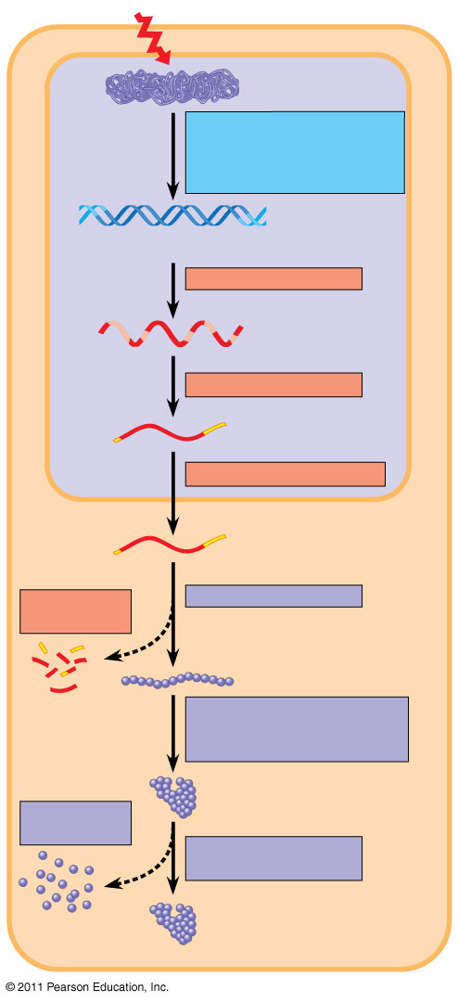
Figure 18.6
Signal
NUCLEUS
Chromatin
Chromatin modification: DNA unpacking involving histone acetylation and DNA demethylation
DNA
Gene available for transcription
Gene
Transcription
RNA
Exon
Primary transcript
Intron
RNA processing
Tail
Cap
mRNA in nucleus
Transport to cytoplasm
CYTOPLASM
mRNA in cytoplasm
Degradation of mRNA
Translation
Polypeptide
Protein processing, such as cleavage and chemical modification
Degradation of protein
Active protein
Transport to cellular destination
Cellular function (such as enzymatic activity, structural support)
Notes:
Figure 18.6 Stages in gene expression that can be regulated in eukaryotic cells.

Slide 6
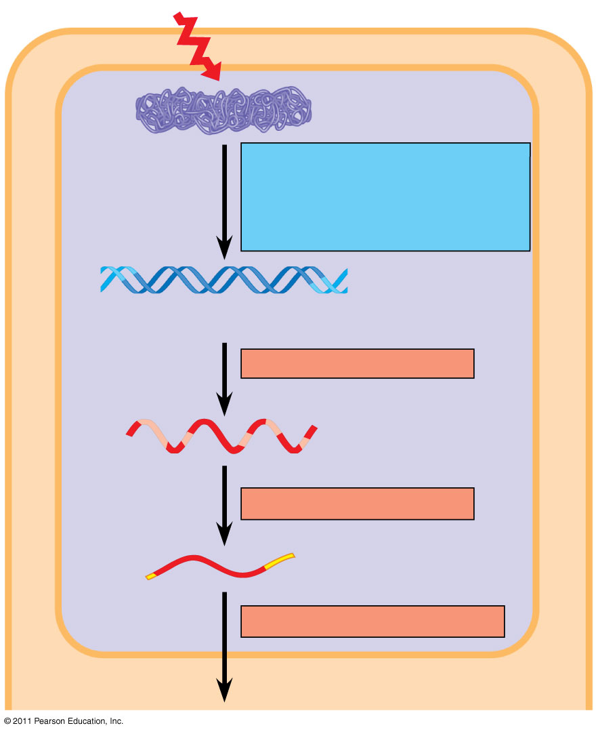
Figure 18.6a
Signal
NUCLEUS
Chromatin
Chromatin modification: DNA unpacking involving histone acetylation and DNA demethylation
DNA
Gene available for transcription
Gene
Transcription
RNA
Exon
Primary transcript
Intron
RNA processing
Tail
Cap
mRNA in nucleus
Transport to cytoplasm
CYTOPLASM
Notes:
Figure 18.6 Stages in gene expression that can be regulated in eukaryotic cells.

Slide 7
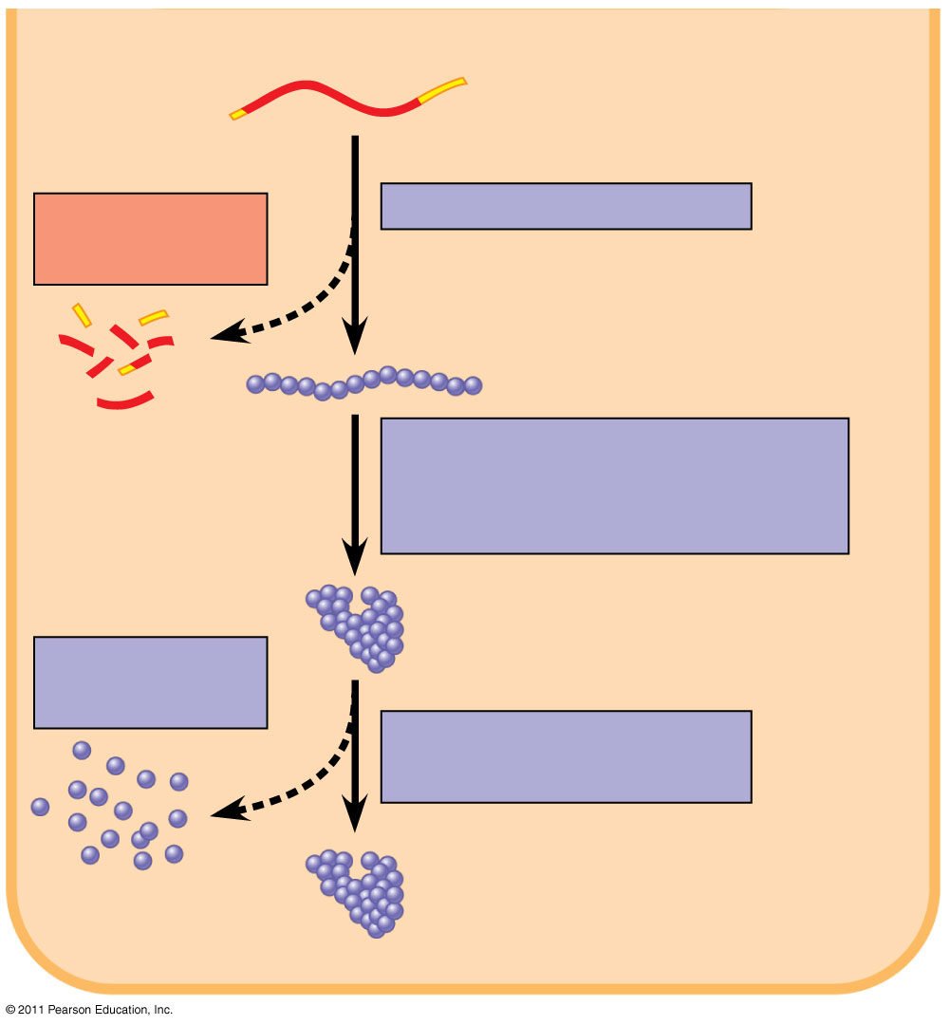
Figure 18.6b
CYTOPLASM
mRNA in cytoplasm
Degradation of mRNA
Translation
Polypeptide
Protein processing, such as cleavage and chemical modification
Active protein
Degradation of protein
Transport to cellular destination
Cellular function (such as enzymatic activity, structural support)
Notes:
Figure 18.6 Stages in gene expression that can be regulated in eukaryotic cells.

Slide 8
Regulation of Chromatin Structure
Genes within highly packed heterochromatin are usually not expressed
Chemical modifications to histones and DNA of chromatin influence both chromatin structure and gene expression
© 2011 Pearson Education, Inc.

Slide 9
Histone Modifications
In histone acetylation, acetyl groups are attached to positively charged lysines in histone tails
This loosens chromatin structure, thereby promoting the initiation of transcription
The addition of methyl groups (methylation) can condense chromatin; the addition of phosphate groups (phosphorylation) next to a methylated amino acid can loosen chromatin
© 2011 Pearson Education, Inc.

Slide 10
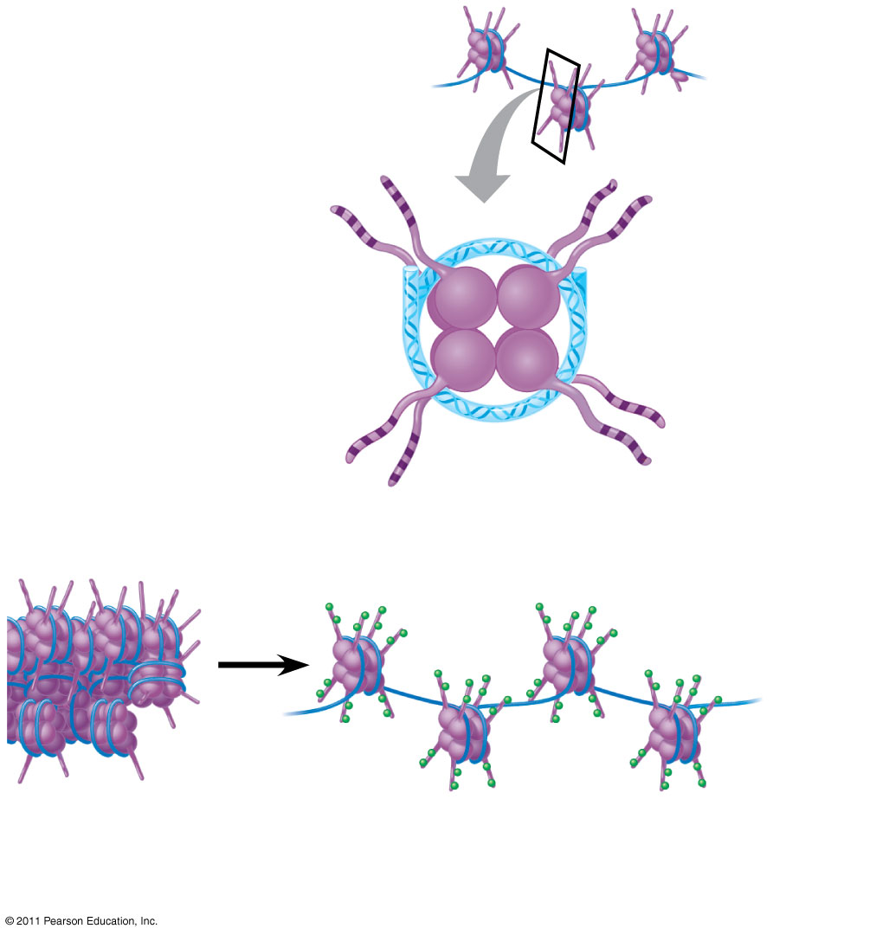
Figure 18.7
Histone tails
DNA double helix
Amino acids available for chemical modification
Nucleosome (end view)
(a) Histone tails protrude outward from a nucleosome
Unacetylated histones
Acetylated histones
(b)
Acetylation of histone tails promotes loose chromatin structure that permits transcription
Notes:
Figure 18.7 A simple model of histone tails and the effect of histone acetylation.

Slide 11
The histone code hypothesis proposes that specific combinations of modifications, as well as the order in which they occur, help determine chromatin configuration and influence transcription
© 2011 Pearson Education, Inc.

Slide 12
DNA Methylation
DNA methylation, the addition of methyl groups to certain bases in DNA, is associated with reduced transcription in some species
DNA methylation can cause long-term inactivation of genes in cellular differentiation
In genomic imprinting, methylation regulates expression of either the maternal or paternal alleles of certain genes at the start of development
© 2011 Pearson Education, Inc.

Slide 13
Epigenetic Inheritance
Although the chromatin modifications just discussed do not alter DNA sequence, they may be passed to future generations of cells
The inheritance of traits transmitted by mechanisms not directly involving the nucleotide sequence is called epigenetic inheritance
© 2011 Pearson Education, Inc.

Slide 14
Regulation of Transcription Initiation
Chromatin-modifying enzymes provide initial control of gene expression by making a region of DNA either more or less able to bind the transcription machinery
© 2011 Pearson Education, Inc.

Slide 15
Organization of a Typical Eukaryotic Gene
Associated with most eukaryotic genes are multiple control elements, segments of noncoding DNA that serve as binding sites for transcription factors that help regulate transcription
Control elements and the transcription factors they bind are critical to the precise regulation of gene expression in different cell types
© 2011 Pearson Education, Inc.

Slide 16
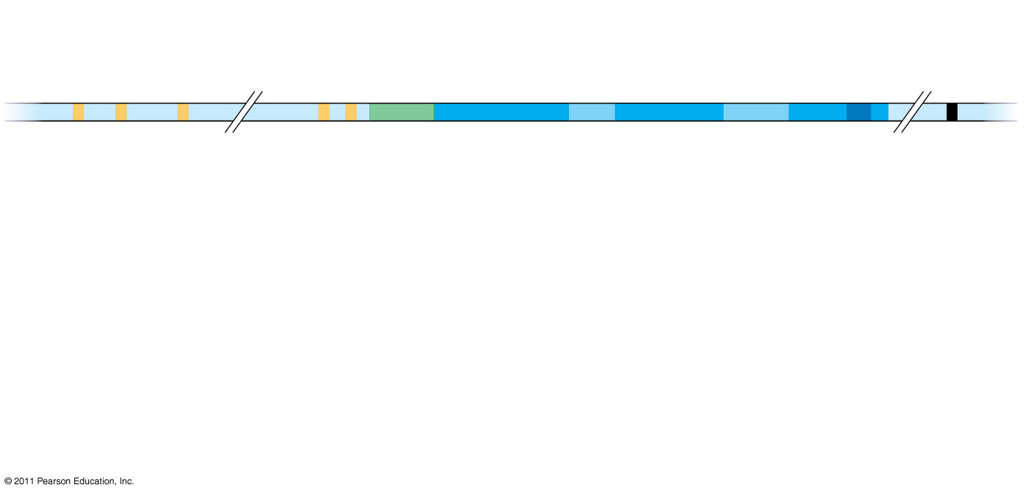
Figure 18.8-1
Enhancer (distal control elements)
Proximal control elements
Poly-A signal sequence
Transcription start site
Transcription termination region
DNA
Exon
Intron
Exon
Intron
Exon
Upstream
Promoter
Downstream
Notes:
Figure 18.8 A eukaryotic gene and its transcript.

Slide 17
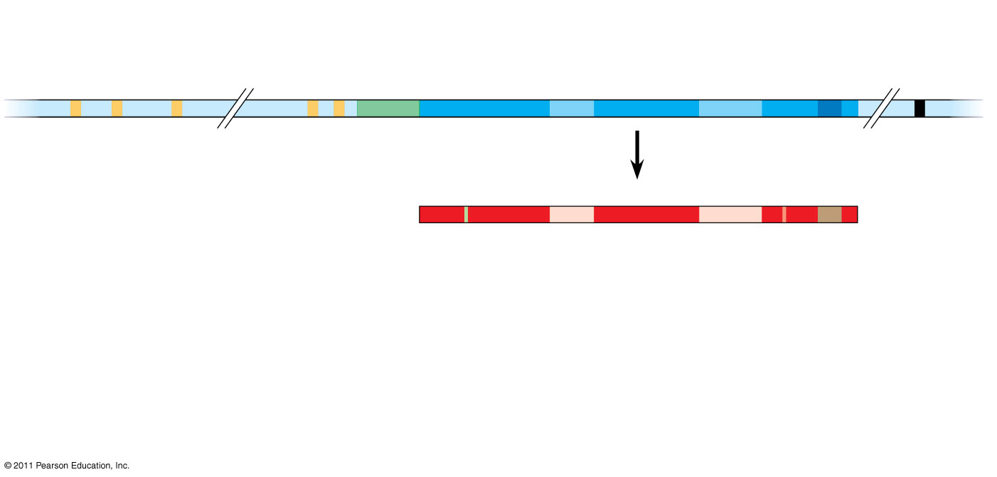
Figure 18.8-2
Enhancer (distal control elements)
Proximal control elements
Poly-A signal sequence
Transcription start site
Transcription termination region
DNA
Exon
Intron
Exon
Intron
Exon
Upstream
Promoter
Poly-A signal
Downstream
Transcription
Primary RNA transcript (pre-mRNA)
Exon
Intron
Exon
Intron
Exon
Cleaved 3′ end of primary transcript
5′
Notes:
Figure 18.8 A eukaryotic gene and its transcript.

Slide 18
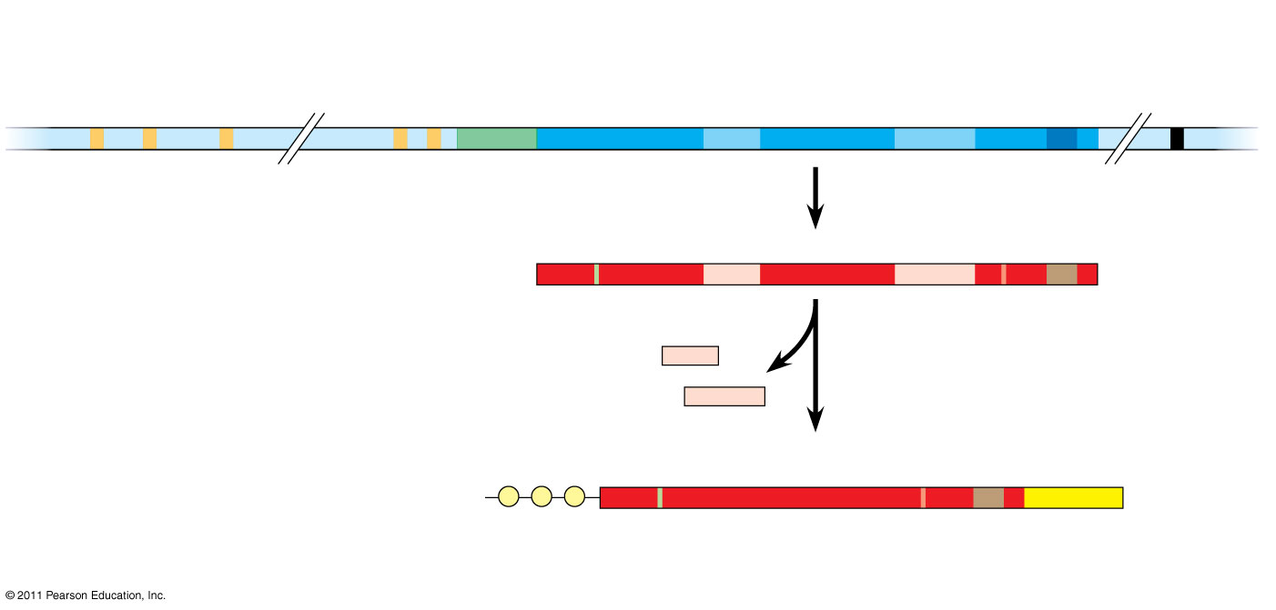
Figure 18.8-3
Enhancer (distal control elements)
Proximal control elements
Poly-A signal sequence
Transcription start site
Transcription termination region
DNA
Exon
Intron
Exon
Intron
Exon
Upstream
Promoter
Poly-A signal
Downstream
Transcription
Primary RNA transcript (pre-mRNA)
Exon
Intron
Exon
Intron
Exon
Cleaved 3′ end of primary transcript
5′
RNA processing
Intron RNA
Coding segment
mRNA
G
P
P
P
AAA ⋅⋅⋅ AAA
3′
5′ UTR
Start codon
Stop codon
Poly-A tail
5′ Cap
3′ UTR
Notes:
Figure 18.8 A eukaryotic gene and its transcript.

Slide 19
The Roles of Transcription Factors
To initiate transcription, eukaryotic RNA polymerase requires the assistance of proteins called transcription factors
General transcription factors are essential for the transcription of all protein-coding genes
In eukaryotes, high levels of transcription of particular genes depend on control elements interacting with specific transcription factors
© 2011 Pearson Education, Inc.

Slide 20
Enhancers and Specific Transcription Factors
Proximal control elements are located close to the promoter
Distal control elements, groupings of which are called enhancers, may be far away from a gene or even located in an intron
© 2011 Pearson Education, Inc.

Slide 21
An activator is a protein that binds to an enhancer and stimulates transcription of a gene
Activators have two domains, one that binds DNA and a second that activates transcription
Bound activators facilitate a sequence of protein-protein interactions that result in transcription of a given gene
© 2011 Pearson Education, Inc.

Slide 22
Some transcription factors function as repressors, inhibiting expression of a particular gene by a variety of methods
Some activators and repressors act indirectly by influencing chromatin structure to promote or silence transcription
© 2011 Pearson Education, Inc.

Slide 23
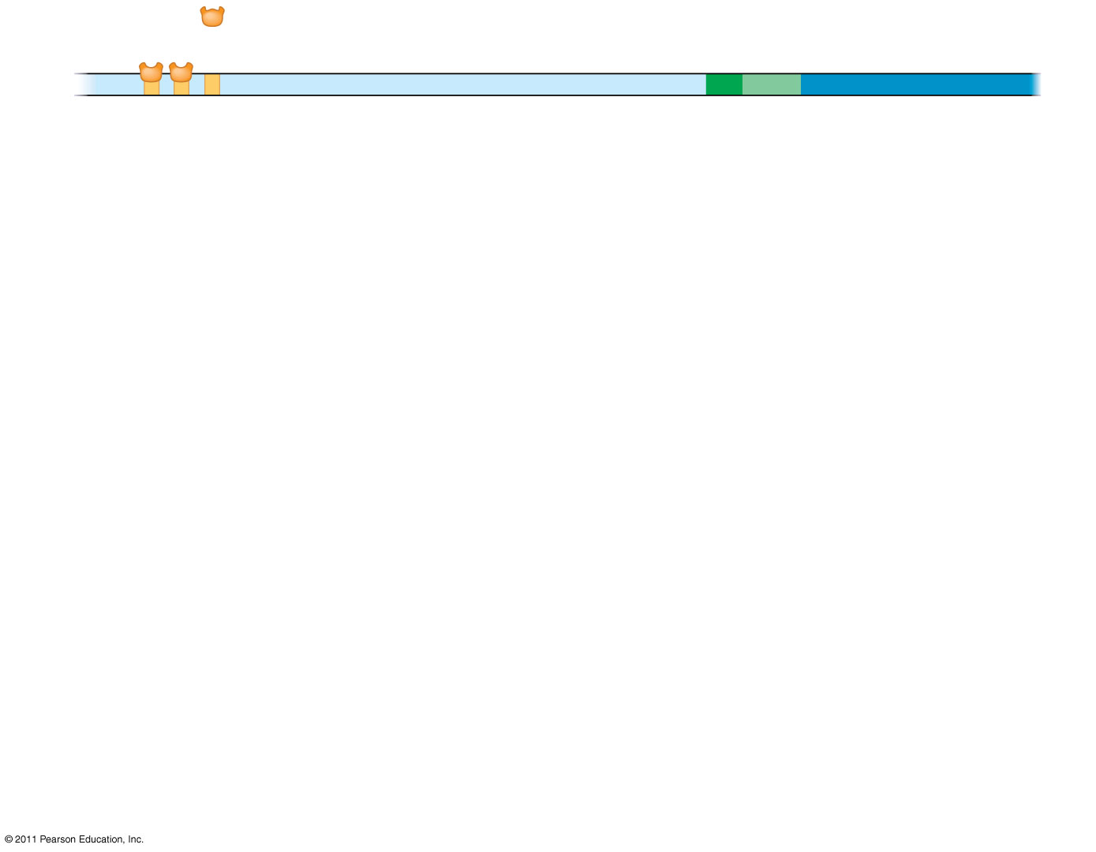
Figure 18.10-1
Activators
Promoter
Gene
DNA
Distal control element
TATA box
Enhancer
Notes:
Figure 18.10 A model for the action of enhancers and transcription activators.

Slide 24
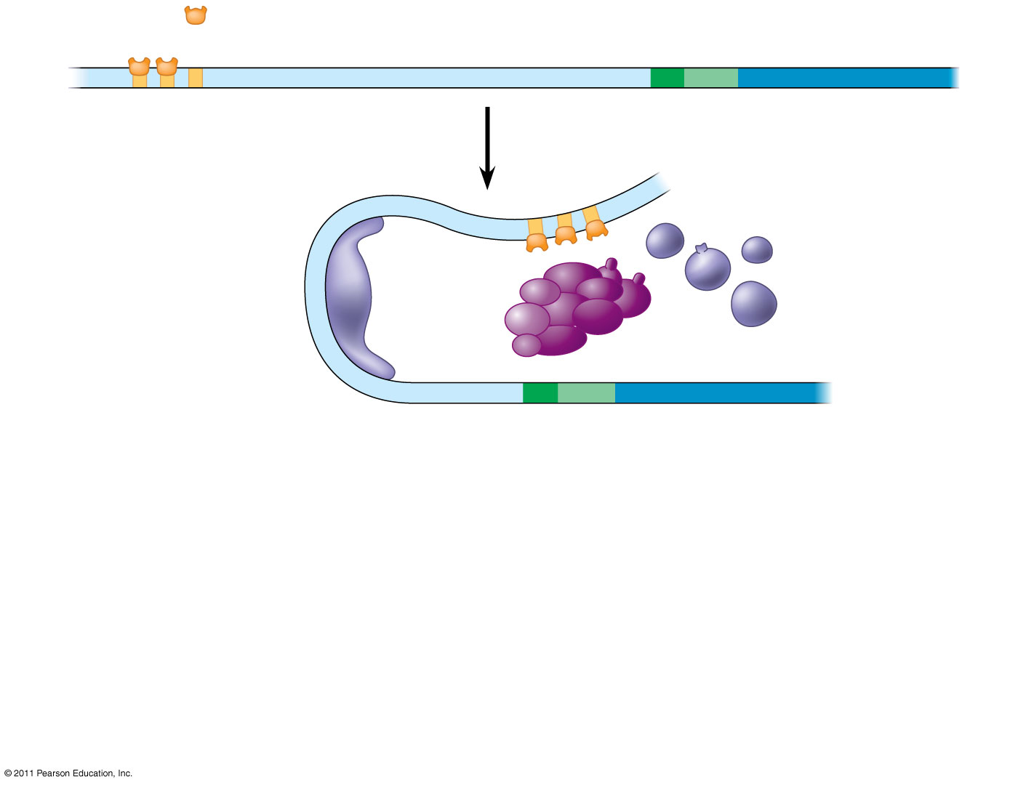
Figure 18.10-2
Activators
Promoter
Gene
DNA
Distal control element
TATA box
Enhancer
General transcription factors
DNA- bending protein
Group of mediator proteins
Notes:
Figure 18.10 A model for the action of enhancers and transcription activators.

Slide 25
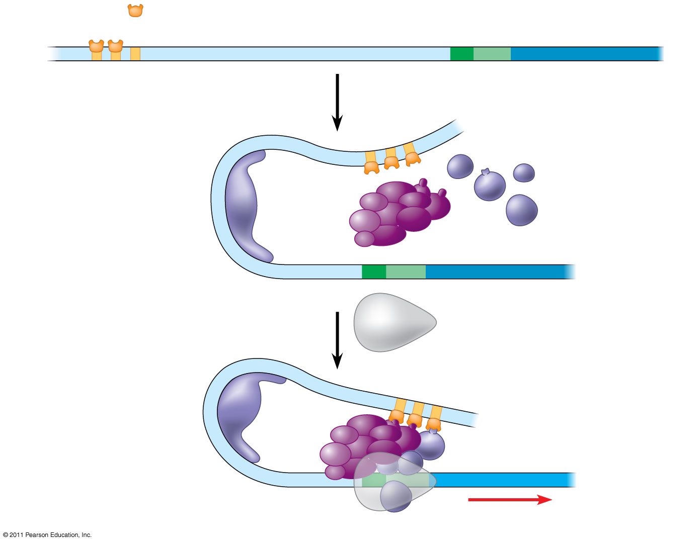
Figure 18.10-3
Activators
Promoter
Gene
DNA
Distal control element
TATA box
Enhancer
General transcription factors
DNA- bending protein
Group of mediator proteins
RNA polymerase II
RNA polymerase II
Transcription initiation complex
RNA synthesis
Notes:
Figure 18.10 A model for the action of enhancers and transcription activators.

Slide 26
Combinatorial Control of Gene Activation
A particular combination of control elements can activate transcription only when the appropriate activator proteins are present
© 2011 Pearson Education, Inc.

Slide 27
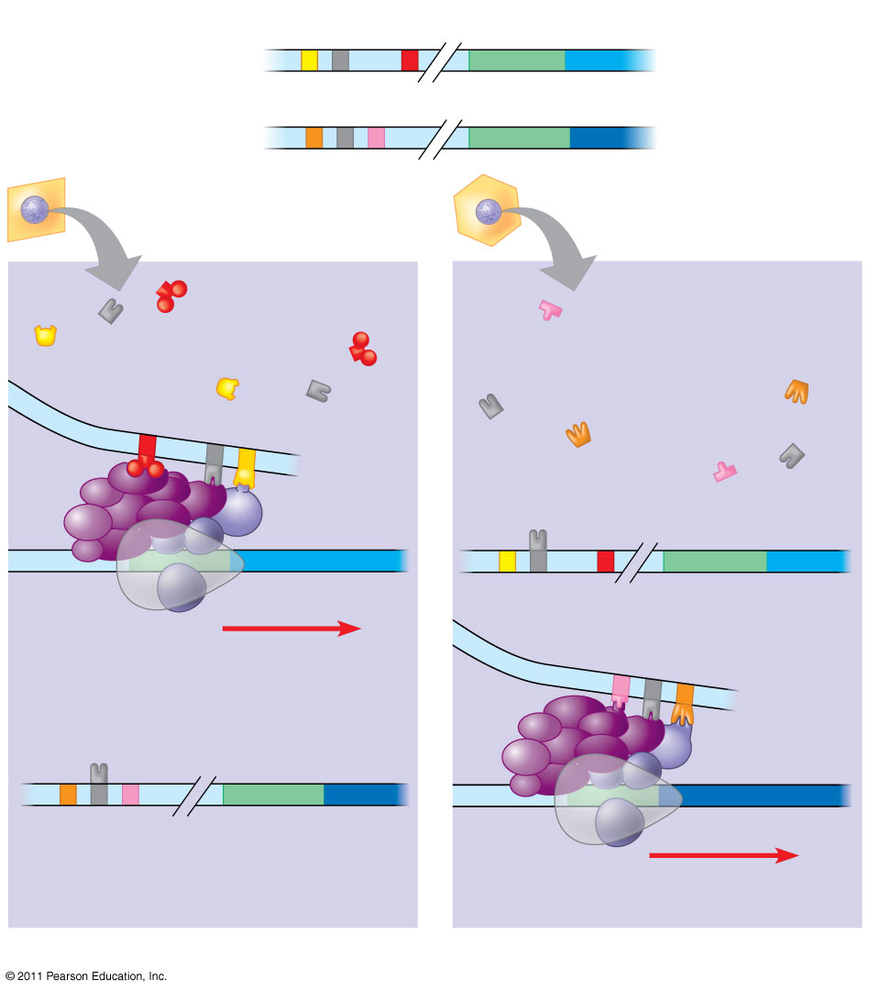
Figure 18.11
Enhancer
Promoter
Control elements
Albumin gene
Crystallin gene
LIVER CELL NUCLEUS
LENS CELL NUCLEUS
Available activators
Available activators
Albumin gene not expressed
Albumin gene expressed
Crystallin gene not expressed
Crystallin gene expressed
(a) Liver cell
(b) Lens cell
Notes:
Figure 18.11 Cell type–specific transcription.

Slide 28
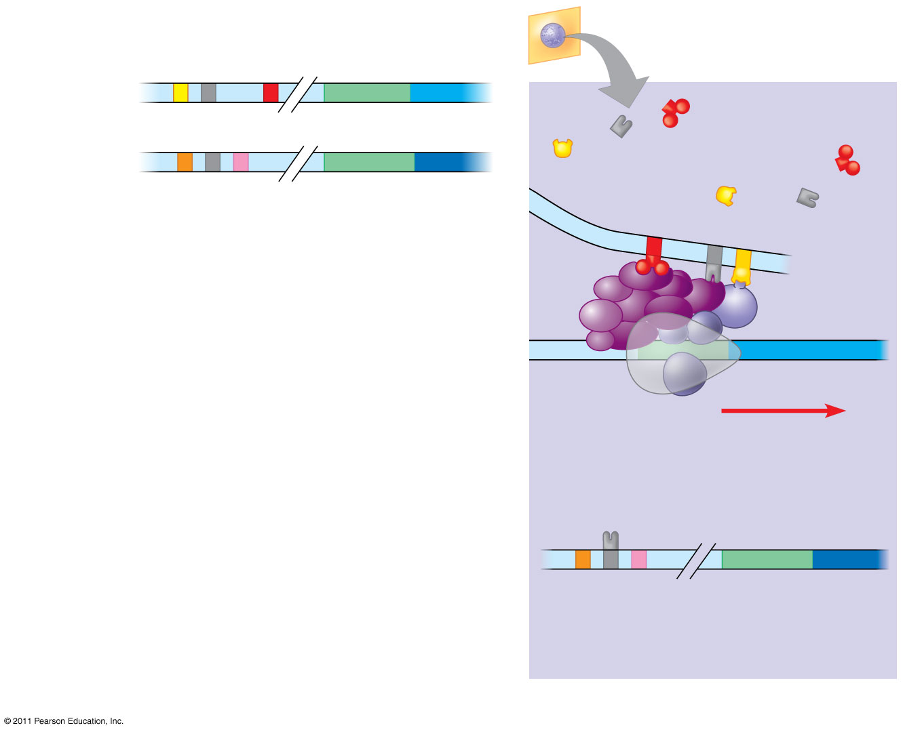
Figure 18.11a
Enhancer
Promoter
Control elements
LIVER CELL NUCLEUS
Albumin gene
Available activators
Crystallin gene
Albumin gene expressed
Crystallin gene not expressed
(a) Liver cell
Notes:
Figure 18.11 Cell type–specific transcription.

Slide 29
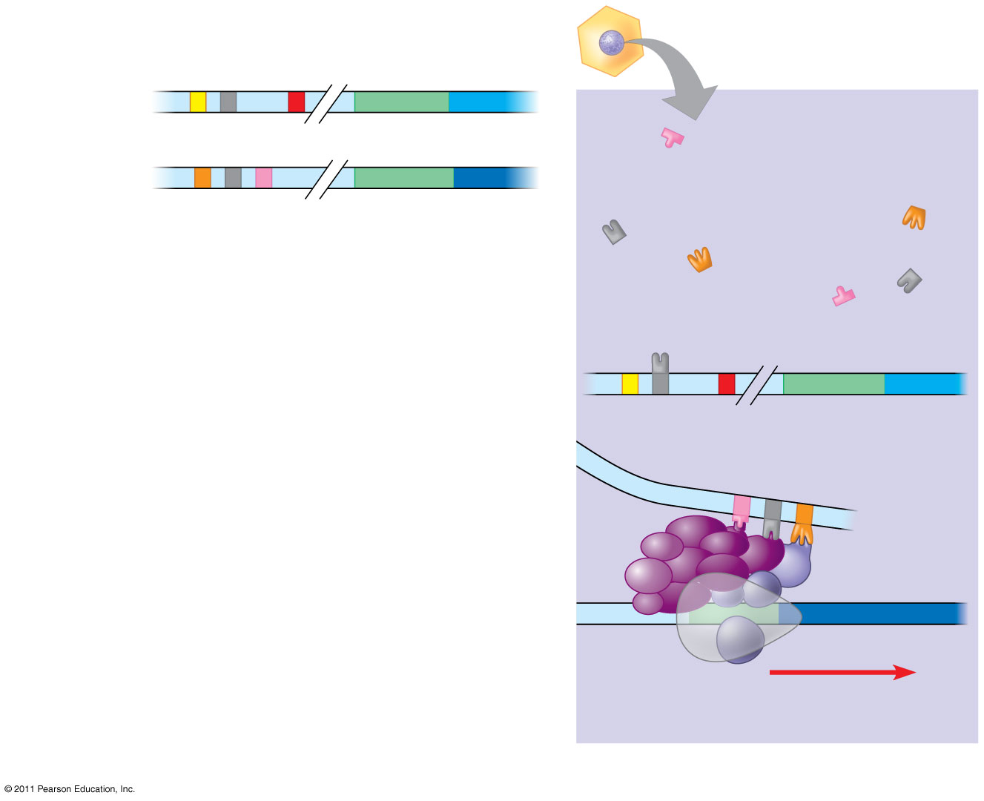
Figure 18.11b
Enhancer
Promoter
Control elements
LENS CELL NUCLEUS
Albumin gene
Available activators
Crystallin gene
Albumin gene not expressed
Crystallin gene expressed
(b) Lens cell
Notes:
Figure 18.11 Cell type–specific transcription.

Slide 30
Mechanisms of Post-Transcriptional Regulation
Transcription alone does not account for gene expression
Regulatory mechanisms can operate at various stages after transcription
Such mechanisms allow a cell to fine-tune gene expression rapidly in response to environmental changes
© 2011 Pearson Education, Inc.

Slide 31
RNA Processing
In alternative RNA splicing, different mRNA molecules are produced from the same primary transcript, depending on which RNA segments are treated as exons and which as introns
© 2011 Pearson Education, Inc.

Slide 32
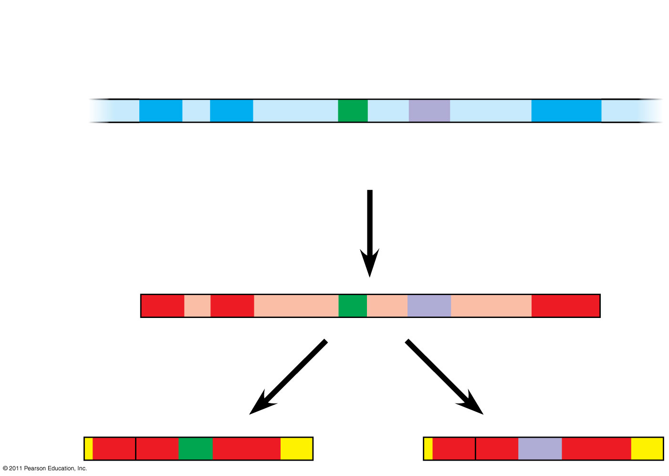
Figure 18.13
Exons
DNA
1
2
3
4
5
Troponin T gene
Primary RNA transcript
1
2
3
4
5
RNA splicing
mRNA
1
2
3
5
or
1
2
4
5
Notes:
Figure 18.13 Alternative RNA splicing of the troponin T gene.

Slide 33
mRNA Degradation
The life span of mRNA molecules in the cytoplasm is a key to determining protein synthesis
Eukaryotic mRNA is more long lived than prokaryotic mRNA
Nucleotide sequences that influence the lifespan of mRNA in eukaryotes reside in the untranslated region (UTR) at the 3′ end of the molecule
© 2011 Pearson Education, Inc.

Slide 34
Initiation of Translation
The initiation of translation of selected mRNAs can be blocked by regulatory proteins that bind to sequences or structures of the mRNA
Alternatively, translation of all mRNAs in a cell may be regulated simultaneously
For example, translation initiation factors are simultaneously activated in an egg following fertilization
© 2011 Pearson Education, Inc.

Slide 35
Protein Processing and Degradation
After translation, various types of protein processing, including cleavage and the addition of chemical groups, are subject to control
Proteasomes are giant protein complexes that bind protein molecules and degrade them
© 2011 Pearson Education, Inc.

Slide 36
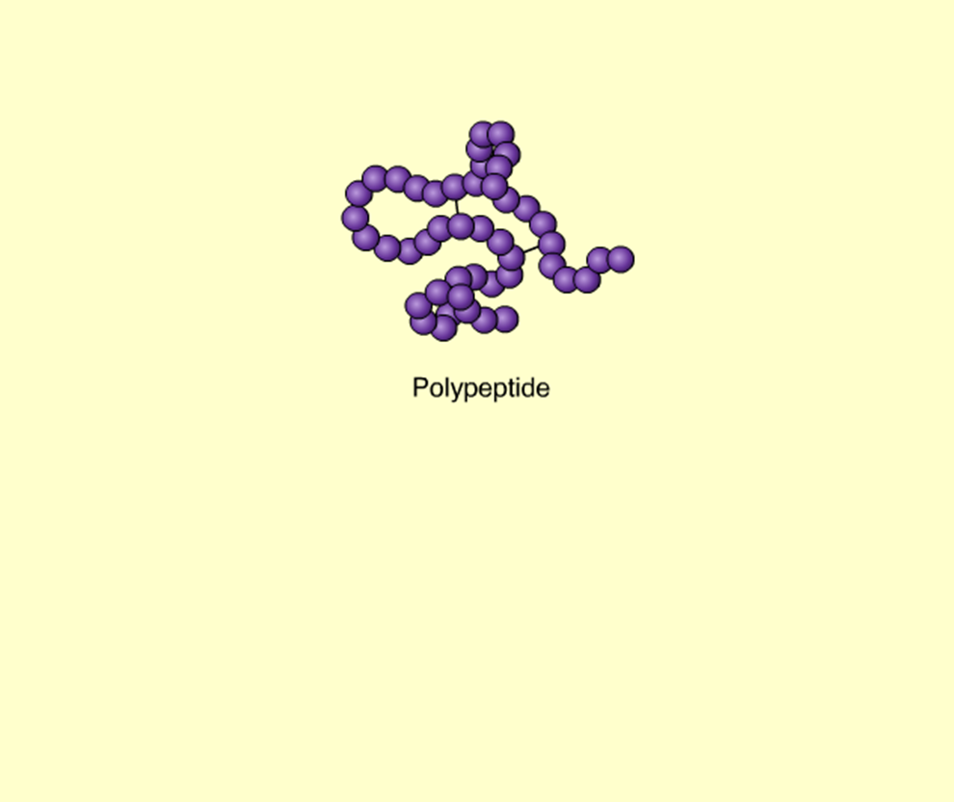
Animation: Protein Processing
Right-click slide / select “Play”
© 2011 Pearson Education, Inc.

Slide 37
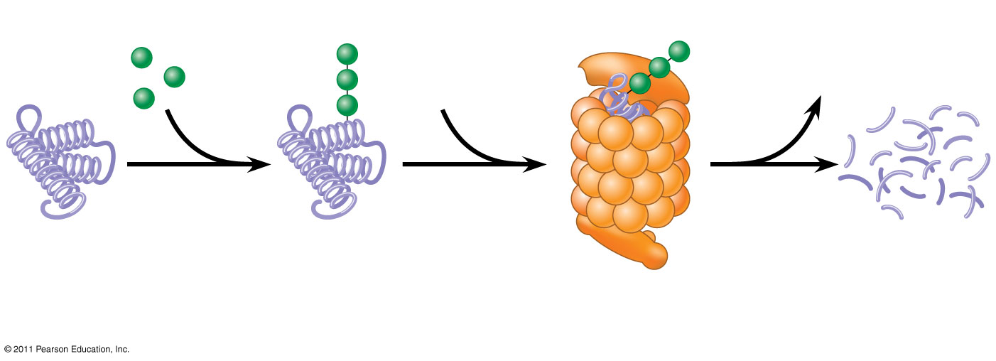
Figure 18.14
Proteasome and ubiquitin to be recycled
Ubiquitin
Proteasome
Protein to be degraded
Ubiquitinated protein
Protein fragments (peptides)
Protein entering a proteasome
Notes:
Figure 18.14 Degradation of a protein by a proteasome.

Slide 38
Concept 18.3: Noncoding RNAs play multiple roles in controlling gene expression
Only a small fraction of DNA codes for proteins, and a very small fraction of the non-protein-coding DNA consists of genes for RNA such as rRNA and tRNA
A significant amount of the genome may be transcribed into noncoding RNAs (ncRNAs)
Noncoding RNAs regulate gene expression at two points: mRNA translation and chromatin configuration
© 2011 Pearson Education, Inc.

Slide 39
Effects on mRNAs by MicroRNAs and Small Interfering RNAs
MicroRNAs (miRNAs) are small single-stranded RNA molecules that can bind to mRNA
These can degrade mRNA or block its translation
© 2011 Pearson Education, Inc.

Slide 40
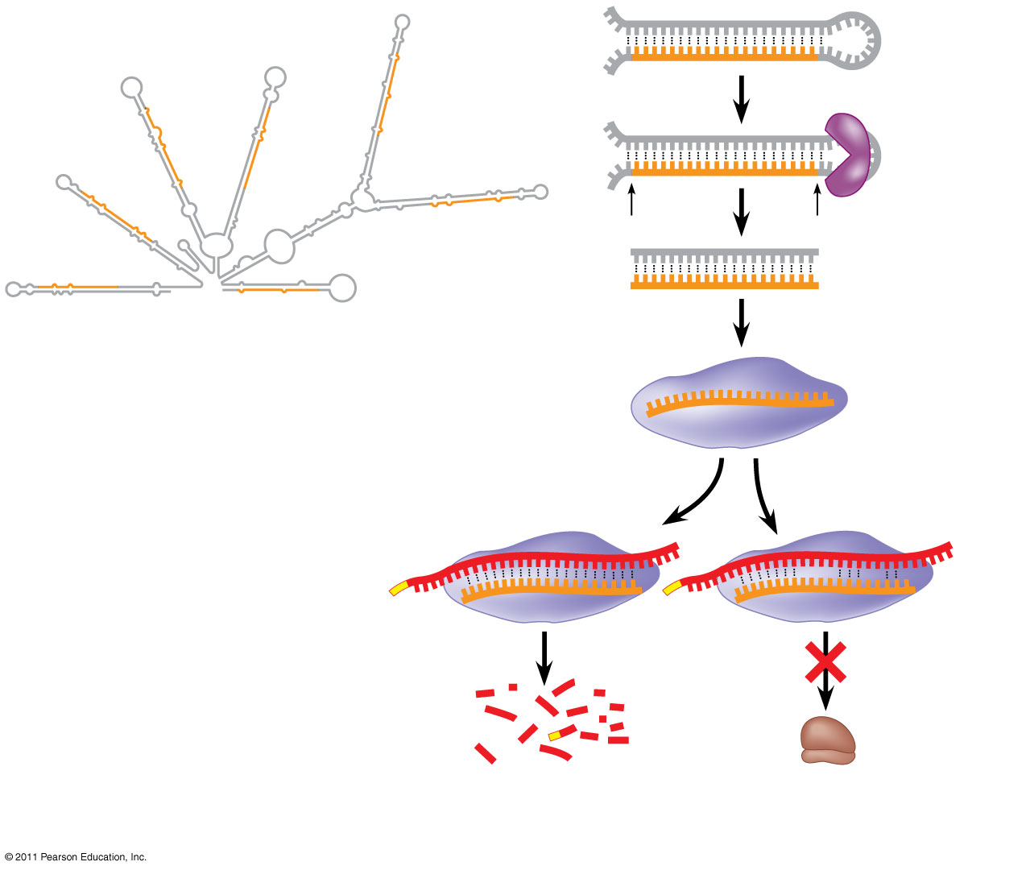
Figure 18.15
Hairpin
miRNA
Hydrogen bond
Dicer
5′
3′
(a) Primary miRNA transcript
miRNA
miRNA- protein complex
mRNA degraded
Translation blocked
(b) Generation and function of miRNAs
Notes:
Figure 18.15 Regulation of gene expression by miRNAs.

Slide 41
The phenomenon of inhibition of gene expression by RNA molecules is called RNA interference (RNAi)
RNAi is caused by small interfering RNAs (siRNAs)
siRNAs and miRNAs are similar but form from different RNA precursors
© 2011 Pearson Education, Inc.

Slide 42
Concept 18.4: A program of differential gene expression leads to the different cell types in a multicellular organism
During embryonic development, a fertilized egg gives rise to many different cell types
Cell types are organized successively into tissues, organs, organ systems, and the whole organism
Gene expression orchestrates the developmental programs of animals
© 2011 Pearson Education, Inc.

Slide 43
A Genetic Program for Embryonic Development
The transformation from zygote to adult results from cell division, cell differentiation, and morphogenesis
© 2011 Pearson Education, Inc.

Slide 44
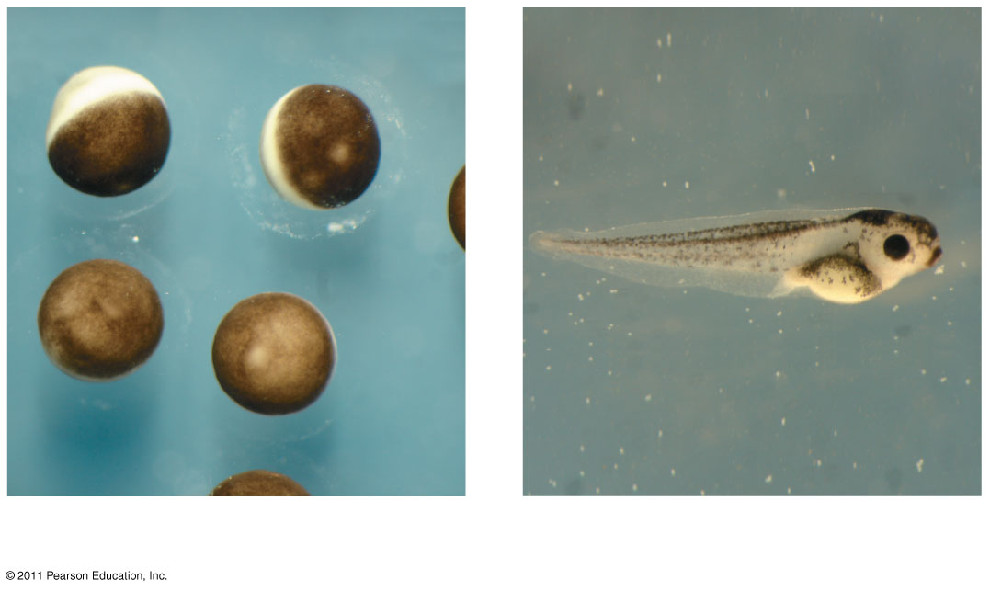
Figure 18.16
1 mm
2 mm
(a) Fertilized eggs of a frog
(b) Newly hatched tadpole
Notes:
Figure 18.16 From fertilized egg to animal: What a difference four days makes.

Slide 45
Cell differentiation is the process by which cells become specialized in structure and function
The physical processes that give an organism its shape constitute morphogenesis
Differential gene expression results from genes being regulated differently in each cell type
Materials in the egg can set up gene regulation that is carried out as cells divide
© 2011 Pearson Education, Inc.

Slide 46
Cytoplasmic Determinants and Inductive Signals
An egg’s cytoplasm contains RNA, proteins, and other substances that are distributed unevenly in the unfertilized egg
Cytoplasmic determinants are maternal substances in the egg that influence early development
As the zygote divides by mitosis, cells contain different cytoplasmic determinants, which lead to different gene expression
© 2011 Pearson Education, Inc.

Slide 47
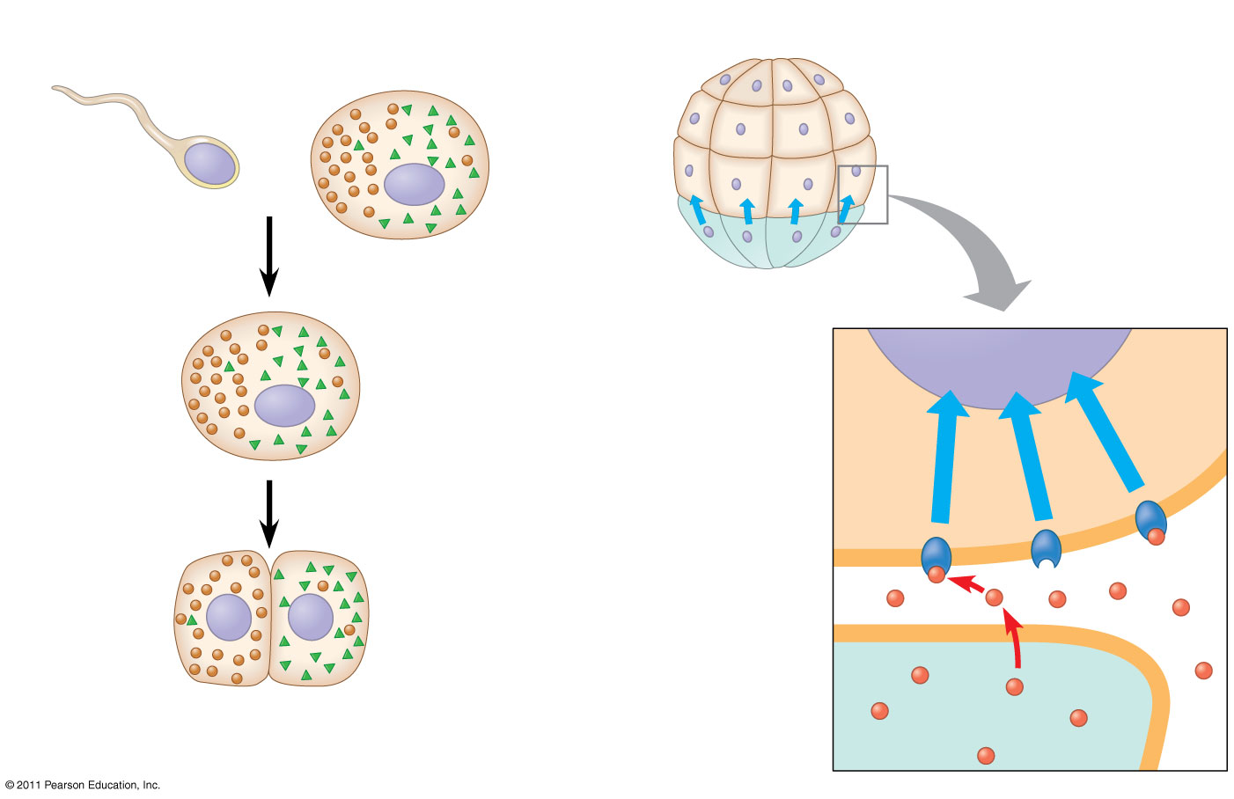
Figure 18.17
(a) Cytoplasmic determinants in the egg
(b) Induction by nearby cells
Unfertilized egg
Early embryo (32 cells)
Sperm
Nucleus
Fertilization
Molecules of two different cytoplasmic determinants
NUCLEUS
Zygote (fertilized egg)
Mitotic cell division
Signal transduction pathway
Signal receptor
Two-celled embryo
Signaling molecule (inducer)
Notes:
Figure 18.17 Sources of developmental information for the early embryo.

Slide 48
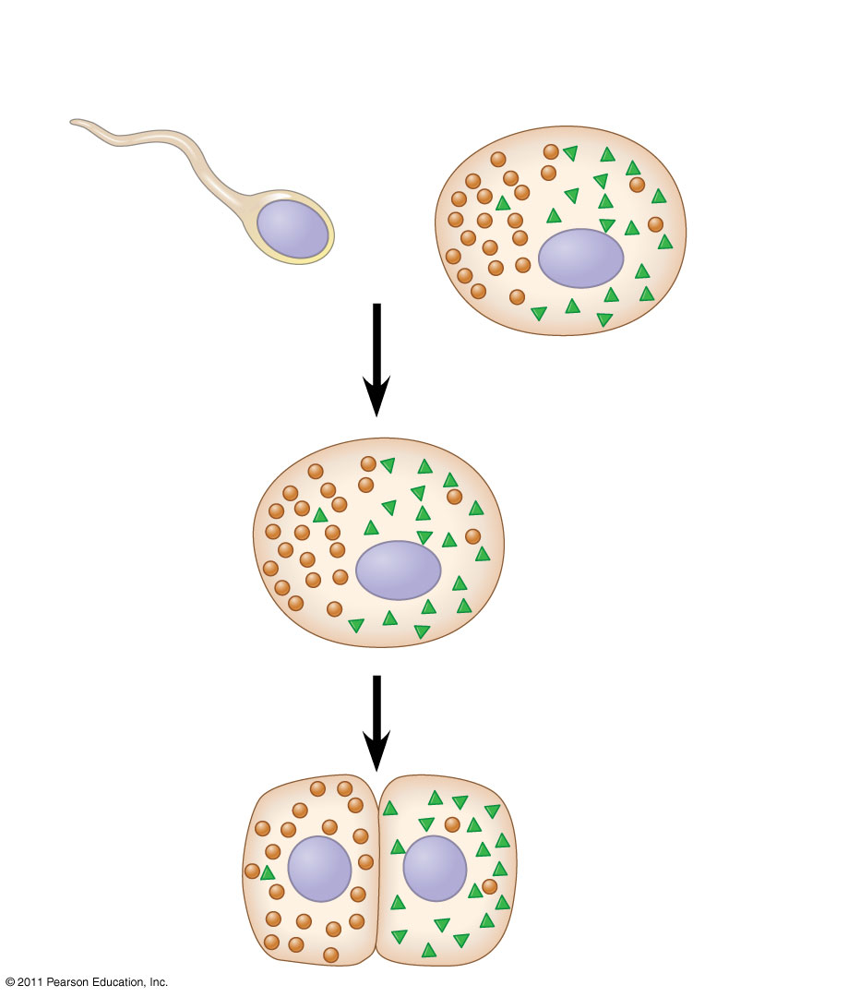
Figure 18.17a
(a) Cytoplasmic determinants in the egg
Unfertilized egg
Sperm
Nucleus
Fertilization
Molecules of two different cytoplasmic determinants
Zygote (fertilized egg)
Mitotic cell division
Two-celled embryo
Notes:
Figure 18.17 Sources of developmental information for the early embryo.

Slide 49
The other important source of developmental information is the environment around the cell, especially signals from nearby embryonic cells
In the process called induction, signal molecules from embryonic cells cause transcriptional changes in nearby target cells
Thus, interactions between cells induce differentiation of specialized cell types
© 2011 Pearson Education, Inc.

Slide 50
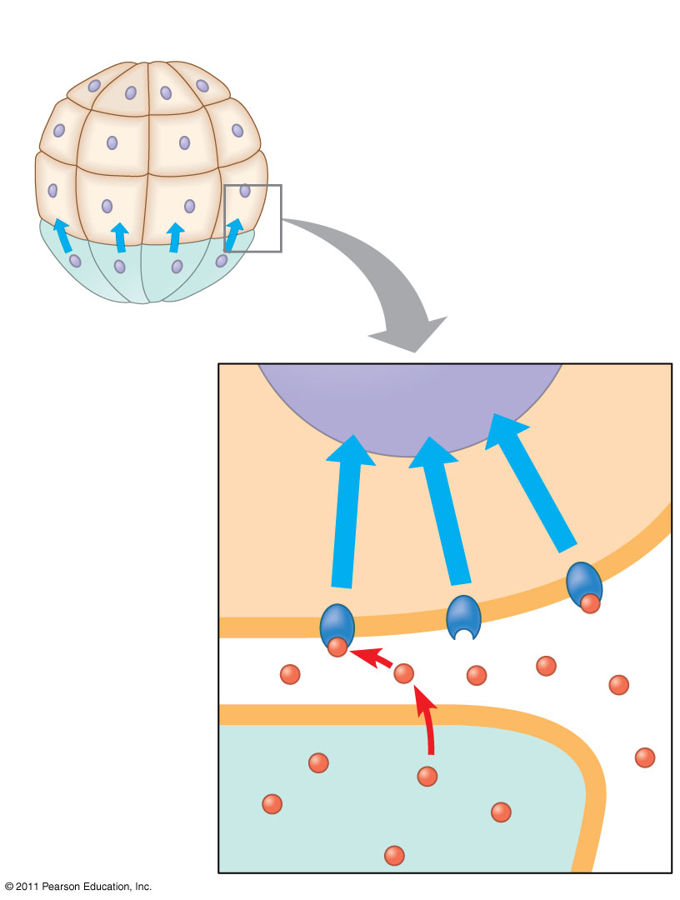
Figure 18.17b
(b) Induction by nearby cells
Early embryo (32 cells)
NUCLEUS
Signal transduction pathway
Signal receptor
Signaling molecule (inducer)
Notes:
Figure 18.17 Sources of developmental information for the early embryo.

Slide 51
Concept 18.5: Cancer results from genetic changes that affect cell cycle control
The gene regulation systems that go wrong during cancer are the very same systems involved in embryonic development
© 2011 Pearson Education, Inc.

Slide 52
Types of Genes Associated with Cancer
Cancer can be caused by mutations to genes that regulate cell growth and division
Tumor viruses can cause cancer in animals including humans
© 2011 Pearson Education, Inc.

Slide 53
Oncogenes are cancer-causing genes
Proto-oncogenes are the corresponding normal cellular genes that are responsible for normal cell growth and division
Conversion of a proto-oncogene to an oncogene can lead to abnormal stimulation of the cell cycle
© 2011 Pearson Education, Inc.

Slide 54
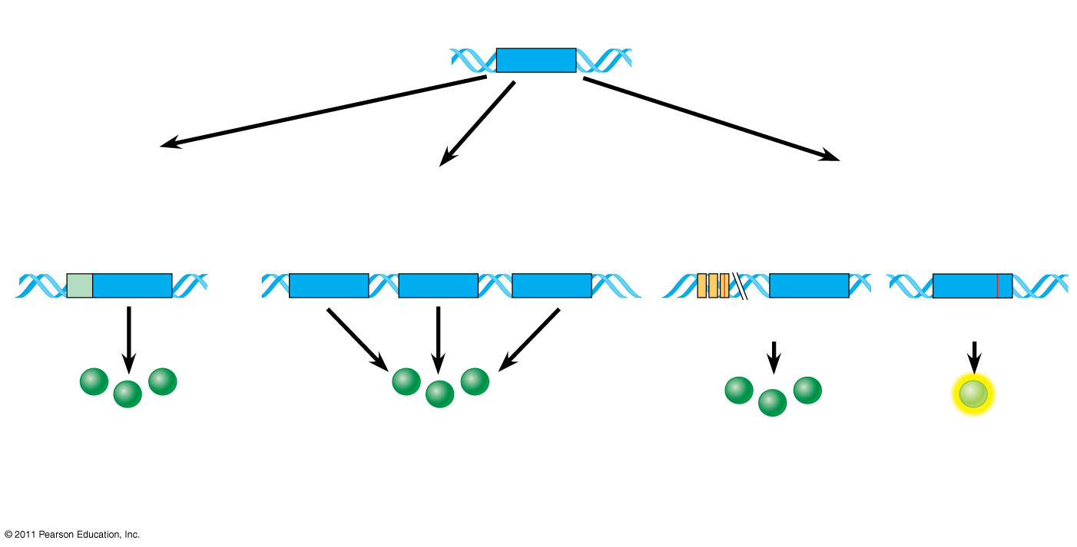
Figure 18.23
Proto-oncogene
DNA
Translocation or transposition: gene moved to new locus, under new controls
Gene amplification: multiple copies of the gene
Point mutation:
within a control element
within the gene
New promoter
Oncogene
Oncogene
Normal growth- stimulating protein in excess
Normal growth-stimulating protein in excess
Normal growth- stimulating protein in excess
Hyperactive or degradation- resistant protein
Notes:
Figure 18.23 Genetic changes that can turn proto-oncogenes into oncogenes.

Slide 55
Proto-oncogenes can be converted to oncogenes by
Movement of DNA within the genome: if it ends up near an active promoter, transcription may increase
Amplification of a proto-oncogene: increases the number of copies of the gene
Point mutations in the proto-oncogene or its control elements: cause an increase in gene expression
© 2011 Pearson Education, Inc.

Slide 56
Tumor-Suppressor Genes
Tumor-suppressor genes help prevent uncontrolled cell growth
Mutations that decrease protein products of tumor-suppressor genes may contribute to cancer onset
Tumor-suppressor proteins
Repair damaged DNA
Control cell adhesion
Inhibit the cell cycle in the cell-signaling pathway
© 2011 Pearson Education, Inc.

Slide 57
Interference with Normal Cell-Signaling Pathways
Mutations in the ras proto-oncogene and p53 tumor-suppressor gene are common in human cancers
Mutations in the ras gene can lead to production of a hyperactive Ras protein and increased cell division
© 2011 Pearson Education, Inc.

Slide 58
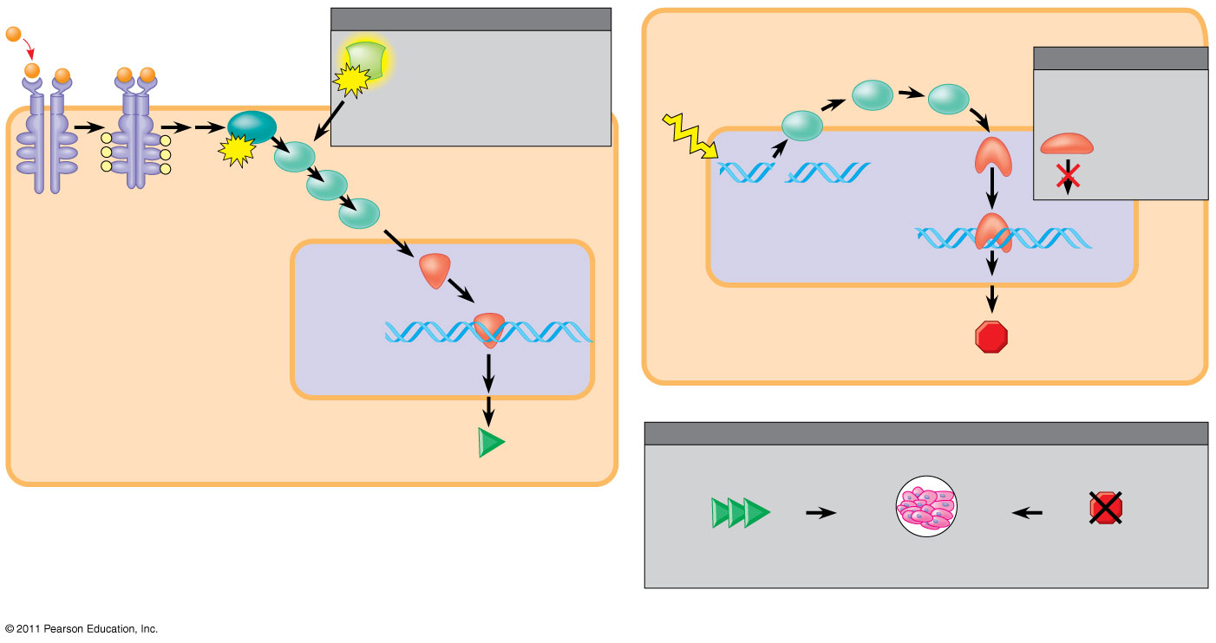
Figure 18.24
1
Growth factor
MUTATION
2
Ras
Hyperactive Ras protein (product of oncogene) issues signals on its own.
Protein kinases
MUTATION
3
G protein
GTP
Defective or missing transcription factor, such as p53, cannot activate transcription.
P
P
Ras
P
P
GTP
UV light
3
Active form of p53
P
P
2
Receptor
4
Protein kinases (phosphorylation
cascade)
1
DNA damage in genome
DNA
NUCLEUS
5
Transcription factor (activator)
DNA
Protein that inhibits the cell cycle
Gene expression
(b) Cell cycle–inhibiting pathway
Protein that
stimulates the cell cycle
EFFECTS OF MUTATIONS
Protein overexpressed
Protein absent
(a) Cell cycle–stimulating pathway
Cell cycle overstimulated
Increased cell division
Cell cycle not inhibited
(c) Effects of mutations
Notes:
Figure 18.24 Signaling pathways that regulate cell division.

Slide 59
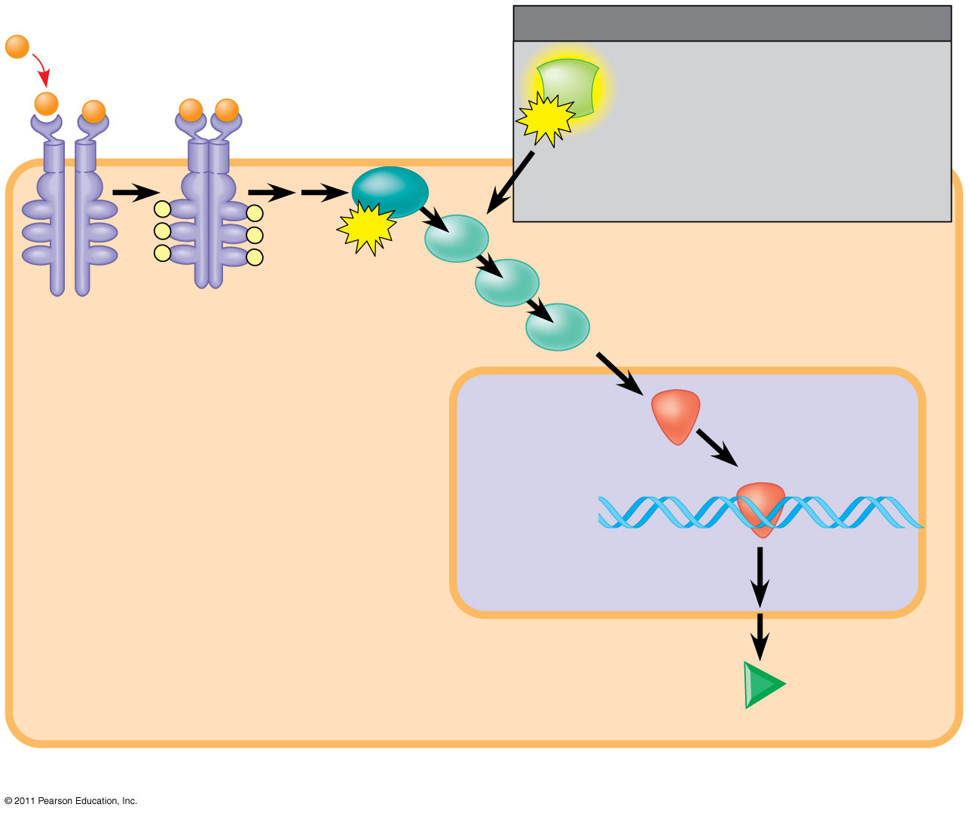
Figure 18.24a
1
Growth factor
MUTATION
Ras
Hyperactive Ras protein (product of oncogene) issues signals on its own.
3
G protein
GTP
Ras
P
P
P
P
GTP
P
P
2
Receptor
4
Protein kinases (phosphorylation
cascade)
NUCLEUS
5
Transcription factor (activator)
DNA
Gene expression
Protein that
stimulates the cell cycle
(a) Cell cycle–stimulating pathway
Notes:
Figure 18.24 Signaling pathways that regulate cell division.

Slide 60
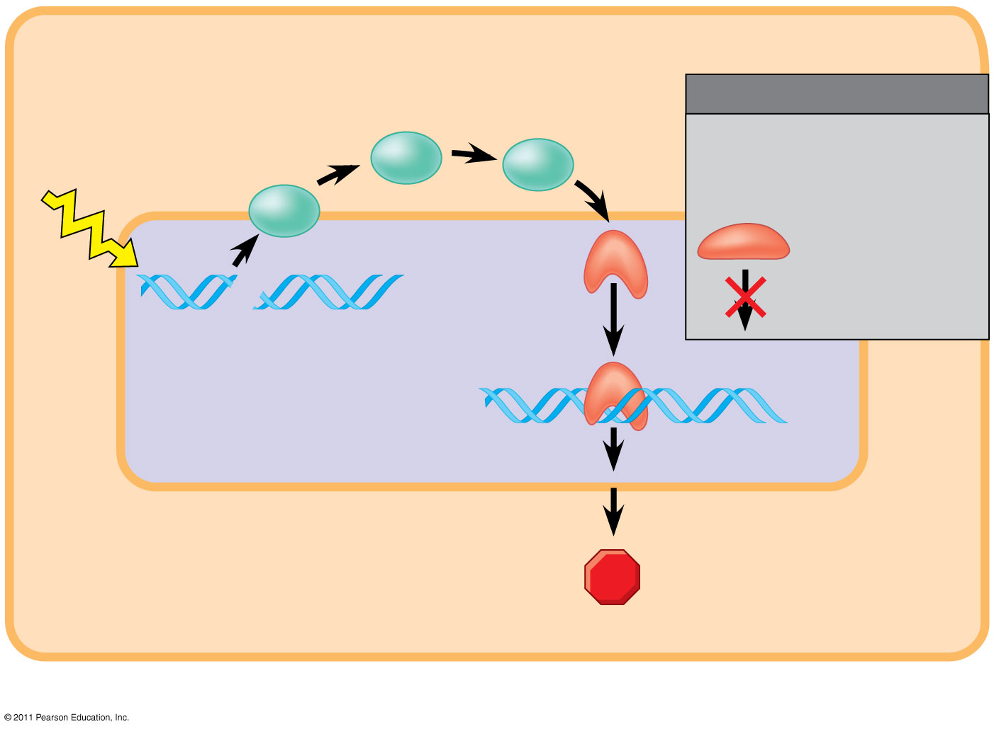
Figure 18.24b
2
Protein kinases
MUTATION
Defective or missing transcription factor, such as p53, cannot activate transcription.
UV light
3
Active form of p53
1
DNA damage in genome
DNA
Protein that inhibits the cell cycle
(b) Cell cycle–inhibiting pathway
Notes:
Figure 18.24 Signaling pathways that regulate cell division.

Slide 61
Suppression of the cell cycle can be important in the case of damage to a cell’s DNA; p53 prevents a cell from passing on mutations due to DNA damage
Mutations in the p53 gene prevent suppression of the cell cycle
© 2011 Pearson Education, Inc.

Slide 62
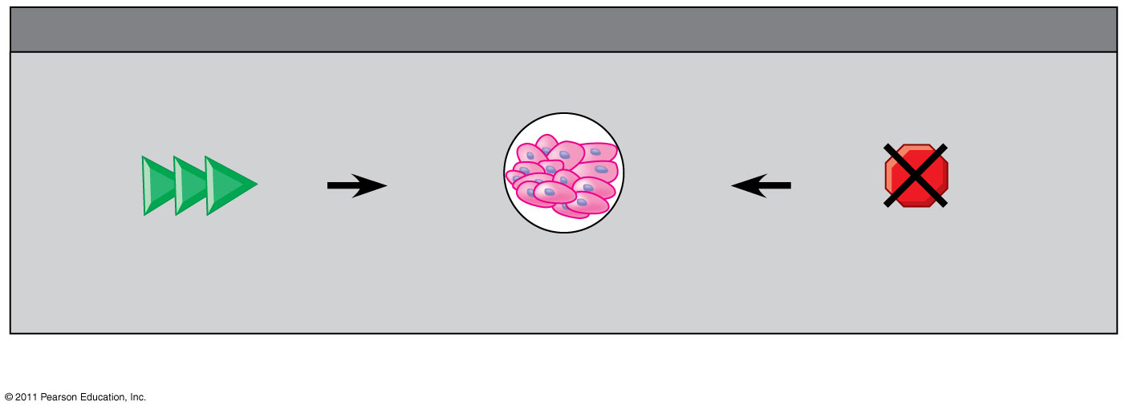
Figure 18.24c
EFFECTS OF MUTATIONS
Protein overexpressed
Protein absent
Cell cycle overstimulated
Increased cell division
Cell cycle not inhibited
(c) Effects of mutations
Notes:
Figure 18.24 Signaling pathways that regulate cell division.

Slide 63
The Multistep Model of Cancer Development
Multiple mutations are generally needed for full-fledged cancer; thus the incidence increases with age
At the DNA level, a cancerous cell is usually characterized by at least one active oncogene and the mutation of several tumor-suppressor genes
© 2011 Pearson Education, Inc.

Slide 64
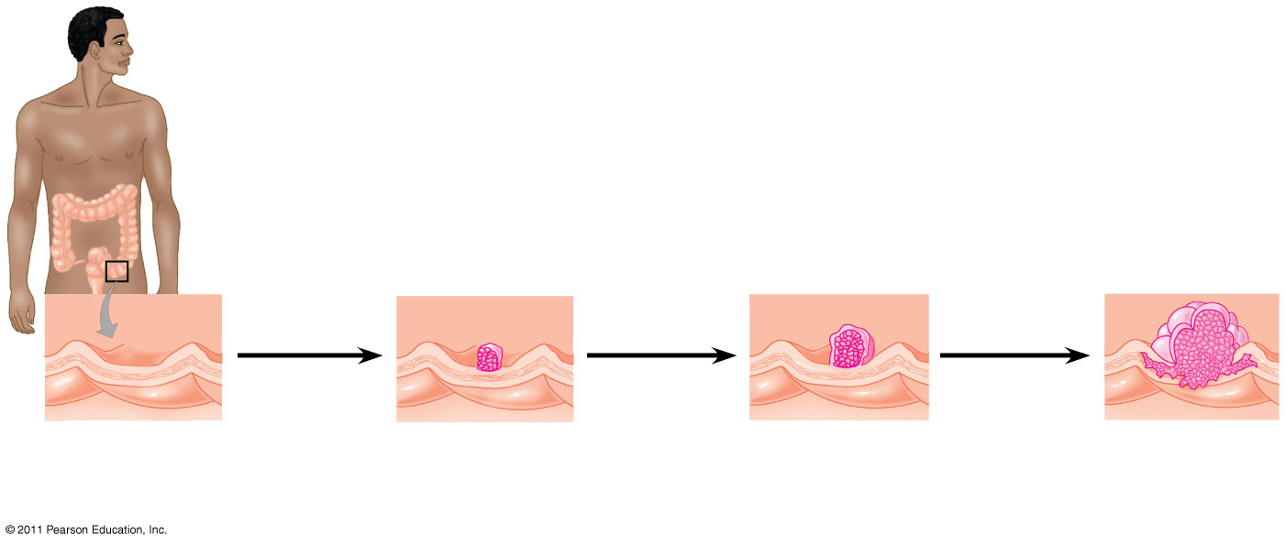
Figure 18.25
Colon
1
Loss of tumor- suppressor gene APC (or other)
4
Loss of tumor- suppressor gene p53
2
Activation of ras oncogene
3
5
Colon wall
Loss of tumor- suppressor gene DCC
Additional mutations
Normal colon epithelial cells
Small benign growth (polyp)
Larger benign growth (adenoma)
Malignant tumor (carcinoma)
Notes:
Figure 18.25 A multistep model for the development of colorectal cancer.

Slide 65
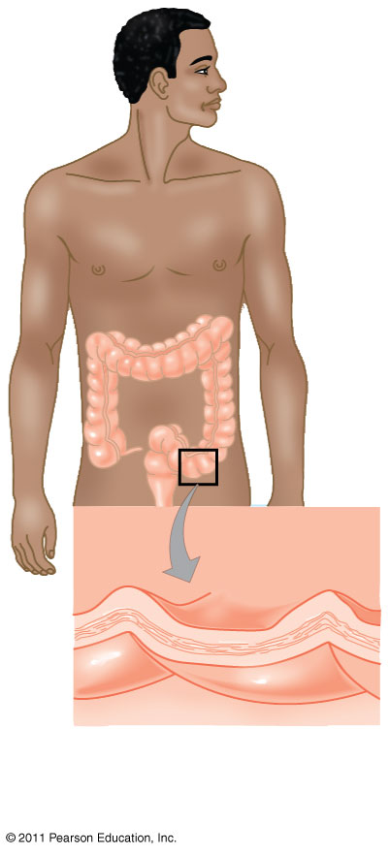
Figure 18.25a
Colon
Colon wall
Normal colon epithelial cells
Notes:
Figure 18.25 A multistep model for the development of colorectal cancer.

Slide 66
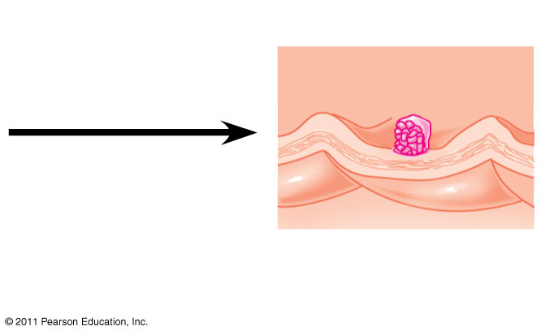
Figure 18.25b
1
Loss of tumor- suppressor gene APC (or other)
Small benign growth (polyp)
Notes:
Figure 18.25 A multistep model for the development of colorectal cancer.

Slide 67
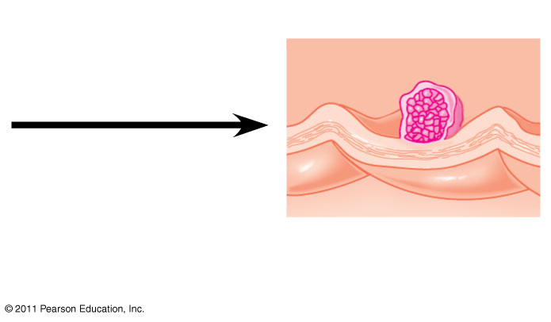
Figure 18.25c
2
Activation of ras oncogene
3
Loss of tumor-suppressor gene DCC
Larger benign growth (adenoma)
Notes:
Figure 18.25 A multistep model for the development of colorectal cancer.

Slide 68
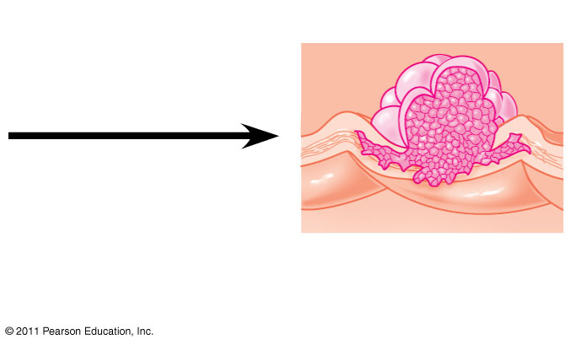
Figure 18.25d
4
Loss of tumor-suppressor gene p53
5
Additional mutations
Malignant tumor (carcinoma)
Notes:
Figure 18.25 A multistep model for the development of colorectal cancer.

Slide 69
Inherited Predisposition and Other Factors Contributing to Cancer
Individuals can inherit oncogenes or mutant alleles of tumor-suppressor genes
Inherited mutations in the tumor-suppressor gene adenomatous polyposis coli are common in individuals with colorectal cancer
Mutations in the BRCA1 or BRCA2 gene are found in at least half of inherited breast cancers, and tests using DNA sequencing can detect these mutations
© 2011 Pearson Education, Inc.

