Slide 1
Chapter 20
Biotechnology

Slide 2
Overview: The DNA Toolbox
Sequencing of the genomes of more than 7,000 species was under way in 2010
DNA sequencing has depended on advances in technology, starting with making recombinant DNA
In recombinant DNA, nucleotide sequences from two different sources, often two species, are combined in vitro into the same DNA molecule
© 2011 Pearson Education, Inc.

Slide 3
Methods for making recombinant DNA are central to genetic engineering, the direct manipulation of genes for practical purposes
DNA technology has revolutionized biotechnology, the manipulation of organisms or their genetic components to make useful products
An example of DNA technology is the microarray, a measurement of gene expression of thousands of different genes
© 2011 Pearson Education, Inc.

Slide 4
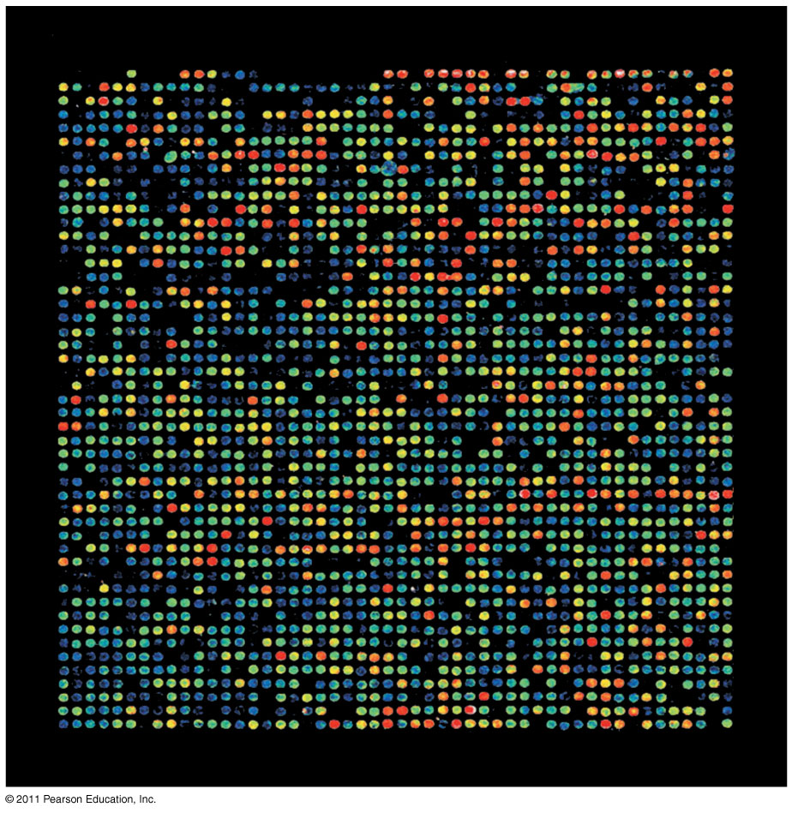
Figure 20.1
Notes:
Figure 20.1 How can this array of spots be used to compare normal and cancerous tissues?

Slide 5
Concept 20.1: DNA cloning yields multiple copies of a gene or other DNA segment
To work directly with specific genes, scientists prepare well-defined segments of DNA in identical copies, a process called DNA cloning
© 2011 Pearson Education, Inc.

Slide 6
DNA Cloning and Its Applications: A Preview
Most methods for cloning pieces of DNA in the laboratory share general features, such as the use of bacteria and their plasmids
Plasmids are small circular DNA molecules that replicate separately from the bacterial chromosome
Cloned genes are useful for making copies of a particular gene and producing a protein product
© 2011 Pearson Education, Inc.

Slide 7
Gene cloning involves using bacteria to make multiple copies of a gene
Foreign DNA is inserted into a plasmid, and the recombinant plasmid is inserted into a bacterial cell
Reproduction in the bacterial cell results in cloning of the plasmid including the foreign DNA
This results in the production of multiple copies of a single gene
© 2011 Pearson Education, Inc.

Slide 8
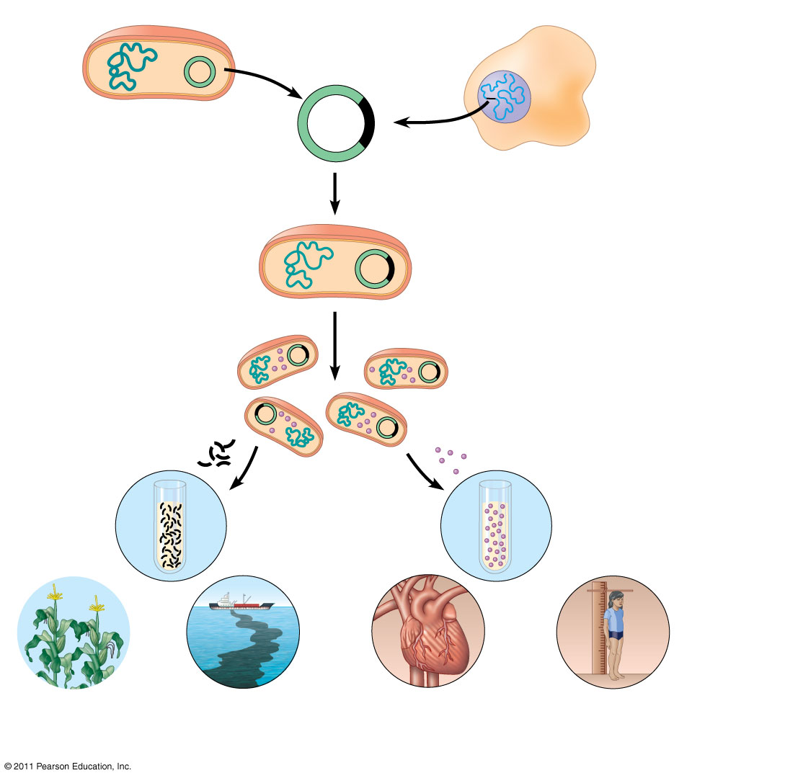
Figure 20.2
Bacterium
1
Gene inserted into plasmid
Cell containing gene of interest
Bacterial chromosome
Plasmid
Gene of interest
Recombinant DNA (plasmid)
DNA of chromosome (“foreign” DNA)
2
Plasmid put into bacterial cell
Recombinant bacterium
3
Host cell grown in culture to form a clone of cells containing the “cloned” gene of interest
Gene of interest
Protein expressed from gene of interest
Copies of gene
Protein harvested
4
Basic research and various applications
Basic research on gene
Basic research on protein
Gene for pest resistance inserted into plants
Gene used to alter bacteria for cleaning up toxic waste
Protein dissolves blood clots in heart attack therapy
Human growth hormone treats stunted growth
Notes:
Figure 20.2 A preview of gene cloning and some uses of cloned genes.

Slide 9
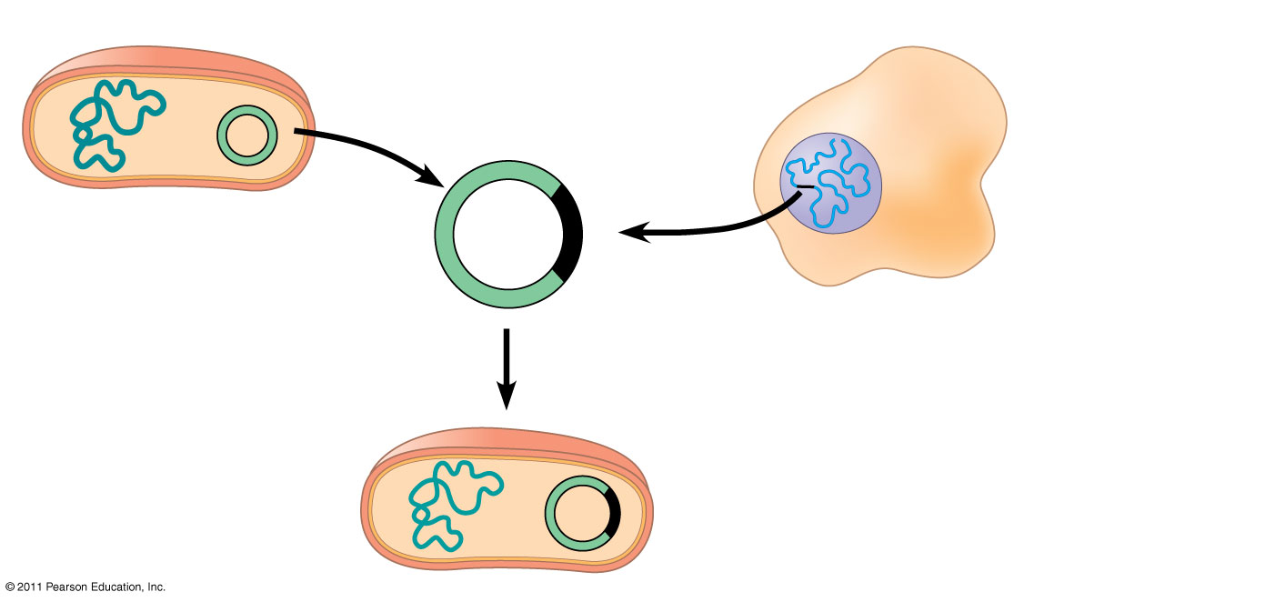
Figure 20.2a
Bacterium
1
Gene inserted into plasmid
Cell containing gene of interest
Bacterial chromosome
Plasmid
Gene of interest
Recombinant DNA (plasmid)
DNA of chromosome (“foreign” DNA)
2
Plasmid put into bacterial cell
Recombinant bacterium
Notes:
Figure 20.2 A preview of gene cloning and some uses of cloned genes.

Slide 10
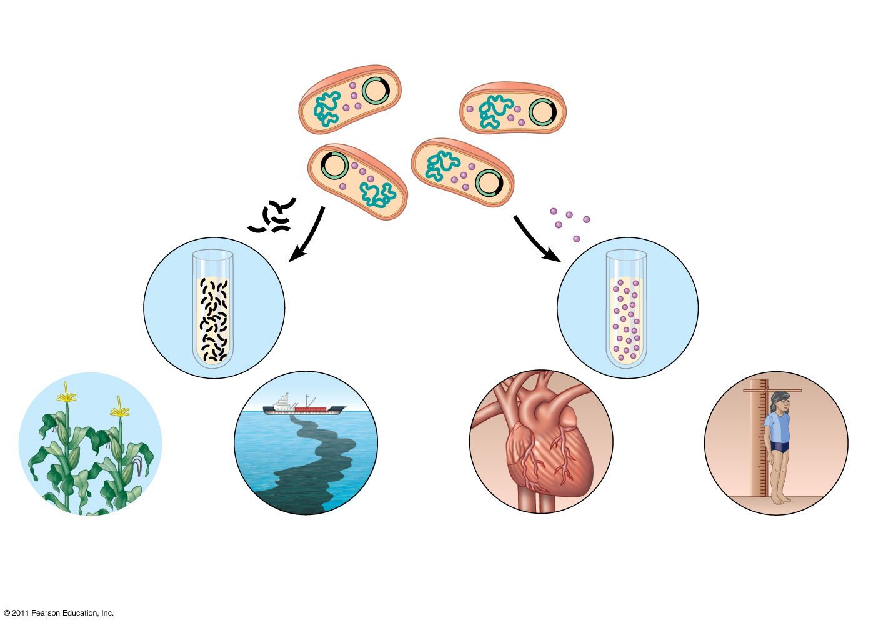
Figure 20.2b
3
Host cell grown in culture to form a clone of cells containing the “cloned” gene of interest
Gene of interest
Protein expressed from gene of interest
Copies of gene
Protein harvested
4
Basic research and various applications
Basic research on gene
Basic research on protein
Gene for pest resistance inserted into plants
Gene used to alter bacteria for cleaning up toxic waste
Protein dissolves blood clots in heart attack therapy
Human growth hormone treats stunted growth
Notes:
Figure 20.2 A preview of gene cloning and some uses of cloned genes.

Slide 11
Using Restriction Enzymes to Make Recombinant DNA
Bacterial restriction enzymes cut DNA molecules at specific DNA sequences called restriction sites
A restriction enzyme usually makes many cuts, yielding restriction fragments
The most useful restriction enzymes cut DNA in a staggered way, producing fragments with “sticky ends.”
© 2011 Pearson Education, Inc.

Slide 12
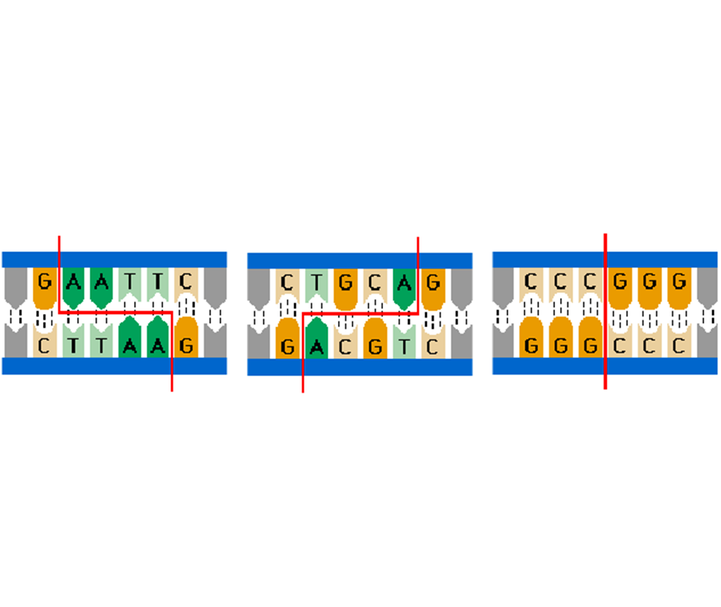
Animation: Restriction Enzymes
Right-click slide / select “Play”
© 2011 Pearson Education, Inc.

Slide 13
Sticky ends can bond with complementary sticky ends of other fragments
DNA ligase is an enzyme that seals the bonds between restriction fragments
© 2011 Pearson Education, Inc.

Slide 14
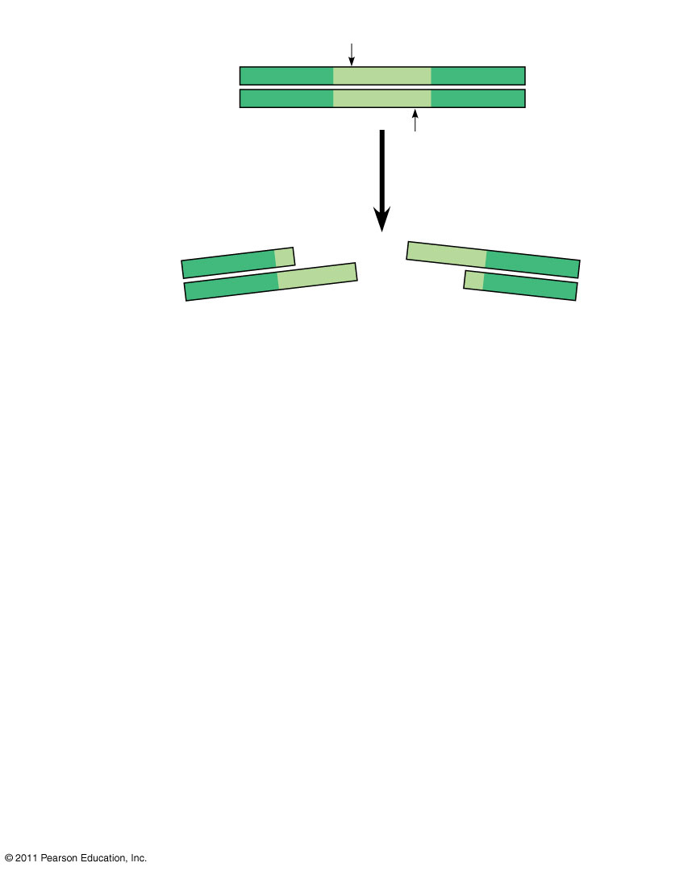
Figure 20.3-1
Restriction site
5′
3′
DNA
GAATTC
CTTAAG
3′
5′
1
Restriction enzyme cuts sugar-phosphate backbones.
3′
5′
3′
5′
G
AATTC
CTTAA
G
5′
Sticky end
3′
5′
3′
Notes:
Figure 20.3 Using a restriction enzyme and DNA ligase to make recombinant DNA.

Slide 15
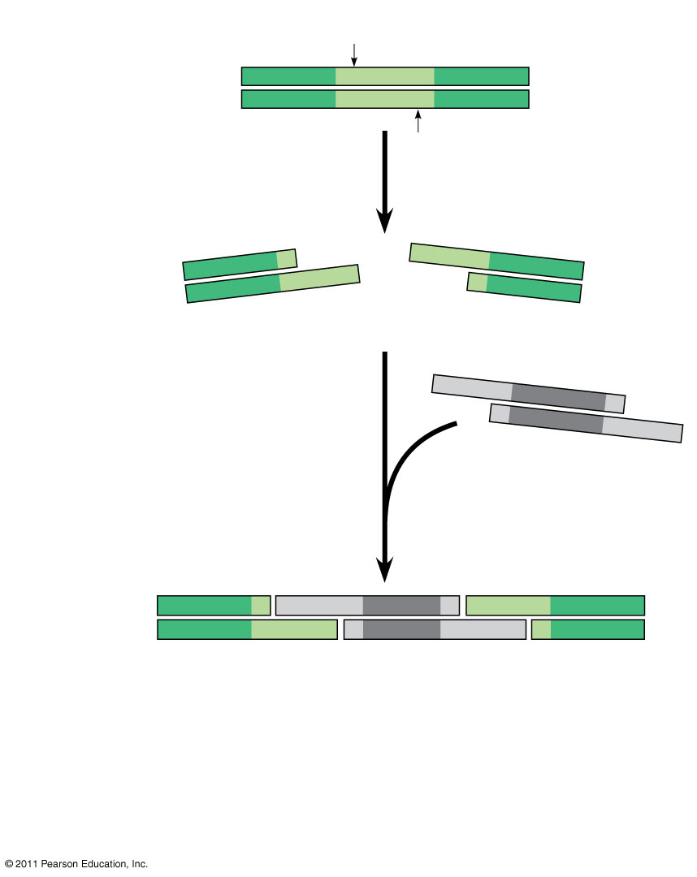
Figure 20.3-2
Restriction site
5′
3′
DNA
GAATTC
CTTAAG
3′
5′
1
Restriction enzyme cuts sugar-phosphate backbones.
3′
5′
3′
5′
G
AATTC
CTTAA
G
5′
Sticky end
3′
5′
3′
5′
AATTC
3′
G
G
2
DNA fragment added from another molecule cut by same enzyme. Base pairing occurs.
3′
CTTAA
5′
5′
3′
5′
3′
5′
3′
G
AATT C
G
AATT C
C TTAA
G
C TTAA
G
3′
5′
3′
5′
3′
5′
One possible combination
Notes:
Figure 20.3 Using a restriction enzyme and DNA ligase to make recombinant DNA.

Slide 16
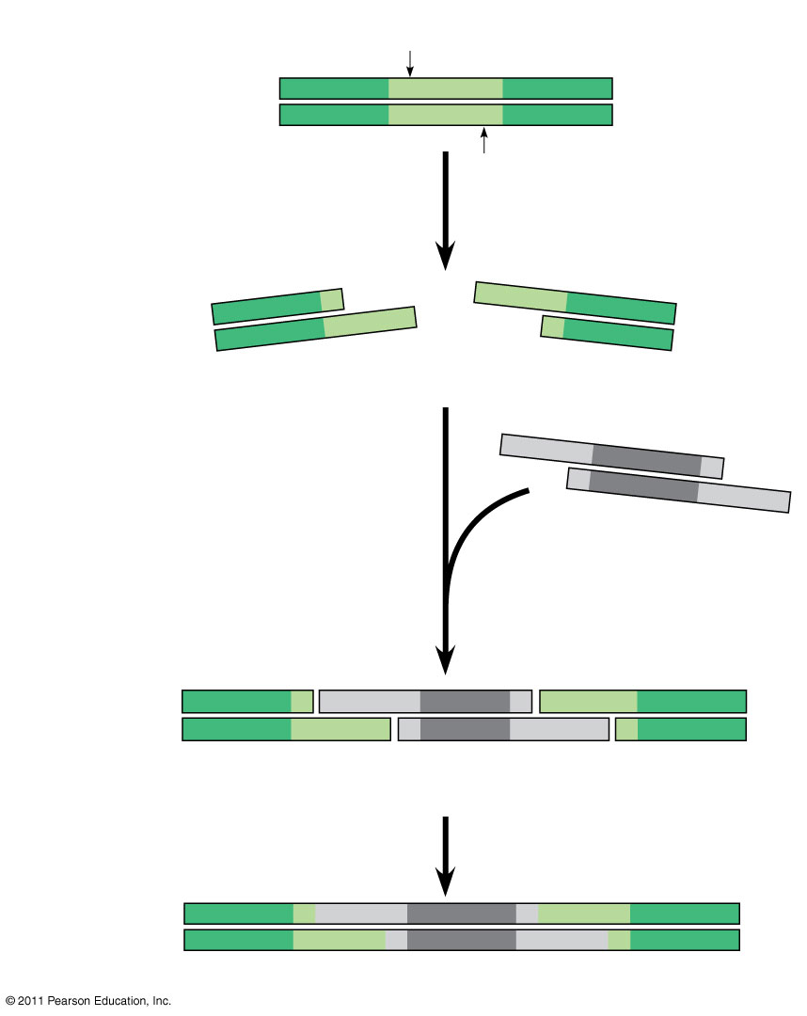
Figure 20.3-3
Restriction site
5′
3′
DNA
GAATTC
CTTAAG
3′
5′
1
Restriction enzyme cuts sugar-phosphate backbones.
3′
5′
3′
5′
G
AATTC
CTTAA
G
5′
Sticky end
3′
5′
3′
5′
AATTC
3′
G
G
2
DNA fragment added from another molecule cut by same enzyme. Base pairing occurs.
3′
CTTAA
5′
5′
3′
5′
3′
5′
3′
G
AATT C
G
AATT C
C TTAA
G
C TTAA
G
3′
5′
3′
5′
3′
5′
3
One possible combination
DNA ligase seals strands
5′
3′
3′
Recombinant DNA molecule
5′
Notes:
Figure 20.3 Using a restriction enzyme and DNA ligase to make recombinant DNA.

Slide 17
Cloning a Eukaryotic Gene in a Bacterial Plasmid
In gene cloning, the original plasmid is called a cloning vector
A cloning vector is a DNA molecule that can carry foreign DNA into a host cell and replicate there
© 2011 Pearson Education, Inc.

Slide 18
Producing Clones of Cells Carrying Recombinant Plasmids
Several steps are required to clone the hummingbird β-globin gene in a bacterial plasmid
The hummingbird genomic DNA and a bacterial plasmid are isolated
Both are cut with the same restriction enzyme
The fragments are mixed, and DNA ligase is added to bond the fragment sticky ends
© 2011 Pearson Education, Inc.

Slide 19
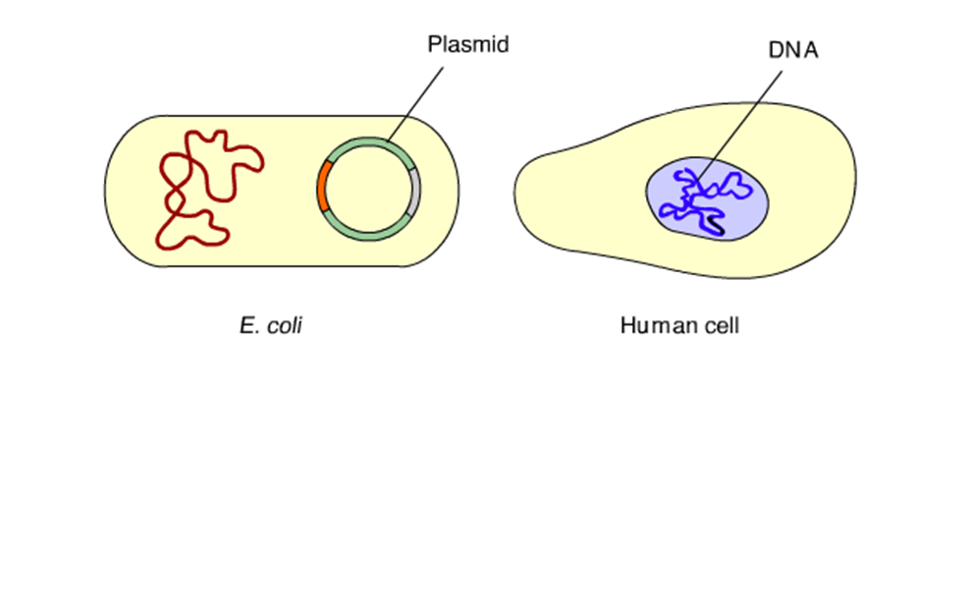
Animation: Cloning a Gene
Right-click slide / select “Play”
© 2011 Pearson Education, Inc.

Slide 20
Some recombinant plasmids now contain hummingbird DNA
The DNA mixture is added to bacteria that have been genetically engineered to accept it
The bacteria are plated on a type of agar that selects for the bacteria with recombinant plasmids
This results in the cloning of many hummingbird DNA fragments, including the β-globin gene
© 2011 Pearson Education, Inc.

Slide 21
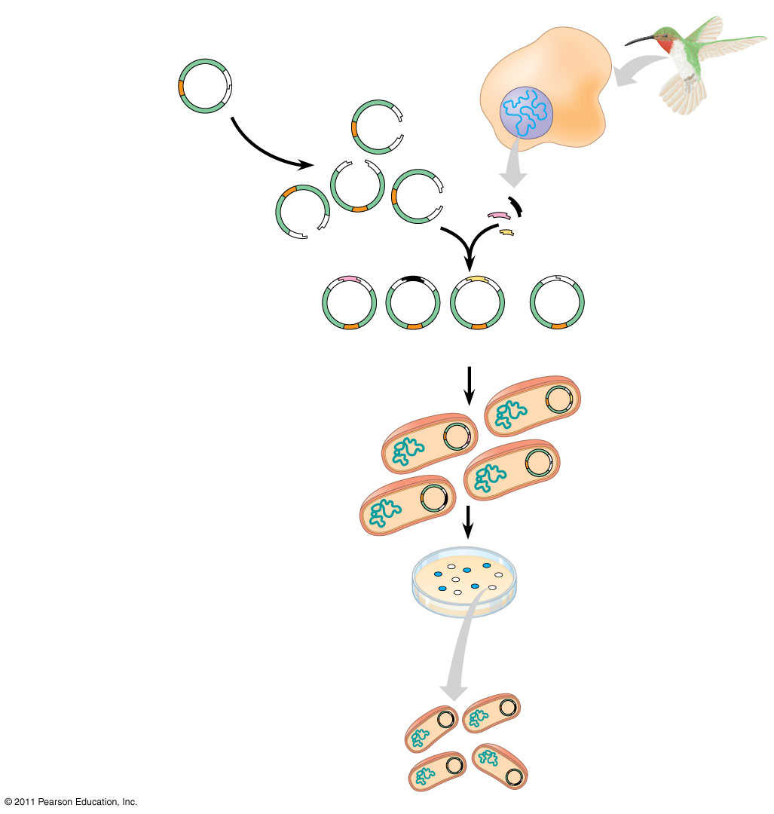
Figure 20.4
TECHNIQUE
Hummingbird cell
Bacterial plasmid
amp^{R} gene
lacZ gene
Restriction site
Sticky ends
Gene of interest
Humming- bird DNA fragments
Recombinant plasmids
Nonrecombinant plasmid
Bacteria carrying plasmids
RESULTS
Colony carrying recombinant plasmid with disrupted lacZ gene
Colony carrying non- recombinant plasmid with intact lacZ gene
One of many bacterial clones
Notes:
Figure 20.4 Research Method: Cloning Genes in Bacterial Plasmids

Slide 22
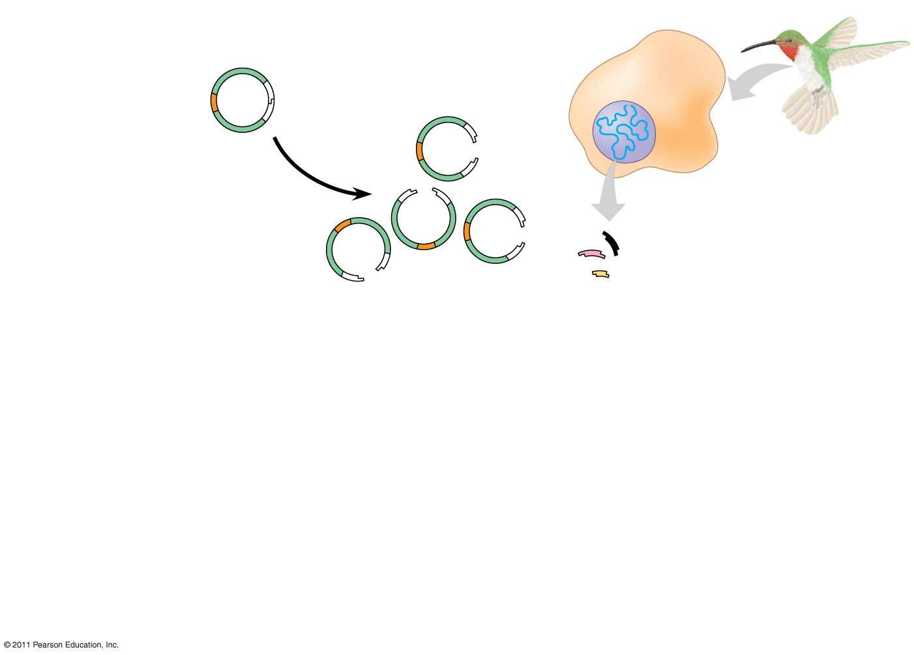
Figure 20.4a-1
TECHNIQUE
Hummingbird cell
Bacterial plasmid
amp^{R} gene
lacZ gene
Restriction site
Sticky ends
Gene of interest
Humming- bird DNA fragments
Notes:
Figure 20.4 Research Method: Cloning Genes in Bacterial Plasmids

Slide 23
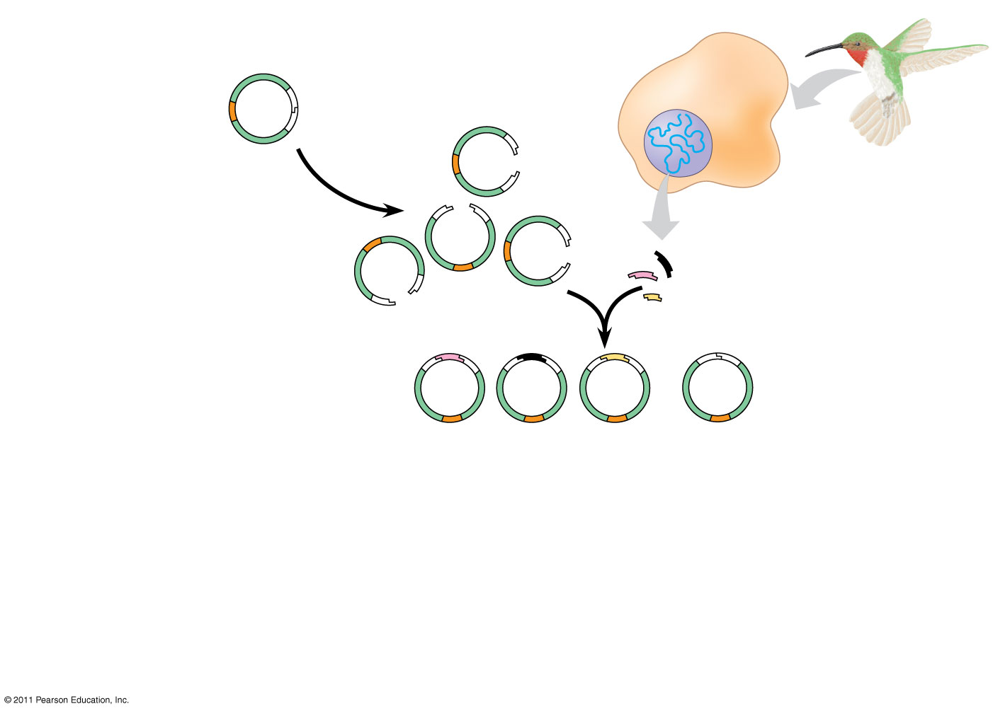
Figure 20.4a-2
TECHNIQUE
Hummingbird cell
Bacterial plasmid
amp^{R} gene
lacZ gene
Restriction site
Sticky ends
Gene of interest
Humming- bird DNA fragments
Recombinant plasmids
Nonrecombinant plasmid
Notes:
Figure 20.4 Research Method: Cloning Genes in Bacterial Plasmids

Slide 24
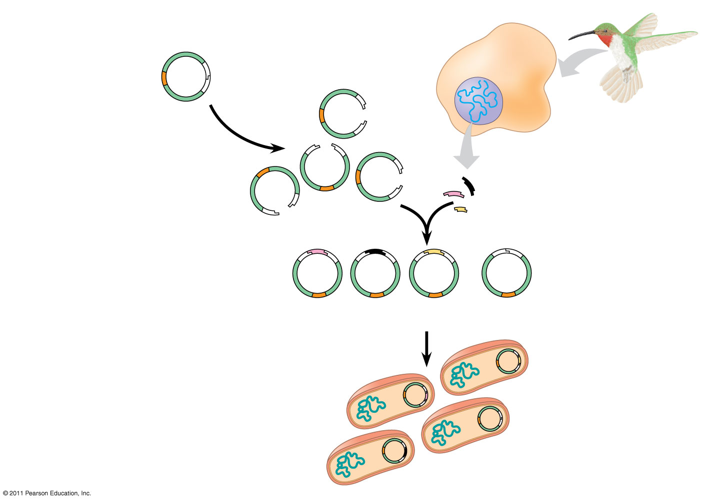
Figure 20.4a-3
TECHNIQUE
Hummingbird cell
Bacterial plasmid
amp^{R} gene
lacZ gene
Restriction site
Sticky ends
Gene of interest
Humming- bird DNA fragments
Recombinant plasmids
Nonrecombinant plasmid
Bacteria carrying plasmids
Notes:
Figure 20.4 Research Method: Cloning Genes in Bacterial Plasmids

Slide 25
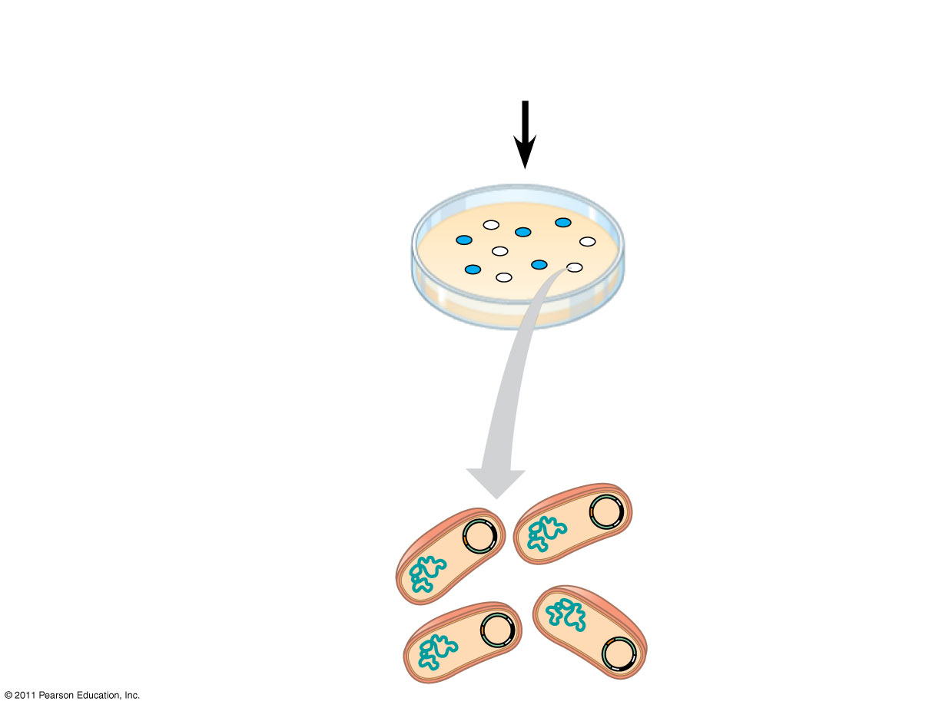
Figure 20.4b
Bacteria carrying plasmids
RESULTS
Colony carrying recombinant plasmid with disrupted lacZ gene
Colony carrying non- recombinant plasmid with intact lacZ gene
One of many bacterial clones
Notes:
Figure 20.4 Research Method: Cloning Genes in Bacterial Plasmids

Slide 26
Storing Cloned Genes in DNA Libraries
A genomic library that is made using bacteria is the collection of recombinant vector clones produced by cloning DNA fragments from an entire genome
A genomic library that is made using bacteriophages is stored as a collection of phage clones
© 2011 Pearson Education, Inc.

Slide 27
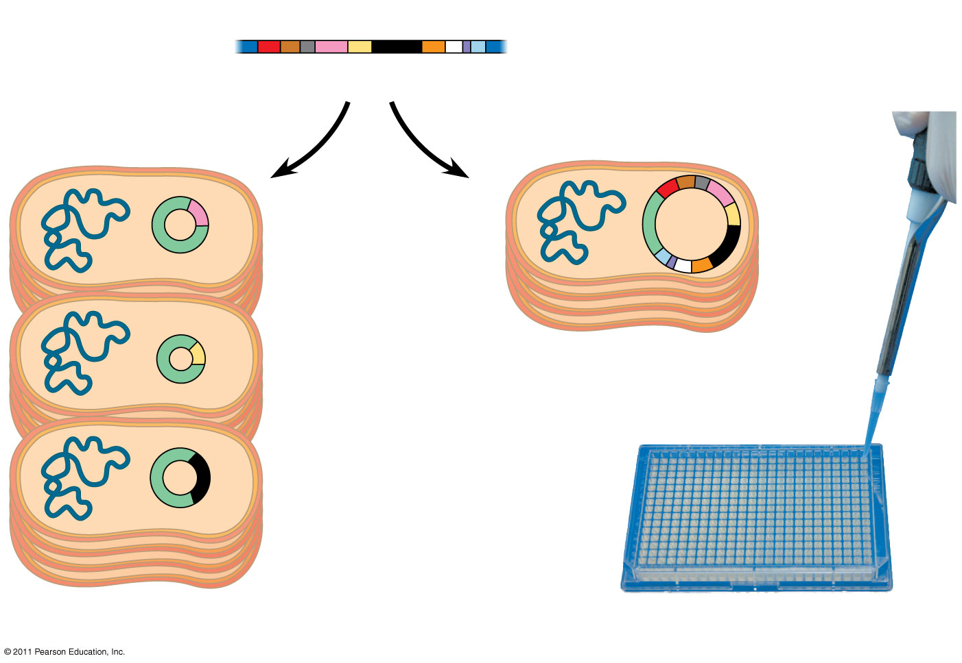
Figure 20.5
Foreign genome
Cut with restriction enzymes into either
small fragments
or
large fragments
Bacterial artificial chromosome (BAC)
Large insert with many genes
Recombinant plasmids
(b) BAC clone
Plasmid clone
(a) Plasmid library
(c) Storing genome libraries
Notes:
Figure 20.5 Genomic libraries.

Slide 28
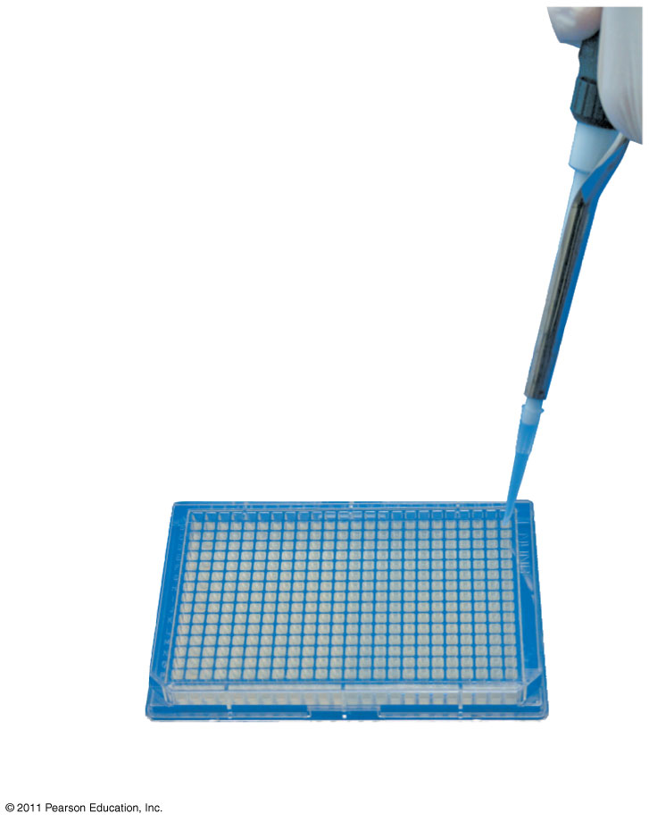
Figure 20.5a
(c) Storing genome libraries
Notes:
Figure 20.5 Genomic libraries.

Slide 29
A bacterial artificial chromosome (BAC) is a large plasmid that has been trimmed down and can carry a large DNA insert
BACs are another type of vector used in DNA library construction
© 2011 Pearson Education, Inc.

Slide 30
A complementary DNA (cDNA) library is made by cloning DNA made in vitro by reverse transcription of all the mRNA produced by a particular cell
A cDNA library represents only part of the genome—only the subset of genes transcribed into mRNA in the original cells
© 2011 Pearson Education, Inc.

Slide 31
Figure 20.6-1
DNA in nucleus
mRNAs in cytoplasm
Notes:
Figure 20.6 Making complementary DNA (cDNA) from eukaryotic genes.

Slide 32
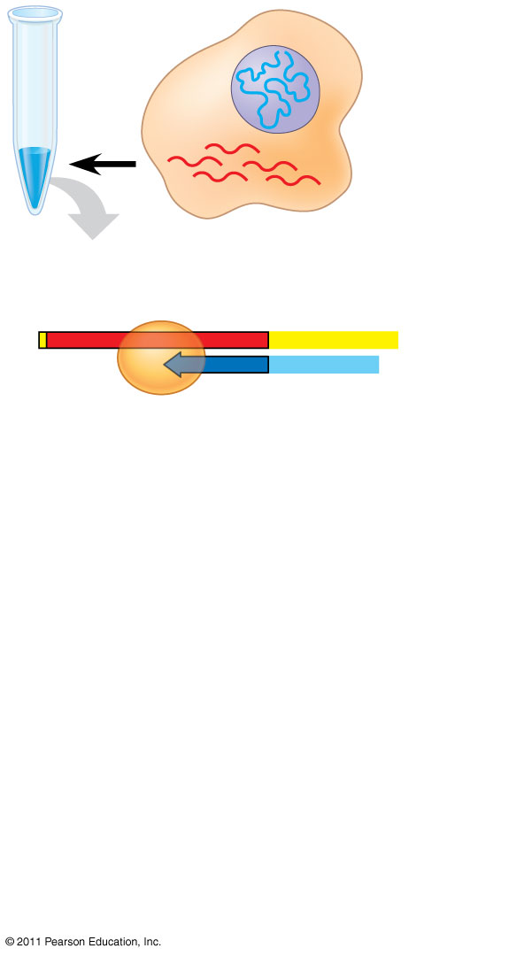
Figure 20.6-2
DNA in nucleus
mRNAs in cytoplasm
Reverse transcriptase
mRNA
Poly-A tail
5′
A A A A A A
3′
3′
T T T T T
5′
DNA strand
Primer
Notes:
Figure 20.6 Making complementary DNA (cDNA) from eukaryotic genes.

Slide 33
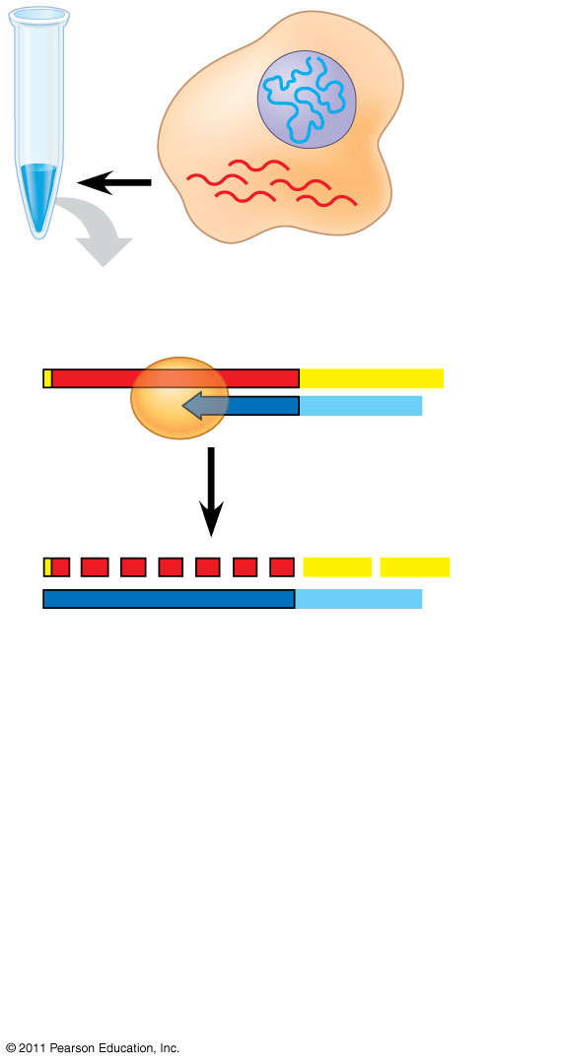
Figure 20.6-3
DNA in nucleus
mRNAs in cytoplasm
Reverse transcriptase
mRNA
Poly-A tail
5′
A A A A A A
3′
3′
T T T T T
5′
DNA strand
Primer
5′
A A A
A A A
3′
3′
T T T T T
5′
Notes:
Figure 20.6 Making complementary DNA (cDNA) from eukaryotic genes.

Slide 34
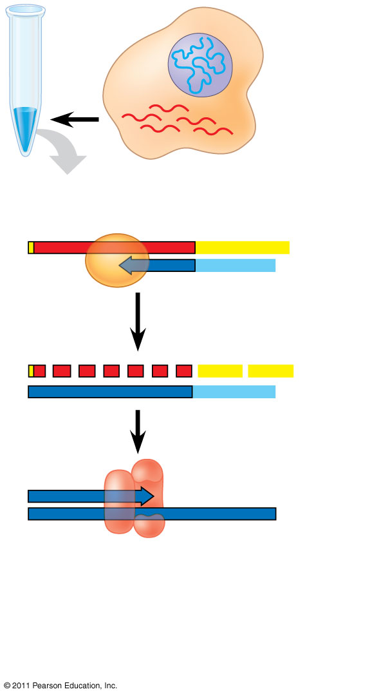
Figure 20.6-4
DNA in nucleus
mRNAs in cytoplasm
Reverse transcriptase
mRNA
Poly-A tail
5′
A A A A A A
3′
3′
T T T T T
5′
DNA strand
Primer
5′
A A A
A A A
3′
3′
T T T T T
5′
5′
3′
3′
5′
DNA polymerase
Notes:
Figure 20.6 Making complementary DNA (cDNA) from eukaryotic genes.

Slide 35
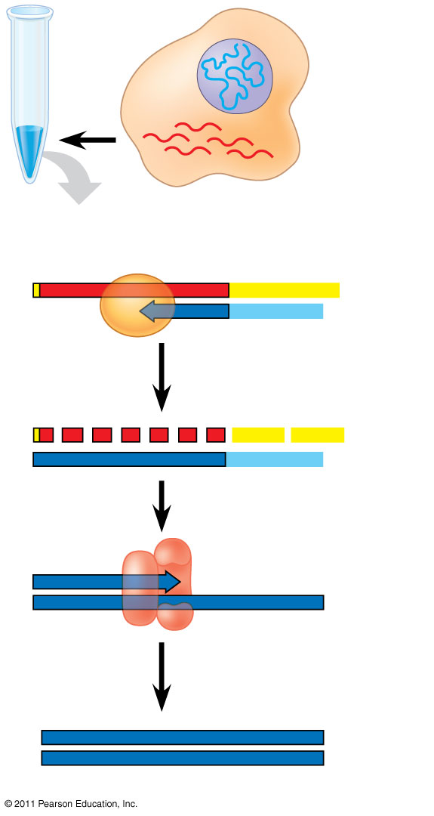
Figure 20.6-5
DNA in nucleus
mRNAs in cytoplasm
Reverse transcriptase
mRNA
Poly-A tail
5′
A A A A A A
3′
3′
T T T T T
5′
DNA strand
Primer
5′
A A A
A A A
3′
3′
T T T T T
5′
5′
3′
3′
5′
DNA polymerase
5′
3′
3′
5′
cDNA
Notes:
Figure 20.6 Making complementary DNA (cDNA) from eukaryotic genes.

Slide 36
Screening a Library for Clones Carrying a Gene of Interest
A clone carrying the gene of interest can be identified with a nucleic acid probe having a sequence complementary to the gene
This process is called nucleic acid hybridization
© 2011 Pearson Education, Inc.

Slide 37
A probe can be synthesized that is complementary to the gene of interest
For example, if the desired gene is
– Then we would synthesize this probe
5′
⋅⋅⋅ CTCAT CACCGGC⋅⋅⋅
3′
3′
G A G T A G T G G C C G
5′
© 2011 Pearson Education, Inc.
Notes:
Figure 20.UN01 In-text figure, p. 401, Figure 20.UN02 In-text figure, p. 401

Slide 38
The DNA probe can be used to screen a large number of clones simultaneously for the gene of interest
Once identified, the clone carrying the gene of interest can be cultured
© 2011 Pearson Education, Inc.

Slide 39
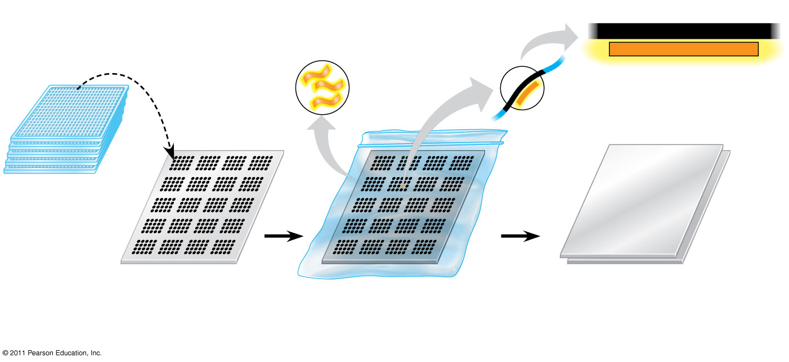
Figure 20.7
TECHNIQUE
Radioactively labeled probe molecules
5′
3′
⋅⋅⋅ CTCATCACCGGC⋅⋅⋅
Gene of interest
GAGTAGTGGCCG
3′
5′
Probe DNA
Single- stranded DNA from cell
Film
Multiwell plates holding library clones
Nylon membrane
Location of DNA with the complementary sequence
Nylon membrane
Notes:
Figure 20.7 Research Method: Detecting a Specific DNA Sequence by Hybridization with a Nucleic Acid Probe

Slide 40
Expressing Cloned Eukaryotic Genes
After a gene has been cloned, its protein product can be produced in larger amounts for research
Cloned genes can be expressed as protein in either bacterial or eukaryotic cells
© 2011 Pearson Education, Inc.

Slide 41
Bacterial Expression Systems
Several technical difficulties hinder expression of cloned eukaryotic genes in bacterial host cells
To overcome differences in promoters and other DNA control sequences, scientists usually employ an expression vector, a cloning vector that contains a highly active bacterial promoter
© 2011 Pearson Education, Inc.

Slide 42
Eukaryotic Cloning and Expression Systems
Molecular biologists can avoid eukaryote-bacterial incompatibility issues by using eukaryotic cells, such as yeasts, as hosts for cloning and expressing genes
Even yeasts may not possess the proteins required to modify expressed mammalian proteins properly
In such cases, cultured mammalian or insect cells may be used to express and study proteins
© 2011 Pearson Education, Inc.

Slide 43
One method of introducing recombinant DNA into eukaryotic cells is electroporation, applying a brief electrical pulse to create temporary holes in plasma membranes
Alternatively, scientists can inject DNA into cells using microscopically thin needles
Once inside the cell, the DNA is incorporated into the cell’s DNA by natural genetic recombination
© 2011 Pearson Education, Inc.

Slide 44
Cross-Species Gene Expression and Evolutionary Ancestry
The remarkable ability of bacteria to express some eukaryotic proteins underscores the shared evolutionary ancestry of living species
For example, Pax-6 is a gene that directs formation of a vertebrate eye; the same gene in flies directs the formation of an insect eye (which is quite different from the vertebrate eye)
The Pax-6 genes in flies and vertebrates can substitute for each other
© 2011 Pearson Education, Inc.

Slide 45
Amplifying DNA in Vitro: The Polymerase Chain Reaction (PCR)
The polymerase chain reaction, PCR, can produce many copies of a specific target segment of DNA
A three-step cycle—heating, cooling, and replication—brings about a chain reaction that produces an exponentially growing population of identical DNA molecules
The key to PCR is an unusual, heat-stable DNA polymerase called Taq polymerase.
© 2011 Pearson Education, Inc.

Slide 46
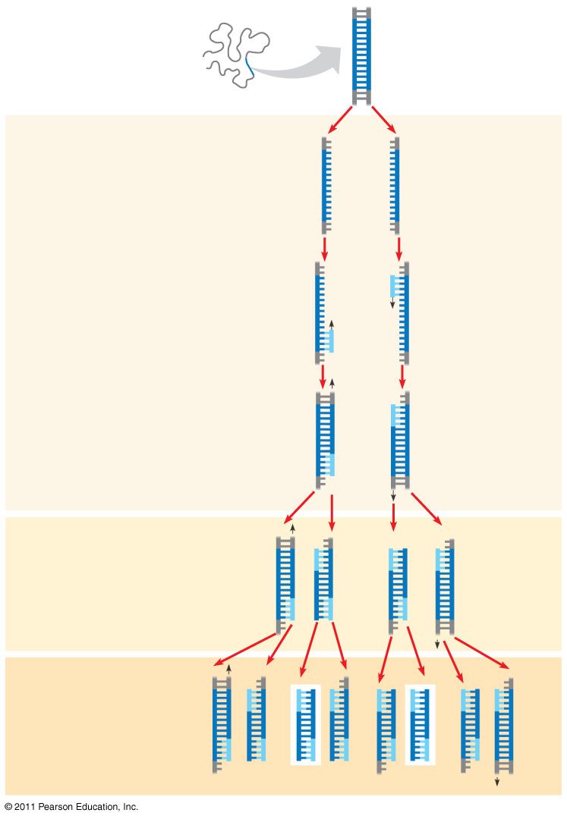
Figure 20.8
5′
3′
TECHNIQUE
Target sequence
Genomic DNA
3′
5′
1
Denaturation
5′
3′
3′
5′
2
Annealing
Cycle 1 yields 2 molecules
Primers
3
Extension
New nucleotides
Cycle 2 yields 4 molecules
Cycle 3 yields 8 molecules; 2 molecules (in white boxes) match target sequence
Notes:
Figure 20.8 Research Method: The Polymerase Chain Reaction (PCR)

Slide 47
Figure 20.8a
TECHNIQUE
5′
3′
Target sequence
Genomic DNA
3′
5′
Notes:
Figure 20.8 Research Method: The Polymerase Chain Reaction (PCR)

Slide 48
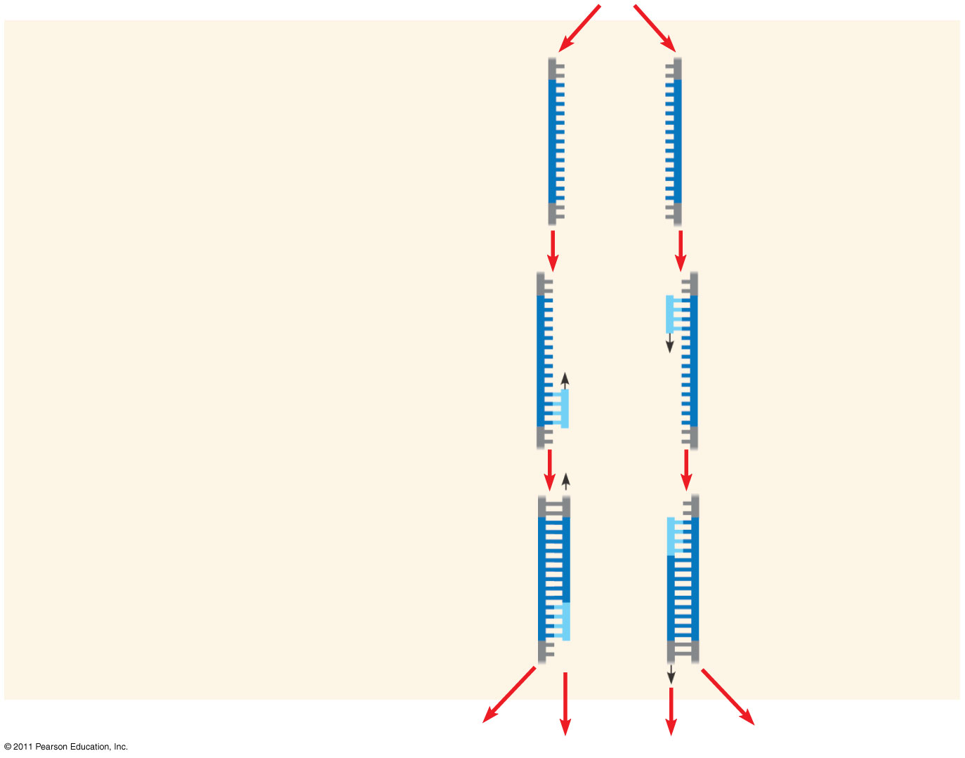
Figure 20.8b
1
Denaturation
5′
3′
3′
5′
2
Annealing
Cycle 1 yields 2 molecules
Primers
3
Extension
New nucleo- tides
Notes:
Figure 20.8 Research Method: The Polymerase Chain Reaction (PCR)

Slide 49
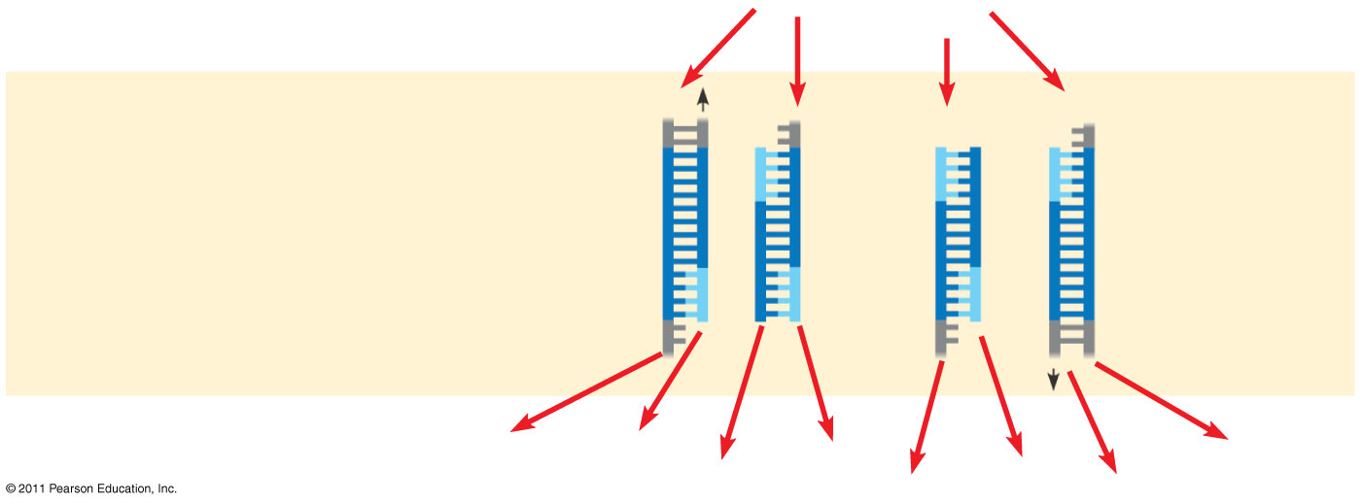
Figure 20.8c
Cycle 2 yields 4 molecules
Notes:
Figure 20.8 Research Method: The Polymerase Chain Reaction (PCR)

Slide 50
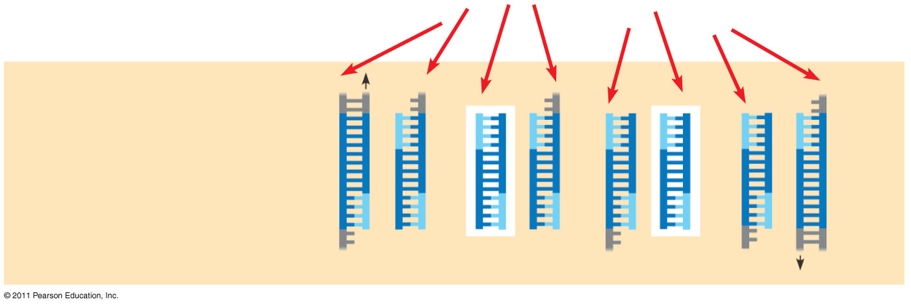
Figure 20.8d
Cycle 3 yields 8 molecules; 2 molecules (in white boxes) match target sequence
Notes:
Figure 20.8 Research Method: The Polymerase Chain Reaction (PCR)

Slide 51
Concept 20.2: DNA technology allows us to study the sequence, expression, and function of a gene
DNA cloning allows researchers to
Compare genes and alleles between individuals
Locate gene expression in a body
Determine the role of a gene in an organism
Several techniques are used to analyze the DNA of genes
© 2011 Pearson Education, Inc.

Slide 52
Gel Electrophoresis and Southern Blotting
One indirect method of rapidly analyzing and comparing genomes is gel electrophoresis
This technique uses a gel as a molecular sieve to separate nucleic acids or proteins by size, electrical charge, and other properties
A current is applied that causes charged molecules to move through the gel
Molecules are sorted into “bands” by their size
© 2011 Pearson Education, Inc.

Slide 53
Animation: Biotechnology Lab
Right-click slide / select “Play”
© 2011 Pearson Education, Inc.

Slide 54
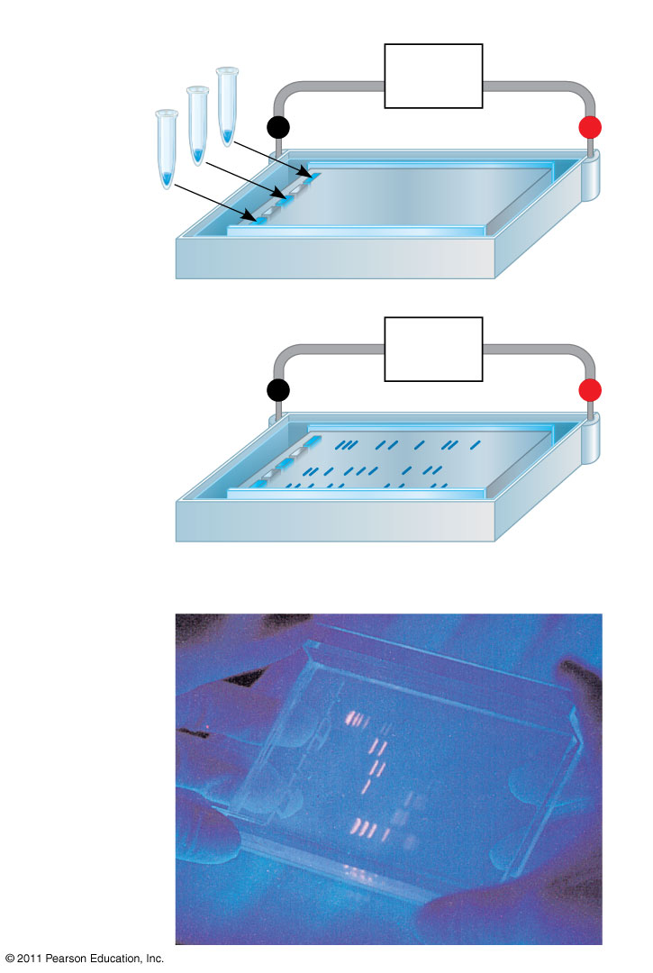
Figure 20.9
TECHNIQUE
1
Power source
Mixture of DNA mol- ecules of different sizes
−
Cathode
Anode
+
Wells
Gel
2
Power source
−
+
Longer molecules
Shorter molecules
RESULTS
Notes:
Figure 20.9 Research Method: Gel Electrophoresis

Slide 55
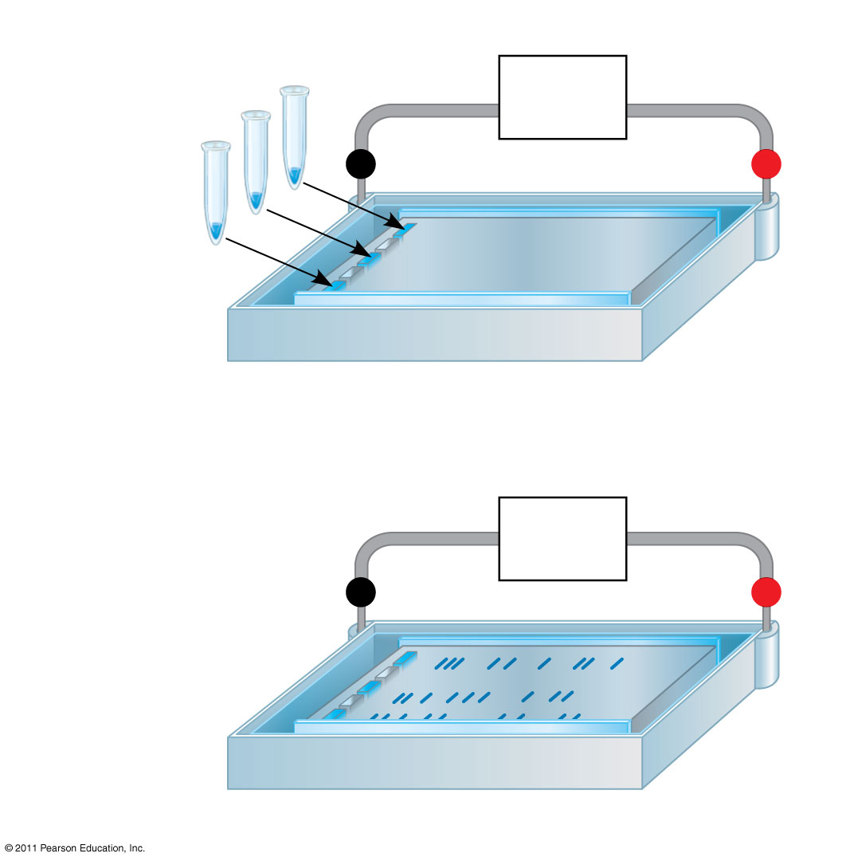
Figure 20.9a
TECHNIQUE
1
Power source
Mixture of DNA mol- ecules of different sizes
−
Cathode
Anode
+
Wells
Gel
2
Power source
−
+
Longer molecules
Shorter molecules
Notes:
Figure 20.9 Research Method: Gel Electrophoresis

Slide 56
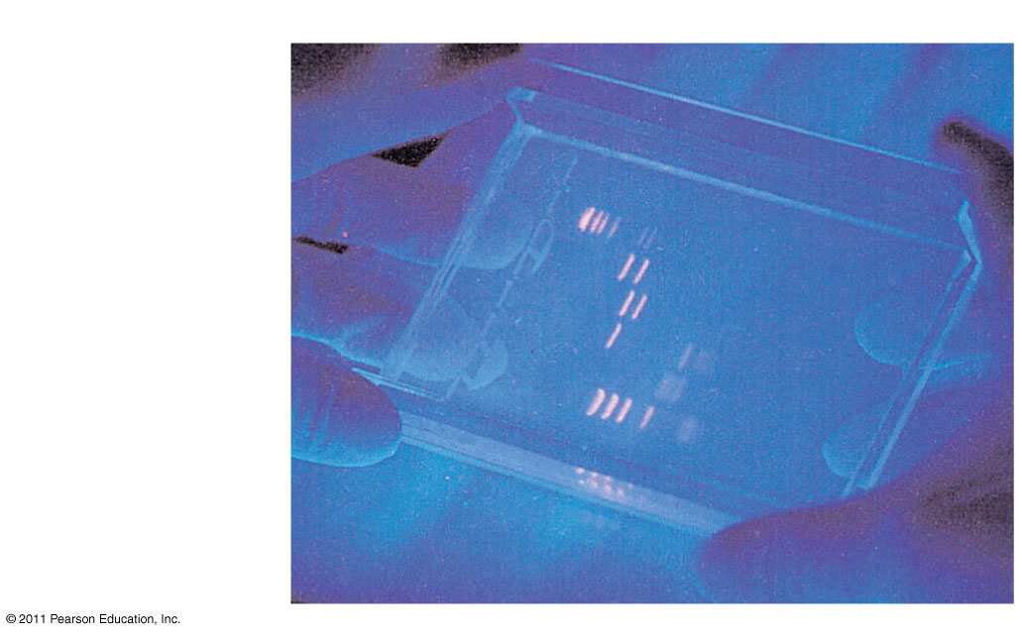
Figure 20.9b
RESULTS
Notes:
Figure 20.9 Research Method: Gel Electrophoresis

Slide 57
In restriction fragment analysis, DNA fragments produced by restriction enzyme digestion of a DNA molecule are sorted by gel electrophoresis
Restriction fragment analysis can be used to compare two different DNA molecules, such as two alleles for a gene, if the nucleotide difference alters a restriction site
© 2011 Pearson Education, Inc.

Slide 58
Variations in DNA sequence are called polymorphisms
Sequence changes that alter restriction sites are called RFLPs (restriction fragment length polymorphisms)
© 2011 Pearson Education, Inc.

Slide 59
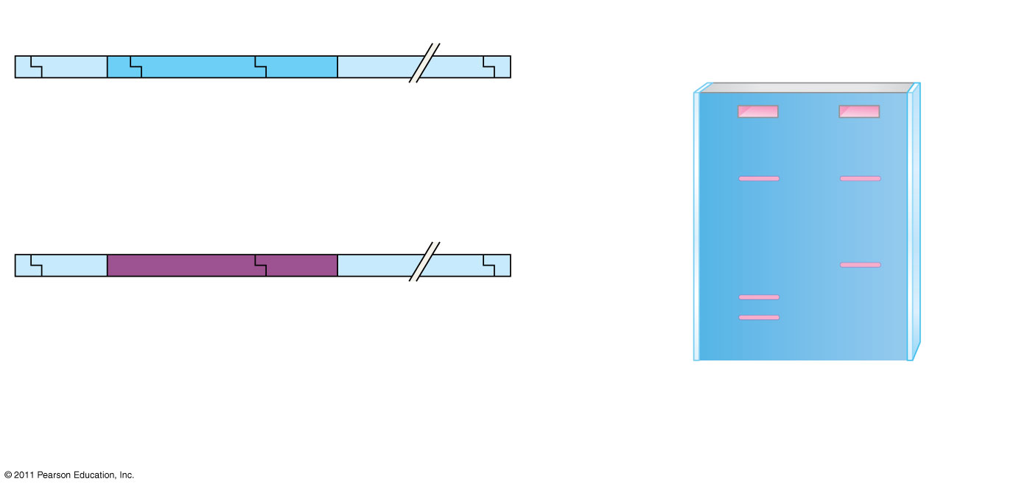
Figure 20.10
Normal β-globin allele
Normal allele
Sickle-cell allele
175 bp
201 bp
Large fragment
DdeI
DdeI
DdeI
DdeI
Large fragment
Sickle-cell mutant β-globin allele
376 bp
201 bp
376 bp
Large fragment
175 bp
DdeI
DdeI
DdeI
(a)
DdeI restriction sites in normal and sickle-cell alleles of the β-globin gene
(b)
Electrophoresis of restriction fragments from normal and sickle-cell alleles
Notes:
Figure 20.10 Using restriction fragment analysis to distinguish the normal and sickle-cell alleles of the human β-globin gene.

Slide 60
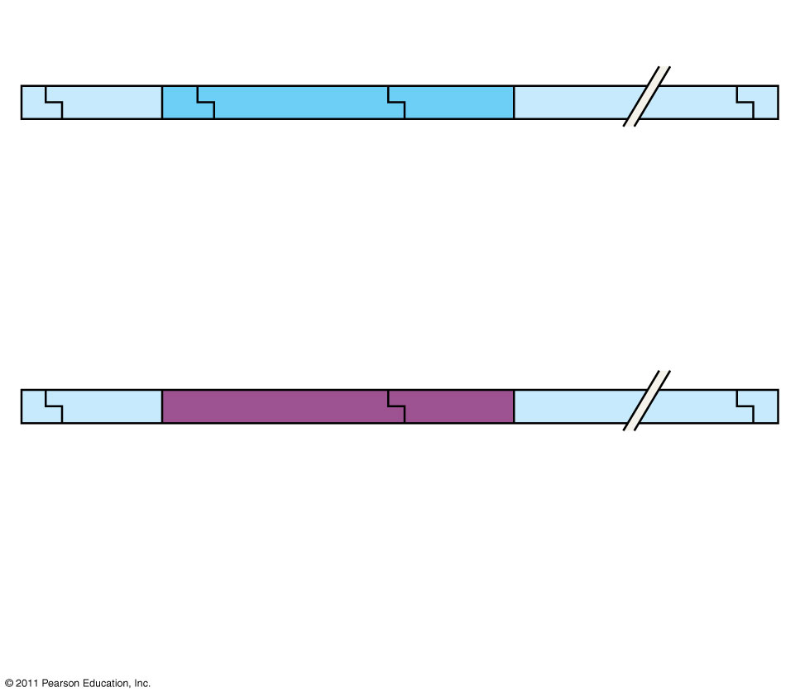
Figure 20.10a
Normal β-globin allele
175 bp
201 bp
Large fragment
DdeI
DdeI
DdeI
DdeI
Sickle-cell mutant β-globin allele
376 bp
Large fragment
DdeI
DdeI
DdeI
(a)
DdeI restriction sites in normal and sickle-cell alleles of the β-globin gene
Notes:
Figure 20.10 Using restriction fragment analysis to distinguish the normal and sickle-cell alleles of the human β-globin gene.

Slide 61
Figure 20.10b
Normal allele
Sickle-cell allele
Large fragment
376 bp
201 bp
175 bp
(b)
Electrophoresis of restriction fragments from normal and sickle-cell alleles
Notes:
Figure 20.10 Using restriction fragment analysis to distinguish the normal and sickle-cell alleles of the human β-globin gene.

Slide 62
A technique called Southern blotting combines gel electrophoresis of DNA fragments with nucleic acid hybridization
Specific DNA fragments can be identified by Southern blotting, using labeled probes that hybridize to the DNA immobilized on a “blot” of gel
© 2011 Pearson Education, Inc.

Slide 63
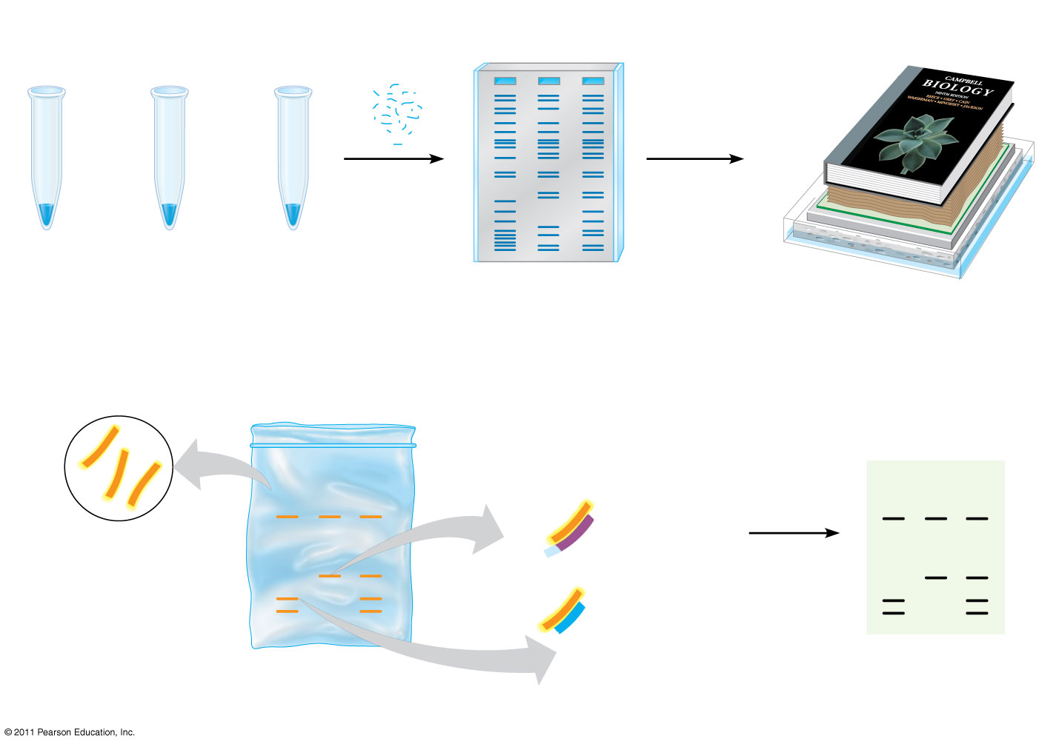
Figure 20.11
TECHNIQUE
Heavy weight
DNA + restriction enzyme
Restriction fragments
I
II
III
Nitrocellulose membrane (blot)
Gel
Sponge
I Normal β-globin allele
II Sickle-cell allele
III Heterozygote
Alkaline solution
Paper towels
1
Preparation of restriction fragments
2
Gel electrophoresis
3
DNA transfer (blotting)
Probe base-pairs with fragments
I
II
III
I
II
III
Radioactively labeled probe for β-globin gene
Fragment from sickle-cell β-globin allele
Film over blot
Fragment from normal β- globin allele
Nitrocellulose blot
4
Hybridization with labeled probe
5
Probe detection
Notes:
Figure 20.11 Research Method: Southern Blotting of DNA Fragments

Slide 64
DNA Sequencing
Relatively short DNA fragments can be sequenced by the dideoxy chain termination method, the first automated method to be employed
Modified nucleotides called dideoxyribonucleotides (ddNTP) attach to synthesized DNA strands of different lengths
Each type of ddNTP is tagged with a distinct fluorescent label that identifies the nucleotide at the end of each DNA fragment
The DNA sequence can be read from the resulting spectrogram
© 2011 Pearson Education, Inc.

Slide 65
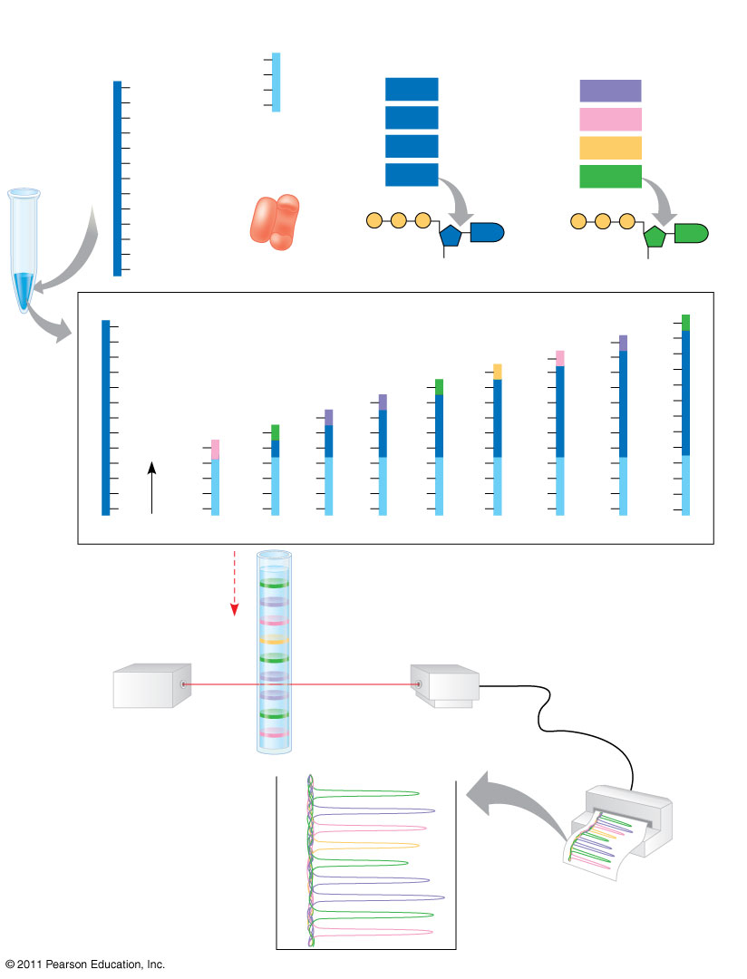
Figure 20.12
TECHNIQUE
DNA (template strand)
Primer
Deoxyribonucleotides
Dideoxyribonucleotides (fluorescently tagged)
T
3′
5′
C
G
T
T
dATP
ddATP
G
T
5′
dCTP
ddCTP
A
DNA polymerase
dTTP
C
ddTTP
T
dGTP
T
ddGTP
C
G
P
P
P
P
P
P
A
G
G
C
3′
A
OH
H
A
5′
DNA (template strand)
Labeled strands
3′
C
ddG
T
ddA
A
G
ddC
C
C
A
ddT
T
T
T
C
ddG
G
G
G
G
T
ddA
A
A
A
A
A
T
ddA
A
A
A
A
A
A
C
ddG
G
G
G
G
G
G
G
G
ddC
C
C
C
C
C
C
C
C
A
T
T
T
T
T
T
T
T
T
T
T
T
C
G
G
T
T
T
T
T
G
A
T
G
T
G
G
G
G
G
T
3′
T
T
T
T
T
T
T
T
T
5′
A
Shortest
T
T
T
T
T
T
Longest
Direction of movement of strands
Longest labeled strand
Detector
Laser
Shortest labeled strand
RESULTS
Last nucleotide of longest labeled strand
G
A
C
T
G
Last nucleotide of shortest labeled strand
A
A
G
C
Notes:
Figure 20.12 Research Method: Dideoxy Chain Termination Method for Sequencing DNA

Slide 66
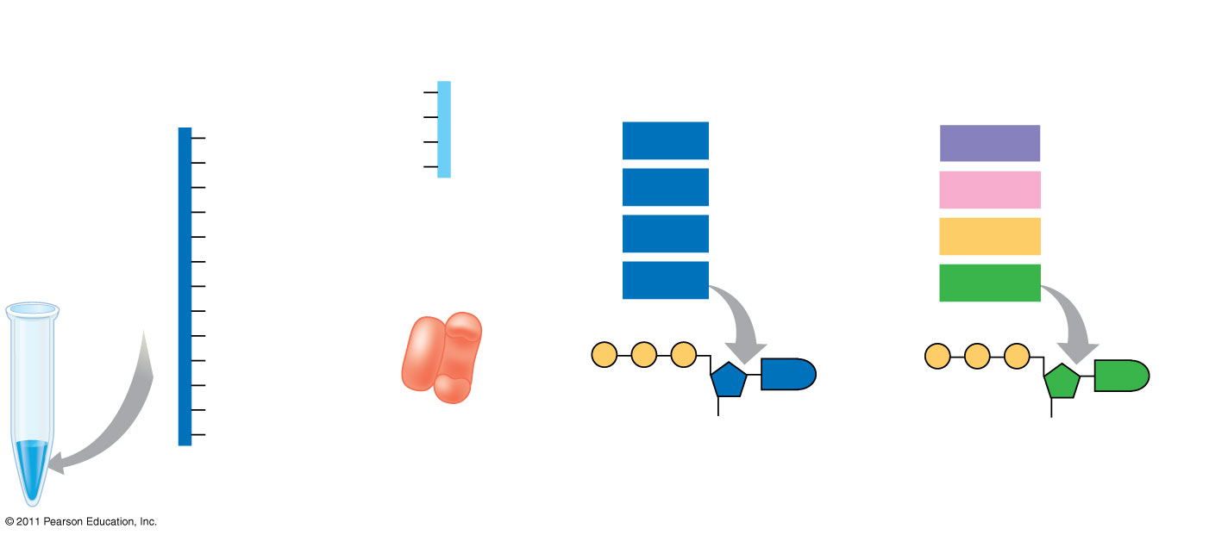
Figure 20.12a
TECHNIQUE
DNA (template strand)
Primer
Deoxyribonucleotides
Dideoxyribonucleotides (fluorescently tagged)
T
3′
5′
G
C
T
dATP
ddATP
T
T
5′
G
dCTP
ddCTP
A
DNA polymerase
C
dTTP
ddTTP
T
T
dGTP
ddGTP
C
G
P
P
P
A
G
P
P
P
C
G
A
3′
A
OH
H
Notes:
Figure 20.12 Research Method: Dideoxy Chain Termination Method for Sequencing DNA

Slide 67
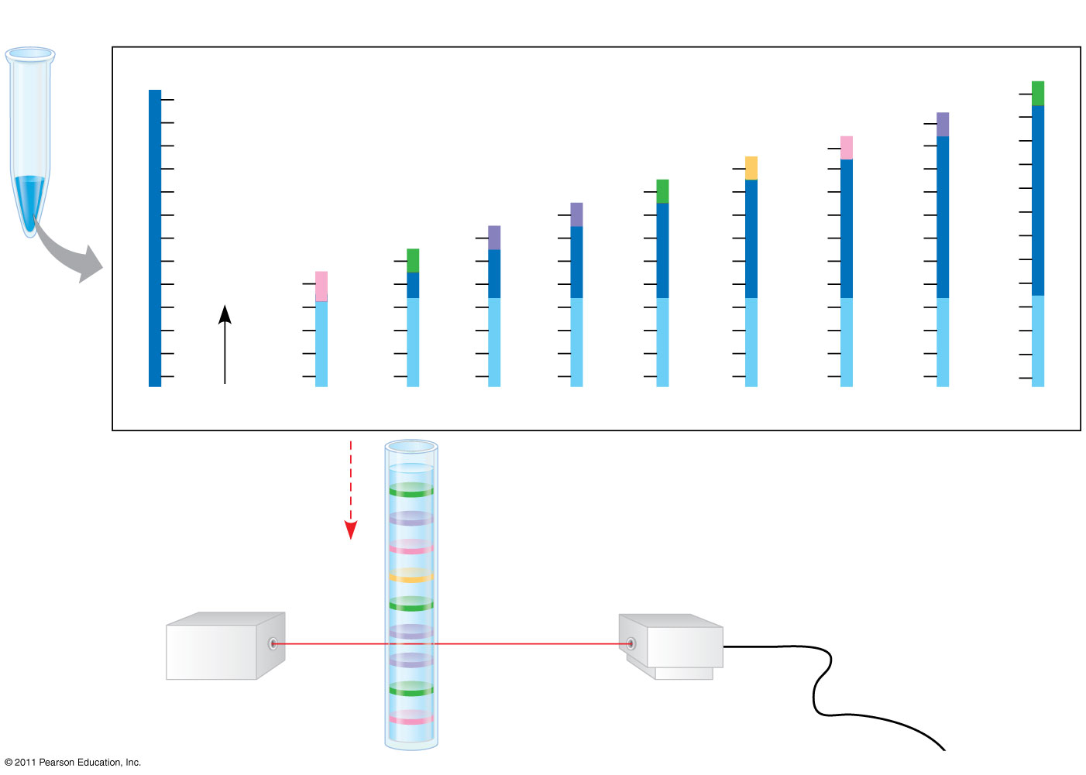
Figure 20.12b
TECHNIQUE (continued)
DNA (template strand)
Labeled strands
3′
5′
C
ddG
T
ddA
A
G
ddC
C
C
A
ddT
T
T
T
C
ddG
G
G
G
G
T
ddA
A
A
A
A
A
T
ddA
A
A
A
A
A
A
C
ddG
G
G
G
G
G
G
G
G
ddC
C
C
C
C
C
C
C
C
A
T
T
T
T
T
T
T
T
T
C
G
G
G
G
G
G
G
G
G
A
T
T
T
T
T
T
T
T
T
3′
A
T
T
T
T
T
T
T
T
T
5′
Shortest
Longest
Direction of movement of strands
Longest labeled strand
Detector
Laser
Shortest labeled strand
Notes:
Figure 20.12 Research Method: Dideoxy Chain Termination Method for Sequencing DNA

Slide 68
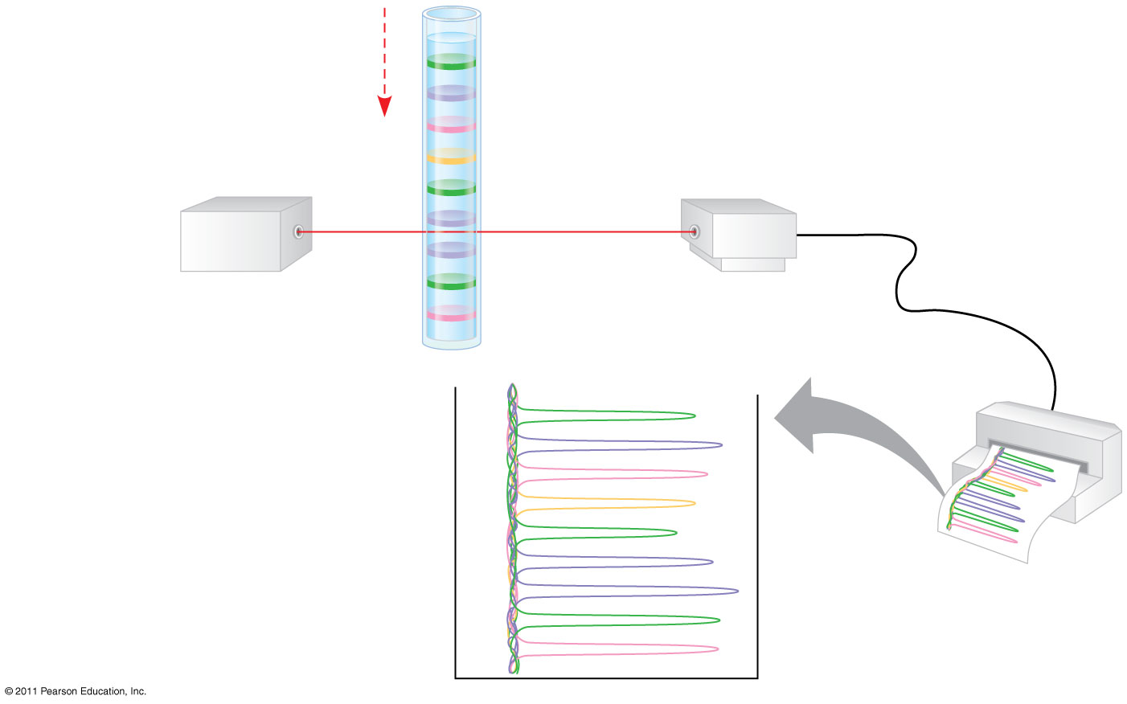
Figure 20.12c
Direction of movement of strands
Longest labeled strand
Detector
Laser
Shortest labeled strand
RESULTS
Last nucleotide of longest labeled strand
G
A
C
T
G
Last nucleotide of shortest labeled strand
A
A
G
C
Notes:
Figure 20.12 Research Method: Dideoxy Chain Termination Method for Sequencing DNA

Slide 69
Analyzing Gene Expression
Nucleic acid probes can hybridize with mRNAs transcribed from a gene
Probes can be used to identify where or when a gene is transcribed in an organism
© 2011 Pearson Education, Inc.

Slide 70
Studying the Expression of Single Genes
Changes in the expression of a gene during embryonic development can be tested using
Northern blotting
Reverse transcriptase-polymerase chain reaction
Both methods are used to compare mRNA from different developmental stages
© 2011 Pearson Education, Inc.

Slide 71
Northern blotting combines gel electrophoresis of mRNA followed by hybridization with a probe on a membrane
Identification of mRNA at a particular developmental stage suggests protein function at that stage
© 2011 Pearson Education, Inc.

Slide 72
Reverse transcriptase-polymerase chain reaction (RT-PCR) is quicker and more sensitive because it requires less mRNA than Northern blotting
Reverse transcriptase is added to mRNA to make cDNA, which serves as a template for PCR amplification of the gene of interest
The products are run on a gel and the mRNA of interest is identified
© 2011 Pearson Education, Inc.

Slide 73
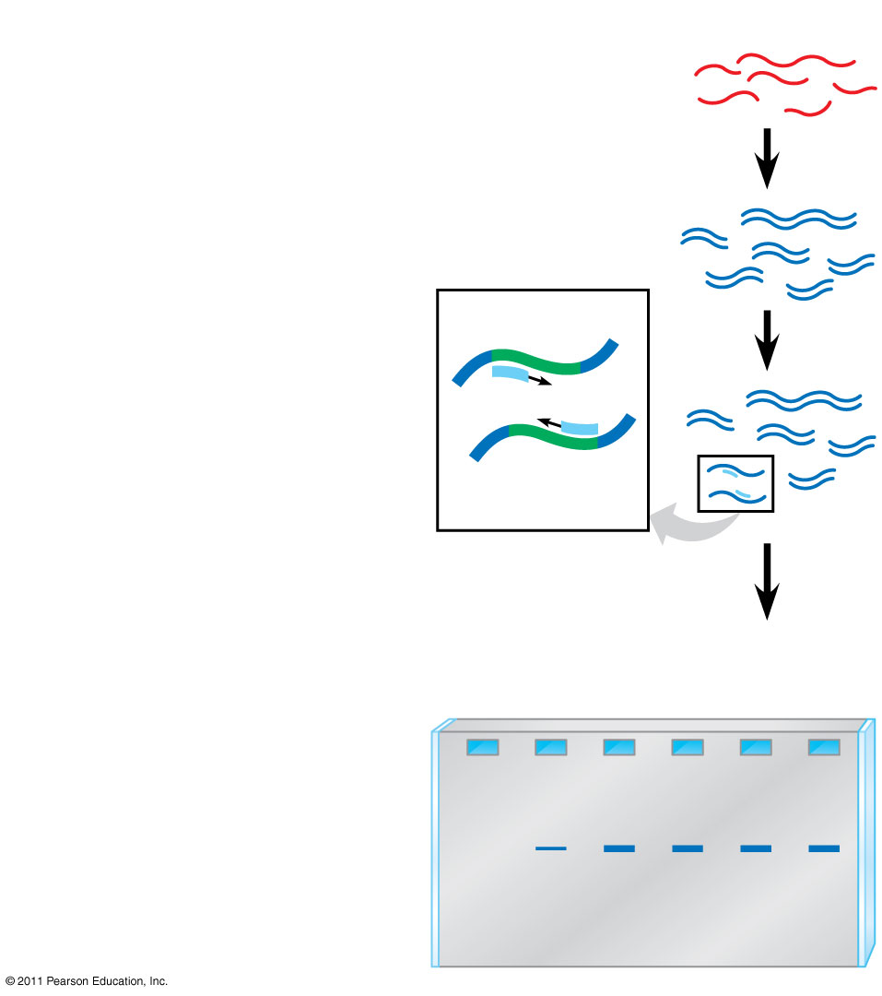
Figure 20.13
TECHNIQUE
1
cDNA synthesis
mRNAs
cDNAs
Primers
2
PCR amplification
β-globin gene
3
Gel electrophoresis
RESULTS
Embryonic stages
1
2
3
4
5
6
Notes:
Figure 20.13 Research Method: RT-PCR Analysis of the Expression of Single Genes

Slide 74
In situ hybridization uses fluorescent dyes attached to probes to identify the location of specific mRNAs in place in the intact organism
© 2011 Pearson Education, Inc.

Slide 75
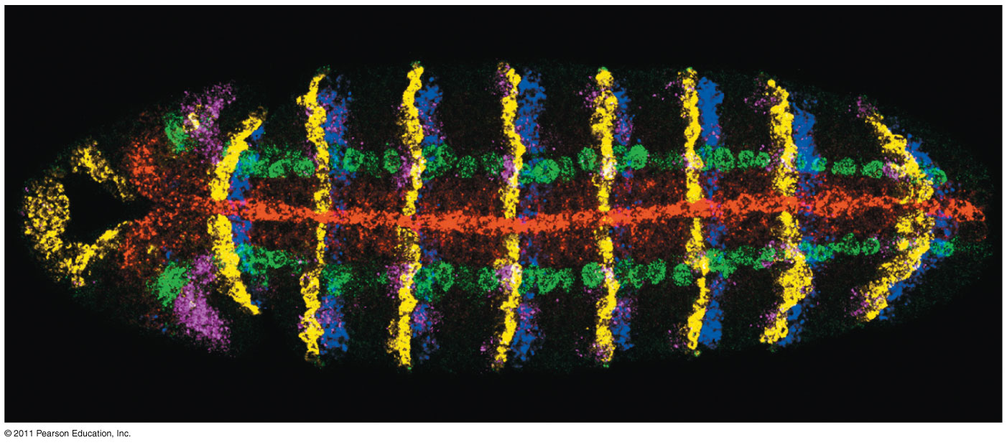
Figure 20.14
50 μm
Notes:
Figure 20.14 Determining where genes are expressed by in situ hybridization analysis.

Slide 76
Studying the Expression of Interacting Groups of Genes
Automation has allowed scientists to measure the expression of thousands of genes at one time using DNA microarray assays
DNA microarray assays compare patterns of gene expression in different tissues, at different times, or under different conditions
© 2011 Pearson Education, Inc.

Slide 77
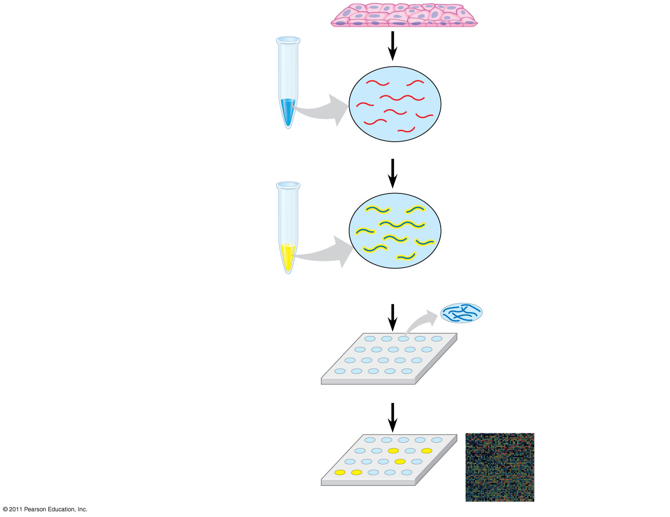
Figure 20.15
TECHNIQUE
1
Isolate mRNA.
Tissue sample
2
Make cDNA by reverse transcription, using fluorescently labeled nucleotides.
mRNA molecules
Labeled cDNA molecules (single strands)
3
Apply the cDNA mixture to a microarray, a different gene in each spot. The cDNA hybridizes with any complementary DNA on the microarray.
DNA fragments representing a specific gene
DNA microarray
4
Rinse off excess cDNA; scan microarray for fluorescence. Each fluorescent spot (yellow) represents a gene expressed in the tissue sample.
DNA microarray with 2,400 human genes
Notes:
Figure 20.15 Research Method: DNA Microarray Assay of Gene Expression Levels

Slide 78
Figure 20.15a
DNA microarray with 2,400 human genes
Notes:
Figure 20.15 Research Method: DNA Microarray Assay of Gene Expression Levels

Slide 79
Determining Gene Function
One way to determine function is to disable the gene and observe the consequences
Using in vitro mutagenesis, mutations are introduced into a cloned gene, altering or destroying its function
When the mutated gene is returned to the cell, the normal gene’s function might be determined by examining the mutant’s phenotype
© 2011 Pearson Education, Inc.

Slide 80
Gene expression can also be silenced using RNA interference (RNAi)
Synthetic double-stranded RNA molecules matching the sequence of a particular gene are used to break down or block the gene’s mRNA
© 2011 Pearson Education, Inc.

Slide 81
In humans, researchers analyze the genomes of many people with a certain genetic condition to try to find nucleotide changes specific to the condition
Genetic markers called SNPs (single nucleotide polymorphisms) occur on average every 100–300 base pairs
SNPs can be detected by PCR, and any SNP shared by people affected with a disorder but not among unaffected people may pinpoint the location of the disease-causing gene
© 2011 Pearson Education, Inc.

Slide 82
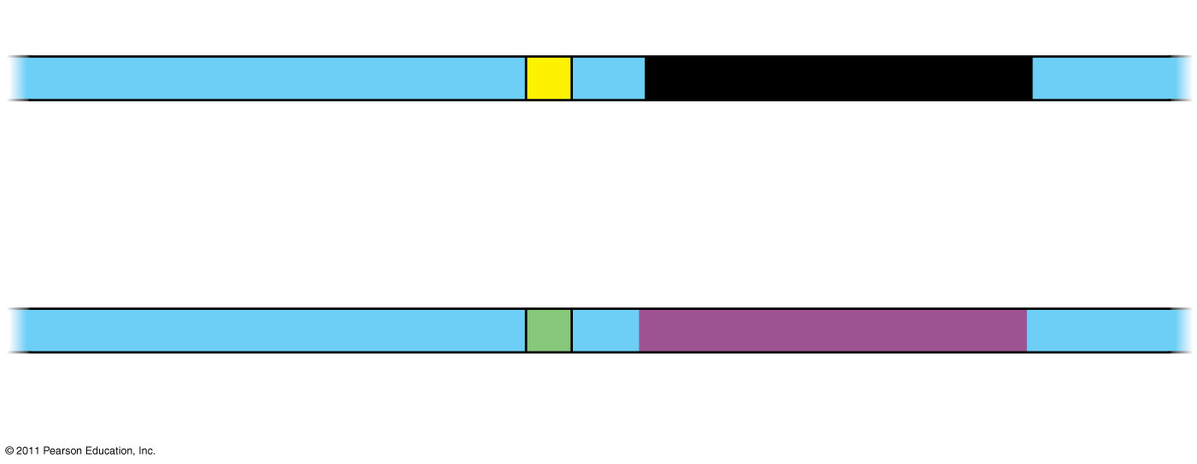
Figure 20.16
DNA
T
Normal allele
SNP
C
Disease-causing allele
Notes:
Figure 20.16 Single nucleotide polymorphisms (SNPs) as genetic markers for disease-causing alleles.

Slide 83
Concept 20.3: Cloning organisms may lead to production of stem cells for research and other applications
Organismal cloning produces one or more organisms genetically identical to the “parent” that donated the single cell
© 2011 Pearson Education, Inc.

Slide 84
Cloning Plants: Single-Cell Cultures
One experimental approach for testing genomic equivalence is to see whether a differentiated cell can generate a whole organism
A totipotent cell is one that can generate a complete new organism
Plant cloning is used extensively in agriculture
© 2011 Pearson Education, Inc.

Slide 85
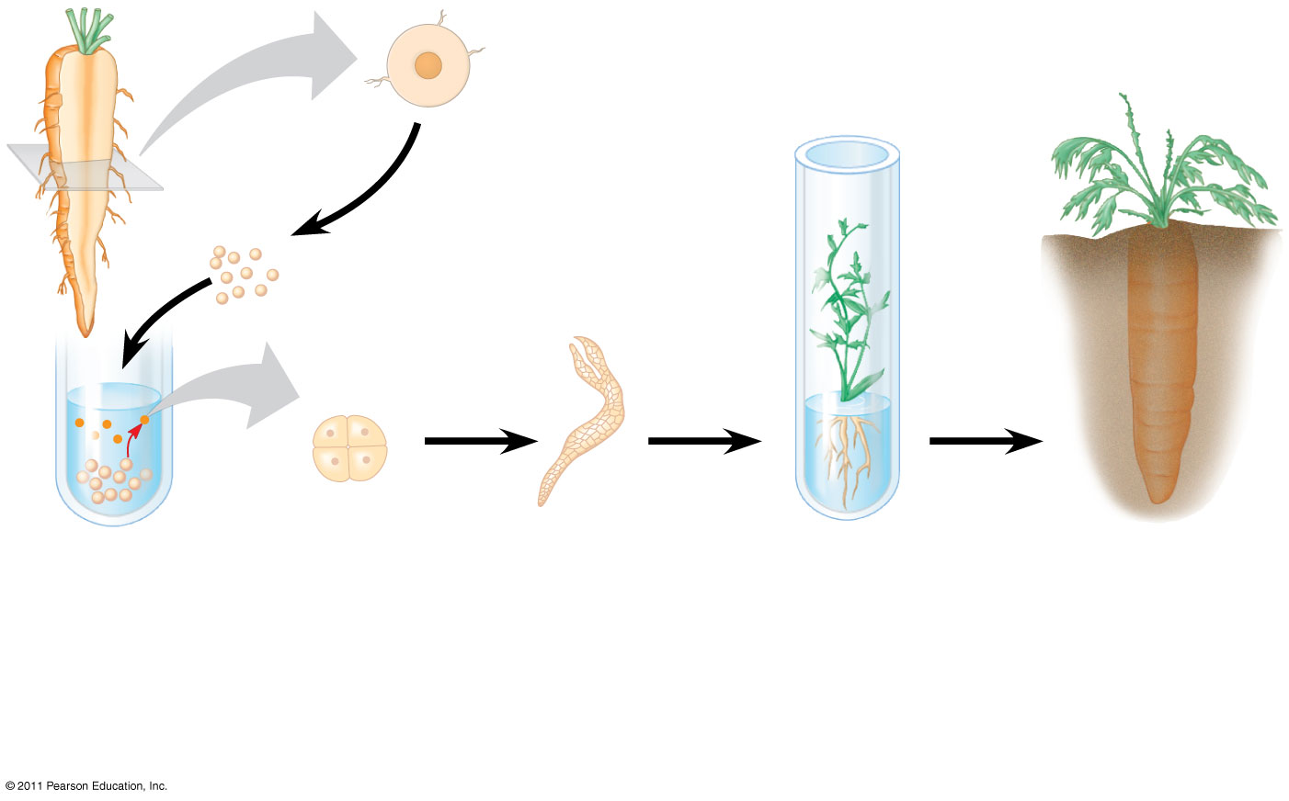
Figure 20.17
Cross section of carrot root
2-mg fragments
Fragments were cultured in nu- trient medium; stirring caused single cells to shear off into the liquid.
Single cells free in suspension began to divide.
Embryonic plant developed from a cultured single cell.
Plantlet was cultured on agar medium. Later it was planted in soil.
Adult plant
Notes:
Figure 20.17 The cloning of a whole carrot plant from a single carrot cell.

Slide 86
Cloning Animals: Nuclear Transplantation
In nuclear transplantation, the nucleus of an unfertilized egg cell or zygote is replaced with the nucleus of a differentiated cell
Experiments with frog embryos have shown that a transplanted nucleus can often support normal development of the egg
However, the older the donor nucleus, the lower the percentage of normally developing tadpoles
© 2011 Pearson Education, Inc.

Slide 87
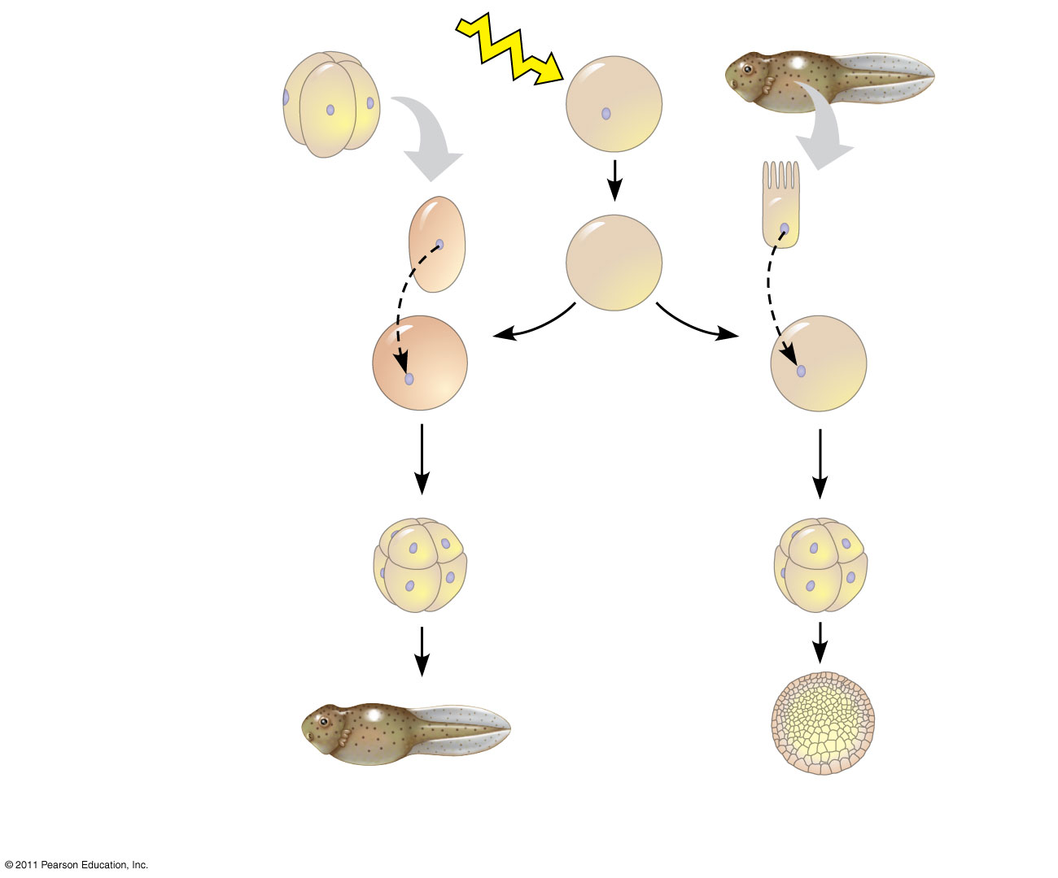
Figure 20.18
EXPERIMENT
Frog embryo
Frog egg cell
Frog tadpole
UV
Fully differ- entiated (intestinal) cell
Less differ- entiated cell
Donor nucleus trans- planted
Donor nucleus trans- planted
Enucleated egg cell
Egg with donor nucleus activated to begin development
RESULTS
Most develop into tadpoles.
Most stop developing before tadpole stage.
Notes:
Figure 20.18 Inquiry: Can the nucleus from a differentiated animal cell direct development of an organism?

Slide 88
Reproductive Cloning of Mammals
In 1997, Scottish researchers announced the birth of Dolly, a lamb cloned from an adult sheep by nuclear transplantation from a differentiated mammary cell
Dolly’s premature death in 2003, as well as her arthritis, led to speculation that her cells were not as healthy as those of a normal sheep, possibly reflecting incomplete reprogramming of the original transplanted nucleus
© 2011 Pearson Education, Inc.

Slide 89
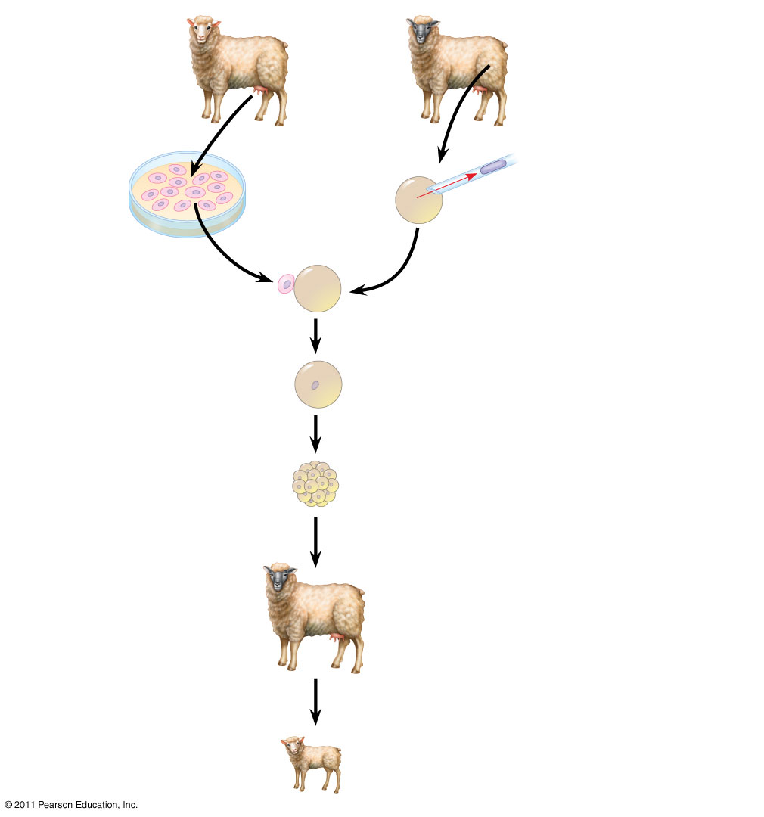
Figure 20.19
TECHNIQUE
Mammary cell donor
Egg cell donor
1
Egg cell from ovary
2
Nucleus removed
3
Cells fused
Cultured mammary cells
Nucleus from mammary cell
4
Grown in culture
Early embryo
5
Implanted in uterus of a third sheep
Surrogate mother
6
Embryonic development
RESULTS
Lamb (“Dolly”) genetically identical to mammary cell donor
Notes:
Figure 20.19 Research Method: Reproductive Cloning of a Mammal by Nuclear Transplantation

Slide 90
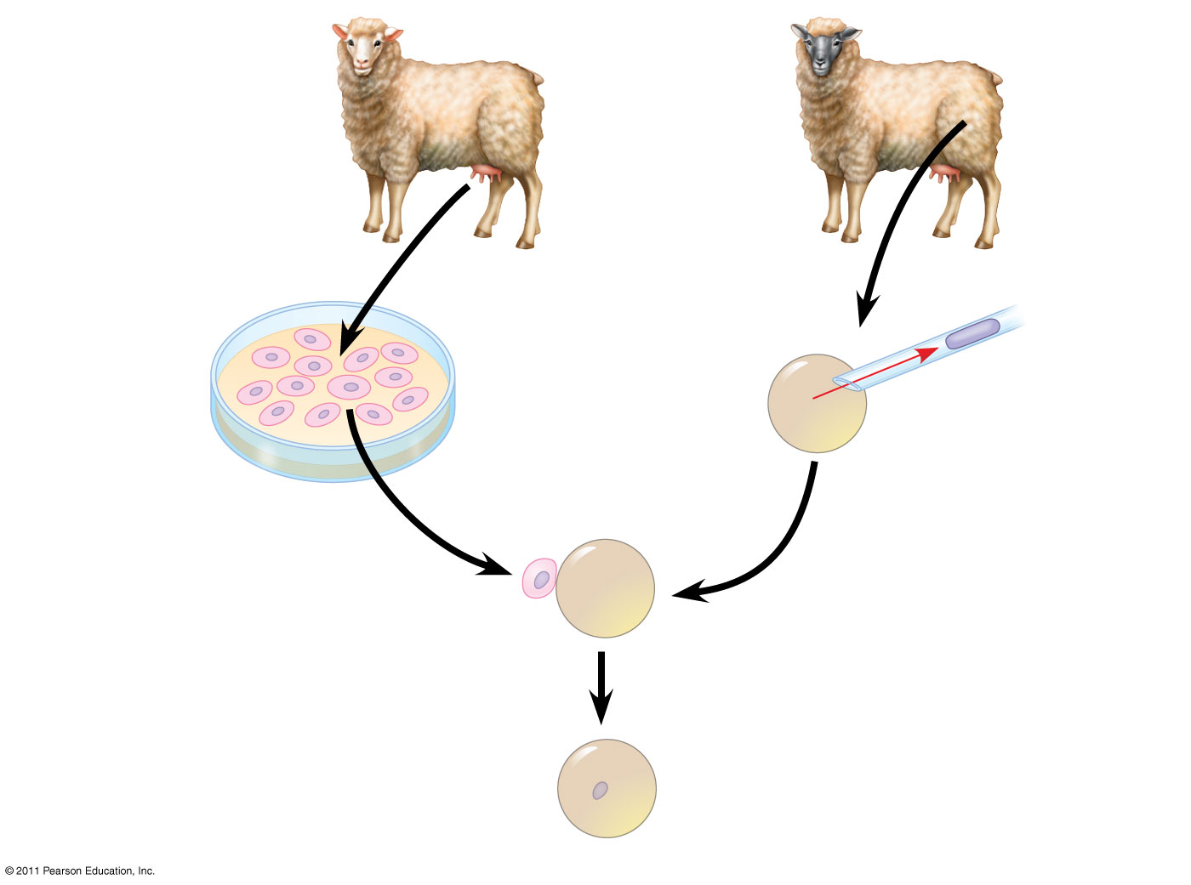
Figure 20.19a
TECHNIQUE
Mammary cell donor
Egg cell donor
1
2
Egg cell from ovary
Nucleus removed
3
Cells fused
Cultured mammary cells
Nucleus from mammary cell
Notes:
Figure 20.19 Research Method: Reproductive Cloning of a Mammal by Nuclear Transplantation

Slide 91
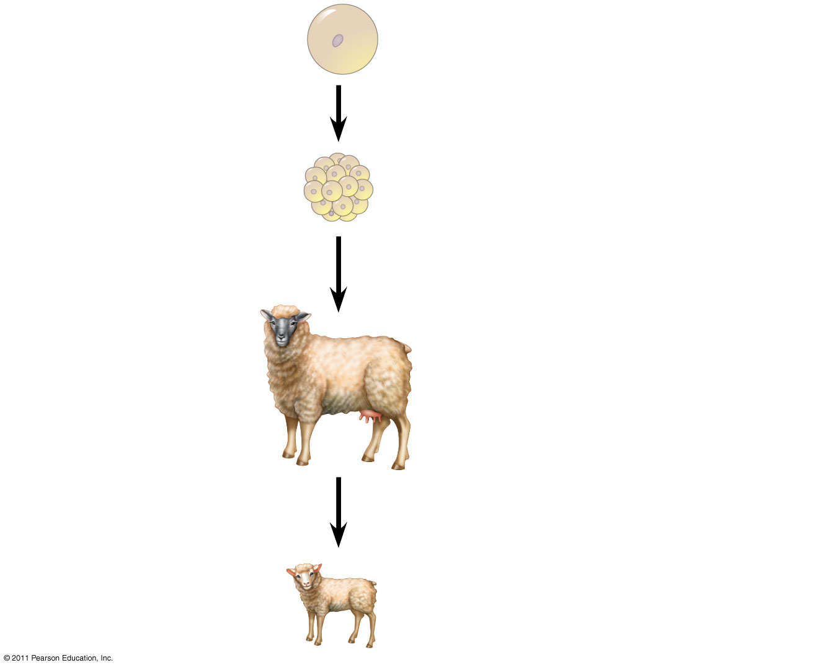
Figure 20.19b
Nucleus from mammary cell
4
Grown in culture
Early embryo
5
Implanted in uterus of a third sheep
Surrogate mother
6
Embryonic development
RESULTS
Lamb (“Dolly”) genetically identical to mammary cell donor
Notes:
Figure 20.19 Research Method: Reproductive Cloning of a Mammal by Nuclear Transplantation

Slide 92
Since 1997, cloning has been demonstrated in many mammals, including mice, cats, cows, horses, mules, pigs, and dogs
CC (for Carbon Copy) was the first cat cloned; however, CC differed somewhat from her female “parent”
Cloned animals do not always look or behave exactly the same
© 2011 Pearson Education, Inc.

Slide 93
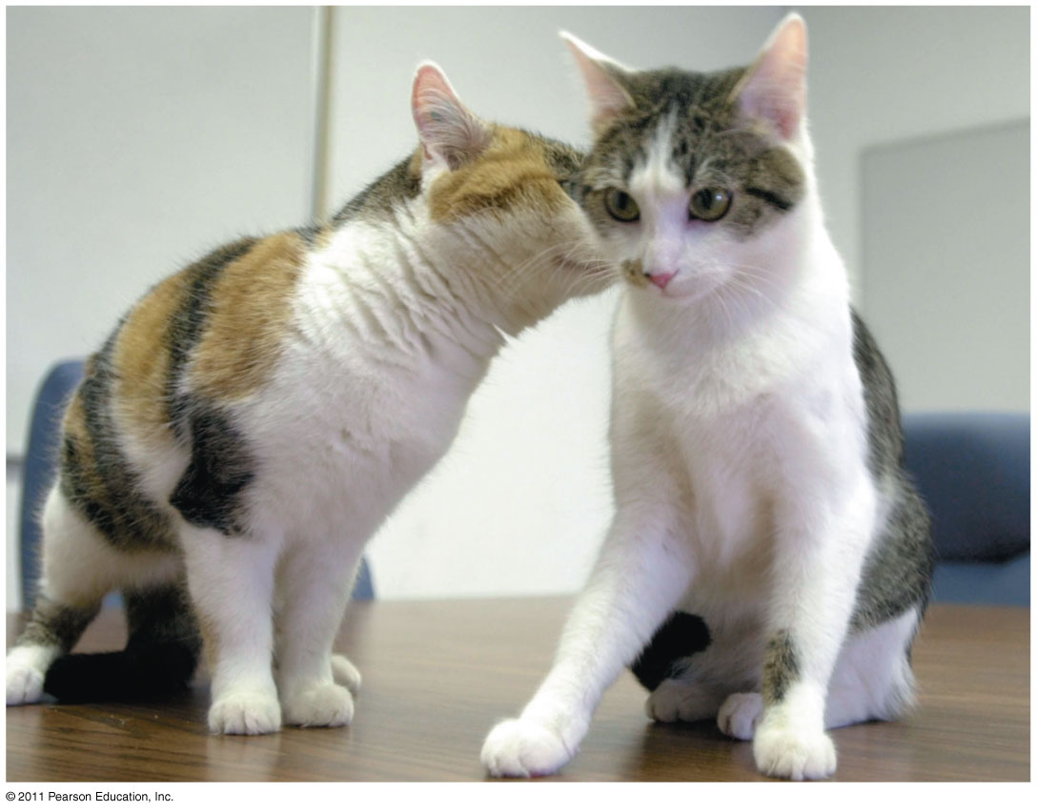
Figure 20.20
Notes:
Figure 20.20 CC, the first cloned cat, and her single parent.

Slide 94
Problems Associated with Animal Cloning
In most nuclear transplantation studies, only a small percentage of cloned embryos have developed normally to birth, and many cloned animals exhibit defects
Many epigenetic changes, such as acetylation of histones or methylation of DNA, must be reversed in the nucleus from a donor animal in order for genes to be expressed or repressed appropriately for early stages of development
© 2011 Pearson Education, Inc.

Slide 95
Stem Cells of Animals
A stem cell is a relatively unspecialized cell that can reproduce itself indefinitely and differentiate into specialized cells of one or more types
Stem cells isolated from early embryos at the blastocyst stage are called embryonic stem (ES) cells; these are able to differentiate into all cell types
The adult body also has stem cells, which replace nonreproducing specialized cells
© 2011 Pearson Education, Inc.

Slide 96
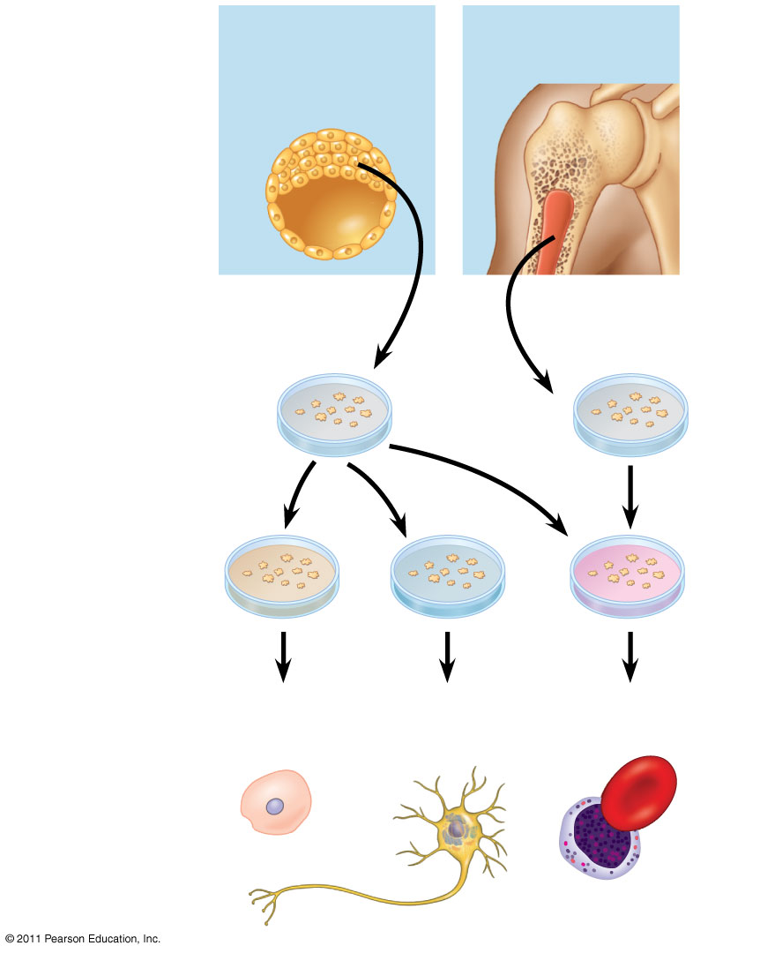
Figure 20.21
Embryonic stem cells
Adult stem cells
Cells generating all embryonic cell types
Cells generating some cell types
Cultured stem cells
Different culture conditions
Liver cells
Nerve cells
Blood cells
Different types of differentiated cells
Notes:
Figure 20.21 Working with stem cells.

Slide 97
Researchers can transform skin cells into ES cells by using viruses to introduce stem cell master regulatory genes
These transformed cells are called iPS cells (induced pluripotent cells)
These cells can be used to treat some diseases and to replace nonfunctional tissues
© 2011 Pearson Education, Inc.

Slide 98
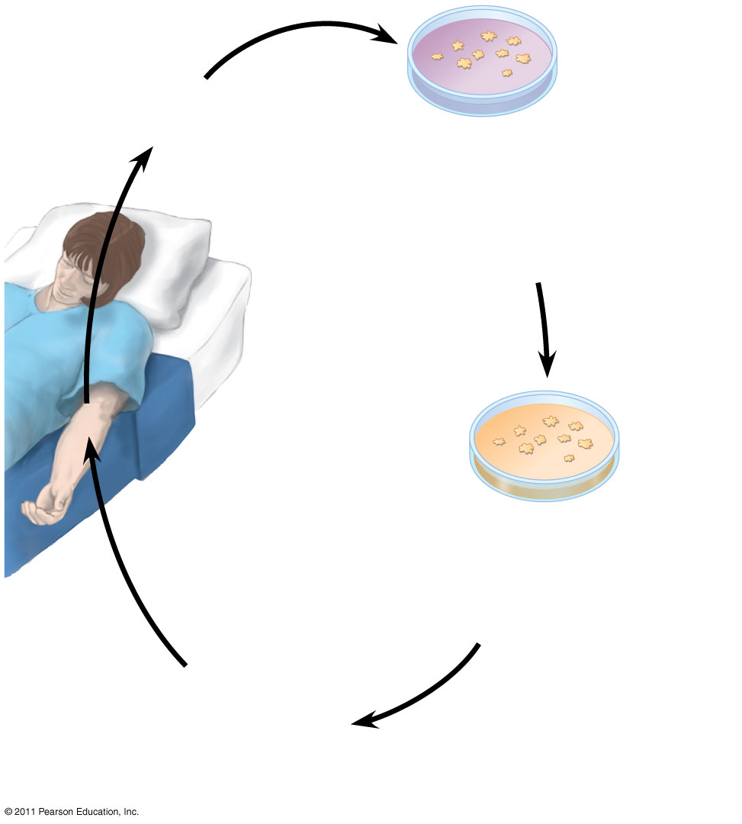
Figure 20.22
1
Remove skin cells from patient.
2
Reprogram skin cells so the cells become induced pluripotent stem (iPS) cells.
Patient with damaged heart tissue or other disease
3
Treat iPS cells so that they differentiate into a specific cell type.
4
Return cells to patient, where they can repair damaged tissue.
Notes:
Figure 20.22 Impact: The Impact of Induced Pluripotent Stem (iPS) Cells on Regenerative Medicine

Slide 99
Concept 20.4: The practical applications of DNA technology affect our lives in many ways
Many fields benefit from DNA technology and genetic engineering
© 2011 Pearson Education, Inc.

Slide 100
Medical Applications
One benefit of DNA technology is identification of human genes in which mutation plays a role in genetic diseases
© 2011 Pearson Education, Inc.

Slide 101
Diagnosis and Treatment of Diseases
Scientists can diagnose many human genetic disorders using PCR and sequence-specific primers, then sequencing the amplified product to look for the disease-causing mutation
SNPs may be associated with a disease-causing mutation
SNPs may also be correlated with increased risks for conditions such as heart disease or certain types of cancer
© 2011 Pearson Education, Inc.

Slide 102
Human Gene Therapy
Gene therapy is the alteration of an afflicted individual’s genes
Gene therapy holds great potential for treating disorders traceable to a single defective gene
Vectors are used for delivery of genes into specific types of cells, for example bone marrow
Gene therapy provokes both technical and ethical questions
© 2011 Pearson Education, Inc.

Slide 103
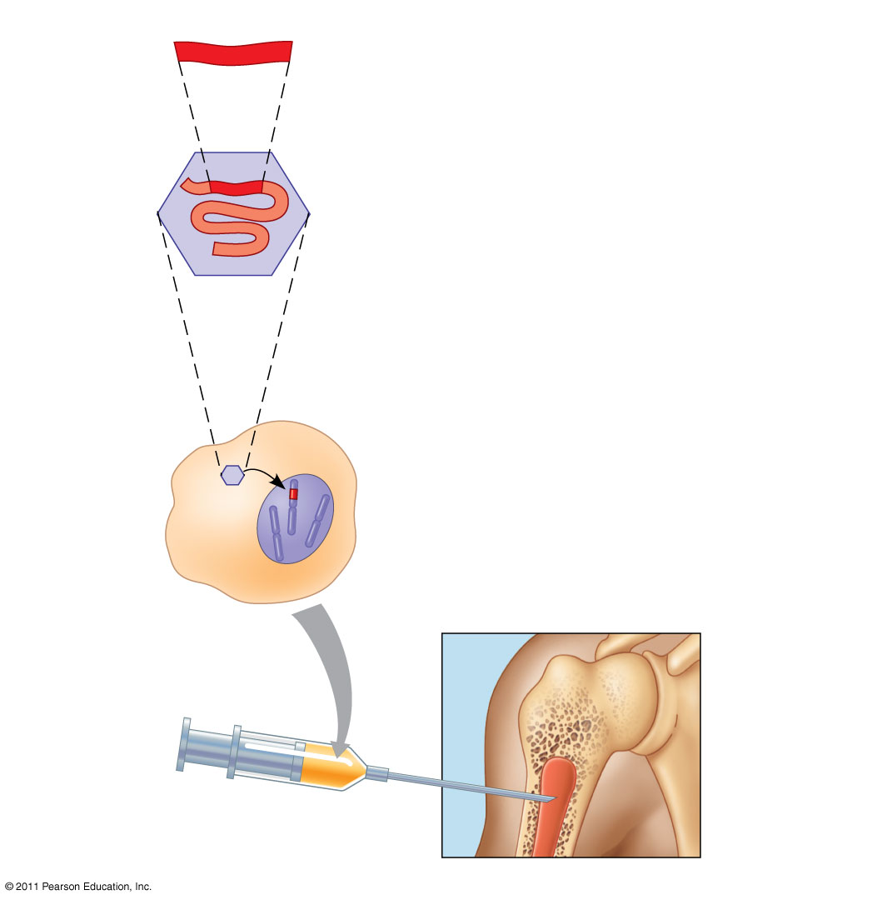
Figure 20.23
Cloned gene
1
Insert RNA version of normal allele into retrovirus.
Viral RNA
2
Let retrovirus infect bone marrow cells that have been removed from the patient and cultured.
Retrovirus capsid
3
Viral DNA carrying the normal allele inserts into chromosome.
Bone marrow cell from patient
Inject engineered cells into patient.
Bone marrow
4
Notes:
Figure 20.23 Gene therapy using a retroviral vector.

Slide 104
Pharmaceutical Products
Advances in DNA technology and genetic research are important to the development of new drugs to treat diseases
© 2011 Pearson Education, Inc.

Slide 105
Synthesis of Small Molecules for Use as Drugs
The drug imatinib is a small molecule that inhibits overexpression of a specific leukemia-causing receptor
Pharmaceutical products that are proteins can be synthesized on a large scale
© 2011 Pearson Education, Inc.

Slide 106
Protein Production in Cell Cultures
Host cells in culture can be engineered to secrete a protein as it is made, simplifying the task of purifying it
This is useful for the production of insulin, human growth hormones, and vaccines
© 2011 Pearson Education, Inc.

Slide 107
Protein Production by “Pharm” Animals
Transgenic animals are made by introducing genes from one species into the genome of another animal
Transgenic animals are pharmaceutical “factories,” producers of large amounts of otherwise rare substances for medical use
© 2011 Pearson Education, Inc.

Slide 108
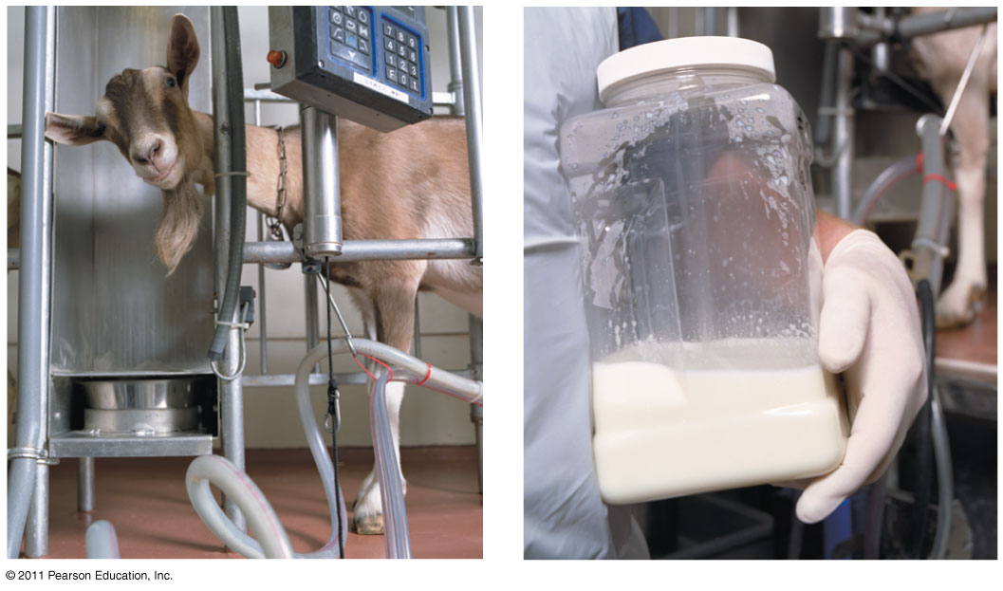
Figure 20.24
Notes:
Figure 20.24 Goats as “pharm” animals.

Slide 109
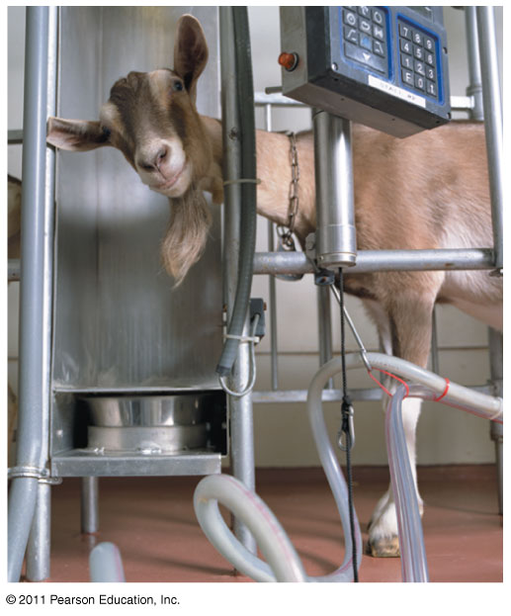
Figure 20.24a
Notes:
Figure 20.24 Goats as “pharm” animals.

Slide 110
Figure 20.24b
Notes:
Figure 20.24 Goats as “pharm” animals.

Slide 111
Forensic Evidence and Genetic Profiles
An individual’s unique DNA sequence, or genetic profile, can be obtained by analysis of tissue or body fluids
DNA testing can identify individuals with a high degree of certainty
Genetic profiles can be analyzed using RFLP analysis by Southern blotting
© 2011 Pearson Education, Inc.

Slide 112
Even more sensitive is the use of genetic markers called short tandem repeats (STRs), which are variations in the number of repeats of specific DNA sequences
PCR and gel electrophoresis are used to amplify and then identify STRs of different lengths
The probability that two people who are not identical twins have the same STR markers is exceptionally small
© 2011 Pearson Education, Inc.

Slide 113
Figure 20.25
(a)
This photo shows Washington just before his release in 2001, after 17 years in prison.
Source of sample
STR marker 1
STR marker 2
STR marker 3
Semen on victim
17,19
13,16
12,12
Earl Washington
16,18
14,15
11,12
Kenneth Tinsley
17,19
13,16
12,12
(b)
These and other STR data exonerated Washington and led Tinsley to plead guilty to the murder.
Notes:
Figure 20.25 STR analysis used to release an innocent man from prison.

Slide 114
Figure 20.25a
(a)
This photo shows Washington just before his release in 2001, after 17 years in prison.
Notes:
Figure 20.25 STR analysis used to release an innocent man from prison.

Slide 115
Environmental Cleanup
Genetic engineering can be used to modify the metabolism of microorganisms
Some modified microorganisms can be used to extract minerals from the environment or degrade potentially toxic waste materials
© 2011 Pearson Education, Inc.

Slide 116
Agricultural Applications
DNA technology is being used to improve agricultural productivity and food quality
Genetic engineering of transgenic animals speeds up the selective breeding process
Beneficial genes can be transferred between varieties or species
© 2011 Pearson Education, Inc.

Slide 117
Agricultural scientists have endowed a number of crop plants with genes for desirable traits
The Ti plasmid is the most commonly used vector for introducing new genes into plant cells
Genetic engineering in plants has been used to transfer many useful genes including those for herbicide resistance, increased resistance to pests, increased resistance to salinity, and improved nutritional value of crops
© 2011 Pearson Education, Inc.

Slide 118
Figure 20.26
TECHNIQUE
Agrobacterium tumefaciens
Ti plasmid
Site where restriction enzyme cuts
T DNA
DNA with the gene of interest
RESULTS
Recombinant Ti plasmid
Plant with new trait
Notes:
Figure 20.26 Research Method: Using the Ti Plasmid to Produce Transgenic Plants

Slide 119
Safety and Ethical Questions Raised by DNA Technology
Potential benefits of genetic engineering must be weighed against potential hazards of creating harmful products or procedures
Guidelines are in place in the United States and other countries to ensure safe practices for recombinant DNA technology
© 2011 Pearson Education, Inc.

Slide 120
Most public concern about possible hazards centers on genetically modified (GM) organisms used as food
Some are concerned about the creation of “super weeds” from the transfer of genes from GM crops to their wild relatives
Other worries include the possibility that transgenic protein products might cause allergic reactions
© 2011 Pearson Education, Inc.

Slide 121
As biotechnology continues to change, so does its use in agriculture, industry, and medicine
National agencies and international organizations strive to set guidelines for safe and ethical practices in the use of biotechnology
© 2011 Pearson Education, Inc.

Slide 122
Figure 20.UN03
5′
3′
5′
3′
G
AATTC
CTTAA
G
3′
5′
3′
5′
Sticky end
Notes:
Figure 20.UN03 Summary figure, Concept 20.1

Slide 123
Figure 20.UN04
Cloning vector
DNA fragments from genomic DNA or cDNA or copy of DNA obtained by PCR
Mix and ligate
Recombinant DNA plasmids
Notes:
Figure 20.UN04 Summary figure, Concept 20.1

Slide 124
Figure 20.UN05
5′
TCCATGAATTCTAAAGCGCTTATGAATTCACGGC
3′
3′
AGGTACTTAAGATTTCGCGAATACTTAAGTGCCG
5′
Aardvark DNA
G
A
A
T
C
T
T
T
A
C
A
G
Plasmid
Notes:
Figure 20.UN05 Test Your Understanding, question 9

Slide 125
Figure 20.UN06
Notes:
Figure 20.UN06 Appendix A: answer to Figure 20.3 legend question

Slide 126
Figure 20.UN07
Notes:
Figure 20.UN07 Appendix A: answer to Concept Check 20.1, question 2

Slide 127
Figure 20.UN08
Notes:
Figure 20.UN08 Appendix A: answer to Test Your Understanding, question 9

