Slide 1
Chapter 30
Plant Diversity II: The Evolution of Seed Plants
Notes:
‹#›

Slide 2
Overview: Transforming the World
Seeds changed the course of plant evolution, enabling their bearers to become the dominant producers in most terrestrial ecosystems
Seed plants originated about 360 million years ago
A seed consists of an embryo and nutrients surrounded by a protective coat
Domestication of seed plants had begun by 8,000 years ago and allowed for permanent settlements
© 2011 Pearson Education, Inc.
Notes:
‹#›

Slide 3
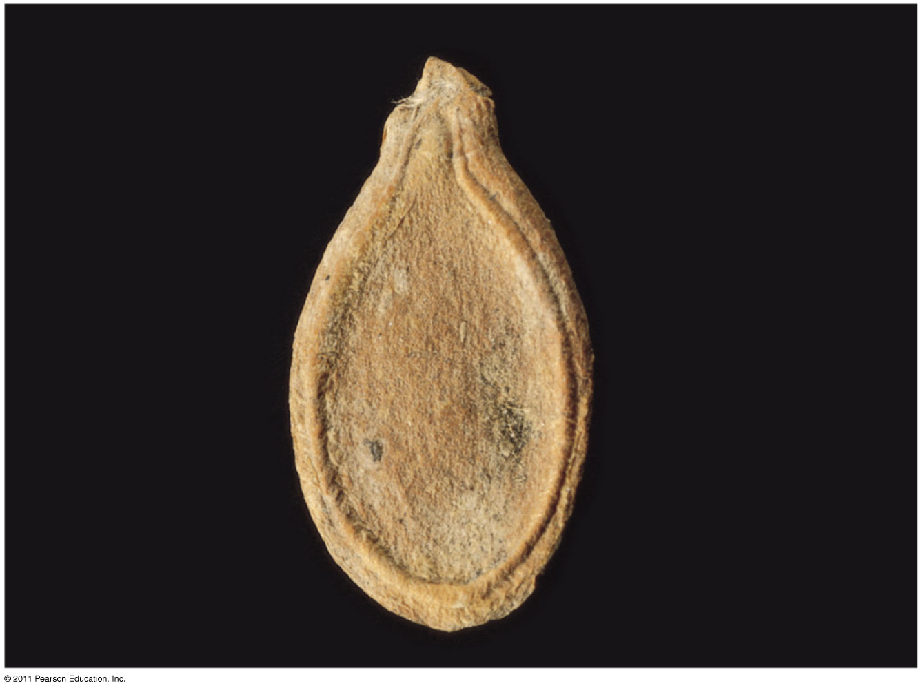
Figure 30.1
Notes:
‹#›
‹#›
Figure 30.1 What human reproductive organ is functionally similar to this seed?

Slide 4
Concept 30.1: Seeds and pollen grains are key adaptations for life on land
In addition to seeds, the following are common to all seed plants
Reduced gametophytes
Heterospory
Ovules
Pollen
© 2011 Pearson Education, Inc.
Notes:
‹#›

Slide 5
Advantages of Reduced Gametophytes
The gametophytes of seed plants develop within the walls of spores that are retained within tissues of the parent sporophyte
© 2011 Pearson Education, Inc.
Notes:
‹#›

Slide 6
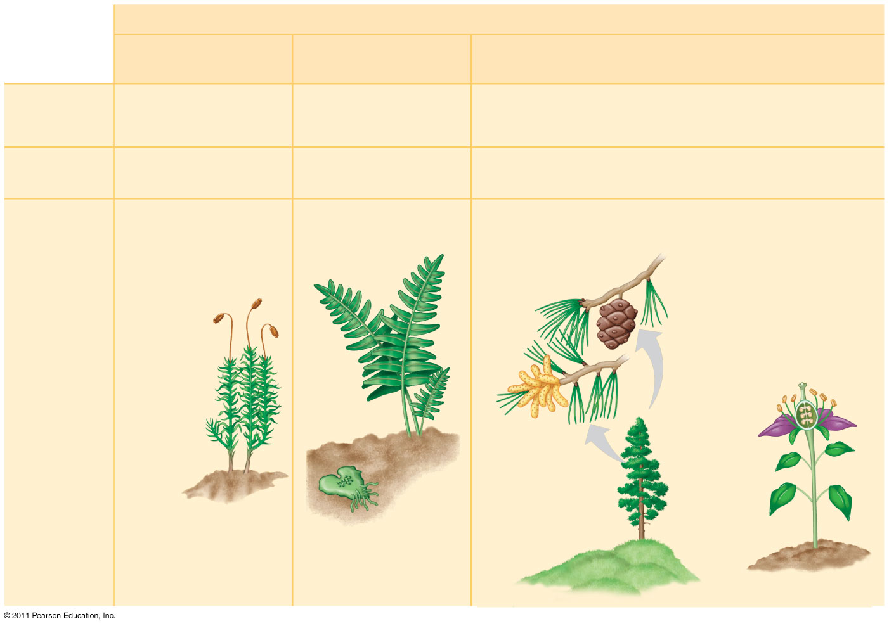
Figure 30.2
PLANT GROUP
Mosses and other
nonvascular plants
Ferns and other seedless
vascular plants
Seed plants (gymnosperms and angiosperms)
Reduced, independent
(photosynthetic and
free-living)
Reduced (usually microscopic), dependent on surrounding
sporophyte tissue for nutrition
Gametophyte
Dominant
Sporophyte
Reduced, dependent on
gametophyte for nutrition
Dominant
Dominant
Gymnosperm
Angiosperm
Sporophyte
(2n)
Microscopic female
gametophytes (n) inside
ovulate cone
Sporophyte
(2n)
Microscopic
female
gametophytes
(n) inside
these parts
of flowers
Gametophyte
(n)
Example
Microscopic
male
gametophytes
(n) inside
these parts
of flowers
Microscopic male
gametophytes (n)
inside pollen
cone
Gametophyte
(n)
Sporophyte (2n)
Sporophyte (2n)
Notes:
‹#›
‹#›
Figure 30.2 Gametophyte-sporophyte relationships in different plant groups.

Slide 7
Heterospory: The Rule Among Seed Plants
The ancestors of seed plants were likely homosporous, while seed plants are heterosporous
Megasporangia produce megaspores that give rise to female gametophytes
Microsporangia produce microspores that give rise to male gametophytes
© 2011 Pearson Education, Inc.
Notes:
‹#›

Slide 8
Ovules and Production of Eggs
An ovule consists of a megasporangium, megaspore, and one or more protective integuments
Angiosperm megaspores usually have two integuments
© 2011 Pearson Education, Inc.
Notes:
‹#›

Slide 9
Pollen and Production of Sperm
Microspores develop into pollen grains, which contain the male gametophytes
Pollination is the transfer of pollen to the part of a seed plant containing the ovules
Pollen eliminates the need for a film of water and can be dispersed great distances by air or animals
If a pollen grain germinates, it gives rise to a pollen tube that discharges sperm into the female gametophyte within the ovule
© 2011 Pearson Education, Inc.
Notes:
‹#›

Slide 10
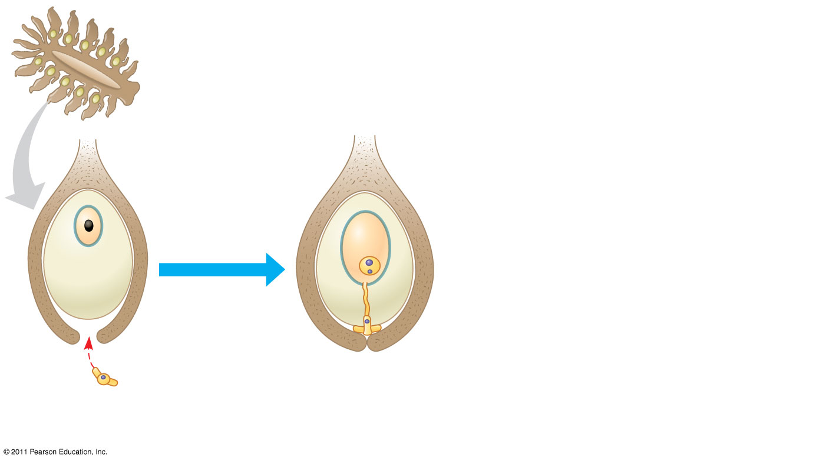
Figure 30.3-2
Immature
ovulate cone
Integument (2n)
Female
gametophyte (n)
Spore wall
Megaspore (n)
Egg nucleus
(n)
Discharged
sperm nucleus
(n)
Megasporangium
(2n)
Pollen tube
Micropyle
Male gametophyte (n)
Pollen grain (n)
(a) Unfertilized ovule
(b) Fertilized ovule
Notes:
‹#›
‹#›
Figure 30.3 From ovule to seed in a gymnosperm.

Slide 11
The Evolutionary Advantage of Seeds
A seed develops from the whole ovule
A seed is a sporophyte embryo, along with its food supply, packaged in a protective coat
© 2011 Pearson Education, Inc.
Notes:
‹#›

Slide 12
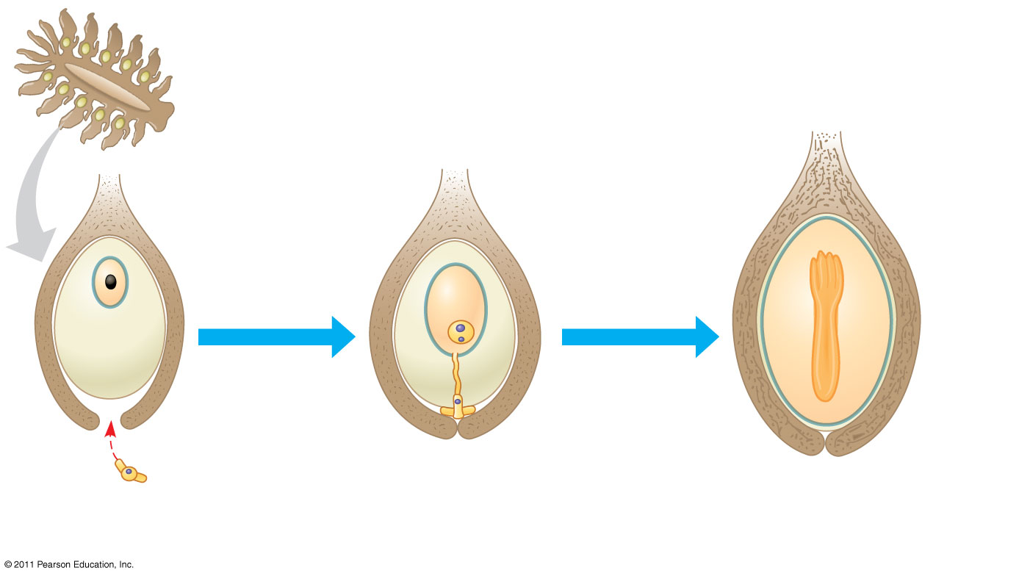
Figure 30.3-3
Immature
ovulate cone
Seed
coat
Integument (2n)
Female
gametophyte (n)
Spore wall
Spore
wall
Megaspore (n)
Egg nucleus
(n)
Discharged
sperm nucleus
(n)
Megasporangium
(2n)
Food
supply (n)
Pollen tube
Micropyle
Male gametophyte (n)
Embryo (2n)
Pollen grain (n)
(a) Unfertilized ovule
(b) Fertilized ovule
(c) Gymnosperm seed
Notes:
‹#›
‹#›
Figure 30.3 From ovule to seed in a gymnosperm.

Slide 13
Seeds provide some evolutionary advantages over spores
They may remain dormant for days to years, until conditions are favorable for germination
Seeds have a supply of stored food
They may be transported long distances by wind or animals
© 2011 Pearson Education, Inc.
Notes:
‹#›

Slide 14
Concept 30.2: Gymnosperms bear “naked” seeds, typically on cones
Gymnosperms means “naked seeds”
The seeds are exposed on sporophylls that form cones
Angiosperm seeds are found in fruits, which are mature ovaries
© 2011 Pearson Education, Inc.
Notes:
‹#›

Slide 15
Figure 30.UN01
Nonvascular plants (bryophytes)
Seedless vascular plants
Gymnosperms
Angiosperms
Notes:
‹#›
‹#›
Figure 30.UN01 In-text figure, p. 621

Slide 16
Living seed plants can be divided into two clades:
gymnosperms and
angiosperms
Gymnosperms appear early in the fossil record about 305 million years ago
Gymnosperms were better suited than nonvascular plants to drier conditions
© 2011 Pearson Education, Inc.
Notes:
‹#›

Slide 17
Angiosperms now dominate more terrestrial ecosystems
Today, cone-bearing gymnosperms called conifers dominate in the northern latitudes
© 2011 Pearson Education, Inc.
Notes:
‹#›

Slide 18
The gymnosperm consist of four phyla
Cycadophyta (cycads)
Gingkophyta (one living species: Ginkgo biloba)
Gnetophyta (three genera: Gnetum, Ephedra, Welwitschia)
Coniferophyta (conifers, such as pine, fir, and redwood)
© 2011 Pearson Education, Inc.
Notes:
‹#›

Slide 19
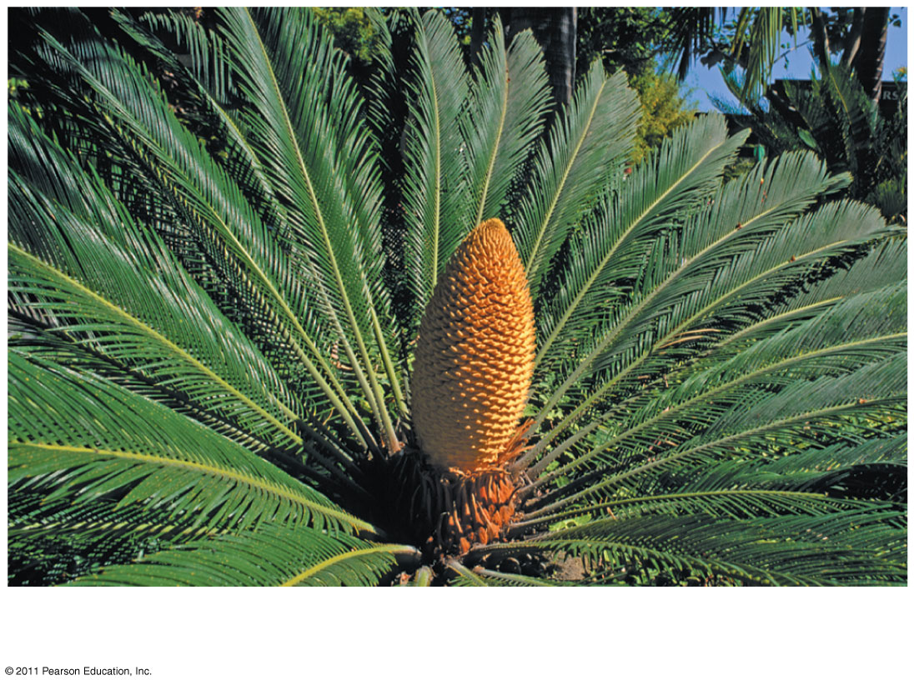
Figure 30.5a
Cycas revoluta
Notes:
‹#›
‹#›
Figure 30.5 Exploring: Gymnosperm Diversity

Slide 20
Phylum Ginkgophyta
This phylum consists of a single living species, Ginkgo biloba
It has a high tolerance to air pollution and is a popular ornamental tree
© 2011 Pearson Education, Inc.
Notes:
‹#›

Slide 21
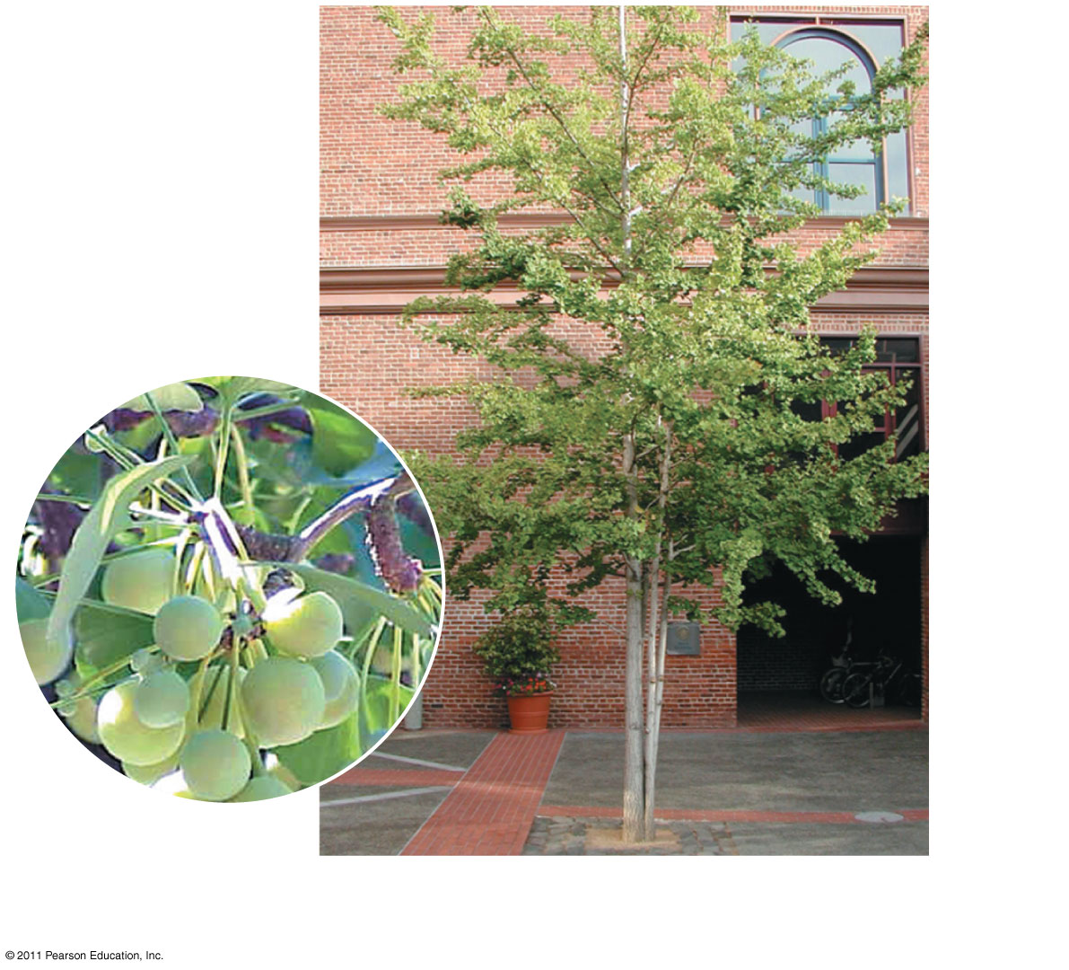
Figure 30.5b
Ginkgo biloba
leaves and
fleshy seeds
Ginkgo biloba pollen-producing tree
Notes:
‹#›
‹#›
Figure 30.5 Exploring: Gymnosperm Diversity

Slide 22
Phylum Coniferophyta
This phylum is by far the largest of the gymnosperm phyla
Most conifers are evergreens and can carry out photosynthesis year round
© 2011 Pearson Education, Inc.
Notes:
‹#›

Slide 23
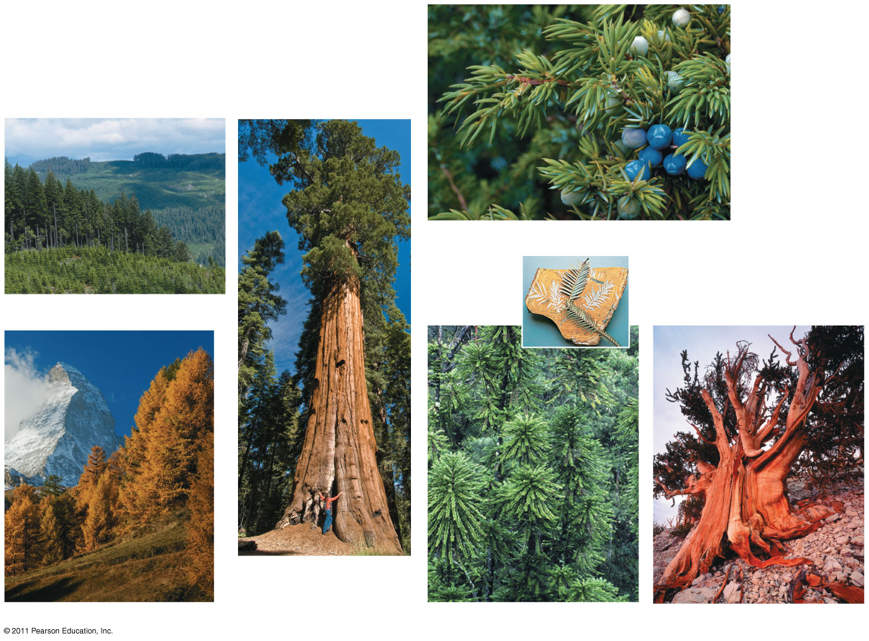
Figure 30.5e
Common juniper
Douglas fir
Sequoia
European larch
Wollemi pine
Bristlecone pine
Notes:
‹#›
‹#›
Figure 30.5 Exploring: Gymnosperm Diversity

Slide 24
The Life Cycle of a Pine: A Closer Look
Three key features of the gymnosperm life cycle are
Dominance of the sporophyte generation
Development of seeds from fertilized ovules
The transfer of sperm to ovules by pollen
The life cycle of a pine provides an example
© 2011 Pearson Education, Inc.
Notes:
‹#›

Slide 25
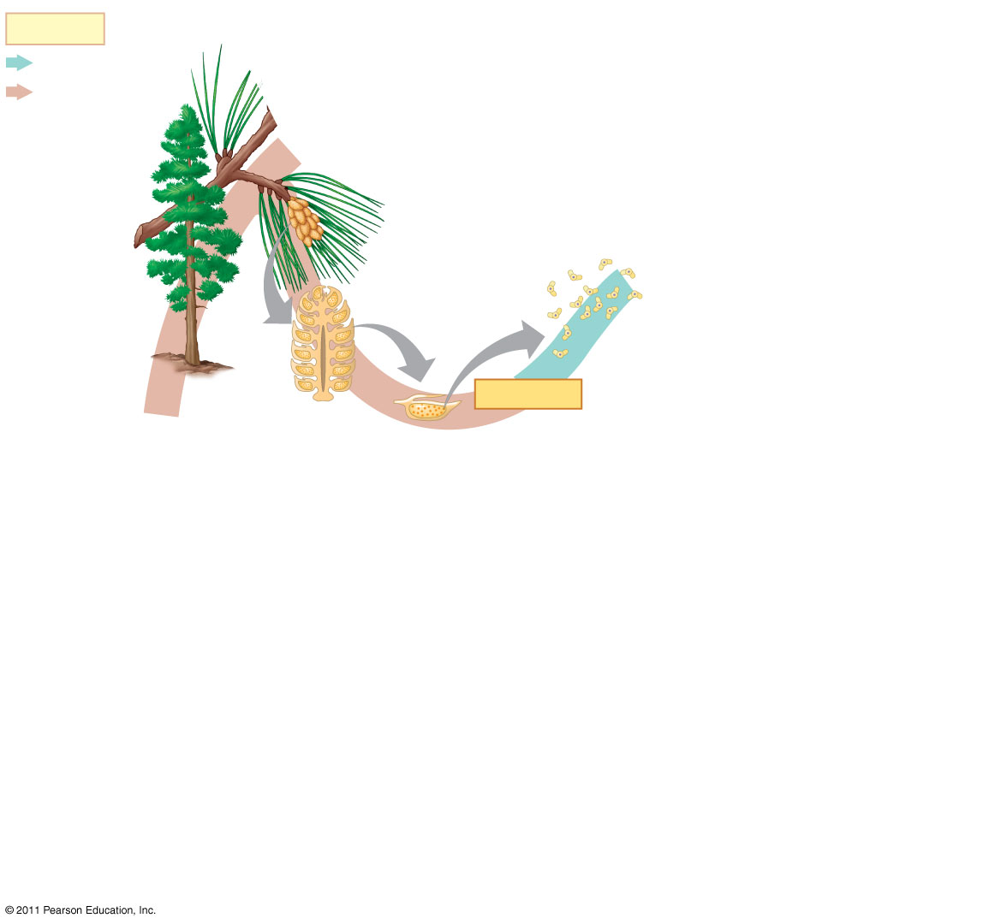
Figure 30.6-1
Key
Haploid (n)
Diploid (2n)
Pollen
cone
Mature
sporophyte
(2n)
Microsporocytes
(2n)
Pollen
grains (n)
MEIOSIS
Microsporangia
Microsporangium (2n)
Notes:
‹#›
‹#›
Figure 30.6 The life cycle of a pine.

Slide 26
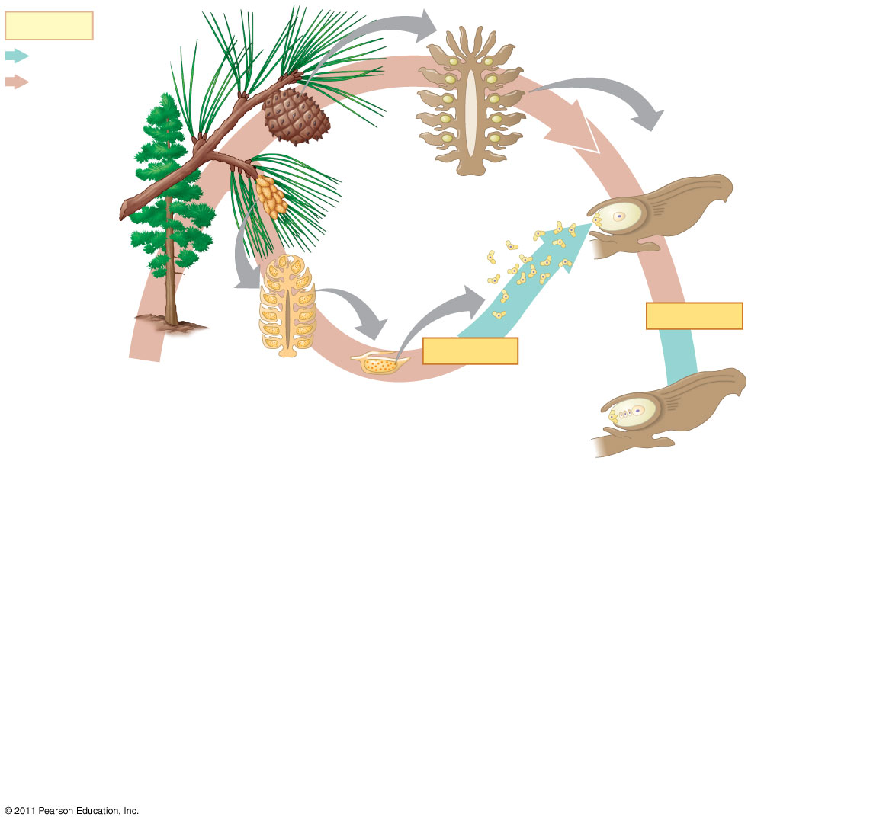
Figure 30.6-2
Key
Haploid (n)
Diploid (2n)
Ovule
Ovulate
cone
Megasporocyte (2n)
Pollen
cone
Integument
Mature
sporophyte
(2n)
Microsporocytes
(2n)
Megasporangium (2n)
Pollen
grain
Pollen
grains (n)
MEIOSIS
MEIOSIS
Microsporangia
Microsporangium (2n)
Surviving
megaspore (n)
Notes:
‹#›
‹#›
Figure 30.6 The life cycle of a pine.

Slide 27
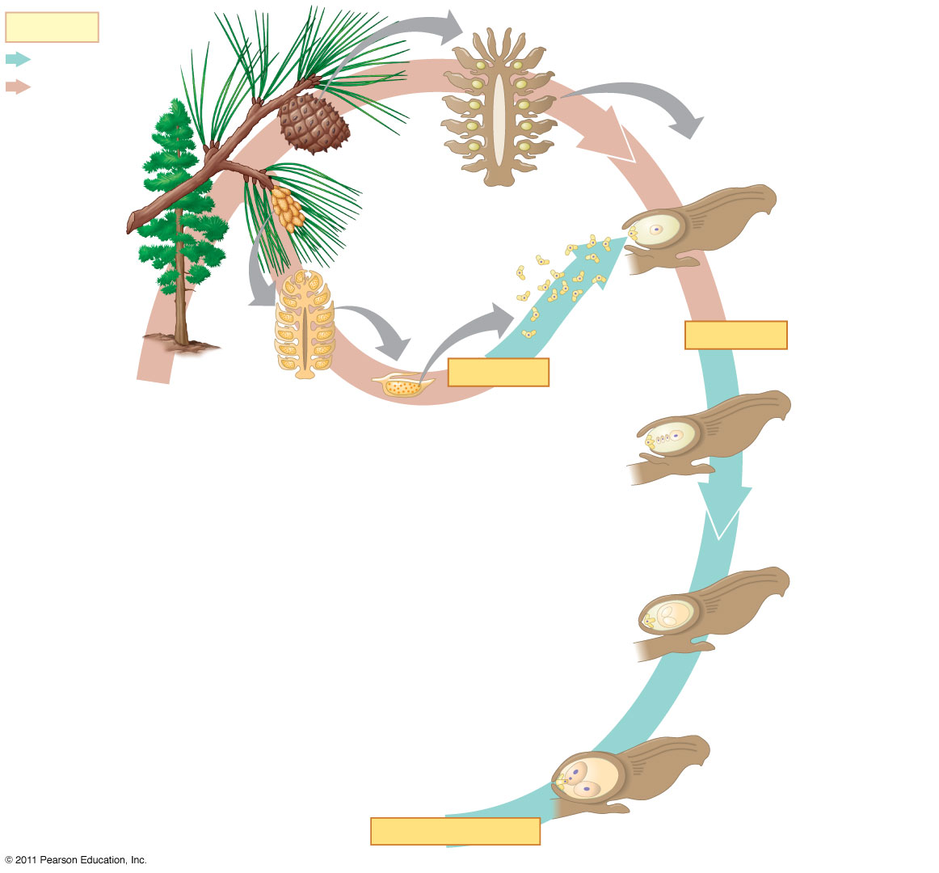
Figure 30.6-3
Key
Haploid (n)
Diploid (2n)
Ovule
Ovulate
cone
Megasporocyte (2n)
Pollen
cone
Integument
Mature
sporophyte
(2n)
Microsporocytes
(2n)
Megasporangium (2n)
Pollen
grain
Pollen
grains (n)
MEIOSIS
MEIOSIS
Microsporangia
Microsporangium (2n)
Surviving
megaspore (n)
Archegonium
Female
gametophyte
Sperm
nucleus (n)
Egg nucleus (n)
Pollen
tube
FERTILIZATION
Notes:
‹#›
‹#›
Figure 30.6 The life cycle of a pine.

Slide 28
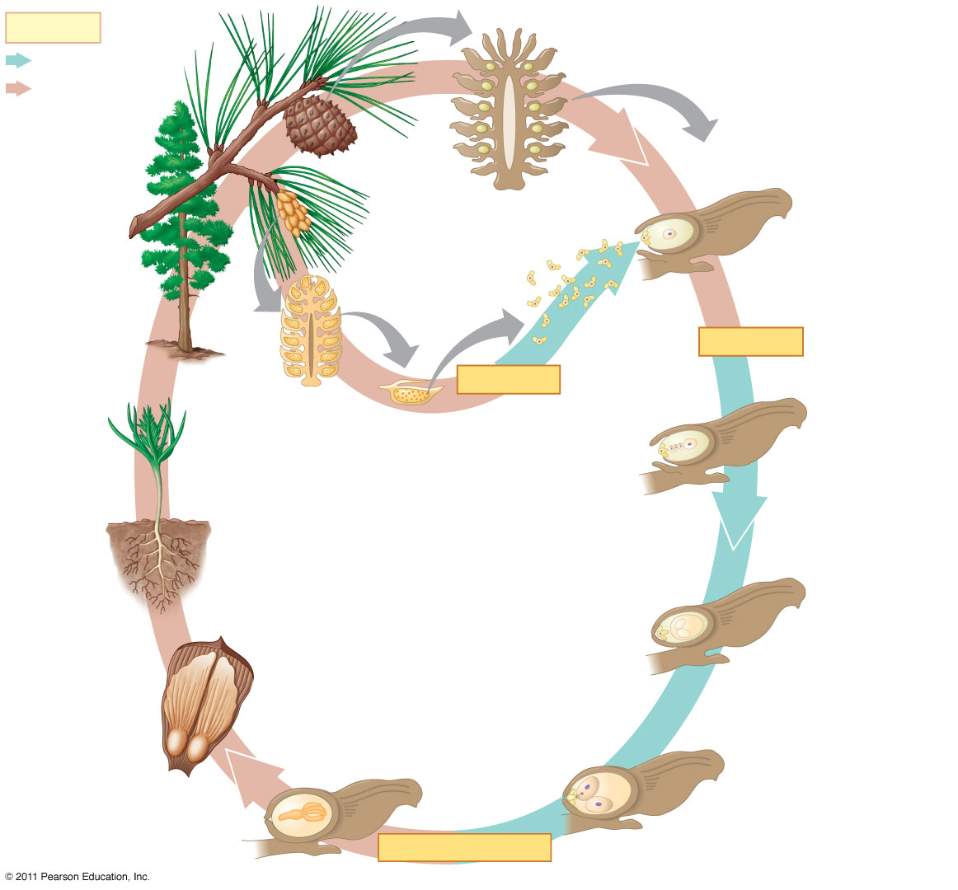
Figure 30.6-4
Key
Haploid (n)
Diploid (2n)
Ovule
Ovulate
cone
Megasporocyte (2n)
Pollen
cone
Integument
Mature
sporophyte
(2n)
Microsporocytes
(2n)
Megasporangium (2n)
Pollen
grain
Pollen
grains (n)
MEIOSIS
MEIOSIS
Microsporangia
Microsporangium (2n)
Surviving
megaspore (n)
Seedling
Archegonium
Female
gametophyte
Seeds
Food
reserves (n)
Sperm
nucleus (n)
Egg nucleus (n)
Seed coat (2n)
Embryo
(new sporophyte)
(2n)
Pollen
tube
FERTILIZATION
Notes:
‹#›
‹#›
Figure 30.6 The life cycle of a pine.

Slide 29
Concept 30.3: The reproductive adaptations of angiosperms include flowers and fruits
Angiosperms are seed plants with reproductive structures called flowers and fruits
They are the most widespread and diverse of all plants
© 2011 Pearson Education, Inc.
Notes:
‹#›

Slide 30
Characteristics of Angiosperms
All angiosperms are classified in a single phylum, Anthophyta, from the Greek anthos for flower
Angiosperms have two key adaptations
Flowers
Fruits
© 2011 Pearson Education, Inc.
Notes:
‹#›

Slide 31
Flowers
The flower is an angiosperm structure specialized for sexual reproduction
Many species are pollinated by insects or animals, while some species are wind-pollinated
© 2011 Pearson Education, Inc.
Notes:
‹#›

Slide 32
A flower is a specialized shoot with up to four types of modified leaves
Sepals, which enclose the flower
Petals, which are brightly colored and attract pollinators
Stamens, which produce pollen
Carpels, which produce ovules
© 2011 Pearson Education, Inc.
Notes:
‹#›

Slide 33
A stamen consists of a stalk called a filament, with a sac called an anther where the pollen is produced
A carpel consists of an ovary at the base and a style leading up to a stigma, where pollen is received
© 2011 Pearson Education, Inc.
Notes:
‹#›

Slide 34
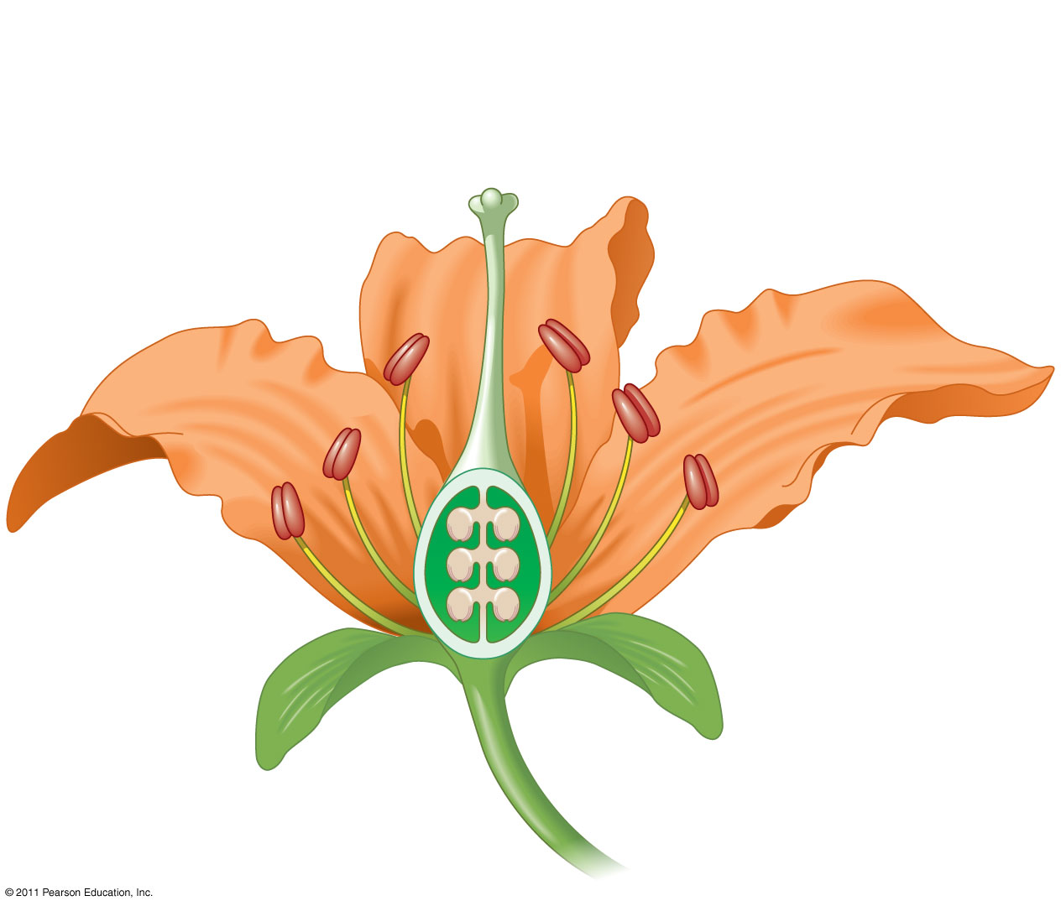
Figure 30.7
Stigma
Carpel
Stamen
Anther
Style
Filament
Ovary
Petal
Sepal
Ovule
Notes:
‹#›
‹#›
Figure 30.7 The structure of an idealized flower.

Slide 35
Fruits
A fruit typically consists of a mature ovary but can also include other flower parts
Fruits protect seeds and aid in their dispersal
Mature fruits can be either fleshy or dry
© 2011 Pearson Education, Inc.
Notes:
‹#›

Slide 36
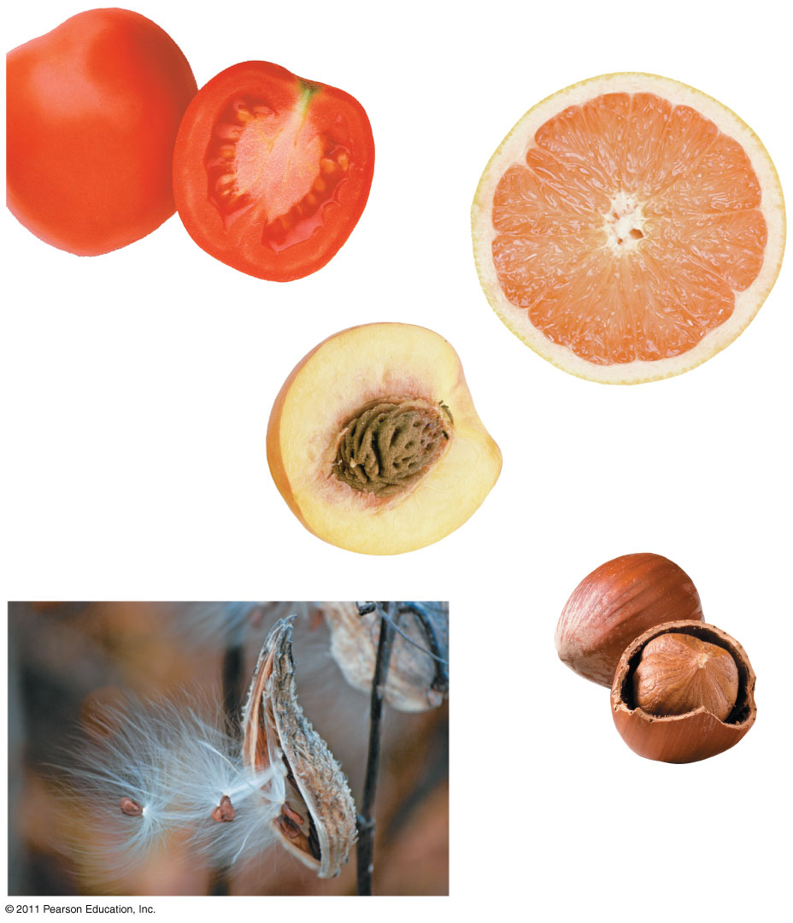
Figure 30.8
Tomato
Ruby grapefruit
Nectarine
Hazelnut
Milkweed
Notes:
‹#›
‹#›
Figure 30.8 Some variations in fruit structure.

Slide 37
Various fruit adaptations help disperse seeds
Seeds can be carried by wind, water, or animals to new locations
© 2011 Pearson Education, Inc.
Notes:
‹#›

Slide 38
The Angiosperm Life Cycle
The flower of the sporophyte is composed of both male and female structures
Male gametophytes are contained within pollen grains produced by the microsporangia of anthers
The female gametophyte, or embryo sac, develops within an ovule contained within an ovary at the base of a stigma
Most flowers have mechanisms to ensure cross-pollination between flowers from different plants of the same species
© 2011 Pearson Education, Inc.
Notes:
‹#›

Slide 39
A pollen grain that has landed on a stigma germinates and the pollen tube of the male gametophyte grows down to the ovary
The ovule is entered by a pore called the micropyle
Double fertilization occurs when the pollen tube discharges two sperm into the female gametophyte within an ovule
© 2011 Pearson Education, Inc.
Notes:
‹#›

Slide 40
One sperm fertilizes the egg, while the other combines with two nuclei in the central cell of the female gametophyte and initiates development of food-storing endosperm
The triploid endosperm nourishes the developing embryo
Within a seed, the embryo consists of a root and two seed leaves called cotyledons
© 2011 Pearson Education, Inc.
Notes:
‹#›

Slide 41
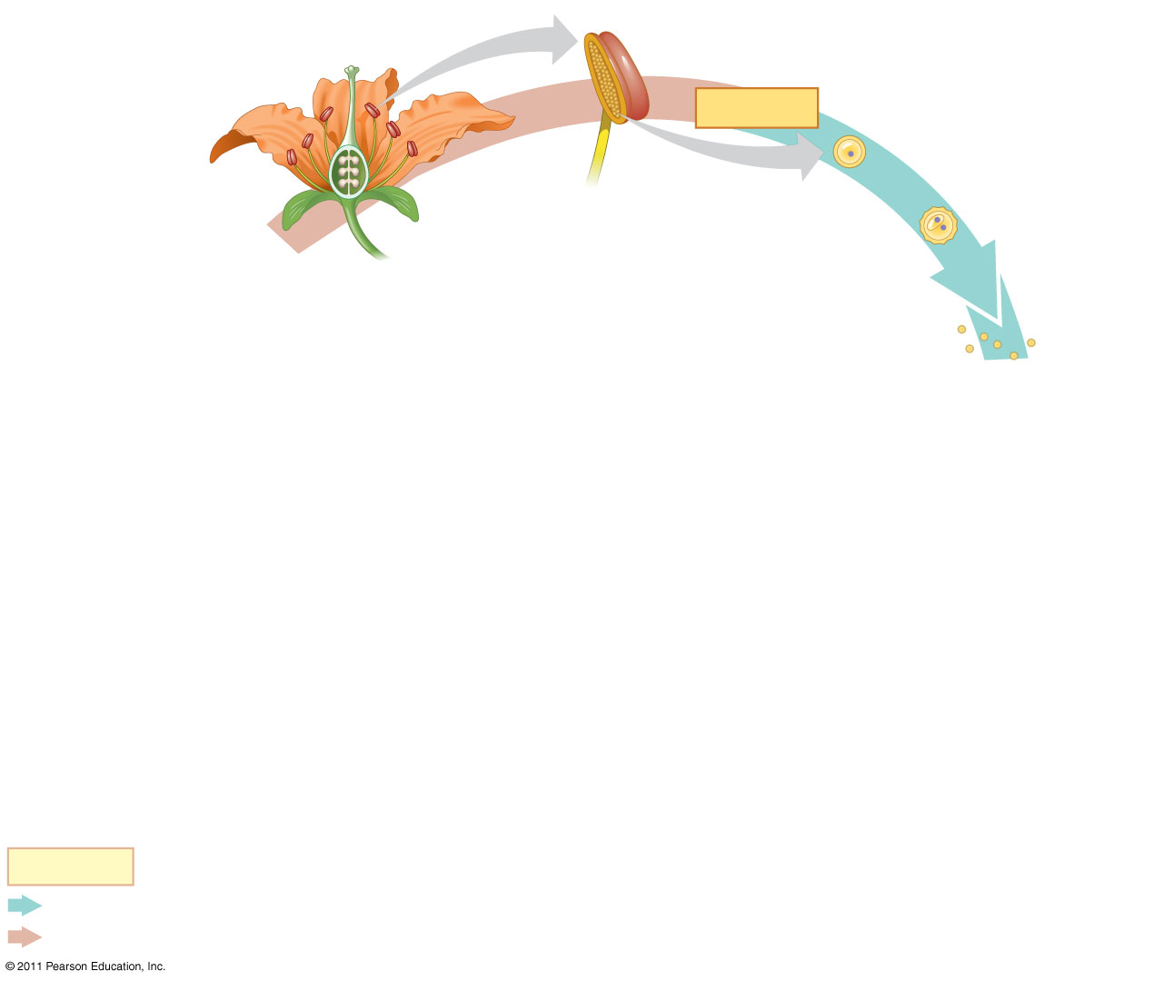
Figure 30.10-1
Microsporangium
Anther
Mature flower on
sporophyte plant
(2n)
Microsporocytes (2n)
MEIOSIS
Microspore (n)
Generative cell
Tube cell
Pollen
grains
Key
Haploid (n)
Diploid (2n)
Notes:
‹#›
‹#›
Figure 30.10 The life cycle of an angiosperm.

Slide 42
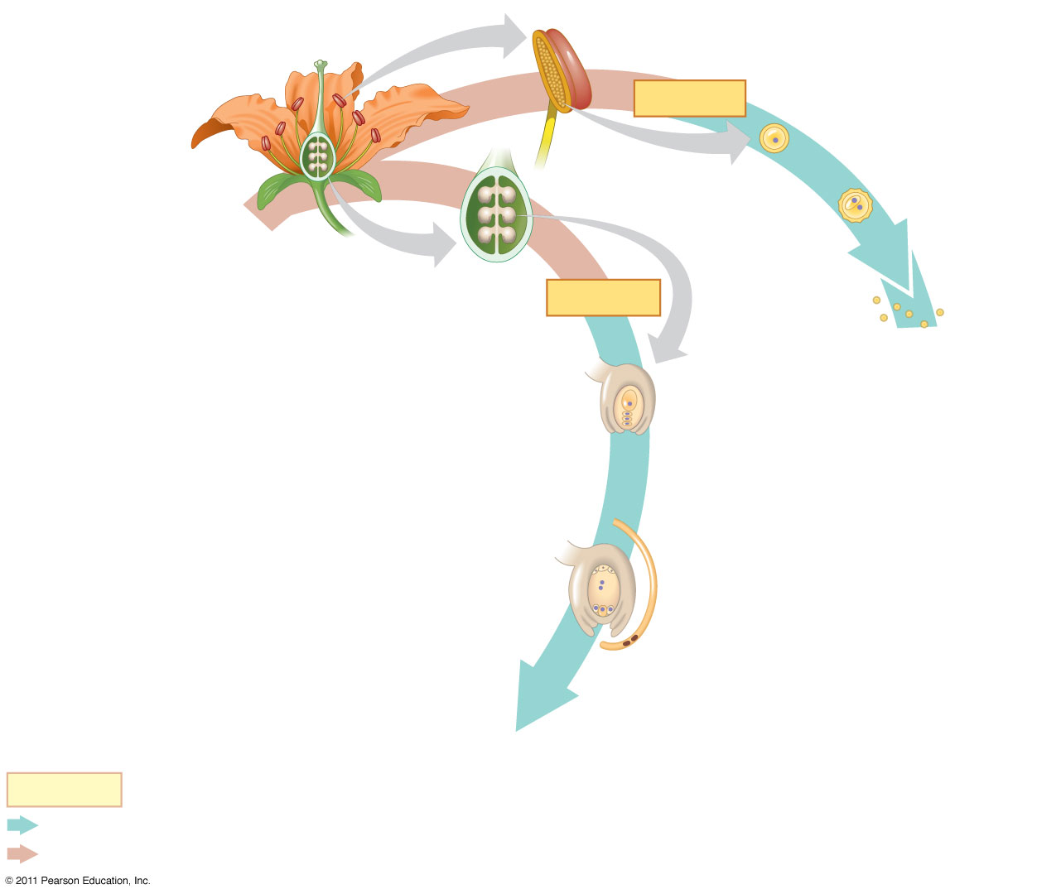
Figure 30.10-2
Microsporangium
Anther
Mature flower on
sporophyte plant
(2n)
Microsporocytes (2n)
MEIOSIS
Microspore (n)
Ovule (2n)
Generative cell
Male
gametophyte
(in pollen
grain) (n)
Tube cell
Ovary
Pollen
grains
MEIOSIS
Megasporangium (2n)
Surviving
megaspore
(n)
Antipodal cells
Female
gametophyte
(embryo sac)
Central cell
Synergids
Pollen
tube
Egg (n)
Sperm
(n)
Key
Haploid (n)
Diploid (2n)
Notes:
‹#›
‹#›
Figure 30.10 The life cycle of an angiosperm.

Slide 43
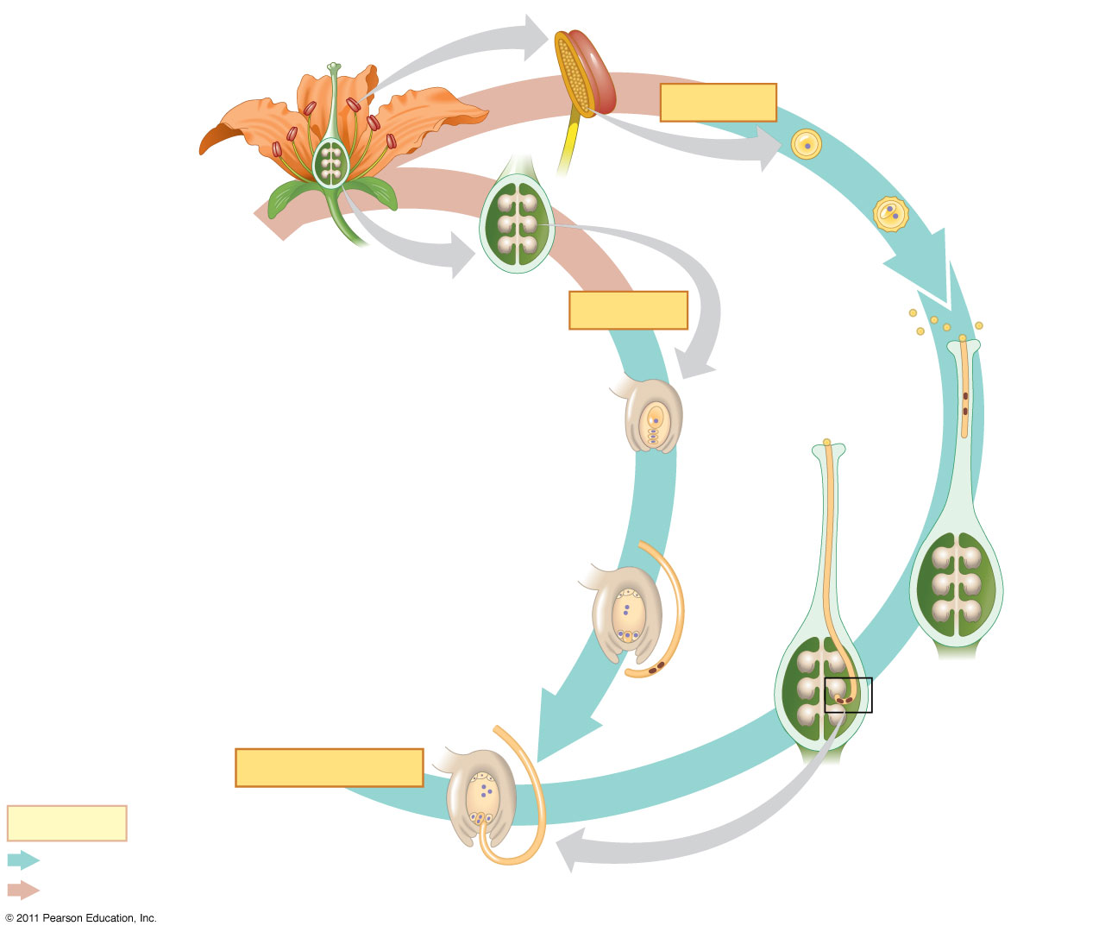
Figure 30.10-3
Microsporangium
Anther
Mature flower on
sporophyte plant
(2n)
Microsporocytes (2n)
MEIOSIS
Microspore (n)
Ovule (2n)
Generative cell
Male
gametophyte
(in pollen
grain) (n)
Tube cell
Ovary
Pollen
grains
MEIOSIS
Megasporangium (2n)
Stigma
Pollen
tube
Sperm
Seed
Surviving
megaspore
(n)
Antipodal cells
Female
gametophyte
(embryo sac)
Central cell
Style
Synergids
Pollen
tube
Egg (n)
Egg
nucleus (n)
Sperm
(n)
FERTILIZATION
Key
Haploid (n)
Diploid (2n)
Discharged sperm nuclei (n)
Notes:
‹#›
‹#›
Figure 30.10 The life cycle of an angiosperm.

Slide 44
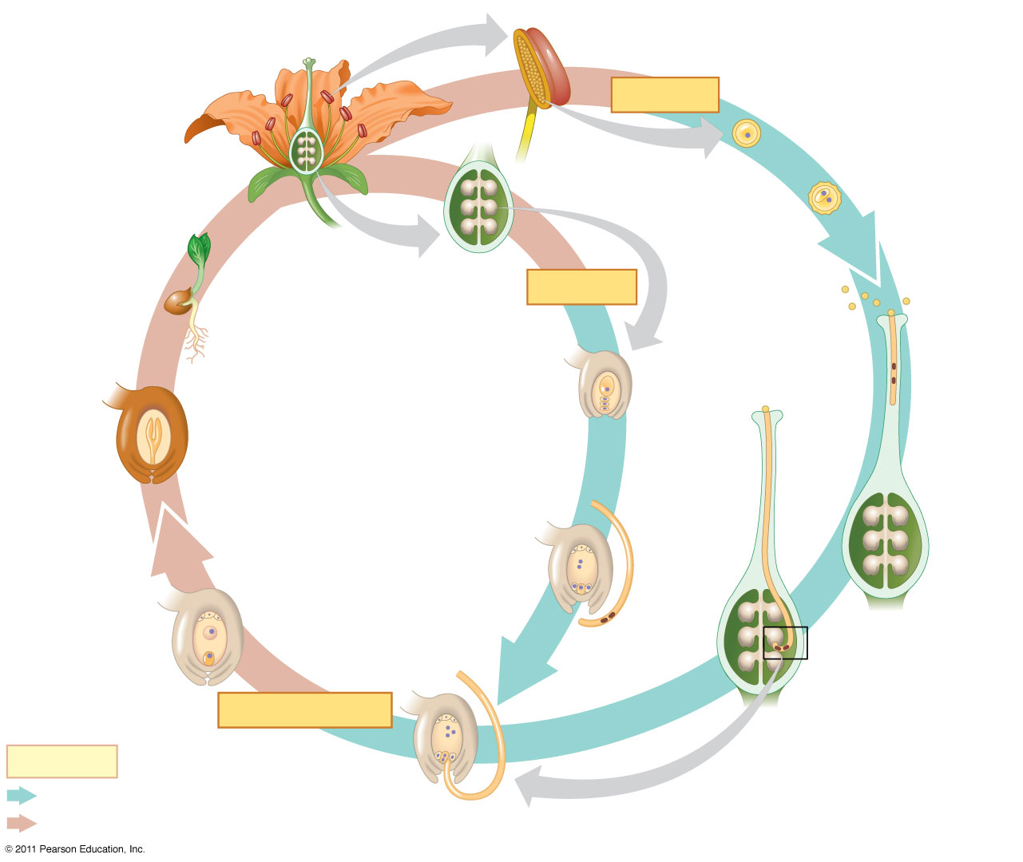
Figure 30.10-4
Microsporangium
Anther
Mature flower on
sporophyte plant
(2n)
Microsporocytes (2n)
MEIOSIS
Microspore (n)
Ovule (2n)
Generative cell
Male
gametophyte
(in pollen
grain) (n)
Tube cell
Germinating
seed
Ovary
Pollen
grains
MEIOSIS
Megasporangium (2n)
Stigma
Embryo (2n)
Pollen
tube
Sperm
Endosperm (3n)
Seed
Surviving
megaspore
(n)
Seed coat (2n)
Antipodal cells
Female
gametophyte
(embryo sac)
Central cell
Style
Synergids
Pollen
tube
Nucleus of
developing
endosperm
(3n)
Egg (n)
Egg
nucleus (n)
Sperm
(n)
Zygote (2n)
FERTILIZATION
Key
Haploid (n)
Diploid (2n)
Discharged sperm nuclei (n)
Notes:
‹#›
‹#›
Figure 30.10 The life cycle of an angiosperm.

Slide 45
Angiosperm Evolution
Darwin called the origin of angiosperms an “abominable mystery”
Angiosperms originated at least 140 million years ago
Scientists are studying fossils, refining phylogenies, and investigating developmental patterns to resolve the mystery
© 2011 Pearson Education, Inc.
Notes:
‹#›

Slide 46
Fossil Angiosperms
Chinese fossils of 125-million-year-old angiosperms share some traits with living angiosperms but lack others
Archaefructus sinensis, for example, has anthers and seeds but lacks petals and sepals
© 2011 Pearson Education, Inc.
Notes:
‹#›

Slide 47
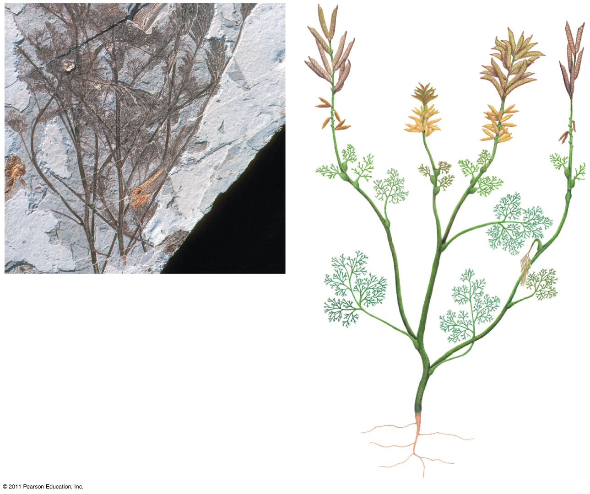
Figure 30.11
Carpel
Stamen
5 cm
(a) Archaefructus sinensis, a 125-
million-year-old fossil
(b) Artist’s reconstruction of
Archaefructus sinensis
Notes:
‹#›
‹#›
Figure 30.11 An early flowering plant.

Slide 48
Angiosperm Diversity
Angiosperms comprise more than 250,000 living species
Previously, angiosperms were divided into two main groups
Monocots (one cotyledon)
Dicots (two dicots)
DNA studies suggest that monocots form a clade, but dicots are polyphyletic
© 2011 Pearson Education, Inc.
Notes:
‹#›

Slide 49
Monocots
More than one-quarter of angiosperm species are monocots
© 2011 Pearson Education, Inc.
Notes:
‹#›

Slide 50
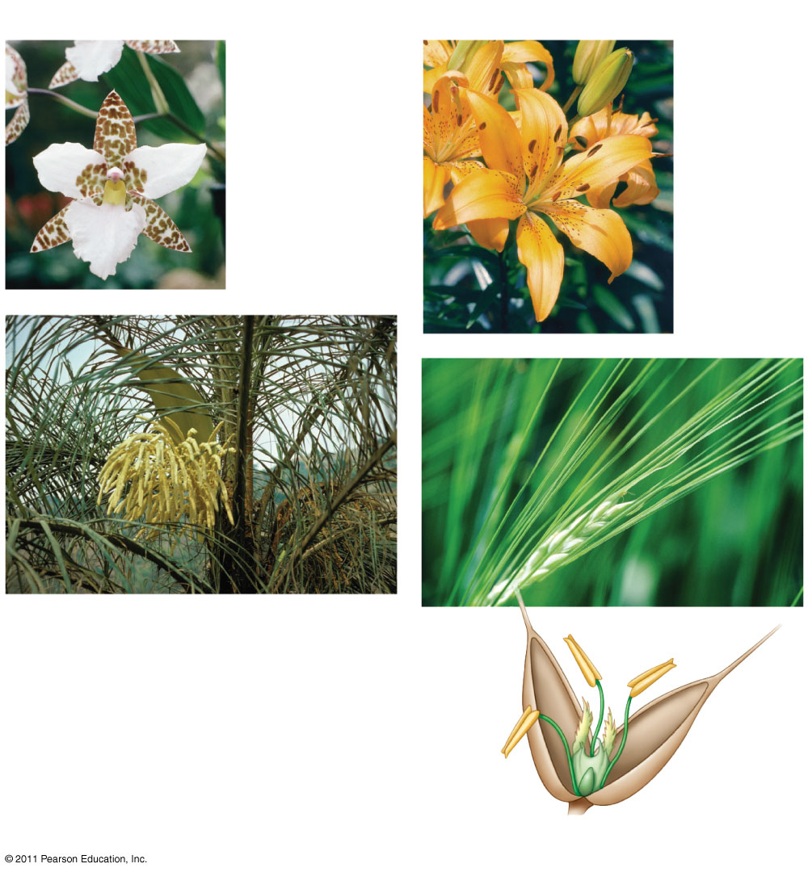
Figure 30.13c
Monocots
Orchid
Lily
Pygmy date palm
Anther
Stigma
Filament
Ovary
Barley, a grass
Notes:
‹#›
‹#›
Figure 30.13 Exploring: Angiosperm Diversity

Slide 51
Eudicots
More than two-thirds of angiosperm species are eudicots
© 2011 Pearson Education, Inc.
Notes:
‹#›

Slide 52
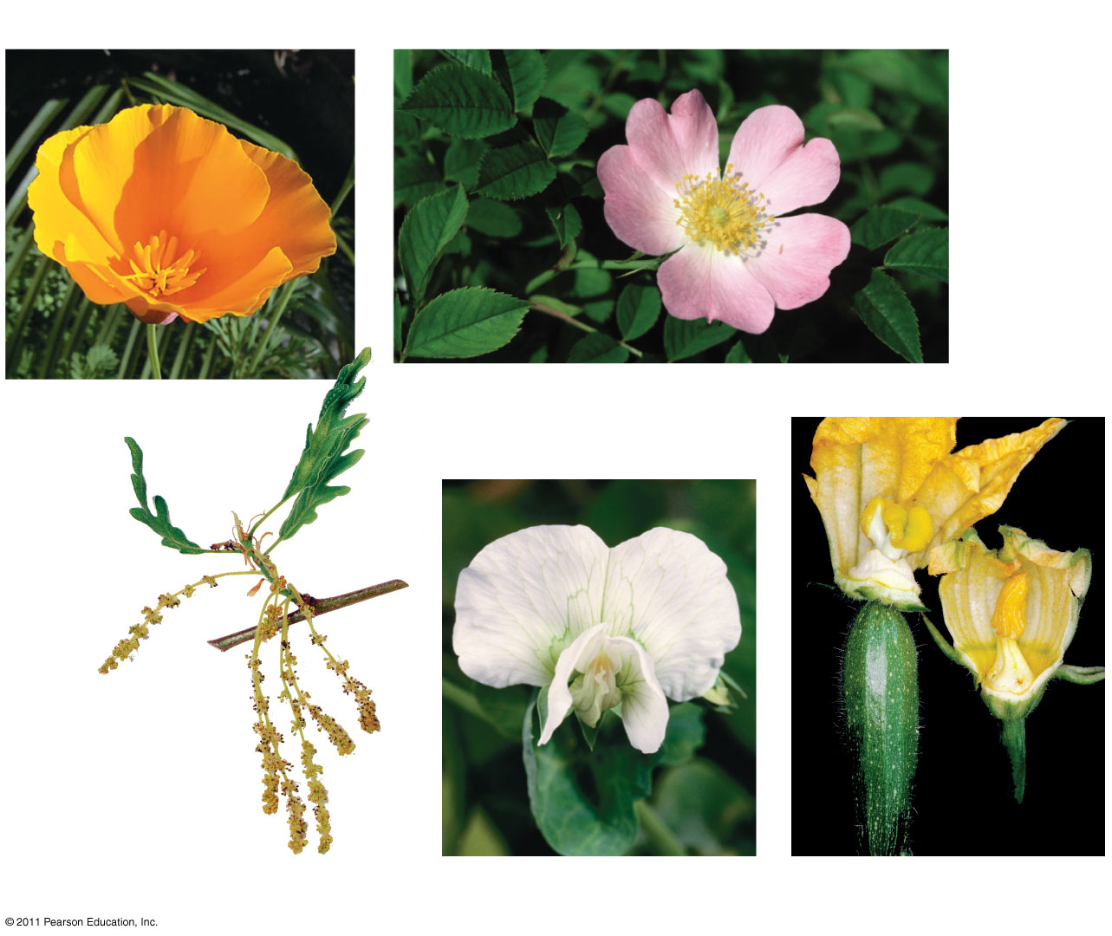
Figure 30.13d
Eudicots
California poppy
Dog rose
Pyrenean oak
Snow pea
Zucchini
Notes:
‹#›
‹#›
Figure 30.13 Exploring: Angiosperm Diversity

Slide 53
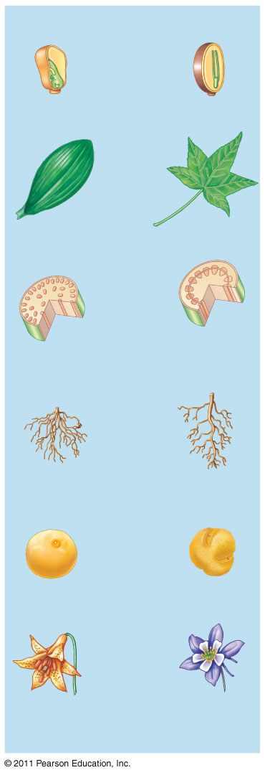
Figure 30.13e
Monocot
Characteristics
Eudicot
Characteristics
Embryos
One cotyledon
Two cotyledons
Leaf
venation
Veins usually
parallel
Veins usually
netlike
Stems
Vascular tissue
scattered
Vascular tissue
usually arranged
in ring
Roots
Root system
usually fibrous
(no main root)
Taproot (main root)
usually present
Pollen
Pollen grain with
one opening
Pollen grain with
three openings
Flowers
Floral organs
usually in
multiples of three
Floral organs
usually in multiples
of four or five
Notes:
‹#›
‹#›
Figure 30.13 Exploring: Angiosperm Diversity

Slide 54
Concept 30.4: Human welfare depends greatly on seed plants
No group of plants is more important to human survival than seed plants
Plants are key sources of food, fuel, wood products, and medicine
Our reliance on seed plants makes preservation of plant diversity critical
© 2011 Pearson Education, Inc.
Notes:
‹#›

Slide 55
Products from Seed Plants
Most of our food comes from angiosperms
Six crops (wheat, rice, maize, potatoes, cassava, and sweet potatoes) yield 80% of the calories consumed by humans
Modern crops are products of relatively recent genetic change resulting from artificial selection
Many seed plants provide wood
Secondary compounds of seed plants are used in medicines
© 2011 Pearson Education, Inc.
Notes:
‹#›

Slide 56
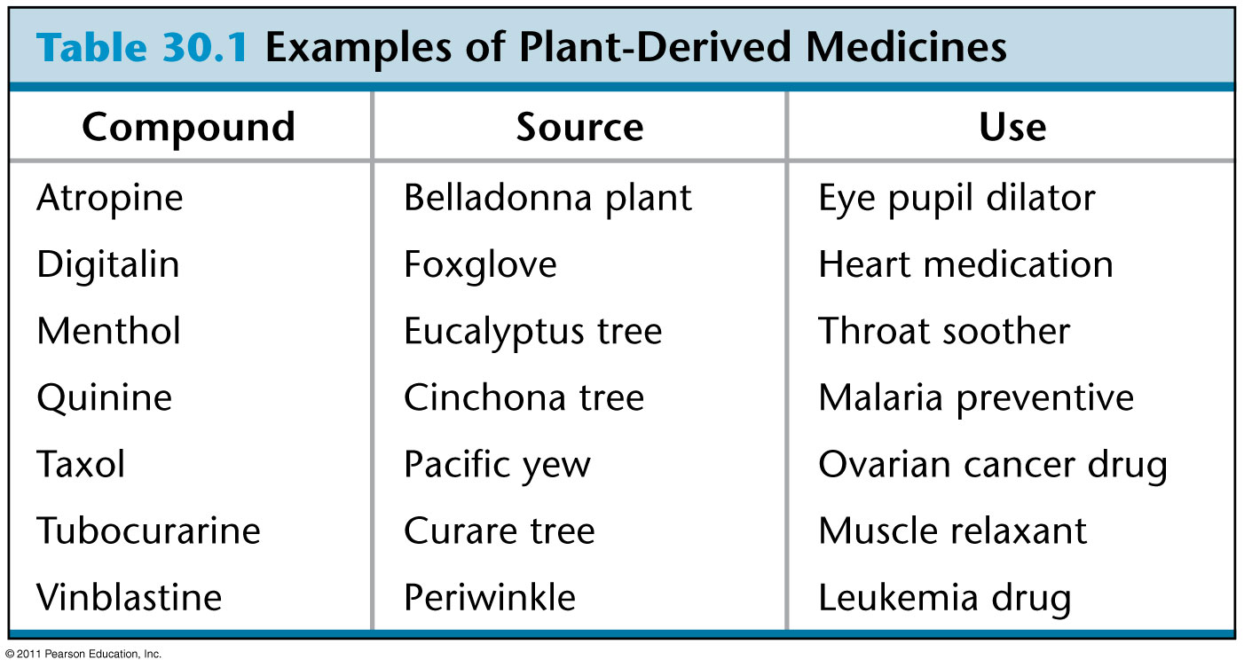
Table 30.1
Notes:
‹#›
‹#›
Table 30.1 Examples of Plant-Derived Medicines

Slide 57
Threats to Plant Diversity
Destruction of habitat is causing extinction of many plant species
In the tropics 55,000 km² are cleared each year
At this rate, the remaining tropical forests will be eliminated in 200 years
Loss of plant habitat is often accompanied by loss of the animal species that plants support
© 2011 Pearson Education, Inc.
Notes:
‹#›

Slide 58
At the current rate of habitat loss, 50% of Earth’s species will become extinct within the next 100–200 years
The tropical rain forests may contain undiscovered medicinal compounds
© 2011 Pearson Education, Inc.
Notes:
‹#›

