Slide 1
Chapter 31
Fungi
Notes:
‹#›

Slide 2
Overview
Fungi are diverse and widespread
They are essential for the well-being of most terrestrial ecosystems because they break down organic material and recycle vital nutrients
About 100,000 species of fungi have been described
It is estimated there are actually 1.5 million species of fungi
© 2011 Pearson Education, Inc.
Notes:
‹#›

Slide 3
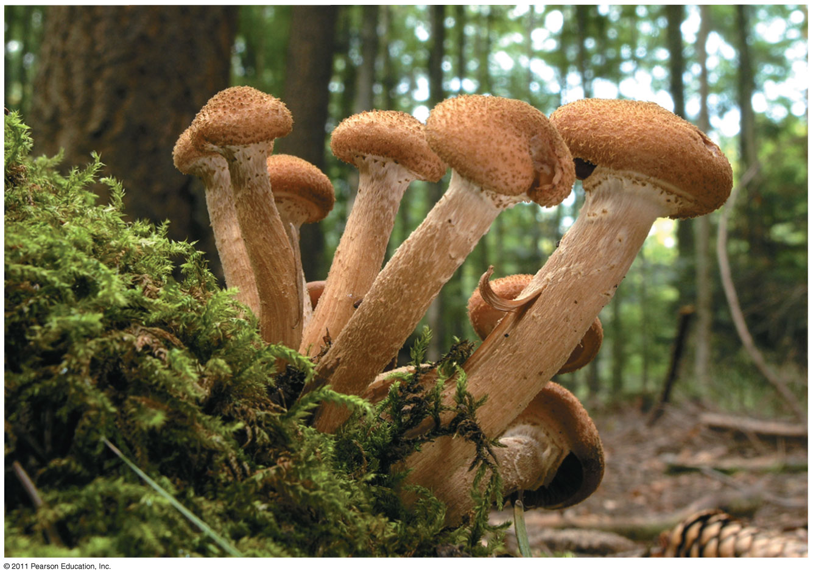
Figure 31.1
Notes:
‹#›
Figure 31.1 Can you spot the largest organism in this forest?

Slide 4
Concept 31.1: Fungi are heterotrophs that feed by absorption
Despite their diversity, fungi share key traits, most importantly the way in which they derive nutrition
© 2011 Pearson Education, Inc.
Notes:
‹#›

Slide 5
Nutrition and Ecology
Fungi are heterotrophs and absorb nutrients from outside of their body
Fungi use enzymes to break down a large variety of complex molecules into smaller organic compounds
The versatility of these enzymes contributes to fungi’s ecological success
© 2011 Pearson Education, Inc.
Notes:
‹#›

Slide 6
Fungi exhibit diverse lifestyles
Decomposers
Parasites
Mutualists
© 2011 Pearson Education, Inc.
Notes:
‹#›

Slide 7
Body Structure
The most common body structures are multicellular filaments and single cells (yeasts)
Some species grow as either filaments or yeasts; others grow as both
© 2011 Pearson Education, Inc.
Notes:
‹#›

Slide 8
The morphology of multicellular fungi enhances their ability to absorb nutrients
Fungi consist of mycelia, networks of branched hyphae adapted for absorption
A mycelium’s structure maximizes its surface area-to-volume ratio
Fungal cell walls contain chitin
© 2011 Pearson Education, Inc.
Notes:
‹#›

Slide 9
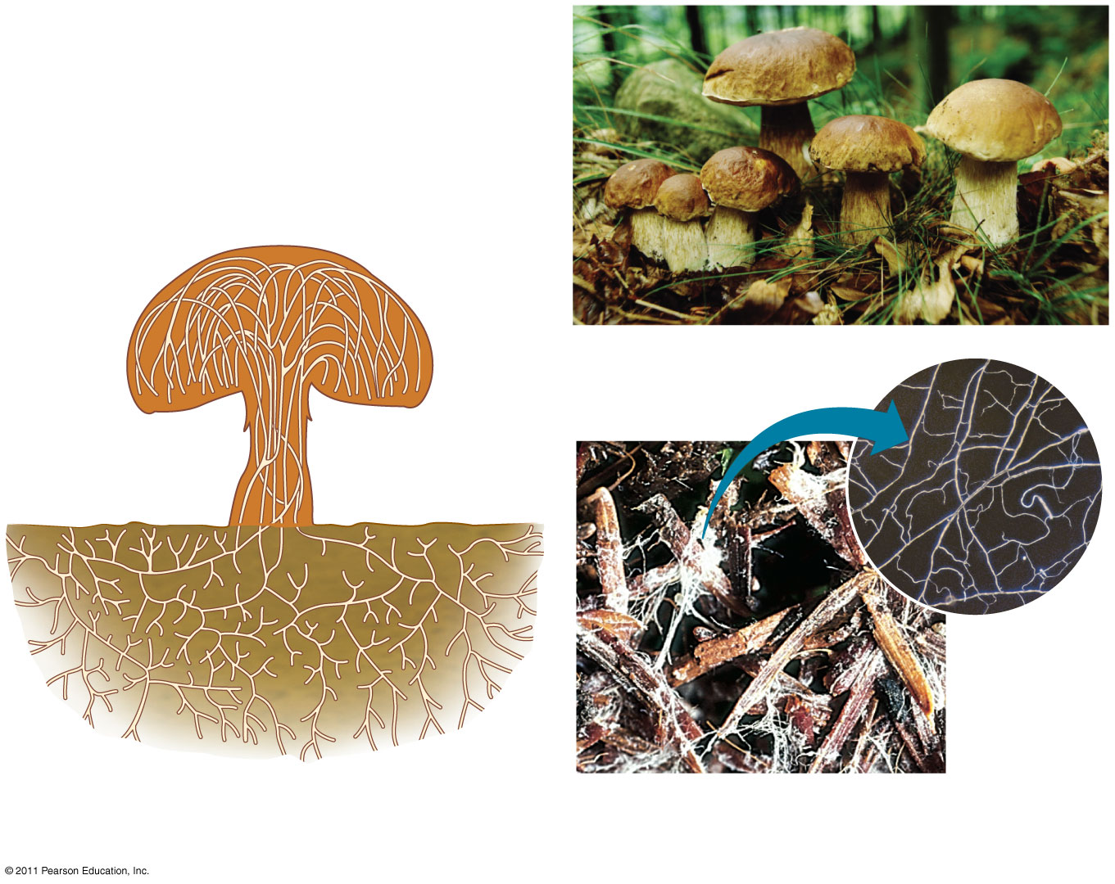
Figure 31.2
Reproductive structure
Hyphae
Spore-producing structures
60 μm
Mycelium
Notes:
‹#›
Figure 31.2 Structure of a multicellular fungus.

Slide 10
Most fungi have hyphae divided into cells by septa, with pores allowing cell-to-cell movement of organelles
Coenocytic fungi lack septa and have a continuous cytoplasmic mass with hundreds or thousands of nuclei
© 2011 Pearson Education, Inc.
Notes:
‹#›

Slide 11
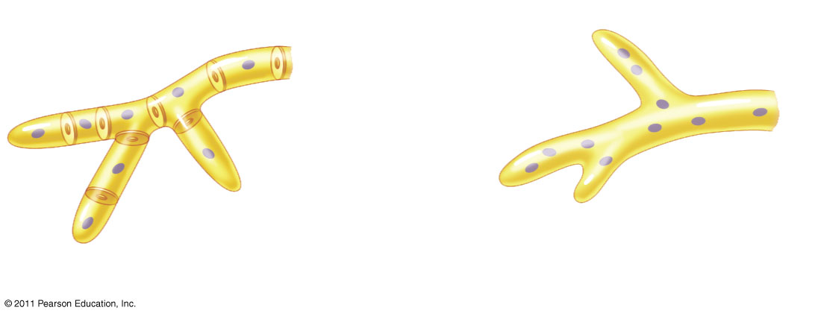
Figure 31.3
Cell wall
Nuclei
Cell wall
Pore
Septum
Nuclei
(a) Septate hypha
(b) Coenocytic hypha
Notes:
‹#›
Figure 31.3 Two forms of hyphae.

Slide 12
Specialized Hyphae in Mycorrhizal Fungi
Some unique fungi have specialized hyphae called haustoria that allow them to penetrate the tissues of their host
© 2011 Pearson Education, Inc.
Notes:
‹#›

Slide 13
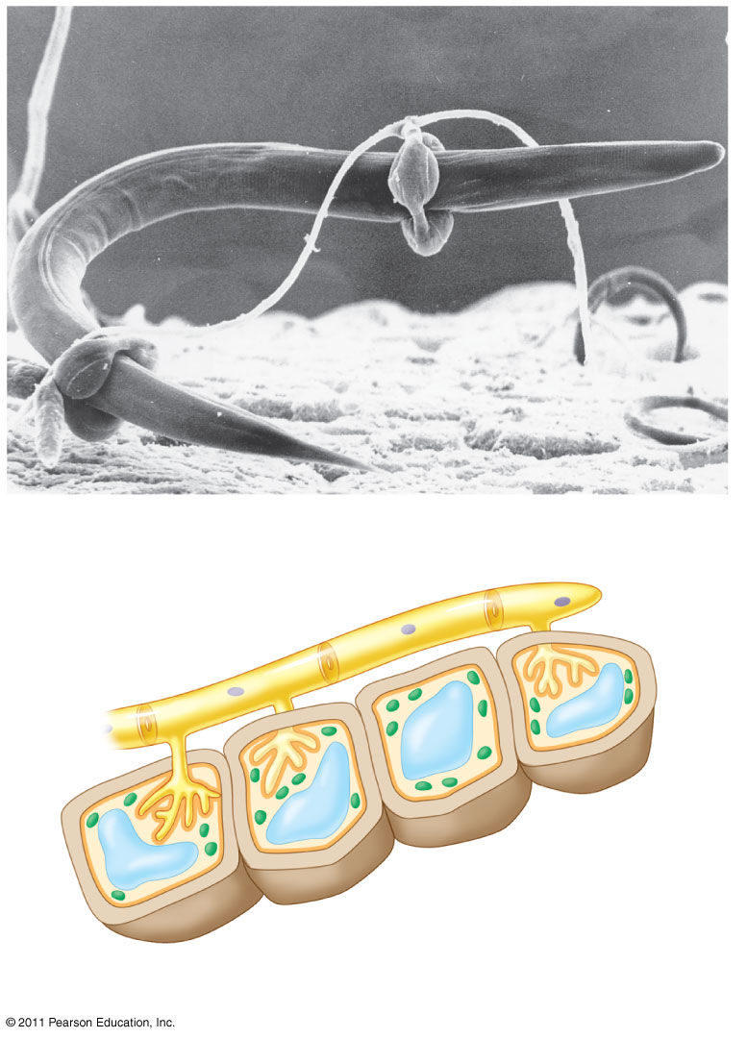
Figure 31.4
Nematode
Hyphae
25 μm
(a) Hyphae adapted for trapping and killing prey
Fungal hypha
Plant cell wall
Plant cell
Plant cell plasma membrane
Haustorium
(b) Haustoria
Notes:
‹#›
Figure 31.4 Specialized hyphae.

Slide 14
Mycorrhizae are mutually(متبادل) beneficial relationships between fungi and plant roots
Ectomycorrhizal fungi form sheaths(أغلفة ،أغمدة) of hyphae over a root and also grow into the extracellular spaces of the root cortex(قشرة)
Arbuscular mycorrhizal fungi extend hyphae through the cell walls of root cells and into tubes formed by invagination of the root cell membrane
© 2011 Pearson Education, Inc.
Notes:
‹#›

Slide 15
Mycorrhizal fungi deliver phosphate ions and minerals to plants
Most vascular plants have mycorrhizae
© 2011 Pearson Education, Inc.
Notes:
‹#›

Slide 16
Concept 31.2: Fungi produce spores through sexual or asexual life cycles
Fungi propagate(تبث) themselves by producing vast numbers of spores, either sexually or asexually
Fungi can produce spores from different types of life cycles
© 2011 Pearson Education, Inc.
Notes:
‹#›

Slide 17
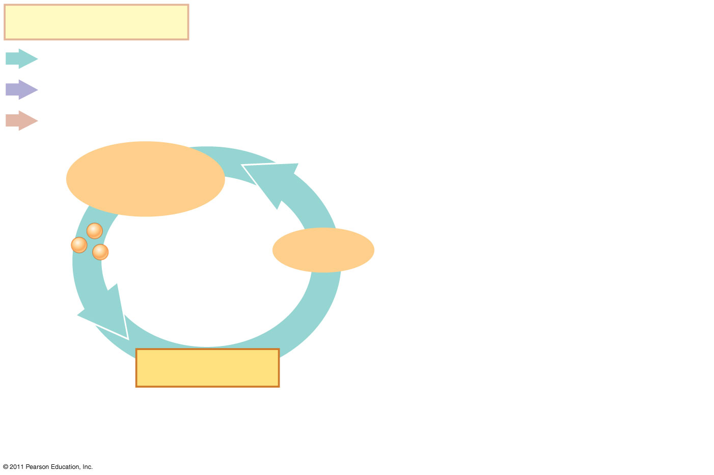
Figure 31.5-1
Key
Haploid (n)
Heterokaryotic
Diploid (2n)
Spore-producing structures
Spores
ASEXUAL REPRODUCTION
Mycelium
GERMINATION
Notes:
‹#›
Figure 31.5 Generalized life cycle of fungi.

Slide 18
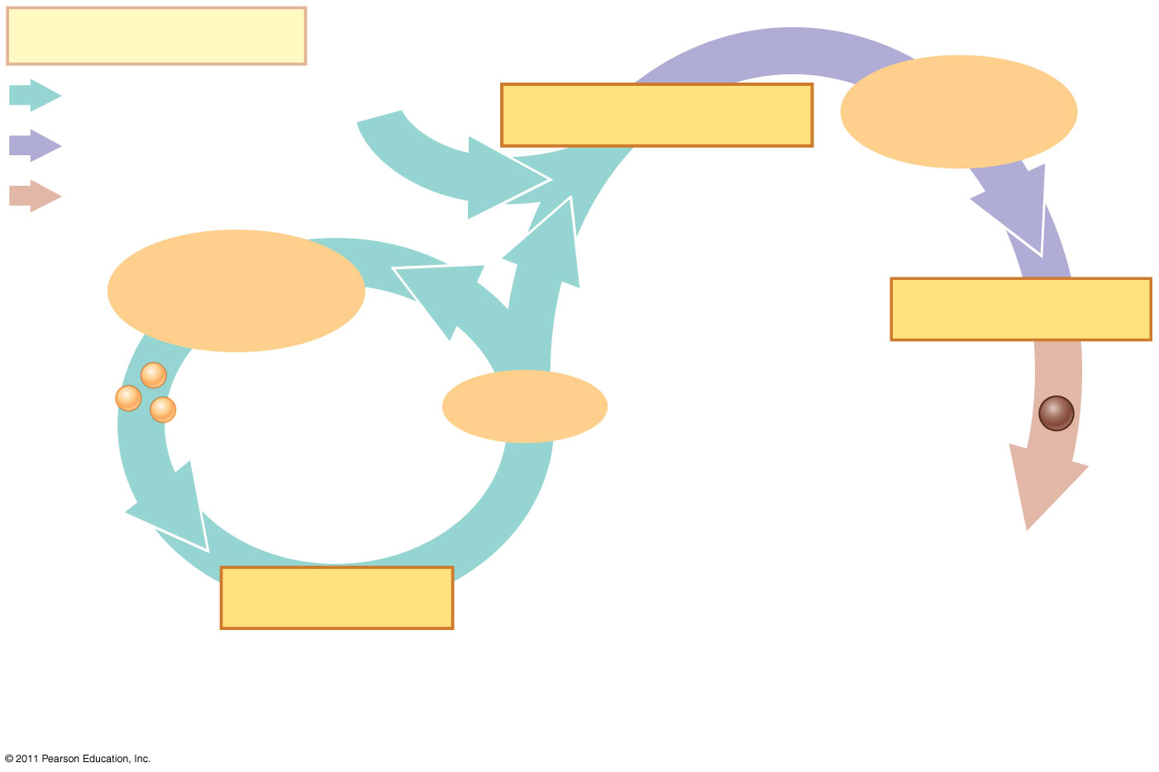
Figure 31.5-2
Key
Haploid (n)
Heterokaryotic stage
PLASMOGAMY
Heterokaryotic
Diploid (2n)
Spore-producing structures
KARYOGAMY
SEXUAL REPRODUCTION
Spores
ASEXUAL REPRODUCTION
Mycelium
Zygote
GERMINATION
Notes:
‹#›
Figure 31.5 Generalized life cycle of fungi.

Slide 19
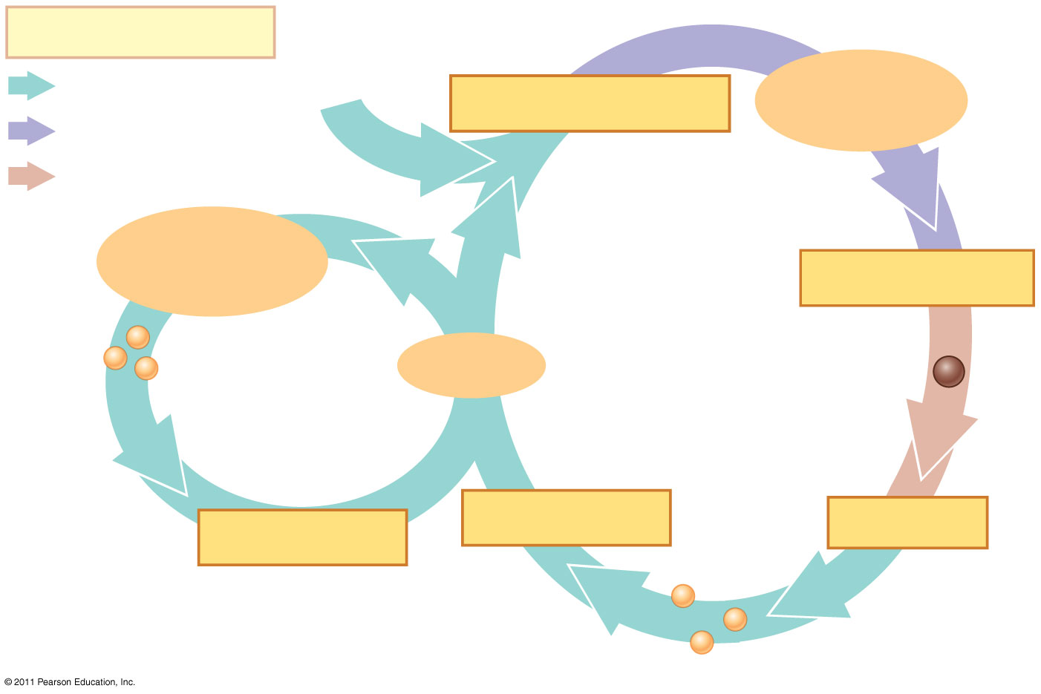
Figure 31.5-3
Key
Haploid (n)
Heterokaryotic stage
PLASMOGAMY
Heterokaryotic
Diploid (2n)
Spore-producing structures
KARYOGAMY
SEXUAL REPRODUCTION
Spores
ASEXUAL REPRODUCTION
Mycelium
Zygote
GERMINATION
MEIOSIS
GERMINATION
Spores
Notes:
‹#›
Figure 31.5 Generalized life cycle of fungi.

Slide 20
Sexual Reproduction
Fungal nuclei are normally haploid, with the exception of transient(عابر) diploid stages formed during the sexual life cycles
Sexual reproduction requires the fusion of hyphae from different mating types
Fungi use sexual signaling molecules called pheromones to communicate their mating type
© 2011 Pearson Education, Inc.
Notes:
‹#›

Slide 21
Plasmogamy is the union of cytoplasm from two parent mycelia
In most fungi, the haploid nuclei from each parent do not fuse right away; they coexist in the mycelium, called a heterokaryon
In some fungi, the haploid nuclei pair off two to a cell; such a mycelium is said to be dikaryotic
© 2011 Pearson Education, Inc.
Notes:
‹#›

Slide 22
Hours, days, or even centuries may pass before the occurrence of karyogamy, nuclear fusion
During karyogamy, the haploid nuclei fuse, producing diploid cells
The diploid phase is short-lived and undergoes meiosis, producing haploid spores
The paired processes of karyogamy and meiosis produce genetic variation
© 2011 Pearson Education, Inc.
Notes:
‹#›

Slide 23
Asexual Reproduction
In addition to sexual reproduction, many fungi can reproduce asexually
Molds produce haploid spores by mitosis and form visible mycelia
© 2011 Pearson Education, Inc.
Notes:
‹#›

Slide 24
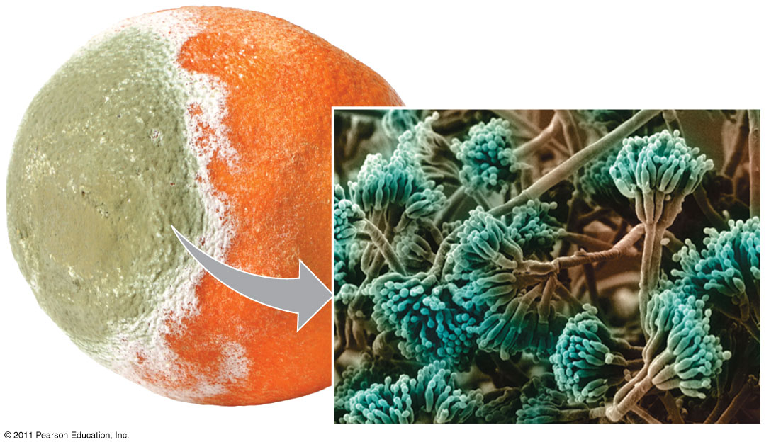
Figure 31.6
1.5 μm
Notes:
‹#›
Figure 31.6 Penicillium, a mold commonly encountered as a decomposer of food.

Slide 25
Other fungi that can reproduce asexually are yeasts, which are single cells
Instead of producing spores, yeasts reproduce asexually by simple cell division and the pinching of “bud cells” from a parent cell
© 2011 Pearson Education, Inc.
Notes:
‹#›

Slide 26
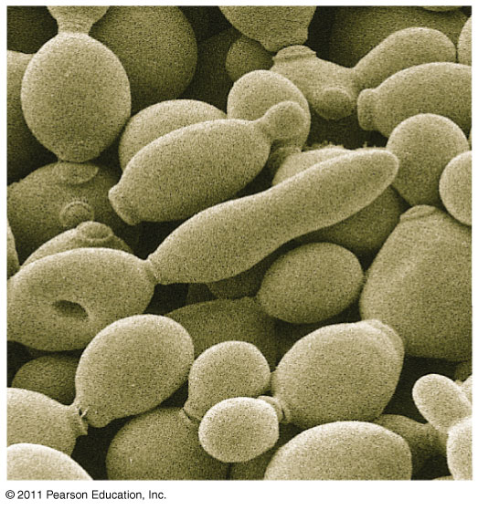
Figure 31.7
10 μm
Parent cell
Bud
Notes:
‹#›
Figure 31.7 The yeast Saccharomyces cerevisiae in several stages of budding (SEM).

Slide 27
Many molds and yeasts have no known sexual stage
Mycologists have traditionally called these deuteromycetes, or imperfect fungi
This is not a sound taxonomic(التصنيفية) group; fungi are reclassified once their sexual stage is discovered
© 2011 Pearson Education, Inc.
Notes:
‹#›

Slide 28
Concept 31.3: The ancestor of fungi was an aquatic, single-celled, flagellated protist
Fungi and animals are more closely related to each other than they are to plants or other eukaryotes
© 2011 Pearson Education, Inc.
Notes:
‹#›

Slide 29
The Move to Land
Fungi were among the earliest colonizers of land and probably formed mutualistic(المنفعة المتبادلة) relationships with early land plants
© 2011 Pearson Education, Inc.
Notes:
‹#›

Slide 30
Concept 31.4: Fungi have radiated into(مشع في) a diverse set of lineages(الأنساب)
Molecular analyses have helped clarify evolutionary relationships among fungal groups, although areas of uncertainty remain
© 2011 Pearson Education, Inc.
Notes:
‹#›

Slide 31
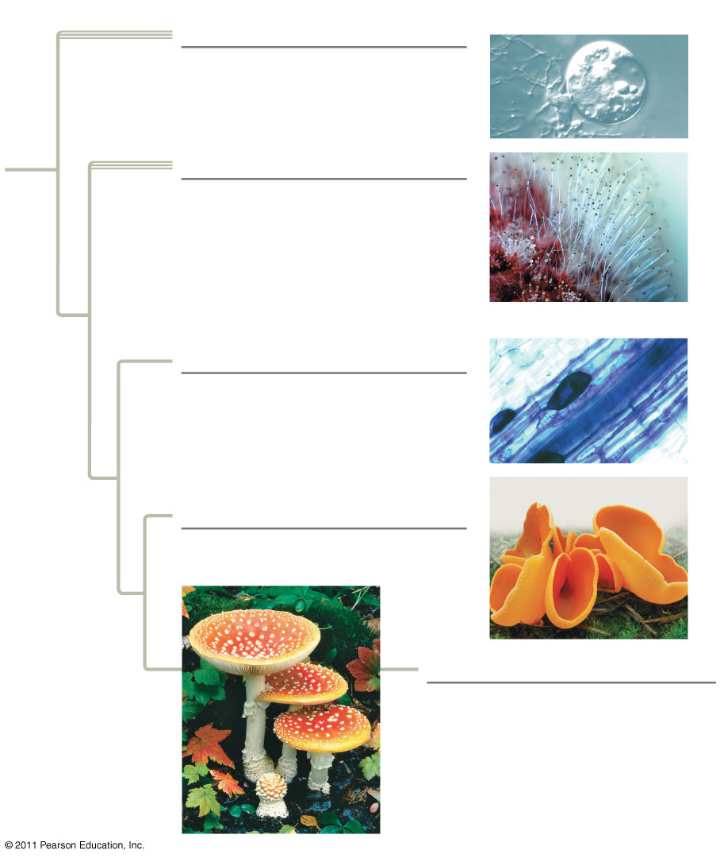
Figure 31.11
Hyphae
25 μm
Chytrids (1,000 species)
Zygomycetes (1,000 species)
Fungal hypha
25 μm
Glomeromycetes (160 species)
Ascomycetes (65,000 species)
Basidiomycetes (30,000 species)
Notes:
‹#›
Figure 31.11 Exploring: Fungal Diversity

Slide 32
Zygomycetes
The zygomycetes (phylum Zygomycota) exhibit great diversity of life histories
They include fast-growing molds, parasites, and commensal symbionts
The life cycle of black bread mold (Rhizopus stolonifer) is fairly typical of the phylum
Its hyphae are coenocytic
Asexual sporangia produce haploid spores
© 2011 Pearson Education, Inc.
Notes:
‹#›

Slide 33
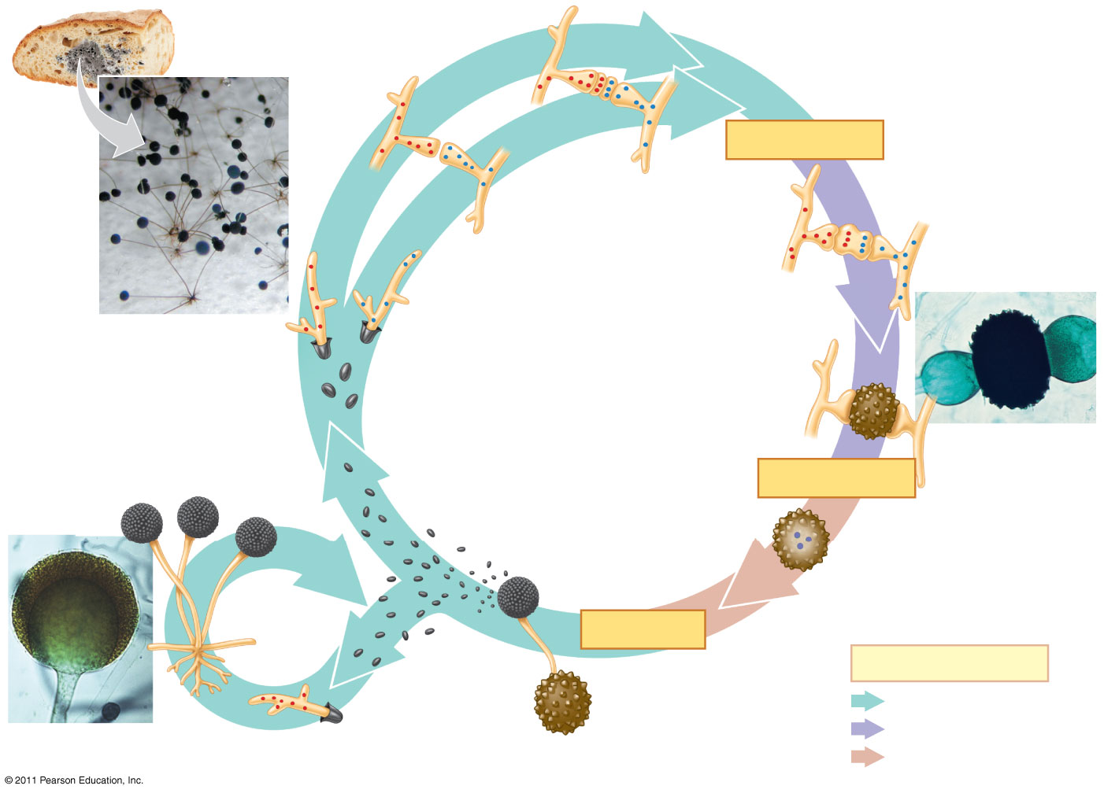
Figure 31.13
PLASMOGAMY
Mating type (−)
Gametangia with haploid nuclei
Mating type (+)
Rhizopus growing on bread
100 μm
Young zygosporangium (heterokaryotic)
SEXUAL REPRODUCTION
Dispersal and germination
Zygosporangium
Sporangia
Flagellum
KARYOGAMY
Diploid nuclei
ASEXUAL REPRODUCTION
Sporangium
MEIOSIS
Key
Dispersal and germination
Haploid (n)
Mycelium
Heterokaryotic (n + n)
50 μm
Diploid (2n)
Notes:
‹#›
Figure 31.13 The life cycle of the zygomycete Rhizopus stolonifer (black bread mold).

Slide 34
The zygomycetes are named for their sexually produced zygosporangia
Zygosporangia are the site of karyogamy and then meiosis
Zygosporangia, which are resistant to freezing and drying, can survive unfavorable conditions
© 2011 Pearson Education, Inc.
Notes:
‹#›

Slide 35
Glomeromycetes
The glomeromycetes (phylum Glomeromycota) were once considered zygomycetes
They are now classified in a separate clade
Glomeromycetes form arbuscular mycorrhizae
© 2011 Pearson Education, Inc.
Notes:
‹#›

Slide 36
Figure 31.UN03
Chytrids
Zygomycetes
Glomeromycetes
Ascomycetes
Basidiomycetes
Notes:
‹#›
Figure 31.UN03

Slide 37
Ascomycetes
Ascomycetes (phylum Ascomycota) live in marine, freshwater, and terrestrial habitats
Ascomycetes produce sexual spores in saclike asci contained in fruiting bodies called ascocarps
Ascomycetes are commonly called sac fungi
Ascomycetes vary in size and complexity
© 2011 Pearson Education, Inc.
Notes:
‹#›

Slide 38
Ascomycetes include plant pathogens, decomposers, and symbionts
Ascomycetes reproduce asexually by enormous numbers of asexual spores called conidia
Conidia are not formed inside sporangia; they are produced asexually at the tips of specialized hyphae called conidiophores
© 2011 Pearson Education, Inc.
Notes:
‹#›

Slide 39
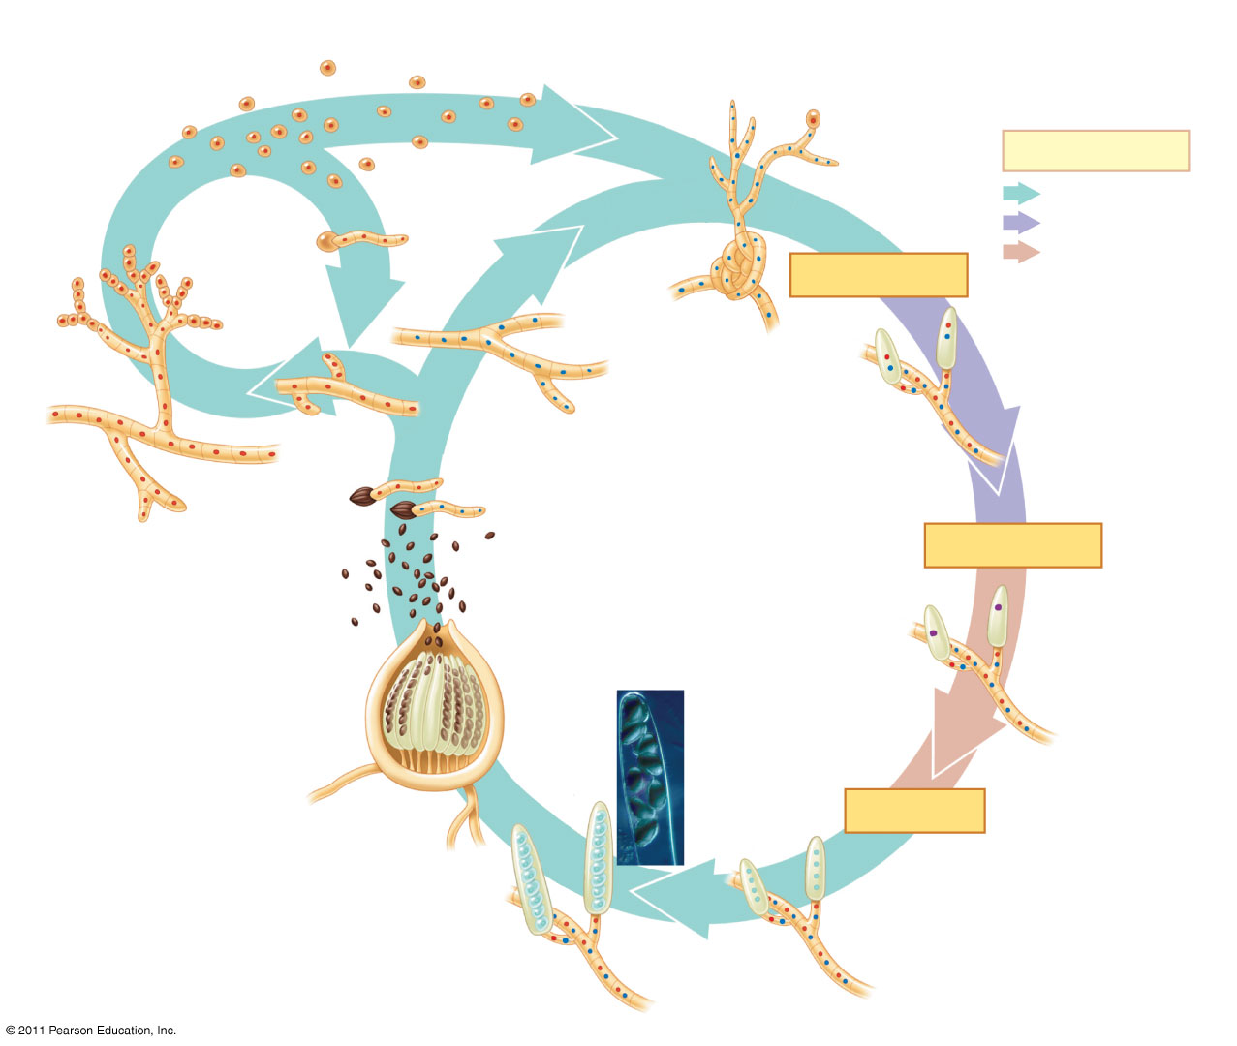
Figure 31.17
Conidia; mating type (−)
Key
Dispersal
Germination
Haploid (n)
Mating type (+)
Dikaryotic (n + n)
ASEXUAL REPRODUCTION
Diploid (2n)
Hypha
PLASMOGAMY
Ascus (dikaryotic)
Conidiophore
Mycelia
Dikaryotic hyphae
Mycelium
Germination
SEXUAL REPRODUCTION
Dispersal
KARYOGAMY
Diploid nucleus (zygote)
Asci
Eight ascospores
Ascocarp
Four haploid nuclei
MEIOSIS
Notes:
‹#›
Figure 31.17 The life cycle of Neurospora crassa, an ascomycete.

Slide 40
Basidiomycetes
Basidomycetes (phylum Basidiomycota) include mushrooms, puffballs, and shelf fungi, mycorrhizae, and plant parasites
The phylum is defined by a clublike structure called a basidium, a transient diploid stage in the life cycle
The basidiomycetes are also called club fungi
Many basidiomycetes are decomposers of wood
© 2011 Pearson Education, Inc.
Notes:
‹#›

Slide 41
Figure 31.UN05
Chytrids
Zygomycetes
Glomeromycetes
Ascomycetes
Basidiomycetes
Notes:
‹#›
Figure 31.UN05

Slide 42
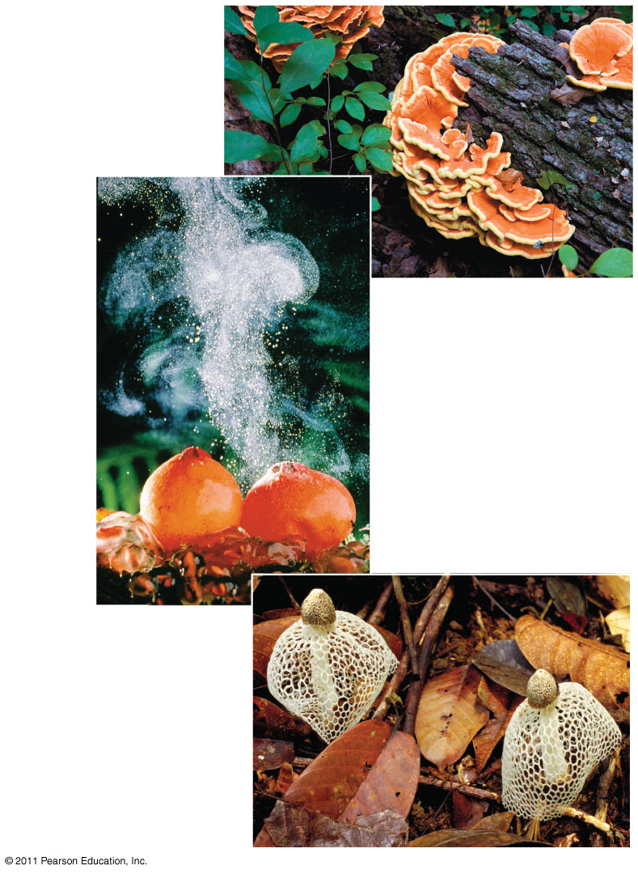
Figure 31.18
Shelf fungi
Puffballs emitting spores
Maiden veil fungus (Dictyphora)
Notes:
‹#›
Figure 31.18 Basidiomycetes (club fungi).

Slide 43
The life cycle of a basidiomycete usually includes a long-lived dikaryotic mycelium
In response to environmental stimuli, the mycelium reproduces sexually by producing elaborate fruiting bodies call basidiocarps
Mushrooms are examples of basidiocarps
The numerous basidia in a basidiocarp are sources of sexual spores called basidiospores
© 2011 Pearson Education, Inc.
Notes:
‹#›

Slide 44
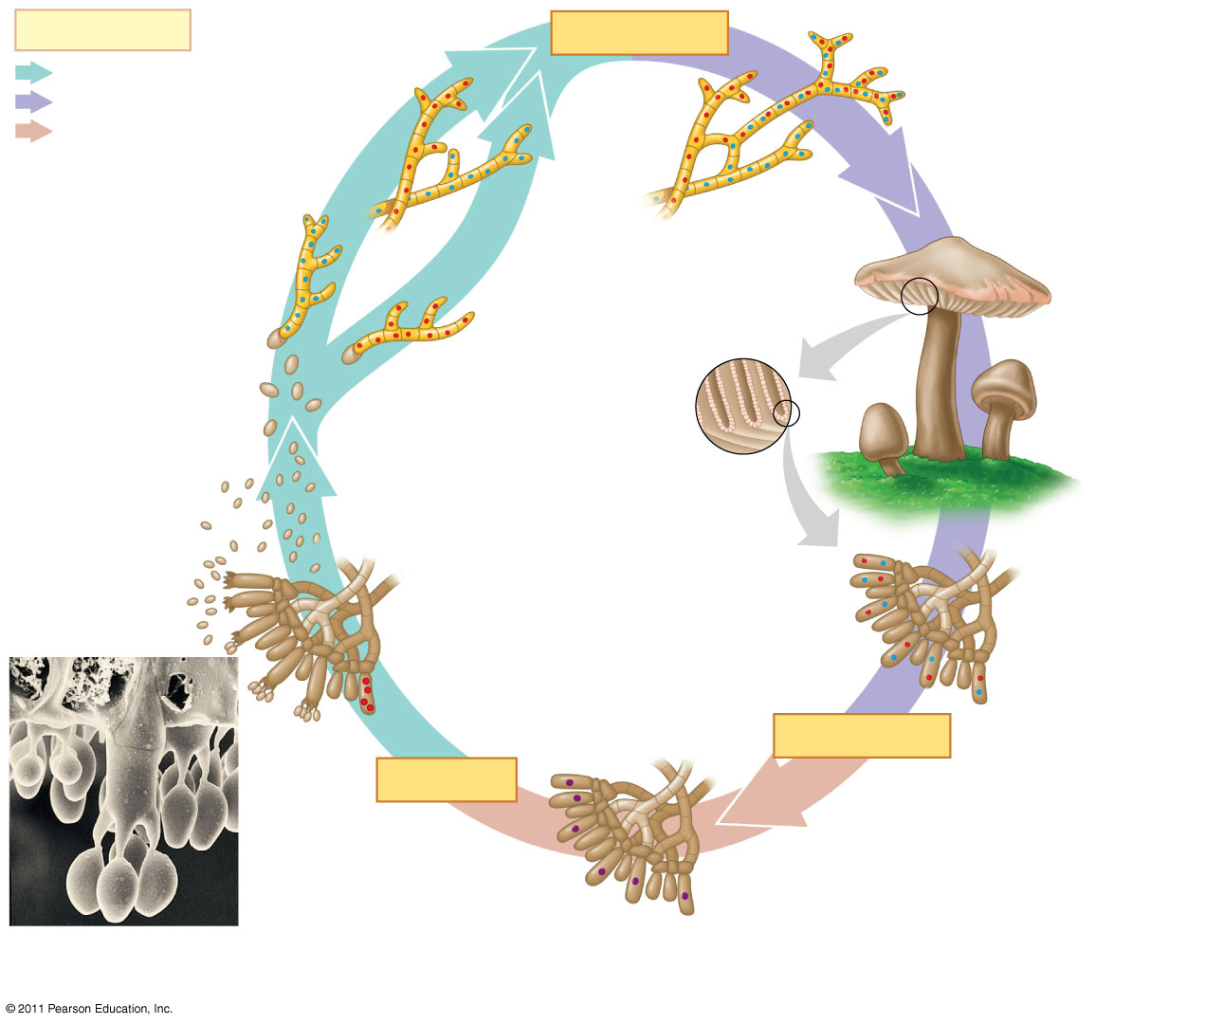
Figure 31.19
Key
PLASMOGAMY
Dikaryotic mycelium
Haploid (n)
Dikaryotic (n + n)
Mating type (−)
Diploid (2n)
Mating type (+)
Haploid mycelia
Gills lined with basidia
SEXUAL REPRODUCTION
Basidiocarp (n + n)
Dispersal and
germination
Basidiospores (n)
Basidium
Basidium with four basidiospores
Basidia (n + n)
Basidium containing four haploid nuclei
KARYOGAMY
MEIOSIS
1 μm
Basidiospore
Diploid nuclei
Notes:
‹#›
Figure 31.19 The life cycle of a mushroom-forming basidiomycete.

Slide 45
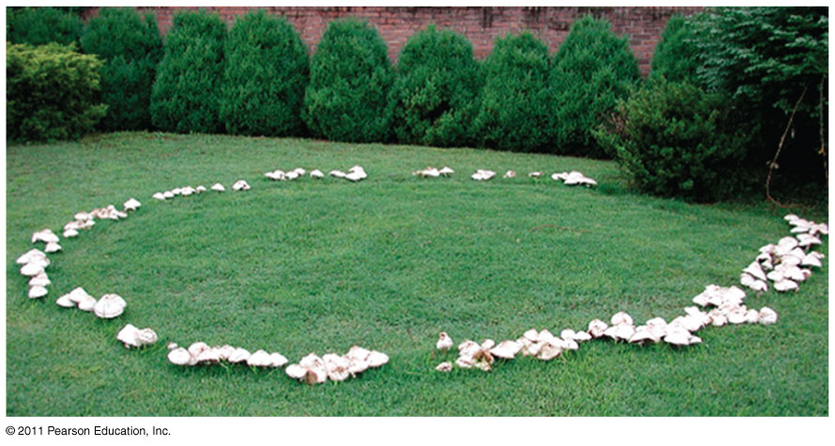
Figure 31.20
Notes:
‹#›
Figure 31.20 A fairy ring.

Slide 46
Concept 31.5: Fungi play key roles in nutrient cycling, ecological interactions, and human welfare
Fungi interact with other organisms as decomposers, mutualists, and pathogens
© 2011 Pearson Education, Inc.
Notes:
‹#›

Slide 47
Fungi as Decomposers
Fungi are efficient decomposers of organic material including cellulose and lignin
They perform essential recycling of chemical elements between the living and nonliving world
Fungi are also used in bioremediation(المعالجة البيولوجية) projects
© 2011 Pearson Education, Inc.
Notes:
‹#›

Slide 48
Fungi as Mutualists
Fungi form mutualistic relationships with plants, algae, cyanobacteria, and animals
All of these relationships have profound(عميقة) ecological effects
© 2011 Pearson Education, Inc.
Notes:
‹#›

Slide 49
Fungus-Plant Mutualisms
Mycorrhizae are enormously important in natural ecosystems and agriculture
Plants harbor harmless symbiotic endophytes, fungi that live inside leaves or other plant parts
Endophytes make toxins that deter herbivores and defend against pathogens
Most endophytes are ascomycetes
© 2011 Pearson Education, Inc.
Notes:
‹#›

Slide 50
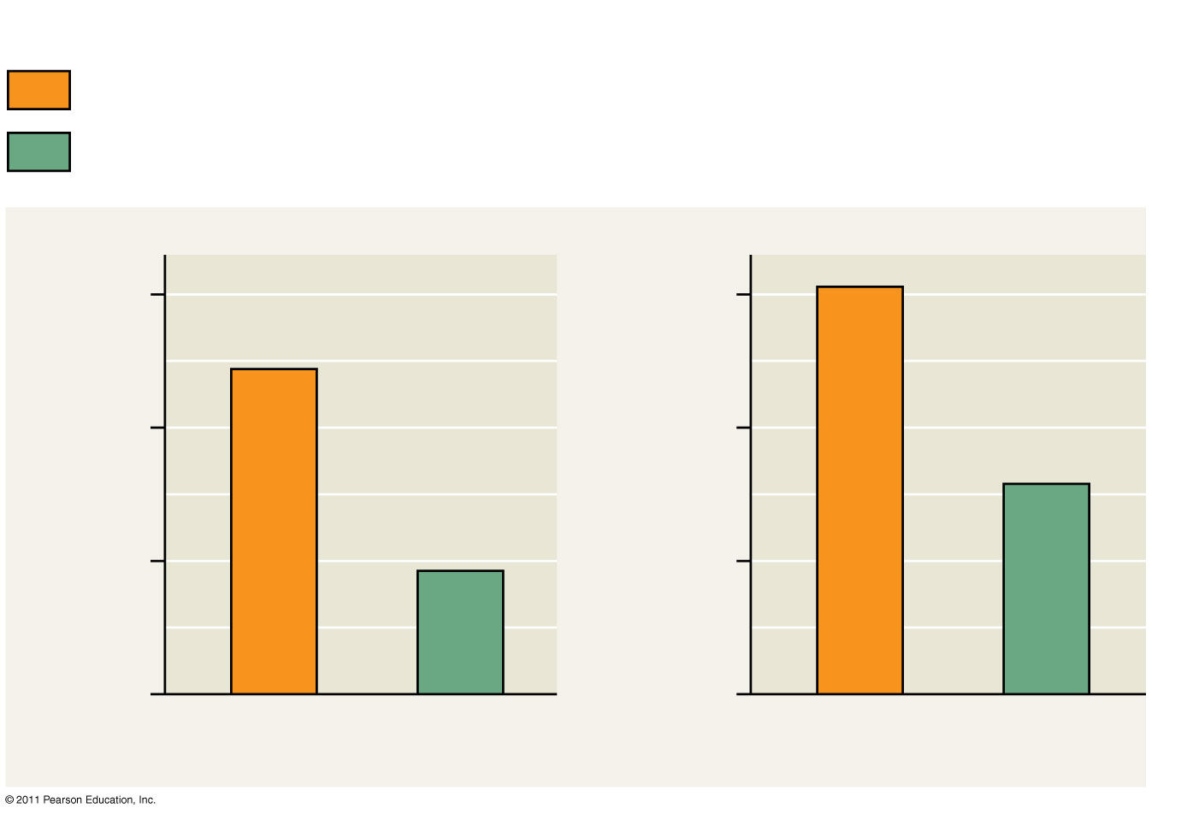
Figure 31.21
RESULTS
Endophyte not present; pathogen present (E−P+)
Both endophyte and pathogen present (E+P+)
30
15
20
10
Leaf mortality (%)
Leaf area damaged (%)
10
5
0
0
E−P+
E+P+
E−P+
E+P+
Notes:
‹#›
Figure 31.21 Inquiry: Do endophytes benefit a woody plant?

Slide 51
Fungus-Animal Symbioses
Some fungi share their digestive services with animals
These fungi help break down plant material in the guts of cows and other grazing mammals
© 2011 Pearson Education, Inc.
Notes:
‹#›

Slide 52
Lichens
A lichen is a symbiotic association between a photosynthetic microorganism and a fungus
Millions of photosynthetic cells are held in a mass of fungal hyphae
The photosynthetic component is green algae of cyanobacteria
The fungal component is most often an ascomycete
© 2011 Pearson Education, Inc.
Notes:
‹#›

Slide 53
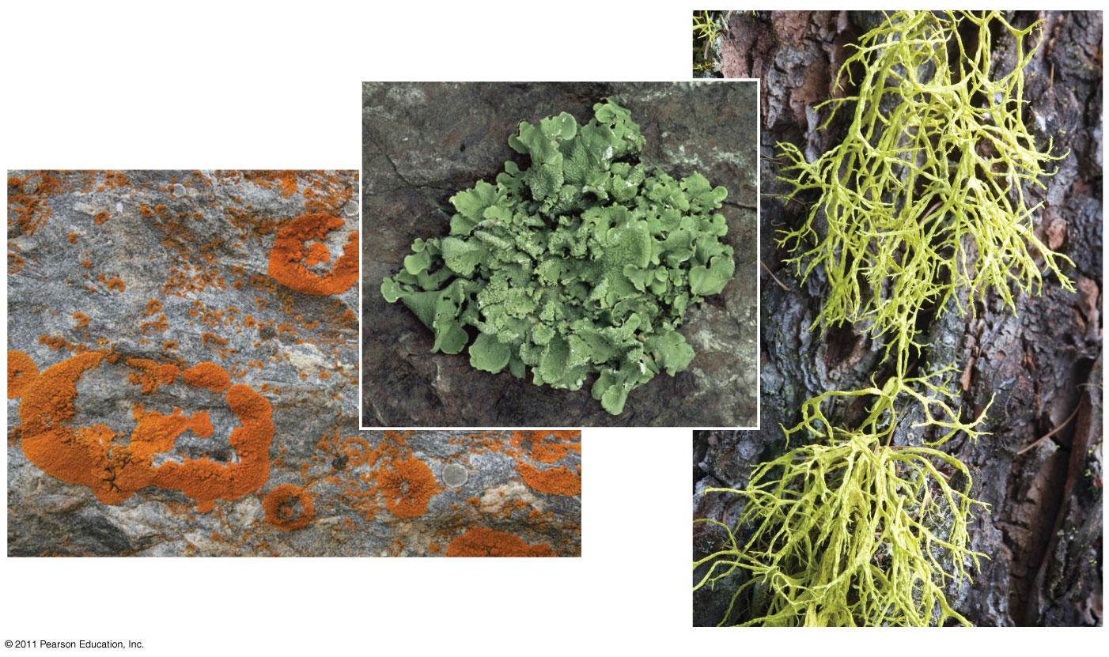
Figure 31.23
A foliose (leaflike) lichen
Crustose (encrusting) lichens
A fruticose (shrublike) lichen
Notes:
‹#›
Figure 31.23 Variation in lichen growth forms.

Slide 54
The symbioses are so complete that lichens are given scientific names
Algae or cyanobacteria occupy an inner layer below the lichen surface
© 2011 Pearson Education, Inc.
Notes:
‹#›

Slide 55
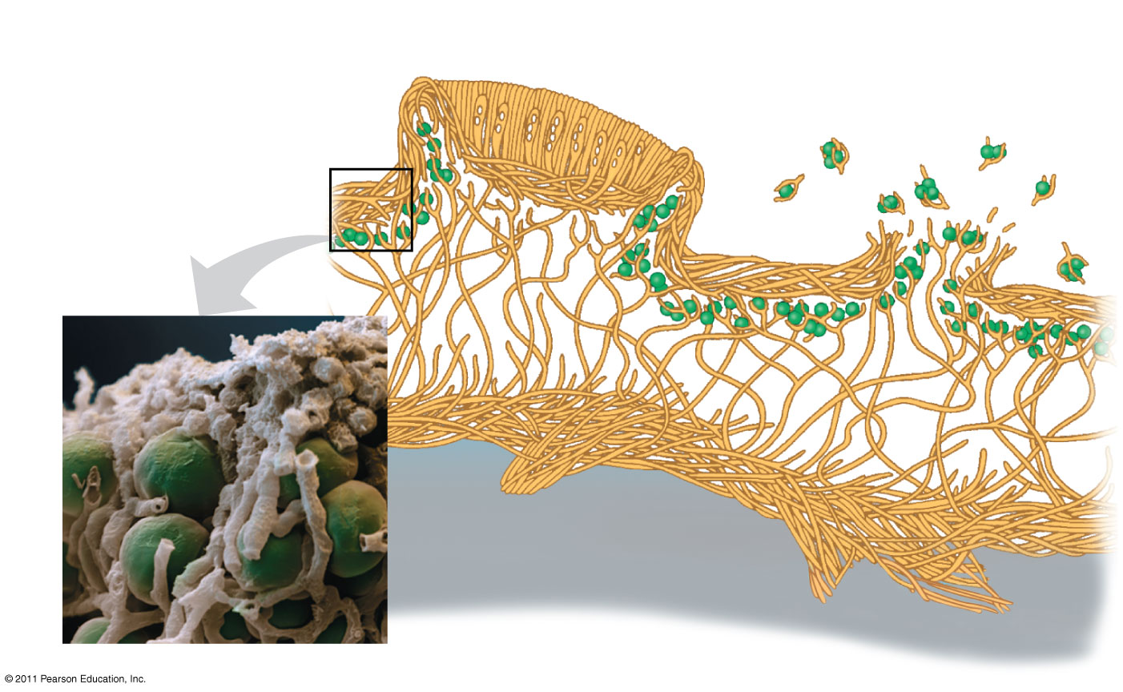
Figure 31.24
Ascocarp of fungus
Soredia
Fungal hyphae
Algal layer
50 μm
Fungal hyphae
Algal cell
Notes:
‹#›
Figure 31.24 Anatomy of an ascomycete lichen (colorized SEM).

Slide 56
The algae provide carbon compounds, cyanobacteria also provide organic nitrogen, and fungi provide the environment for growth
The fungi of lichens can reproduce sexually and asexually
Asexual reproduction is by fragmentation or the formation of soredia, small clusters of hyphae with embedded algae
© 2011 Pearson Education, Inc.
Notes:
‹#›

Slide 57
Lichens are important pioneers on new rock and soil surfaces
Lichens may have helped the colonization of land by plants 550–600 million years ago
Lichens are sensitive to pollution, and their death can be a warning that air quality is deteriorating(تدهور)
© 2011 Pearson Education, Inc.
Notes:
‹#›

Slide 58
Fungi as Pathogens
About 30% of known fungal species are parasites or pathogens, mostly on or in plants
Each year, 10% to 50% of the world’s fruit harvest is lost due to fungi
Some fungi that attack food crops are toxic to humans
© 2011 Pearson Education, Inc.
Notes:
‹#›

Slide 59
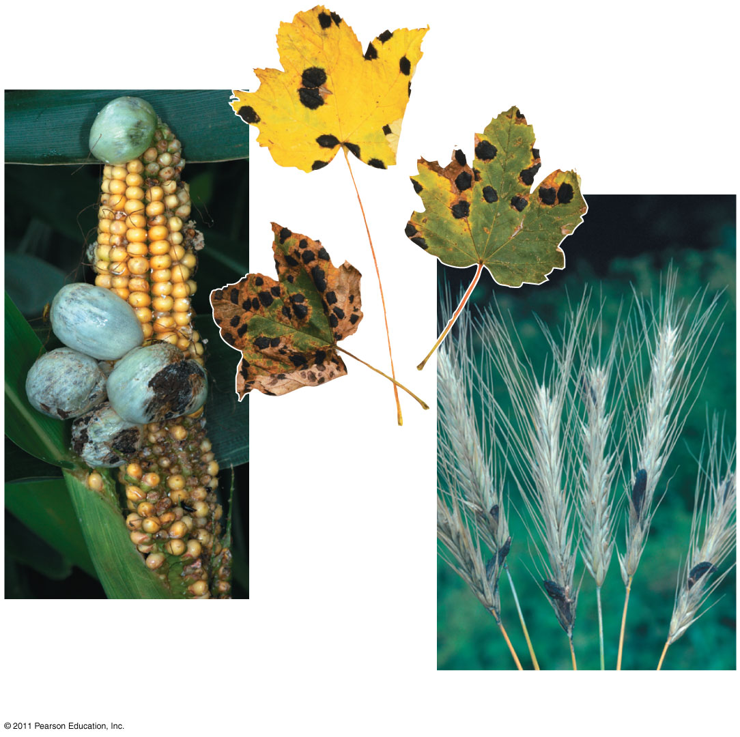
Figure 31.25
(b)
Tar spot fungus on maple leaves
(a) Corn smut on corn
(c) Ergots on rye
Notes:
‹#›
Figure 31.25 Examples of fungal diseases of plants.

Slide 60
Ergot of rye is caused by an ascomycete, and produces toxins
More than 40,000 people died from an epidemic of ergotism during the middle ages
Ergotism is characterized by gangrene, nervous spasms(تشنجات), burning sensations, hallucinations(هلوسة), and temporary insanity(الجنون المؤقت)
Ergots contain lysergic acid, the raw material for LSD
© 2011 Pearson Education, Inc.
Notes:
‹#›

Slide 61
Animals are much less susceptible(سريع التأثر) to parasitic fungi than are plants
The chytrid Batrachochytrium dendrobatidis might be the cause of the recent decline in amphibians worldwide
© 2011 Pearson Education, Inc.
Notes:
‹#›

Slide 62
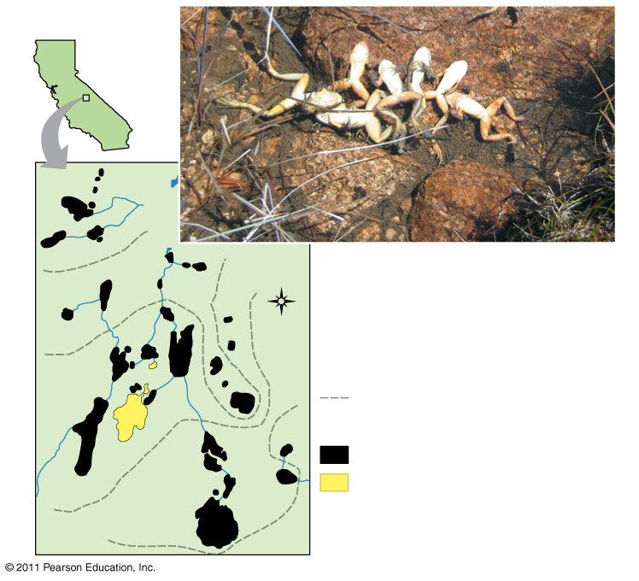
Figure 31.26
California
Sixty Lake Basin
2004
Yellow-legged frogs killed by B. dendrobatidis infection
N
2005
Key
Boundary of chytrid spread
Lake status in 2009:
Frog population extinct
2006
Treatment lake: frogs treated with fungicides and released
2007
2008
Notes:
‹#›
Figure 31.26 Impact: Amphibians Under Attack

Slide 63
The general term for a fungal infection in animals is mycosis
Ringworm and athlete’s foot are examples a human mycoses
Systemic mycoses spread through the body
For example, coccidioidomycosis produces tuberculosis-like symptoms
Some mycoses are opportunistic
For example, Candida albicans, which causes yeast infections
© 2011 Pearson Education, Inc.
Notes:
‹#›

Slide 64
Practical Uses of Fungi
Humans eat many fungi and use others to make cheeses, alcoholic beverages, and bread
Some fungi are used to produce antibiotics for the treatment of bacterial infections
For example, the ascomycete Penicillium
© 2011 Pearson Education, Inc.
Notes:
‹#›

Slide 65
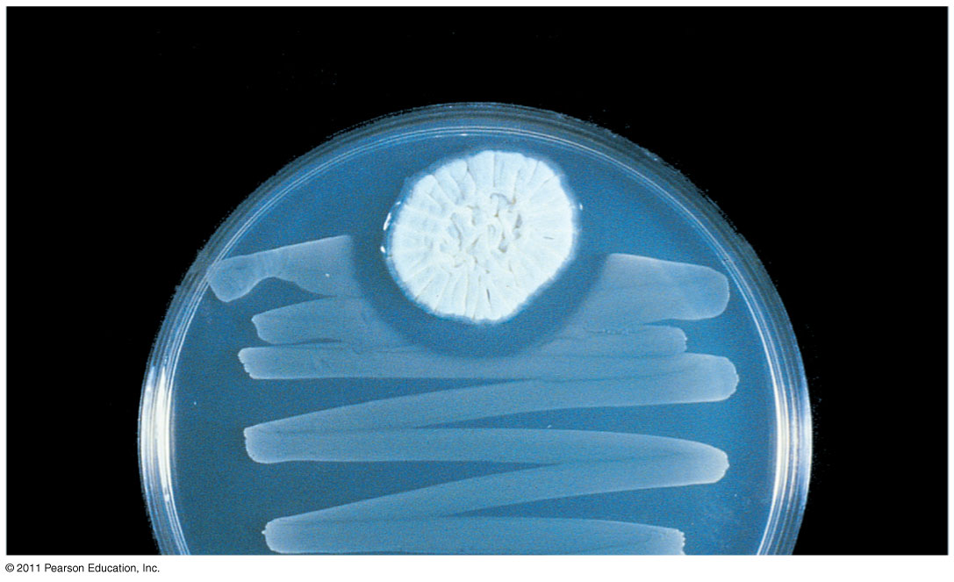
Figure 31.27
Staphylococcus
Penicillium
Zone of inhibited growth
Notes:
‹#›
Figure 31.27 Fungal production of an antibiotic.

Slide 66
Genetic research on fungi is leading to applications in biotechnology
For example, scientists are using Saccharomyces to study homologs of the genes involved in Parkinson’s and Huntington’s diseases
For example, insulin-like growth factor can be produced in the fungus Saccharomyces cerevisiae
© 2011 Pearson Education, Inc.
Notes:
‹#›

