Slide 1
Chapter 43
The Immune System

Slide 2
Overview: Recognition and Response
Pathogens, agents that cause disease, infect a wide range of animals, including humans
The immune system recognizes foreign bodies and responds with the production of immune cells and proteins
All animals have innate immunity, a defense active immediately upon infection
Vertebrates also have adaptive immunity
مسببات الأمراض ، العوامل التي تسبب المرض ، تصيب مجموعة واسعة من الحيوانات ، بما في ذلك البشريتعرف الجهاز المناعي على الأجسام الغريبة ويستجيب بإنتاج الخلايا والبروتينات المناعيةتتمتع جميع الحيوانات بمناعة فطرية ، وهي وسيلة دفاع نشطة فور الإصابة بالعدوىتمتلك الفقاريات أيضًا مناعة تكيفية
© 2011 Pearson Education, Inc.

Slide 3
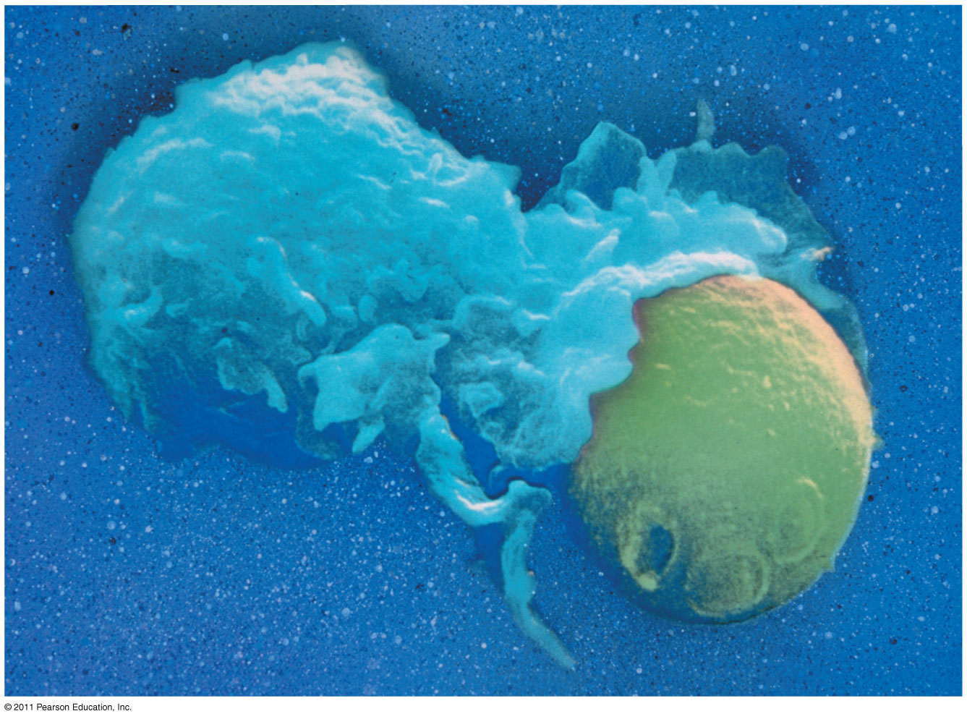
Figure 43.1
Notes:
Figure 43.1 How do an animal’s immune cells recognize foreign cells?

Slide 4
Innate immunity is present before any exposure to pathogens and is effective from the time of birth
It involves nonspecific responses to pathogens
Innate immunity consists of external barriers plus internal cellular and chemical defenses
توجد المناعة الفطرية قبل أي تعرض لمسببات الأمراض وهي فعالة من وقت الولادةأنه ينطوي على استجابات غير محددة لمسببات الأمراضتتكون المناعة الفطرية من حواجز خارجية بالإضافة إلى دفاعات خلوية وكيميائية داخلية
© 2011 Pearson Education, Inc.

Slide 5
Adaptive immunity, or acquired immunity, develops after exposure to agents such as microbes, toxins, or other foreign substances
It involves a very specific response to pathogens
تتطور المناعة التكيفية أو المناعة المكتسبة بعد التعرض لعوامل مثل الميكروبات أو السموم أو المواد الغريبة الأخر
ىإنه ينطوي على استجابة محددة للغاية لمسببات الأمراض
© 2011 Pearson Education, Inc.

Slide 6
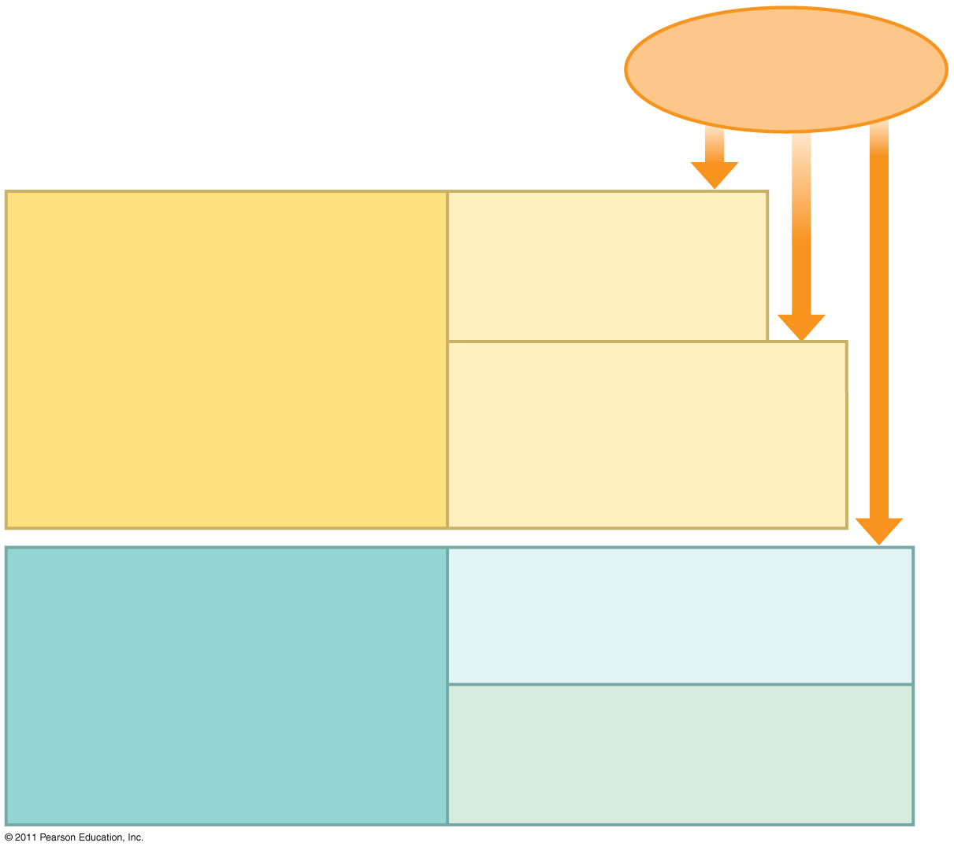
Figure 43.2
Pathogens (such as bacteria, fungi, and viruses)
INNATE IMMUNITY (all animals)
Barrier defenses:
Skin Mucous membranes Secretions
•
Recognition of traits shared by broad ranges of pathogens, using a small set of receptors
Internal defenses:
Phagocytic cells Natural killer cells Antimicrobial proteins Inflammatory response
• Rapid response
ADAPTIVE IMMUNITY (vertebrates only)
Humoral response:
Antibodies defend against infection in body fluids.
•
Recognition of traits specific to particular pathogens, using a vast array of receptors
Cell-mediated response:
Cytotoxic cells defend against infection in body cells.
• Slower response
Notes:
Figure 43.2 Overview of animal immunity.

Slide 7
Concept 43.1: In innate immunity, recognition and response rely on traits common to groups of pathogens
Innate immunity is found in all animals and plants
In vertebrates, innate immunity is a first response to infections and also serves as the foundation of adaptive immunity
توجد المناعة الفطرية في جميع الحيوانات والنباتات
في الفقاريات ، المناعة الفطرية هي الاستجابة الأولى للعدوى وهي أيضًا بمثابة أساس المناعة التكيفية
© 2011 Pearson Education, Inc.

Slide 8
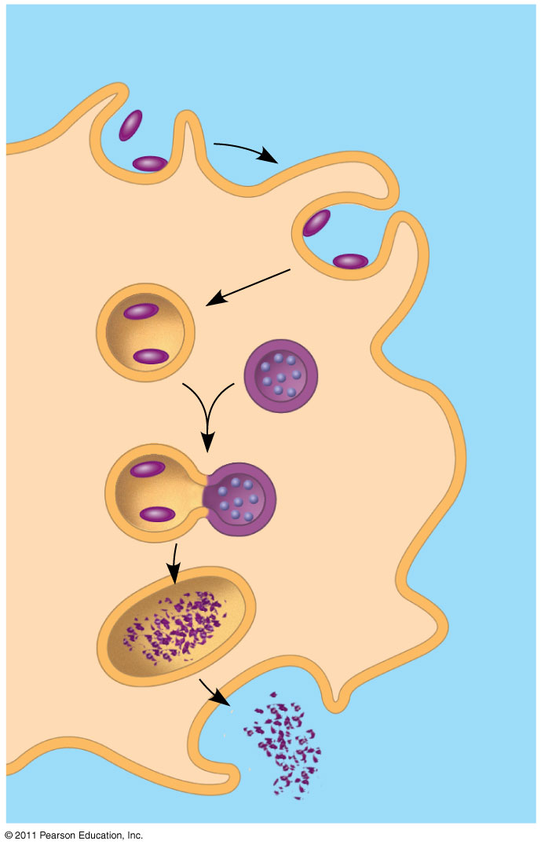
Figure 43.3
Pathogen
PHAGOCYTIC CELL
Vacuole
Lysosome containing enzymes
Notes:
Figure 43.3 Phagocytosis.

Slide 9
The immune system recognizes bacteria and fungi by structures on their cell walls
An immune response varies with the class of pathogen encountered
يتعرف الجهاز المناعي على البكتيريا والفطريات من خلال الهياكل الموجودة على جدران الخلاياتختلف الاستجابة المناعية باختلاف فئة الممرضات التي تصادفها
© 2011 Pearson Education, Inc.

Slide 10
Innate Immunity of Vertebrates
The immune system of mammals is the best understood of the vertebrates
Innate defenses include barrier defenses, phagocytosis, antimicrobial peptides
Additional defenses are unique to vertebrates: natural killer cells, interferons, and the inflammatory response
أفضل ما يفهمه الفقاريات هو الجهاز المناعي للثدييات
تشمل الدفاعات الفطرية دفاعات الحاجز ، البلعمة ، الببتيدات المضادة للميكروبات
الدفاعات الإضافية تنفرد بها الفقاريات: الخلايا القاتلة الطبيعية ، والإنترفيرون ، والاستجابة الالتهابية
© 2011 Pearson Education, Inc.

Slide 11
Barrier Defenses
Barrier defenses include the skin and mucous membranes of the respiratory, urinary, and reproductive tracts
Mucus traps and allows for the removal of microbes
Many body fluids including saliva, mucus, and tears are hostile to many microbes
The low pH of skin and the digestive system prevents growth of many bacteria
© 2011 Pearson Education, Inc.

Slide 12
تشمل دفاعات الحاجز الجلد والأغشية المخاطية للجهاز التنفسي والمسالك البولية والتناسلية
يحبس المخاط ويسمح بإزالة الميكروبات
العديد من سوائل الجسم بما في ذلك اللعاب والمخاط والدموع معادية للعديد من الميكروبات
يمنع انخفاض درجة الحموضة في الجلد والجهاز الهضمي نمو العديد من البكتيريا

Slide 13
Cellular Innate Defenses
Pathogens entering the mammalian body are subject to phagocytosis
Phagocytic cells recognize groups of pathogens by TLRs, Toll-like receptors
تخضع مسببات الأمراض التي تدخل جسم الثدييات للبلعمة
تتعرف الخلايا البلعمية على مجموعات من مسببات الأمراض عن طريق المستقبلات الشبيهة بالمستقبلات TLRs
© 2011 Pearson Education, Inc.

Slide 14
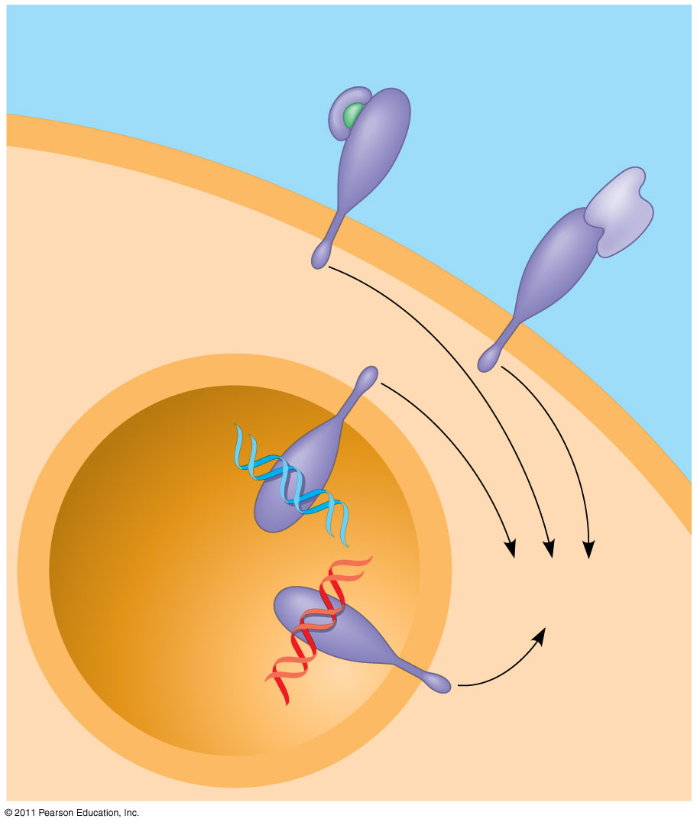
Figure 43.6
EXTRACELLULAR FLUID
Lipopolysaccharide
Helper protein
Flagellin
TLR4
PHAGOCYTIC CELL
TLR5
VESICLE
TLR9
CpG DNA
TLR3
Innate immune responses
ds RNA
Notes:
Figure 43.6 TLR signaling.

Slide 15
A white blood cell engulfs a microbe, then fuses with a lysosome to destroy the microbe
There are different types of phagocytic cells
Neutrophils engulf and destroy pathogens
Macrophages are found throughout the body
Dendritic cells stimulate development of adaptive immunity
Eosinophils discharge destructive enzymes
© 2011 Pearson Education, Inc.

Slide 16
تبتلع خلية الدم البيضاء ميكروبًا ، ثم تندمج مع الليزوزوم لتدمير الميكروب
هناك أنواع مختلفة من الخلايا البلعمية
العدلات تبتلع وتدمر مسببات الأمراض
تم العثور على الضامة في جميع أنحاء الجسم
تحفز الخلايا المتغصنة تطور المناعة التكيفية
تفرز الحمضات إنزيمات مدمرة

Slide 17
Cellular innate defenses in vertebrates also involve natural killer cells
These circulate through the body and detect abnormal cells
They release chemicals leading to cell death, inhibiting the spread of virally infected or cancerous cells
Many cellular innate defenses involve the lymphatic system
© 2011 Pearson Education, Inc.

Slide 18
تشمل الدفاعات الخلوية الفطرية في الفقاريات أيضًا الخلايا القاتلة الطبيعية
تنتشر هذه عبر الجسم وتكتشف الخلايا غير الطبيعية
يطلقون مواد كيميائية تؤدي إلى موت الخلايا ، مما يمنع انتشار الخلايا السرطانية أو المصابة بالفيروس
تتضمن العديد من الدفاعات الخلوية الفطرية الجهاز اللمفاوي

Slide 19
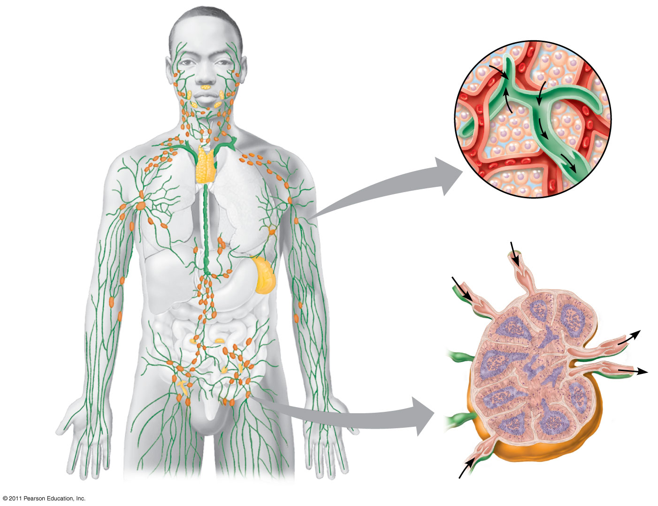
Figure 43.7
Interstitial fluid
Blood capillary
Adenoid
Tonsils
Lymphatic vessels
Thymus
Tissue cells
Lymphatic vessel
Peyer’s patches (small intestine)
Lymphatic vessel
Spleen
Lymph nodes
Appendix (cecum)
Lymph node
Masses of defensive cells
Notes:
Figure 43.7 The human lymphatic system.

Slide 20
Antimicrobial Peptides and Proteins
Peptides and proteins function in innate defense by attacking pathogens or impeding their reproduction
Interferon proteins provide innate defense, interfering with viruses and helping activate macrophages
About 30 proteins make up the complement system, which causes lysis of invading cells and helps trigger inflammation
© 2011 Pearson Education, Inc.

Slide 21
تعمل الببتيدات والبروتينات في الدفاع الفطري عن طريق مهاجمة مسببات الأمراض أو إعاقة تكاثرهاتوفر بروتينات الإنترفيرون دفاعًا فطريًا ، وتتدخل في الفيروسات وتساعد على تنشيط البلاعم
يشكل النظام التكميلي حوالي 30 بروتينًا ، مما يتسبب في تحلل الخلايا الغازية ويساعد على تحفيز الالتهاب

Slide 22
Inflammatory Responses
The inflammatory response, such as pain and swelling, is brought about by molecules released upon injury of infection
Mast cells, a type of connective tissue, release histamine, which triggers blood vessels to dilate and become more permeable
Activated macrophages and neutrophils release cytokines, signaling molecules that enhance the immune response
© 2011 Pearson Education, Inc.

Slide 23
تحدث الاستجابة الالتهابية ، مثل الألم والتورم ، عن طريق الجزيئات المنبعثة عند إصابة العدوى
تُفرز الخلايا البدينة ، وهي نوع من الأنسجة الضامة ، الهيستامين ، الذي يحفز الأوعية الدموية على التمدد وتصبح أكثر نفاذية
تقوم الخلايا الضامة النشطة والعدلات بإطلاق السيتوكينات ، مما يشير إلى الجزيئات التي تعزز الاستجابة المناعية

Slide 24
Pus, a fluid rich in white blood cells, dead pathogens, and cell debris from damaged tissues
القيح ، وهو سائل غني بخلايا الدم البيضاء ومسببات الأمراض الميتة وحطام الخلايا من الأنسجة التالفة
© 2011 Pearson Education, Inc.

Slide 25
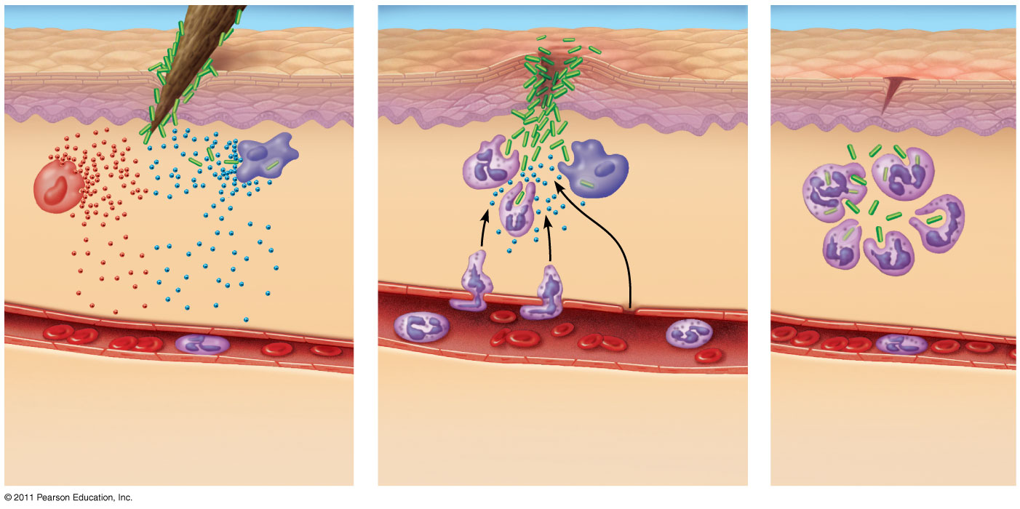
Figure 43.8-3
Pathogen
Splinter
Signaling molecules
Macro- phage
Movement of fluid
Mast cell
Capillary
Phagocytosis
Red blood cells
Neutrophil
Notes:
Figure 43.8 Major events in a local inflammatory response.

Slide 26
Inflammation can be either local or systemic (throughout the body)
Fever is a systemic inflammatory response triggered by pyrogens released by macrophages and by toxins from pathogens
Septic shock is a life-threatening condition caused by an overwhelming inflammatory response
© 2011 Pearson Education, Inc.

Slide 27
Evasion of Innate Immunity by Pathogens
Some pathogens avoid destruction by modifying their surface to prevent recognition or by resisting breakdown following phagocytosis
Tuberculosis (TB) is one such disease and kills more than a million people a year
© 2011 Pearson Education, Inc.

Slide 28
Concept 43.2: In adaptive immunity, receptors provide pathogen-specific recognition
The adaptive response relies on two types of lymphocytes, or white blood cells
Lymphocytes that mature in the thymus above the heart are called T cells, and those that mature in bone marrow are called B cells
© 2011 Pearson Education, Inc.

Slide 29
Antigens are substances that can elicit a response from a B or T cell
Exposure to the pathogen activates B and T cells with antigen receptors specific for parts of that pathogen
The small accessible part of an antigen that binds to an antigen receptor is called an epitope
© 2011 Pearson Education, Inc.

Slide 30
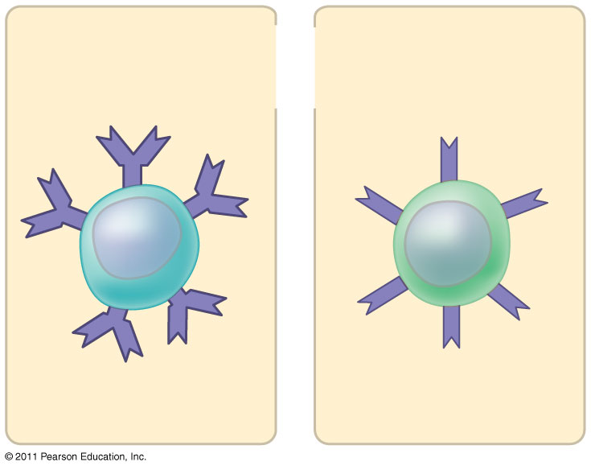
Figure 43.UN01
Antigen receptors
Mature B cell
Mature T cell
Notes:
Figure 43.UN01 In-text figure, p. 935

Slide 31
B cells and T cells have receptor proteins that can bind to foreign molecules
Each individual lymphocyte is specialized to recognize a specific type of molecule
© 2011 Pearson Education, Inc.

Slide 32
Antigen Recognition by B Cells and Antibodies
Each B cell antigen receptor is a Y-shaped molecule with two identical heavy chains and two identical light chains
The constant regions of the chains vary little among B cells, whereas the variable regions differ greatly
The variable regions provide antigen specificity
© 2011 Pearson Education, Inc.

Slide 33
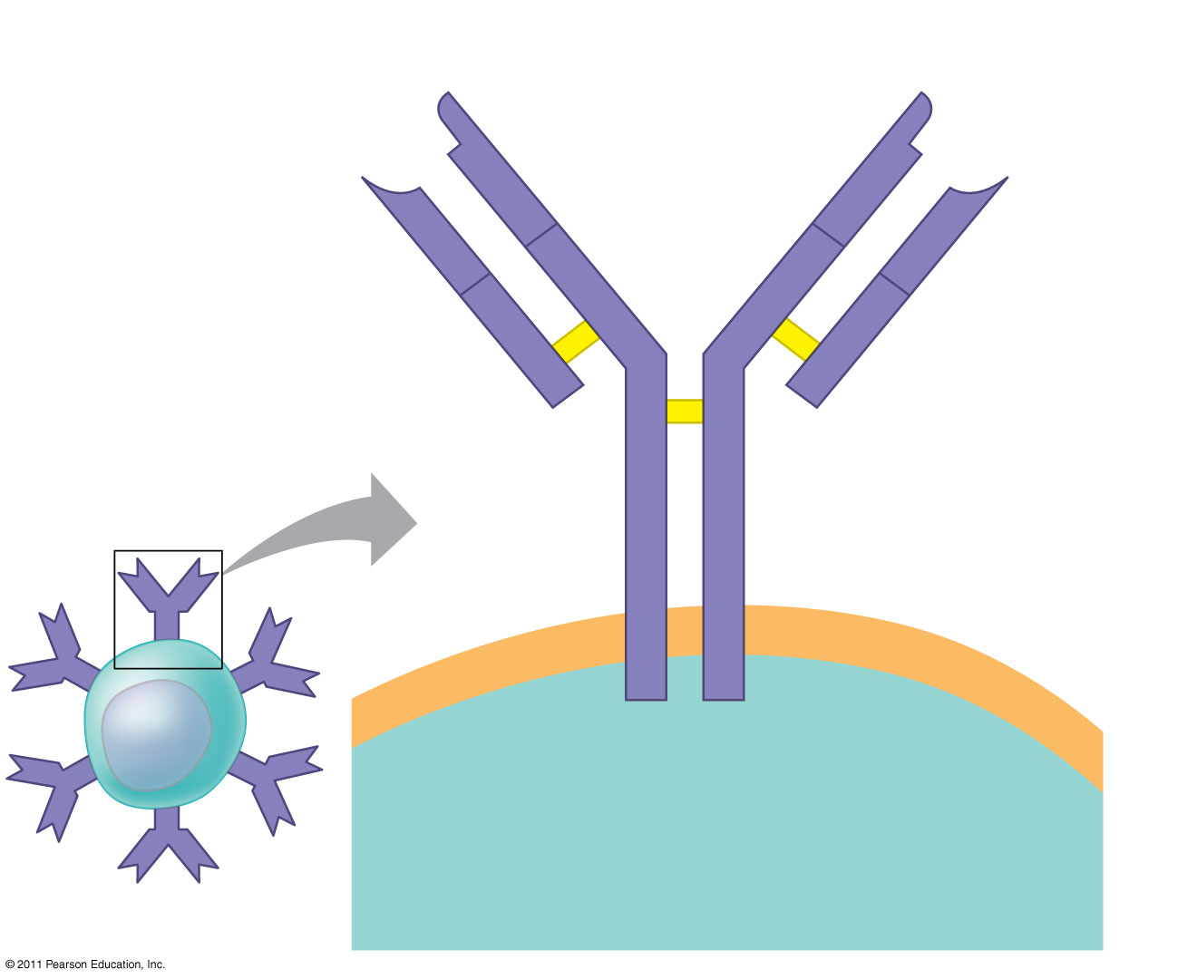
Figure 43.9
Antigen- binding site
Antigen- binding site
V
Disulfide bridge
V
V
V
Variable regions
C
C
B cell antigen receptor
Constant regions
C
C
Light chain
Transmembrane region
Heavy chains
Plasma membrane
B cell
Cytoplasm of B cell
Notes:
Figure 43.9 The structure of a B cell antigen receptor.

Slide 34
Binding of a B cell antigen receptor to an antigen is an early step in B cell activation
This gives rise to cells that secrete a soluble form of the protein called an antibody or immunoglobulin (Ig)
Secreted antibodies are similar to B cell receptors but lack transmembrane regions that anchor receptors in the plasma membrane
© 2011 Pearson Education, Inc.

Slide 35
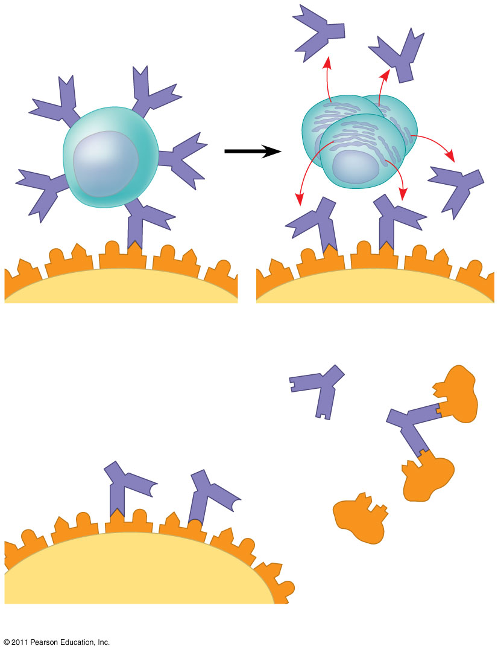
Figure 43.10
Antigen receptor
Antibody
B cell
Antigen
Epitope
Pathogen
(a) B cell antigen receptors and antibodies
Antibody C
Antibody A
Antibody B
Antigen
(b) Antigen receptor specificity
Notes:
Figure 43.10 Antigen recognition by B cells and antibodies.

Slide 36
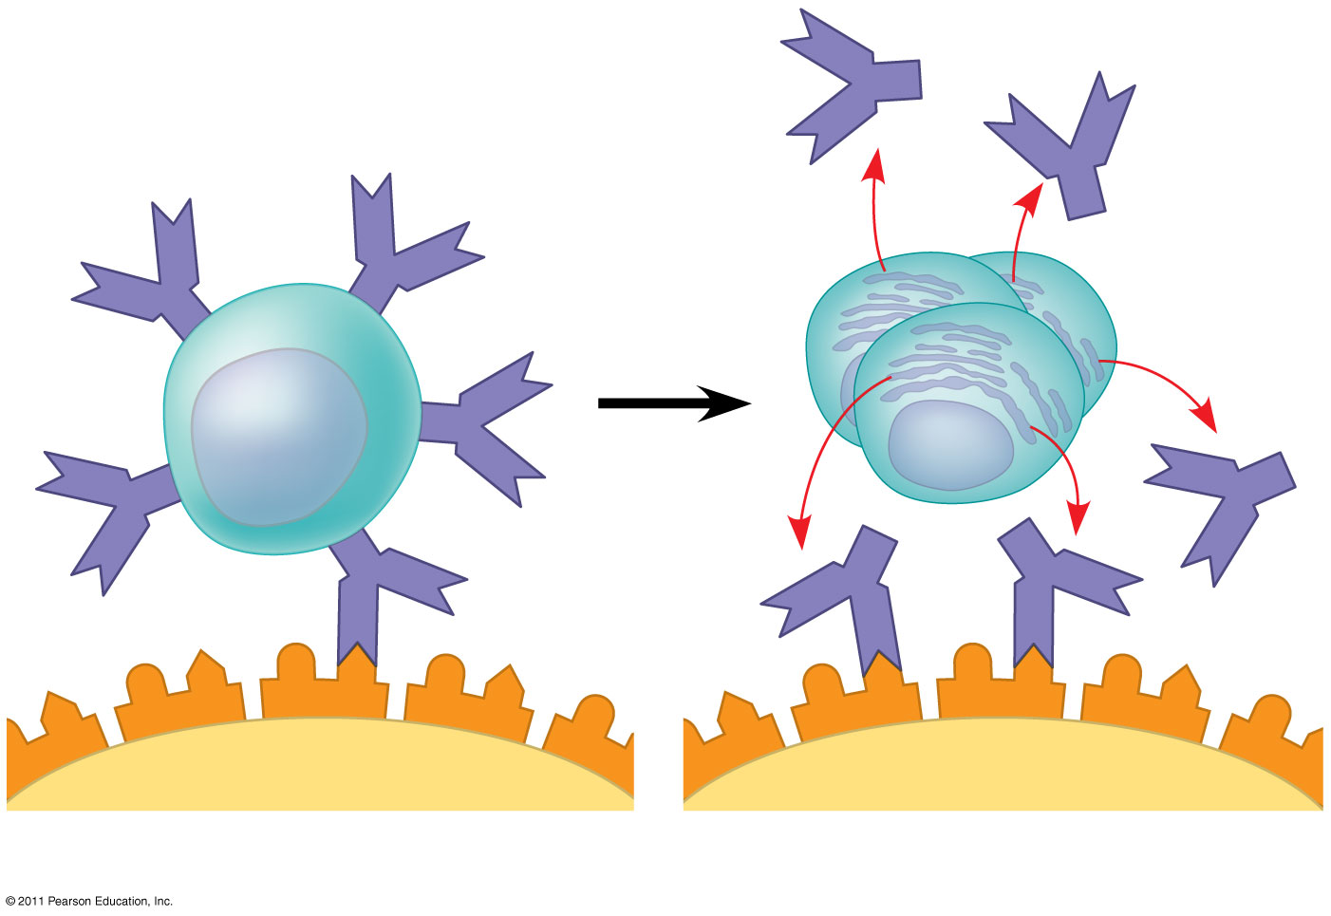
Figure 43.10a
Antigen receptor
Antibody
B cell
Antigen
Epitope
Pathogen
(a) B cell antigen receptors and antibodies
Notes:
Figure 43.10 Antigen recognition by B cells and antibodies.

Slide 37
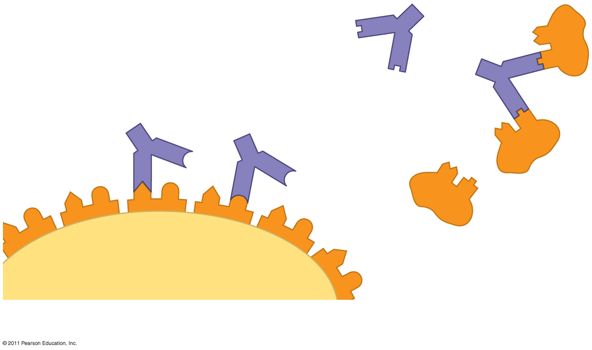
Figure 43.10b
Antibody C
Antibody A
Antibody B
Antigen
(b) Antigen receptor specificity
Notes:
Figure 43.10 Antigen recognition by B cells and antibodies.

Slide 38
Antigen Recognition by T Cells
Each T cell receptor consists of two different polypeptide chains (called α and β)
The tips of the chain form a variable (V) region; the rest is a constant (C) region
T cell and B cell antigen receptors are functionally different
© 2011 Pearson Education, Inc.

Slide 39
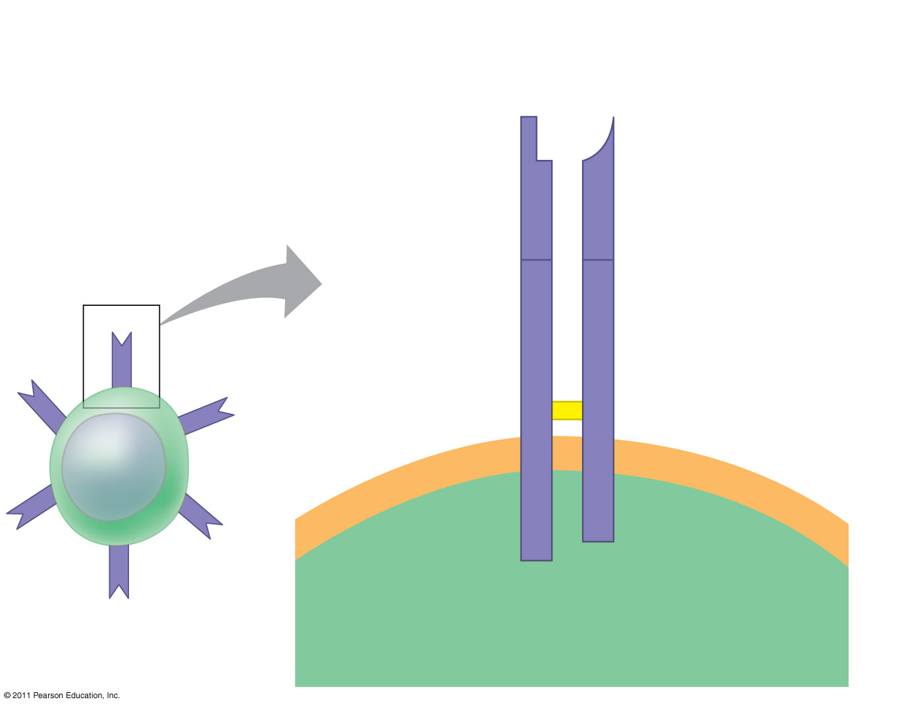
Figure 43.11
Antigen- binding site
T cell antigen receptor
Variable regions
V
V
C
C
Constant regions
Disulfide bridge
Transmembrane region
α chain
β chain
Plasma membrane
T cell
Cytoplasm of T cell
Notes:
Figure 43.11 The structure of a T cell antigen receptor.

Slide 40
T cells bind to antigen fragments displayed or presented on a host cell
These antigen fragments are bound to cell-surface proteins called MHC molecules
MHC (major histocompatibility complex) molecules are host proteins that display the antigen fragments on the cell surface
© 2011 Pearson Education, Inc.

Slide 41
In infected cells, MHC molecules bind and transport antigen fragments to the cell surface, a process called antigen presentation
A T cell can then bind both the antigen fragment and the MHC molecule
This interaction is necessary for the T cell to participate in the adaptive immune response
© 2011 Pearson Education, Inc.

Slide 42
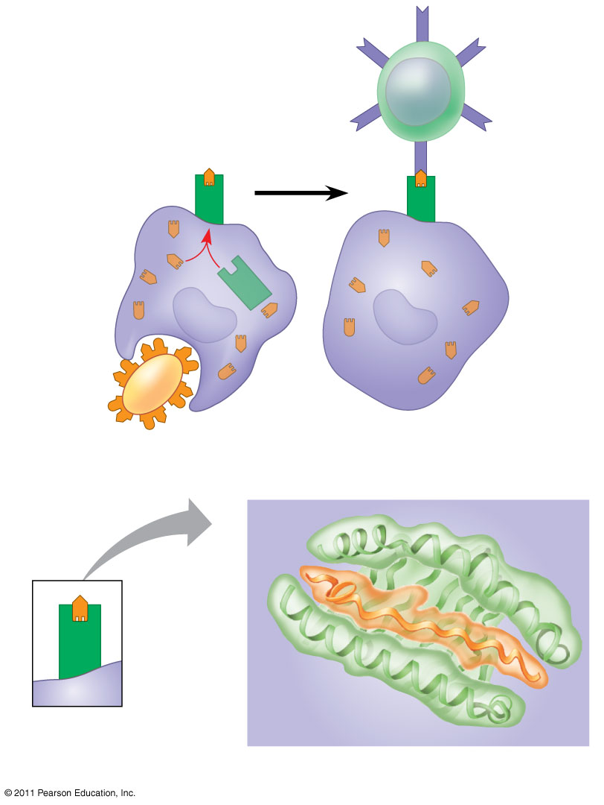
Figure 43.12
Displayed antigen fragment
T cell
MHC molecule
T cell antigen receptor
Antigen fragment
Pathogen
Host cell
(a) Antigen recognition by a T cell
Top view
Antigen fragment
MHC molecule
Host cell
(b) A closer look at antigen presentation
Notes:
Figure 43.12 Antigen recognition by T cells.

Slide 43
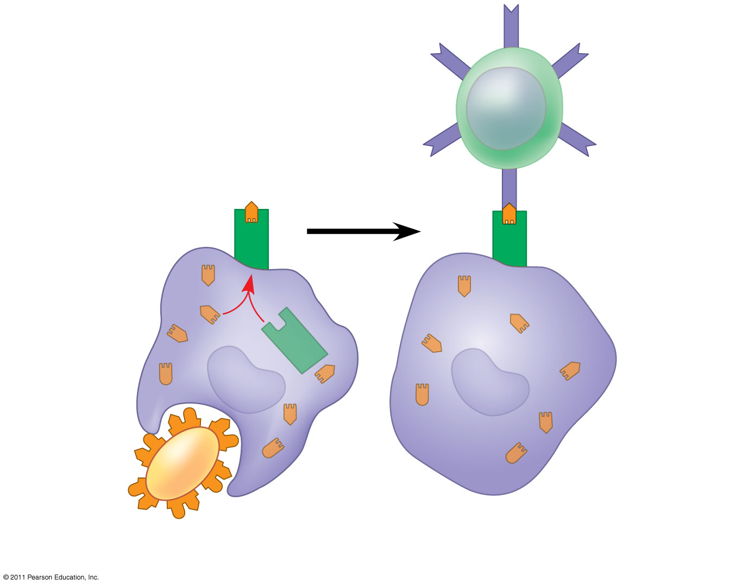
Figure 43.12a
Displayed antigen fragment
T cell
T cell antigen receptor
MHC molecule
Antigen fragment
Pathogen
Host cell
(a) Antigen recognition by a T cell
Notes:
Figure 43.12 Antigen recognition by T cells.

Slide 44
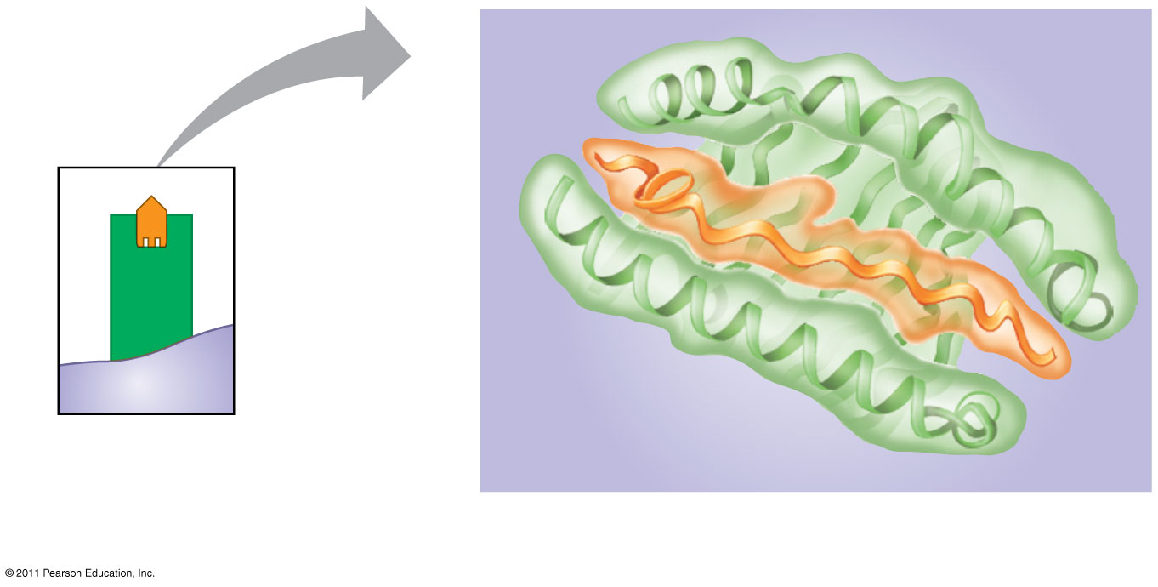
Figure 43.12b
Top view
Antigen fragment
MHC molecule
Host cell
(b) A closer look at antigen presentation
Notes:
Figure 43.12 Antigen recognition by T cells.

Slide 45
B Cell and T Cell Development
The adaptive immune system has four major characteristics
Diversity of lymphocytes and receptors
Self-tolerance; lack of reactivity against an animal’s own molecules
B and T cells proliferate after activation
Immunological memory
© 2011 Pearson Education, Inc.

Slide 46
Origin of Self-Tolerance
Antigen receptors are generated by random rearrangement of DNA
As lymphocytes mature in bone marrow or the thymus, they are tested for self-reactivity
Some B and T cells with receptors specific for the body’s own molecules are destroyed by apoptosis, or programmed cell death
The remainder are rendered nonfunctional
© 2011 Pearson Education, Inc.

Slide 47
Proliferation of B Cells and T Cells
In the body there are few lymphocytes with antigen receptors for any particular epitope
In the lymph nodes, an antigen is exposed to a steady stream of lymphocytes until a match is made
This binding of a mature lymphocyte to an antigen initiates events that activate the lymphocyte
© 2011 Pearson Education, Inc.

Slide 48
Once activated, a B or T cell undergoes multiple cell divisions
This proliferation of lymphocytes is called clonal selection
Two types of clones are produced: short-lived activated effector cells that act immediately against the antigen and long-lived memory cells that can give rise to effector cells if the same antigen is encountered again
© 2011 Pearson Education, Inc.

Slide 49
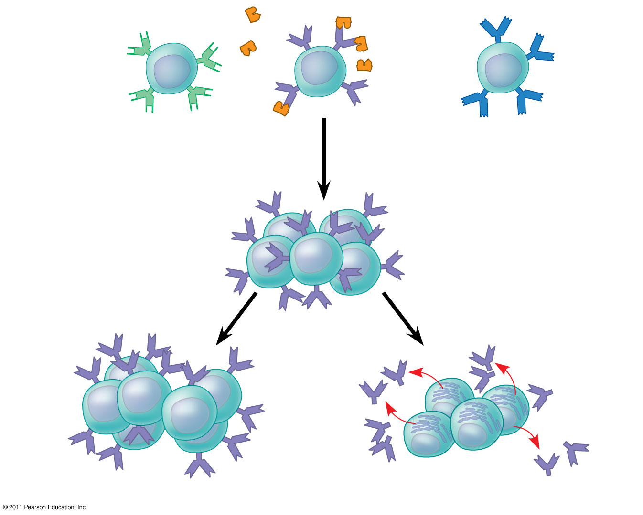
Figure 43.14
B cells that differ in antigen specificity
Antigen
Antigen receptor
Antibody
Memory cells
Plasma cells
Notes:
Figure 43.14 Clonal selection.

Slide 50
Immunological Memory
Immunological memory is responsible for long-term protections against diseases, due to either a prior infection or vaccination
The first exposure to a specific antigen represents the primary immune response
During this time, selected B and T cells give rise to their effector forms
In the secondary immune response, memory cells facilitate a faster, more efficient response
Animation: Role of B Cells
© 2011 Pearson Education, Inc.

Slide 51
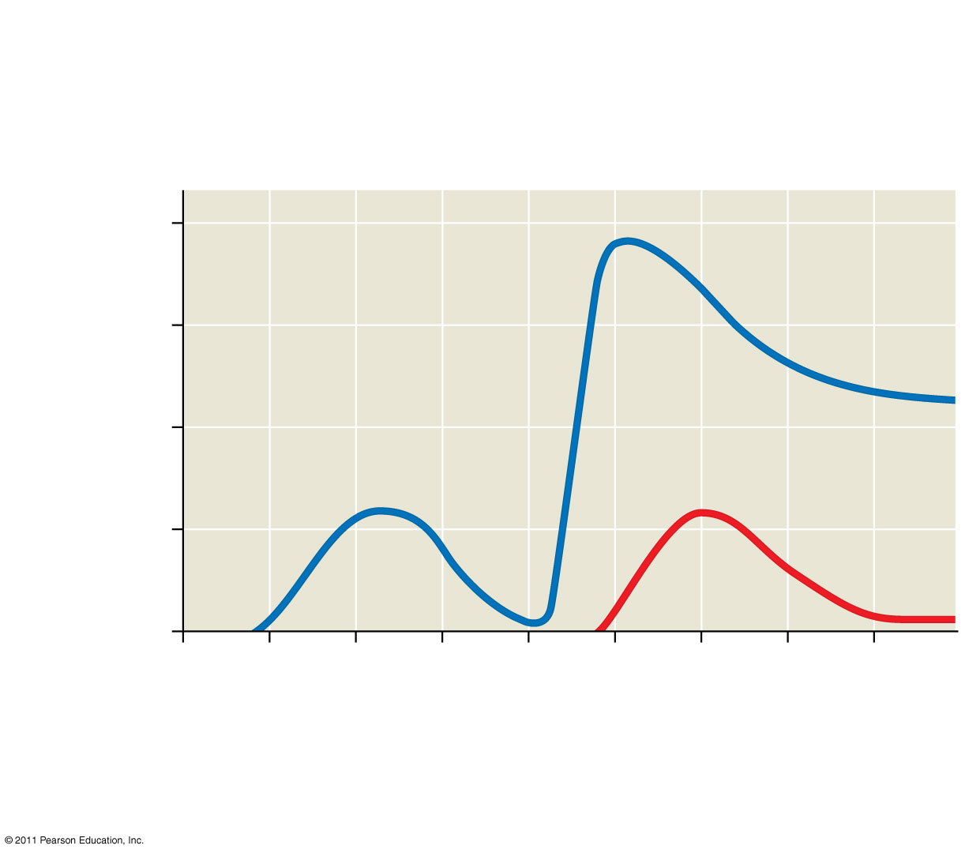
Figure 43.15
Primary immune response to antigen A produces antibodies to A.
Secondary immune response to antigen A produces antibodies to A; primary immune response to antigen B produces antibodies to B.
10⁴
10³
Antibodies to A
Antibody concentration (arbitrary units)
10²
Antibodies to B
10¹
10⁰
0
7
14
21
28
35
42
49
56
Exposure to antigen A
Exposure to antigens A and B
Time (days)
Notes:
Figure 43.15 The specificity of immunological memory.

Slide 52
Concept 43.3: Adaptive immunity defends against infection of body fluids and body cells
Acquired immunity has two branches: the humoral immune response and the cell-mediated immune response
In the humoral immune response antibodies help neutralize or eliminate toxins and pathogens in the blood and lymph
In the cell-mediated immune response specialized T cells destroy affected host cells
© 2011 Pearson Education, Inc.

Slide 53
Helper T Cells: A Response to Nearly All Antigens
A type of T cell called a helper T cell triggers both the humoral and cell-mediated immune responses
Signals from helper T cells initiate production of antibodies that neutralize pathogens and activate T cells that kill infected cells
Antigen-presenting cells have class I and class II MHC molecules on their surfaces
© 2011 Pearson Education, Inc.

Slide 54
Class II MHC molecules are the basis upon which antigen-presenting cells are recognized
Antigen receptors on the surface of helper T cells bind to the antigen and the class II MHC molecule; then signals are exchanged between the two cells
The helper T cell is activated, proliferates, and forms a clone of helper T cells, which then activate the appropriate B cells
Animation: Helper T Cells
© 2011 Pearson Education, Inc.

Slide 55
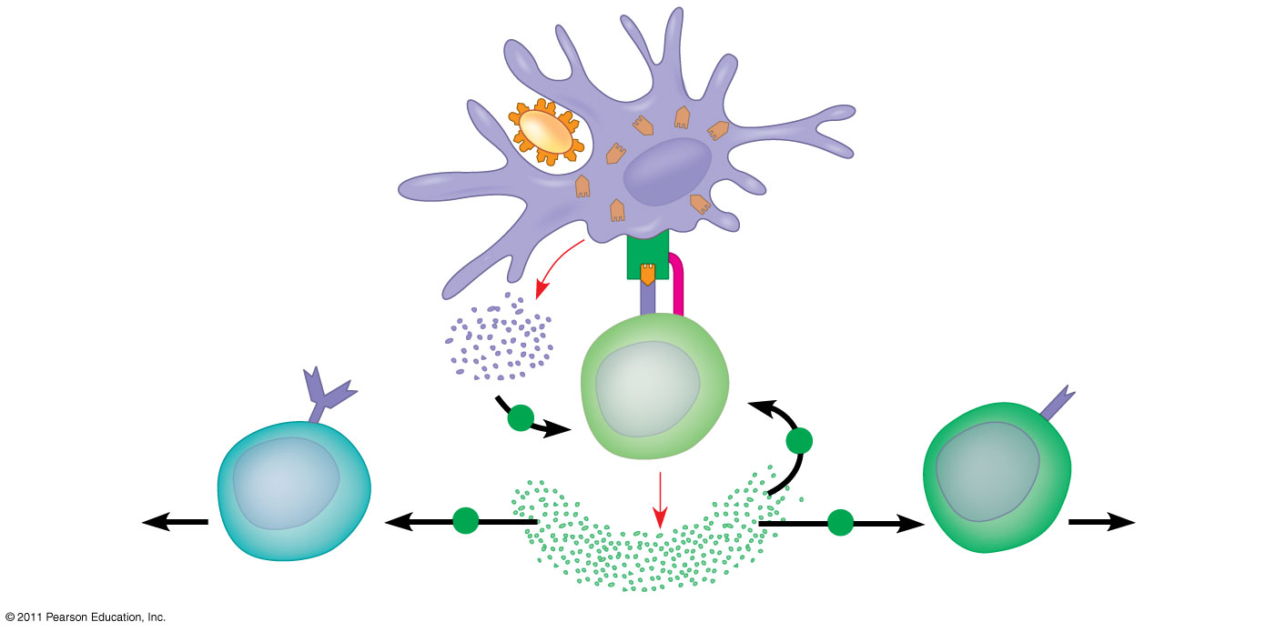
Figure 43.16
Antigen- presenting cell
Antigen fragment
Pathogen
Class II MHC molecule
1
Accessory protein
Antigen receptor
Helper T cell
+
Cytokines
+
Humoral immunity
2
Cell- mediated immunity
+
+
B cell
3
Cytotoxic T cell
Notes:
Figure 43.16 The central role of helper T cells in humoral and cell-mediated immune responses.

Slide 56
Cytotoxic T Cells: A Response to Infected Cells
Cytotoxic T cells are the effector cells in the cell-mediated immune response
Cytotoxic T cells recognize fragments of foreign proteins produced by infected cells and possess an accessory protein that binds to class I MHC molecules
The activated cytotoxic T cell secretes proteins that disrupt the membranes of target cells and trigger apoptosis
Animation: Cytotoxic T Cells
© 2011 Pearson Education, Inc.

Slide 57
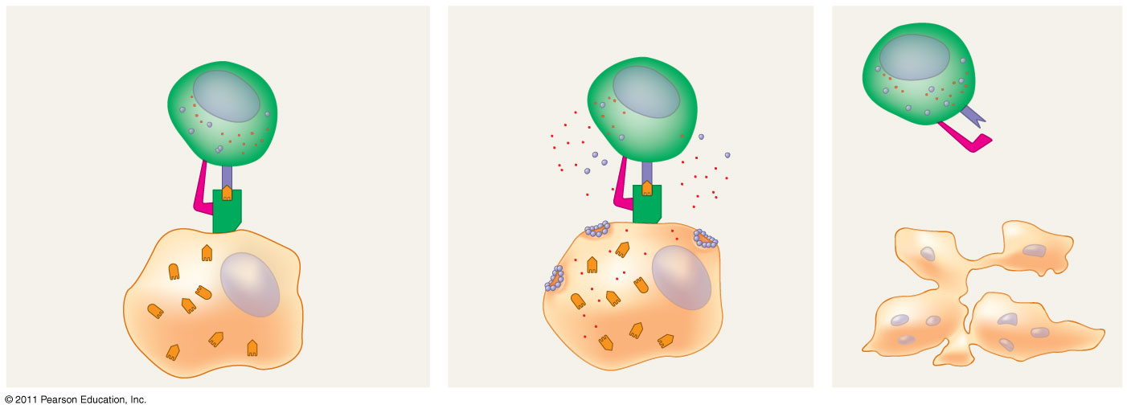
Figure 43.17-3
Cytotoxic T cell
Released cytotoxic T cell
Accessory protein
Antigen receptor
Dying infected cell
Class I MHC molecule
Perforin
Gran- zymes
Pore
Infected cell
Antigen fragment
1
2
3
Notes:
Figure 43.17 The killing action of cytotoxic T cells on an infected host cell.

Slide 58
B Cells and Antibodies: A Response to Extracellular Pathogens
The humoral response is characterized by secretion of antibodies by B cells
© 2011 Pearson Education, Inc.

Slide 59
Activation of B Cells
Activation of the humoral immune response involves B cells and helper T cells as well as proteins on the surface of pathogens
In response to cytokines from helper T cells and an antigen, a B cell proliferates and differentiates into memory B cells and antibody- secreting effector cells called plasma cells
© 2011 Pearson Education, Inc.

Slide 60
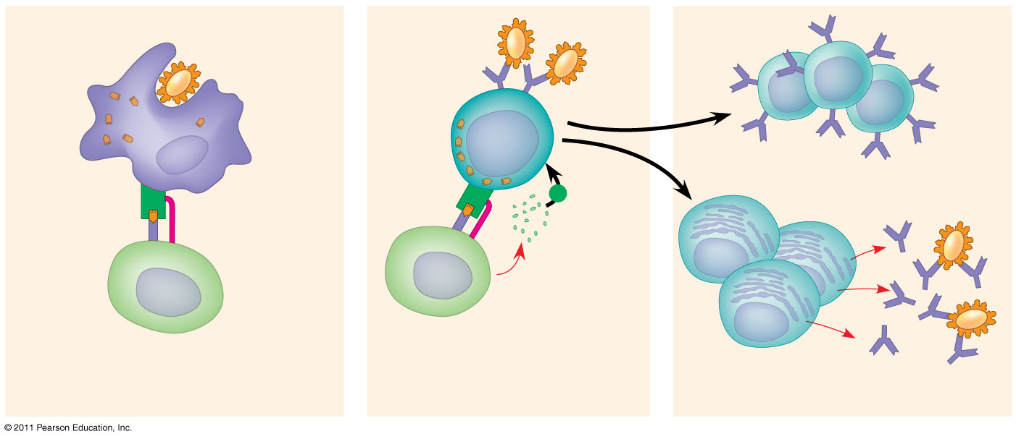
Figure 43.18-3
Antigen-presenting cell
Pathogen
Antigen fragment
B cell
Class II MHC molecule
Memory B cells
+
Accessory protein
Antigen receptor
Cytokines
Activated helper T cell
Plasma cells
Helper T cell
Secreted antibodies
1
2
3
Notes:
Figure 43.18 Activation of a B cell in the humoral immune response.

Slide 61
Antibody Function
Antibodies do not kill pathogens; instead they mark pathogens for destruction
In neutralization, antibodies bind to viral surface proteins preventing infection of a host cell
Antibodies may also bind to toxins in body fluids and prevent them from entering body cells
© 2011 Pearson Education, Inc.

Slide 62
In opsonization, antibodies bind to antigens on bacteria creating a target for macrophages or neutrophils, triggering phagocytosis
Antigen-antibody complexes may bind to a complement protein—which triggers a cascade of complement protein activation
Ultimately a membrane attack complex forms a pore in the membrane of the foreign cell, leading to its lysis
© 2011 Pearson Education, Inc.

Slide 63
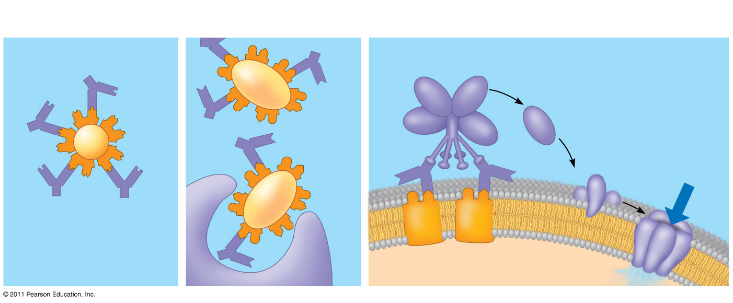
Figure 43.19
Activation of complement system and pore formation
Neutralization
Opsonization
Complement proteins
Antibody
Formation of membrane attack complex
Virus
Bacterium
Flow of water and ions
Pore
Foreign cell
Antigen
Macrophage
Notes:
Figure 43.19 Antibody-mediated mechanisms of antigen disposal.

Slide 64
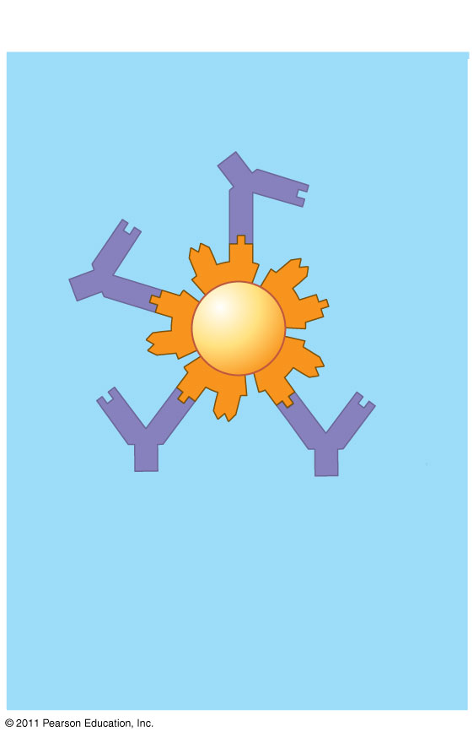
Figure 43.19a
Neutralization
Antibody
Virus
Notes:
Figure 43.19 Antibody-mediated mechanisms of antigen disposal.

Slide 65
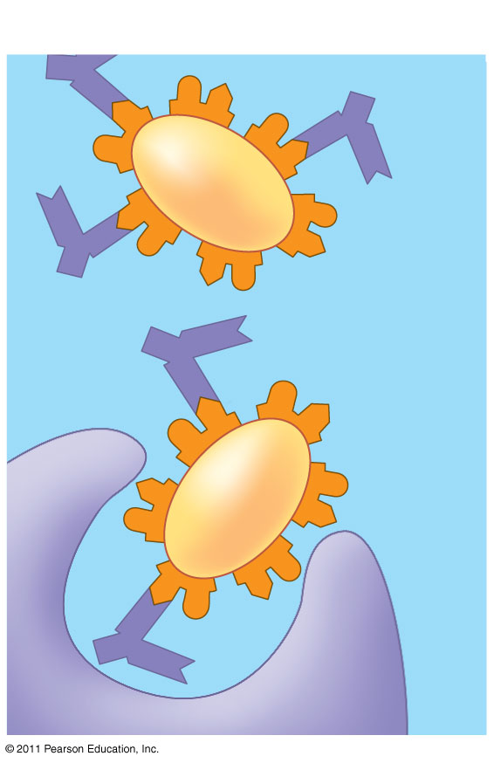
Figure 43.19b
Opsonization
Bacterium
Macrophage
Notes:
Figure 43.19 Antibody-mediated mechanisms of antigen disposal.

Slide 66
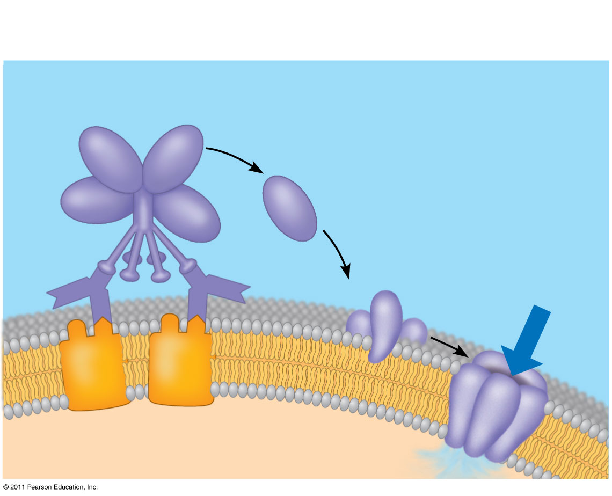
Figure 43.19c
Activation of complement system and pore formation
Complement proteins
Formation of membrane attack complex
Flow of water and ions
Pore
Foreign cell
Antigen
Notes:
Figure 43.19 Antibody-mediated mechanisms of antigen disposal.

Slide 67
B cells can express five different forms (or classes) of immunoglobulin (Ig) with similar antigen-binding specificity but different heavy chain C regions
IgD: Membrane bound
IgM: First soluble class produced
IgG: Second soluble class; most abundant
IgA and IgE: Remaining soluble classes
© 2011 Pearson Education, Inc.

Slide 68
Summary of the Humoral and Cell-Mediated Immune Responses
Both the humoral and cell-mediated responses can include primary and secondary immune response
Memory cells enable the secondary response
© 2011 Pearson Education, Inc.

Slide 69
Active and Passive Immunization
Active immunity develops naturally when memory cells form clones in response to an infection
It can also develop following immunization, also called vaccination
In immunization, a nonpathogenic form of a microbe or part of a microbe elicits an immune response to an immunological memory
© 2011 Pearson Education, Inc.

Slide 70
Passive immunity provides immediate, short-term protection
It is conferred naturally when IgG crosses the placenta from mother to fetus or when IgA passes from mother to infant in breast milk
It can be conferred artificially by injecting antibodies into a nonimmune person
© 2011 Pearson Education, Inc.

Slide 71
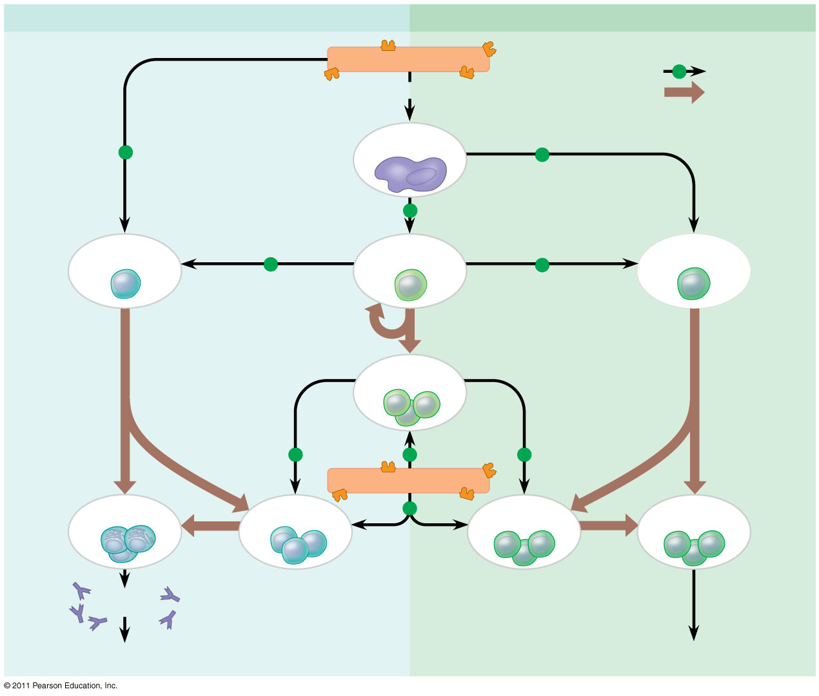
Figure 43.20
Humoral (antibody-mediated) immune response
Cell-mediated immune response
Antigen (1st exposure)
Key
+
Stimulates
Engulfed by
Gives rise to
Antigen- presenting cell
+
+
+
B cell
+
Helper T cell
+
Cytotoxic T cell
Memory helper T cells
+
+
+
Antigen (2nd exposure)
Plasma cells
Memory B cells
+
Memory cytotoxic T cells
Active cytotoxic T cells
Secreted antibodies
Defend against extracellular pathogens
Defend against intracellular pathogens and cancer
Notes:
Figure 43.20 An overview of the adaptive immune response.

Slide 72
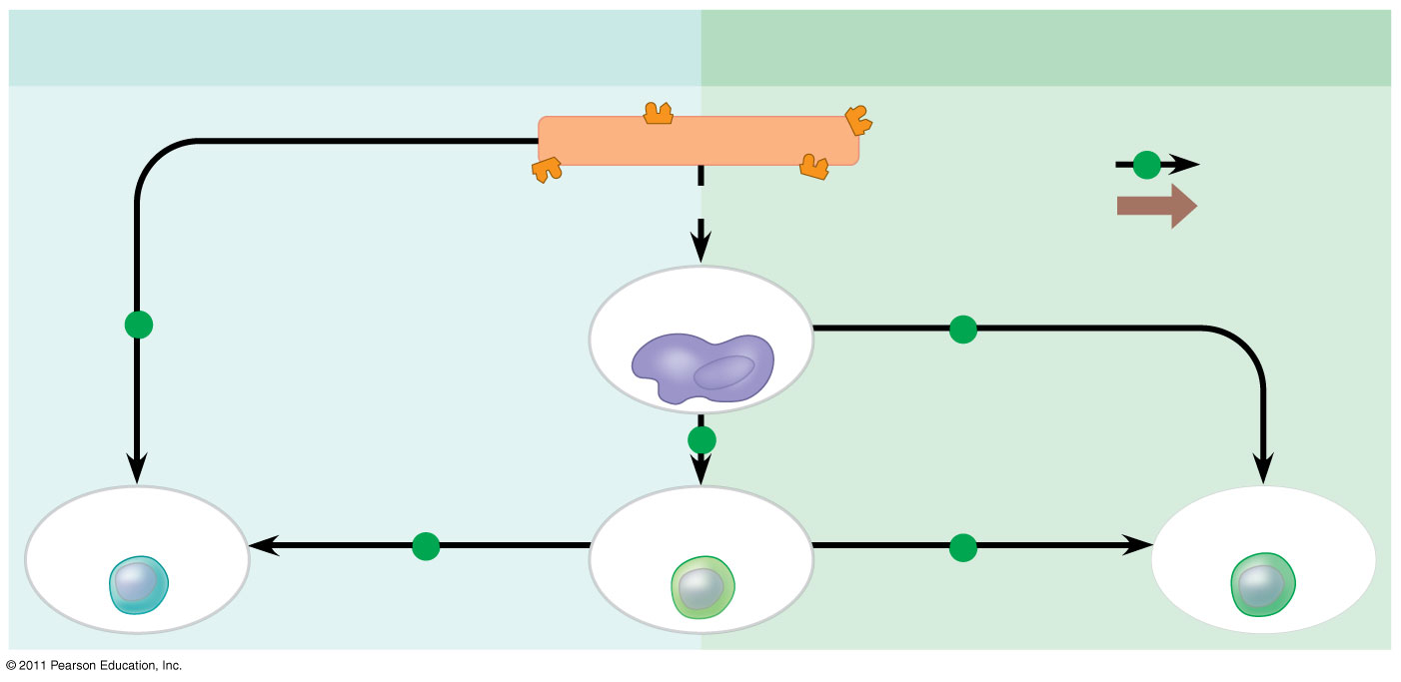
Figure 43.20a
Humoral (antibody-mediated) immune response
Cell-mediated immune response
+
Antigen (1st exposure)
Key
+
Stimulates
Engulfed by
Gives rise to
Antigen- presenting cell
+
+
+
B cell
+
Helper T cell
+
Cytotoxic T cell
Notes:
Figure 43.20 An overview of the adaptive immune response.

Slide 73
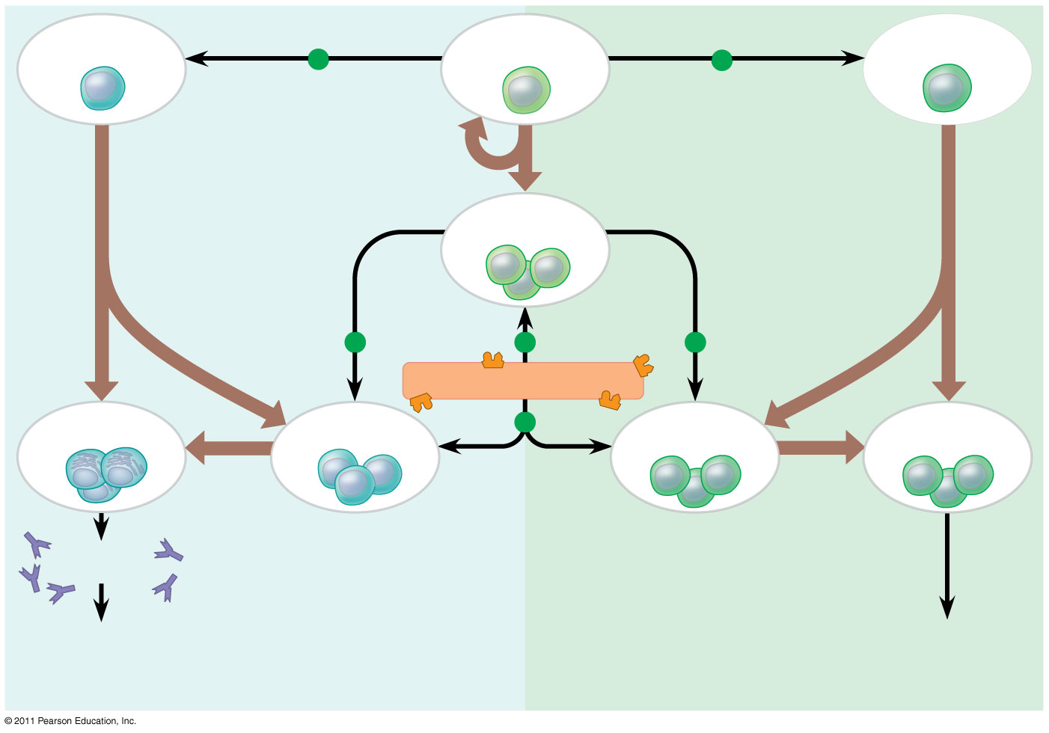
Figure 43.20b
B cell
+
Helper T cell
+
Cytotoxic T cell
Memory helper T cells
+
+
+
Antigen (2nd exposure)
+
Memory cytotoxic T cells
Active cytotoxic T cells
Plasma cells
Memory B cells
Secreted antibodies
Defend against extracellular pathogens
Defend against intracellular pathogens and cancer
Notes:
Figure 43.20 An overview of the adaptive immune response.

Slide 74
Immune Rejection
Cells transferred from one person to another can be attacked by immune defenses
This complicates blood transfusions or the transplant of tissues or organs
© 2011 Pearson Education, Inc.

Slide 75
Blood Groups
Antigens on red blood cells determine whether a person has blood type A (A antigen), B (B antigen), AB (both A and B antigens), or O (neither antigen)
Antibodies to nonself blood types exist in the body
Transfusion with incompatible blood leads to destruction of the transfused cells
Recipient-donor combinations can be fatal or safe
© 2011 Pearson Education, Inc.

Slide 76
Tissue and Organ Transplants
MHC molecules are different among genetically nonidentical individuals
Differences in MHC molecules stimulate rejection of tissue grafts and organ transplants
© 2011 Pearson Education, Inc.

Slide 77
Chances of successful transplantation increase if donor and recipient MHC tissue types are well matched
Immunosuppressive drugs facilitate transplantation
Lymphocytes in bone marrow transplants may cause the donor tissue to reject the recipient
© 2011 Pearson Education, Inc.

Slide 78
Concept 43.4: Disruptions in immune system function can elicit or exacerbate disease
Some pathogens have evolved to diminish the effectiveness of host immune responses
© 2011 Pearson Education, Inc.

Slide 79
Exaggerated, Self-Directed, and Diminished Immune Responses
If the delicate balance of the immune system is disrupted, effects range from minor to sometimes fatal
© 2011 Pearson Education, Inc.

Slide 80
Allergies
Allergies are exaggerated (hypersensitive) responses to antigens called allergens
In localized allergies such as hay fever, IgE antibodies produced after first exposure to an allergen attach to receptors on mast cells
© 2011 Pearson Education, Inc.

Slide 81
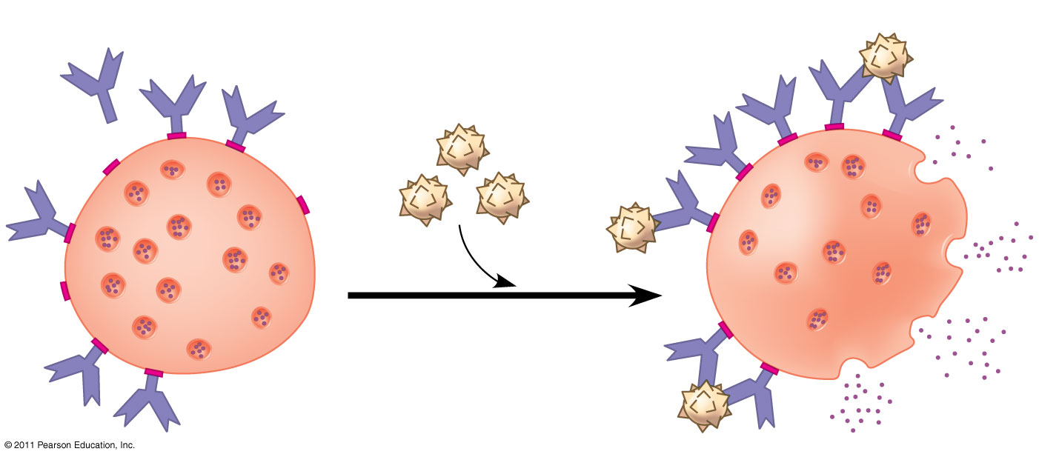
Figure 43.22
Histamine
IgE
Allergen
Granule
Mast cell
Notes:
Figure 43.22 Mast cells, IgE, and the allergic response.

Slide 82
The next time the allergen enters the body, it binds to mast cell–associated IgE molecules
Mast cells release histamine and other mediators that cause vascular changes leading to typical allergy symptoms
An acute allergic response can lead to anaphylactic shock, a life-threatening reaction, within seconds of allergen exposure
© 2011 Pearson Education, Inc.

Slide 83
Exertion, Stress, and the Immune System
Moderate exercise improves immune system function
Psychological stress has been shown to disrupt immune system regulation by altering the interactions of the hormonal, nervous, and immune systems
Sufficient rest is also important for immunity
© 2011 Pearson Education, Inc.

Slide 84
Evolutionary Adaptations of Pathogens That Underlie Immune System Avoidance
Pathogens have evolved mechanisms to thwart immune responses
© 2011 Pearson Education, Inc.

