Slide 1
Chapter 44
Osmoregulation and Excretion

Slide 2
Overview: A Balancing Act
Physiological systems of animals operate in a fluid environment
Relative concentrations of water and solutes must be maintained within fairly narrow limits
Osmoregulation regulates solute concentrations and balances the gain and loss of water
© 2011 Pearson Education, Inc.

Slide 3
Freshwater animals show adaptations that reduce water uptake and conserve solutes
Desert and marine animals face desiccating environments that can quickly deplete body water
Excretion gets rid of nitrogenous metabolites and other waste products
© 2011 Pearson Education, Inc.

Slide 4
Concept 44.1: Osmoregulation balances the uptake and loss of water and solutes
Osmoregulation is based largely on controlled movement of solutes between internal fluids and the external environment
© 2011 Pearson Education, Inc.

Slide 5
Land Animals
Adaptations to reduce water loss are key to survival on land
Body coverings of most terrestrial animals help prevent dehydration
Desert animals get major water savings from simple anatomical features and behaviors such as a nocturnal lifestyle
Land animals maintain water balance by eating moist food and producing water metabolically through cellular respiration
© 2011 Pearson Education, Inc.

Slide 6
Figure 44.6
Water balance in a kangaroo rat (2 mL/day)
Water balance in a human (2,500 mL/day)
Ingested in food (0.2)
Ingested in food (750)
Ingested in liquid (1,500)
Water gain (mL)
Derived from metabolism (1.8)
Derived from metabolism (250)
Feces (0.09)
Feces (100)
Water loss (mL)
Urine (0.45)
Urine (1,500)
Evaporation (1.46)
Evaporation (900)
Notes:
Figure 44.6 Water balance in two terrestrial mammals.

Slide 7
Concept 44.2: An animal’s nitrogenous wastes reflect its phylogeny and habitat
The type and quantity of an animal’s waste products may greatly affect its water balance
Among the most significant wastes are nitrogenous breakdown products of proteins and nucleic acids
Some animals convert toxic ammonia (NH₃) to less toxic compounds prior to excretion
© 2011 Pearson Education, Inc.

Slide 8
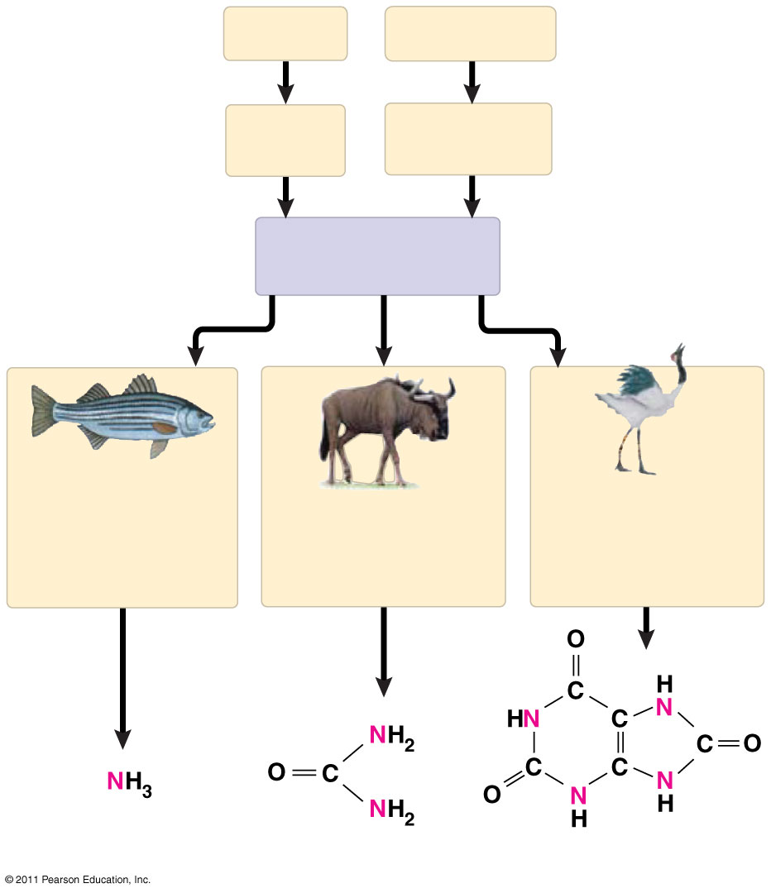
Figure 44.8
Proteins
Nucleic acids
Amino acids
Nitrogenous bases
—NH₂ Amino groups
Most aquatic animals, including most bony fishes
Mammals, most amphibians, sharks, some bony fishes
Many reptiles (including birds), insects, land snails
Ammonia
Urea
Uric acid
Notes:
Figure 44.8 Forms of nitrogenous waste.

Slide 9
Concept 44.3: Diverse excretory systems are variations on a tubular theme
Excretory systems regulate solute movement between internal fluids and the external environment
© 2011 Pearson Education, Inc.

Slide 10
Excretory Processes
Most excretory systems produce urine by refining a filtrate derived from body fluids
Key functions of most excretory systems
Filtration: Filtering of body fluids
Reabsorption: Reclaiming valuable solutes
Secretion: Adding nonessential solutes and wastes from the body fluids to the filtrate
Excretion: Processed filtrate containing nitrogenous wastes, released from the body
© 2011 Pearson Education, Inc.

Slide 11
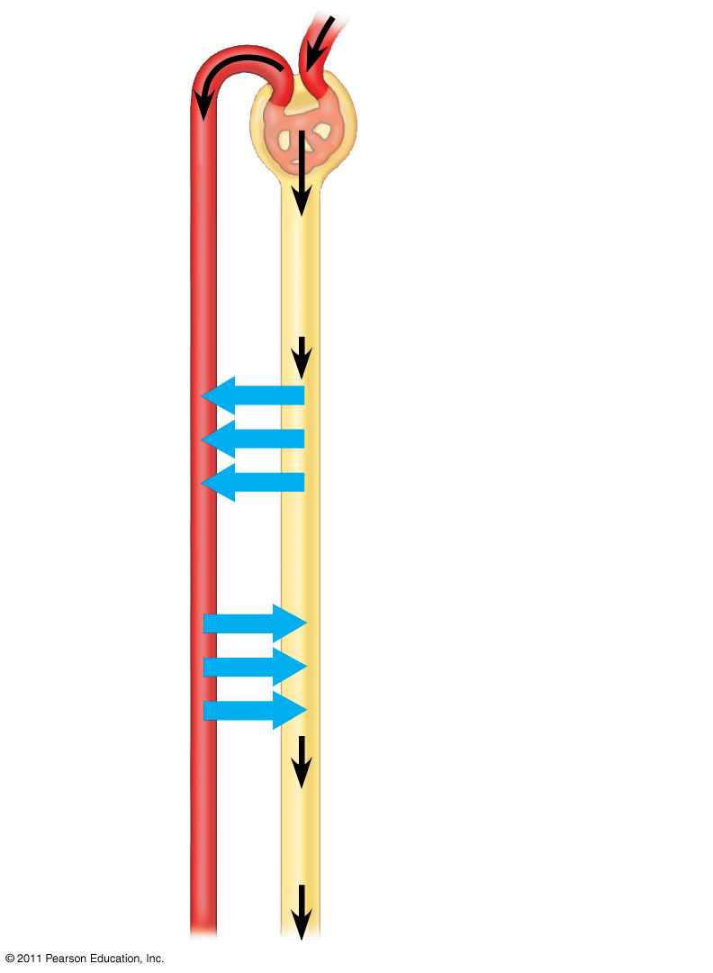
Figure 44.10
1
Filtration
Capillary
Filtrate
Excretory tubule
2
Reabsorption
3
Secretion
Urine
4
Excretion
Notes:
Figure 44.10 Key steps of excretory system function: an overview.

Slide 12
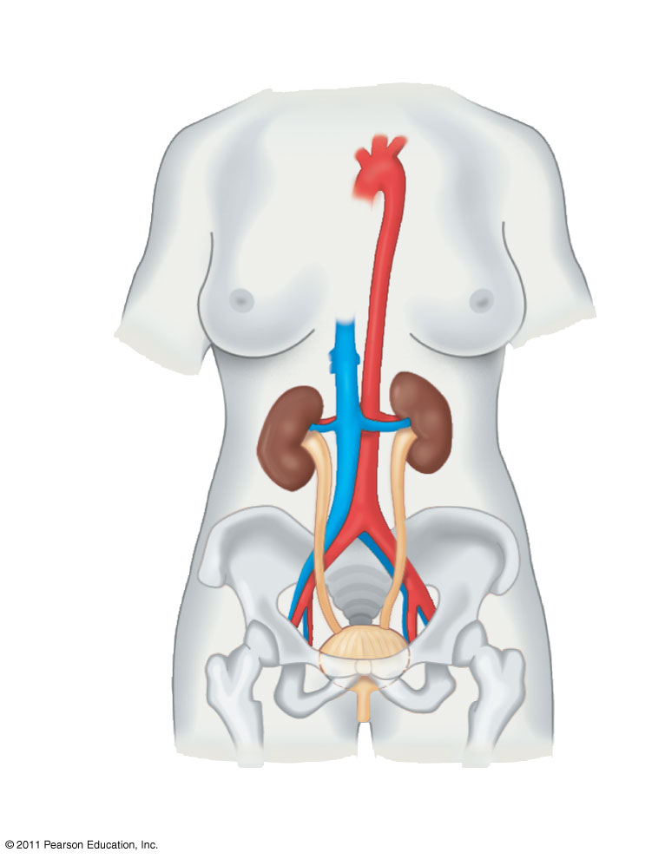
Figure 44.14a
Excretory Organs
Posterior vena cava
Renal artery and vein
Kidney
Aorta
Ureter
Urinary bladder
Urethra
Notes:
Figure 44.14 Exploring: the Mammalian Excretory System

Slide 13
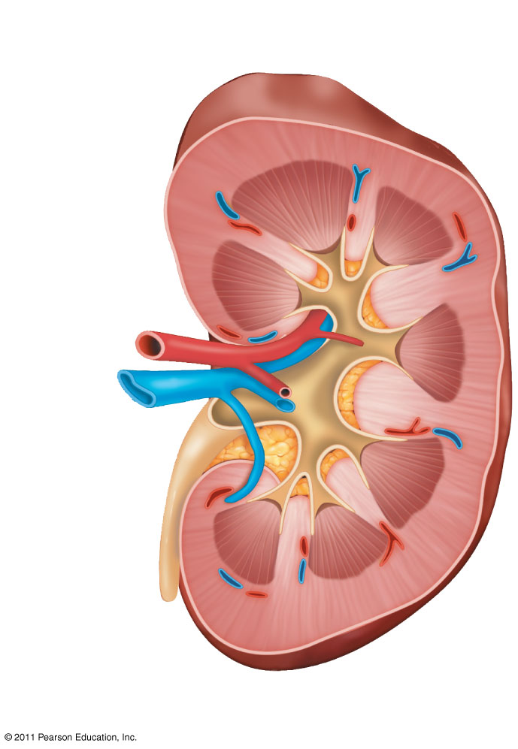
Figure 44.14b
Kidney Structure
Renal cortex
Renal medulla
Renal artery
Renal vein
Ureter
Renal pelvis
Notes:
Figure 44.14 Exploring: the Mammalian Excretory System

Slide 14
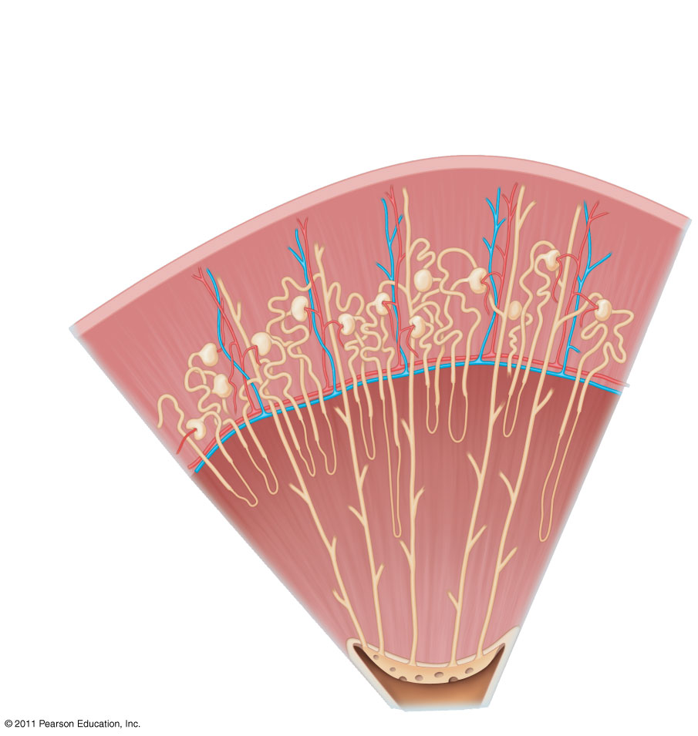
Figure 44.14c
Nephron Types
Cortical nephron
Juxtamedullary
nephron
Renal cortex
Renal medulla
Notes:
Figure 44.14 Exploring: the Mammalian Excretory System

Slide 15
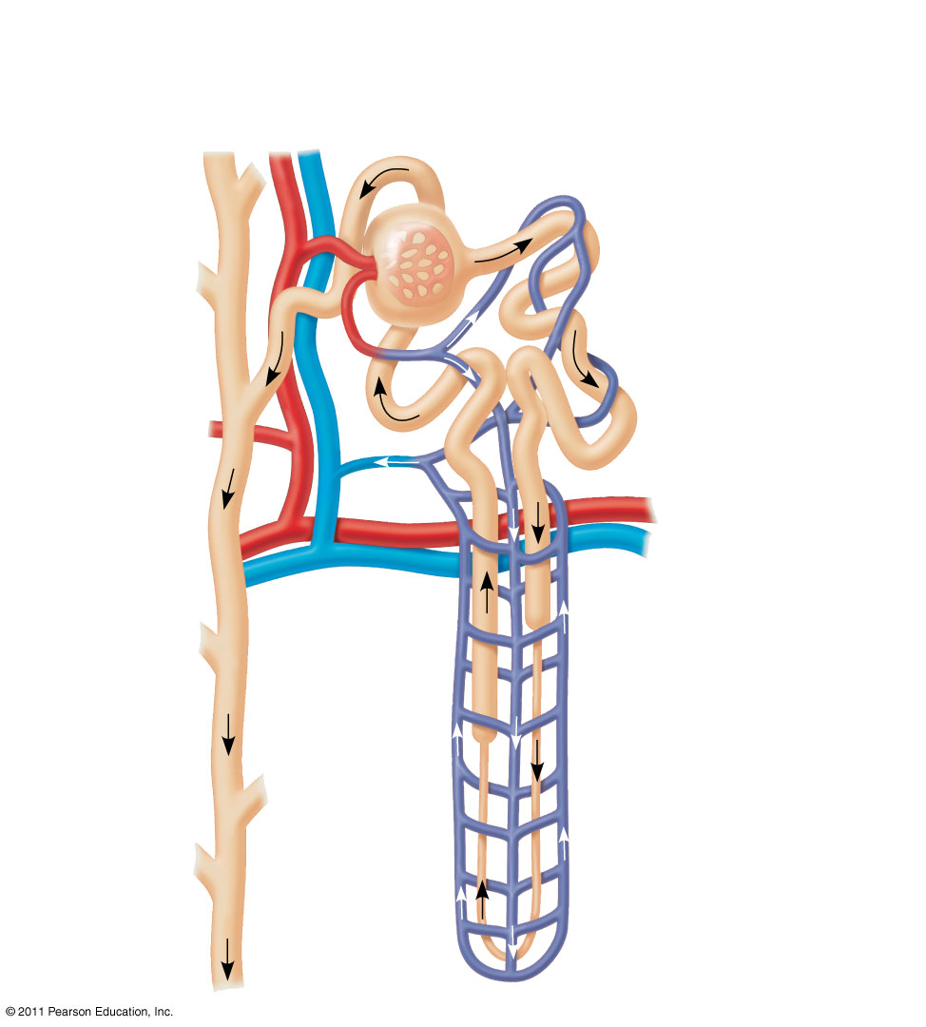
Figure 44.14d
Nephron Organization
Afferent arteriole from renal artery
Glomerulus
Bowman’s capsule
Proximal tubule
Distal tubule
Peritubular capillaries
Efferent arteriole from glomerulus
Branch of renal vein
Descending limb
Vasa recta
Loop of Henle
Collecting duct
Ascending limb
Notes:
Figure 44.14 Exploring: the Mammalian Excretory System

Slide 16
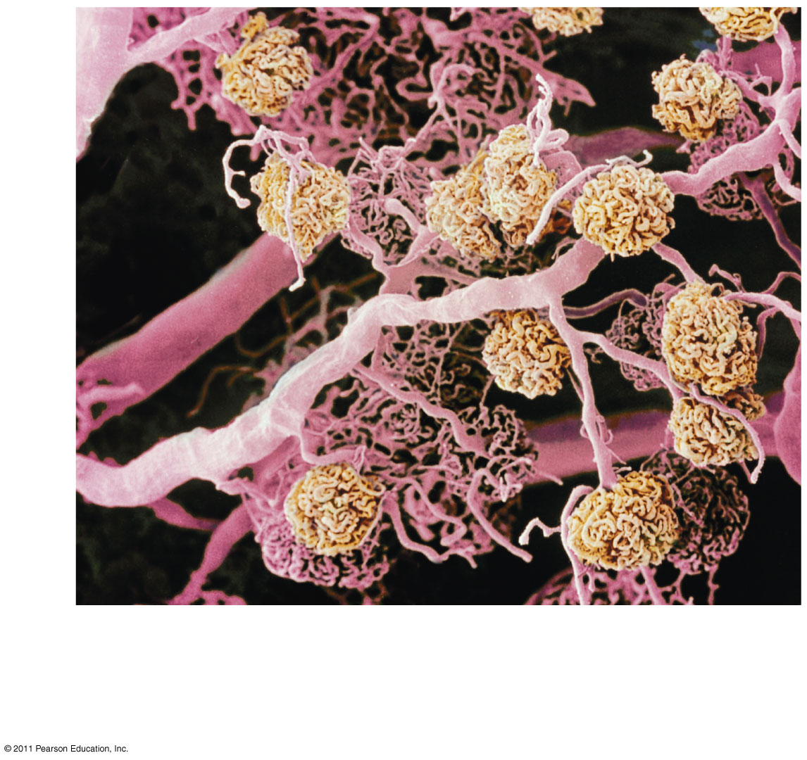
Figure 44.14e
200 μm
Blood vessels from a human kidney. Arterioles and peritubular capillaries appear pink; glomeruli appear yellow.
Notes:
Figure 44.14 Exploring: the Mammalian Excretory System

Slide 17
Concept 44.4: The nephron is organized for stepwise processing of blood filtrate
The filtrate produced in Bowman’s capsule contains salts, glucose, amino acids, vitamins, nitrogenous wastes, and other small molecules
© 2011 Pearson Education, Inc.

Slide 18
From Blood Filtrate to Urine: A Closer Look
Proximal Tubule
Reabsorption of ions, water, and nutrients takes place in the proximal tubule
Molecules are transported actively and passively from the filtrate into the interstitial fluid and then capillaries
Some toxic materials are actively secreted into the filtrate
As the filtrate passes through the proximal tubule, materials to be excreted become concentrated
© 2011 Pearson Education, Inc.

Slide 19
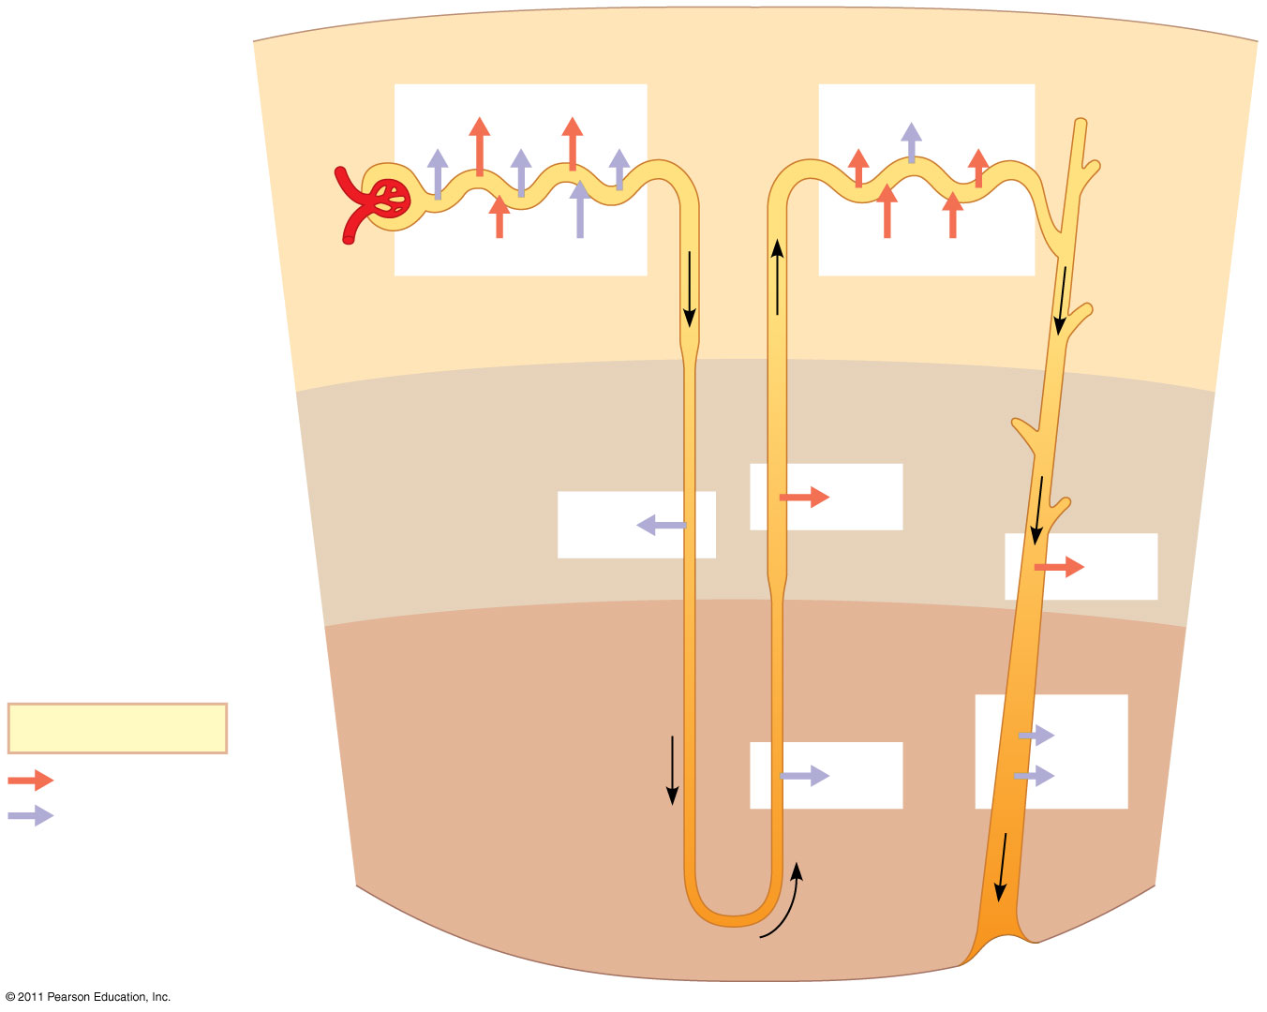
Figure 44.15
Proximal tubule
Distal tubule
NaCl
Nutrients
H₂O
HCO₃⁻
H₂O
K⁺
NaCl
HCO₃⁻
H⁺
NH₃
K⁺
H⁺
Filtrate
CORTEX
Loop of Henle
NaCl
H₂O
OUTER MEDULLA
NaCl
Collecting duct
Key
Urea
Active transport
NaCl
H₂O
Passive transport
INNER MEDULLA
Notes:
Figure 44.15 The nephron and collecting duct: regional functions of the transport epithelium.

Slide 20
Descending Limb of the Loop of Henle
Reabsorption of water continues through channels formed by aquaporin proteins
Movement is driven by the high osmolarity of the interstitial fluid, which is hyperosmotic to the filtrate
The filtrate becomes increasingly concentrated
© 2011 Pearson Education, Inc.

Slide 21
Ascending Limb of the Loop of Henle
In the ascending limb of the loop of Henle, salt but not water is able to diffuse from the tubule into the interstitial fluid
The filtrate becomes increasingly dilute
© 2011 Pearson Education, Inc.

Slide 22
Distal Tubule
The distal tubule regulates the K⁺ and NaCl concentrations of body fluids
The controlled movement of ions contributes to pH regulation
© 2011 Pearson Education, Inc.

Slide 23
Collecting Duct
The collecting duct carries filtrate through the medulla to the renal pelvis
One of the most important tasks is reabsorption of solutes and water
Urine is hyperosmotic to body fluids
© 2011 Pearson Education, Inc.

Slide 24
Solute Gradients and Water Conservation
The mammalian kidney’s ability to conserve water is a key terrestrial adaptation
Hyperosmotic urine can be produced only because considerable energy is expended to transport solutes against concentration gradients
The two primary solutes affecting osmolarity are NaCl and urea
© 2011 Pearson Education, Inc.

Slide 25
The Two-Solute Model
In the proximal tubule, filtrate volume decreases, but its osmolarity remains the same
The countercurrent multiplier system involving the loop of Henle maintains a high salt concentration in the kidney
This system allows the vasa recta to supply the kidney with nutrients, without interfering with the osmolarity gradient
Considerable energy is expended to maintain the osmotic gradient between the medulla and cortex
© 2011 Pearson Education, Inc.

Slide 26
The collecting duct conducts filtrate through the osmolarity gradient, and more water exits the filtrate by osmosis
Urea diffuses out of the collecting duct as it traverses the inner medulla
Urea and NaCl form the osmotic gradient that enables the kidney to produce urine that is hyperosmotic to the blood
© 2011 Pearson Education, Inc.

Slide 27
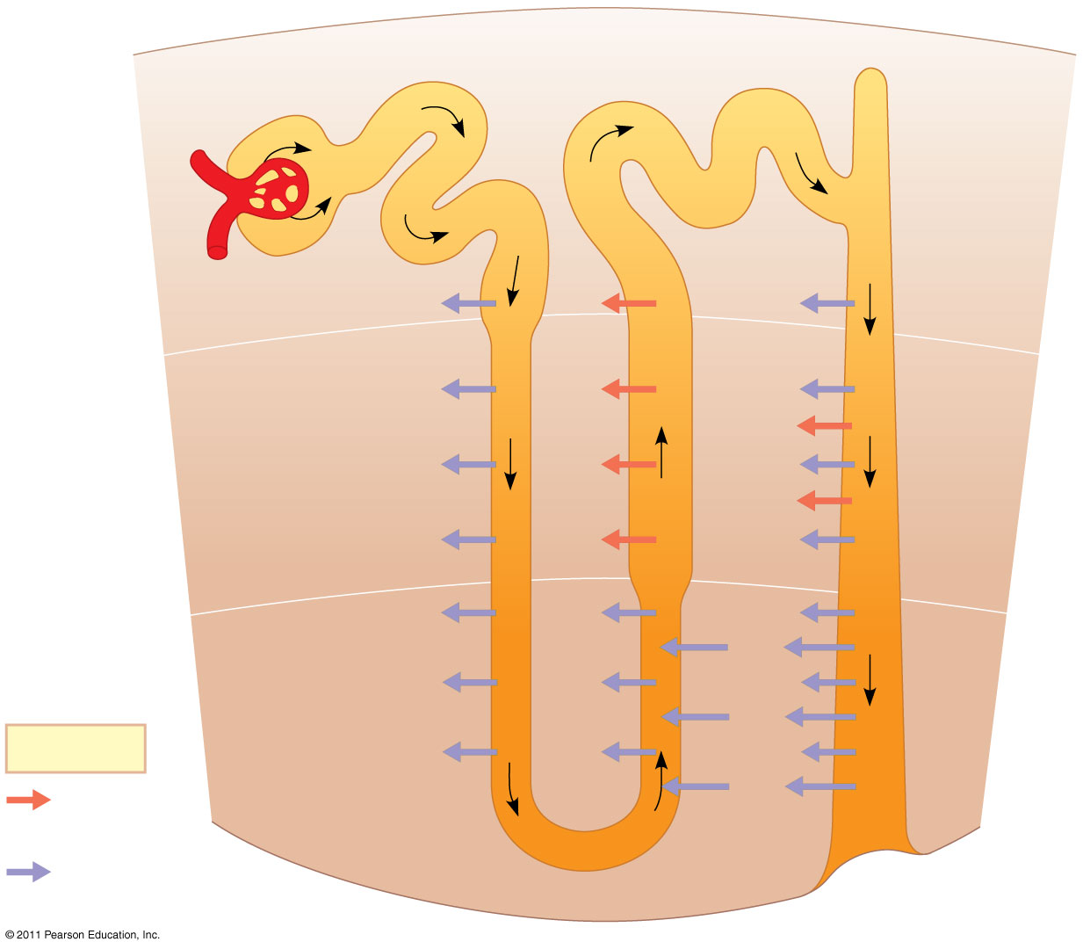
Figure 44.16-3
Osmolarity of interstitial fluid (mOsm/L)
300
300
300
100
100
300
300
CORTEX
H₂O
NaCl
H₂O
H₂O
400
NaCl
200
H₂O
400
400
NaCl
H₂O
NaCl
H₂O
NaCl
OUTER MEDULLA
H₂O
NaCl
H₂O
600
400
600
600
H₂O
NaCl
H₂O
Urea
H₂O
900
NaCl
700
H₂O
900
Urea
Key
H₂O
NaCl
H₂O
INNER MEDULLA
Urea
Active transport
1,200
1,200
Passive transport
1,200
Notes:
Figure 44.16 How the human kidney concentrates urine: the two-solute model.

Slide 28
Adaptations of the Vertebrate Kidney to Diverse Environments
The form and function of nephrons in various vertebrate classes are related to requirements for osmoregulation in the animal’s habitat
© 2011 Pearson Education, Inc.

Slide 29
Mammals
The juxtamedullary nephron is key to water conservation in terrestrial animals
Mammals that inhabit dry environments have long loops of Henle, while those in fresh water have relatively short loops
© 2011 Pearson Education, Inc.

Slide 30
Antidiuretic Hormone
The osmolarity of the urine is regulated by nervous and hormonal control
Antidiuretic hormone (ADH) makes the collecting duct epithelium more permeable to water
An increase in osmolarity triggers the release of ADH, which helps to conserve water
© 2011 Pearson Education, Inc.

Slide 31
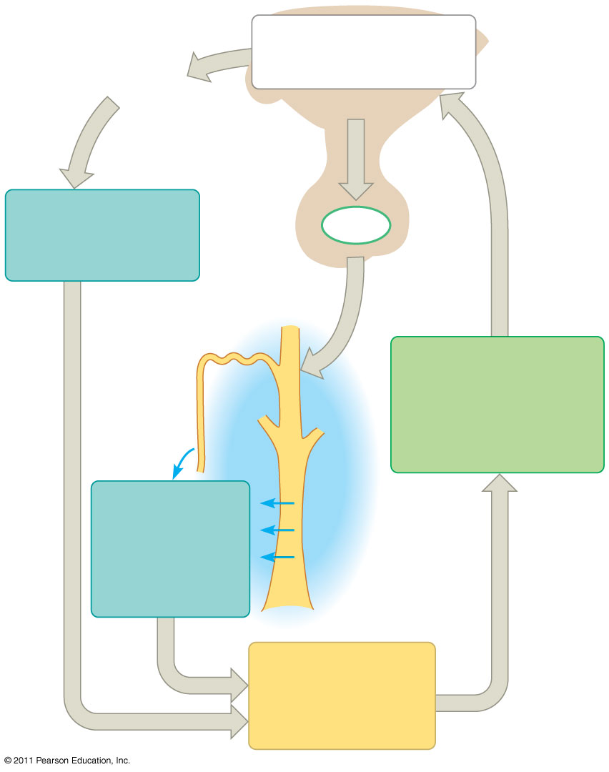
Figure 44.19-2
Osmoreceptors in hypothalamus trigger release of ADH.
Thirst
Hypothalamus
Drinking reduces blood osmolarity to set point.
ADH
Increased permeability
Pituitary gland
Distal tubule
STIMULUS: Increase in blood osmolarity (for instance, after sweating profusely)
H₂O reab- sorption helps prevent further osmolarity increase.
Collecting duct
Homeostasis: Blood osmolarity (300 mOsm/L)
Notes:
Figure 44.19 Regulation of fluid retention in the kidney by antidiuretic hormone (ADH).

Slide 32
Binding of ADH to receptor molecules leads to a temporary increase in the number of aquaporin proteins in the membrane of collecting duct cells
© 2011 Pearson Education, Inc.

Slide 33
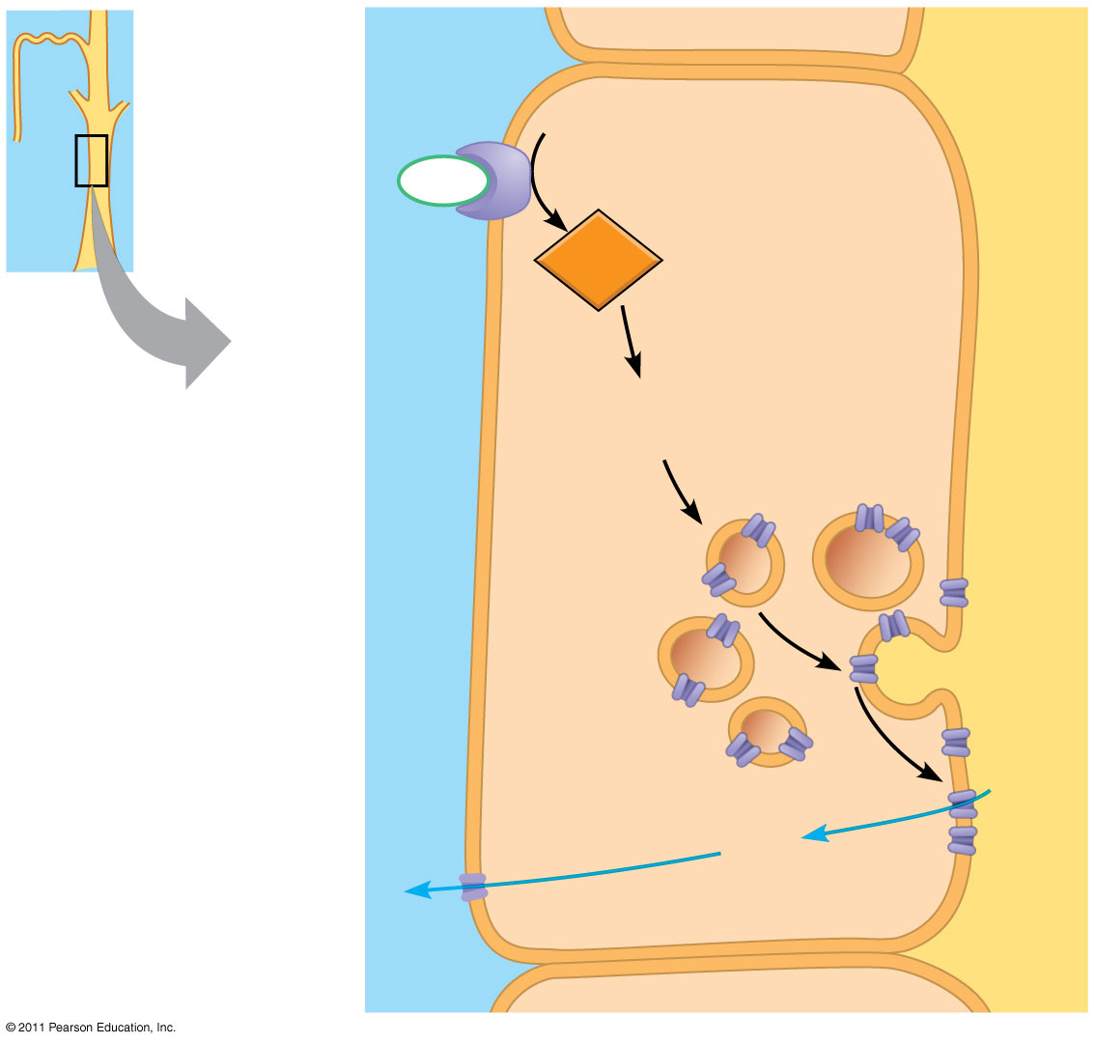
Figure 44.20
ADH receptor
Collecting duct
LUMEN
COLLECTING DUCT CELL
ADH
cAMP
Second-messenger signaling molecule
Storage vesicle
Exocytosis
Aquaporin water channel
H₂O
H₂O
Notes:
Figure 44.20 ADH response pathway in the collecting duct.

Slide 34
Mutation in ADH production causes severe dehydration and results in diabetes insipidus
Alcohol is a diuretic as it inhibits the release of ADH
© 2011 Pearson Education, Inc.

Slide 35
The Renin-Angiotensin-Aldosterone System
The renin-angiotensin-aldosterone system (RAAS) is part of a complex feedback circuit that functions in homeostasis
A drop in blood pressure near the glomerulus causes the juxtaglomerular apparatus (JGA) to release the enzyme renin
Renin triggers the formation of the peptide angiotensin II
© 2011 Pearson Education, Inc.

Slide 36
Angiotensin II
Raises blood pressure and decreases blood flow to the kidneys
Stimulates the release of the hormone aldosterone, which increases blood volume and pressure
© 2011 Pearson Education, Inc.

Slide 37
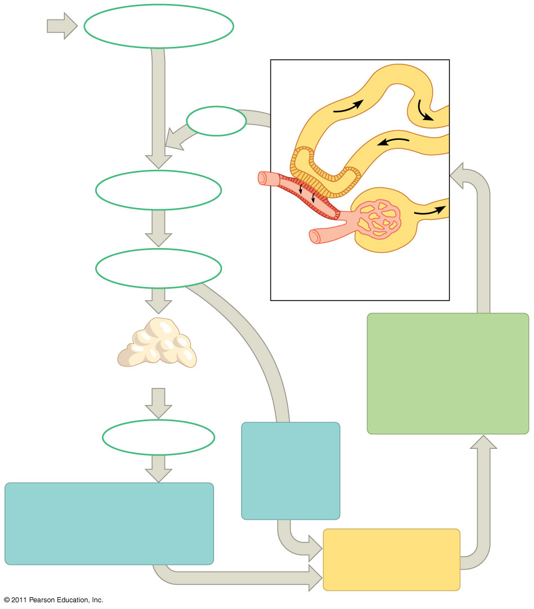
Figure 44.22-3
Liver
Angiotensinogen
JGA releases renin.
Distal tubule
Renin
Angiotensin I
ACE
Angiotensin II
Juxtaglomerular apparatus (JGA)
STIMULUS: Low blood volume or blood pressure (for example, due to dehydration or blood loss)
Adrenal gland
Aldosterone
Arterioles constrict, increasing blood pressure.
More Na⁺ and H₂O are reabsorbed in distal tubules, increasing blood volume.
Homeostasis: Blood pressure, volume
Notes:
Figure 44.22 Regulation of blood volume and blood pressure by the renin-angiotensin-aldosterone system (RAAS).

Slide 38
Homeostatic Regulation of the Kidney
ADH and RAAS both increase water reabsorption, but only RAAS will respond to a decrease in blood volume
Another hormone, atrial natriuretic peptide (ANP), opposes the RAAS
ANP is released in response to an increase in blood volume and pressure and inhibits the release of renin
© 2011 Pearson Education, Inc.

Slide 39
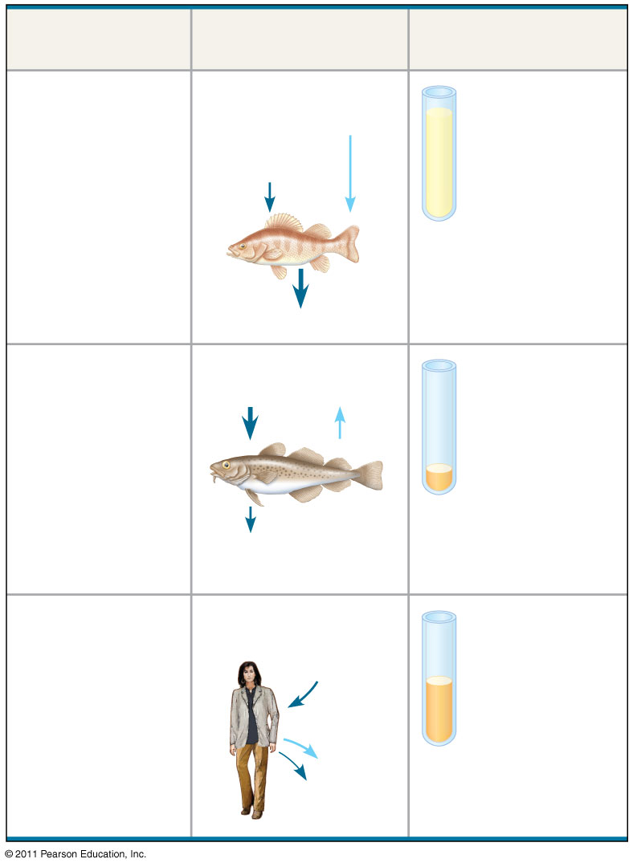
Figure 44.UN01
Animal
Inflow/Outflow
Urine
Freshwater fish. Lives in water less concentrated than body fluids; fish tends to gain water, lose salt
Does not drink water
Large volume of urine
Salt in (active trans- port by gills)
H₂O in
Urine is less concentrated than body fluids
Salt out
Marine bony fish. Lives in water more concentrated than body fluids; fish tends to lose water, gain salt
Drinks water
Small volume of urine
Salt in
H₂O out
Urine is slightly less concentrated than body fluids
Salt out (active transport by gills)
Terrestrial vertebrate. Terrestrial environment; tends to lose body water to air
Drinks water
Moderate volume of urine
Salt in (by mouth)
Urine is more concentrated than body fluids
H₂O and salt out
Notes:
Figure 44.UN01 Summary figure, Concept 44.1

Slide 40
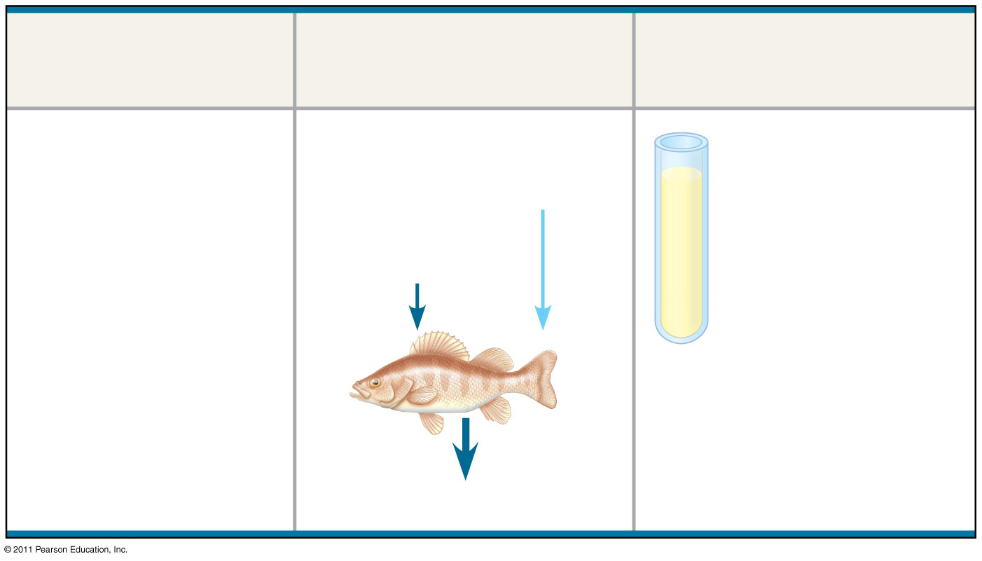
Figure 44.UN01a
Animal
Inflow/Outflow
Urine
Freshwater fish. Lives in water less concentrated than body fluids; fish tends to gain water, lose salt
Does not drink water
Large volume of urine
Salt in (active trans- port by gills)
H₂O in
Urine is less concentrated than body fluids
Salt out
Notes:
Figure 44.UN01 Summary figure, Concept 44.1

Slide 41
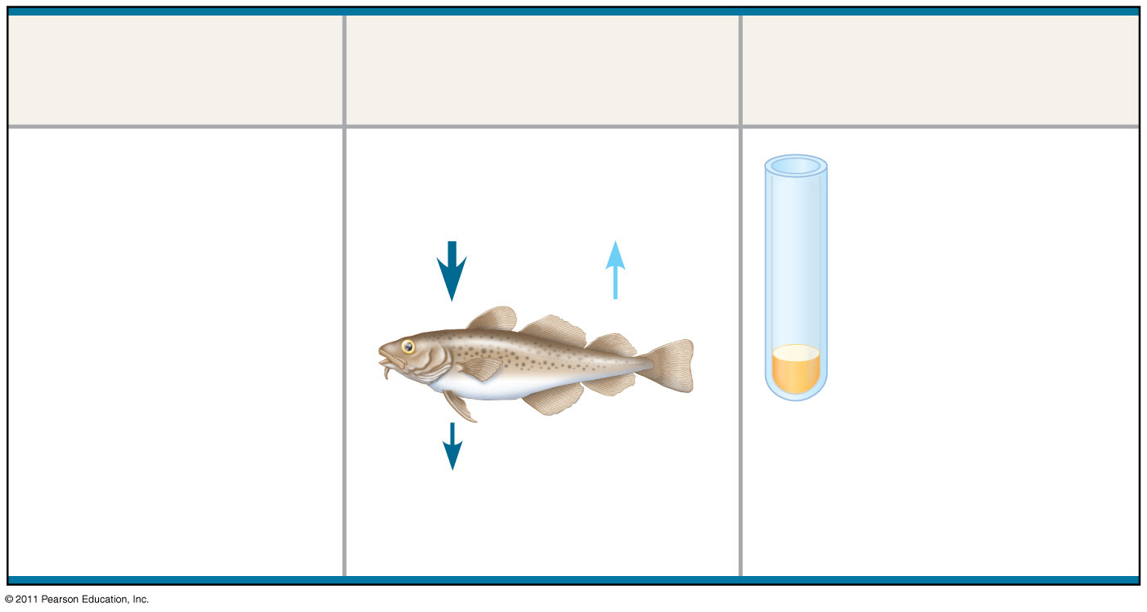
Figure 44.UN01b
Animal
Inflow/Outflow
Urine
Marine bony fish. Lives in water more concentrated than body fluids; fish tends to lose water, gain salt
Drinks water
Small volume of urine
Salt in
H₂O out
Urine is slightly less concentrated than body fluids
Salt out (active transport by gills)
Notes:
Figure 44.UN01 Summary figure, Concept 44.1

Slide 42
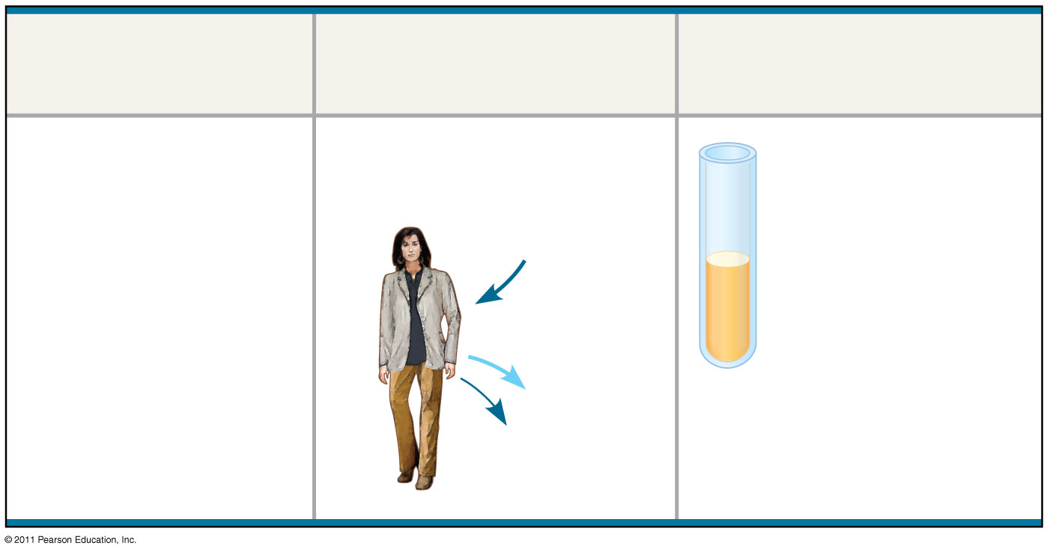
Figure 44.UN01c
Animal
Inflow/Outflow
Urine
Terrestrial vertebrate. Terrestrial environment; tends to lose body water to air
Drinks water
Moderate volume of urine
Salt in (by mouth)
Urine is more concentrated than body fluids
H₂O and salt out
Notes:
Figure 44.UN01 Summary figure, Concept 44.1

Slide 43
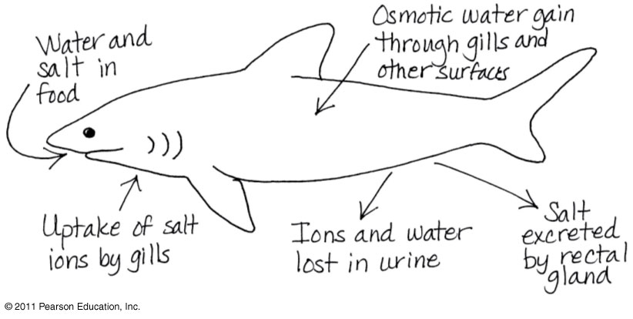
Figure 44.UN02
Notes:
Figure 44.UN02 Appendix A: answer to Test Your Understanding, question 7

