Slide 1
1
The Evolution of Microorganisms and Microbiology
Copyright © McGraw-Hill Global Education Holdings, LLC. Permission required for reproduction or display.

Slide 2
The Importance of Microorganisms
Most populous and diverse group of organisms
Found everywhere on the planet
Play a major role in recycling essential elements
Source of nutrients and some carry out photosynthesis
Benefit society by their production of food, beveragesالمشروبات , antibiotics, and vitamins
Some cause disease in plants and animals

Slide 3
Members of the Microbial World
Organisms and acellular entities too small to be clearly seen by the unaided eye
some < 1 mm, some macroscopic
These organisms are relatively simple in their construction and lack highly differentiated cells and distinct tissues

Slide 4
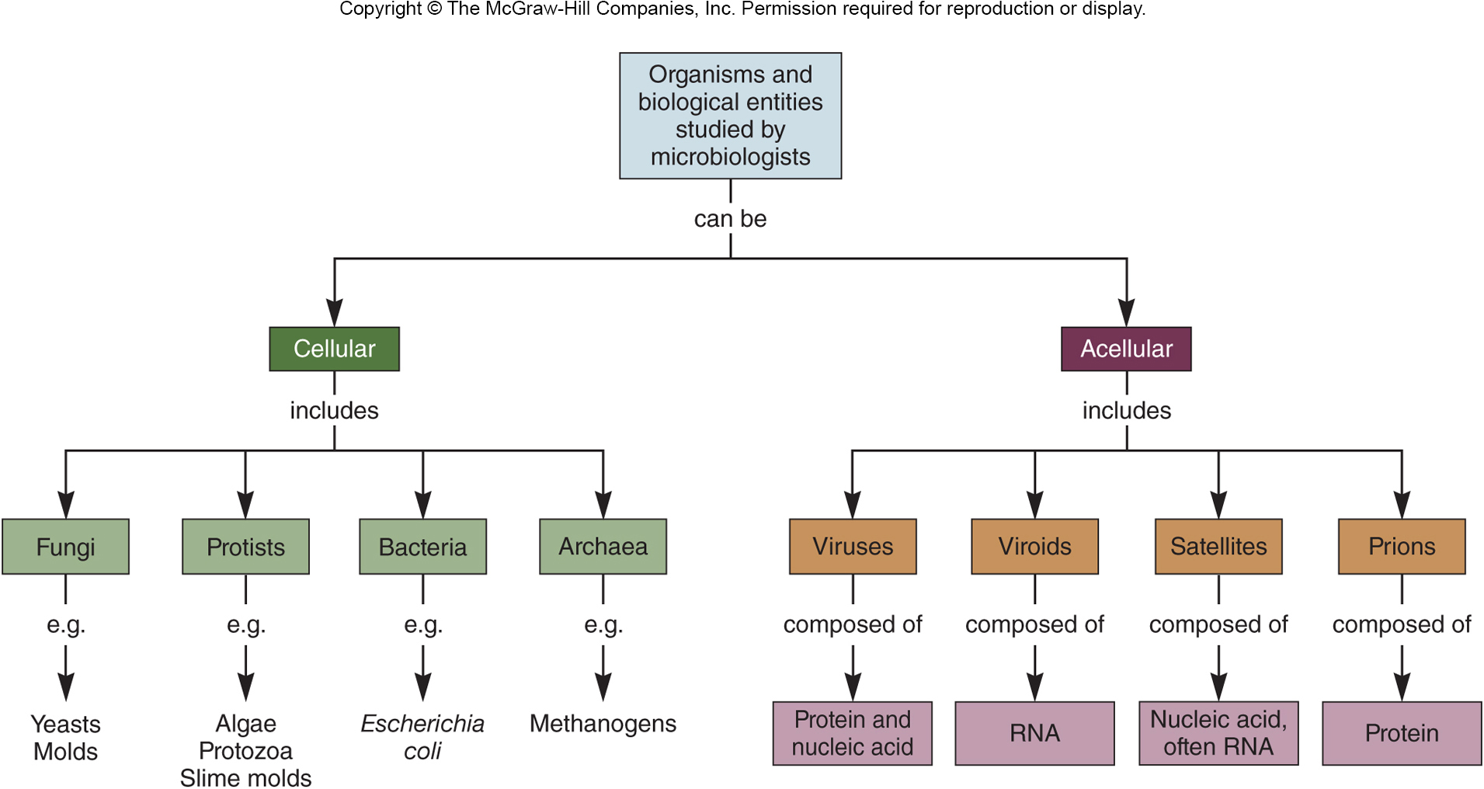

Slide 5
Type of Microbial Cells
Prokaryotic cells lack a true membrane-delimited nucleus
this is not absolute!
Eukaryotic cells have a membrane-enclosed nucleus, are more complex morphologically, and are usually larger than prokaryotic cells

Slide 6
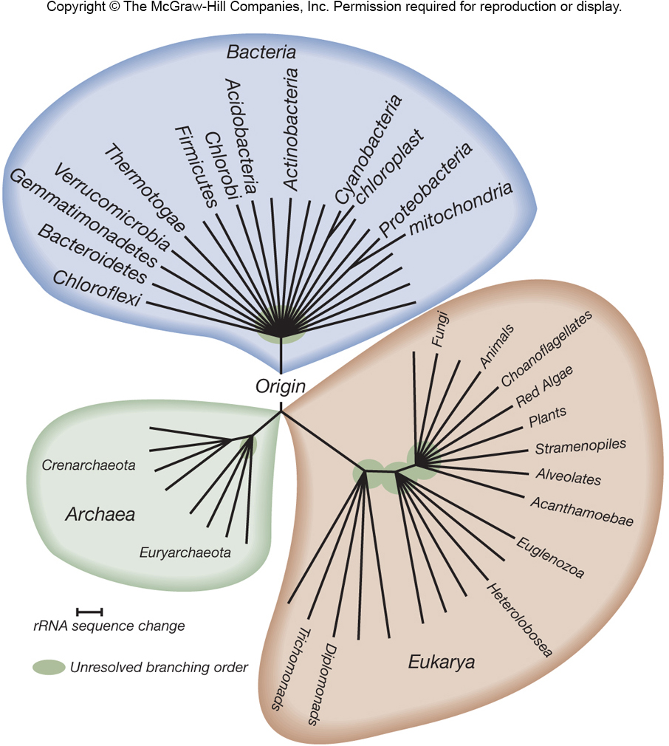
Classification Schemes
Three domain system, based on a comparison of ribosomal RNA genes, divides microorganisms into
Bacteria (true bacteria),
Archaea
Eukarya (eukaryotes)

Slide 7
Domain Bacteria
Usually single-celled
Majority have cell wall with peptidoglycan
Most lack a membrane-bound nucleus
Ubiquitous واسع الانتشار and some live in extreme environments
Cyanobacteria produce significant amounts of oxygen

Slide 8
Domain Archaea
Distinguished from Bacteria by unique rRNA gene sequences
Lack peptidoglycan in cell walls
Have unique membrane lipids
Some have unusual metabolic characteristics
Many live in extreme environments

Slide 9
Domain Eukarya - Eukaryotic
Protists – generally larger than Bacteria and Archaea
algae – photosynthetic
protozoa – may be motile, “hunters, grazers”
slime molds – two life cycle stages
water molds – devastatingمدمّر disease in plants
Fungi
yeast - unicellular
mold - multicellular

Slide 10
Acellular Infectious Agents
Viruses
smallest of all microbes
requires host cell to replicate
cause range of diseases, some cancers
Viroids and virusoids
infectious agents composed of RNA
Prions – infectious proteins

Slide 11
Microbial Species
Eukaryotic microbes fit definition of reproducing isolated populations
Bacteria and Archaea do not reproduce sexually and are referred to as strains
a strain consists of descendents of a single, pure microbial culture
may be biovars, serovars, morphovars, pathovars
binomial nomenclature
genus and species epithet

Slide 12
Microbiology - Origins
Study of microorganisms
Tools used for the study
microscopes
culture techniques
molecular genetics
genomics

Slide 13
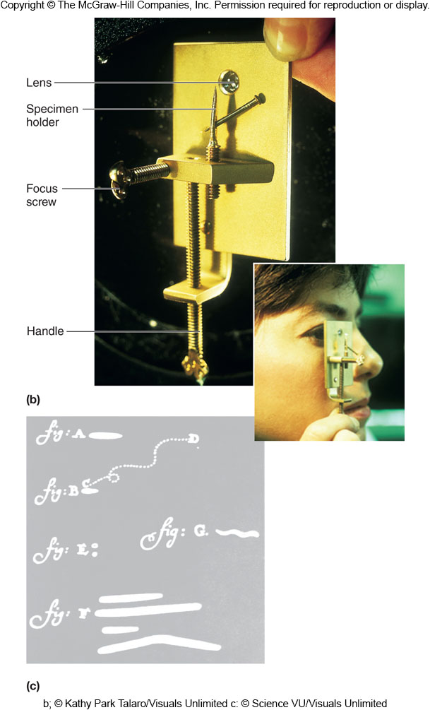
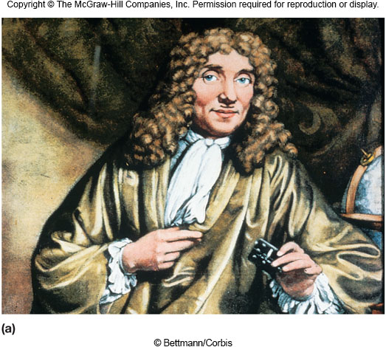
Discovery of Microorganisms
Antony van Leeuwenhoek (1632-1723)
first person to observe and describe microorganisms accurately

Slide 14
The Role of Microorganisms in Disease
Was not immediately obvious
Infectious disease believed to be due to supernatural forces or imbalances of 4 bodily-fluid ‘humors’
Establishing connection depended on development of techniques for studying microbes

Slide 15
Some Evidence…
Louis Pasteur
demonstrated microorganisms carried out fermentations, helping French wine industry
developed pasteurization to avoid wine spoilage by microbes
showed that the pébrine disease of silkworms was caused by a protozoan

Slide 16
Other Evidence…
Joseph Lister
provided indirect evidence that microorganisms were the causal agents of disease
developed a system of surgery designed to prevent microorganisms from entering wounds as well as methods for treating instruments and surgical dressings
his patients had fewer postoperative infections

Slide 17
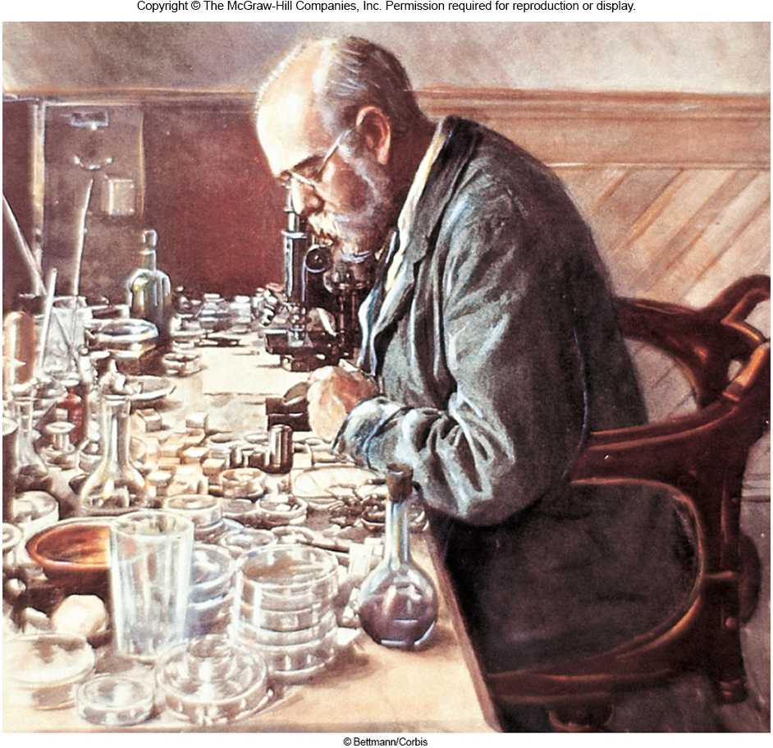
Final Proof…
Robert Koch (1843-1910)
established the relationship between Bacillus anthracis and anthrax
used criteria developed by his teacher Jacob Henle (1809-1895)
these criteria now known as Koch’s postulates
still used today to establish the link between a particular microorganism and a particular disease

Slide 18
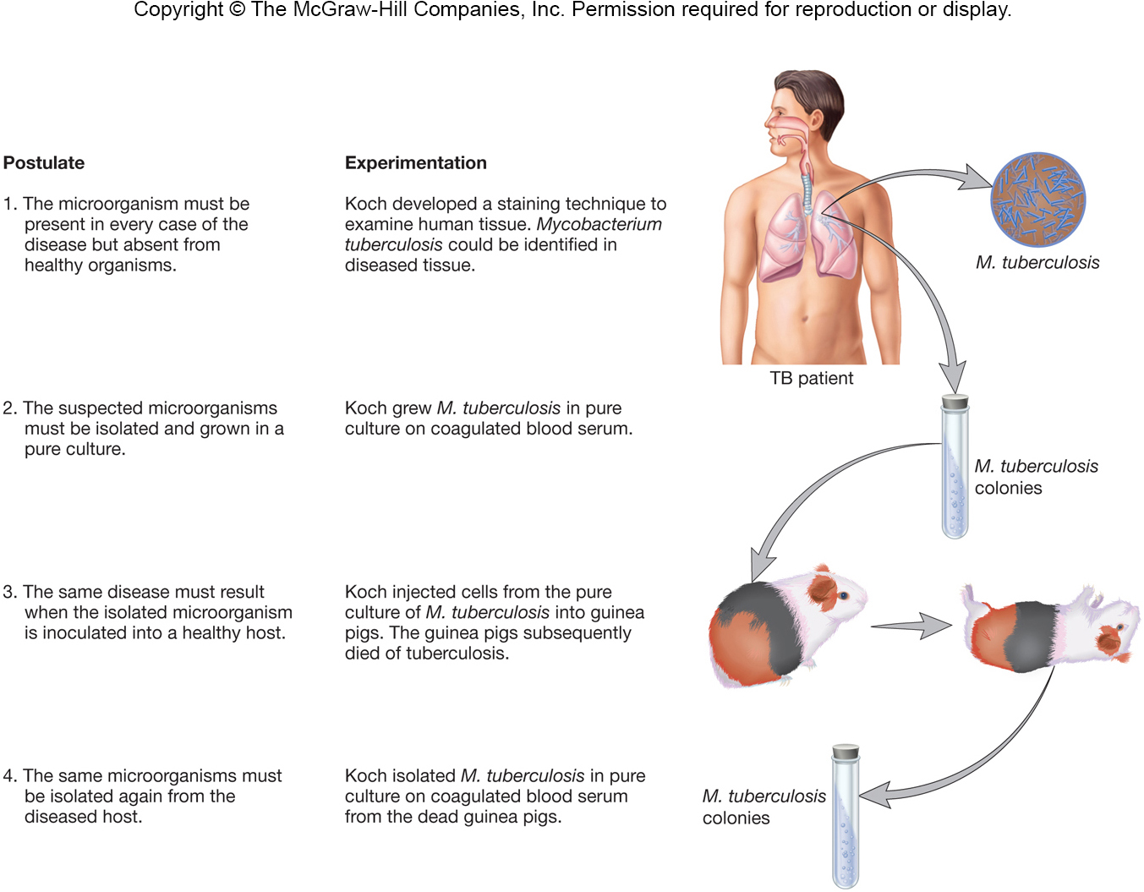

Slide 19
Limitations of Koch’s Postulates
Some organisms cannot be grown in pure culture
Using humans in completing the postulates is unethical
Molecular and genetic evidence may replace and overcome these limits

Slide 20
The Development of Techniques for Studying Microbial Pathogens
Koch’s work led to discovery or development of:
agar
Petri dishes
nutrient broth and nutrient agar
methods for isolating microorganisms

Slide 21
Other Developments…
Pasteur and Roux
discovered that incubation of cultures for long intervals between transfers caused pathogens to lose their ability to cause disease (termed ‘attenuation’)
Pasteur and his coworkers
developed vaccines for chicken cholera, anthrax, and rabies

Slide 22
Immunological Studies
once established, led to study of host defenses - immunology
Edward Jenner (ca. 1798)
used a vaccination procedure to protect individuals from smallpox
NOTE: this preceded the work establishing the role of microorganisms in disease!

Slide 23
More Developments…
Emil von Behring (1854-1917) and Shibasaburo Kitasato (1852-1931)
developed antitoxins for diphtheria and tetanus
evidence for humoral (antibody-based) immunity
Elie Metchnikoff (1845-1916)
discovered bacteria-engulfing, phagocytic cells in the blood
evidence for cellular immunity

Slide 24
The Development of Industrial Microbiology and Microbial Ecology
Louis Pasteur
demonstrated that alcohol fermentations and other fermentations were the result of microbial activity
developed the process of pasteurization to preserve wine during storage

Slide 25
Microbiology Has Basic and Applied Aspects
Basic aspects are concerned with individual groups of microbes, microbial physiology, genetics, molecular biology and taxonomy
Applied aspects are concerned with practical problems – disease, water, food and industrial microbiology

Slide 26
Major Fields in Microbiology
Medical microbiology – diseases of humans and animals
Public health microbiology – control and spread of communicable diseases
Immunology – how the immune system protects a host from pathogens

Slide 27
More Fields…
Microbial ecology is concerned with the relationship of organisms with their environment
less than 1% of earth’s microbial population has been cultured
Agricultural microbiology is concerned with the impact of microorganisms on agriculture
food safety microbiology
animal and plant pathogens

Slide 28
More Fields….
Industrial microbiology began in the 1800s
fermentation
antibiotic production
production of cheese, bread, etc.
Microbial physiology studies metabolic pathways of microorganisms

Slide 29
More Fields….
Molecular biology, microbial genetics, and bioinformatics study the nature of genetic information and how it regulates the development and function of cells and organisms
Microbes are a model system of genomics

