Slide 1
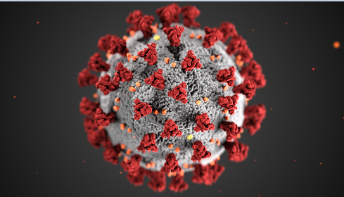
Coronavirus Disease 2019 (COVID-19)
CDC/ Alissa Eckert, MS; Dan Higgins, MAMS
© 2020 McGraw Hill. All rights reserved. Authorized only for instructor use in the classroom.
No reproduction or further distribution permitted without the prior written consent of McGraw Hill.

Slide 2
Lecture Summary
Overview
History
Virus characteristics
Virus transmission
Entry into the host
Mechanisms of pathogenicity
Disease manifestations
Epidemiology/testing
Treatment/prevention

Slide 3
Overview
The World Health Organization (WHO) named the novel coronavirus that causes the disease COVID-19 “severe acute respiratory syndrome coronavirus 2” (SARS-CoV-2) in January 2020.
The disease is named from a contraction of the term coronavirus disease 2019.
This disease was first observed in humans in Wuhan, China in December 2019, although it’s circulation a month earlier is inferred.
The WHO declared COVID-19 a Public Health Emergency of International Concern (PHEIC) on January 30, 2020.

Slide 4
History 1
Three pathogenic β-coronaviruses have crossed the species barrier since 2000:
SARS-CoV emerged in the Guangdong province of China in 2002 ultimately infecting 8,098 people and causing 774 deaths across 5 continents.
Middle-East respiratory syndrome coronavirus (MERS-CoV) emerged in the Arabian peninsula in 2012 and remains a public health concern.
SARS-CoV-2 was identified in December 2019.
In addition, four low-pathogenicity coronaviruses are endemic in humans.

Slide 5
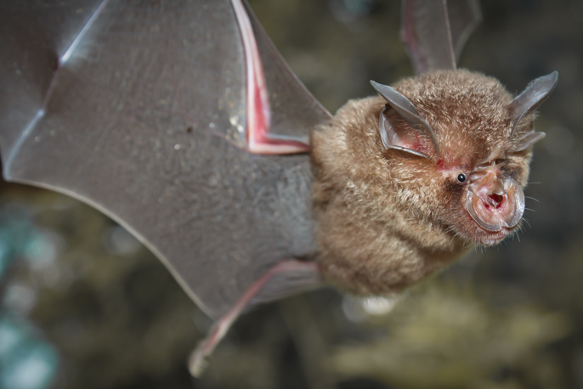
History 2
Three years after the discovery of Sars-CoV, a related virus, in the subgenus Sarbecovirus, was found in horseshoe bats in China.
This virus seeded the progenitor of SARS-CoV in an intermediate animal, the most plausible being civet cats, which are consumed and could easily serve as the conduit of transmission to humans.
Horseshoe bat
Horseshoe bat
Following the SARS epidemic, further surveillance identified sarbecovirus and other coronavirus species in bats as a clear and immediate threat to humans.
Charoenchai Tothaisong/123RF

Slide 6
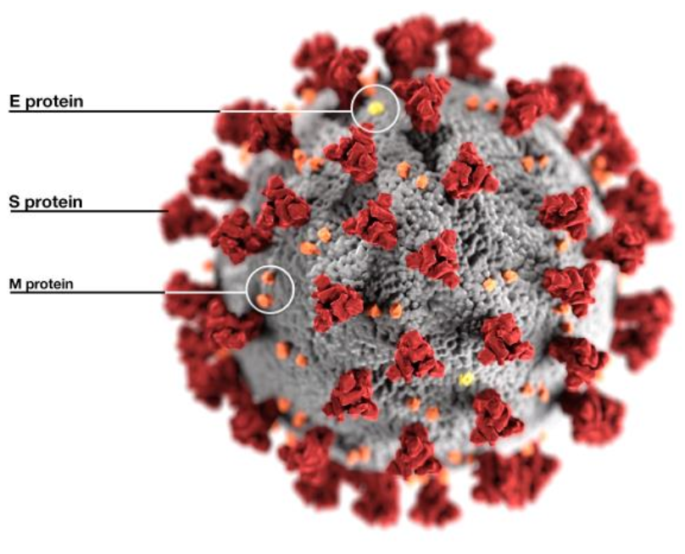
Virus Characteristics 1
The S proteins protrude from the viral surface resembling a crown, or corona.
SARS-CoV-2
CDC/Alissa Eckert, MS; Dan Higgins, MAMS

Slide 7
Virus Characteristics 2
SARS-CoV-2 belongs to the genus β-coronavirus, family Coronaviridae.
It is an enveloped virus with an unsegmented single-stranded positive-sense RNA genome.
It is comprised of four main structural proteins:
spike (S) glycoproteins
envelope (E) glycoproteins
membrane (M) glycoproteins
nucleocapsid (N) proteins
The genome also codes for 16 nonstructural proteins that are involved in viral replication, maturation, and release.
Scientists published the SARS-CoV-2 genome sequence by January 10, 2020, just one month after it was first reported; it took over a year to sequence SARS-CoV in 2003.

Slide 8
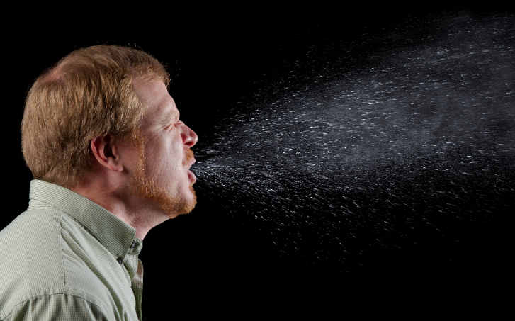
Virus Transmission 1
SARS-CoV-2 is transmitted from human-to-human (droplet) and in rare cases animal-to-human (direct contact).
Human-to-human transmission of the virus is primarily through small liquid particles emitted from the infected person’s nose or mouth through coughing, sneezing, singing, or talking.
The liquid particles range in size from larger respiratory droplets to smaller aerosols.
Current evidence suggests the virus spreads mainly through larger respiratory droplets between individuals in close contact (< 6 feet) with each other.
CDC/James Gathany

Slide 9

Virus Transmission 2
Indirect transmission is less of a concern.
Handshaking, or touching a contaminated article could spread the virus, but it is not considered a significant mode of transmission.
Population-dense areas, large public gatherings, and facilities such as prisons, cruise ships, and senior living centers provide ideal conditions for spread of the virus.
Shutterstock/Melinda Nagy

Slide 10

Entry into the Host 1
Portals of entry include:
Nasal and oral passages of the respiratory tract
Conjunctiva of the eyes passing through nasolacrimal duct
Oral cavity and esophagus
Once transmitted, viral S-proteins bind to host cells via angiotensin-converting enzyme 2 (ACE2) (viral tropism).
S-proteins embedded in viral envelope bind to ACE2 on host cells, which triggers either viral endocytosis, or membrane fusion and viral genome entry.
Shutterstock/Kateryna Kon

Slide 11
Entry into the Host 2
The physiological functions of ACE2 include lowering blood pressure, controlling fluid balance, and regulating the inflammatory response.
ACE2 proteins are present in many tissues, including lungs, kidneys, heart, arteries, and the gastrointestinal tract.
Multicellular viral tropism accounts for the high rate of infectivity.
When SARS-CoV-2 binds to ACE2, it not only triggers viral entry into the cell, but it also prevents the binding of endogenous ligands, such as angiotensin II, thereby disrupting normal cell function.

Slide 12
Mechanisms of Pathogenicity 1
Once inside the host cell, the virus takes over the replicative machinery and multiplies within the cell (Stage 1).
Direct damage to the infected cell includes rounding, detachment, degeneration, and syncytium formation.
Progeny are released from cells through exocytosis and infect nearby cells.
Immune system triggers inflammatory response (Stage 2).
If not blocked by the immune system, virions migrate to the lower respiratory tract where they infect alveoli type II cells (gas exchange units) that are rich in ACE2 proteins.

Slide 13
Mechanisms of Pathogenicity 2
Extensive exocytosis of virus particles leads to apoptosis and death of alveolar cells.
Non-specific immune cells release chemokines that stimulate a targeted attack on the infected cells, crippling normal cell function (Stage 3).
In critical cases, a “cytokine storm,” an overreaction by the immune system, causes immune cells to attack healthy tissues.
Multiorgan failure ensues.

Slide 14
Disease Manifestations 1
Stage 1 – Asymptomatic state
Incubation time - median 4 to 5 days, range 2 to 14 days.
Virus is detected by a nasal swab and is shed by the host in droplets.
Virus propagates, mild innate immune response initiated.
Stage 2 – Upper airway and conducting airway response
Robust immune response
Clinical manifestations of disease appear 2 to 14 days post-exposure and include cough, fever, shortness of breath, chills, muscle pain, loss of taste and/or smell, sore throat, nausea, diarrhea.
Up to 80% of COVID-19 cases will be either asymptomatic or will arrest at this stage.

Slide 15
Disease Manifestations 2
Stage 3 – Hypoxia, progression to acute respiratory distress syndrome (ARDS) within 8 to 12 days.
Critical care/hospitalization necessary .
Approximately 15% of COVID-19 patients require oxygen and 5% ventilation.
Manifestations include pneumonia, difficulty breathing, persistent chest pain/pressure, confusion, inability to stay awake, bluish lips or skin.
Oxygen levels fall as lungs become filled with fluid, white blood cells, mucus, and cellular debris.
Cytokine storm leads to dramatic drop in blood pressure, leaky blood vessels, formation of blood clots, organ failure.

Slide 16
Disease Manifestations 3
Organs/systems affected in critical care patients:
Eyes - conjunctivitis more common in critical patients.
Nose - patients lose their sense of smell from viral damage of nerve cells in the nasal passage.
Lungs - inflammation and breakdown of alveolar walls restrict oxygen uptake and delivery.
Liver - overactive immune system and therapeutic drugs affect liver enzymes.
Kidneys - damage is common in severe cases either from direct viral attack or multisystem organ failure.
Cardiovascular system - virus directly infects cells that have ACE2 receptors leading to clots, inflammation, and heart attacks.
Brain - some patients experience confusion, seizures, inflammation, strokes.
Intestines - GI tract is rich in ACE2 receptors; 20% of patients experience diarrhea.

Slide 17
Disease Manifestations 4
Multisystem Inflammatory Syndrome (MIS-C) was first reported in April 2020 in the United Kingdom in children who either tested positive for, or were exposed to SARS-CoV-2.
Manifestations include:
Persistent fever
Hypotension
Rashes
Multiorgan involvement (kidneys, heart, GI, vasculature, neurologic)
Inflammation
The symptoms present weeks after (often asymptomatic) exposure to the virus, and Black and older children appear disproportionately affected.
As of August 2021, the link between the virus and the occurrence of multisystem inflammatory syndrome in children (MIS-C) is validated, but the pathophysiology is still largely unexplored, although studies suggest that inflammation and autoreactivity secondary to SARS-CoV-2 infection contributes to the pathogenesis of MIS-C.

Slide 18
Disease Manifestations 5
‘Long COVID’ is a term used for disease manifestations that linger long after SARS-CoV-2 has been eliminated from the body.
Manifestations that persist include:
Cough and shortness of breath
Fatigue
Headache
Heart palpitations
Chest pain
Joint pain
Physical limitations
Depression
Insomnia
In December 2020, the National Institute of Allergy and Infectious Diseases held a federal workshop to discuss the financial burden and prevent mismanagement of patients suffering with long COVID.

Slide 19
Clinical Care
Several changes have been made in the treatment of critical patients since the first wave of COVID hospitalizations in March – May 2020.
Initially, physicians were quick to put patients on ventilators, and were willing to try drugs that showed even a hint of promise against the virus.
There was little in the way of consistency of care across the nation as healthcare providers were desperately trying to battle a largely unknown enemy.
Now, doctors have instituted several changes that seem to have lowered the case fatality rate among the sickest patients:
Increasing oxygen in a less invasive way than a ventilator
Proning – placing the patient face-down to expand the dorsal lung region
Prescribing remdesivir
Delivering convalescent plasma
Prescribing the steroid dexamethasone to dampen an overreactive immune response

Slide 20
Epidemiology 1
Risk Factors
COVID-19 can affect anyone.
As a new disease, ongoing research is being conducted to determine the risk factors for severe illness or complications.
Certain populations are more at risk:
Individuals aged 65 and older, especially those in a care facility
Anyone with an underlying medical condition, such as diabetes, asthma, kidney disease, pulmonary disease, blood disorders, obesity/metabolic syndrome, heart conditions
Immunocompromised individuals due to AIDS, cancer, blood or organ transplantation, autoimmune and taking immunosuppressants, and immune deficiencies for example

Slide 21
Epidemiology 2
Statistics
When a pandemic is ongoing, the data changes daily.
The table reflects number of reported cases and deaths throughout the world as of May 16, 2022.
 | Worldwide | Palestine
Number of cases | 521,349,566 | 582,119
Number of deaths | 6,288,525 | 5,353
SOURCEs: https://www.worldometers.info/coronavirus/country/state-of-palestine/
https://www.worldometers.info/coronavirus/

Slide 22
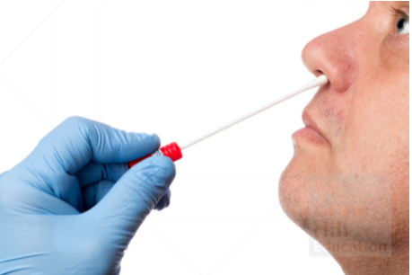
Epidemiology 4
Public Health Pandemic Control
Effectively managing a pandemic involves 4 coordinated response measures:
Testing the population with speed and accuracy
Isolation of infected individuals
Contact tracing - identifying those who have been exposed to the virus
Quarantine - restricting movement of those who were exposed
Henrik Dolle/Shutterstock

Slide 23
Epidemiology 5
Testing – 2 Types
Diagnostic tests – to determine if an individual is currently infected.
Types of diagnostic tests available:
PCR test - this was the first available test; it amplifies and detects viral genetic material (RNA) if present in a person’s secretions collected with a swab.
Advantages: accurate if sample is taken approximately 3+ days post-exposure, option of at-home saliva test limits need for healthcare provider wearing PPE.
Disadvantages: may not catch early infections, takes several days for results, rapid tests (results in less than an hour) lack accuracy, positive results exceed transmission period.
Antigen test – also known as the lateral flow test, this detects viral proteins (those that act as antigens) vs. viral genetic material.
Advantages: results in a few minutes, good screening tool.
Disadvantages: not as accurate as PCR test.
Shutterstock / Jarun Ontakrai

Slide 24
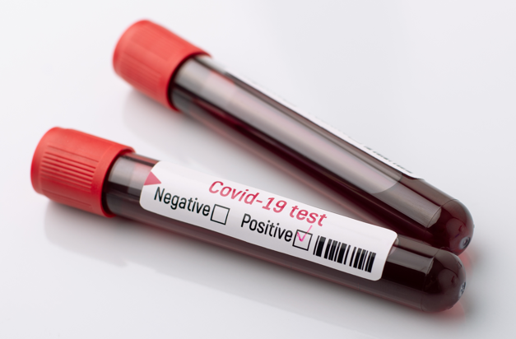
Epidemiology 6
Testing – 2 Types continued
Antibody tests – to determine if an individual has had a past infection.
This is a blood test to determine the presence of antibodies that appear 5+ days post-infection.
Advantages: over 120 tests on the market, good tool to track spread of disease.
Disadvantages: most tests are not FDA approved; quality is an issue.
NOTE: Because this is a novel coronavirus/disease, we do not know the extent/duration of protection from acquired antibodies via infection or vaccination.
Vitalii Petrushenko/Shutterstock

Slide 25
Epidemiology 8
Basic Reproductive Number (R₀) cont.
A contagious disease has a high R₀ value (for example, measles transmitted via aerosol R₀ = 12 − 18), compared to a disease that does not spread easily from person to person (for example, Ebola transmitted directly through body fluids R₀ = 2).
The highest R₀ for COVID-19 was estimated in May 2020 in the 5 to 6 range, higher than earlier estimates from China of 2.2 to 2.7, although it is difficult to pinpoint a specific number in the early stages of a novel disease.
The R₀ is used to determine what percentage of the population must be immune in order to halt the disease spread.
Scientists are proposing a 75 – 85% vaccination rate will be necessary to prevent the spread of COVID-19 through herd immunity.

Slide 26
Epidemiology 7
Basic Reproductive Number (R₀)
When dealing with a novel infectious agent like SARS-CoV-2, epidemiologists attempt to determine the ability of the infectious agent to spread throughout a population.
The capacity to spread can be quantified - it is given an R₀ (“R naught”) value, which represents the number of individuals that can be infected from one single person.
The R₀ is not a constant number, and it is difficult to calculate; it can vary depending on the environment (for example, population density) and the behavior of the population (for example, social distancing), but assumes that all members are susceptible to the infectious agent.
An R₀ of less than 1 suggests a disease will ultimately die out in a population.

Slide 27
Epidemiology 9
Herd Immunity
Herd immunity is achieved by protecting people from a virus, not by exposing them to it.
When a virus has a high case fatality rate, attempts to achieve herd immunity via population exposure is problematic and unethical, and can lead to unnecessary infections, suffering and death.
Another value, the effective reproduction rate (R_{e}) represents the current (recovered/vaccinated) state of the population.
The goal is, through vaccination, to lower the R_{e} to a value of 1 or less whereby the virus can no longer spread through susceptible hosts and the pandemic dissipates.
The duration of viable antibodies in the blood as a result of either vaccine or recovery is yet to be determined.

Slide 28

Prevention/Treatment 1
Prevention - Personal Safety
Before we had a vaccine against SARS-CoV-2, the best way to avoid becoming ill was to avoid exposure to the virus.
Avoidance involves:
Washing hands often
Use a hand sanitizer of >60% alcohol when washing is not an option
Maintaining a safe distance from others outside the home >6 feet
Covering the mouth and nose with cloth in public places to avoid spread from yourself to others
Clean and disinfect frequently touched surfaces often
FamVeld/Shutterstock

Slide 29

Prevention/Treatment 2
Prevention – Safety for Healthcare Professionals
Healthcare providers caring for COVID-19 patients are at greater risk for contracting and spreading the virus.
A higher level of personal protective equipment (PPE) is necessary for those who risk daily workplace exposure.
Appropriate care must be taken when putting on or taking off the PPE which includes:
N95 facemask (filters out 95% of airborne pathogens)
Eye protection
Gloves
Gown
Mongkolchon Akesin/Shutterstock

Slide 30
Prevention/Treatment 3
Prevention – Public Safety
Before areas can safely open to the public, a disinfection plan must be implemented to prevent spread in areas that typically host high numbers: schools, public transit, aviation, shops, restaurants, churches, etc.
Natural methods
Studies have shown that SARS-CoV-2 lasts hours to days (one study suggests a maximum of 7 days on the outer layer of mask) on surfaces, less in the sunlight.
Leaving items untouched for over 24 hours, or outside in direct sun can reduce the risk of transmission via a fomite.

Slide 31
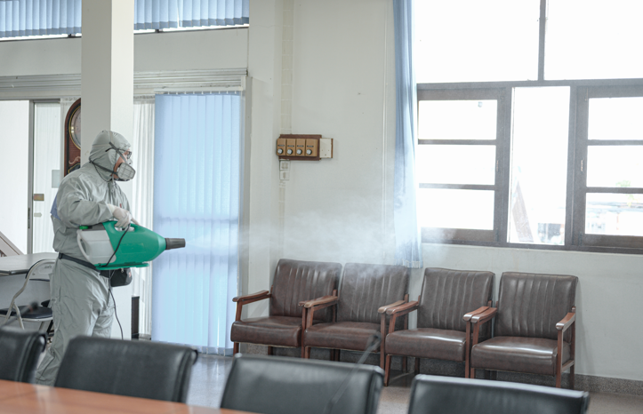
Prevention/Treatment 4
Prevention – Public Safety continued
Disinfection
The EPA has an approved list of disinfectants for removal of the virus from most surfaces, particularly frequently touched surfaces such as doorknobs, light switches, ATM machines, faucets, etc.
https://www.epa.gov/pesticide-registration/list-n-disinfectants-use-against-sars-cov-2
If approved disinfectants are not available, dilute bleach or 70% alcohol is recommended.
GrooveZ/Shutterstock

Slide 32
Prevention/Treatment 5
Prevention – Public Safety continued
Ultraviolet radiation
UV radiation in the range of 200 – 260 nm is an effective germicide for removing airborne and surface viruses and has been used effectively in hospitals for many years.
While effective, UV radiation can pose a safety hazard to skin and eyes, whereas far-UVC radiation with a specific wavelength of 222nm kills pathogens without harming human tissues.
UVC has been shown to destroy the outer protein coat of the SARS-coronavirus, and studies suggest it is also effective in destroying SARS-CoV-2.
During the pandemic, authorities in public places such as schools, offices, and mass transit are using UVC as a means of disinfection.

Slide 33
Prevention/Treatment 6
Prevention – Vaccines
Under normal circumstances, vaccine development may take up to 15 years from exploration to clinical use.
In the case of a global pandemic with a novel virus, the development can be fast-tracked and often involves eliminating stages of testing in animals.
Within the first 6 months of the COVID-19 pandemic, vaccine testing in humans began, largely due to a head start from previous coronavirus research, and running phases I and II concurrently, rather than consecutively.
Certain steps cannot be rushed, such as the wait to see whether antibodies against the virus develop in response to the foreign agent being introduced into the body.
The goal is to induce production of antibodies that bind to the virus, effectively blocking entry into the host cell.
As of December 2020, 52 vaccines were in clinical trials, and 162 candidates were in the preclinical evaluation stage globally.

Slide 34

Prevention/Treatment 7
Prevention – Vaccines continued
On December 11th, 2020, the FDA granted the first emergency use authorization (EUA) to Pfizer Pharmaceuticals/BioNTech for their COVID-19 vaccine.
On August 23rd, 2021, the FDA granted the vaccine full approval for use. The vaccine can be administered to individuals aged 12 and over in a 2-shot regimen.
As of August 2021, clinical trials are underway in pregnant woman and children between 2 and 12 years of age.
Ivan Pantic/E+/Getty Images

Slide 35
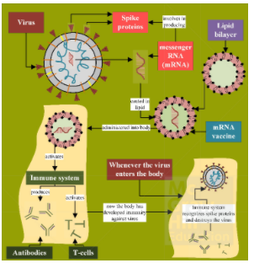
Prevention/Treatment 8
Prevention – Vaccines continued
On December 18th, 2020, Moderna Therapeutics was granted an EUA from the FDA for their vaccine. Individuals aged 18 and over can receive the Moderna vaccine in a 2-shot regimen.
As of August 2021, clinical trials are in progress for children aged 6 months – 11 years, and adults over 18 who have previously had an organ transplant.
The Pfizer and Moderna vaccines involve brand new technology; injecting mRNA, rather than a protein product, via a lipid nanoparticle, into cells. The cells will translate the mRNA into the viral spike protein, which acts as a T-dependent endogenous antigen.
Usman Zafar Paracha/Shutterstock

Slide 36
Prevention/Treatment 9
Prevention – Vaccines continued
Johnson & Johnson/Janssen received its EUA on February 27th 2021, for use in adults 18 years of age and older in a single shot regimen. The EUA was amended in April 2021 after rare but serious blood clots were reported following administration.
As of August 2021, clinical trials include adolescents aged 12 – 17.
In January 2021, the AstraZeneca/Oxford University vaccine was approved for use in the European Union, then in February 2021 it was granted an EUA by the WHO for use in low- and middle-income countries. As of August 2021, the FDA has no plans to issue an EUA for this vaccine.
The J&J and AstraZeneca vaccines are comprised of a genetically-modified adenovirus (cannot replicate in humans) containing DNA from SARS-CoV-2 that codes for the spike protein.

Slide 37
Other vaccines
Sputnik: Developed in Russia: Adenovirus based vaccine similar to the Astra Zeneca vaccine.
Sinovac: Developed in China. The virus is killed and used for the vaccine

Slide 38
Prevention/Treatment 10
Prevention – Vaccines continued
Booster Shots
As of August 13th, 2021, the FDA has authorized the use of a 3rd dose of either the Pfizer or Moderna COVID-19 vaccine for certain immunocompromised individuals.
On August 18^{th,} 2021, experts affiliated with the U.S. Department of Health and Human Services recommended a Pfizer or Moderna booster shot 8 months after the second dose, citing the dominance of the Delta variant, evidence of diminished antibody levels over time, and breakthrough cases of COVID-19 in the fully vaccinated as motivation.
These booster shots will begin on September 20th, 2021, with the anticipation of a second J&J booster shot once more data on the safety and efficacy has been gathered.
As of August 2021, over 4.5 billion vaccine doses have been administered worldwide. https://www.who.int/emergencies/diseases/novel-coronavirus-2019

Slide 39
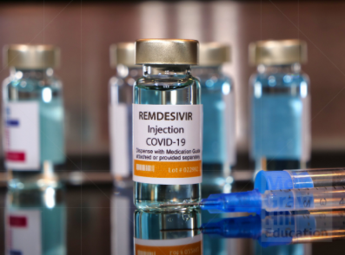
Prevention/Treatment 11
Treatment – Drugs
The first and only antiviral drug approved by the FDA for use against COVID-19 is the Gilead drug remdesivir sold under the trade name of VEKLURY®.
This antiviral drug showed promise against SARS and MERS, also coronaviruses; it works by targeting RNA-dependent RNA-polymerase.
The FDA also granted an EUA for the drug baricitinib (CIMZIA®) to be used in conjunction with remdesivir for the treatment of COVID-19 in hospitalized adult and pediatric patients (an immune modulator; not approved as a stand-alone treatment).
Following a clinical trial, the National Institutes of Health formally concluded that chloroquine/hydroxychloroquine provides no clinical benefit to patients with COVID-19.
Bernard Chantal/Shutterstock

Slide 40
Prevention/Treatment 12
Treatment – Monoclonal Antibodies
The FDA issued EUAs for certain laboratory-produced monoclonal antibodies (mAbs) that block entry of the virus into cells.
The following may be administered in certain patients:
REGEN-CoV (casirivimab and imdevimab)
Sotrovimab
Bamlanivimab and etesevimab (nationwide pause as of June 2021)
Actemra (tocilizumab)
Treatment – Sedatives
Sedatives are authorized for emergency use in intubated patients.
Propofol-Lipuro 1%
Fresenius Kabi Propoven 2%

Slide 41
Prevention/Treatment 13
Treatment - Convalescent Plasma
Extracting plasma from recovered patients and donating it to sick individuals has been carried out for over 100 years for a variety of diseases including measles, polio, and Ebola.
In March 2020, the FDA allowed treatment using donated plasma for patients suffering from life-threatening COVID-19, considering it “promising” but not yet “safe and effective.”
In August 2020, the FDA issued an EUA for convalescent plasma.
While the treatment is still considered experimental, anecdotal reports from patients state their condition improved significantly after the plasma was transfused.

Slide 42
Variants 1
Variants are expected due to the constant change through mutation as the virus replicates. Some variants persist, while others emerge then disappear.
The original virus present in the U.S. in January 2020 is no longer circulating.
Numerous variants of SARS-CoV-2 are being tracked and are classified as either variants of interest (VOI), concern (VOC), or high consequence (VOHC) based on their transmissibility, response to immunity, and disease severity.
On May 2021, the WHO announces a simplified naming system for variants using the Greek alphabet.
Variants of Interest:
Eta B.1.525 First identified in Nigeria
Iota B.1.526 First identified in the U.S.
Theta P.3 First identified in the Philippines
Kappa B.1.617.1 First identified in India
Lambda C.37 First identified in Peru

Slide 43
Variants 2
Variants of Concern:
Alpha B.1.1.7 First identified in the United Kingdom
Beta B.1.351 First identified in South Africa
Gamma P.1 First identified in Brazil
Delta B.1.617.2 First identified in India
All four VOC evolved from mutations within the spike protein’s receptor binding domain.
The Delta variant’s mutation is P681R; a proline at position 681 in the wild-type is mutated such that an arginine is inserted instead, enhancing receptor recognition and invasion.
All three vaccines approved for emergency use by the FDA protect against these variants.
As of August 2021, there are no Variants of High Consequence in the U.S.

Slide 44
Omicron variant
This variant has a large number of mutations some of which are of concern because the vaccines might not protect against this variant.
This variant seem to be more able to infect but appears to give milder or no symptoms especially in vaccinated people.
The total number of mutations is 49 of which 30 occur in the spike protein.
Sources: WHO, The Lancet

Slide 45
Resources
Science 17 Aug 2021:eDOI: 10.1126/science.abh0117
World Health Organization www.who.int
National Institute of Allergy & Infectious Diseases www.niaid.nih.gov
Centers for Disease Control and Prevention www.cdc.gov
Johns Hopkins Medicine www.hopkinsmedicine.org
Infection Genetics and Evolution Volume 79, April 2020, 104211
American Society for Microbiology www.asm.org
The Lancet Microbe Volume 1, Issue 1, E10, May 01, 2020
The Scientist www.the-scientist.com
National Library of Medicine www.ncbi.nlm.nih.gov/pmc/about/covid-19/
Mayo Clinic www.mayoclinic.org
Cell Volume 184 Issue 4 12 Nov 2020 pp982-995
National Institutes of Health www.nih.gov
Food and Drug Administration www.fda.gov
Scientific Reports www.nature.com/articles/s41598-020-67211-2.pdf
BMJ 2021;374:n1971

Slide 46
End of Main Content
© 2020 McGraw Hill. All rights reserved. Authorized only for instructor use in the classroom.
No reproduction or further distribution permitted without the prior written consent of McGraw Hill.

