Slide 1
Prescott’s
MICROBIOLOGY
Eleventh edition
JOANNE WILLEY
KATHLEEN SANDMAN
DOROTHY WOOD
Chapter 26
Viruses
©2020 McGraw-Hill Education. All rights reserved. Authorized only for instructor use in the classroom. No reproduction or further distribution permitted without the prior written consent of McGraw-Hill Education.

Slide 2
Baltimore System of Classification
Focuses on viral genome and process used to synthesize viral mRNA.
7 life cycle groups:
  Double-stranded (ds) DNA viruses.
  Single-stranded (ss) DNA viruses.
  dsRNA viruses.
  Plus-strand ssRNA viruses.
  Negative-strand ssRNA viruses.
  Retroviruses.
  Reverse transcribing DNA viruses.

Slide 3
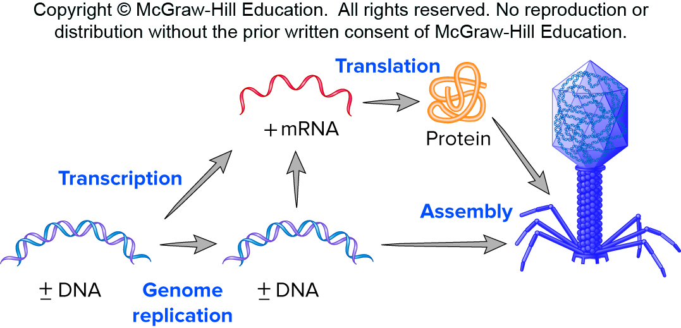
Double-Stranded DNA Viruses
Largest group of known viruses.
Most bacteriophages and archaeal viruses.
Important vertebrate viruses.
  Herpesviruses, poxviruses.
Insect viruses.
Many can rely on host’s DNA/RNA polymerases.
Access the text alternative for these images

Slide 4
Eukaryotic Viruses—Herpesviruses
Herpes simplex virus I and II—cold sores and genital herpes, respectively.
Varicella zoster virus—chickenpox, shingles.
Epstein–Barr virus—infectious mononucleosis, some cancers.
Cytomegalovirus.
HHV 6 and HHV 7—infect children.
HHV 8—Kaposi’s sarcoma in AIDS patients.

Slide 5
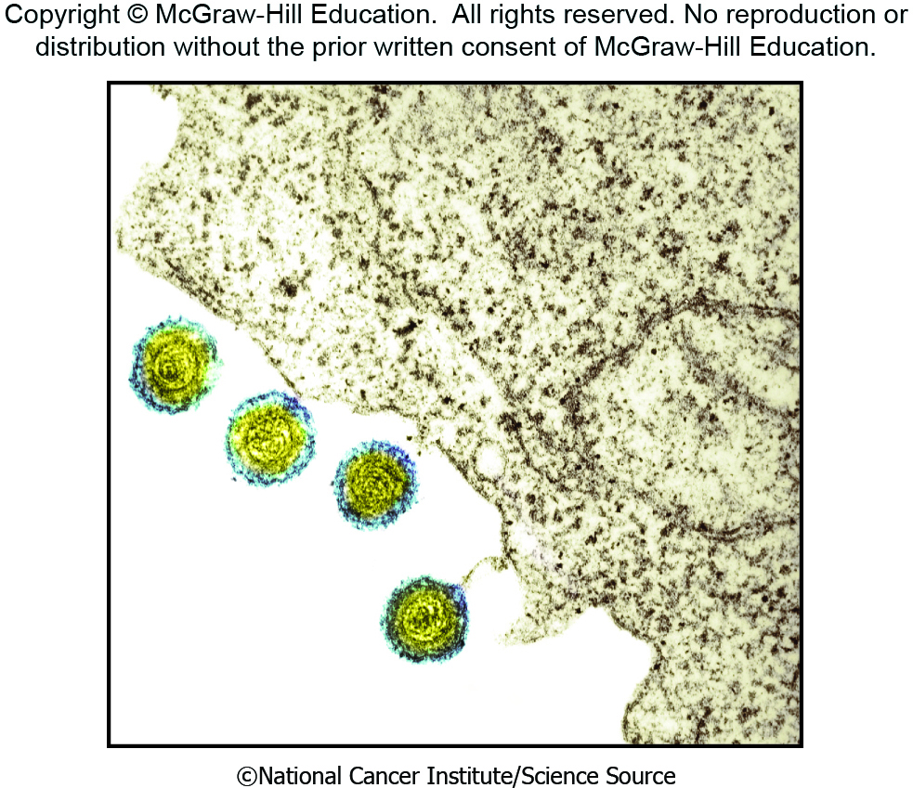
Herpesvirus Virions
Icosahedral, 150 to 200 nm, pleomorphic, enveloped, surface spikes.
Envelope surrounds tegument (layer of proteins) which surrounds nucleocapsid.
Linear genomes encode 70 to over 200 proteins.
Targets are epithelial or nerve cells.
©National Cancer Institute/Science Source

Slide 6
Herpesvirus Infections
Productive (primary) infections.
  Virus multiplies explosively—50,000 to 200,000 virions produced from each infected cell.
  Cell dies due to degraded DNA.
Latent infections.
  Infectious virus not detected.
  Can be reactivated in host cells.
  Productive infection.
  Viral genome remains in the host cell after reactivation; recurs.

Slide 7
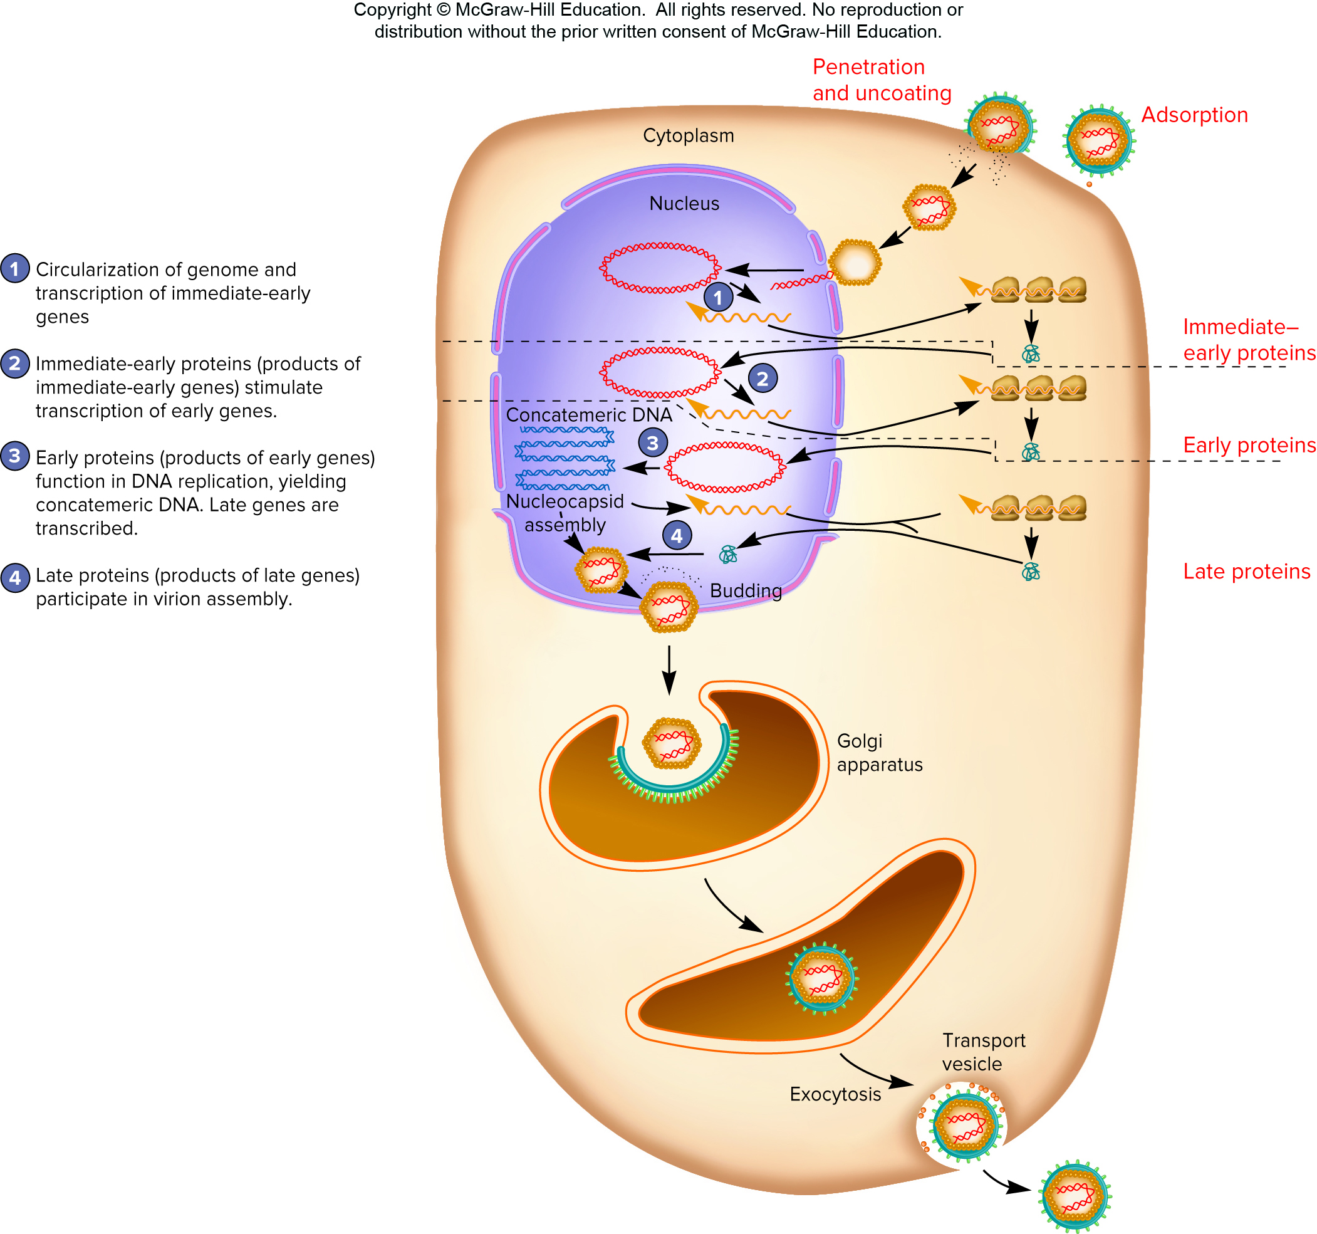
Herpesvirus Productive Infection
Receptor mediated attachment.
Virus envelope fuses with host cell membrane.
Linear dsDNA enters nucleus, circularizes.
  Immediate early and early proteins made—used for viral DNA replication.
  Late gene transcription—viral structural proteins.
Access the text alternative for these images

Slide 8
Herpesvirus Productive Infection—Assembly and Release
Nucleocapsid assembles and leaves nucleus.
Tegument proteins associate with nucleocapsid.
Virus envelope is generated by Golgi apparatus or endosomes.
Mature enveloped virion leaves cell.

Slide 9
Herpesvirus Latent Infection
In epithelial cells:
  Viral protein 16 (VP16) and host cell factor 1 (HCF-1) enter nucleus with the viral genome.
  Both required for full expression of immediate early genes and lytic infection.
In neurons, where virus is latent:
  HCF-1 is cytoplasmic.
  Small noncoding RNAs (microRNAs) act to repress the viral lytic cycle.
  Inhibition of early gene expression helps establish latency.
  During reactivation, HCF-1 moves to the nucleus and VP16 is produced.

Slide 10
26.4 Double-Stranded RNA Viruses: RNA-Dependent RNA Polymerase Replicates the Genome and Synthesizes mRNA
Distinguish RNA-dependent RNA polymerases from DNA-dependent RNA polymerases.
Describe what an RNA-dependent RNA polymerase is doing when functioning as a replicase and when functioning as a transcriptase.
Describe in general terms the strategy used by dsRNA viruses to synthesize their nucleic acids and proteins.
Describe the major events in the life cycles of φ6 and rotaviruses, noting, when possible, the specific mechanisms used to accomplish each step.

Slide 11
Rotavirus
Human rotavirus kills >200,000 children worldwide each year.
  Causes severe diarrhea resulting in dehydration.
Virion has wheel-like appearance, nonenveloped, segmented genome, dsRNA, three concentric layers of proteins.
Virus loses outer layer of protein when it enters host cell—double-layered particle (DLP).
  mRNA transcription, translation.
  Proteins form inclusion called viroplasm.
  RNA genome replication occurs here.
  Third layer added in ER.

Slide 12
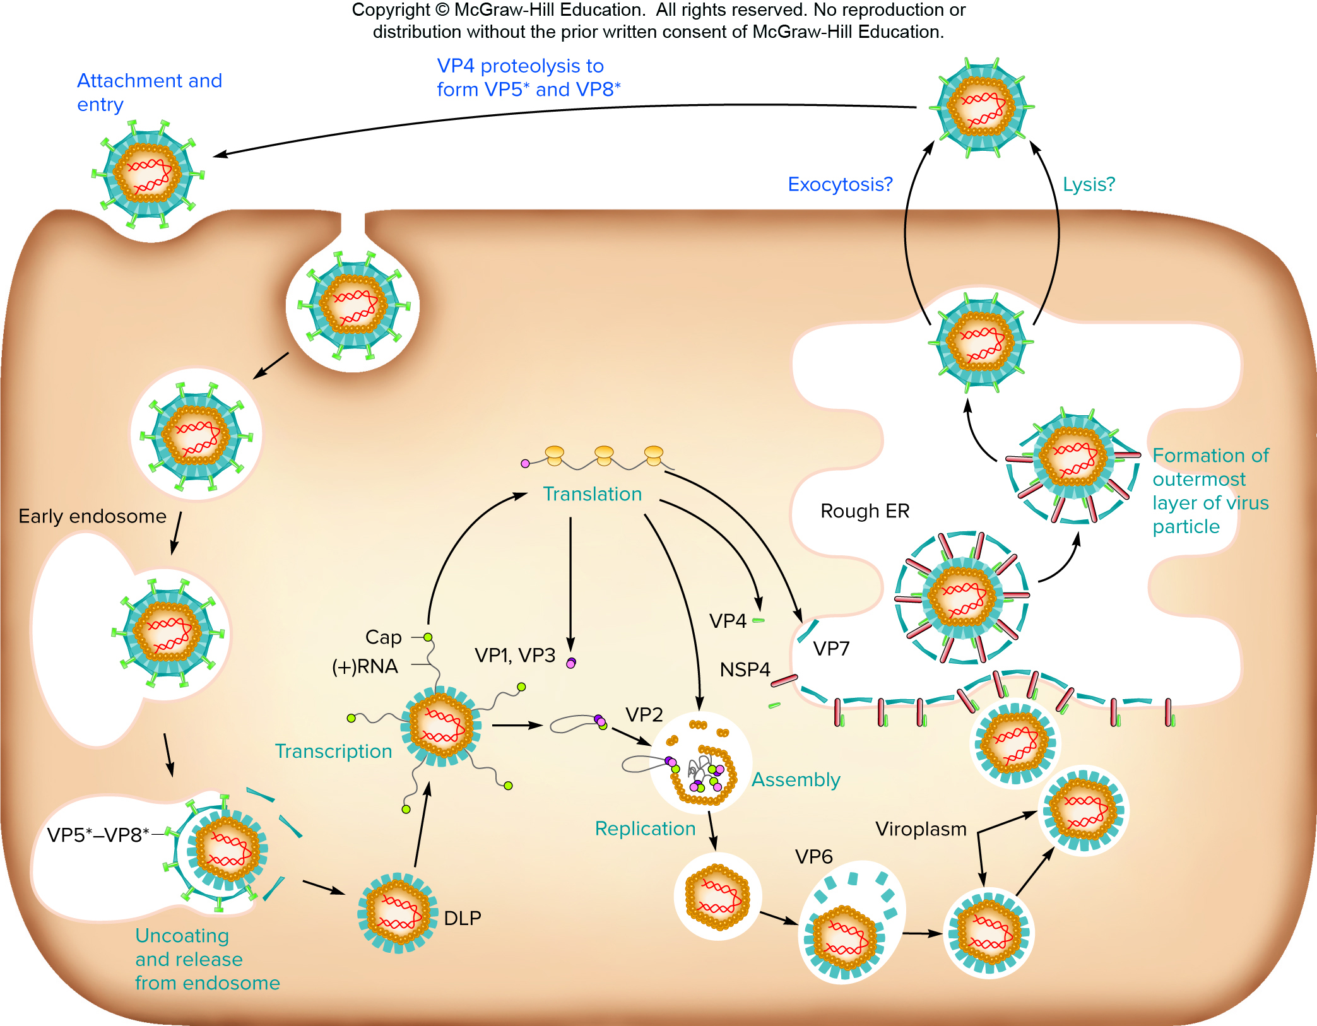
Rotavirus Life Cycle
Access the text alternative for these images

Slide 13
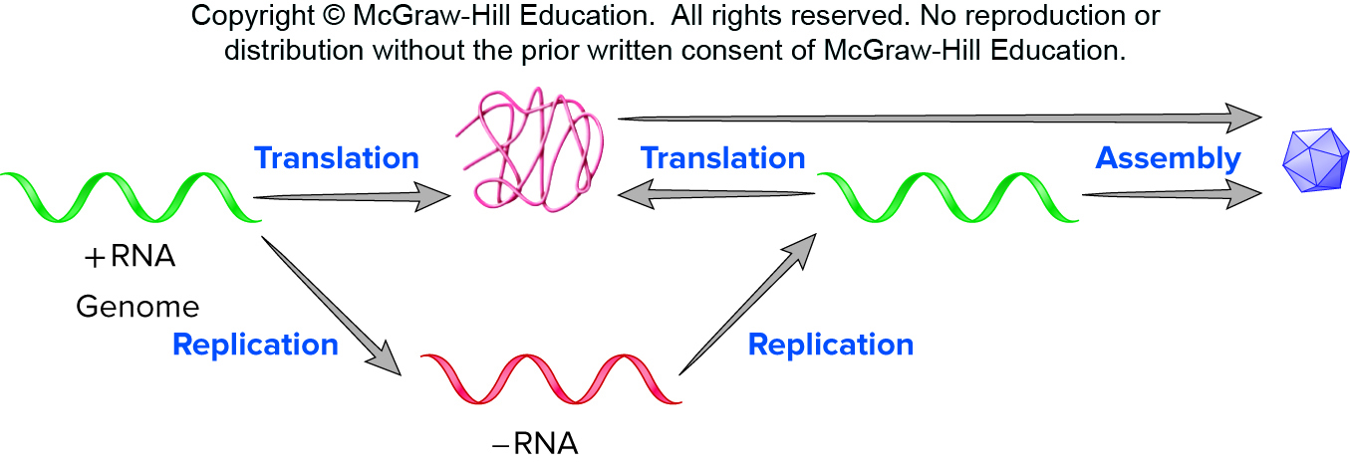
Plus-Strand RNA Viruses
Nonsegmented plus-strand RNA genomes.
Replicate in cytoplasm and synthesize RNA-dependent RNA polymerase.
  Synthesizes negative-strand RNA.
Replication complex for assembly.
  Derived from different cell organelles.
Access the text alternative for these images

Slide 14
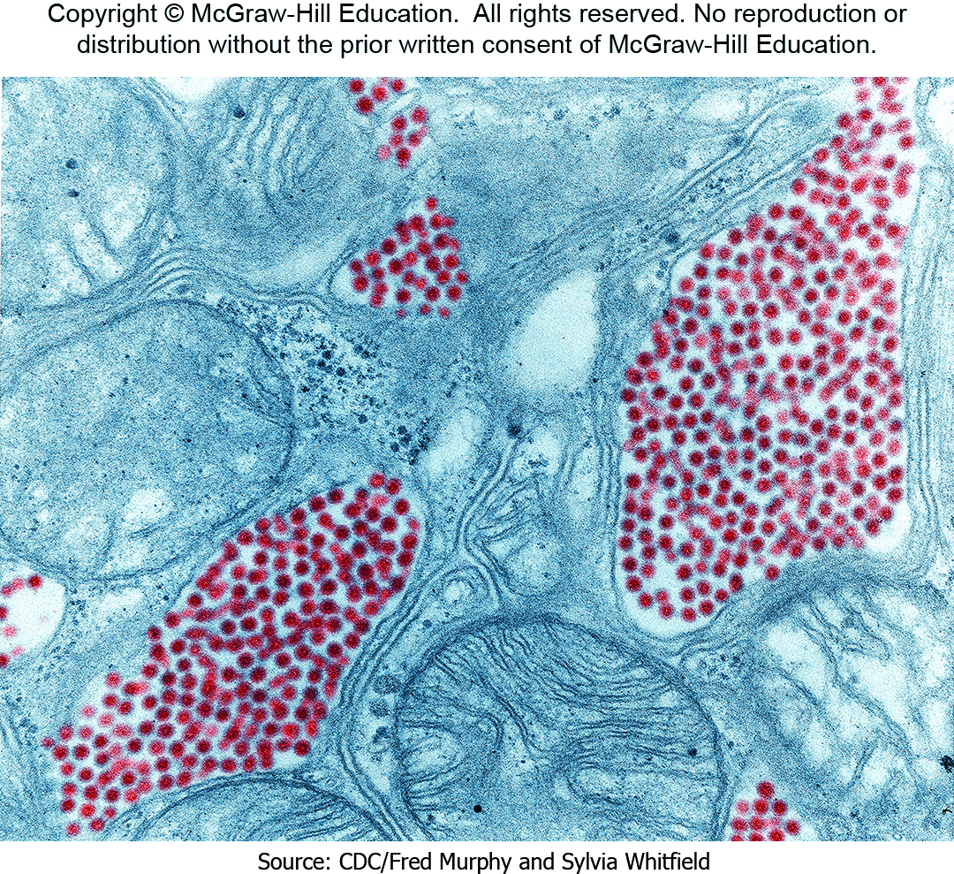
Medically Important Positive-Strand Animal Viruses
Poliovirus.
Zika virus.
Eastern equine encephalitis virus.
Hepatitis A virus.
Source: CDC/Fred Murphy and Sylvia Whitfield

Slide 15
Poliovirus Life Cycle
Causative agent of poliomyelitis.
  Transmitted by ingestion.
  May cripple and paralyze.
  Vaccine is eradicating the disease.
Virion.
  Nonenveloped.

Slide 16
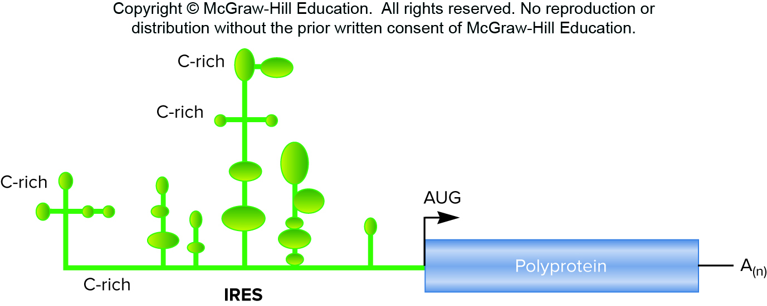
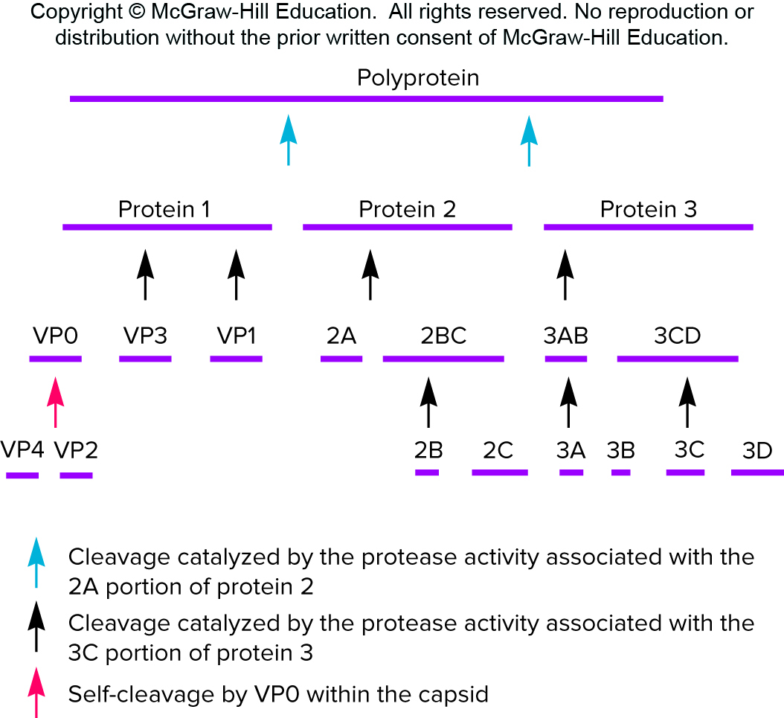
Poliovirus Genome
Attaches to CD155, found
on certain white blood cells and neurons of the CNS.
Viral genome acts as mRNA.
  Virus uses internal ribosome entry site (IRES) instead of 5′ cap.
  Polyprotein translated, cleaves itself into small proteins.
  Genomic RNA synthesized.
  Assembly, lysis.
Access the text alternative for these images

Slide 17
Minus-Strand RNA Viruses
Enveloped virions.
Vary in morphology from spherical, to filamentous, rod-shaped, bullet-shaped, and pleomorphic.
Segmented and nonsegmented genomes.
Minus-sense RNA virus families and examples:
  Rhabdoviridae—rabies virus.
  Filoviridae—Ebola virus.
  Paramyxoviridae—measles and mumps virus.
  Orthomyxoviridae—influenza virus.

Slide 18
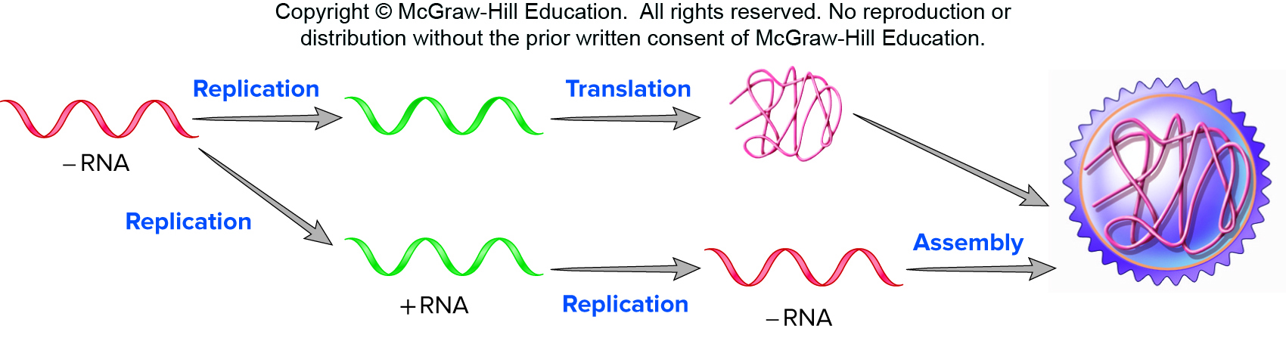
Negative-Strand Viruses
Cannot serve as mRNA to form viral proteins.
Must bring into cell preformed RNA-dependent RNA polymerase.
  New plus-strand intermediates are synthesized.
  The newly synthesized plus-strand serves as template for genome synthesis and mRNA as well.
Access the text alternative for these images

Slide 19
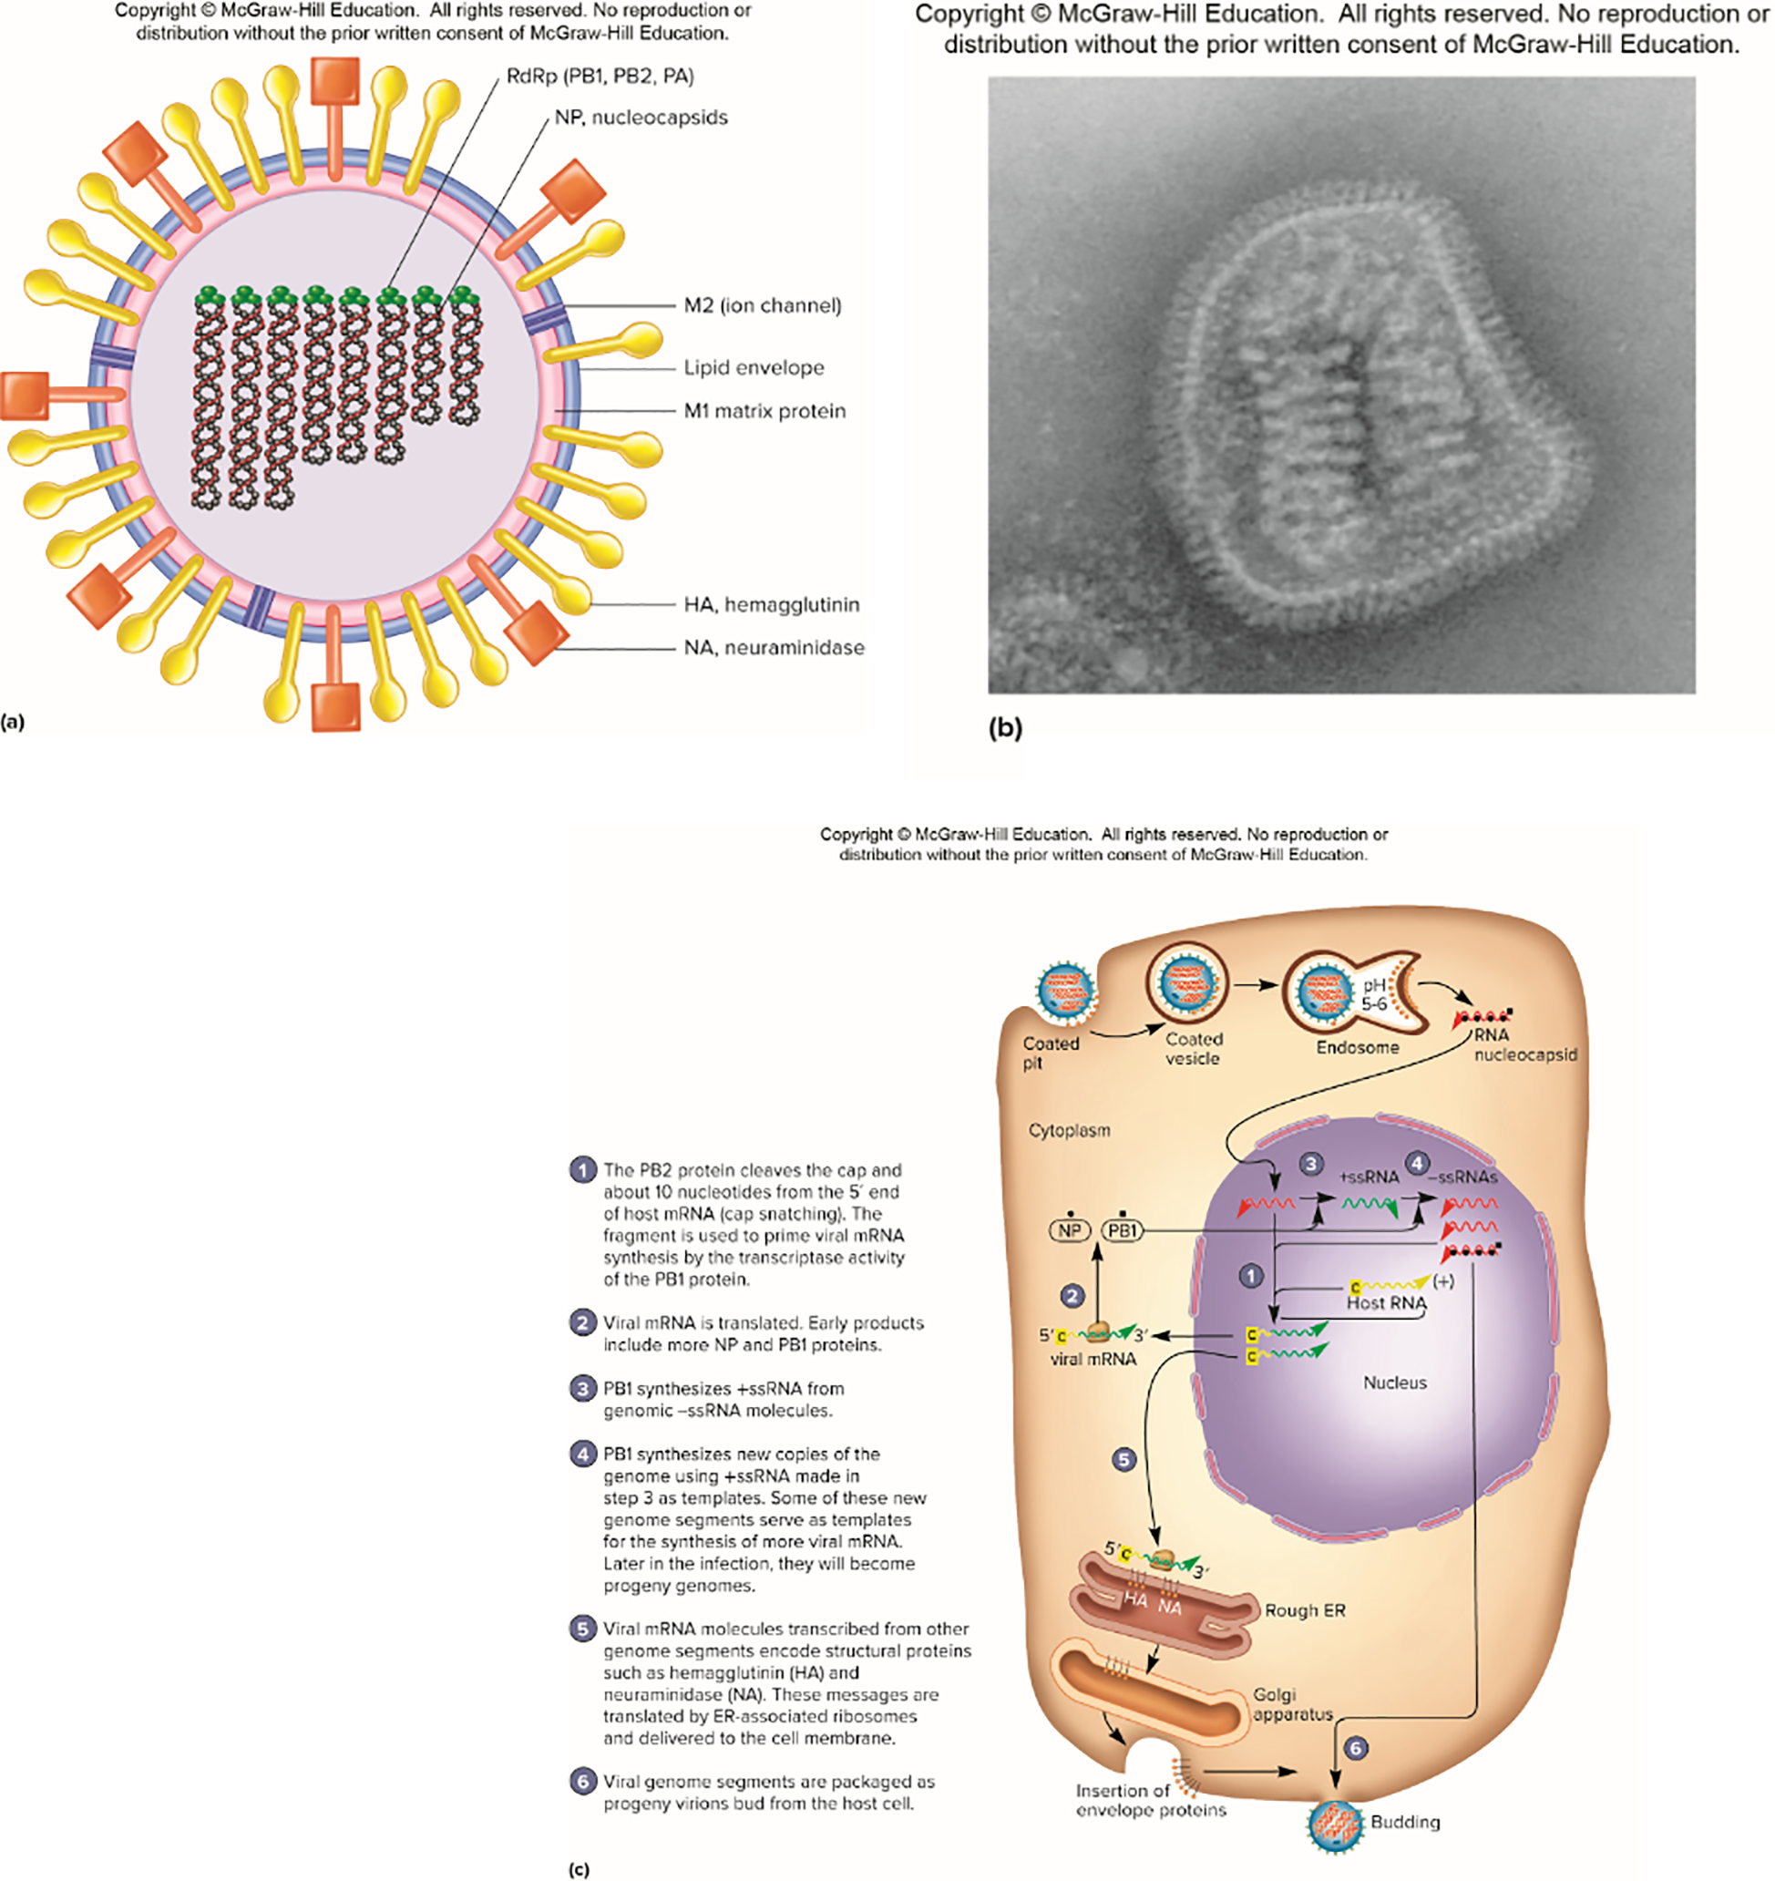
Influenza Virus Life Cycle
Access the text alternative for these images
(b) Source: CDC/Fred Murphy, Cynthia Goldsmith, Dr. Erskine L. Palmer and Dr. M.L. Martin

Slide 20
Influenza Virus
Virion contains seven or eight nucleocapsids.
Enters in endosome.
  Low pH causes conformational change in hemagglutinin protein—hydrophobic ends swing outward, membranes fuse; nucleocapsid released.
Genome template for genome synthesis and mRNA synthesis.
Virus buds from host cell acquiring envelope.

Slide 21
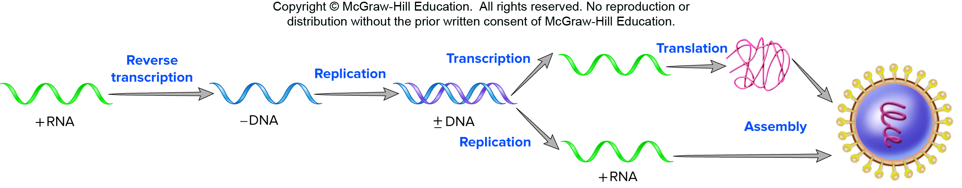
Retroviruses
Convert ssRNA into dsDNA using reverse transcriptase.
dsDNA integrates into host cell genome and serves as template for mRNA synthesis and genome synthesis.
Access the text alternative for these images

Slide 22
Retroviruses—HIV
Human immunodeficiency virus (HIV).
  Cause of acquired immunodeficiency syndrome (AIDS).
  Globally important pandemic.
Member of genus Lentivirus.
  HIV-1 (most common cause of AIDS in US), HIV-2 (common in developing nations).
HIV-1—enveloped virus.
  Two copies of RNA genome.
  Reverse transcriptase and integrase.

Slide 23
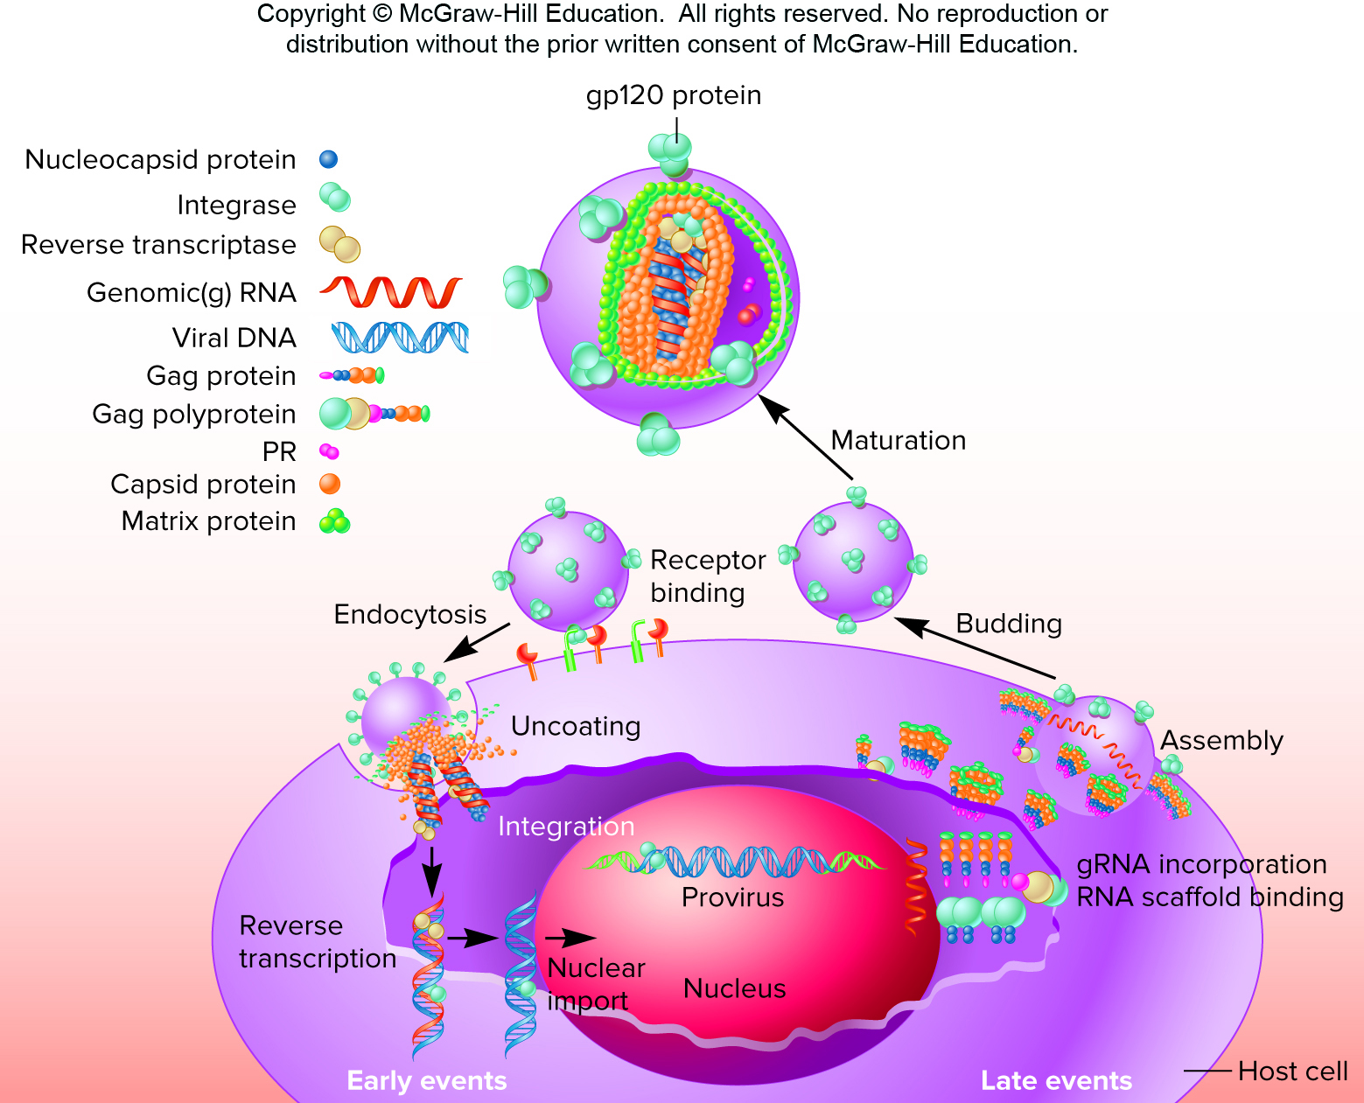
HIV Life Cycle
Access the text alternative for these images

Slide 24
HIV—Initial Infection
gp120 binds CD4⁺ T cells, macrophages, dendritic cells, and monocytes.
  Coreceptor (which can vary) also required to gain entry into cell.
  Virus may enter by viral envelope fusion with the plasma membrane and by endocytosis.
Reverse transcriptase.
  RNA-dependent DNA polymerase.
  DNA-dependent DNA polymerase.
  Ribonuclease.
  Error prone, has no proofreading capability.

Slide 25
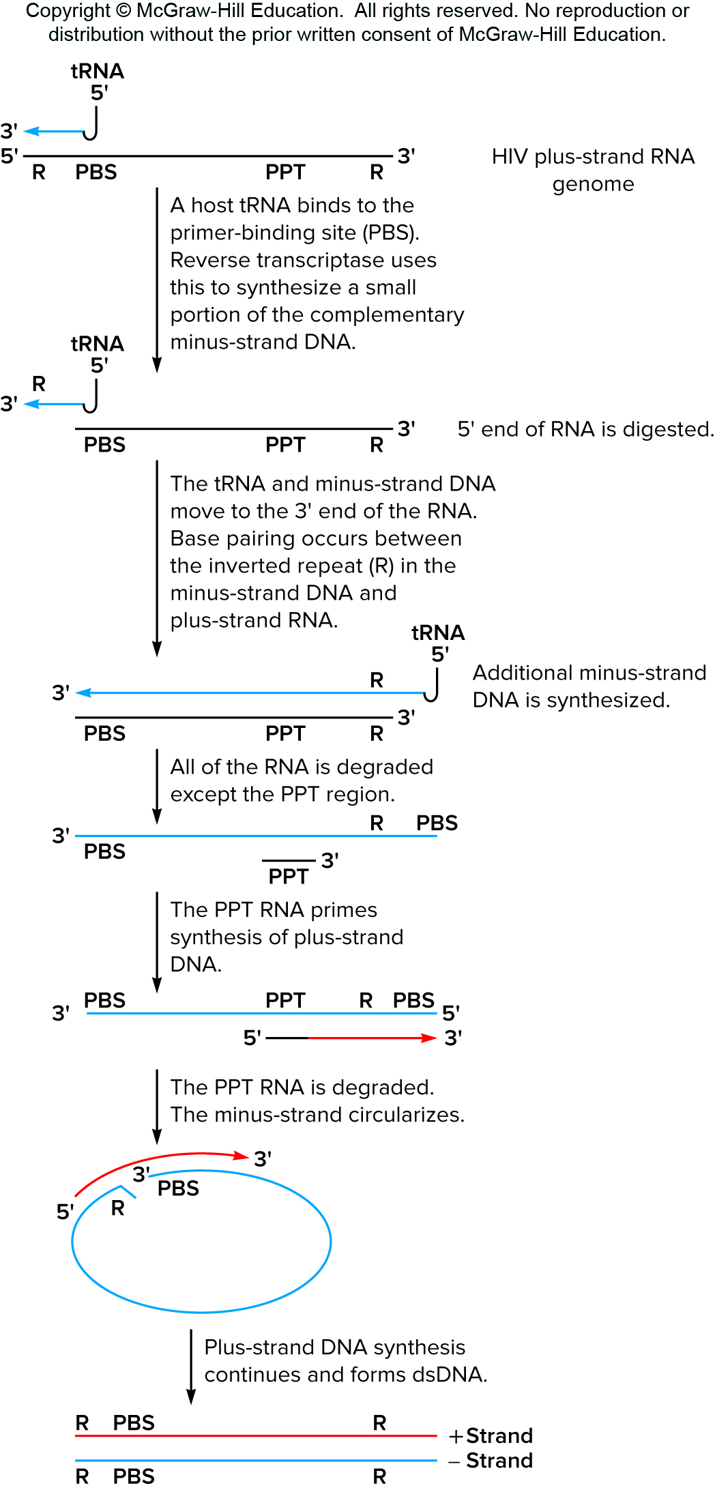
HIV Life Cycle—Middle Steps and Genome Synthesis
Host tRNA molecule is used as a primer.
Small negative-strand DNA molecule is transferred from one end of the RNA template to the other to prime minus-strand synthesis.
Full-length minus-strand circularizes.
dsDNA is formed.
Access the text alternative for these images

Slide 26
HIV Life Cycle—Synthesis, Assembly, Release
dsDNA is moved to the nucleus.
  Integrase and other proteins integrate proviral DNA.
  Forces cell to synthesize viral mRNA.
  Splicing forms 10 viral transcripts.
Cleavage forms viral proteins.
Assembly and budding occurs.
Eventually cell dies.

