Slide 1
35
Pathogenicity and Infection
Copyright © McGraw-Hill Global Education Holdings, LLC. Permission required for reproduction or display.

Slide 2
Pathogenicity and Infectious Disease
Infection
a parasite growing and multiplying within/on a host
may or may not result in overt infectious disease
Pathogen
any parasitic organism causing infectious disease
primary (frank) pathogen – causes disease by direct interaction with healthy host
opportunistic pathogen – may be part of normal flora and causes disease when it has gained access to other tissue sites or host is immunocompromised
Pathogenicity
ability of parasite to cause disease

Slide 3
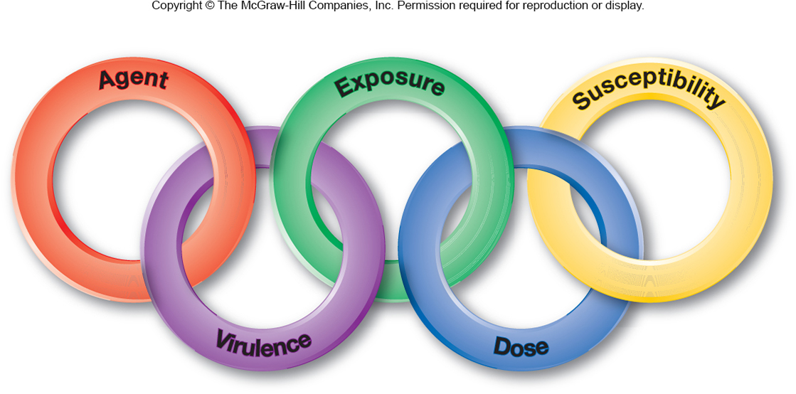
The Chain of Infection
Chain of events for a successful infection
agent identity
virulence of agent
dose of agent
means of exposure to agent
susceptibility of host to agent

Slide 4
Sources of Pathogens
Can be animate (other humans or animals)
infections passed from animal to human are termed zoonoses
many examples of zoonoses exist (see tables on next two slides)
Can be inanimate (water, soil, food)
Reservoir = natural environmental location in which the pathogen normally resides

Slide 5
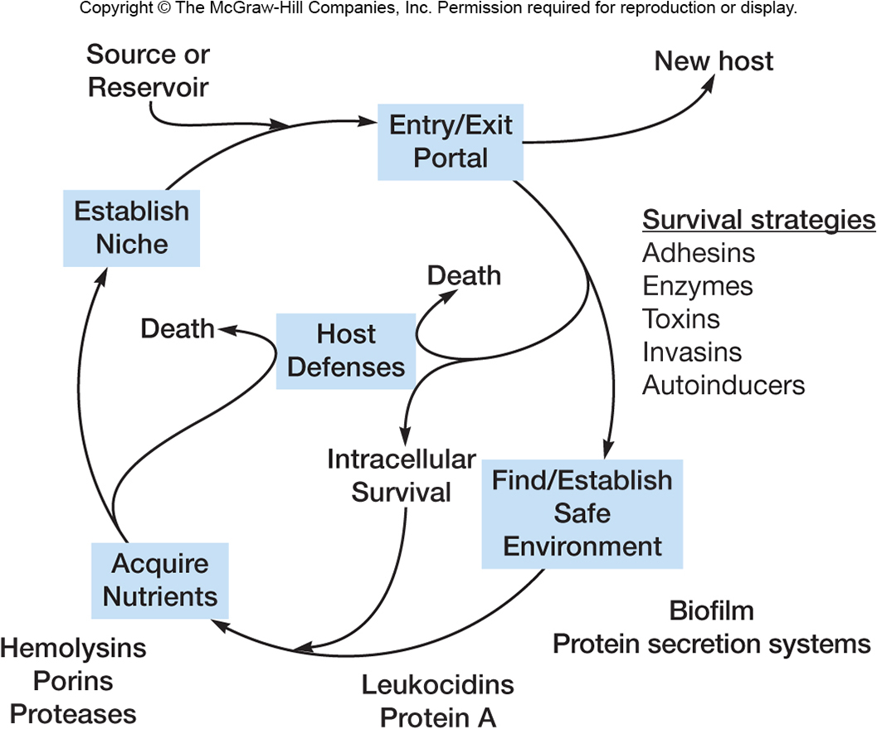
Infectious Process
A pathogen must contact a host AND survive within it to cause a disease. To survive, it needs
a suitable environment
a source of nutrients
in competition with
eukaryotic host cells
Protection from harmful
elements
virulence factors allow
a pathogen to outcompete
host cells and resist their defenses

Slide 6
Toxigenicity
Some microbes possess toxigenicity
ability to produce toxins
Toxin
specific substance that damages host
Intoxications
diseases that result from entry of a specific preformed toxin into host
Toxemia
condition caused by toxins in the blood of host

Slide 7
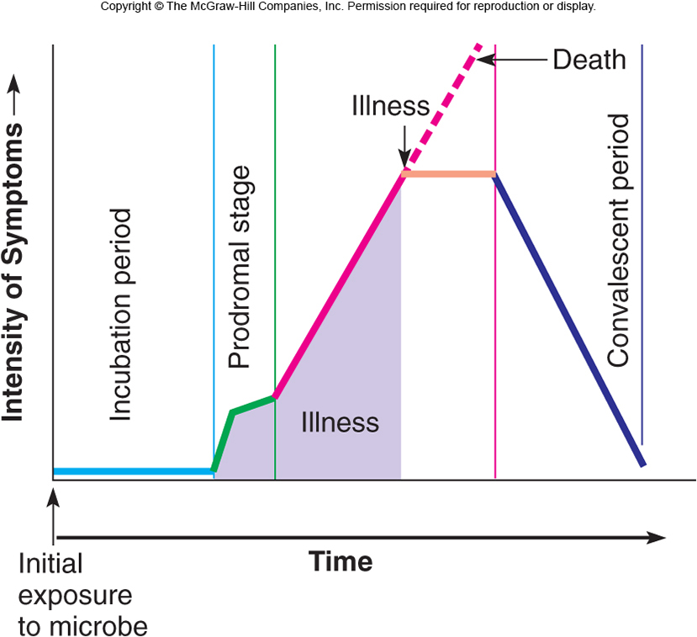
Course of Infectious Disease
incubation period
period after patho-
gen entry, before
signs and symptoms
prodromal stage
onset of signs and
symptoms
not clear enough for diagnosis
period of illness
disease is most severe, signs and symptoms
convalescence
signs and symptoms begin to disappear

Slide 8
Virulence
Degree or intensity of pathogenicity
Virulence factors
determine the degree to which the pathogen causes damage, invasion, infectivity
Determined in part by pathogen’s ability to survive outside host

Slide 9
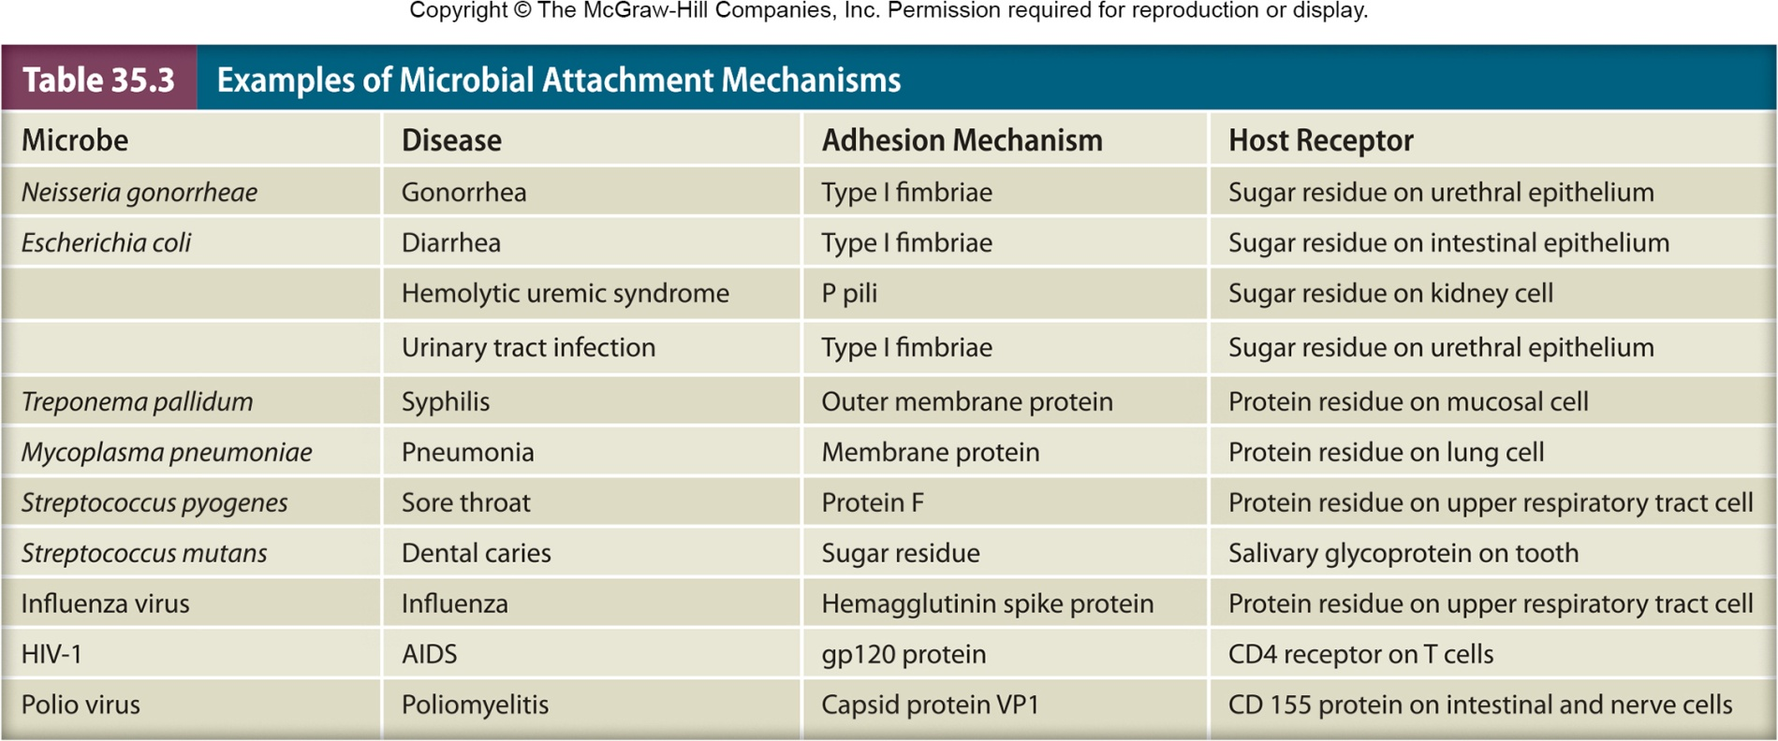
Virulence Factors
Animal model systems may be used to determine role of virulence factor in disease process
Determined by characteristics of the pathogen
adherence and colonization
invasion

Slide 10
Adherence and Colonization
First step in disease is entrance and attachment
Portal of entry
skin, respiratory, gastrointestinal, urogenital systems, or conjunctiva of eye
vector borne, sexual contact, blood transfusion, or organ transplant
Adherence
mediated by special molecules called adhesins
Colonization
a site of microbial reproduction on or within host
does not necessarily result in tissue invasion or damage

Slide 11
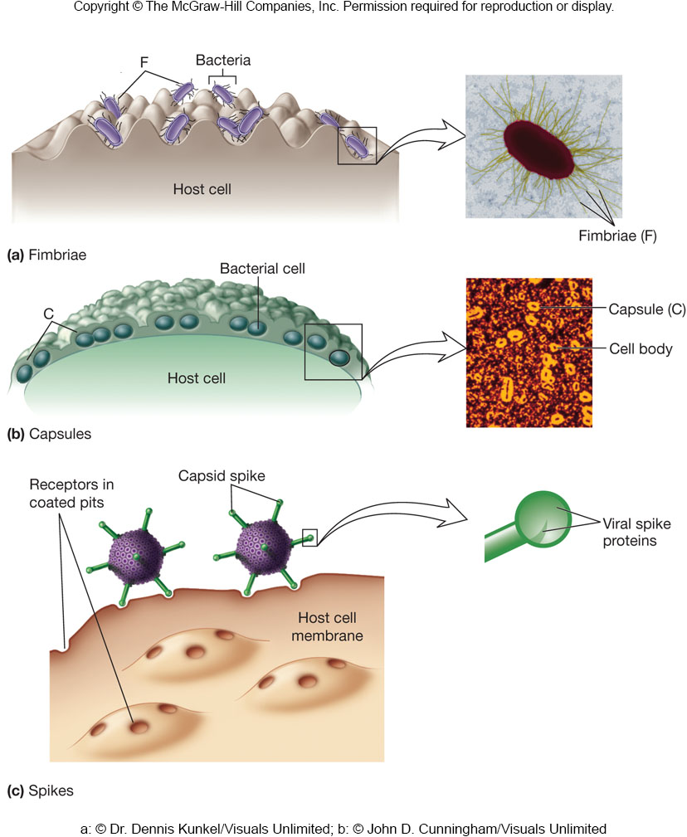
Attachment and Colonization
Adherence structures
pili, fimbriae (adhesion molecules on bacterium’s cell surface) bind complementary receptor sites on host cell surface
Colonization
a site of microbial reproduction on/in host
does not necessarily result in tissue damage

Slide 12
Invasion
Infectivity - ability to create a discrete point of infection
Invasiveness - ability to spread to adjacent tissues
Penetration can be active or passive
active occurs through lytic substances which
attack the extracellular matrix and basement membranes of integuments and intestinal linings
degrade carbohydrate-protein complexes between cells
disrupt host cell surface
passive (e.g., skin lesions, insect bites, wounds)
spread to deeper tissues involves production of specific products and/or enzymes that promote spreading

Slide 13
Invasion
Once in circulatory system, bacteria have access to all organs and systems
bacteremia – presence of viable bacteria in the blood
septicemia –pathogens or their toxins in the blood
varies among pathogens
e.g., Clostridium tetani (tetanus) produces a number of virulence factors but is non-invasive
e.g., Bacillus anthracis (anthrax) and Yersinia pestis (plague) also produce many virulence factors and are highly invasive
e.g., Streptococcus spp. span the spectrum of virulence factors and invasiveness

Slide 14
Exotoxins
Soluble, heat-labile, proteins
Secreted into surroundings as pathogen grows
Most exotoxin producers are Gram-negative
Often travel from site of infection to other tissues or cells where they exert their effects
Usually synthesized by specific bacteria that have toxin genes in their plasmids or prophage DNA
Among the most lethal substances known
Are highly immunogenic
Stimulate production of neutralizing Ab (antitoxins)
Chemically inactivated to form immunogenic toxoids
e.g., tetanus toxoid

Slide 15
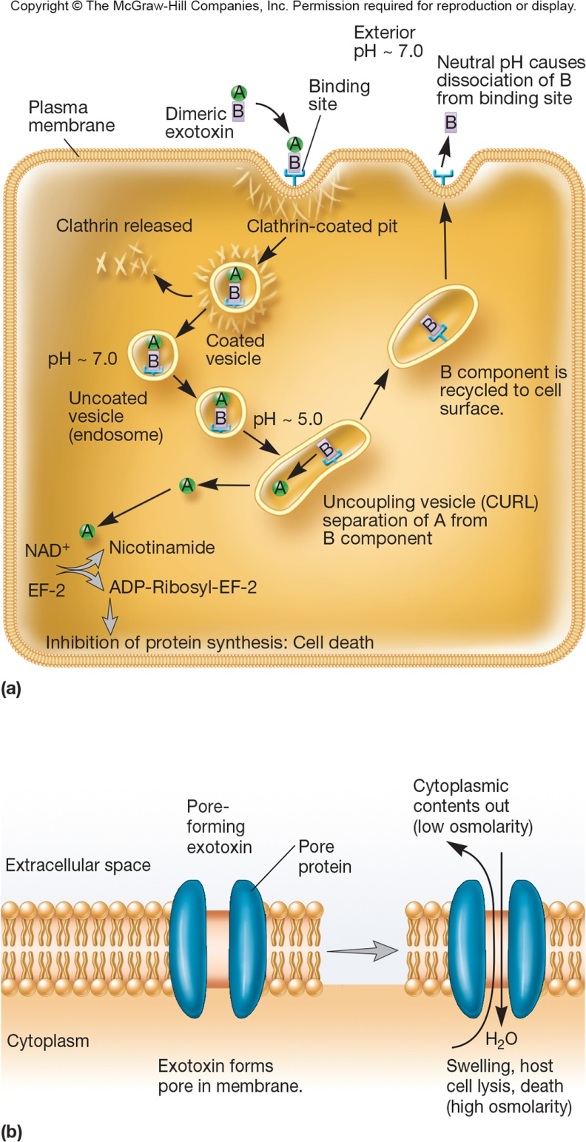
Types of Exotoxins
AB exotoxins
composed of two subunits
A subunit – responsible for toxic effect
B subunit – binds to specific target cell
Specific host site exotoxins
Membrane-disrupting exotoxins
Superantigens

Slide 16
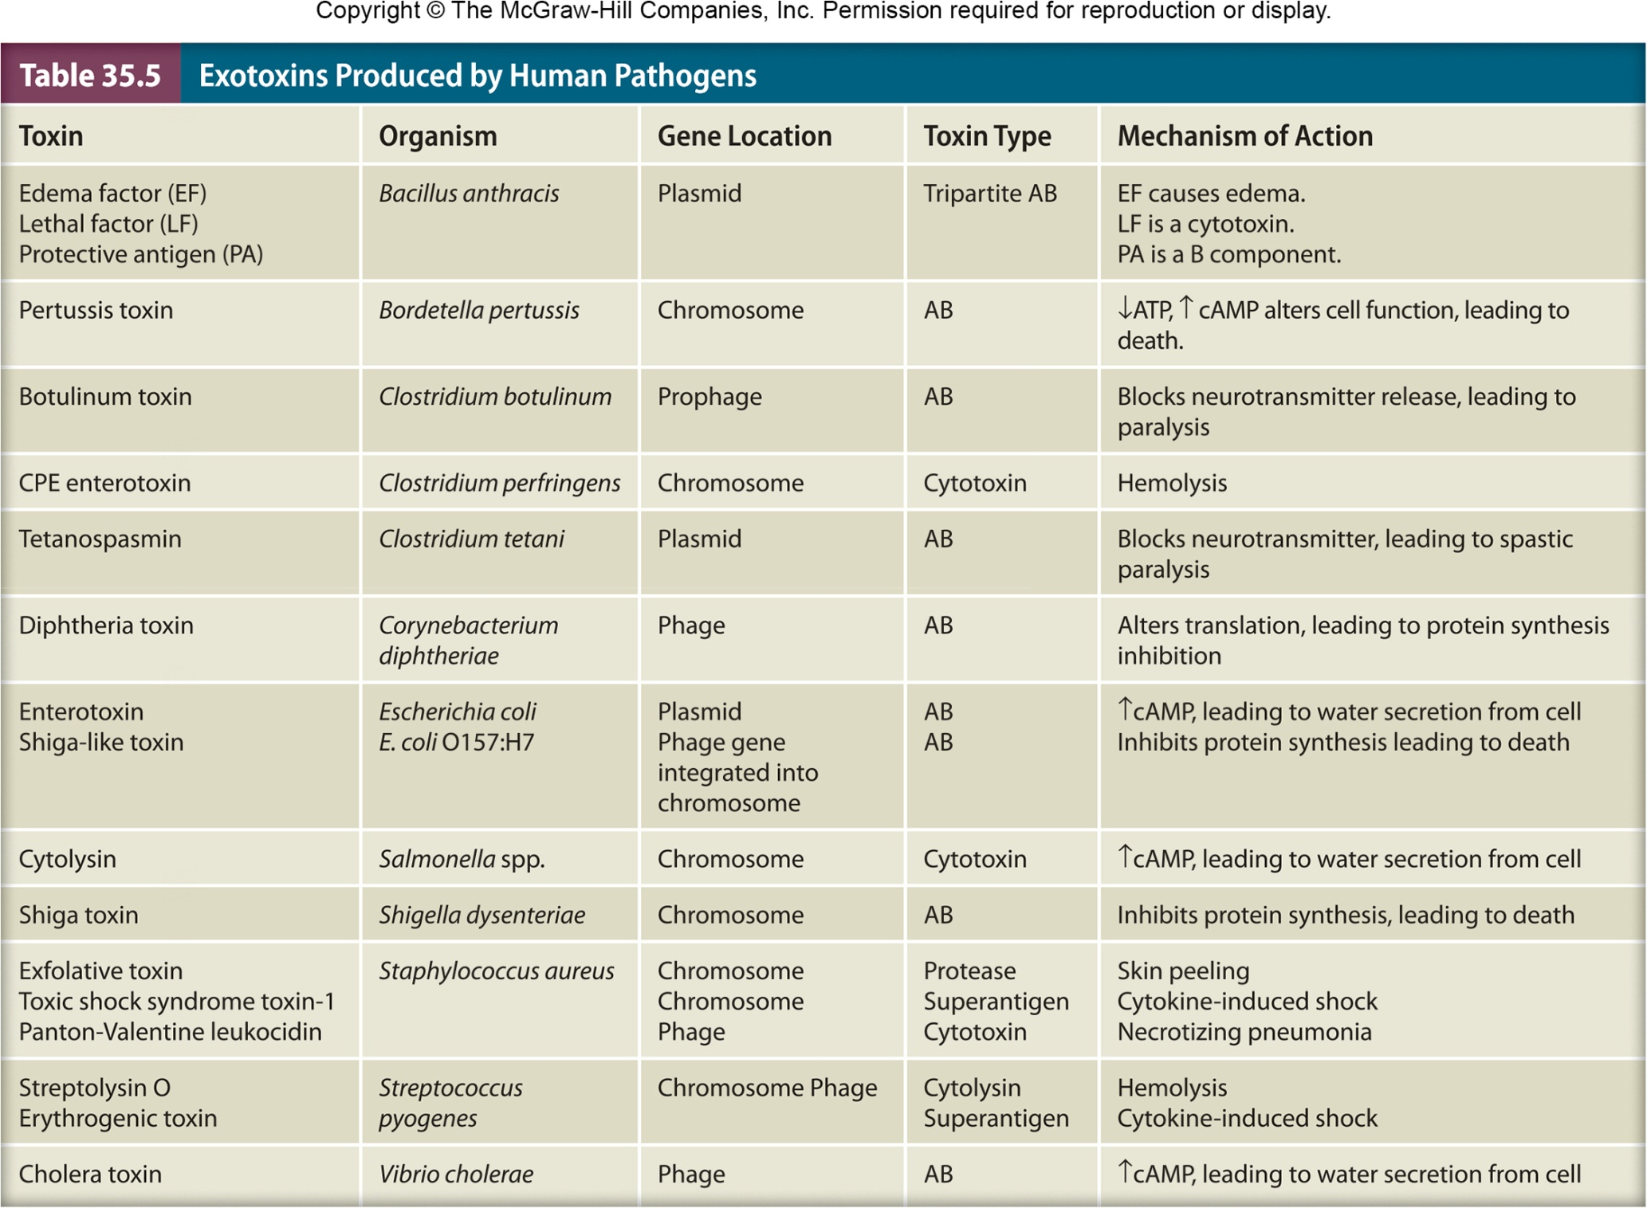

Slide 17
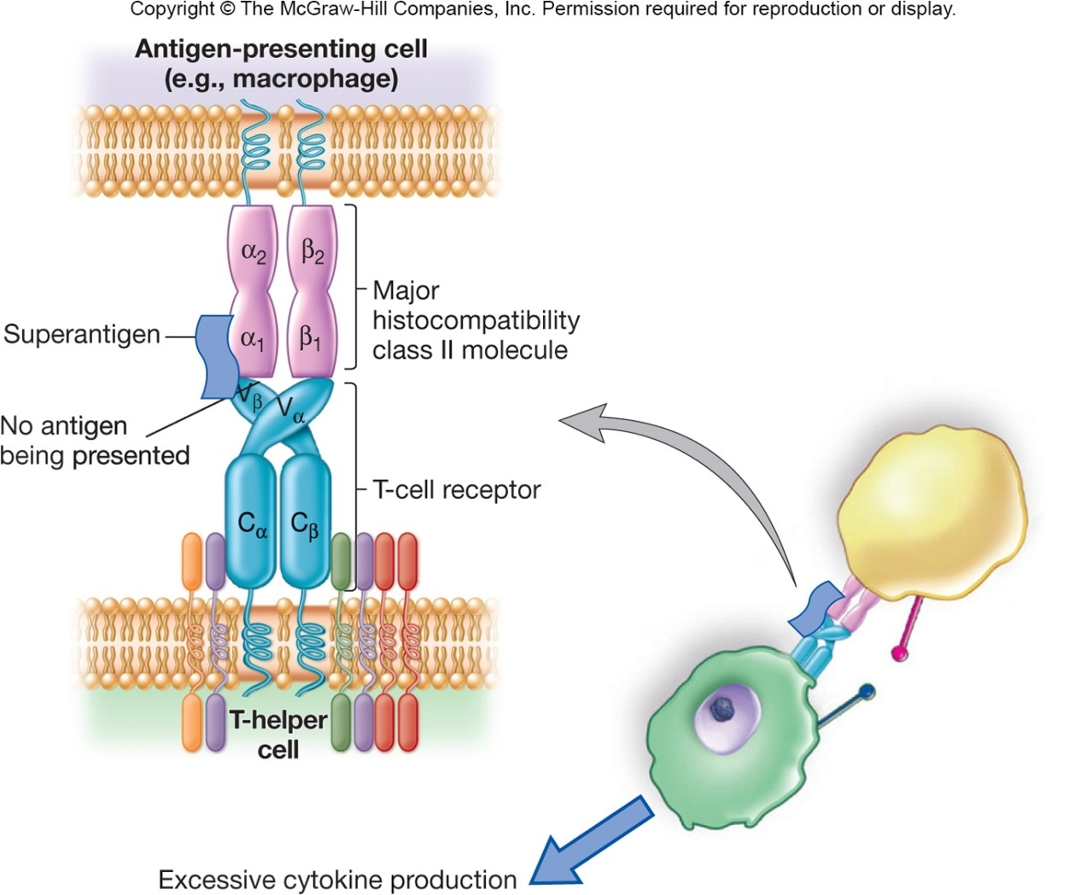
Superantigens
Stimulate ~30% of T cells of the immune system
causes the T cells to overexpress and release cytokines
results in failure of multiple host organs allowing time for the microbe to disseminate
Example is staphylococcal enterotoxin B

Slide 18
Endotoxins
Lipopolysaccharide (LPS) in Gram-negative cell wall can be toxic to specific hosts
called endotoxin because it is an endogenous (part) of the bacterium and released when organism lyses
some is also released during multiplication
toxic component is the lipid portion, lipid A

Slide 19
Endotoxins
Heat stable
Toxic (nanogram amounts)
Weakly immunogenic
Generally similar, despite source
Cause general system effects
fever, weakness, diarrhea, inflammation, intestinal hemorrhage, and fibrinolysis, the enzymatic breakdown of fibrin, the major protein component of blood clots

Slide 20
Endotoxins
Bring about these effects indirectly
endotoxin interacts with host molecules and cells, activating host systems
coagulation, complement, fibrinolytic, and kininogen system
e.g., interaction with macrophages → release of endogenous pyrogen (induces fever)
e.g., binding to LPS-binding protein → release of cytokines
tumor necrosis and others lead to septic shock

Slide 21
Mycotoxins
Secondary metabolites of fungi
common contaminants of food crops
Aspergillus flavus and A. parasiticus produce carcinogenic aflatoxin
Stachybotrys produce tissue-damaging satratoxins
Claviceps purpurea (ergot) produce hallucinogen lysergic acid (LSD)

Slide 22
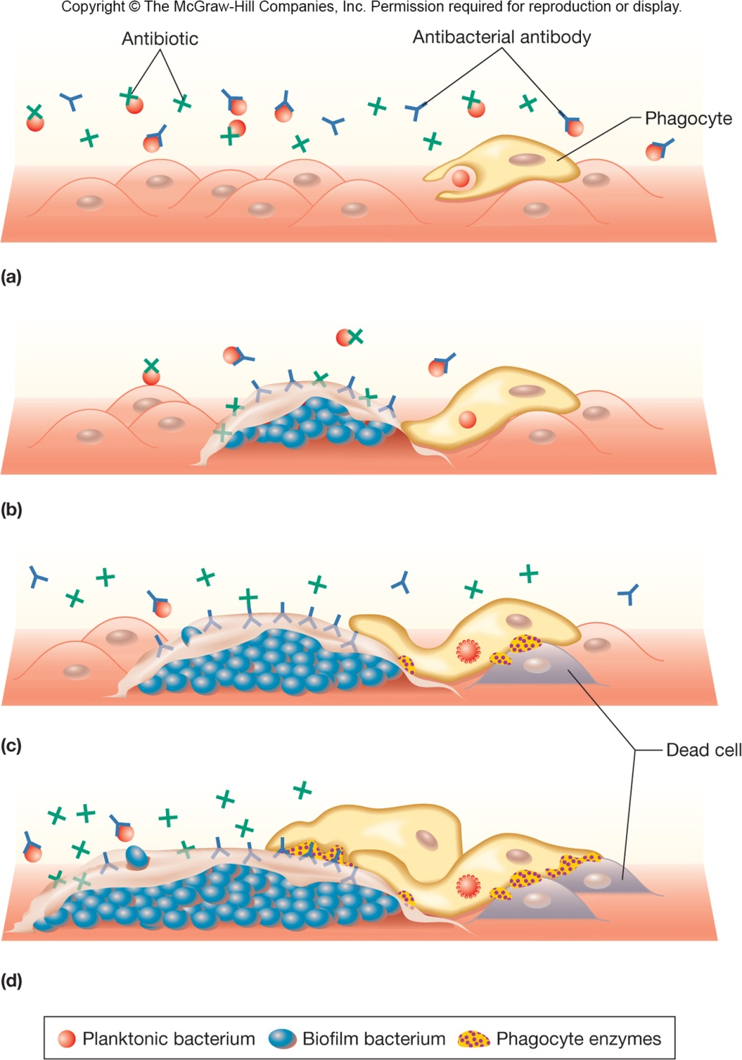
Biofilm Development
Biofilm growth is physiologically different from planktonic growth
may cause chronic infection
increases virulence
become less sensitive to antibiotics
make cells in biofilm more resistant to host defense (“frustrates” phagocytes)

Slide 23
Resisting Host Defenses
Most microbes eliminated before they can cause disease due to immune system
Successful pathogen evades immune system
Numerous mechanisms for both viral and bacterial pathogens

Slide 24
Resisting Host Defenses
Infection of immune system cells, diminishing function
Fuse with adjacent cells to prevent exposure to antimicrobial proteins in host
Capsules prevent phagocytosis
Mutations change antigenic sites or alter expression of antigens
through downregulation or phase variation
Produce substances that resemble host tissue
Produce proteases that degrade host proteins
Special proteins that interfere with host defenses

Slide 25
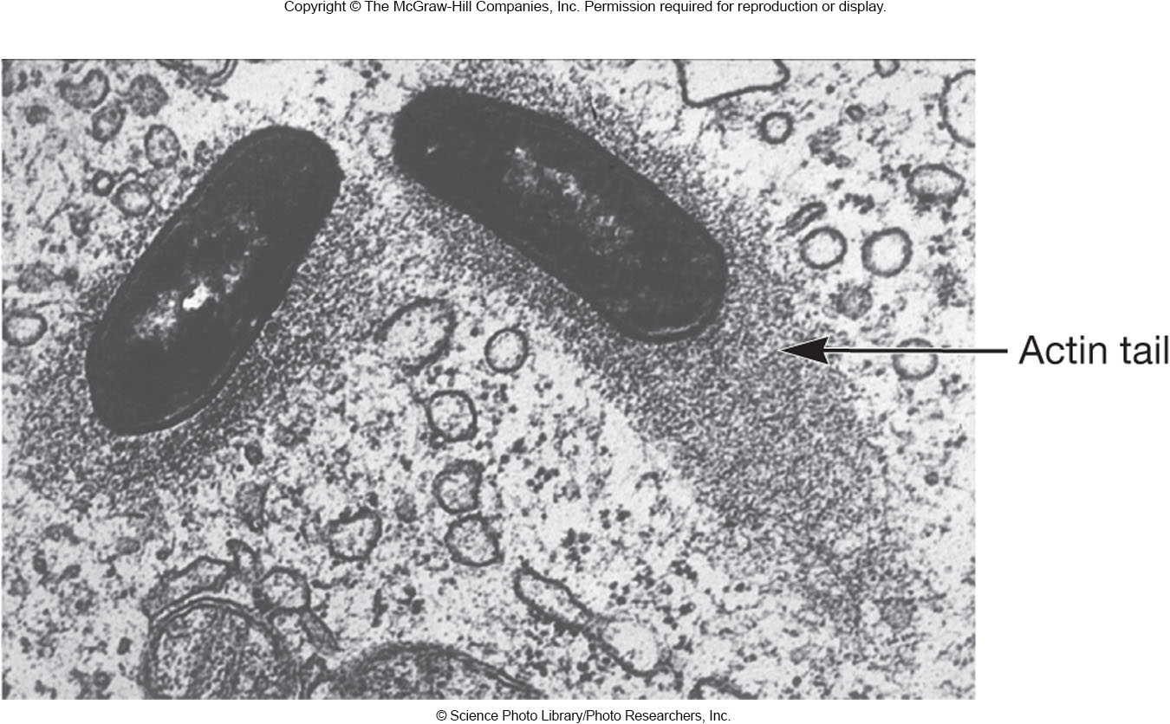
Resisting Host Defenses
Production of decoy proteins to bind available neutralizing antibodies
Lengthened O-chains to prevent host detection or lysis
Some survive inside
host cells
eject themselves from
cell to cell using host
actin

Slide 26
Pathogen Transmission
Initial transmission of pathogen to host
evidence suggests correlation between mode of transmission and degree of virulence
direct contact → less virulent
vector-borne → highly virulent in human host; relatively benign in vector
greater ability to survive outside host → more virulent
Transmission from host to host
Transmission alone not enough for infection to occur
Tropism - pathogen must make contact with appropriate host tissue
determined by specific cell surface receptors

Slide 27
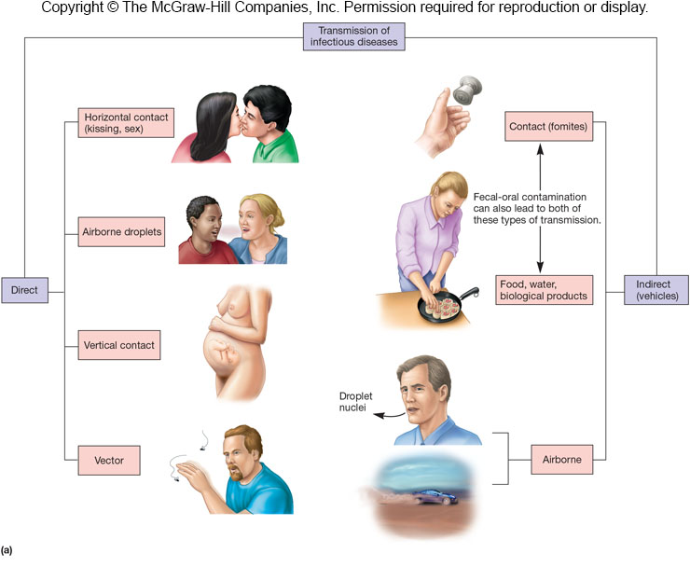

Slide 28
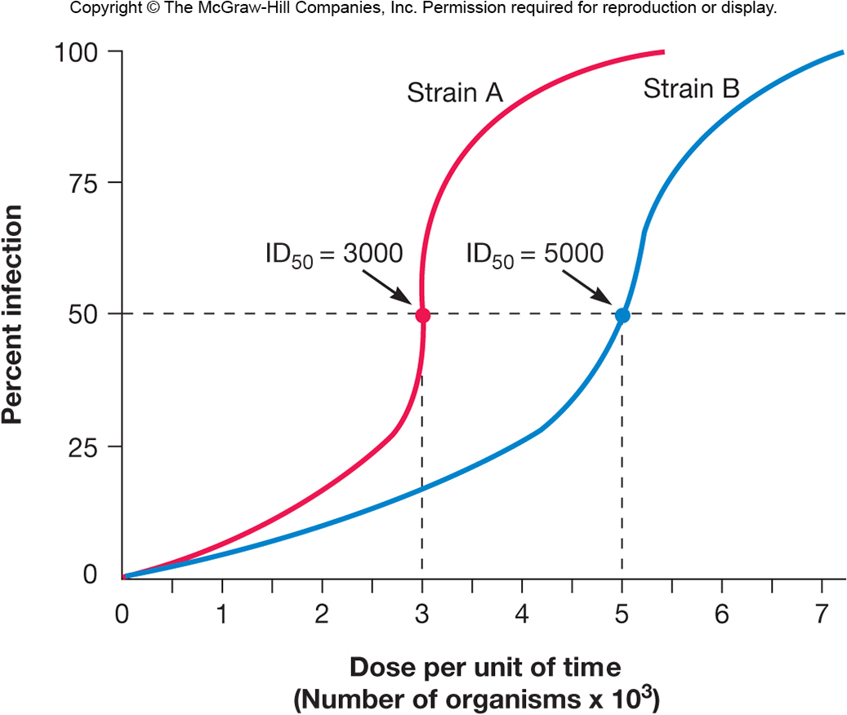
Infectious Dose
Infectious dose 50 (ID₅₀)
number of pathogens that will infect 50% of an experimental group of hosts in a specified time
varies with pathogen
handwashing reduces number of pathogens

Slide 29
Infectious Dose
Lethal dose 50 (LD₅₀)
dose that kills 50% of experimental animals within a specified period
Cytopathology – cellular changes
Can be used to observe cells in tissue culture for death rates rather than entire organisms
Examining virulence factors and their release

Slide 30
Growth Rate
Pathogen must find most favorable conditions in the host
extracellular pathogens
grow outside cells in blood, tissue fluids
intracellular pathogens
grow and multiply within cells
facultative intracellular pathogens
grow within or outside cells
obligate intracellular pathogens
only grow when inside cells

Slide 31
Host Susceptibility
Two main factors
defense mechanisms of host (discussed in Chs. 33 and 34)
pathogenicity of pathogen
Nutrition, genetic predisposition, and stress also play a role in host susceptibility to infection

