Slide 1
Microscopy Lab #1

Slide 2
Microscopy
Microorganisms range in size from the smallest viruses which are measured in nanometers (nm), to the largest protists and bacteria, which can be about 200 micrometers (μm).

Slide 3
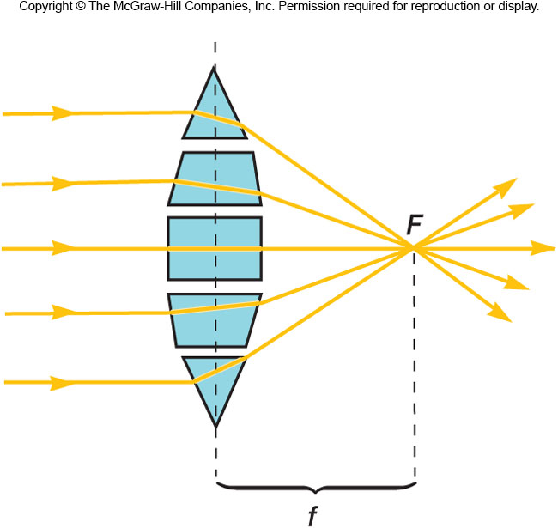
Lenses
Focus light rays at a specific place called the focal point
Distance between center of lens and focal point is the focal length
Strength of lens related to focal length
short focal length ⇒more magnification

Slide 4
The Light Microscope
Many varieties
bright-field microscope
dark-field microscope
phase-contrast microscope
fluorescence microscope
confocal microscope
Compound microscopes
image formed by action of ≥2 lenses

Slide 5
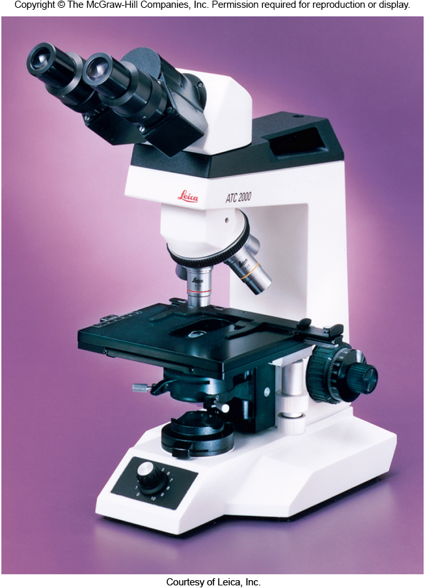
The Bright-Field Microscope
Produces a dark image against a brighter background
Has several objective lenses
parfocal microscopes remain in focus when objectives are changed
Total magnification
product of the magnifications of the ocular lenses and the objective lenses

Slide 6
Microscope Resolution
Ability of a lens to separate or distinguish small objects that are close together
Wavelength of light used is major factor in resolution
shorter wavelength ⇒ greater resolution

Slide 7
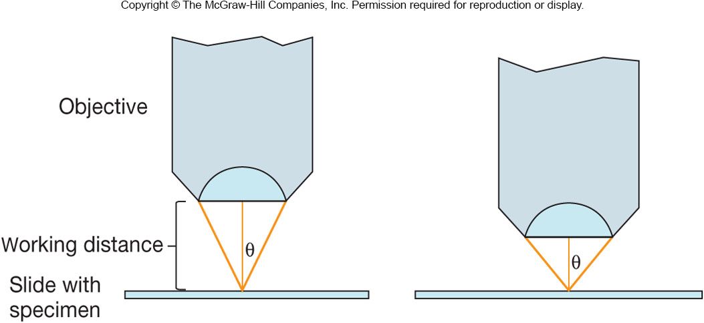
Working distance
distance between the front surface of lens and surface of cover glass or specimen when it is in sharp focus

Slide 9
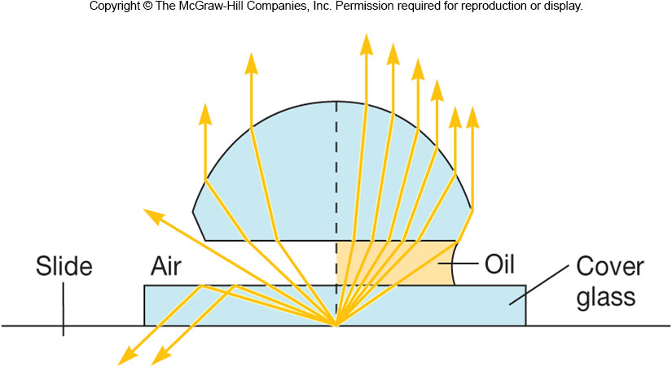
If air is replaced with immersion oil, many light rays that did not enter the objective due to reflection and refraction at the surfaces of the objective lens and slide will now do so. This results in an increase in resolution and numerical aperture.

Slide 10
Electron Microscopy
Electrons replace light as the ‘illuminating’ beam
Wavelength of electron beam is much shorter than light, resulting in much higher resolution
Allows for study of microbial morphology in great detail

Slide 11
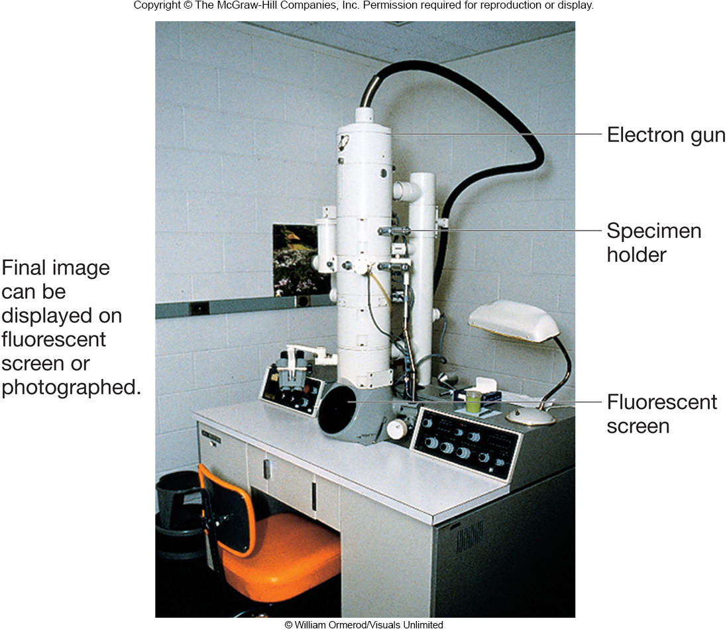
The Transmission Electron Microscope (TEM)
Electrons scatter when they pass through thin sections of a specimen
Transmitted electrons are under vacuum which reduces scatter and are used to produce clear image
Denser regions in specimen scatter more electrons and appear darker

Slide 12
