Slide 1
Laboratory 1: SAFETY RULES and Streaking technique

Slide 2
Good Laboratory Conduct
Follow all instructions
Do not play in the laboratory
Do not use any laboratory equipment until you are told to do so
Do not perform any laboratory procedure until you are told to do so

Slide 3
Good Laboratory Conduct
Do not bring food, beverages or tobacco products into the laboratory
Do not eat or drink in the laboratory

Slide 4
Personal Protection
Tie long hair neatly at the back of the neck
Wear shoes that enclose your entire feet

Slide 5
Emergency Procedures
If a reagent spills onto the workbench or floor, or if a glass container gets broken, notify the instructor immediately for cleanup instructions

Slide 6
Before Beginning Any Laboratory Exercise
Wear a lab coat in the proper manner
Clean the benches with disinfectants
Wash hands thoroughly with 70% Ethanol

Slide 7
Before You Leave The Laboratory
Clean your workbench with disinfectant
Dispose all used glassware and cultures appropriately
Wash your hands with soap and water

Slide 8
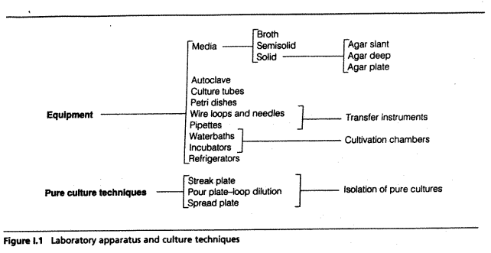
Laboratory apparatus

Slide 9
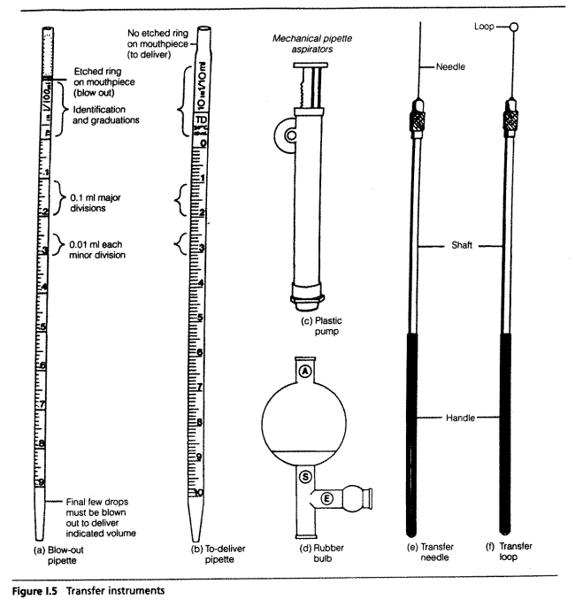

Slide 10
Media
In working with microorganisms we must also have a sterile nutrient-containing-medium in which to grow the organisms.
The media can either be solid (AGAR) or liquid.

Slide 11
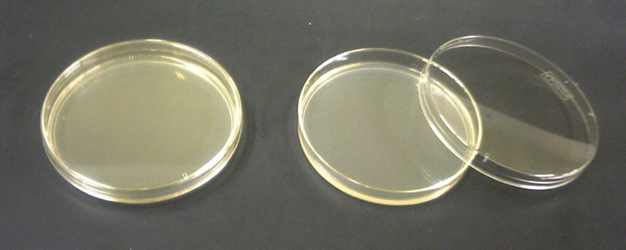
The media can be poured in:
Petri dishes.

Slide 12
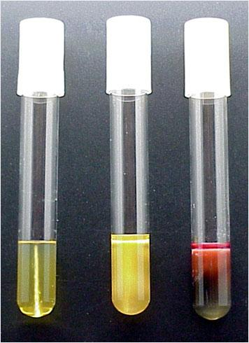
Slant tubes.
Stab tubes.

Slide 13
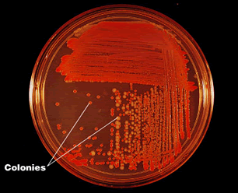
Streaking
Purpose
to check:
whether a culture consists of only one organism ( a "pure culture") or if there are more than one organisms in it (contaminated)
2) whether a culture is viable, i.e. able to grow
3) Describe colony morphology

Slide 14
Aseptic Techniques
Refers to a procedure that is performed under sterile conditions

Slide 15
Flaming

Slide 16
Streaking

Slide 17
Streaking

Slide 18
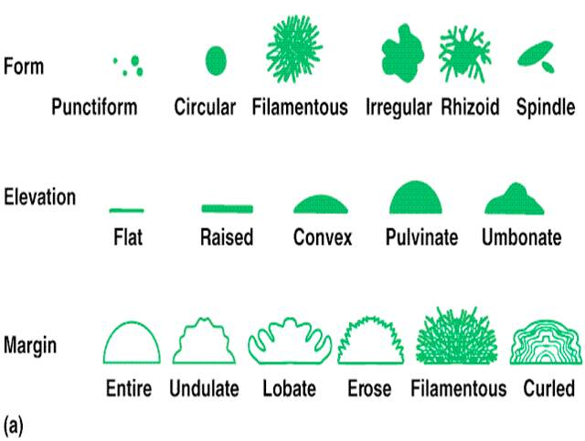
Colony Morphology

Slide 19
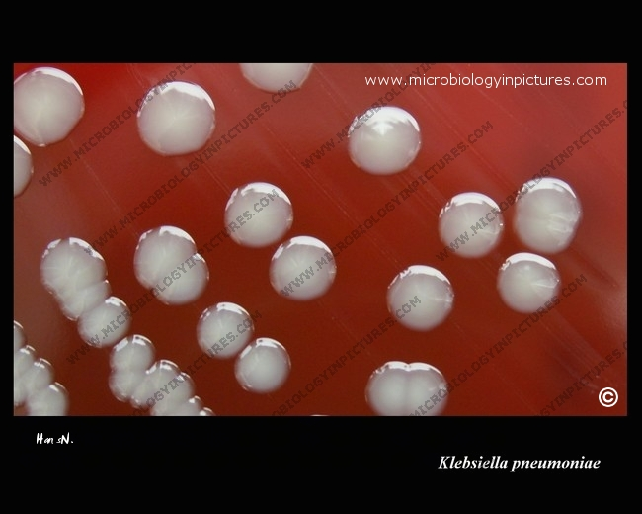

Slide 20
Different types of bacteria in this lab
Staphylococcus aureus
Micrococcus luteus
Staphylococcus epidermidis
Enterococcus faecalis
Escherichia coli
Klebsiella pneumoniae
Proteus mirabilis
Pseudomonas aeruginosa
Bacillus subtilis
S.aureus
M.luteus
S. epidermidis
E.faecalis
E.coli
K.pneumoniae
P.mirabilis
P.aeruginosa
B.subtilis

