Slide 1
Lab #2 Preparation and Staining of Specimens
Recommend a fixation process to use when the microbe is a bacterium
Learn the proper procedure for preparing a bacterial smear
Do simple staining procedure
Understand the biochemistry underlying the Gram stain
Perform a satisfactory Gram stain
Compare what happens to Gram-positive and Gram-negative bacterial cells at each step of the Gram-staining procedure.
Plan a series of appropriate staining procedures to describe an unknown bacterium as fully as possible.

Slide 2
Preparation and Staining of Specimens
Increases visibility of specimen
Accentuates specific morphological features
Preserves specimens

Slide 3
Fixation
Preserves internal and external structures and fixes them in position
Organisms usually killed and firmly attached to microscope slide
heat fixation – routinely used with bacteria and archaea
preserves overall morphology but not internal structures
chemical fixation – used with larger, more delicate organisms
protects fine cellular substructure and morphology

Slide 4
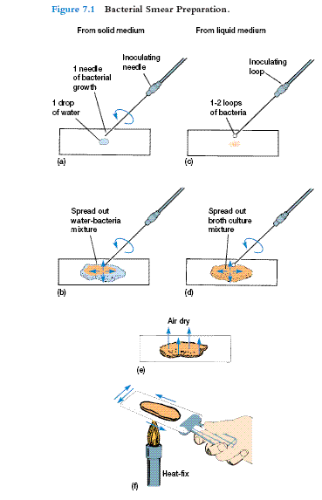
Smear Preparation
First step in Bacterial staining
Kill bacteria
Fix bacteria to slide

Slide 5
Dyes and Simple Staining
Dyes
make internal and external structures of cell more visible by increasing contrast with background
Ionizable dyes have charged groups
basic dyes have positive charges
acidic dyes have negative charges

Slide 6
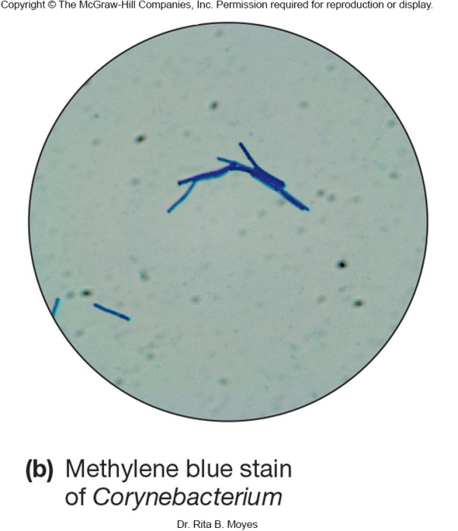
Simple Staining
Simple stains
a single stain is used
use can determine size, shape, and arrangement of bacteria

Slide 7
Simple Staining
1. Perform a bacterial smear.
2. Saturate the smear with basic dye for approximately 1 minute
crystal violet, safranin, or methylene blue
3. Rinse the slide gently with water.
4. Carefully blot dry with towel paper.
5. Observe the slide under the microscope.

Slide 8
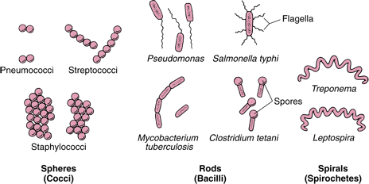

Slide 9
Differential Staining
Divides microorganisms into groups based on their staining properties
e.g., Gram stain. used to differentiate between Gram positive (purple) and Gram negative (pink) bacteria
e.g., Acid fast stain. The stain binds strongly to waxy material present in some bacteria’s cell wall. Used to identify Mycobacteria and Nocardia

Slide 10
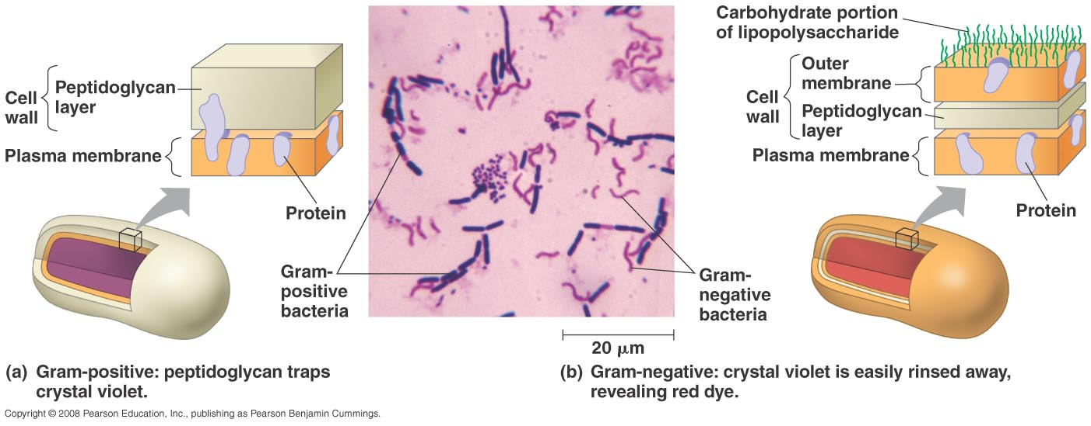

Slide 11
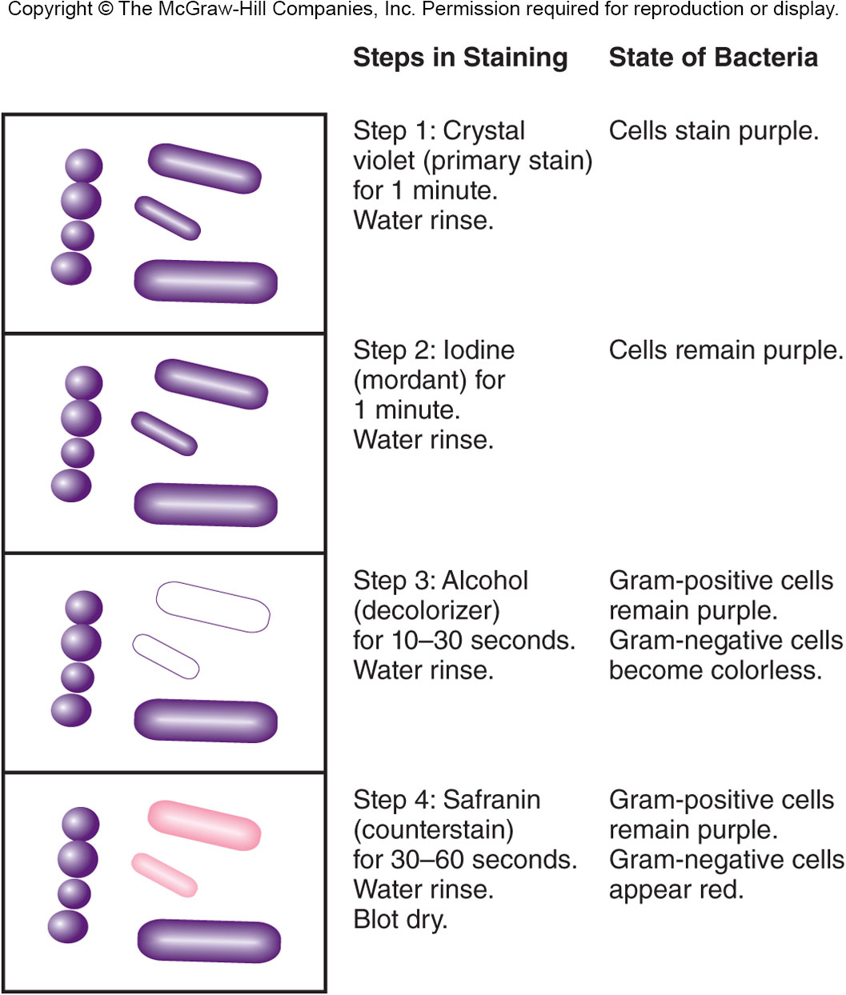
Gram Staining
Most widely used differential staining procedure
Divides bacteria into two groups, Gram-positive and Gram-negative, based on differences in cell wall structure

Slide 12
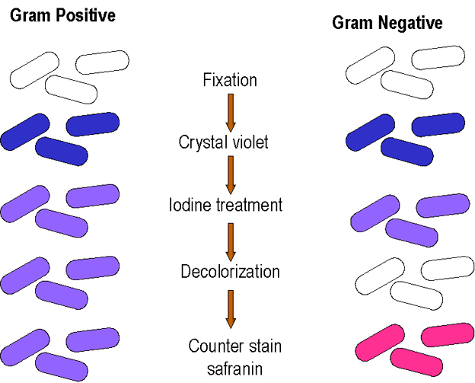

Slide 13
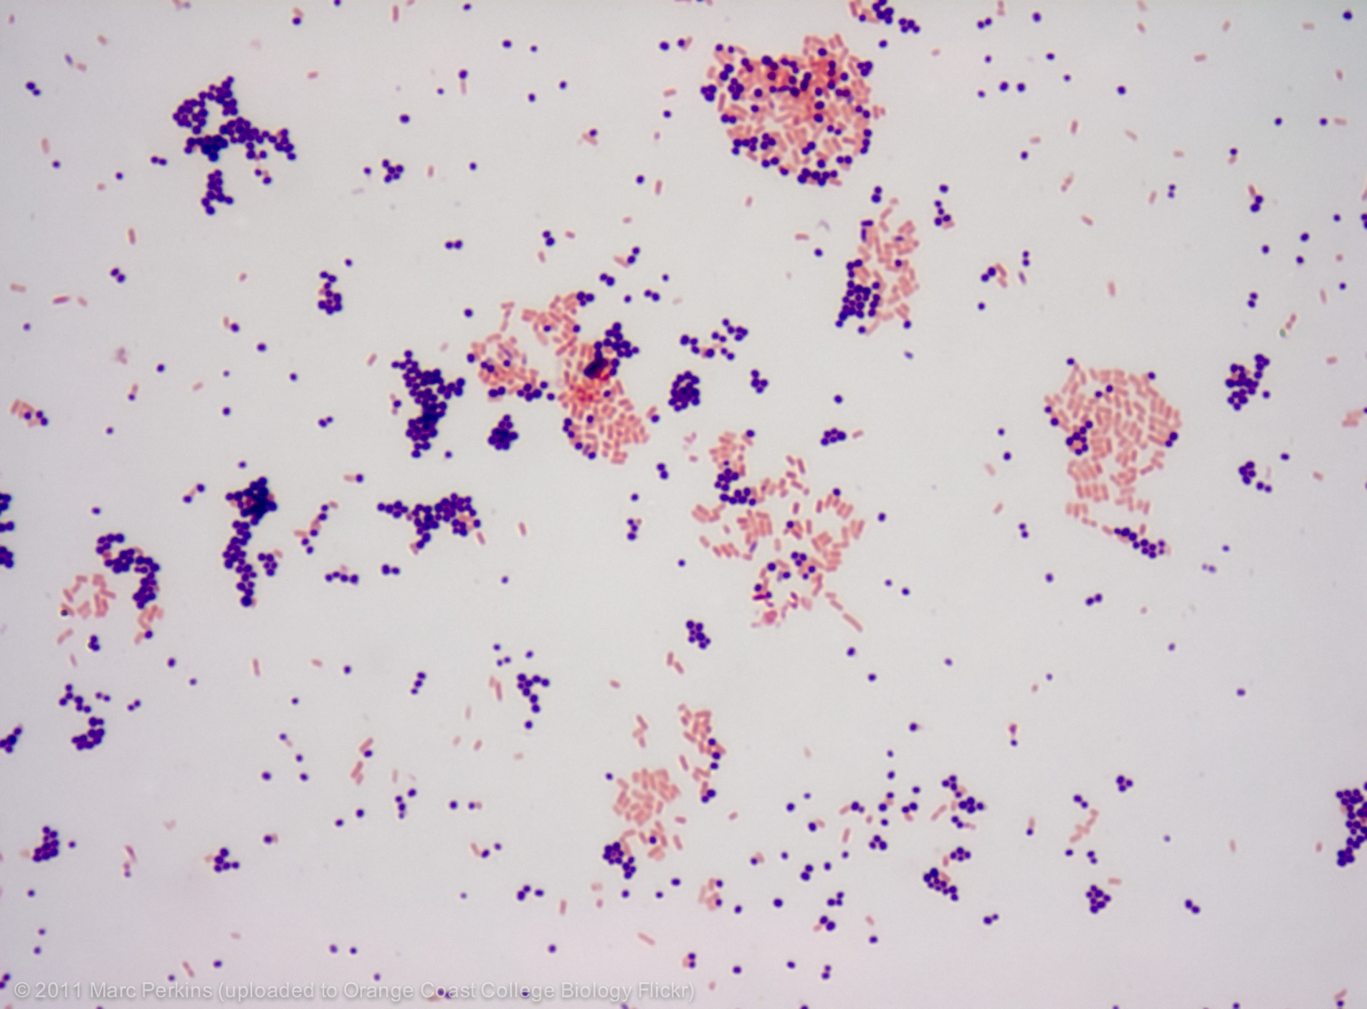

Slide 14
Acid-Fast Staining
Particularly useful for staining members of the genus Mycobacterium
e.g., Mycobacterium tuberculosis – causes tuberculosis
e.g., Mycobacterium leprae – causes leprosy
high lipid content in cell walls (mycolic acid) is responsible for their staining characteristics

Slide 15
Staining Specific Structures
Endospore staining
heated, double-staining technique
bacterial endospore is one color and vegetative cell is a different color
Capsule stain used to visualize polysaccharide capsules surrounding bacteria
negative stain - capsules may be colorless against a stained background
Flagella staining
mordant applied to increase thickness of flagella

Slide 16
