Slide 1
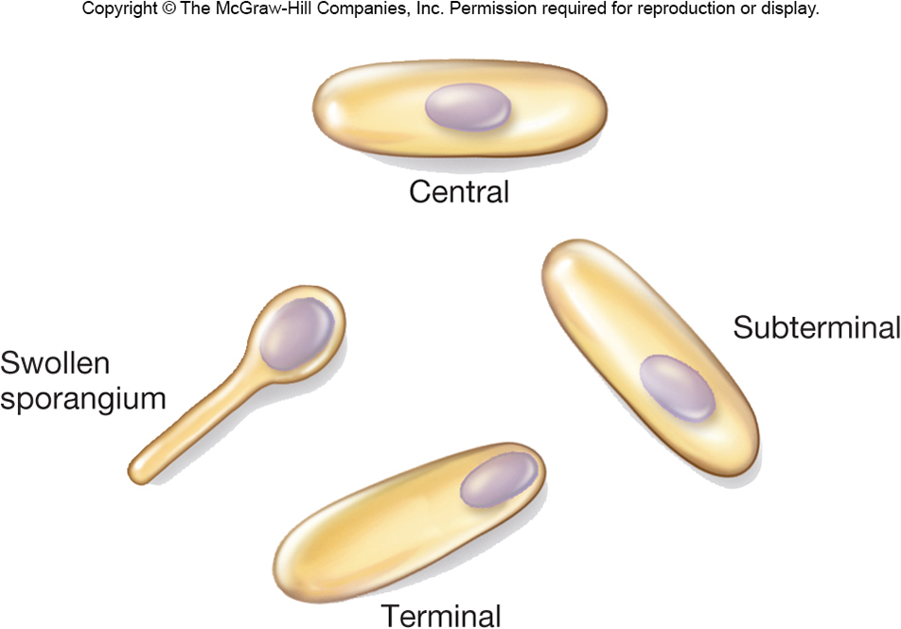
Endospore staining Lab # 3

Slide 2
Endospores form within the Cell
Endospore is dormant stage of some bacterium that allows it to survive unfavorable conditions that would normally be lethal such as extreme drought or heat
Endospores are resistant against;
Drought
Low nutrient conditions
Radiation
High temperatures
Various chemical disinfectants

Slide 3
Endospores
The spore is a dehydrated, multishelled structure that protects and allows the bacteria to exist in “suspended animation”
It contains a complete copy of the chromosome, the bare minimum concentrations of essential proteins and ribosomes, and a high concentration of calcium bound to dipicolinic acid.

Slide 4
The Vegetative Cell Gives Rise to One Spore
Bacterial Cell
Spore
Bacterial Cell
The endospore is able to survive for long periods
of time until environmental conditions again become favorable for growth.
The endospore then germinates, producing a single vegetative bacterium.

Slide 5
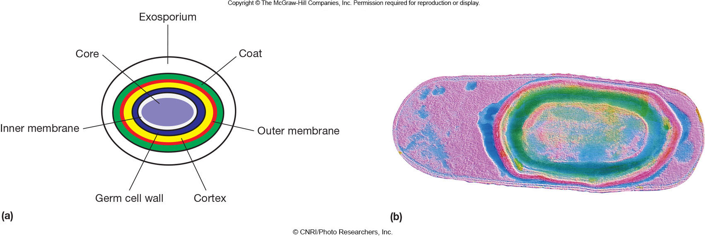
Endospore structure
Spore surrounded by thin covering called exosporium
Thick layers of protein form the spore coat
Cortex, beneath the coat, thick peptidoglycan
Core has nucleoid and ribosomes

Slide 6
What Makes an Endospore so Resistant?
Calcium (complexed with dipicolinic acid)
Small, acid-soluble, DNA-binding proteins (SASPs)
Dehydrated core
Spore coat and exosporium protect

Slide 7
Endospore Function
Endospores are ultimately protection for the bacterial genome
Spores form within the cell and contain a full copy of the bacterial genome
Endospores are not a form of reproduction, because only one new cell germinates from each spore
Spores can be variable in size and location within the cell

Slide 8
Sporulation
Process of endospore formation within a vegetative (parent) cell
Germination = return of an endospore to its vegetative state

Slide 9
Sporulation
Process of endospore formation
Occurs in a hours (up to 10 hours)
Normally commences when growth ceases because of lack of nutrients
Complex multistage process

Slide 10
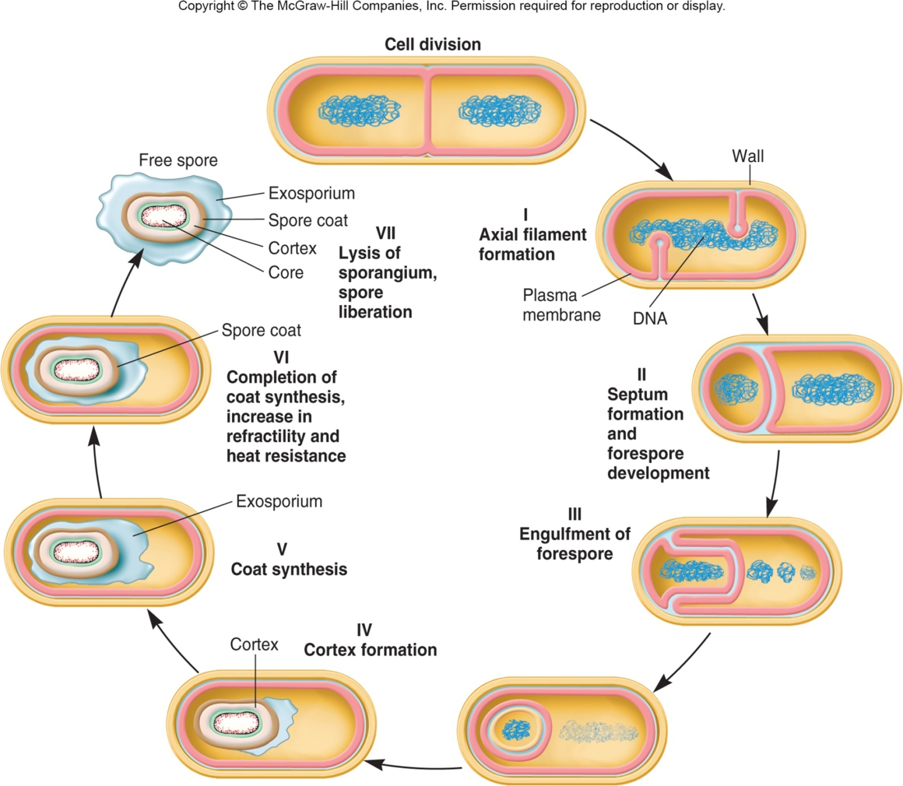

Slide 11
Not all bacterial species can form spores
A few genera of bacteria produce endospore such as Clostridium (gangrene) and Bacillus (anthrax), both of them are gram + rods
Endospore production is associated with Gram Positive bacteria
Since not all bacteria form endospores, we can use this as an identification factor

Slide 12
The location of the spore is also an identifying characteristic
Central, Sub-Terminal, and Terminal spores

Slide 13
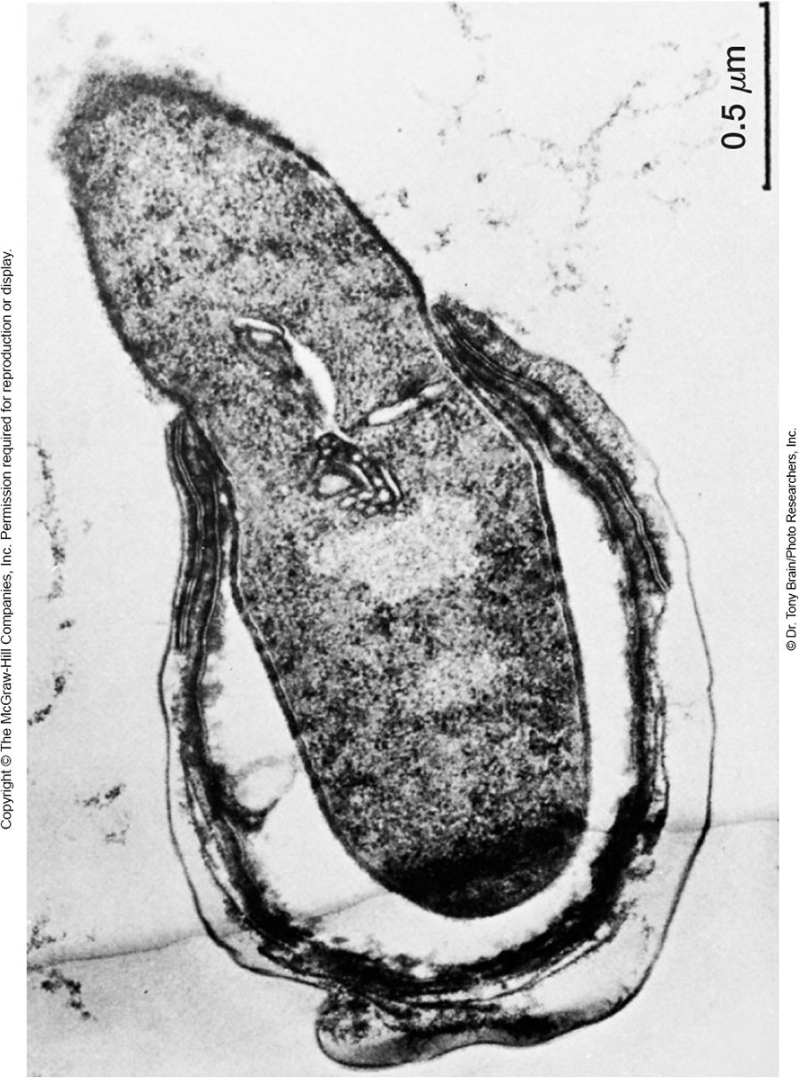
Formation of Vegetative Cell
Activation
prepares spores for germination
often results from treatments like heating
Germination
environmental nutrients are detected
spore swelling and rupture of absorption of spore coat
increased metabolic activity
Outgrowth - emergence of vegetative cell

Slide 14
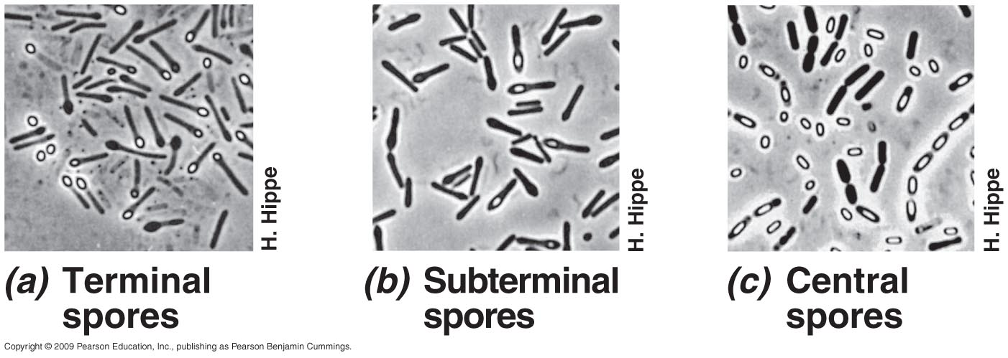
Endospores
Endospores can remain dormant indefinitely but germinate quickly when the appropriate trigger is applied
Endospores differ significantly from the vegetative, or normally functioning, cells

Slide 15
Stain Procedure Schaeffer-Fulton Method
1. Prepare a smear. Air Dry. Heat fix
2. Put the slide on steam rack
3. Flood the smear with Malachite Green stain
4. Steam slide for 10 minutes (every minute, add a few more drops of Malachite Green stain)
5. Allow slide to cool (after the 10 min. steam process)
6. Drain slide and rinse for 30 seconds with DI water (discard filter paper)
7. Flood smear with Safranin (counter stain). This stains the vegetative cell. (Leave for 1 minute)
8. Drain the slide and rinse with DI water
9. Blot Dry
10. Use oil immersion objective to view

Slide 16
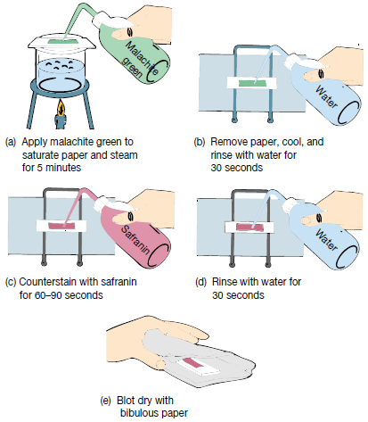
Spore Staining procedure

Slide 17
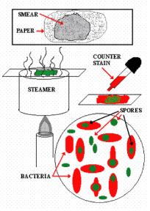
Endospore Stain
Spores: Green Cell: Red or Pink
To Do
Each student is expected to prepare a smear of:
1- Bacillus subtilis
2- Any other organism from the list
3- perform endospore staining

Slide 18
